Slide 1
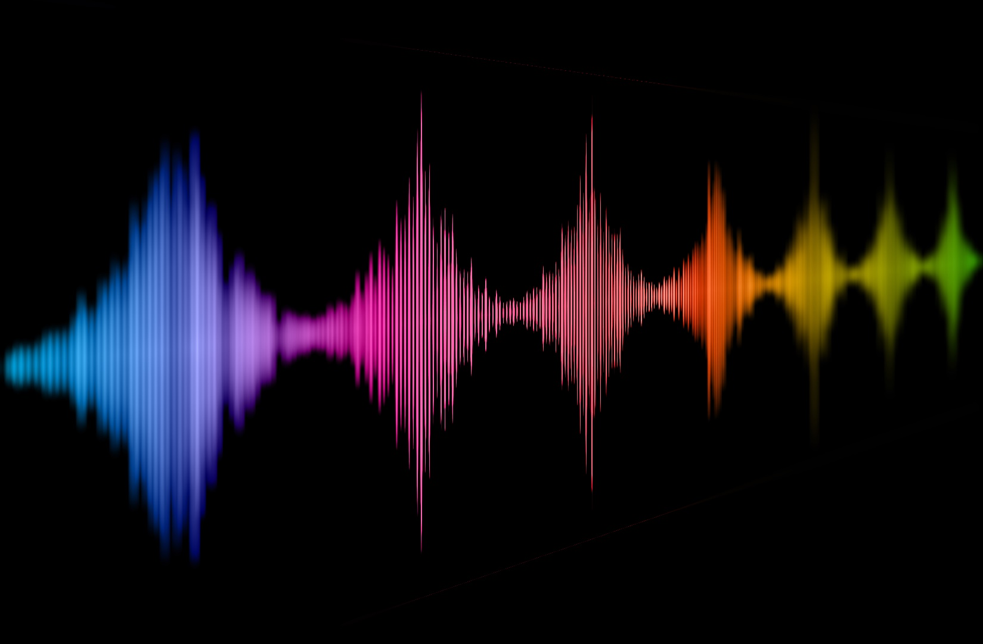
Naturalness of voices – from human to artificial agents
Christine Nussbaum and Stefan R. Schweinberger
Voice ID 2024, Marburg, 29.08.2024
Naturalness of voices
Notes:
Provocative title
I want to tell you a story (sorry if its still a bit chaotic) and I want to convince you of my mission
Mission: naturalness is something we talk about -> we should strive for a systematic understanding (pooling insight from all available angles)
Human voice perception can help to understand artificial voice perception and vice versa

Slide 2
Who of you…
…owns a smart home device with a voice assistant?
… almost lost their temper while trying to communicate with a synthetic voice assistent in a service hotline?
… suffered through a meeting/talk because the speaker had such a bad cold (or another type of voice condition) that it was almost painful to listen?
… played around with voice manipulation tools (like voice morphing or pitch transformation) and accidently ended up with some artificial artefacts in the vocal material?
-> Naturalness in voices
Notes:
Some warm-up questions.
Add-on to the last one: who used the stimuli for their study nevertheless? ;)

Slide 3
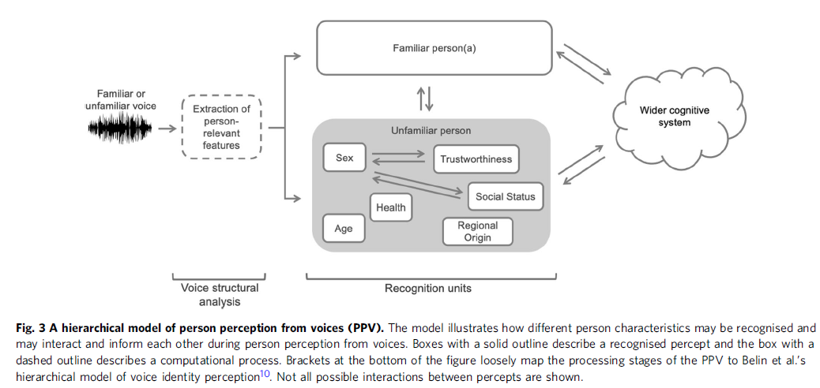
Person Perception from Voices (PPV)
Naturalness
[Lavan & McGettigan 2023, Communications Psychology]
Notes:
Next 15 minutes is an advertisement talk, why I think we should study naturalness?
Less about current insights into voice naturalness, but rather the meta-perspective – how it the research on naturalness conducted

Slide 4
My Motivation
“Impairments in speech naturalness can lead to communication partners perceiving the affected individuals as unhappy, cold, withdrawn, introverted, or bored. These false perceptions can interrupt participation in regular life roles, leading to loss of employment and independence. Thus, impaired speech naturalness can result in social isolation, reduced quality of life, and depression.” (Stepp & Voijtech, 2019)
My Mission:
A systematic understanding of vocal naturalness
“The growing popularity of speech interfaces goes hand in hand with the creation of synthetic voices that sound ever more human. Previous research has been inconclusive about whether anthropomorphic design features of machines are more likely to be associated with positive user responses or, conversely, with uncanny experiences. To avoid detrimental effects of synthetic voice design, it is therefore crucial to explore what level of human realism human interactors prefer and whether their evaluations may vary across different domains of application.” (Schreibelmayer & Mara, 2022)
“It is like my toaster is speaking to me.” (Kühne et al. 2020)
Notes:
Because it simply affects how we interact with the voice (or the source of that voice)

Slide 5
Research on naturalness – a systematic literature search
Web of Science search on 26 April 2023 and 28 May 2024
“naturalness AND voice” and “human-likeness AND voice”
Inclusion critaria:
Published in English
Peer-reviewed journal or conference contribution
Voice naturalness/human-likeness was either measures or manipulated
Quantitative empirical data or integration of these
Spoken utterances only (no singing voices or nonverbal vocalizations)
72 publications
[Nussbaum, Frühholz & Schweinberger (2024), under review in Trends in Cognitive Sciences]
Voice Naturalness
Notes:
- To ground my claims a little bit on data, we conducted a little mini-review to get a representative overview of the research on naturalness that already exists
-> This is the „data basis“ of my talk

Slide 6
Research on naturalness – overview
year range: 1984 – 2024 (53% published in the last 5 years)
67 report empirical data (of these 48 rating data)
2 literature reviews
3 using neurophysiological measures (EEG, fNIRS)
Voice categories:
33 synthetic
18 human-pathological
6 human-manipulated
5 healthy human voices
10 used more than one of these voice categories
[Nussbaum, Frühholz & Schweinberger (2024), under review in Trends in Cognitive Sciences]
Notes:
Just overview over basic numbers
3 main players:
pathological human voices
manipulated human voices
synthesized/artificial voices

Slide 7
Current problems in voice naturalness research
Conceptual underspecification
Inconsistent operationalization
Lack of exchange between different research domains
Insufficient anchoring in voice perception theory
Precluded a systematic understanding of vocal naturalness
Impeded the visibility of this research to a wider readership
Has kept us from asking some crucial research questions
Has led to a divergence between theory and practice
[Nussbaum, Frühholz & Schweinberger (2024), under review in Trends in Cognitive Sciences]
Notes:
Make really clear: this is all valuable research (my claim is not that everything done until this point is bad work)
If you want to see the „bigger picture“ this is close to impossible due to the way the research is conducted

Slide 8
Towards a concise framework for voice naturalness
Notes:
- Defining naturalness is already a tough challenge

Slide 9
Defining voice naturalness – quite a challenge
“Naturalness was defined as conforming to the listener’s standards of rate, rhythm, intonation, and stress patterning […] ” [e.g. Yorkston et al. 1990]
“Natural speech is the speech most closely perceived as a human voice“ [e.g. Mawalim et al. 2022]
"By naturalness, we understand the voice stimulus to be perceived as a plausible outcome of the human speech production system.“ [Nussbaum et al. 2023]
only 32 publications provide an explicit definition
[Nussbaum, Frühholz & Schweinberger (2024), under review in Trends in Cognitive Sciences]

Slide 10
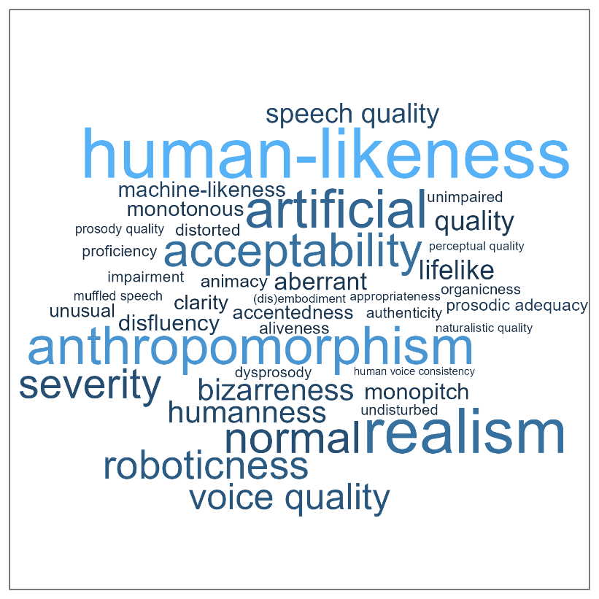
Inconsistent terminology
58 papers provided keywords
32 had keywords related to naturalness or any of its synonyms
[Nussbaum, Frühholz & Schweinberger (2024), under review in Trends in Cognitive Sciences]
Notes:
- Getting a grasp of the verbal space we are dealing with

Slide 11
Proposing a taxonomy for the definition voice naturalness
(1) Deviation-based naturalness
(2) Human-likeness-based naturalness
Deviation from a reference that represents maximum naturalness
Human-likeness i.e. resemblance to human voice
27 employed a deviation-based conceptualization, 35 used human-likeness, and 10 used a combination of both
[Nussbaum, Frühholz & Schweinberger (2024), under review in Trends in Cognitive Sciences]

Slide 12
Lack of exchange between different research domains

Slide 13
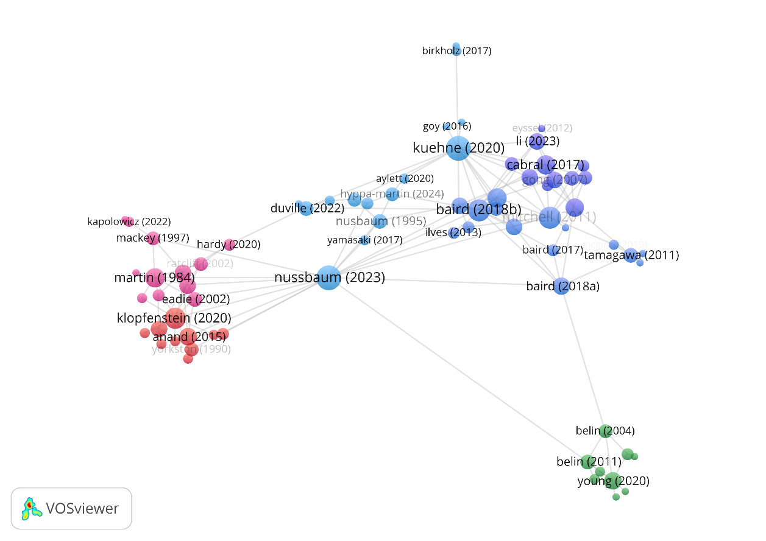
(Lacking) interconnectivity of voice naturalness research
[Nussbaum, Frühholz & Schweinberger (2024), under review in Trends in Cognitive Sciences]
Notes:
Red: voice pathology
Blue: primarily synthetiv voices
Green: influential voice theory papers)
Echo chambers within science
Not rooted in voice perception theory

Slide 14
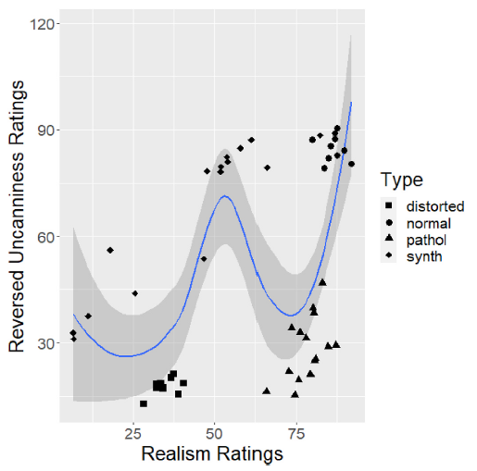
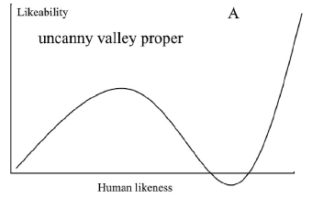
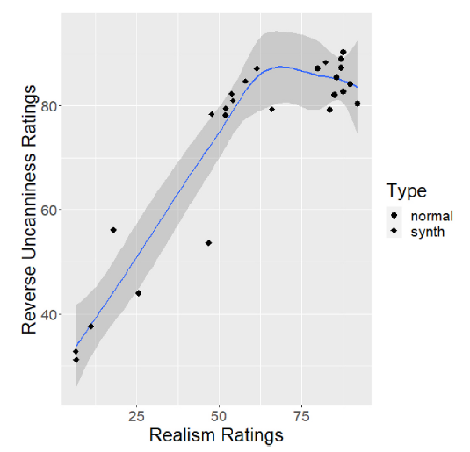
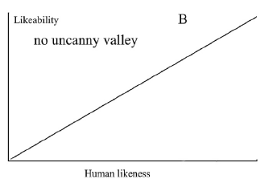
Pooling evidence from all possible research angles
[Diel & Lewis (2024), Computers in Human Behavior]

Slide 15
Insufficient anchoring in voice perception theory

Slide 16
(Lacking) interconnectivity of voice naturalness research
[Nussbaum, Frühholz & Schweinberger (2024), under review in Trends in Cognitive Sciences]
Notes:
Red: voice pathology
Blue: primarily synthetiv voices
Green: influential voice theory papers)
Echo chambers within science
Not rooted in voice perception theory

Slide 17
Rooting voice naturalness in voice processing theory
[Nussbaum, Frühholz & Schweinberger (2024), under review in Trends in Cognitive Sciences]
Notes:
Voices recruit networks/recourses in the brain that are not recruited by other tyes of acoustic stimuly
What happens, when they are no longer natural/human?
Trying to understand the impact of naturalness on perception is trying to understand what makes voices special

Slide 18
Practical recommendations for voice naturalness research
Conceptual underspecification
Inconsistent operationalization
Lack of exchange between different research domains
Insufficient anchoring in voice perception theory
Consistent definition and terminology
Consistent keywords
Full report on methodological details, ideally stimulus examples
Communicate findings inclusively enough for readerships from diverse backgrounds
Link research to current insights in voice perception theory and a broader multimodal context
Notes:
My Mission: naturalness as a voice features that we systematically understand
Provide explicit definitions, avoid technical jargon, adopt scientific standards from other fields where
appropriate, and discuss findings against the wider interdisciplinary literature.

Slide 19
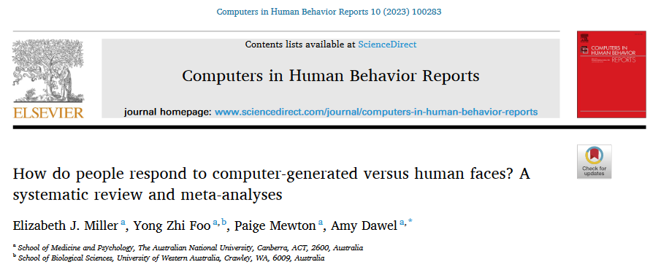
Including the multimodal perspective
2023

Slide 20
Take home messages
Perceived naturalness is a voice feature we should study systematically.
We propose a conceptual framework:
Deviation-based naturalness
Human-likeness-based naturalness
For the complete picture, we need to pool evidence from all the interdisciplinary literature.
Research efforts on voice naturalness should be rooted in voice perception theory.

Slide 21
Thank you for your attention ☺

Slide 22
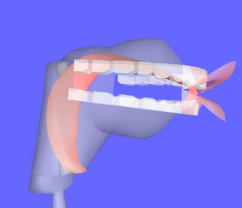
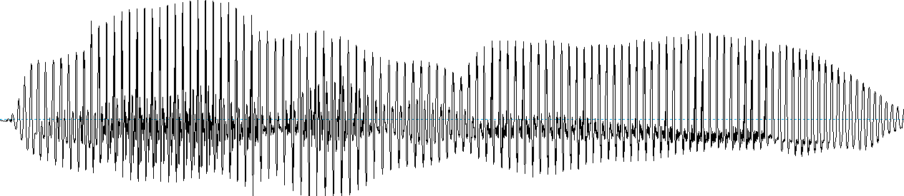
Overview over voice synthesis methods
Concatenative synthesis
Articulatory synthesis
Statistical parametric speech synthesis
Hidden Markov Models
+
Deep Learning Methods
Text-to-Speech (TTS)
https://www.vocaltractlab.de/
https://www.ibm.com/products/text-to-speech
Notes:
Articulatory synthesis: models for the movement of lips, tongue, glottis, and vocal tract
Concatenative synthesis: where the target utterance is constructed from a set of prerecorded building blocks: words, syllables, half-syllables, phonemes, diphones, or triphones
Statistical parametric synthesis: a machine/network is trained on speech data and this information is then fed to a vocoder

