Slide 1
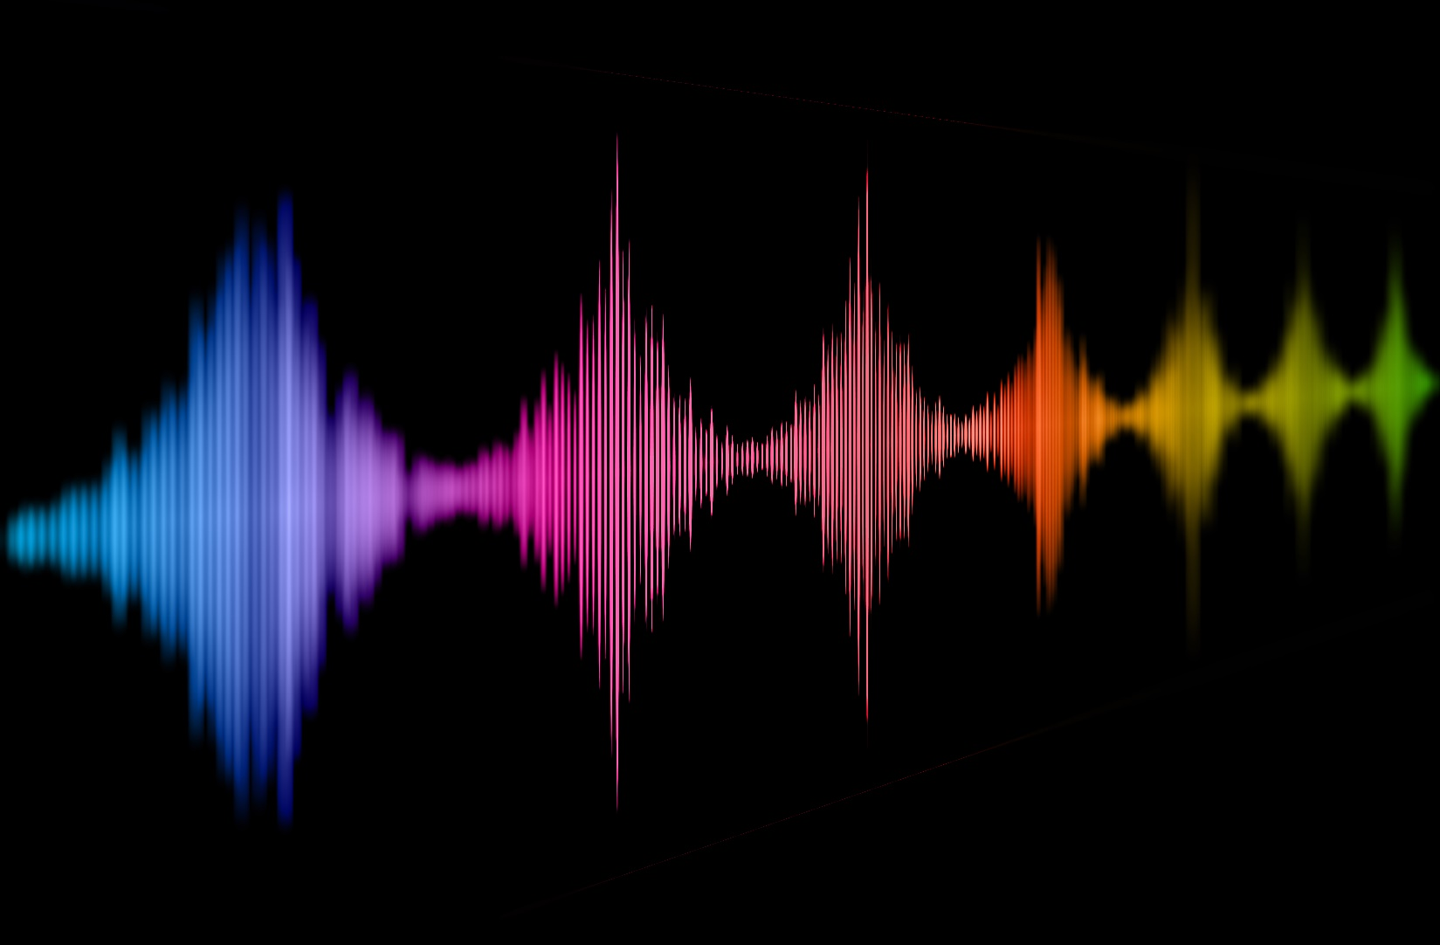
The interplay of perceived naturalness and emotionality in voices
Christine Nussbaum
EPS Symposium, Nottingham April 2024
Notes:
Gonna be raising for more questions and providing answers
Only in the second part presenting own data

Slide 2
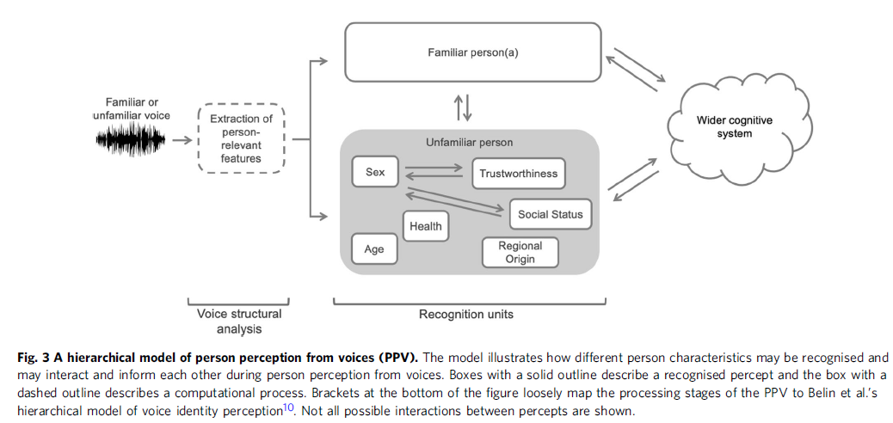
Person Perception from Voices (PPV)
Emotionality
Naturalness
[Lavan & McGettigan 2023]
Notes:
Good starting point
We form impressions about voices the moment we hear them
Manifold, and they interact
I added two…
„When hearing a voice, listeners can form a detailed impression of the person behind the voice. “
- “how the perception of different person characteristics may interact and inform each other,“
Emotions; naturalness, interplay

Slide 3
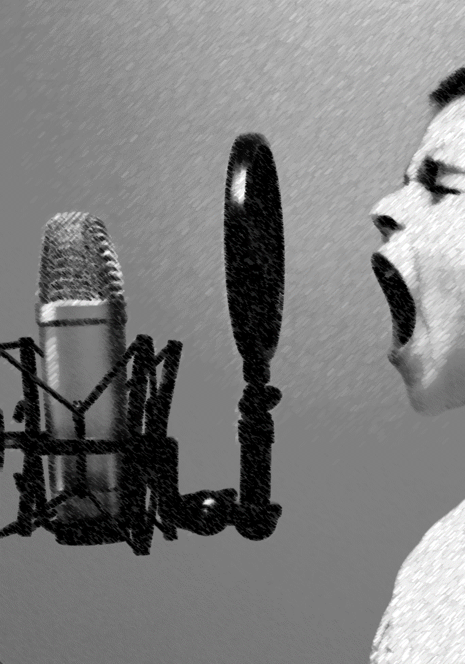
Vocal Emotions
Speakers express vocal emotions through acoustic cues
Fundamental frequency (F0)
Timbre
Amplitude
Speech rate
Listeners recognize vocal emotions above chance
multiple efforts to link emotions to acoustic cues
profound interindividual differences
[Scherer 2018; Juslin & Laukka 2003]
Notes:
Quick overview over emotions
Automatically, fast
Sensitive to
Very well researched topic (a looong tradition)

Slide 4
Voice Naturalness
pathological human voices
manipulated human voices
synthesized/artificial voices
“Naturalness was defined as conforming to the listener’s standards of rate, rhythm, intonation, and stress patterning […] ” [e.g. Yorkston et al. 1990]
“Natural speech is the speech most closely perceived as a human voice“ [e.g. Mawalim et al. 2022]
"By naturalness, we understand the voice stimulus to be perceived as a plausible outcome of the human speech production system.“ [Nussbaum et al. 2023]
Notes:
Voice Naturalness – complete opposite
Verbal space we are dealing with
We are not necessarily talking about the same thing
Fundamental problem: how to define it
- Research domain
- Wouldnt go so far to claim that we see a consistent field of research here
- proxy

Slide 5
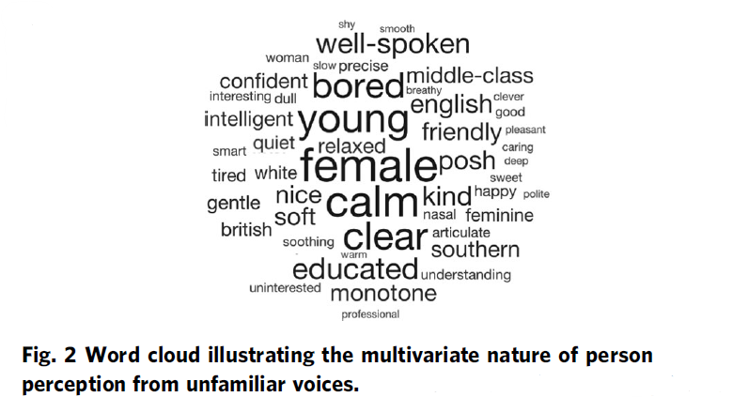
Voice Naturalness
[Lavan & McGettigan, 2023; Lavan 2023]
[e.g. Kühne et al. 2020, Rodero 2017, Rodero & Lucas 2023]
Notes:
Why do I feel this is a feature we should pay more attention to?
Affects how we perceive voices, and how we react to them
rated as more likeable, trustworthy, intelligible, pleasant (Kühne et al., 2020)

Slide 6
Voice Naturalness and Quality of Life
“Impairments in speech naturalness can lead to communication partners perceiving the affected individuals as unhappy, cold, withdrawn, introverted, or bored. These false perceptions can interrupt participation in regular life roles, leading to loss of employment and independence. Thus, impaired speech naturalness can result in social isolation, reduced quality of life, and depression.” [Stepp & Voijtech 2019]
Notes:
A bold statement
Hints that there is an interplay between emotionality and naturalness
> bringts me to the interconnection

Slide 7
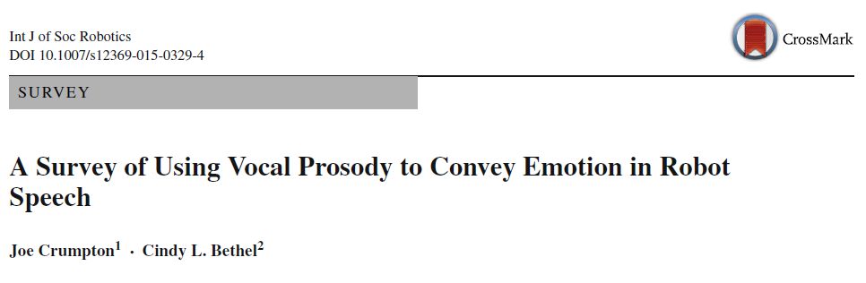
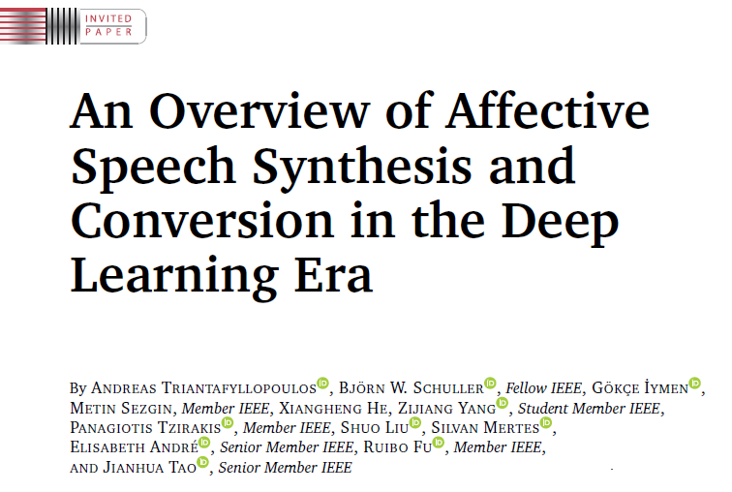
The interplay of perceived naturalness and emotionality in voices
„The communication of emotions through changes in vocal prosody is one way to make synthesized speech sound more natural.”
2015
2023
Notes:
Interplay is fully echoed by efforts in voice synthesis
Biggest challenge
> lack of emotionality interrupts naturalness
> but is is also the other way around?

Slide 8
The Interplay of Perceived Naturalness and Emotionality in Voices
Emotion perception is robust against unnatural voice features
Naturalness affects/disrupts emotion perception
Emotional caricatures are better recognized despite being less natural than unaltered utterances [Ko et al. 2023]
Emotions expressed by participants with autism were better recognized, while rated as being less natural [Hubbard et al. 2017]
Rating of naturalness unrelated to ratings of emotionality [Nussbaum et al. 2023]
Emotion recognition worse in text-to-speech generated voices [Ko et al. 2023]
Human voices rated as more expressive compared to synthesized ones [Cabral et al. 2017]
Reduction of naturalness in voices affects emotion recognition and electrophysiological correlates, but NOT valence and arousal ratings [Duville et al. 2022]
Acoustic manipulation that affects perceived naturalness can be a threat to ecological validity!
Notes:
Simply not fully resolved
Not just because its interesting
Under some circumstances, naturalnes interferes, and this is important information, even if this is not your primary interest
Voice manipulation to study other perceptuel phenomena – like emotion
-> naturalness can be a threat to ecological validity
-> own data

Slide 9
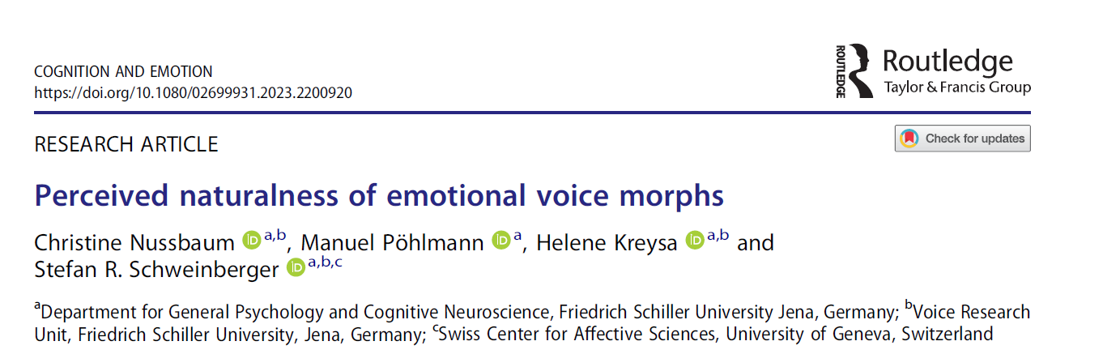
Unwanted Interference by Voice Naturalness
2023
Notes:
Using manipulated voices to study human emotion perception
At least try to quantify
The story how we started to become interested

Slide 10
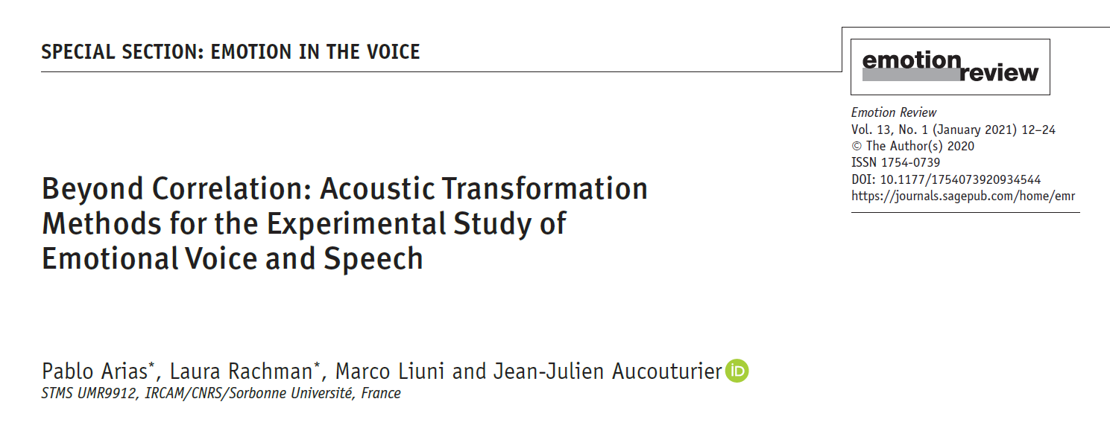
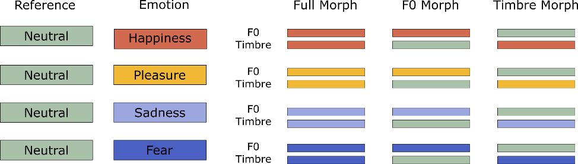

Unwanted Interference by Voice Naturalness
ecological validity of stimuli
distraction from the task
potential confound
2021
parameter-specific voice morphing
Notes:
Causel mechanisms of vocal cues
Using manipulated voices to study human emotion perception
At least try to quantify

Slide 11
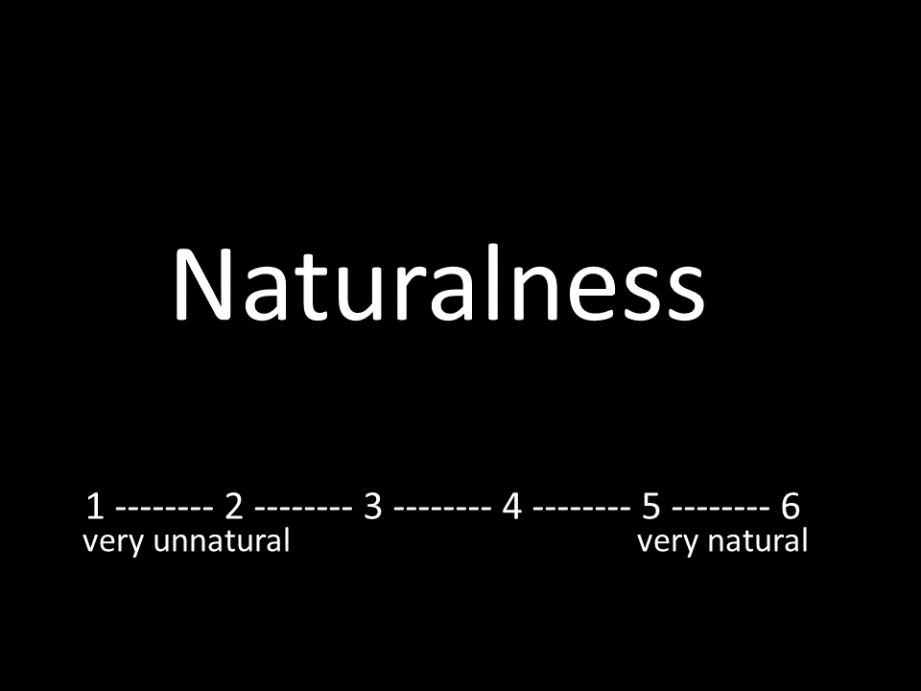
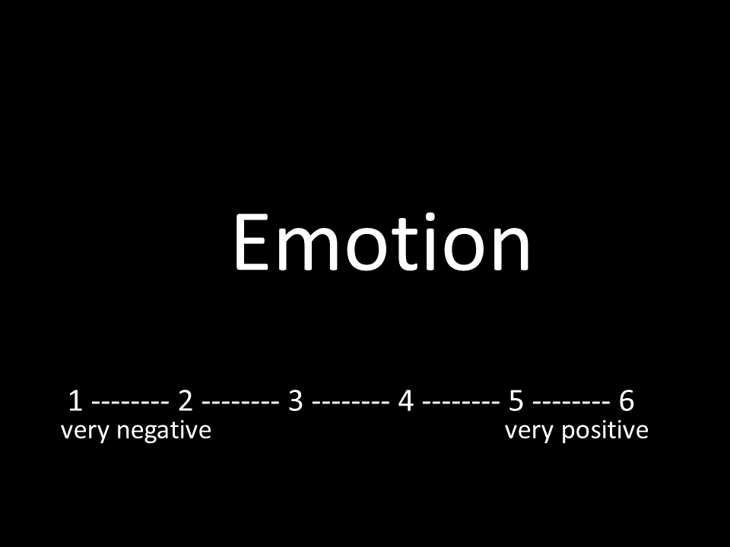
Rating Study:
Stimuli:
8 (speakers) x 3 (pseudowords) x 4 (emotions) x 3 (morphing conditions) x 2 reference types + 48 reference (8 speakers x 3 pseudowords x 2 reference types) = 624 stimuli; split between-subject per pseudoword
Sample:
51 participants, 40 females, 11 males,
aged 19 to 31 years [M = 21.49; Mdn = 21; SD = 2.64],
with 16/18/17 per pseudoword
Notes:
2 min

Slide 12
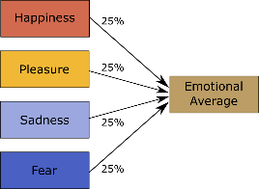
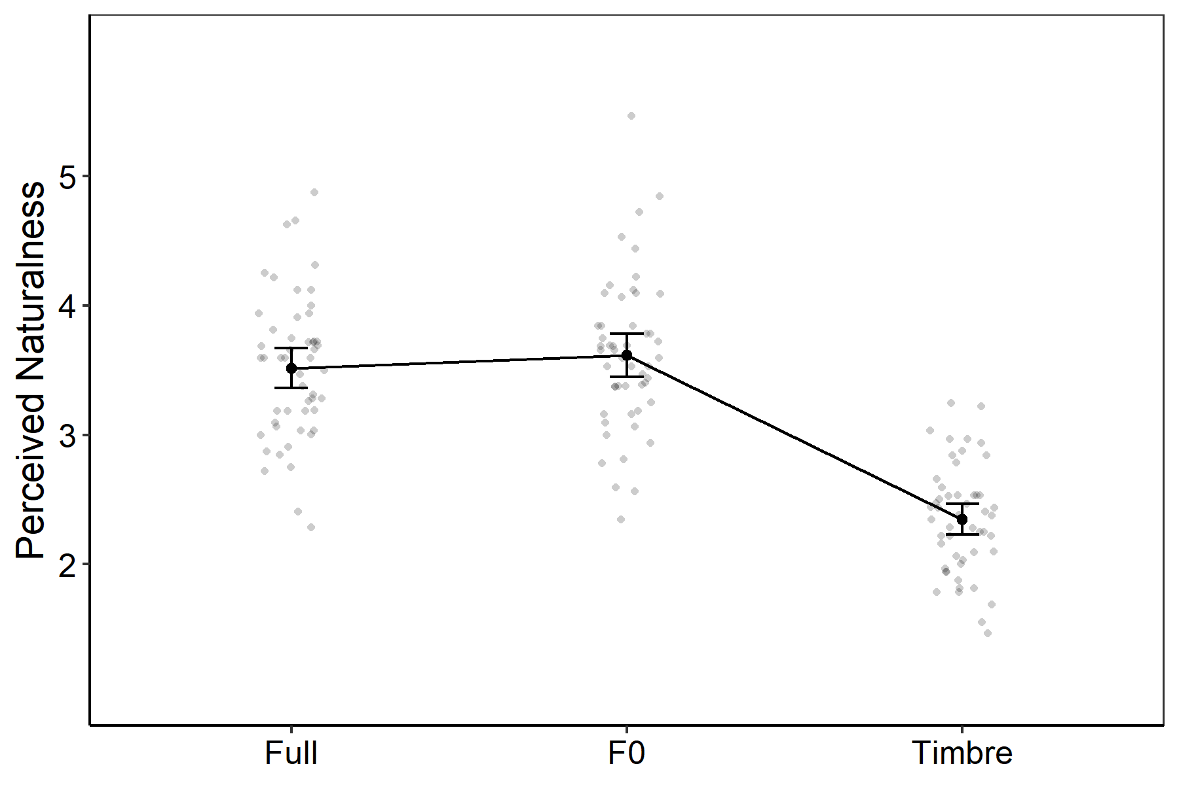
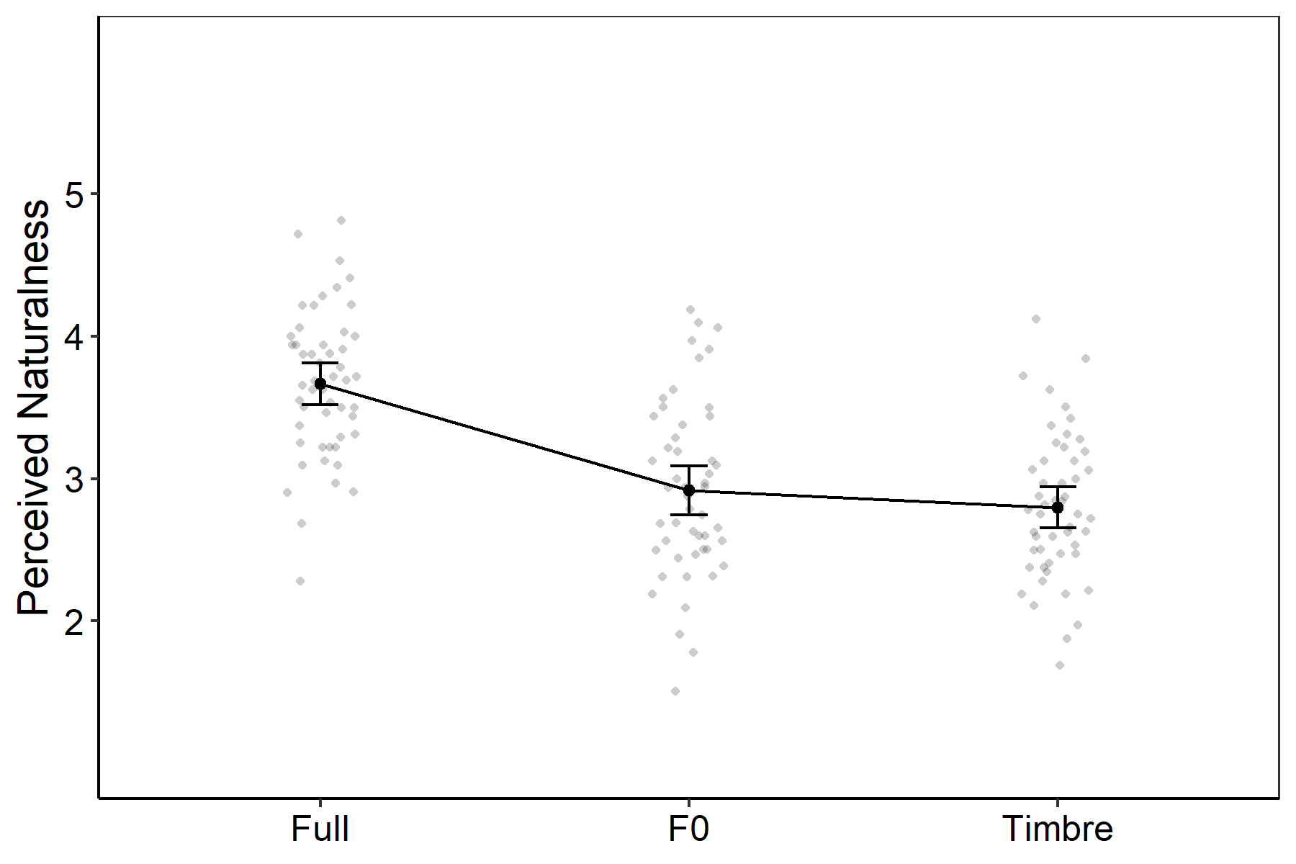
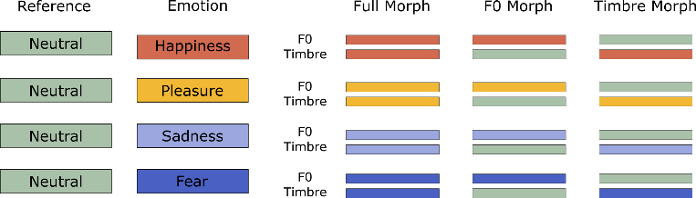
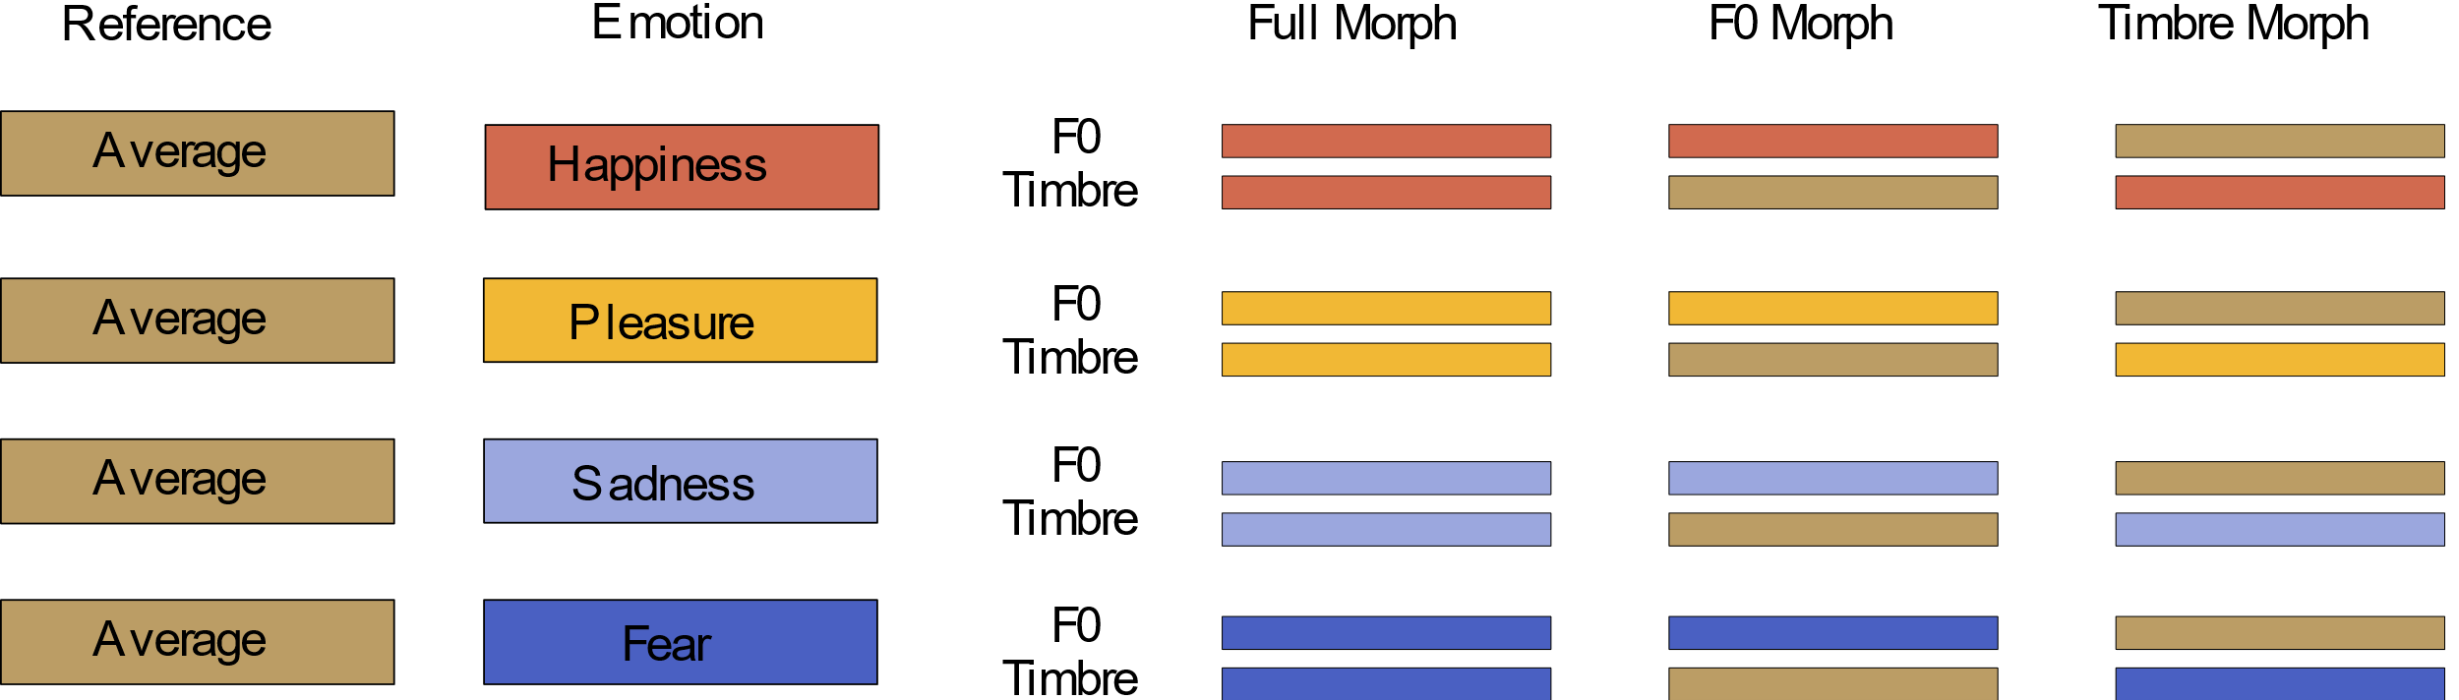
Result 1: Voice Morphing affects Voice Naturalness
F0/Timbre and naturalness confounded
F0/Timbre and naturalness NOT confounded

Slide 13
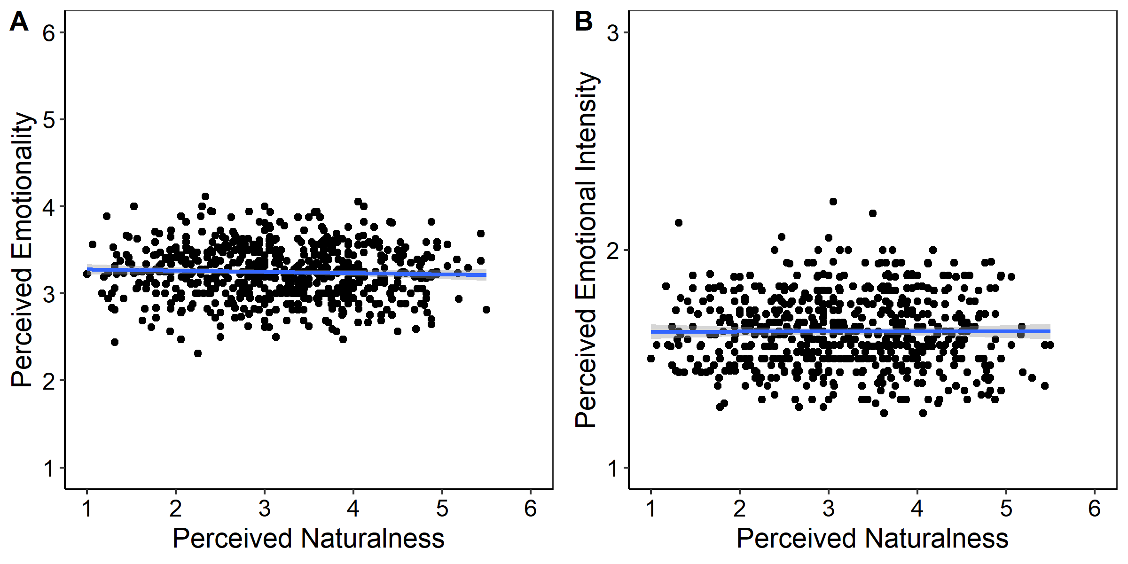
Result 2: No Relationship between Naturalness and Emotionality
Mean ratings of perceived naturalness, emotionality (A), and emotional intensity (B).
[Nussbaum et al. 2023, Cognition and Emotion]

Slide 14
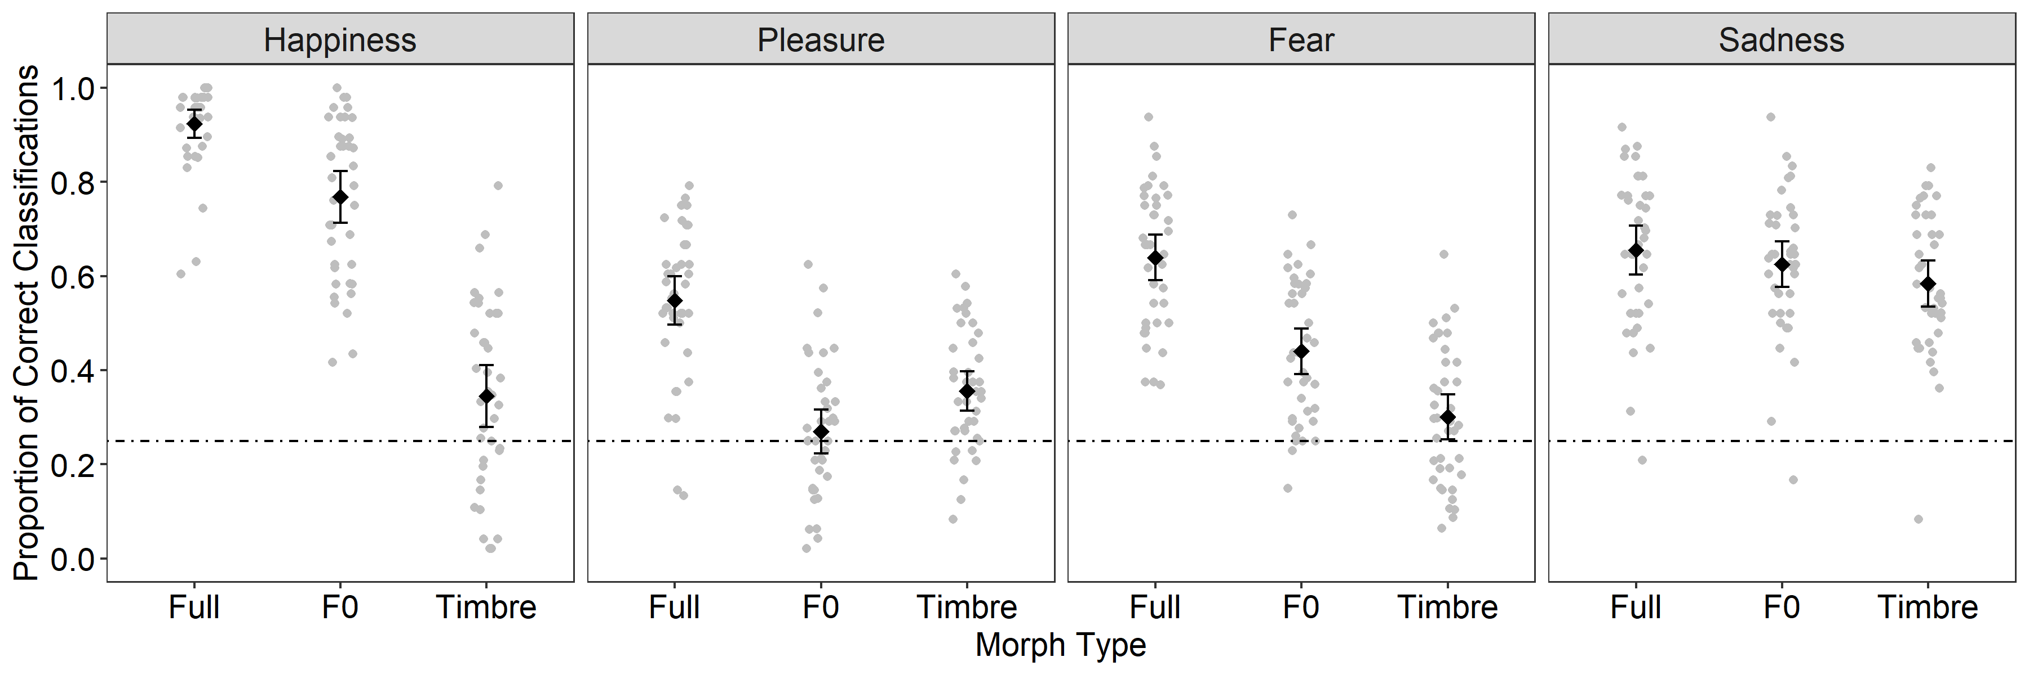
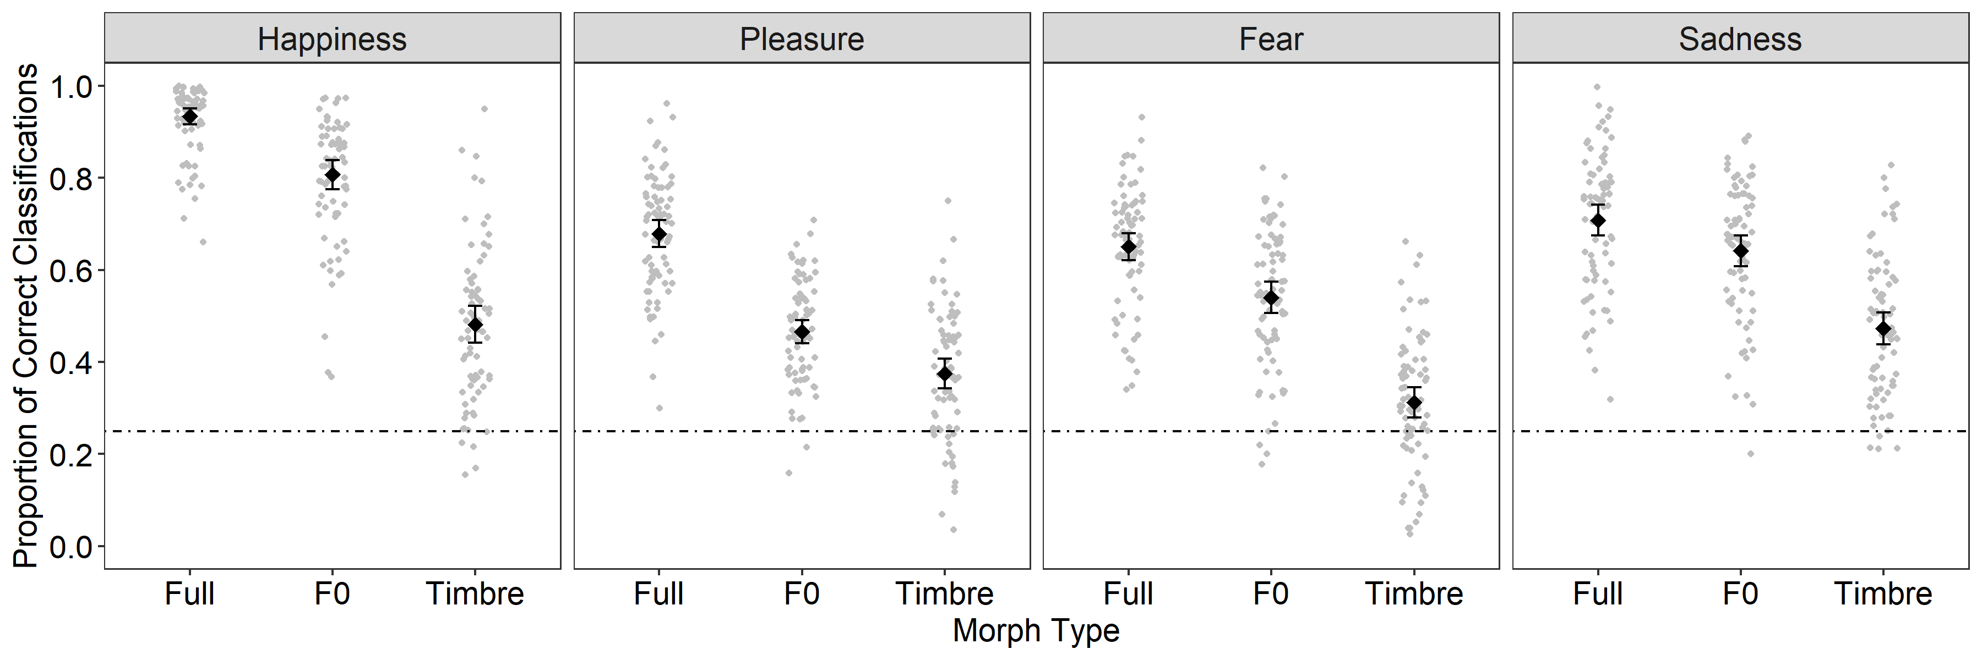
Naturalness may affect Emotion Recognition Performance
F0/Timbre and naturalness confounded
[Nussbaum et al. 2022, SCAN]
F0/Timbre and naturalness NOT confounded
[Nussbaum et al. 2023, BJOP]

Slide 15
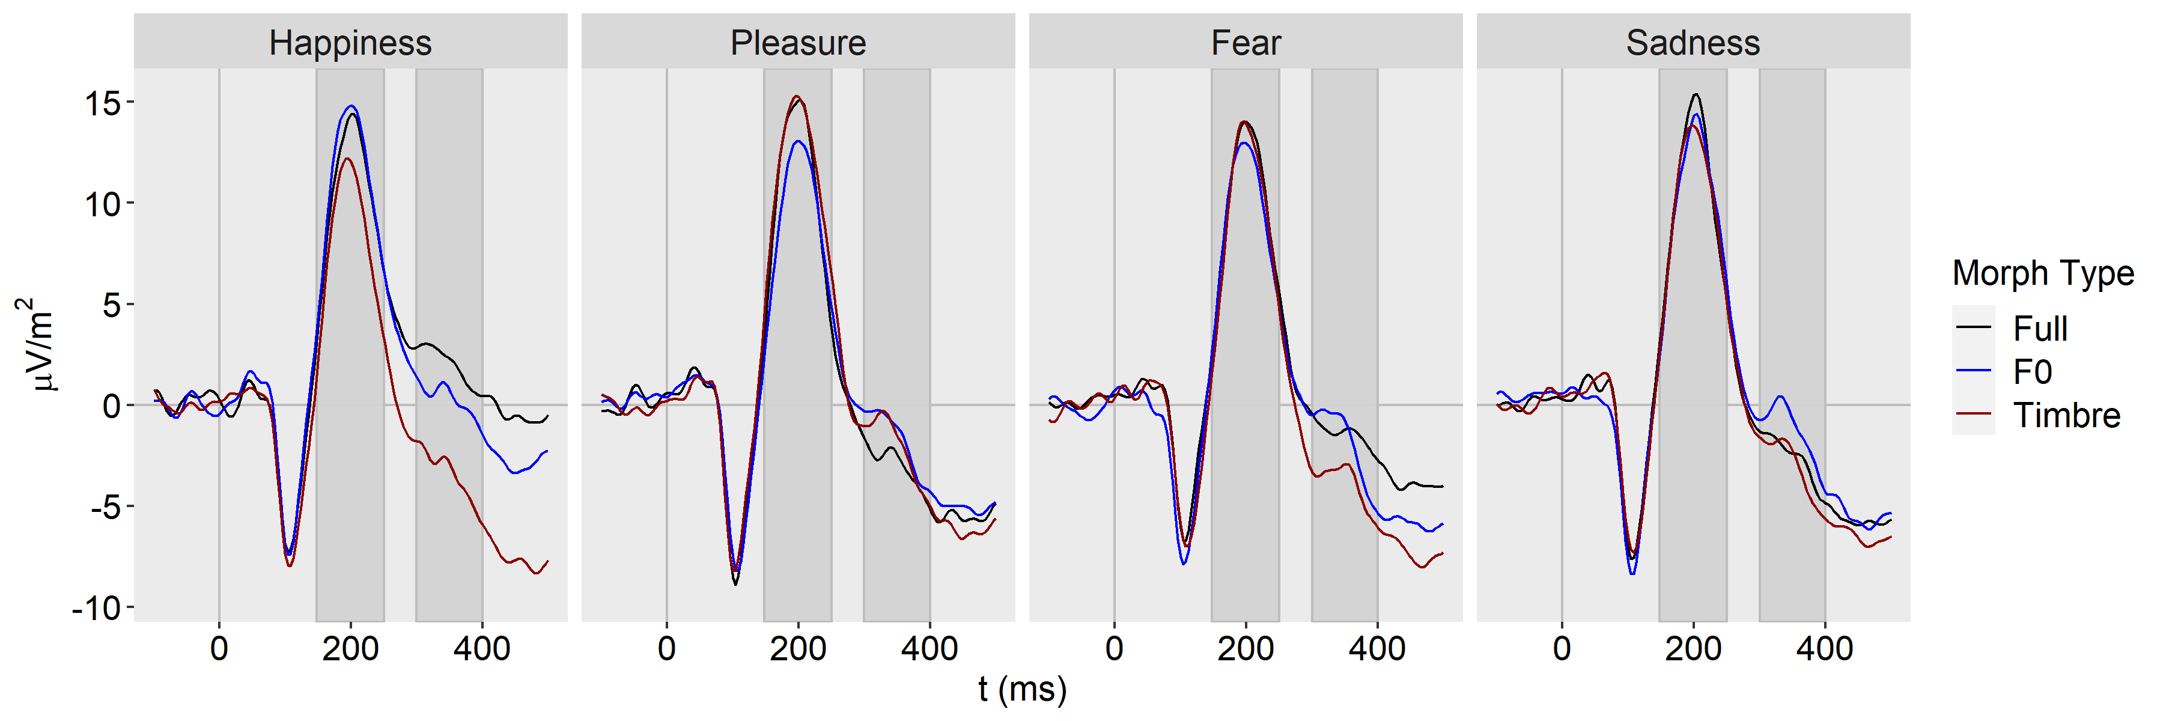
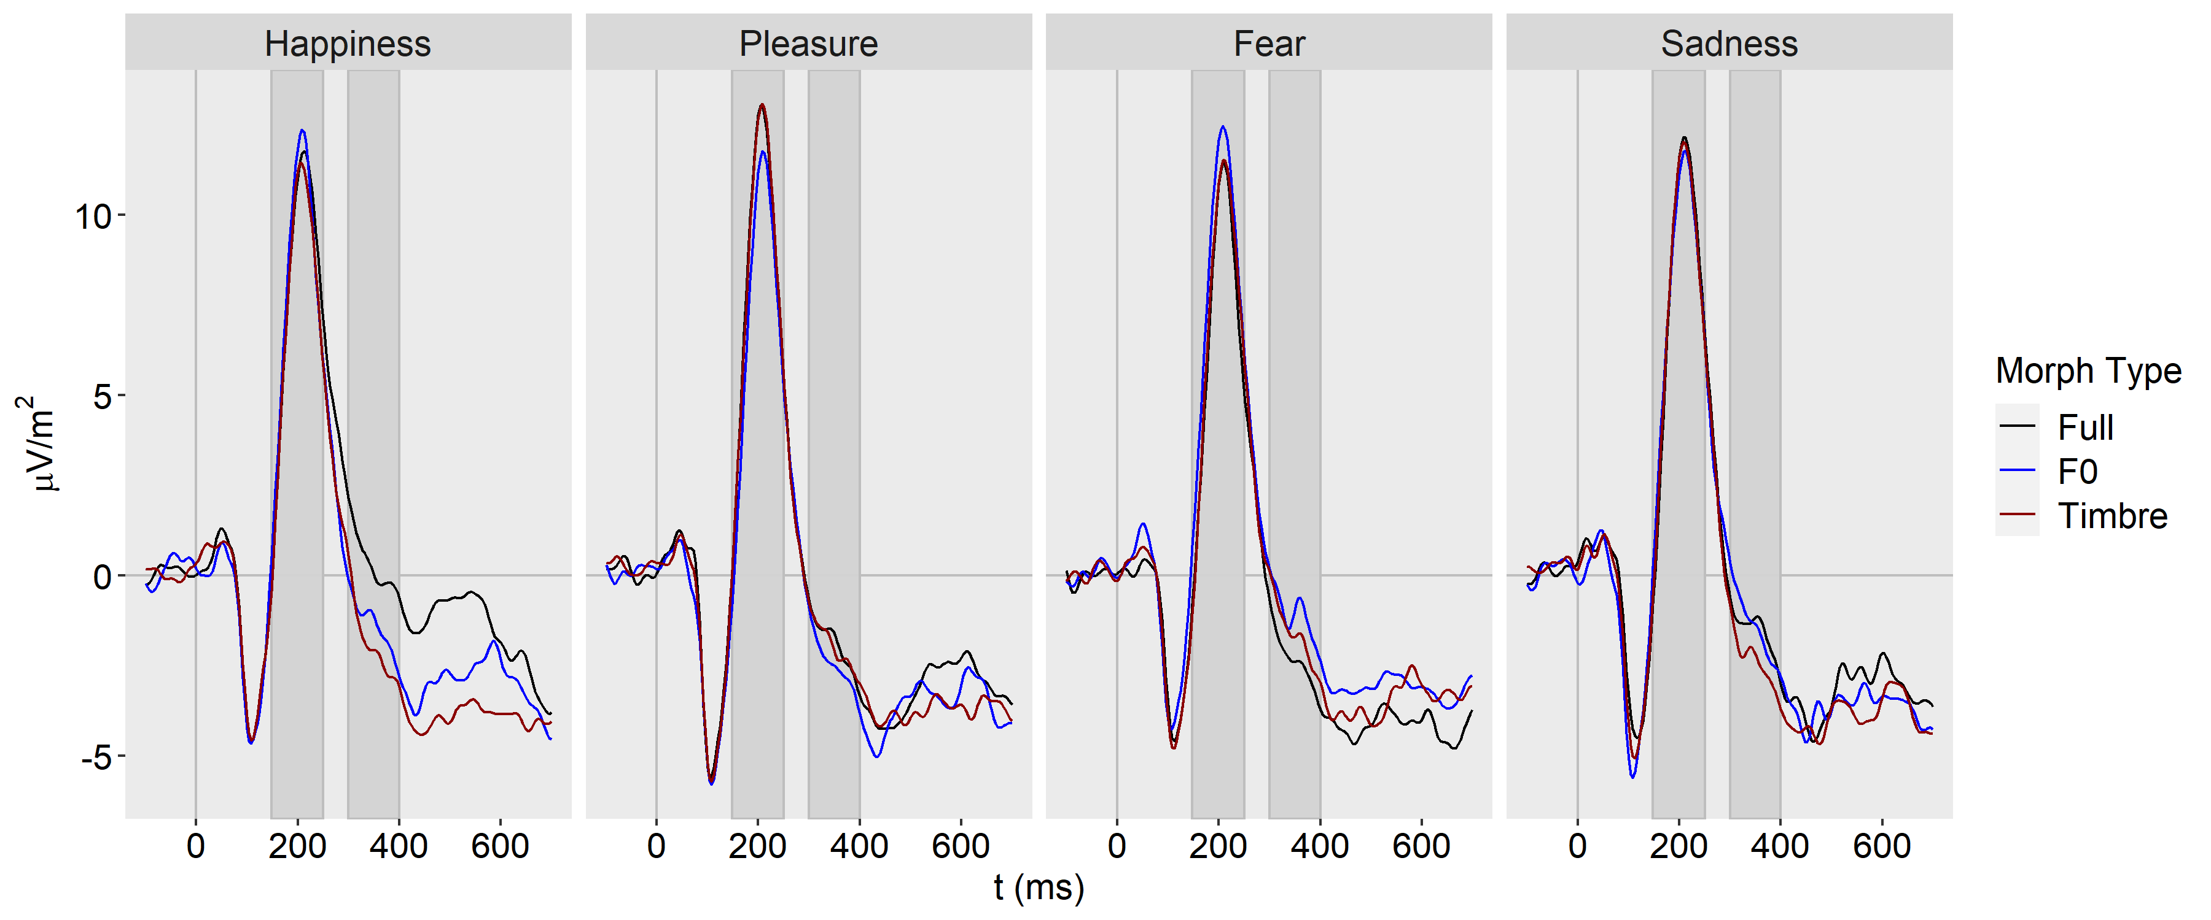
F0/Timbre and naturalness confounded
[Nussbaum et al. 2022, SCAN]
F0/Timbre and naturalness NOT confounded
[Nussbaum et al. 2023, Brain Sciences]
Notes:
It is something we should have on the radar

Slide 16
Summary
Listeners form an impression about the naturalness of a voice
Naturalness interacts with the perception of other person characteristics
There is a complex interplay between perceived naturalness and emotionality
Reduced naturalness can reduce ecological validity of emotional stimuli
Naturalness may not affect ratings of perceived emotionality, but emotion recognition and the associated electrophysiological correlates
… there is a lot of work to do!

Slide 17
Thank you for your attention!

