Slide 1
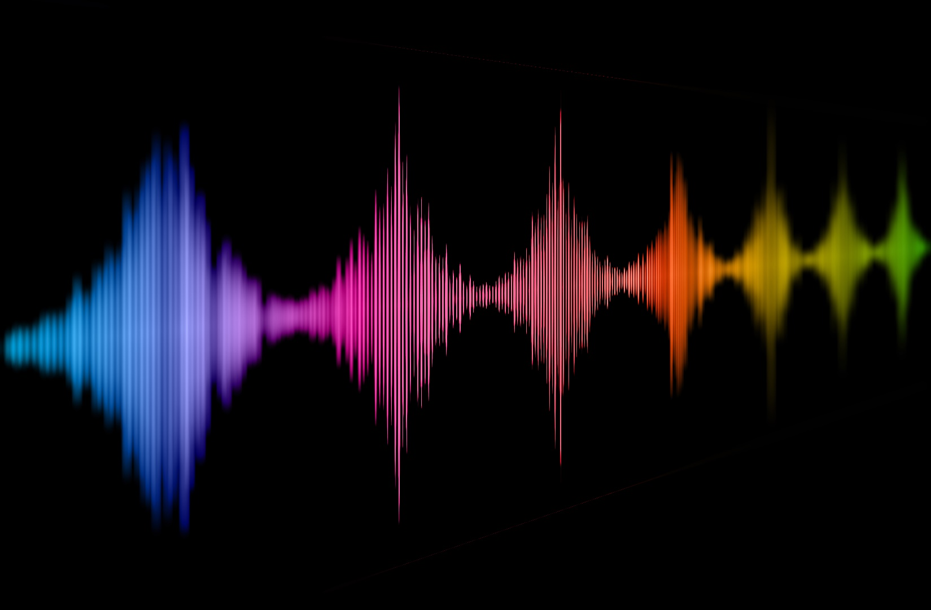
Perceived Naturalness of Emotional Voice Morphs
Christine Nussbaum & Manuel Pöhlmann
TeaP; March 2022

Slide 2
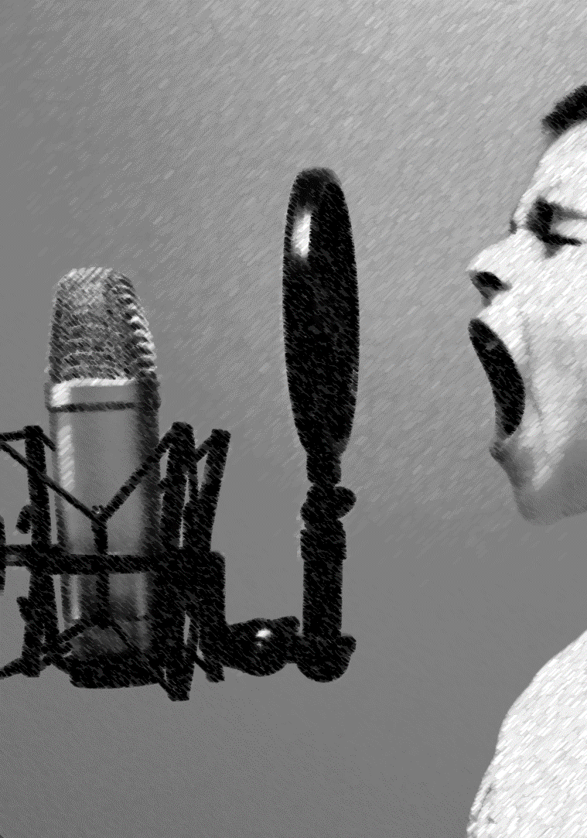
Emotional Voice Morphs
Acoustic parameters [e.g.Juslin & Laukka , 2003]
Fundamental frequency (F0)
Timbre
(Amplitude)
(Speech rate)
Linking acoustic parameter to emotions:
Correlational: measurement of acoustic parameters
Experimental: manipulation of acoustic parameters -> Voice Morphing
Notes:
1 min
I want to start by introducing emotional voice morphing to you and explain what it is good for.

Slide 3
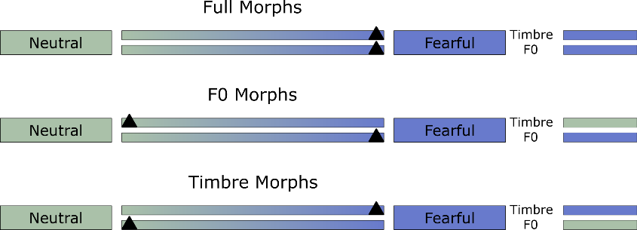
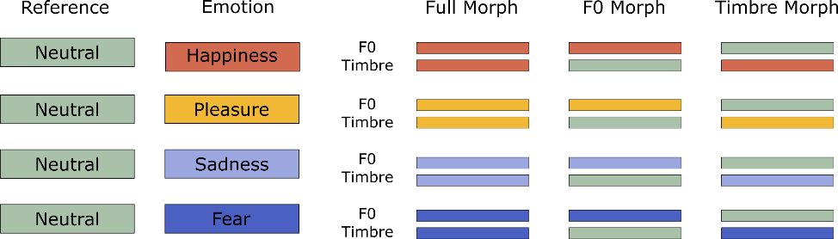

Parameter-specific Voice Morphing
Emotional voice morphs sound unnatural/robotic/not very human like
ecological validity of stimuli
distraction from the task
potential confound
Is parameter-specific voice morphing a suitable tool for research on vocal emotion perception?
Notes:
3 min

Slide 4
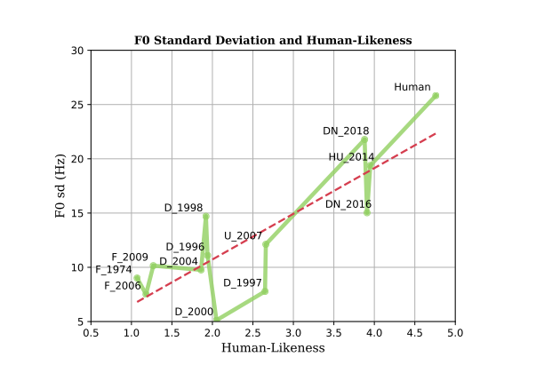
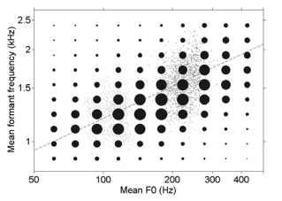
speech-language pathology
human-robot-interaction
What are the determinants of
speech naturalness?
methodology of voice research
F0 Variation
Baird et al. (2018)
F0/Timbre Covariation Assmann & Dembling (2006)
Notes:
3 min

Slide 5
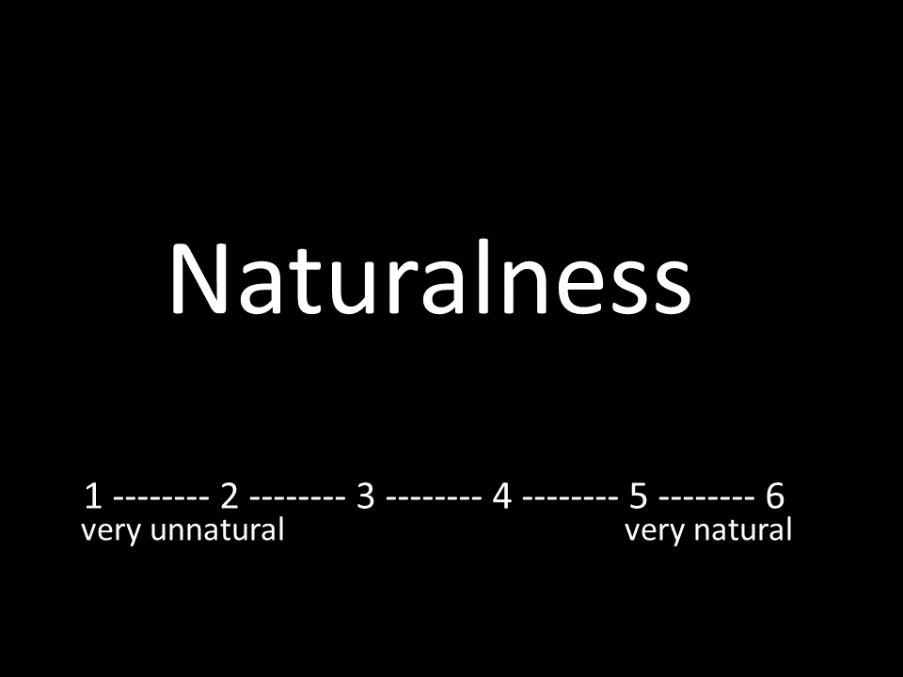
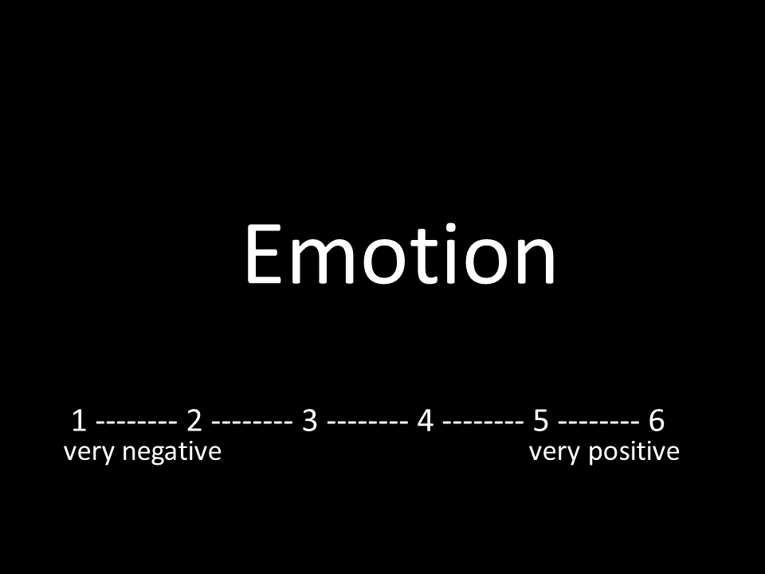
Rating Study:
1
2
How is the impression of voice naturalness affected by voice morphing?
How does it interact with the perception of vocal emotions?
Stimuli:
8 (speakers) x 3 (pseudowords) x 4 (emotions) x 3 (morphing conditions) x 2 reference types + 48 reference (8 speakers x 3 pseudowords x 2 reference types) = 624 stimuli; split between-subject per pseudoword
Sample:
51 participants, 40 females, 11 males,
aged 19 to 31 years [M = 21.49; Mdn = 21; SD = 2.64],
with 16/18/17 per pseudoword
Notes:
2 min

Slide 6
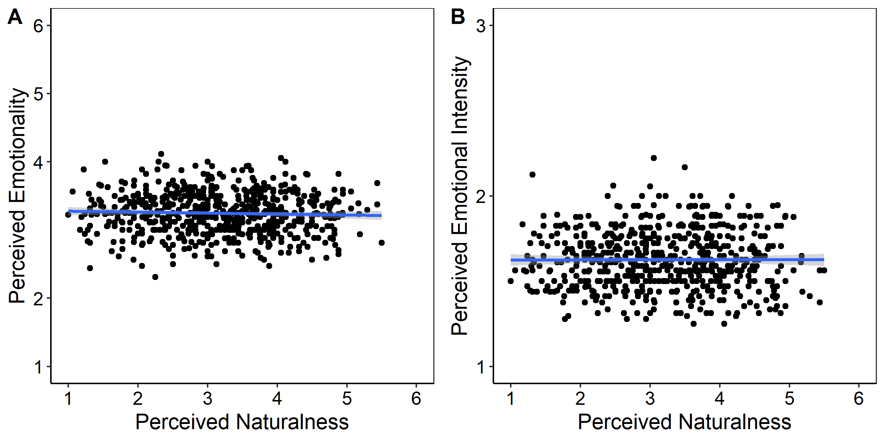
Results – Relationship between Naturalness and Emotionality
Mean ratings of perceived naturalness, emotionality (A), and emotional intensity (B).
Notes:
1 min

Slide 7
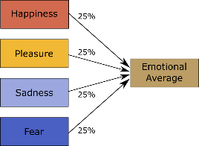
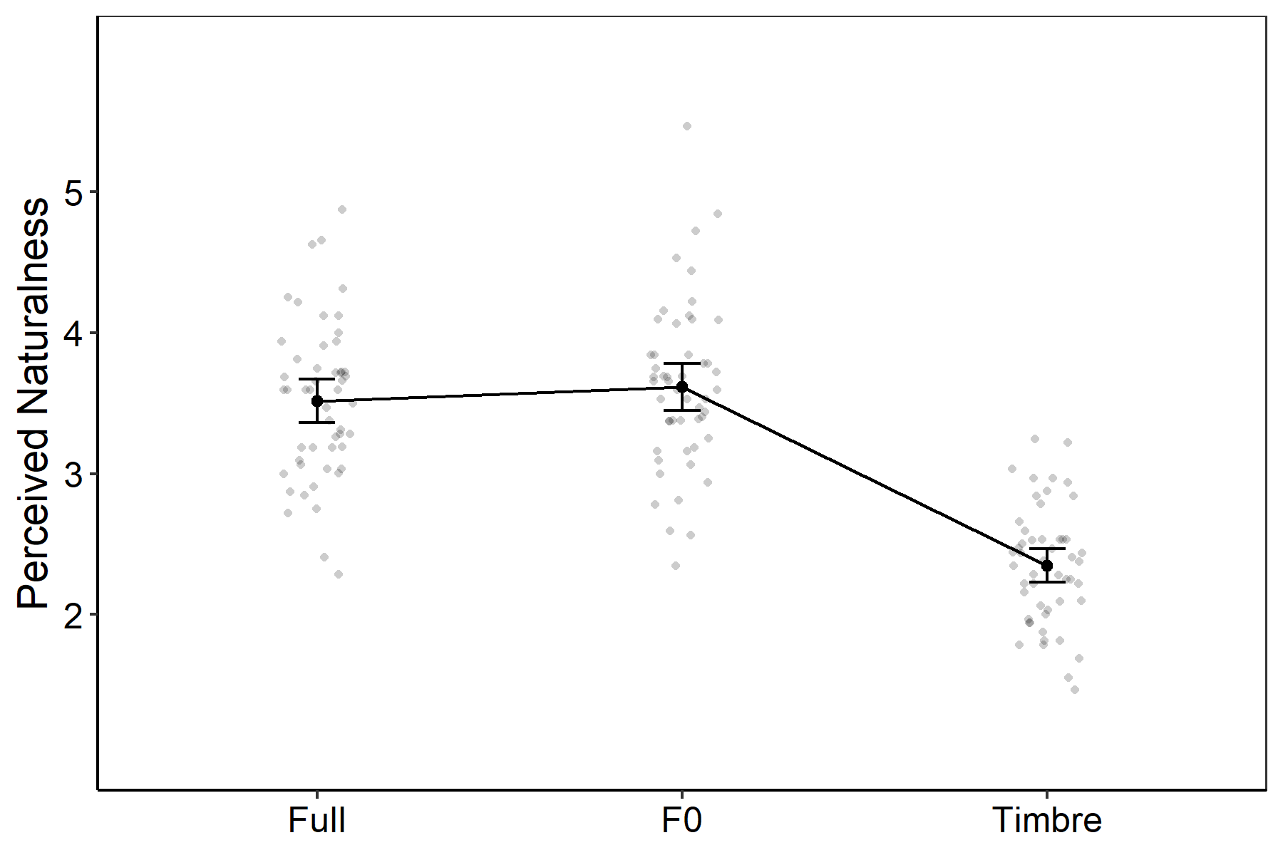
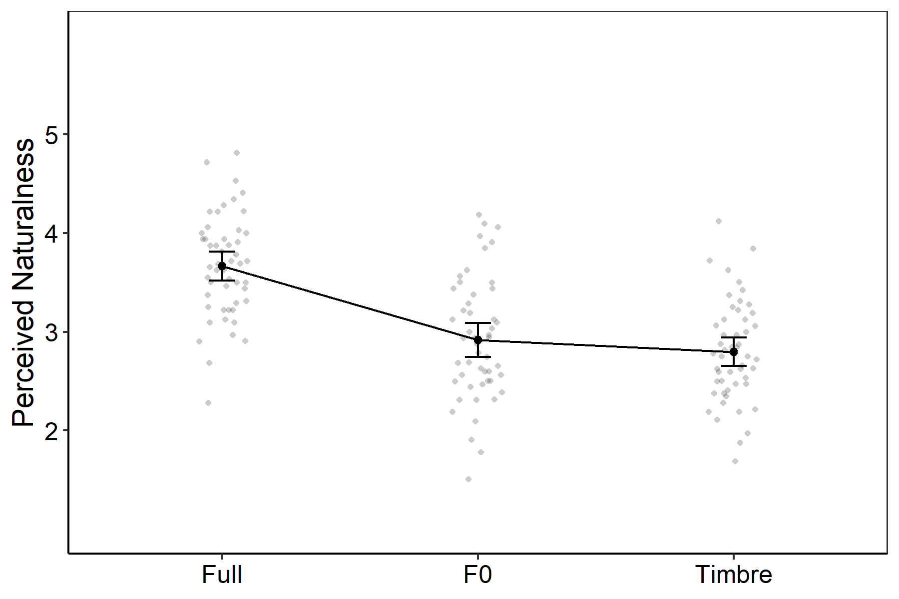
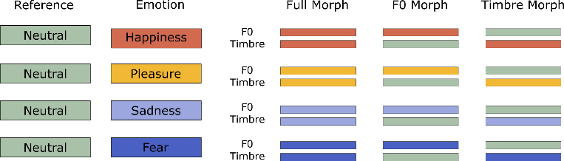
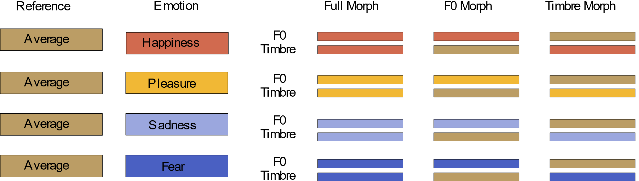
Results – Impact of voice morphing on voice naturalness?
F0 Variation
F0 Variation
Notes:
1 min

Slide 8
Perceived Naturalness of Emotional Voice Morphs
1
2
Parameter-Specific Voice Morphing
does Affect Voice Naturalness
The Perception of Emotion is not Substantially Affected by a Reduction of Voice Naturalness
Parameter-specific voice morphing is a suitable tool for research on vocal emotion perception.
Notes:
1 min

Slide 9

Thank you for your attention!

Slide 10
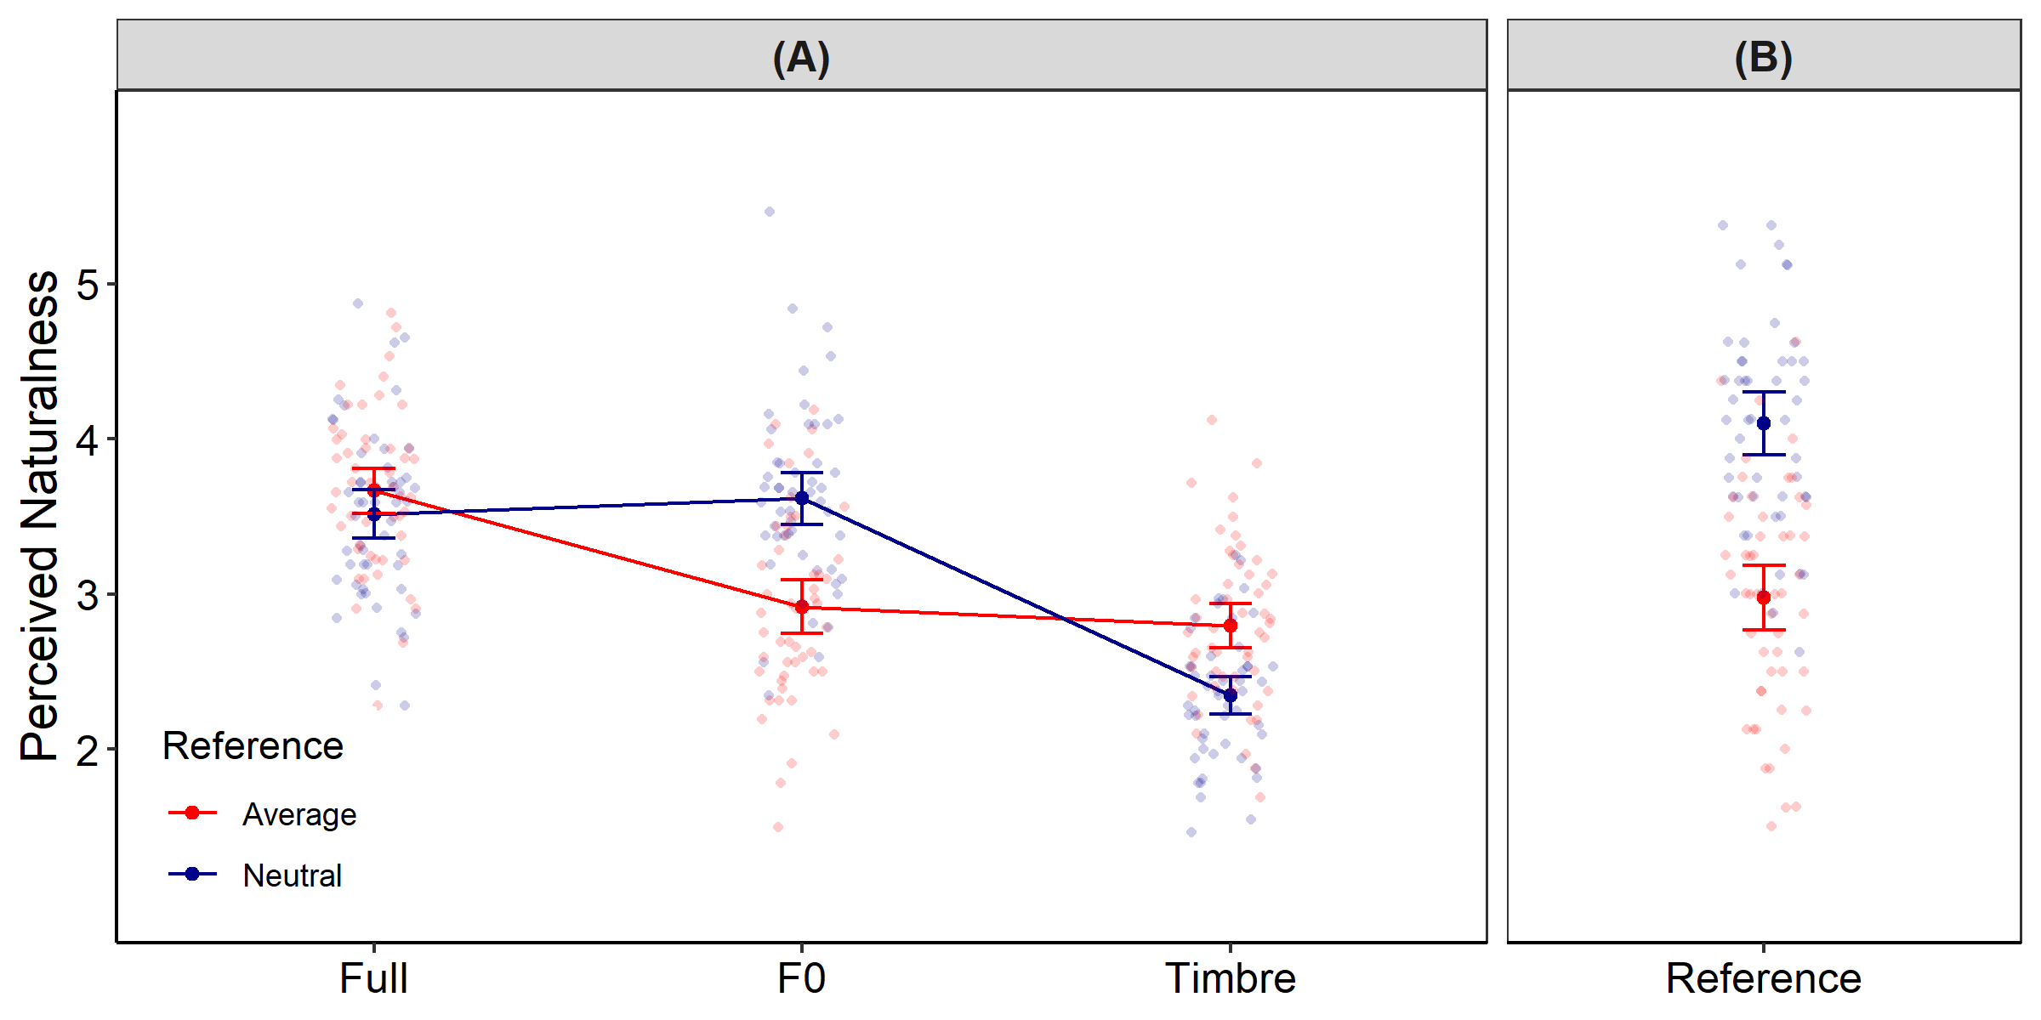
Perceived Naturalness of Emotional Voice Morphs

Slide 11
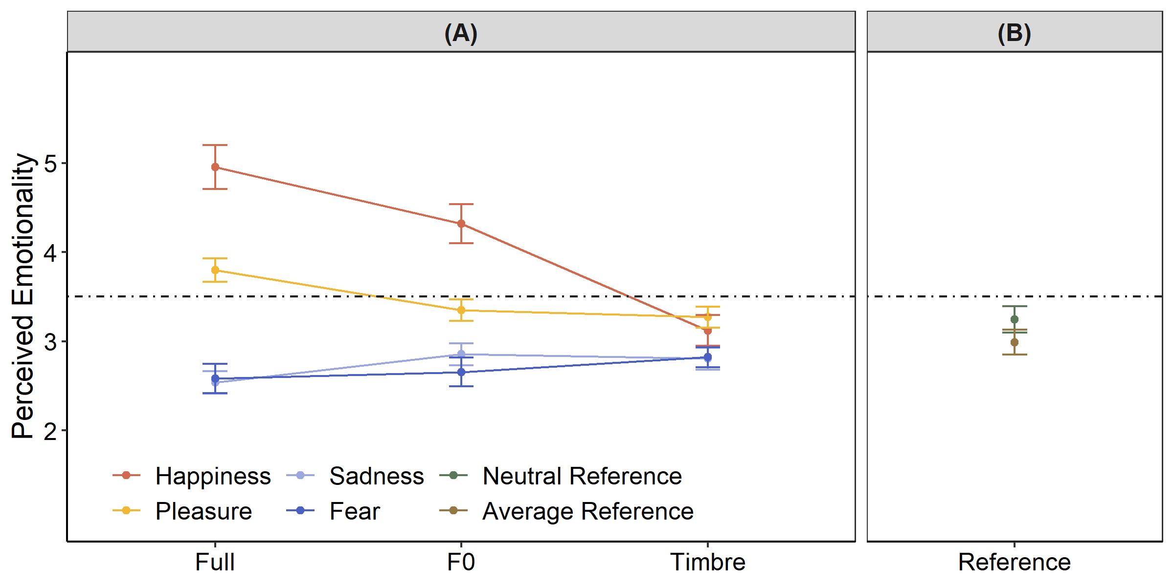
Perceived Naturalness of Emotional Voice Morphs

Slide 12
Perceived Naturalness of Emotional Voice Morphs

Slide 13
Perceived Naturalness of Emotional Voice Morphs
Rating ~ F0_{Mean} + F0_{SD} + F0_{Glide} + FormDisp + HNR + (1 | Participant) + (1 | SpID)

Slide 14
References
Kawahara, H., & Skuk, V. G. (2019). Voice morphing. In S. Frühholz & P. Belin (Eds.), the Oxford Handbook of Voice Perception
(Pp. 685-706). Oxford: Oxford University Press.
Nussbaum, C., Eiff, C. I. von, Skuk, V. G., & Schweinberger, S. R. (2022). Vocal emotion adaptation aftereffects within and across speaker genders: Roles of timbre and fundamental frequency. Cognition, 219, 104967.
Eiff, C. I. von, Skuk, V. G., Zäske, R., Nussbaum, C., Frühholz, S., Feuer, U., Guntinas-Lichius, O., & Schweinberger, S. R. (2022). Parameter-Specific Morphing Reveals Contributions of Timbre to the Perception of Vocal Emotions in Cochlear Implant Users. Ear and Hearing, Publish Ahead of Print.
Nussbaum, C., Schirmer, A, & Schweinberger, S. R. [in revision] Contributions of Fundamental Frequency and Timbre to Vocal Emotion Perception and their Electrophysiological Correlates.
Arias, P., Rachman, L., Liuni, M., & Aucouturier, J.-J. (2021). Beyond Correlation: Acoustic Transformation Methods for the Experimental Study of Emotional Voice and Speech. Emotion Review, 13(1), 12–24. https://doi.org/10.1177/1754073920934544
Baird, A., Parada-Cabaleiro, E., Hantke, S., Burkhardt, F., Cummins, N., & Schuller, B. (2018, September 2). The Perception and Analysis of the Likeability and Human Likeness of Synthesized Speech. In Interspeech 2018 (pp. 2863–2867). ISCA. https://doi.org/10.21437/Interspeech.2018-1093
Assmann, P. F., Dembling, S., & Nearey, T. M. (2006). Effects of frequency shifts on perceived naturalness and gender information in speech. In INTERSPEECH. Symposium conducted at the meeting of Citeseer.
Juslin, P. N., & Laukka, P. (2003). Communication of emotions in vocal expression and music performance: different channels, same code? Psychol Bull, 129(5), 770–814. https://doi.org/10.1037/0033-2909.129.5.770
Skuk, V. G., Dammann, L. M., & Schweinberger, S. R. (2015). Role of timbre and fundamental frequency in voice gender adaptation. J Acoust Soc Am, 138(2), 1180–1193. https://doi.org/10.1121/1.4927696
Skuk, V. G., Kirchen, L., Oberhoffner, T., Guntinas-Lichius, O., Dobel, C., & Schweinberger, S. R. (2020). Parameter-Specific Morphing Reveals Contributions of Timbre and Fundamental Frequency Cues to the Perception of Voice Gender and Age in Cochlear Implant Users. Journal of Speech, Language, and Hearing Research : JSLHR, 63(9), 3155–3175. https://doi.org/10.1044/2020_JSLHR-20-00026

