Slide 1
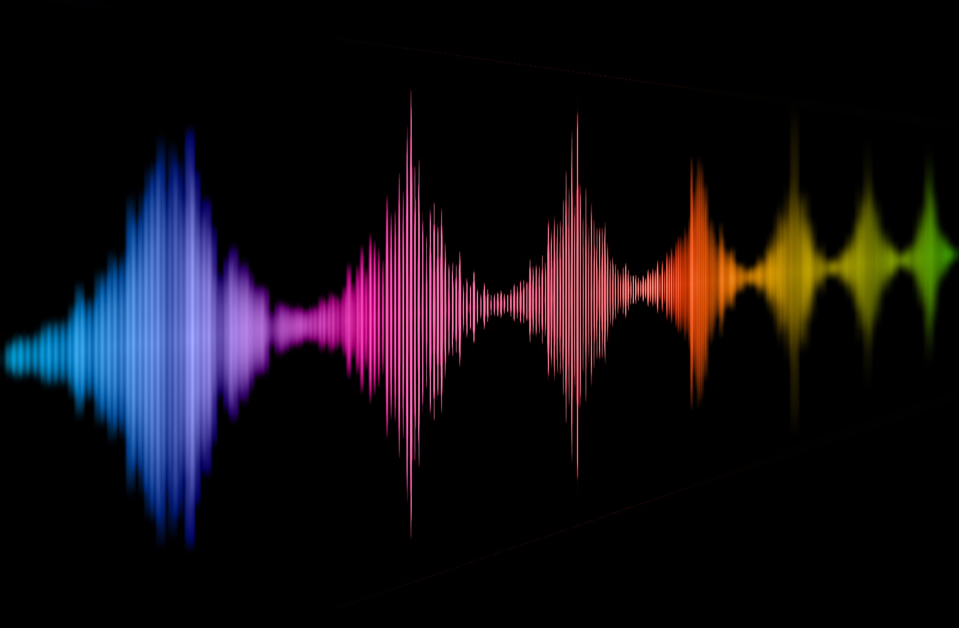
The perception of voice naturalness
Dr. Christine Nussbaum
Friedrich-Schiller-University Jena
Department for General Psychology and Cognitive Neuroscience

Slide 2

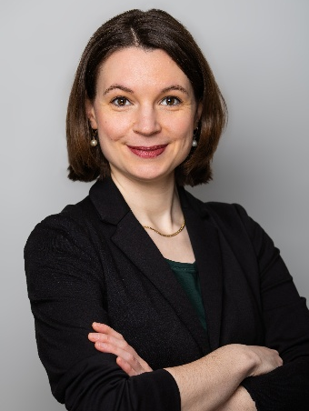
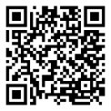
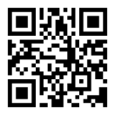

Who am I
Dr. Christine Nussbaum
Research topics: Emotion perception in voices
Naturalness in voices
Teaching: Neuropsychology of auditory processing
Good Scientific Practice
Empirische Forschungsmethoden
Methods: Qualitative methods, empirical research
Electroenzephalographie (EEG)
Voice Morphing
Roles: Coordinator of Jena Voice Research Unit (VRU)
Organisation of the „VoiceID 2026“
„VoCSA“ board member
Chair of the science communication platform „PhDScicom“
2013 – 2018 B.Sc/M.Sc. Psychology
2019 – 2023 PhD Student
since 2023 Post-doctoral researcher
Institut für Psychologie
Lehrstuhl für Allgemeine Psychologie und kognitive Neurowissenschaften

Slide 3
When we hear a voice….
…. we hear a person!

Slide 4
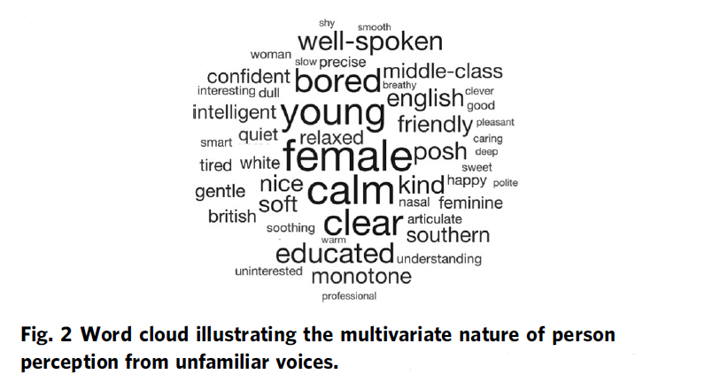
unhealthy
Person Perception from Voices
weird
machinelike
artificial
odd
strange
robotic
distorted
bizarre
[Lavan & McGettigan, 2023; Lavan 2023]

Slide 5
Why is it important to study voice naturalness?
Notes:
ToDo

Slide 6
Naturalness has a (negative) impact on communicative quality
“Impairments in speech naturalness can lead to communication partners perceiving the affected individuals as unhappy, cold, withdrawn, introverted, or bored. These false perceptions can interrupt participation in regular life roles, leading to loss of employment and independence. Thus, impaired speech naturalness can result in social isolation, reduced quality of life, and depression.” [Stepp & Voijtech 2019]

Slide 7
Naturalness is an important aspect for the design of synthetic/artificial voices
“The growing popularity of speech interfaces goes hand in hand with the creation of synthetic voices that sound ever more human. Previous research has been inconclusive about whether anthropomorphic design features of machines are more likely to be associated with positive user responses or, conversely, with uncanny experiences. To avoid detrimental effects of synthetic voice design, it is therefore crucial to explore what level of human realism human interactors prefer and whether their evaluations may vary across different domains of application.” [Schreibelmayer & Mara, 2022]

Slide 8
What are current problems in voice naturalness research?

Slide 9
Conceptual underspecification
“Naturalness was defined as conforming to the listener’s standards of rate, rhythm, intonation, and stress patterning and to the syntactic structure of the utterance being produced” [Abur et al. 2021, page 4687]
“Natural speech is the speech most closely perceived as a human voice.”
[Mawalim et al. 2022, page 10]
"By naturalness, we understand the voice stimulus to be perceived as a plausible outcome of the human speech production system. “ [Nussbaum, et. al. 2023, page 1]
"Naturalness’ will not be defined for you.“ [Martin 1984, page 54]
<50% of the identified articles don’t have an explicit definition of naturalness
Notes:
- Deviation-based
- Category-based
Agree on two things:
Subjective and multifactorial/multidimensional (you dont know whic acoustic features listeners attend to)

Slide 10
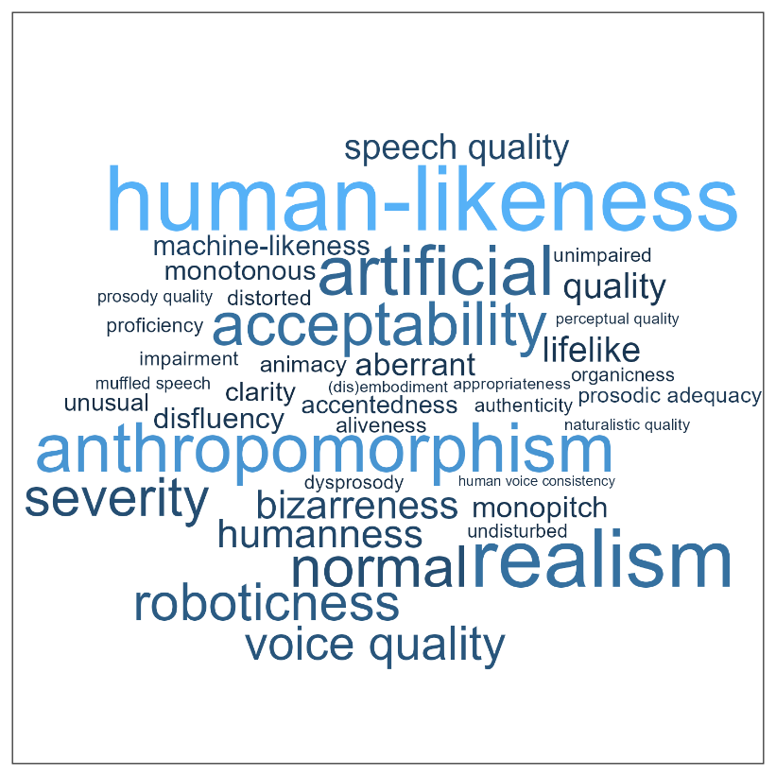
Heterogeneous terminology in the literature

Slide 11
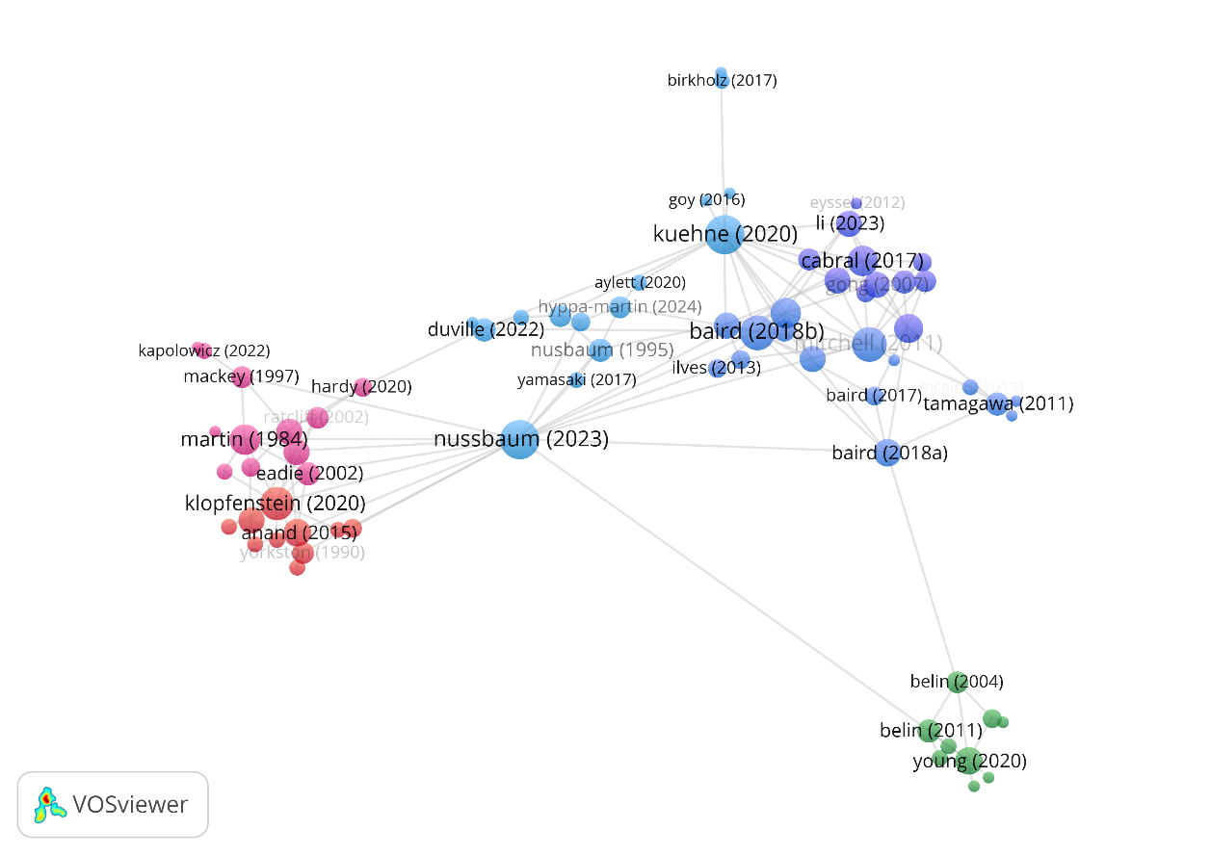
Lack of exchange between different research domains

Slide 12
Towards a concise framework for voice naturalness

Slide 13
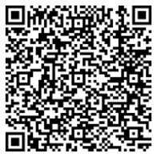
Understanding Voice Naturalness (2025)
Christine Nussbaum, Sascha Frühholz and Stefan R. Schweinberger
In Trends in Cognitive Sciences
A conceptual framework for the definition of voice naturalness

Slide 14
Understanding Voice Naturalness (2025)
Christine Nussbaum, Sascha Frühholz and Stefan R. Schweinberger
In Trends in Cognitive Sciences
Rooting voice naturalness in voice-processing theory

Slide 15
Empirical work on voice naturalness perception (ongoing)
Notes:
ToDo

Slide 16
Study 1: Perceptual adaptation to naturalness in voices
Study 3: The Categorical Perception of Voice Naturalness
Study 2: Effects of the rating scale on naturalness impressions

Slide 17
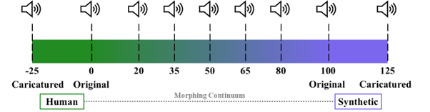
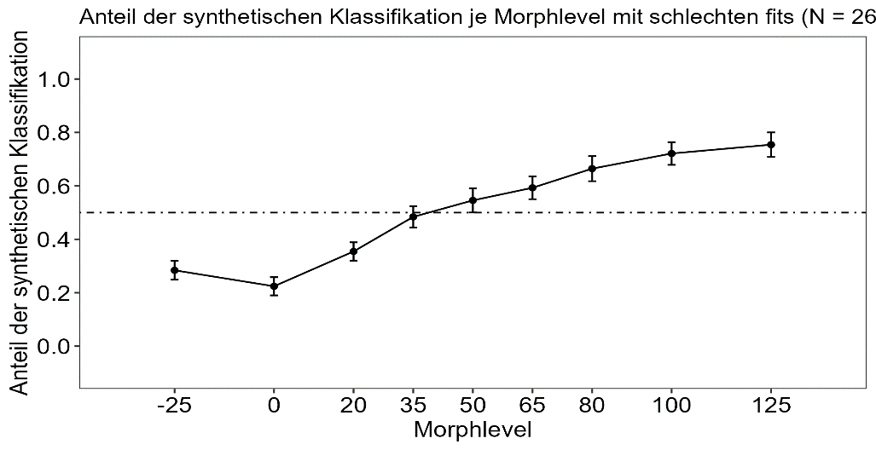
Our Voice Morphing Approach
Bachelor thesis of Sebastian Goerke

Slide 18
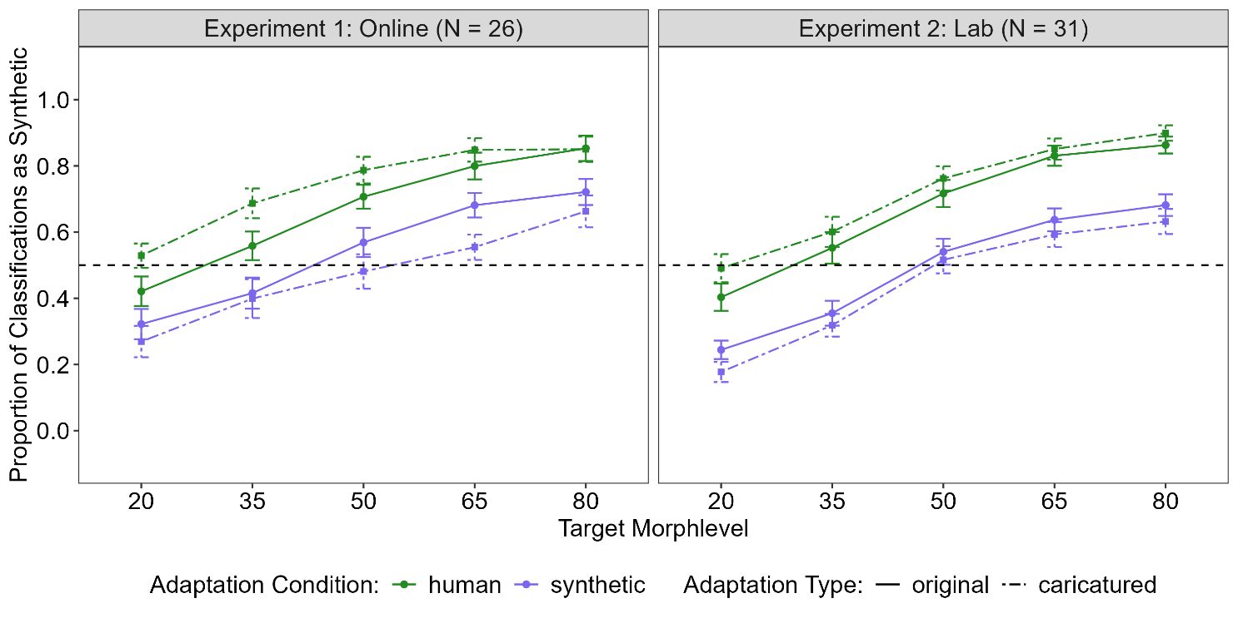
Study 1: Perceptual adaptation to naturalness in voices
Bachelor thesis of Sebastian Goerke

Slide 19
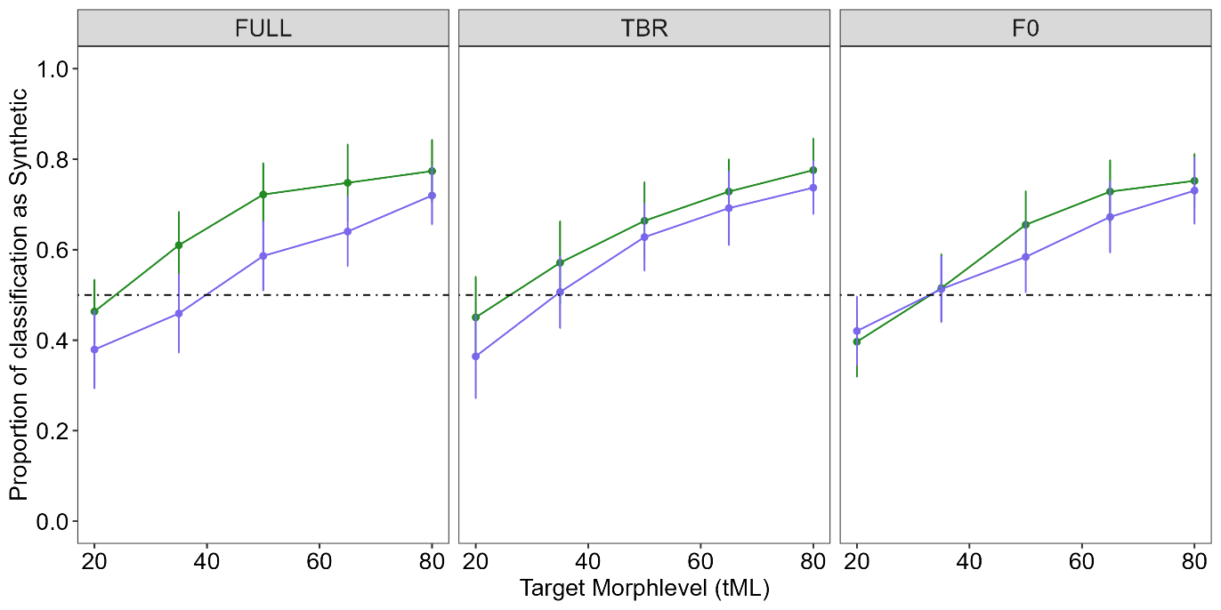
Parameter-specific adaptation (preliminary, N = 29)
FULL: adaptors are full morphs (F0 + timbre)
TBR: adaptors are timbre morphs (human/synthetic info only expressed via timbre)
F0: adaptors are F0 morphs (human/synthetic info only expressed via fundamental frequency)
Bachelor thesis of Klara Heck (ongoing)

Slide 20
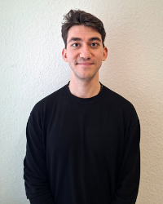
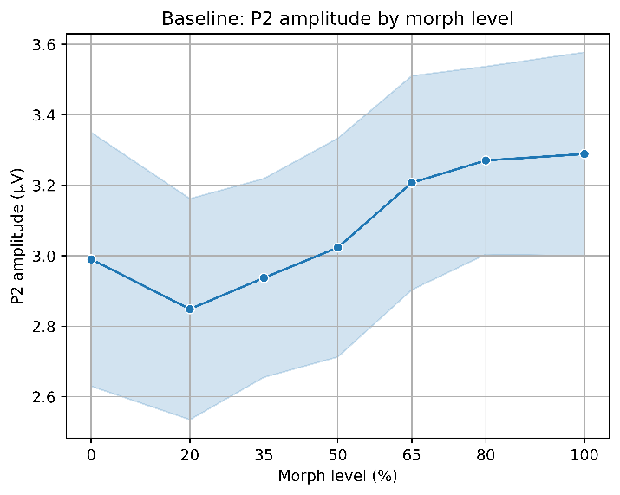
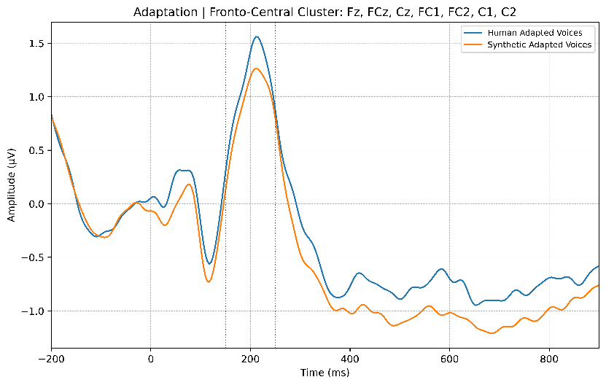
Ibrahim Vefa Arslan, PhD-student on the project „Neurocognitive
processing of voice naturalness in human and synthetic voices “,
funded by the EU-MSCA Nework „Voice Communication Sciences“
EEG Study (preliminary, ongoing)

Slide 21
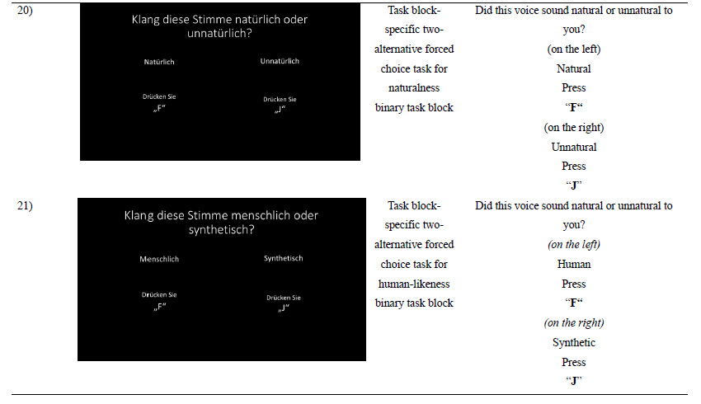
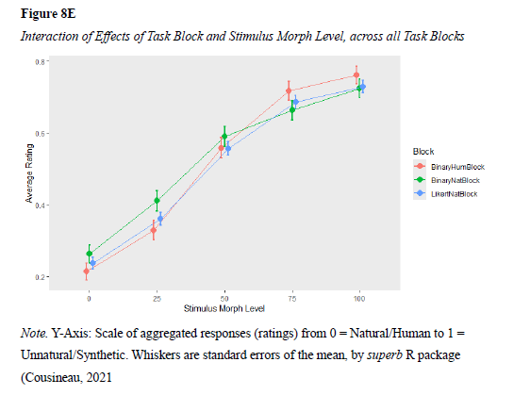
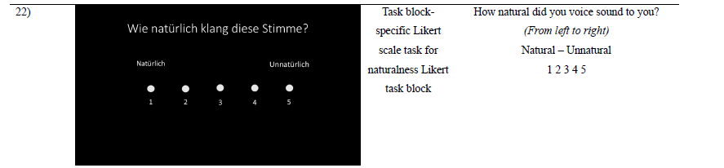
Study 2: Effects of the rating scale on naturalness impressions
Bachelor thesis of Simone Dahmen

Slide 22
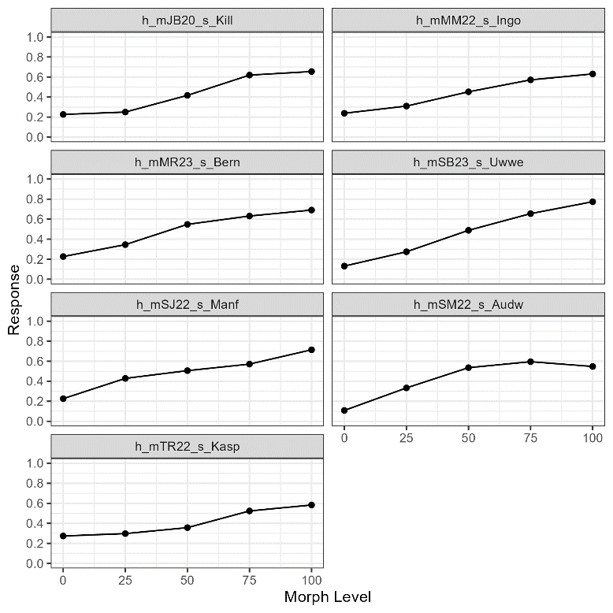
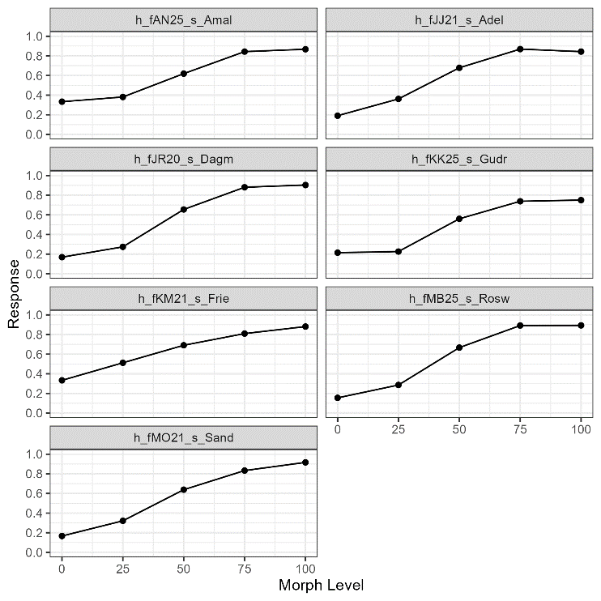
Study 2: Validation of the morphing procedure
Bachelor thesis of Simone Dahmen

Slide 23
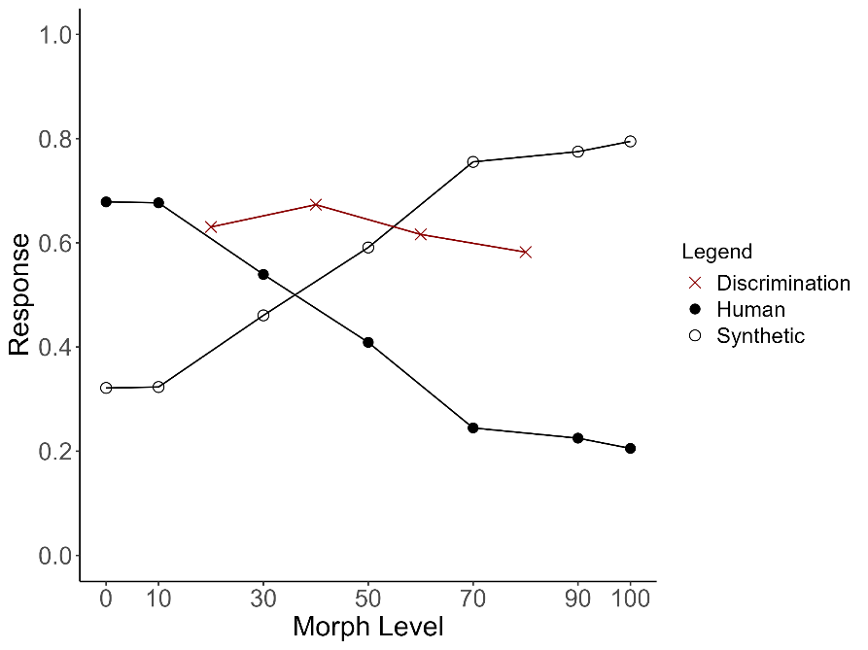
Study 3: The Categorical Perception of Voice Naturalness
Bachelor thesis of Sophia Hering

Slide 24
Open Questions
Brain processing
Context dependence
Individual differences
Flexibilitx

Slide 25

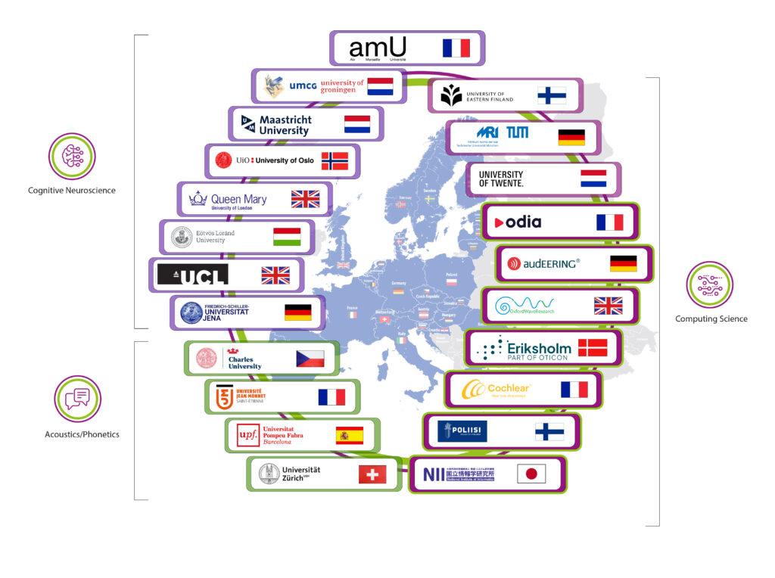

Voice Communication Sciences (VoCS) in Europa

Slide 26
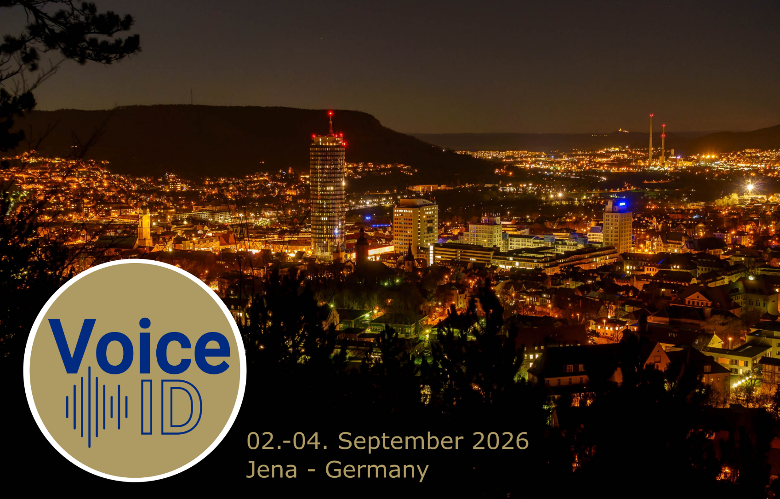

Slide 27
Thank you for your attention ☺

Slide 28
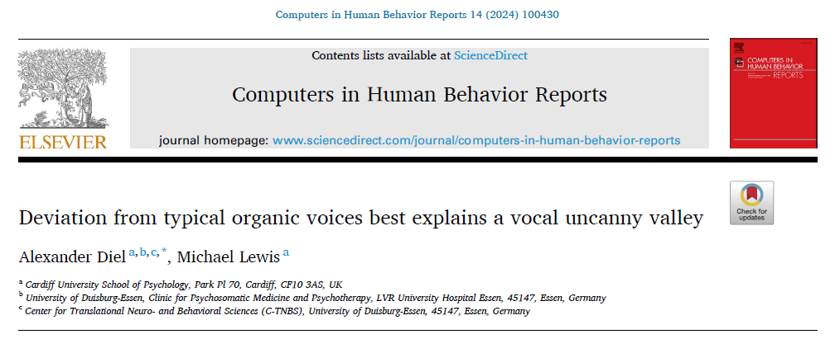
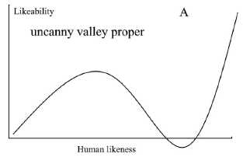
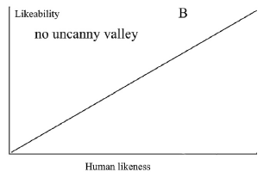
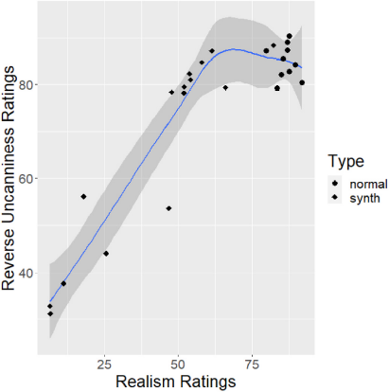
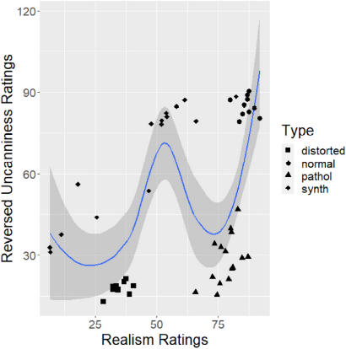
Notes:
Where does naturalness affect the processing pipeline?

Slide 29
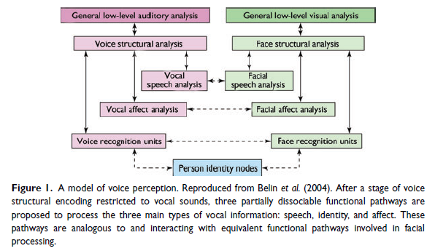
Understanding voice perception
Belin et al (2011)
Notes:
Where does naturalness affect the processing pipeline?

Slide 30
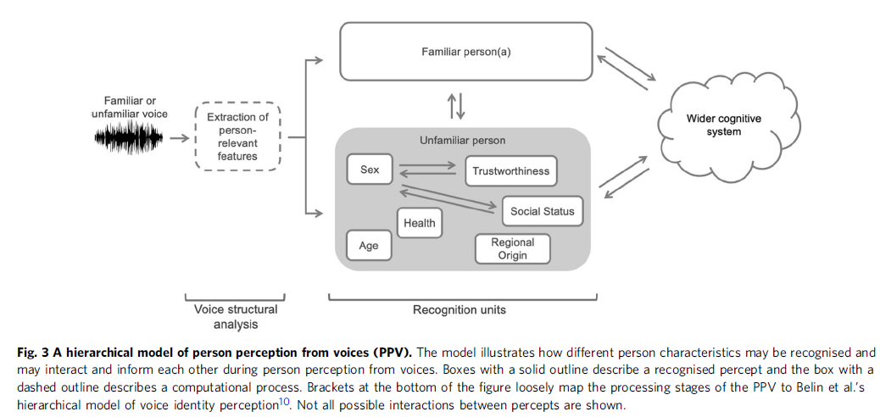
Person Perception from Voices (PPV)
Naturalness
(Lavan & McGettigan 2023)
Notes:
Good starting point
We form impressions about voices the moment we hear them
Manifold, and they interact
I added two…
„When hearing a voice, listeners can form a detailed impression of the person behind the voice. “
- “how the perception of different person characteristics may interact and inform each other,“
-> Theory driven thinking may prompt some obvious research questions that have not been answered yet

