Slide 1
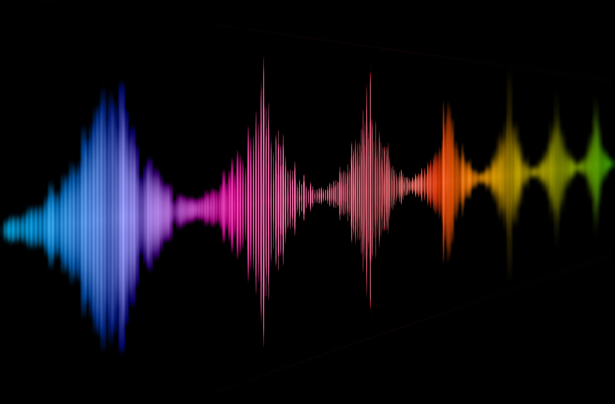
The perception of voice naturalness - a little snapshot
Dr. Christine Nussbaum
Friedrich Schiller University Jena
Department for General Psychology and Cognitive Neuroscience

Slide 2
When we hear a voice….
…. we hear a person!
Notes:
Always steal that from Nadine

Slide 3
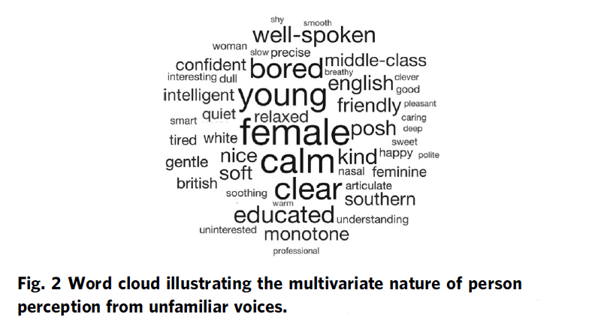
unhealthy
Person Perception from Voices
weird
machinelike
artificial
odd
strange
robotic
distorted
bizarre
[Lavan & McGettigan, 2023; Lavan 2023]
Notes:
Research is located in the whole big field of „person perception from voices“

Slide 4
What are challenges in voice naturalness research?
Notes:
Just a very little „what happened so far“-summary of the key points in the TiCS paper

Slide 5
Conceptual underspecification
“Naturalness was defined as conforming to the listener’s standards of rate, rhythm, intonation, and stress patterning and to the syntactic structure of the utterance being produced” [Abur et al. 2021, page 4687]
“Natural speech is the speech most closely perceived as a human voice.”
[Mawalim et al. 2022, page 10]
"By naturalness, we understand the voice stimulus to be perceived as a plausible outcome of the human speech production system. “ [Nussbaum, et. al. 2023, page 1]
"Naturalness’ will not be defined for you.“ [Martin 1984, page 54]
<50% of the identified articles don’t have an explicit definition of naturalness
Notes:
- Deviation-based
- Category-based
Agree on two things:
Subjective and multifactorial/multidimensional (you dont know whic acoustic features listeners attend to)

Slide 6
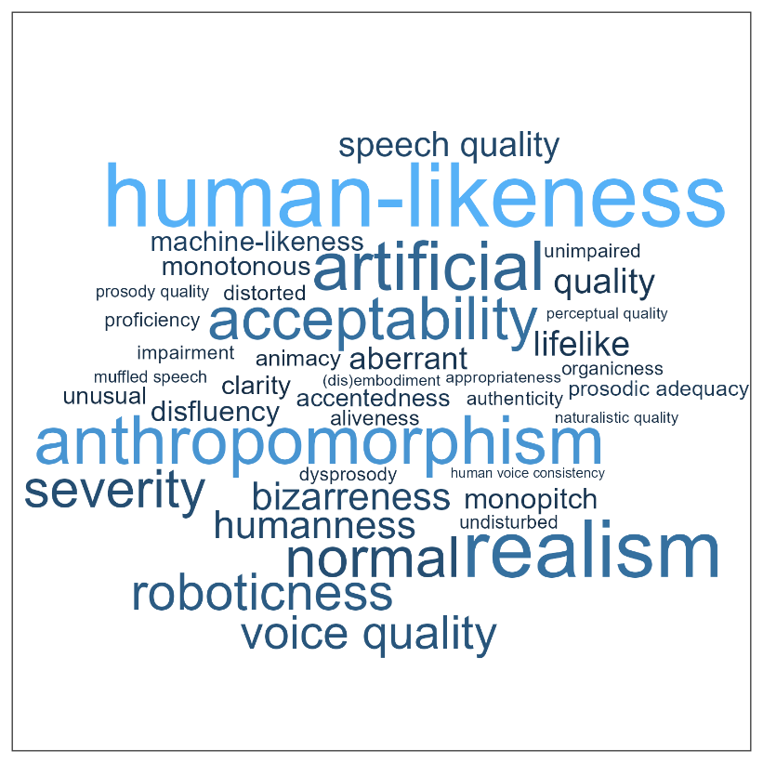
Heterogeneous terminology in the literature

Slide 7
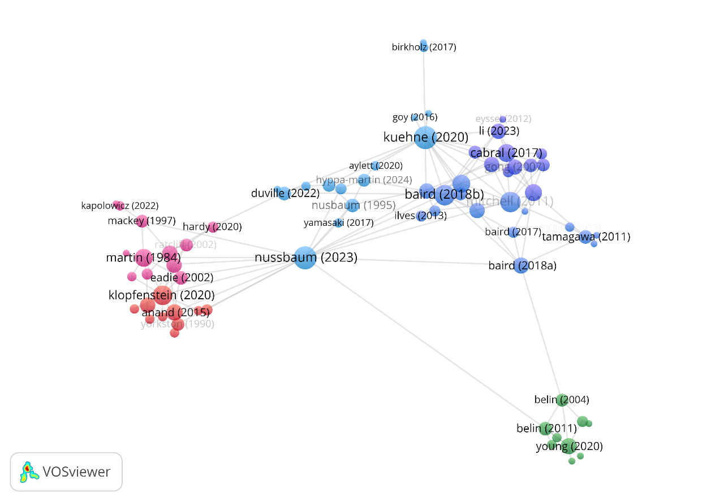
Lack of exchange between different research domains
Notes:
And: importantly.
Connection to voice perception theory
Basic research is missing
My role: to fill this little void

Slide 8
Towards a concise framework for voice naturalness

Slide 9
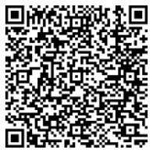
Understanding Voice Naturalness (2025)
Christine Nussbaum, Sascha Frühholz and Stefan R. Schweinberger
In Trends in Cognitive Sciences
A conceptual framework for the definition of voice naturalness
Notes:
- Makes a couple of implicit things explicit

Slide 10
Understanding Voice Naturalness (2025)
Christine Nussbaum, Sascha Frühholz and Stefan R. Schweinberger
In Trends in Cognitive Sciences
Rooting voice naturalness in voice-processing theory
Notes:
Anchoring in voice perception theory
Differentiation from authenticity (which luckily is not complete nonsense)
Predictions: should come in rather early

Slide 11
Empirical work on voice naturalness perception
(this is the snapshot now…)

Slide 12
Is the perception of voice naturalness ammenable to perceptual manipulation?
Is the perceptual transition of human to synthetic voices categorical or continuous?
Does the rating of naturalness depend on the way it is measured?
Notes:
A model does not exist for the sake of itself, but it has to lead to
Model is only helpful if it provides a starting point for meaningful research questions
Either there are model predictions that need to be put to the tests
Reveals obvious questions, that are interesting

Slide 13
Study 1: Perceptual adaptation to naturalness in voices
Study 3: The Categorical Perception of Voice Naturalness
Study 2: Effects of the rating scale on naturalness impressions
Notes:
Study 1: can we shift the inner reference point (for now: short term)
For now: all of this research is based on human vs. synthetic voices
Most of it is ongoing (I am presenting what we currently know)

Slide 14
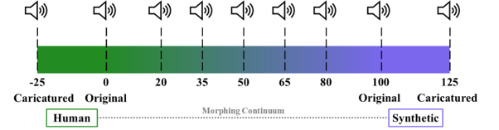
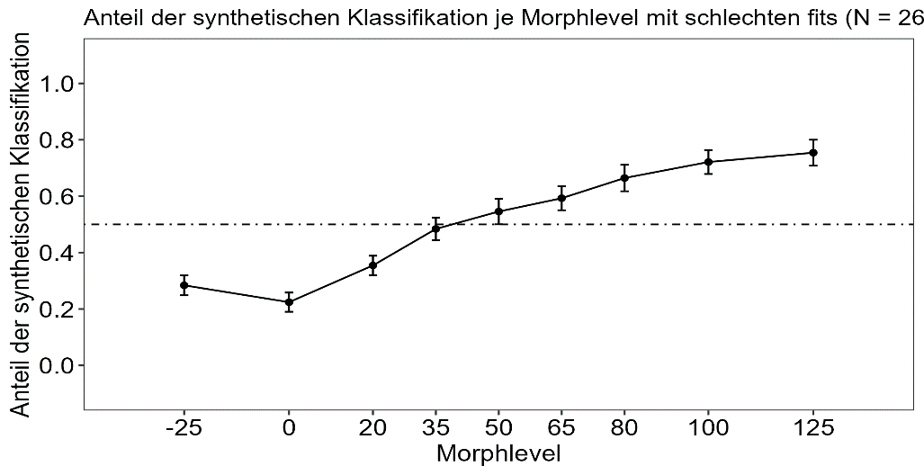
Our Voice Morphing Approach
Bachelor thesis of Sebastian Goerke
Notes:
ToDo: Stimuli
Get used to this psychometric curve (this is called a baseline)
For now: simple, two syllable words (endpoints: clearly synthetic, and clearly human, which has important implications)
This is the backbone of all three studies I am showing you now

Slide 15
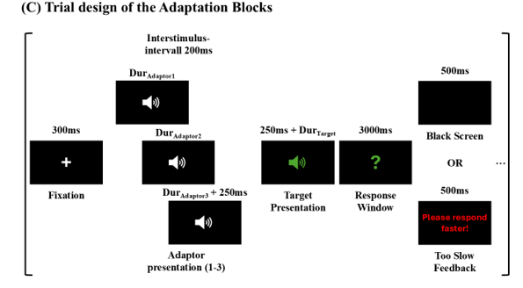
Study 1: Perceptual adaptation to naturalness in voices
Bachelor thesis of Sebastian Goerke

Slide 16
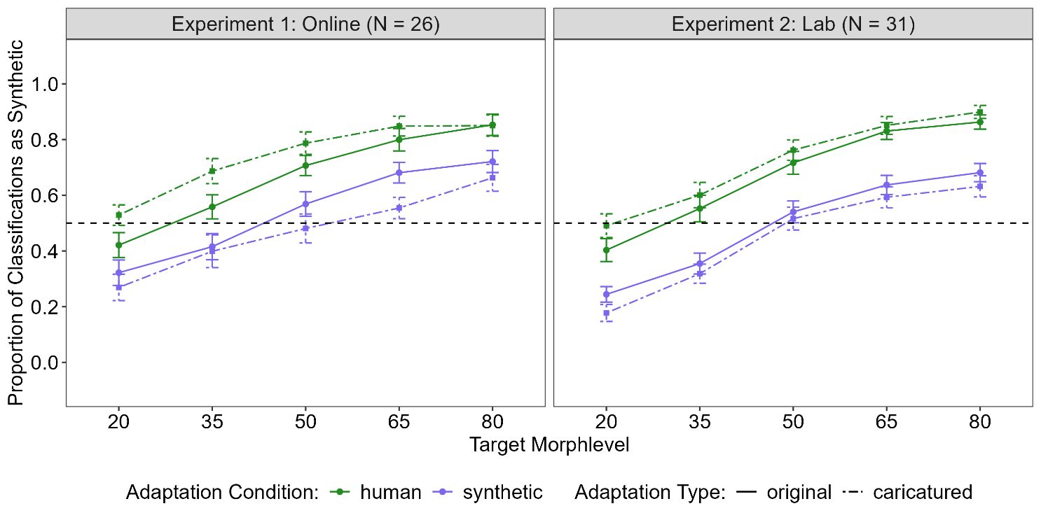
Study 1: Perceptual adaptation to naturalness in voices
Bachelor thesis of Sebastian Goerke

Slide 17
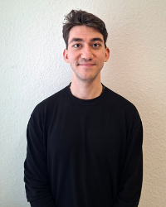
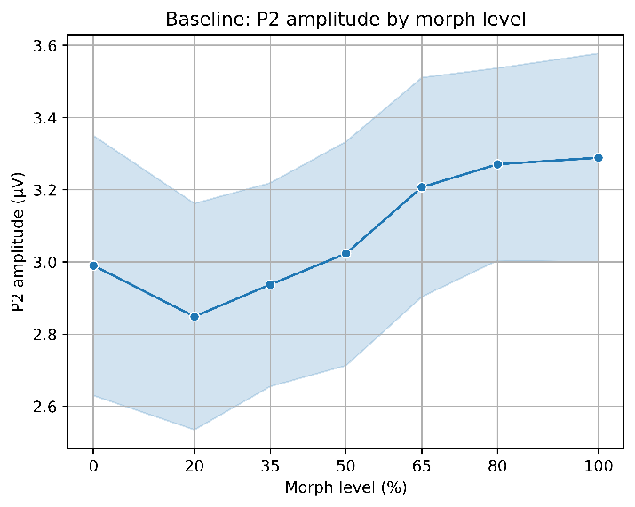
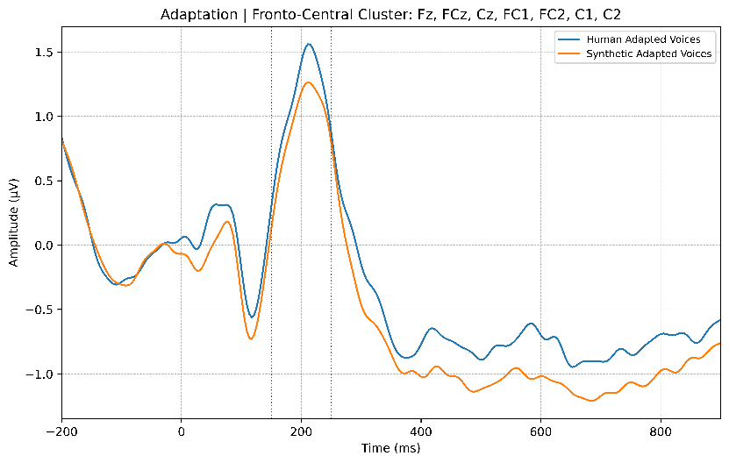
Ibrahim Vefa Arslan, PhD-student on the project „Neurocognitive
processing of voice naturalness in human and synthetic voices “,
funded by the EU-MSCA Nework „Voice Communication Sciences“
EEG Study (preliminary, ongoing)

Slide 18
Is the perception of voice naturalness ammenable to perceptual manipulation?
Is the perceptual transition of human to synthetic voices categorical or continuous?
YES
Does the rating of naturalness depend on the way it is measured?

Slide 19
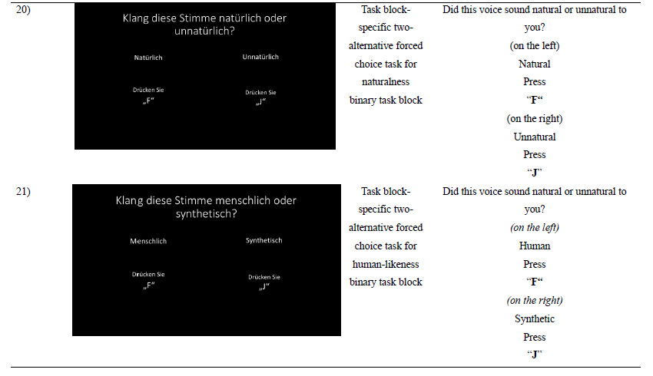
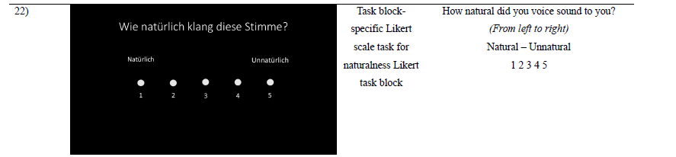
Study 2: Effects of the rating scale on naturalness impressions
Bachelor thesis of Simone Dahmen

Slide 20
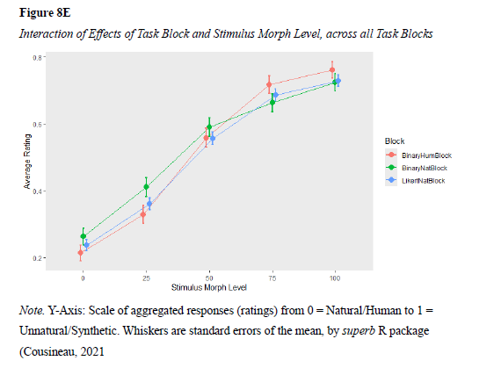
Study 2: Effects of the rating scale on naturalness impressions
Bachelor thesis of Simone Dahmen

Slide 21
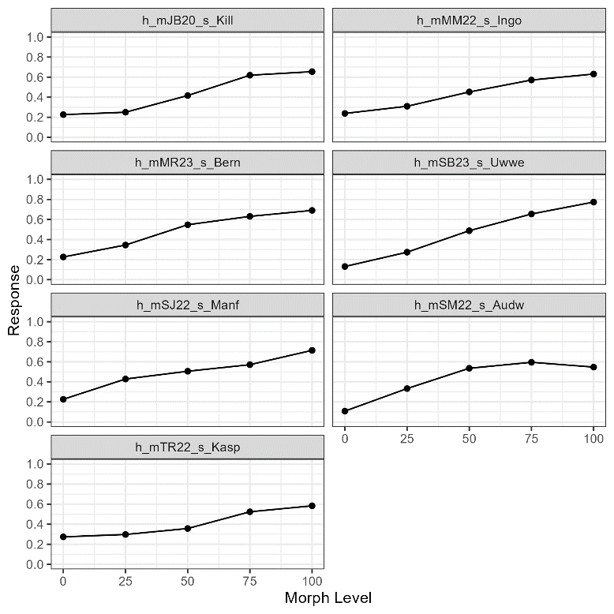
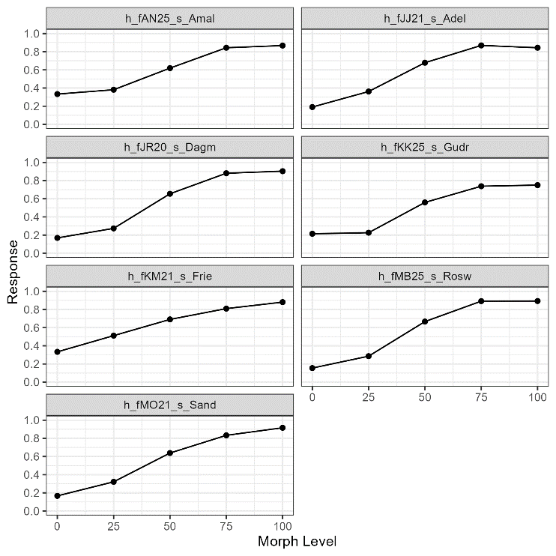
Study 2: Validation of the morphing procedure
Bachelor thesis of Simone Dahmen
Notes:
Little exkursion: methodological hassles of voice morphing
Voice Morphing needs extensive validation

Slide 22
Is the perception of voice naturalness ammenable to perceptual manipulation?
Is the perceptual transition of human to synthetic voices categorical or continuous?
YES
Does the rating of naturalness depend on the way it is measured?
No

Slide 23
Study 3: The Categorical Perception of Voice Naturalness
+
+
Categorization
Discrimination
Categorization predicts Discrimination
Bachelor thesis of Sophia Hering
Notes:
Three conditions need to be met

Slide 24
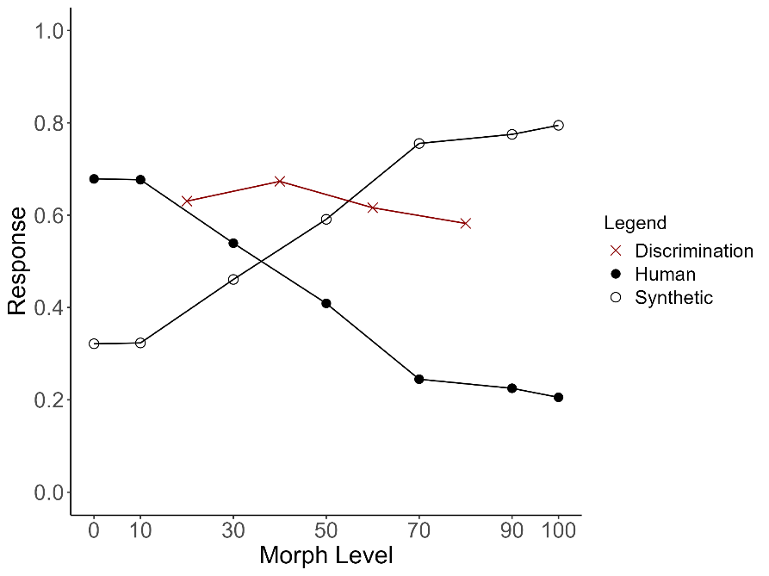
Study 3: The Categorical Perception of Voice Naturalness
Bachelor thesis of Sophia Hering
Notes:
We see categorization
We see discrimination
But the prediction didnt work out -> probably not enough test power (online study and discrimination was really really hard)

Slide 25
Is the perception of voice naturalness ammenable to perceptual manipulation?
Is the perceptual transition of human to synthetic voices categorical or continuous?
YES
Does the rating of naturalness depend on the way it is measured?
Maybe
No

Slide 26
To be continued….
Brain processing
Context dependence
Individual differences
Flexibility

Slide 27
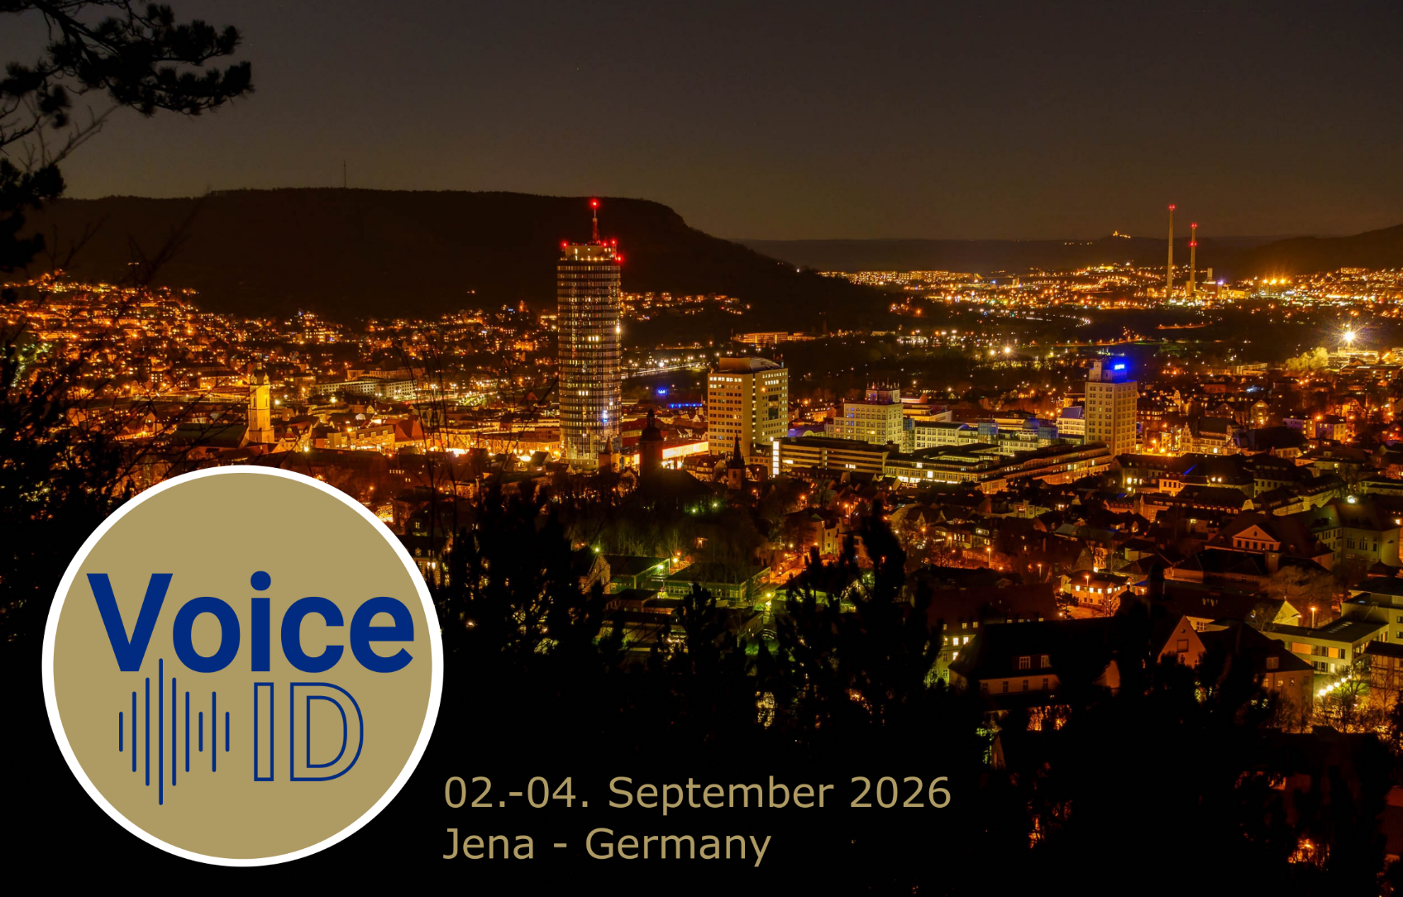

Slide 28
Thank you for your attention ☺
Notes:
Thanks to all my students in the naturalness task force who were driving this work

Slide 29
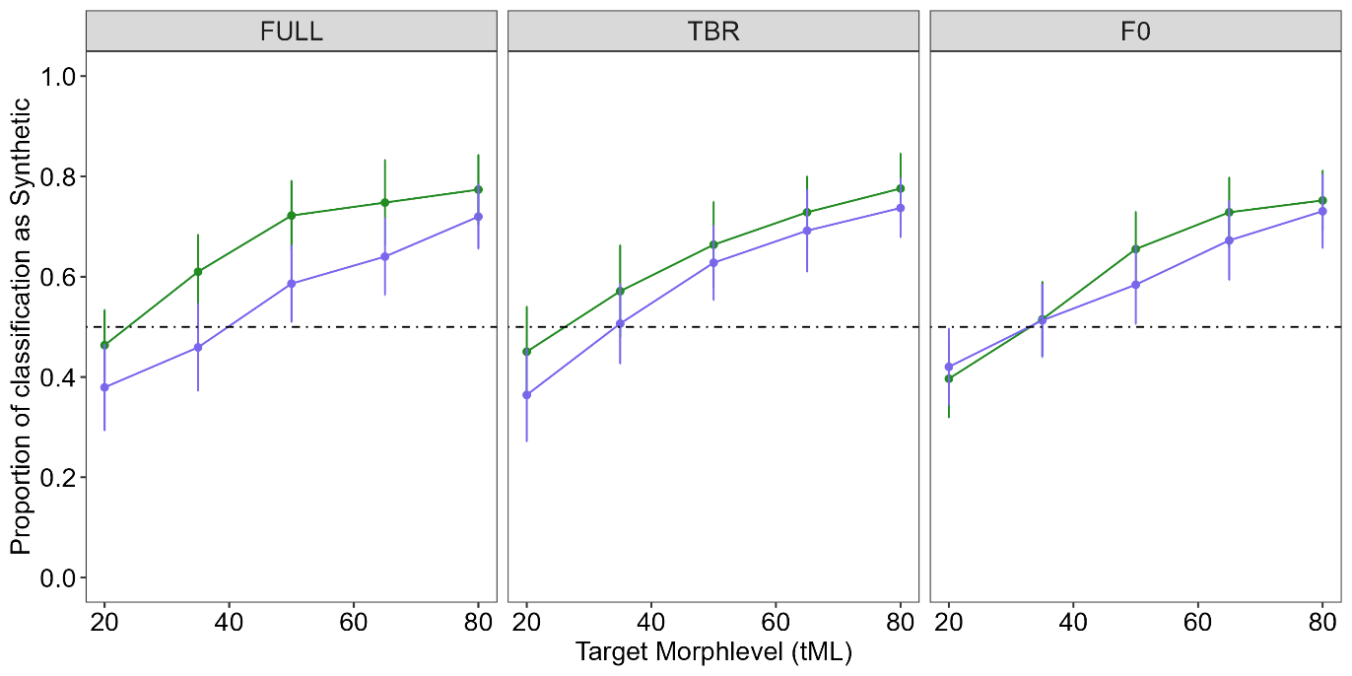
Parameter-specific adaptation (preliminary, N = 29)
FULL: adaptors are full morphs (F0 + timbre)
TBR: adaptors are timbre morphs (human/synthetic info only expressed via timbre)
F0: adaptors are F0 morphs (human/synthetic info only expressed via fundamental frequency)
Bachelor thesis of Klara Heck (ongoing)

Slide 30
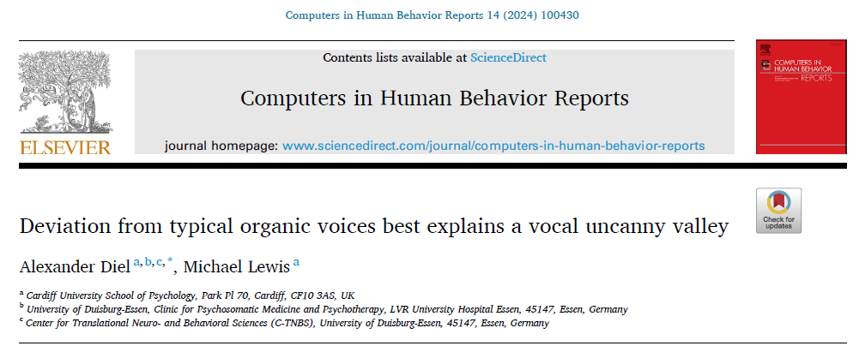
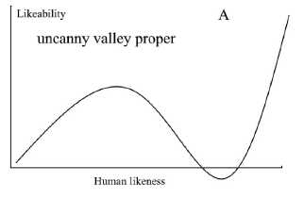
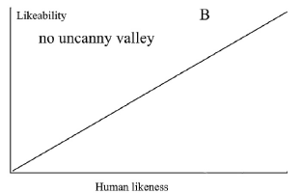
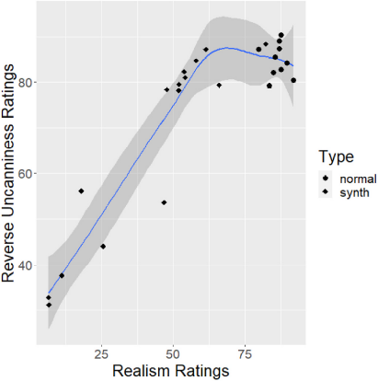
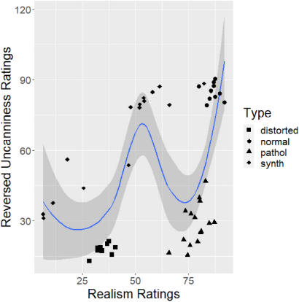
Notes:
Where does naturalness affect the processing pipeline?

Slide 31
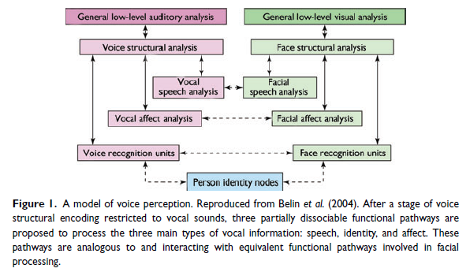
Understanding voice perception
Belin et al (2011)
Notes:
Where does naturalness affect the processing pipeline?

Slide 32
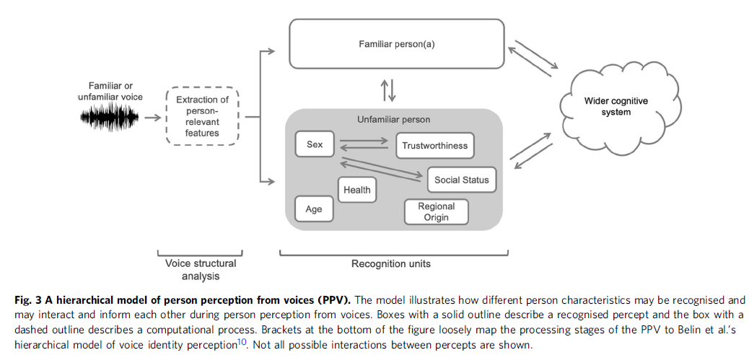
Person Perception from Voices (PPV)
Naturalness
(Lavan & McGettigan 2023)
Notes:
Good starting point
We form impressions about voices the moment we hear them
Manifold, and they interact
I added two…
„When hearing a voice, listeners can form a detailed impression of the person behind the voice. “
- “how the perception of different person characteristics may interact and inform each other,“
-> Theory driven thinking may prompt some obvious research questions that have not been answered yet

