Slide 1
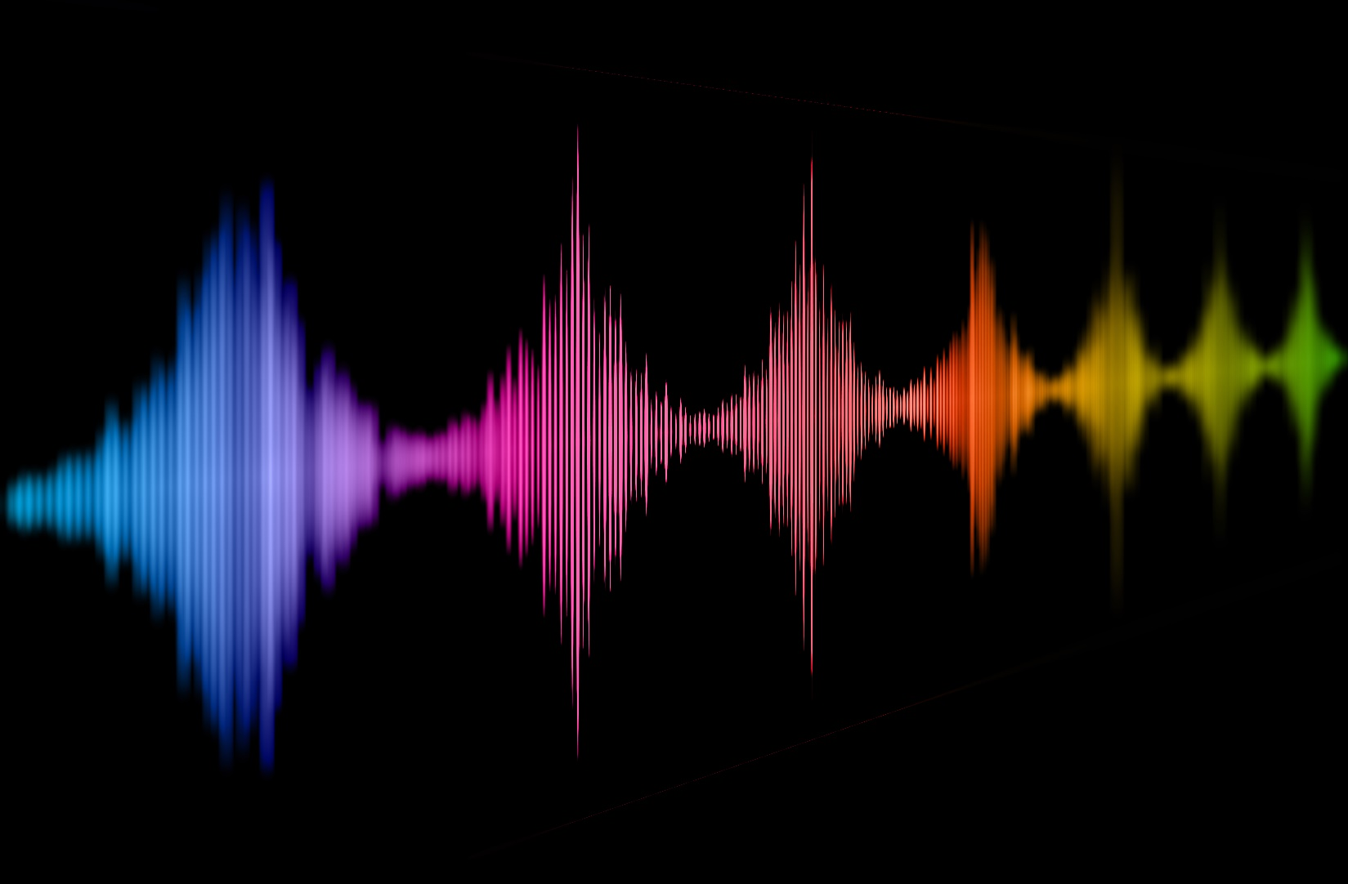
The dimension of naturalness in human voice perception
Christine Nussbaum
University of Oslo, 21.07.2024
Voice Naturalness
Notes:
Short introduction of myself: postdoc in Stefans Lab, voice perception researcher, PhD on emotion perception in voice, using EEG measures, now my main interest has shifted -> voice naturalness
Todays talks: key mission is to convey why naturalness is a super important feature, but completely understudied and - importantly – conceptually underspecified#
- Talk will be less about empirical data, but more about ideas and concepts

Slide 2

Why study voice naturalness?
Notes:
When we talk about voice features, ist always best to start with some examples
Just listen and ask yourself if you find these stimuli natural (or not) and why

Slide 3
Why study voice naturalness?
“Impairments in speech naturalness can lead to communication partners perceiving the affected individuals as unhappy, cold, withdrawn, introverted, or bored. These false perceptions can interrupt participation in regular life roles, leading to loss of employment and independence. Thus, impaired speech naturalness can result in social isolation, reduced quality of life, and depression.” (Stepp & Voijtech, 2019)
“The growing popularity of speech interfaces goes hand in hand with the creation of synthetic voices that sound ever more human. Previous research has been inconclusive about whether anthropomorphic design features of machines are more likely to be associated with positive user responses or, conversely, with uncanny experiences. To avoid detrimental effects of synthetic voice design, it is therefore crucial to explore what level of human realism human interactors prefer and whether their evaluations may vary across different domains of application.” (Schreibelmayer & Mara, 2022)
“It is like my toaster is speaking to me.” (Kühne et al. 2020)
Notes:
Why is naturalness so important:
1. because we are very sensitive for „unnatural“ voice features (whetever these may be)
2. it simply affects how we interact with the voice (or the source of that voice)
Captured very well by two quotes (read them out)
+ one from the only paper (Kühne) that included a qualitative analysis and asked people why they rated voices unnatural
> tremendous practical implications
And we see that the interest in voice naturalness comes primarily from two angles:
Voice pathologies and synthetic voice development
They are not necessarily connected to each other
This is a problem. One of my key points is that this research should be conntected in order to gain a full understanding of voice naturalness and how it affects us

Slide 4
Current problems:
Conceptual underspecification
Heterogeneous operationalization
Lack of exchange between different research domains
Insufficient anchoring in voice perception theory
Precluded a systematic understanding of vocal naturalness
Impeded the visibility of this research to a wider readership
Has kept us from asking some crucial research questions
Has led to a divergence between theory and practice
Notes:
My Mission: naturalness as a voice features that we systematically understand
But we are currently facing several key challenges
-> In what follows, I will go through these points one by one and discuss how they may be addressed.

Slide 5
Research on naturalness:
Web of Science search on 26 April 2023 and 28 May 2024
“naturalness AND voice” and “human-likeness AND voice”
Inclusion critaria:
Published in English
Peer-reviewed journal or conference contribution
Voice naturalness/human-likeness was either measures or manipulated
Quantitative empirical data or integration of these
Spoken utterances only (no singing voices or nonverbal vocalizations)
72 publications
Notes:
- To ground my claims a little bit on data, we conducted a little mini-review to get a representative overview of the research on naturalness that already exists
-> This is the „data basis“ of my talk

Slide 6
Research on naturalness:
year range: 1984 – 2024 (53% published in the last 5 years)
67 report empirical data (of these 48 rating data)
2 literature reviews
3 using neurophysiological measures (EEG, fNIRS)
Voice categories:
33 used synthetic
18 human-pathological
6 human-manipulated
5 healthy human voices
10 used more than one of these voice categories
Notes:
- Just overview ober basic numbers

Slide 7
Conceptual Challenges
Notes:
- Defining naturalness is already a tough challenge

Slide 8
What is a natural voice? What is an unnatural voice?
"naturalness was defined as conforming to the listener’s standards of rate, rhythm, intonation, and stress patterning and to the syntactic structure of the utterance being produced” (Abur et al. 2021, page 4687)
“natural speech is the speech most closely perceived as a human voice.” (Mawalim et al. 2022, page 10)
"By naturalness, we understand the voice stimulus to be perceived as a plausible outcome of the human speech production system. “ (Nussbaum, et. al. 2023, page 1)
"Naturalness’ will not be defined for you.“ (Martin 1984, page 54)
only 32 publications provide an explicit definition
Notes:
- Deviation-based
- Category-based
Agree on two things:
Subjective and multifactorial/multidimensional (you dont know whic acoustic features listeners attend to)

Slide 9
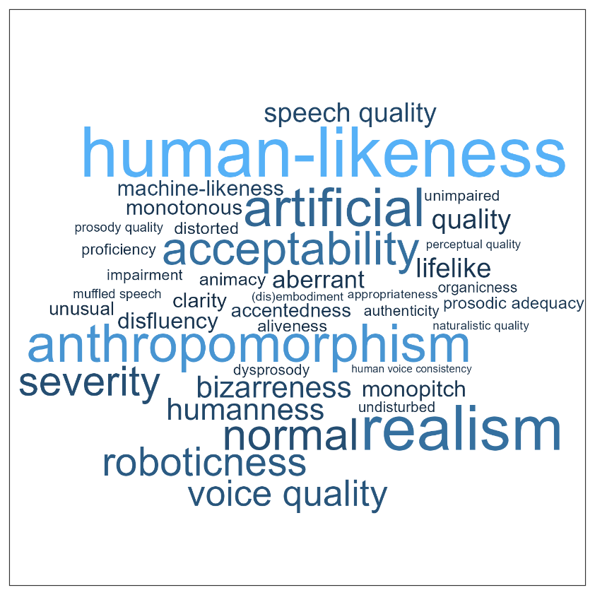
Synonyms and closely related concepts around voice naturalness
Notes:
Getting a grasp of the verbal space we are dealing with
> when people talk about naturalness, they dont use this word, but many others
Makes it incredibly hard to find the research
Even worse:
58 paper provide keywords
But 32 of these have any of the words depicted here as keywords (plus „naturalness“, of course)

Slide 10
A concise conceptual framework for voice naturalness

Slide 11
(1) Deviation-based naturalness
(2) Human-likeness-based naturalness
Deviation from a reference that represents maximum naturalness
Human-likeness i.e. resemblance to human voice
Conceptualization
“Does this voice sound distorted?”/ “Does this voice sound natural?”
Example definitions for participants or readers
“How human-like does the voice sound
to you?”
27 employed a deviation-based conceptualization, 35 used human-likeness, and 10 used a combination of both
Notes:
In deviation-based naturalness, naturalness is defined as the deviation from a reference that represents maximum naturalness. Example instructions for raters could be “Does this voice sound distorted?”, “Does this voice sound unusual”, or just “Does this voice sound natural?”. This conceptualization needs two important specifications: the reference representing maximum naturalness, and the type of deviation. (copied from manuscript)
Human-likeness-based naturalness defines naturalness by its resemblance to a real human voice. An instruction for raters could be “Does this voice sound like a real human speaker?” or “How human-like does the voice sound to you?” Compared to the deviation-based definition, it comes with an important additional assumption: the existence of a non-human voice category, and hence a categorical boundary to human voices (although the transition between categories can be continuous).

Slide 12
Heterogeneous operationalization

Slide 13
Challenges with operationalization
How naturalness is explained to the listener (what they should attend to)
Reliability of measurements
The
appropriate scale
The precise properties of the voice material
Potential
confounds
Insufficient report of empirical details
Notes:
Diverse operationalization would be amazing to compare effects across studies -> but thats not really possible
Always… provide stimulus examples
-> Very different publication cultures, outlets and reporting styles

Slide 14
Lack of exchange between different research domains

Slide 15
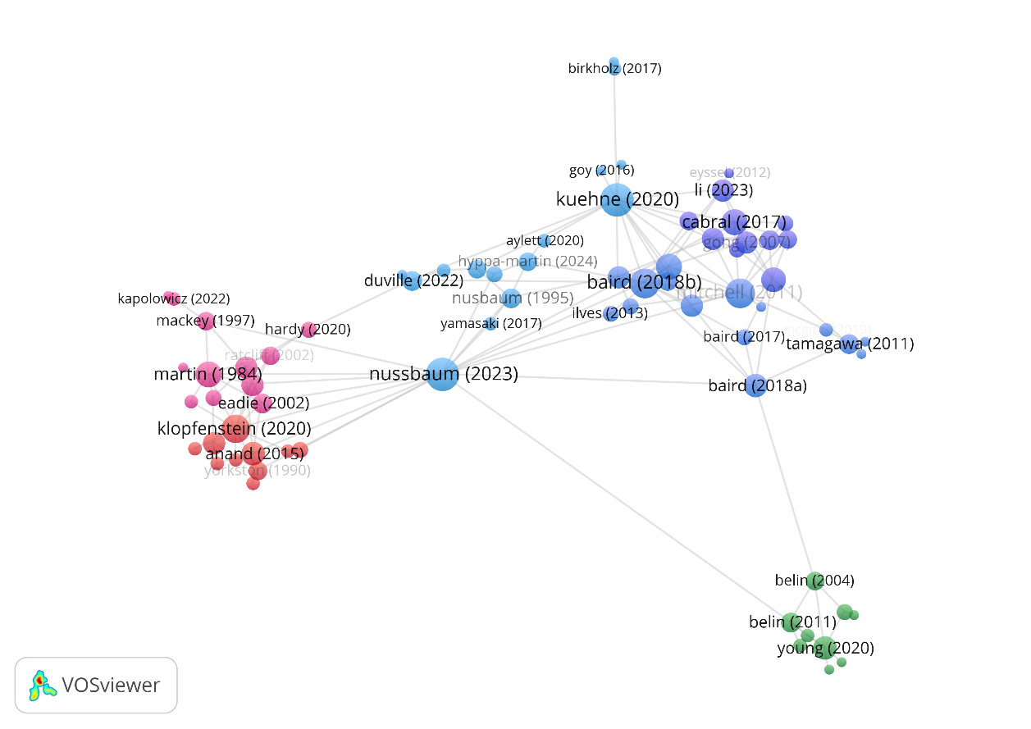
Naturalness - a rag rug rather than a research field
Notes:
Red: voice pathology
Blue: primarily synthetiv voices
Green: influential voice theory papers)
Echo chambers within science
Not rooted in voice perception theory

Slide 16
Insufficient anchoring in voice perception theory
Notes:
Main research is not coming from psychology, but from applied fields

Slide 17
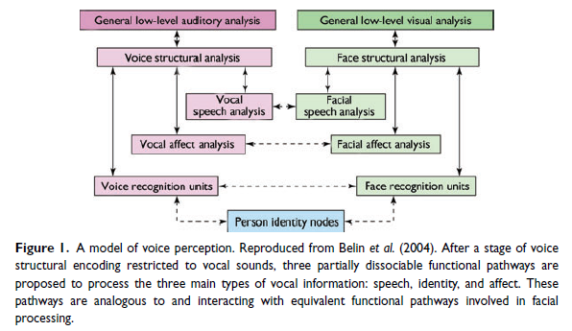
Understanding voice perception
Belin et al (2011)
Notes:
Where does naturalness affect the processing pipeline?

Slide 18
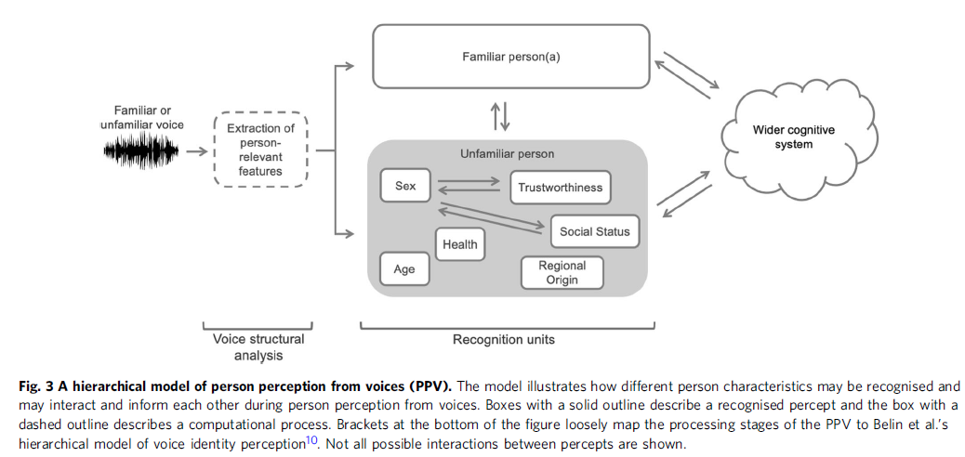
Person Perception from Voices (PPV)
Naturalness
(Lavan & McGettigan 2023)
Notes:
Good starting point
We form impressions about voices the moment we hear them
Manifold, and they interact
I added two…
„When hearing a voice, listeners can form a detailed impression of the person behind the voice. “
- “how the perception of different person characteristics may interact and inform each other,“
-> Theory driven thinking may prompt some obvious research questions that have not been answered yet

Slide 19
Understanding Voice Naturalness – an ongoing mission

Slide 20
Take Home Messages
listeners form an impression about voice naturalness
this affects social interactions, both in a purely human context and in scenarios with human and artificial agents
a systematic understanding of voice naturalness is elusive and the concept is scientifically ill-defined
voice naturalness research is situated within different research domains that resemble echo chambers within science
we propose a taxonomy with two distinct types: deviation-based naturalness and human-likeness-based naturalness.

Slide 21
Thank you for your attention ☺

