Slide 1
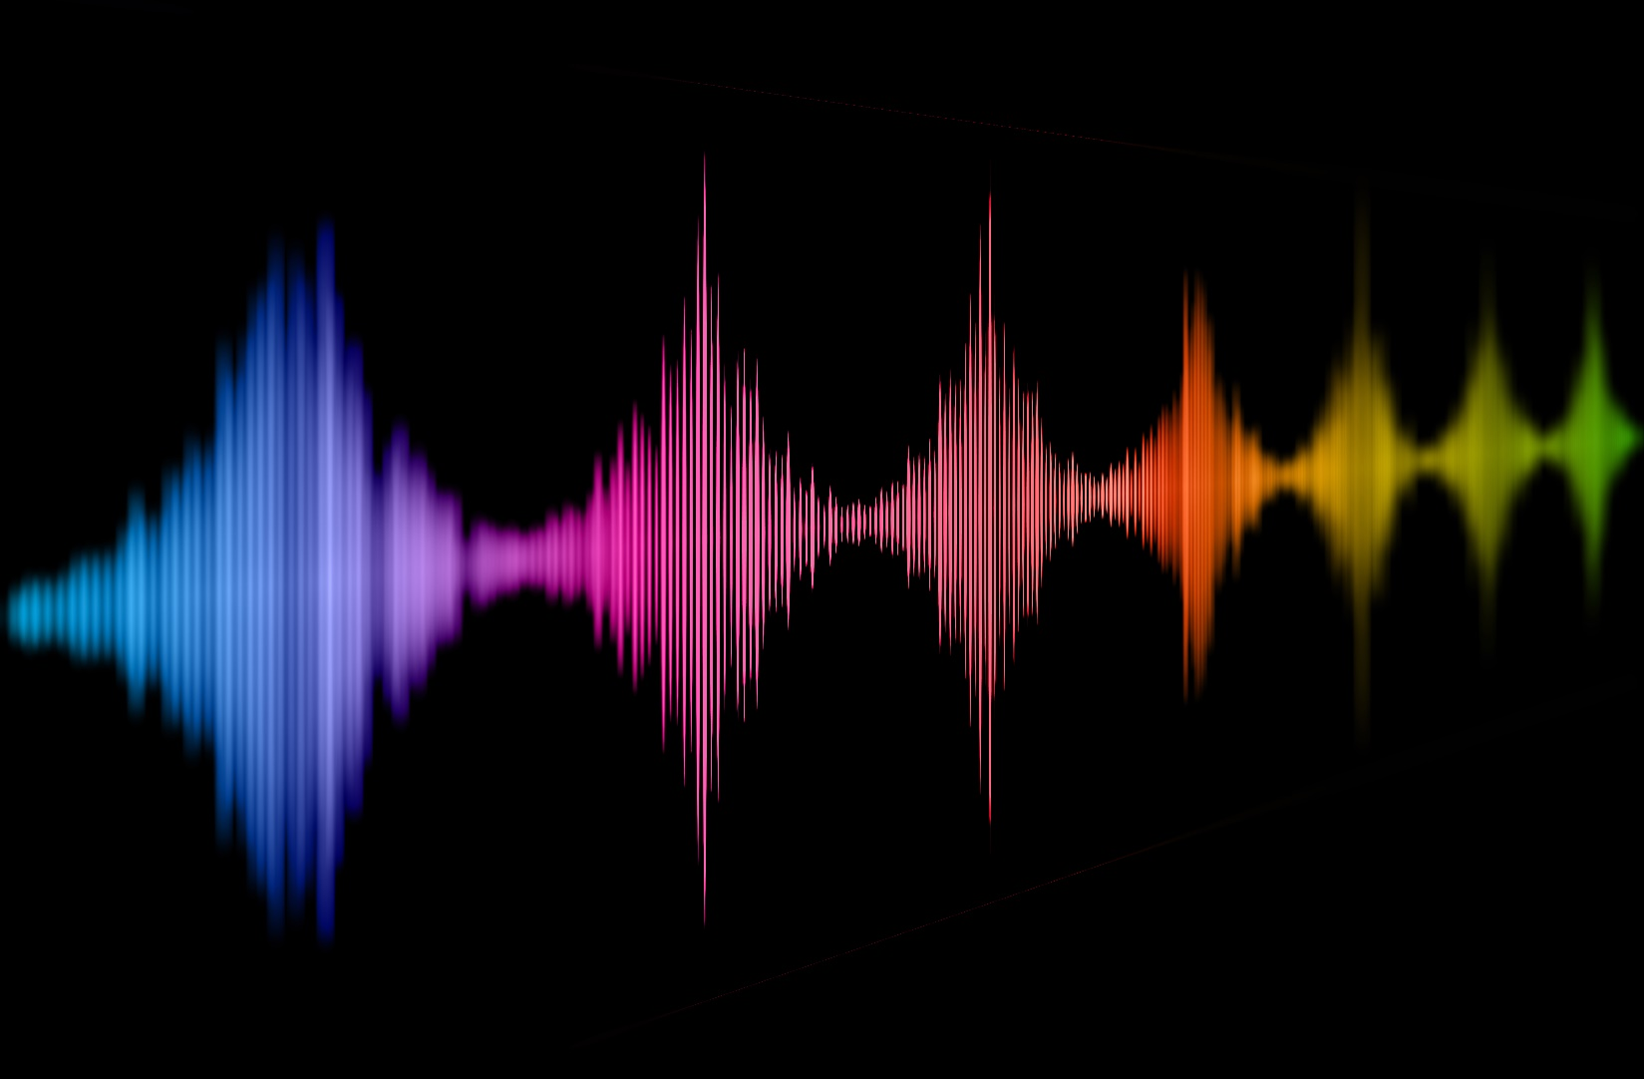
The interplay of perceived naturalness and emotionality in voices
Christine Nussbaum
EPS Symposium, 12.04.2024
Voice Naturalness
Notes:
Gonna be raising for more questions and providing answers
Only in the second part presenting own data

Slide 2
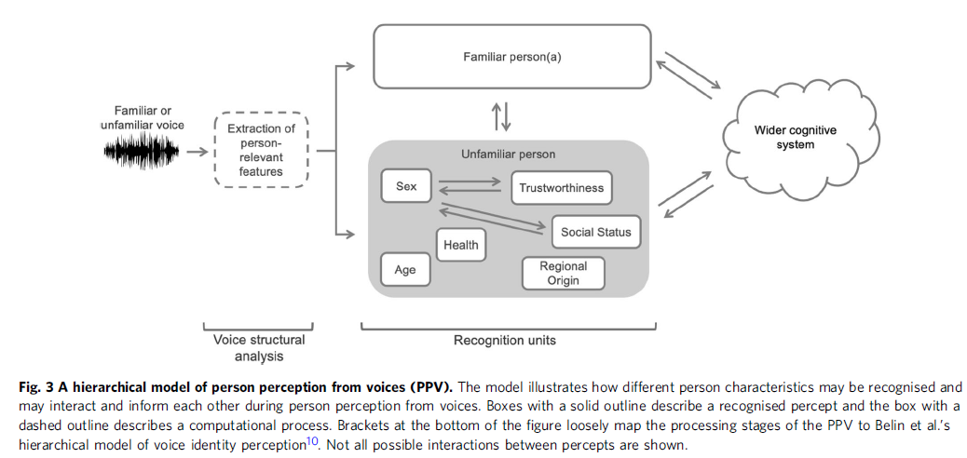
Person perception from voices (PPV)
Emotionality
Naturalness
[Lavan & McGettigan 2023]
Notes:
Good starting point
We form impressions about voices the moment we hear it
„When hearing a voice, listeners can form a detailed impression of the person behind the voice. “
- “how the perception of different person characteristics may interact and inform each other,“
Emotions; naturalness, interplay

Slide 3
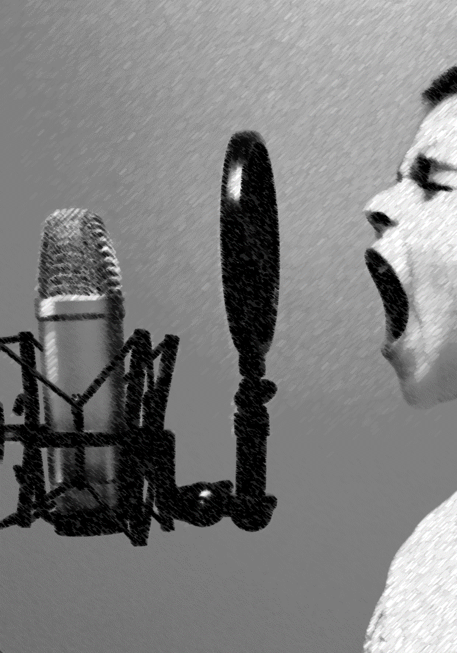
Vocal Emotions
Speakers express vocal emotions through acoustic cues
Fundamental frequency (F0)
Timbre
Amplitude
Speech rate
Listeners recognize vocal emotions above chance
multiple efforts to link emotions to acoustic cues
profound interindividual differences
[Scherer 2018; Juslin & Laukka 2003]
Notes:
Quickly overview over emotions
Automatically, fast
Sensitive to
Very well researched topic (a looong tradition)

Slide 4
Voice Naturalness
pathological human voices
manipulated human voices
synthesized/artificial voices
“Naturalness was defined as conforming to the listener’s standards of rate, rhythm, intonation, and stress patterning […] ” [e.g. Yorkston et al. 1990]
“Natural speech is the speech most closely perceived as a human voice“ [e.g. Mawalim et al. 2022]
"By naturalness, we understand the voice stimulus to be perceived as a plausible outcome of the human speech production system.“ [Nussbaum et al. 2023]
Notes:
- Voice Naturalness – complete opposite
- Would go so far to claim that we see a consistent field of research here
- proxy

Slide 5
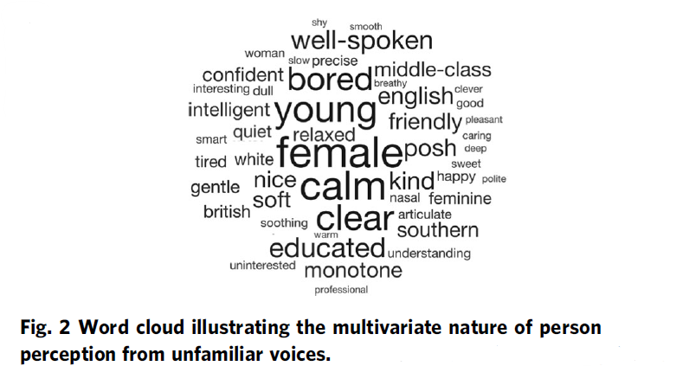
Voice Naturalness
[Lavan & McGettigan, 2023; Lavan 2023]
[e.g. Kühne et al. 2020, Rodero 2017, Rodero & Lucas 2023]
Notes:
Why do I feel its a feature we should pay more attention to?
rated as more likeable, trustworthy, intelligible, pleasent (Kühne et al., 2020)

Slide 6
Voice Naturalness and quality of life
“Impairments in speech naturalness can lead to communication partners perceiving the affected individuals as unhappy, cold, withdrawn, introverted, or bored. These false perceptions can interrupt participation in regular life roles, leading to loss of employment and independence. Thus, impaired speech naturalness can result in social isolation, reduced quality of life, and depression.” [Stepp & Voijtech 2019]

Slide 7
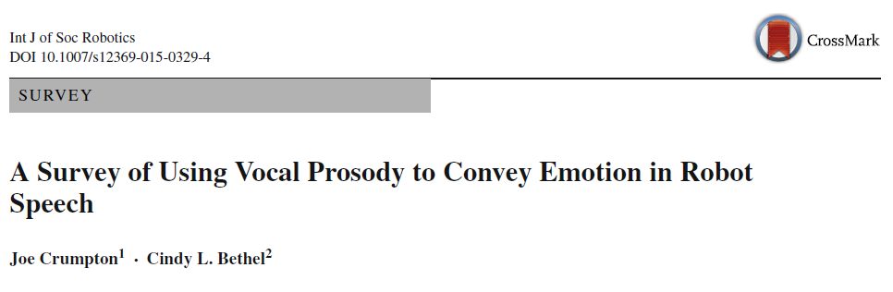
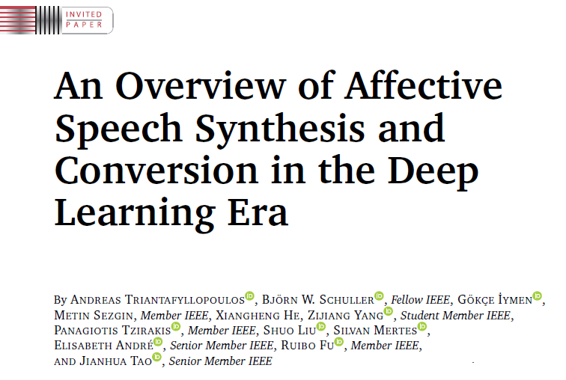
The interplay of perceived naturalness and emotionality in voices
„The communication of emotions through changes in vocal prosody is one way to make synthesized speech sound more natural.”
2015
2023

Slide 8
The interplay of perceived naturalness and emotionality in voices
Emotion perception is robust against unnatural voice features
Naturalness affects/disrupts emotion perception
Emotional caricatures are better recognized despite being less natural [Ko et al. 2023]
Emotions expressed by participants with autism were better recognized, while rated as being less natural [Hubbard et al. 2017]
Rating of naturalness unrelated to ratings of emotionality [Nussbaum et al. 2023]
Emotion recognition worse in text-to-speech generated voices [Ko et al. 2023]
Human voices rated as more expressive compared to synthesized ones [Cabral et al. 2017]
Reduction of naturalness in voices affects emotion recognition and electrophysiological correlates, but NOT valence/arousal ratings [Duville et al. 2022]
Acoustic manipulation that affects perceived naturalness can be a threat to ecological validity
Notes:
Simply not fully resolved
Not just because its interesting
-> naturalness can be a threat to ecological validity
-> own data

Slide 9
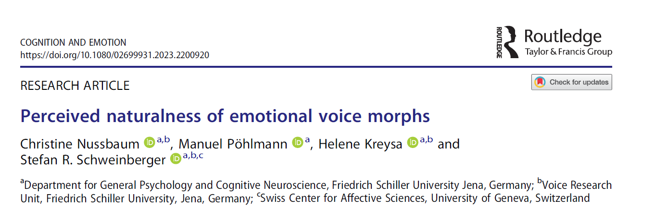
Unwanted interference by voice naturalness
2023
Notes:
Using manipulated voices to study human emotion perception
At least try to quantify

Slide 10
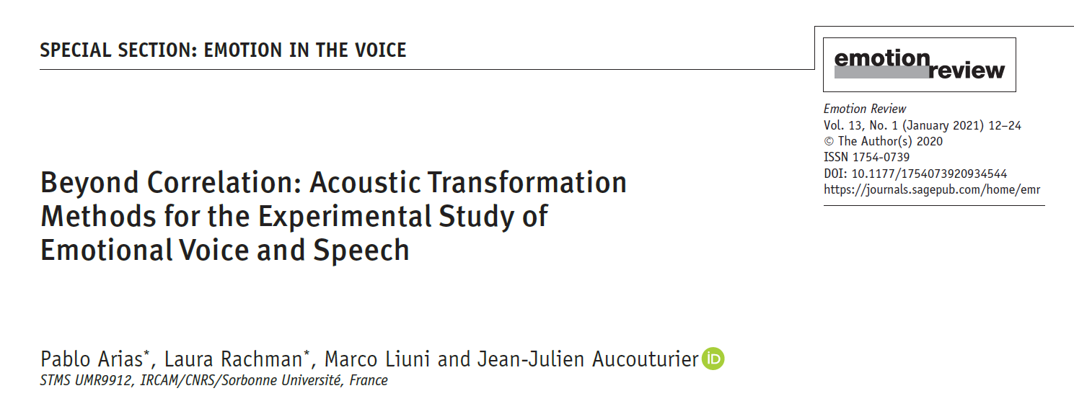
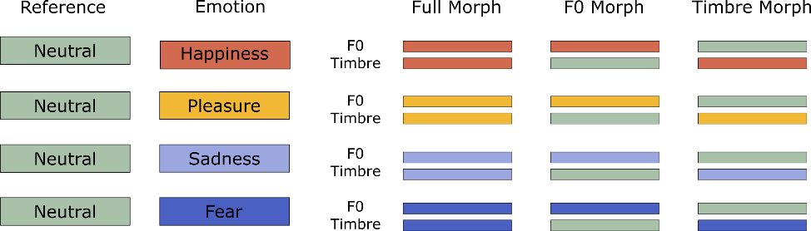

Unwanted interference by voice naturalness
ecological validity of stimuli
distraction from the task
potential confound
2021
parameter-specific voice morphing
Notes:
Using manipulated voices to study human emotion perception
At least try to quantify

Slide 11
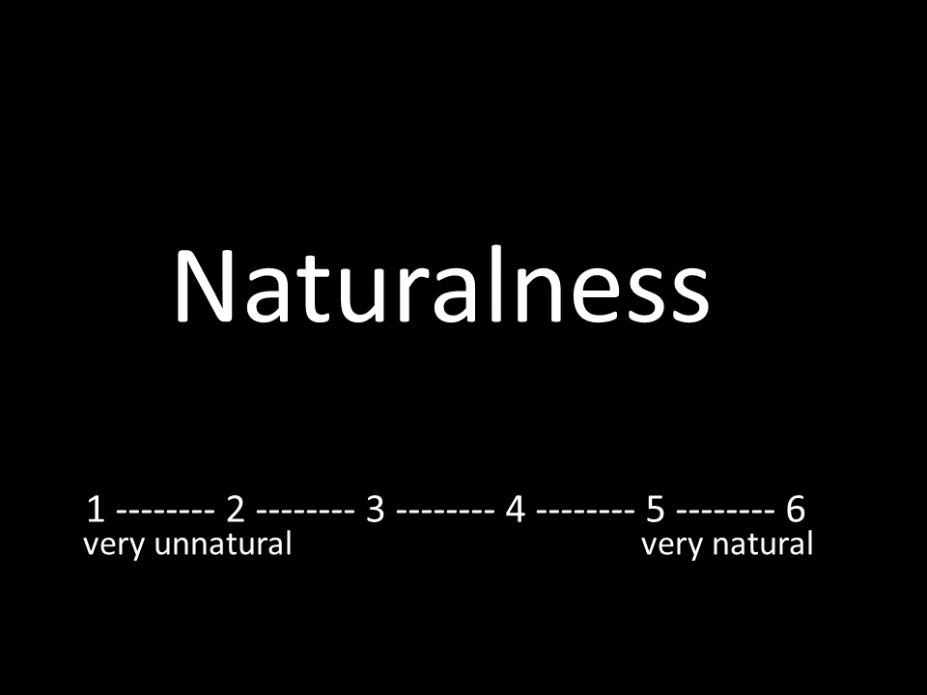
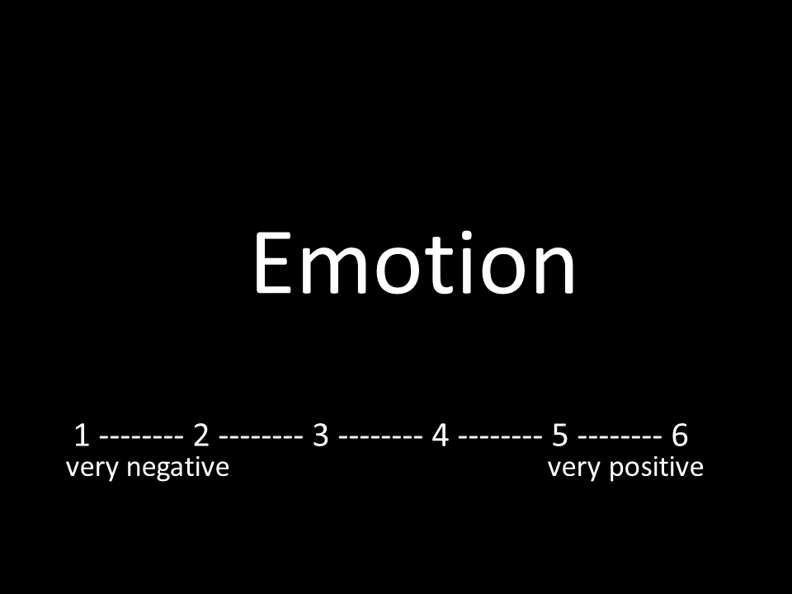
Rating Study:
Stimuli:
8 (speakers) x 3 (pseudowords) x 4 (emotions) x 3 (morphing conditions) x 2 reference types + 48 reference (8 speakers x 3 pseudowords x 2 reference types) = 624 stimuli; split between-subject per pseudoword
Sample:
51 participants, 40 females, 11 males,
aged 19 to 31 years [M = 21.49; Mdn = 21; SD = 2.64],
with 16/18/17 per pseudoword
Notes:
2 min

Slide 12
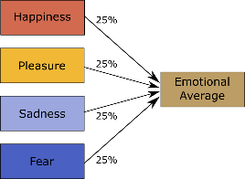
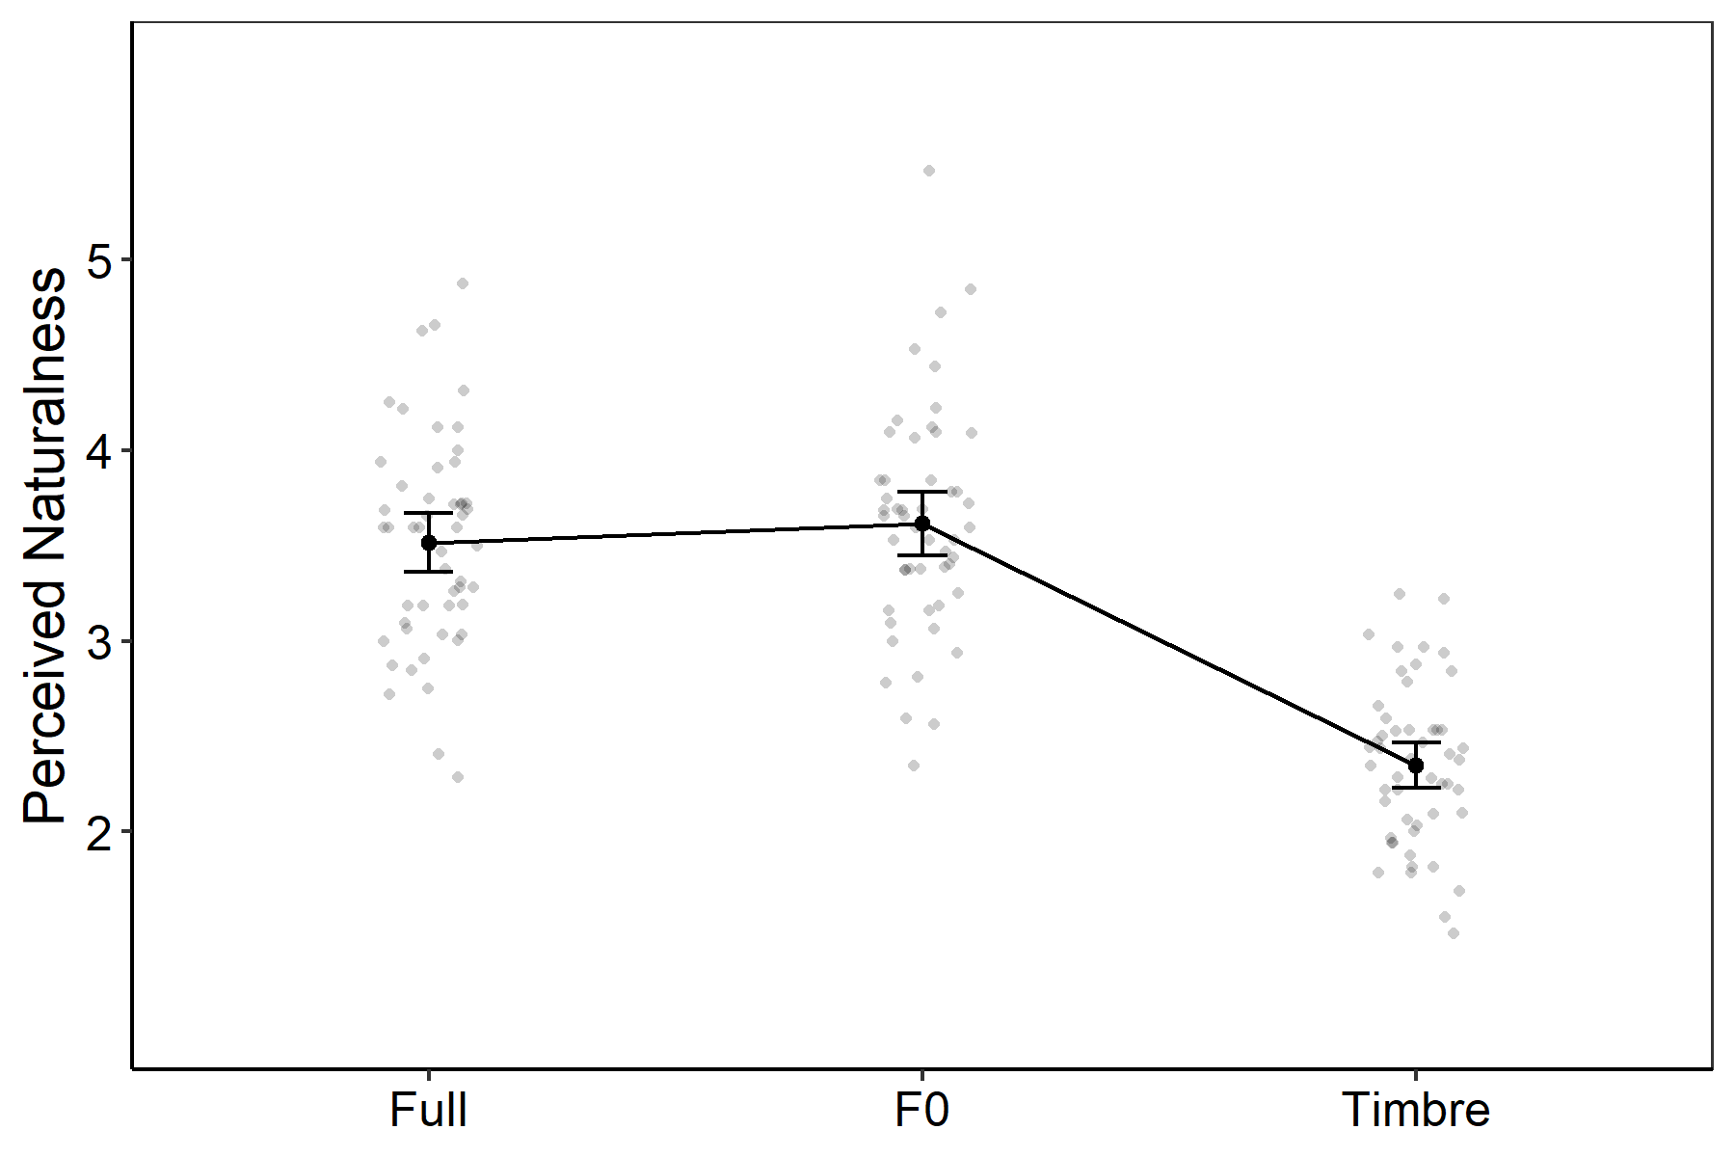
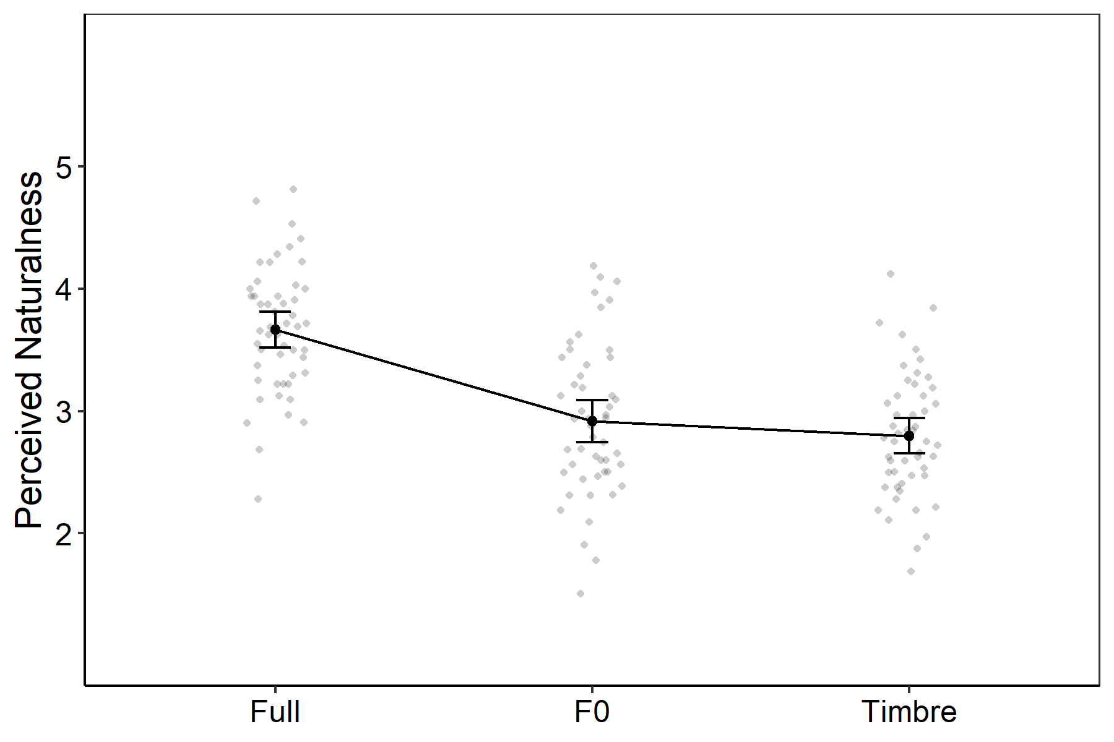
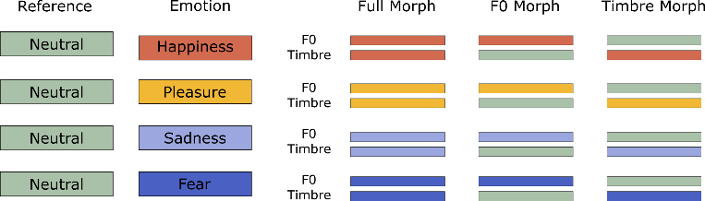
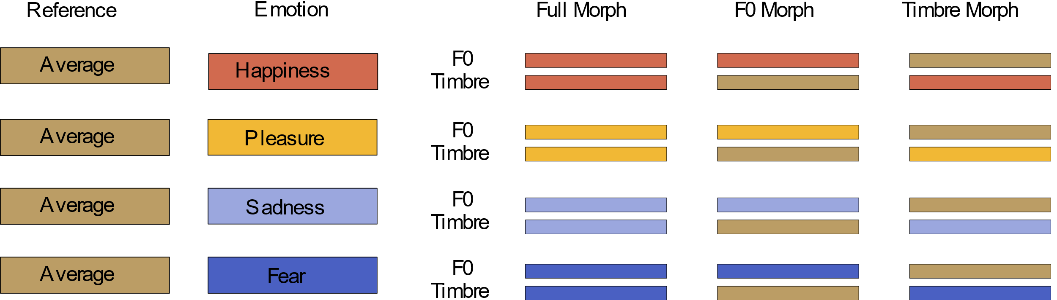
Result 1: Voice morphing affects voice naturalness
F0/Timbre and naturalness confounded
F0/Timbre and naturalness NOT confounded

Slide 13
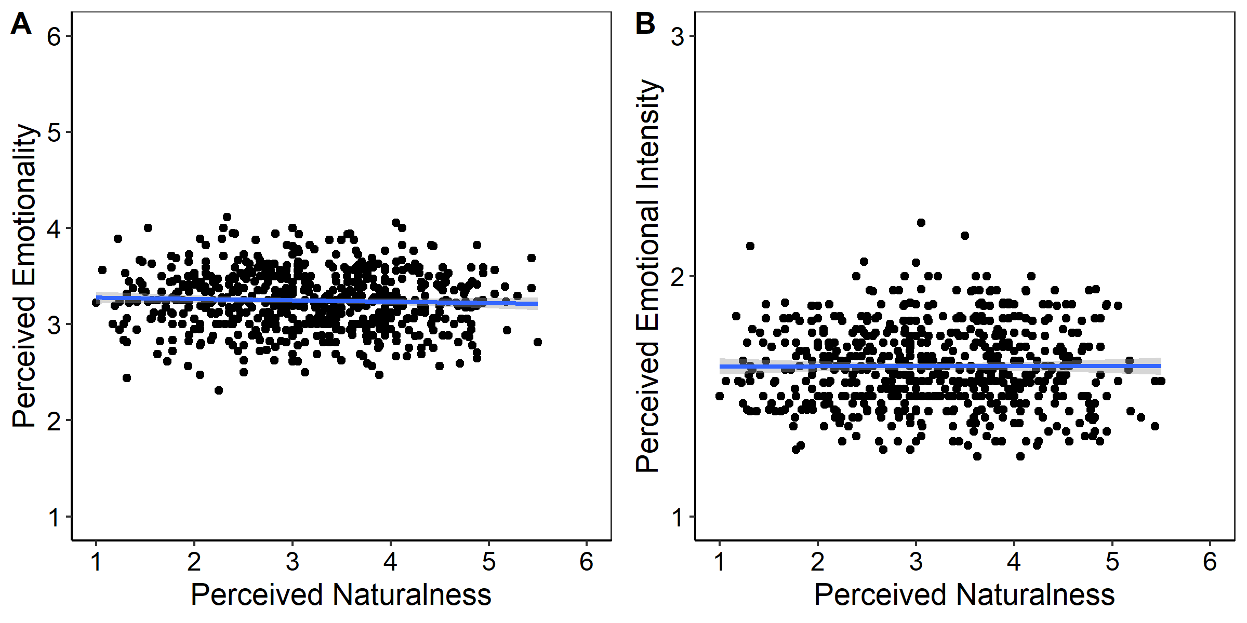
Result 2: No relationship between Naturalness and Emotionality
Mean ratings of perceived naturalness, emotionality (A), and emotional intensity (B).
[Nussbaum et al. 2023, Cognition and Emotion]

Slide 14
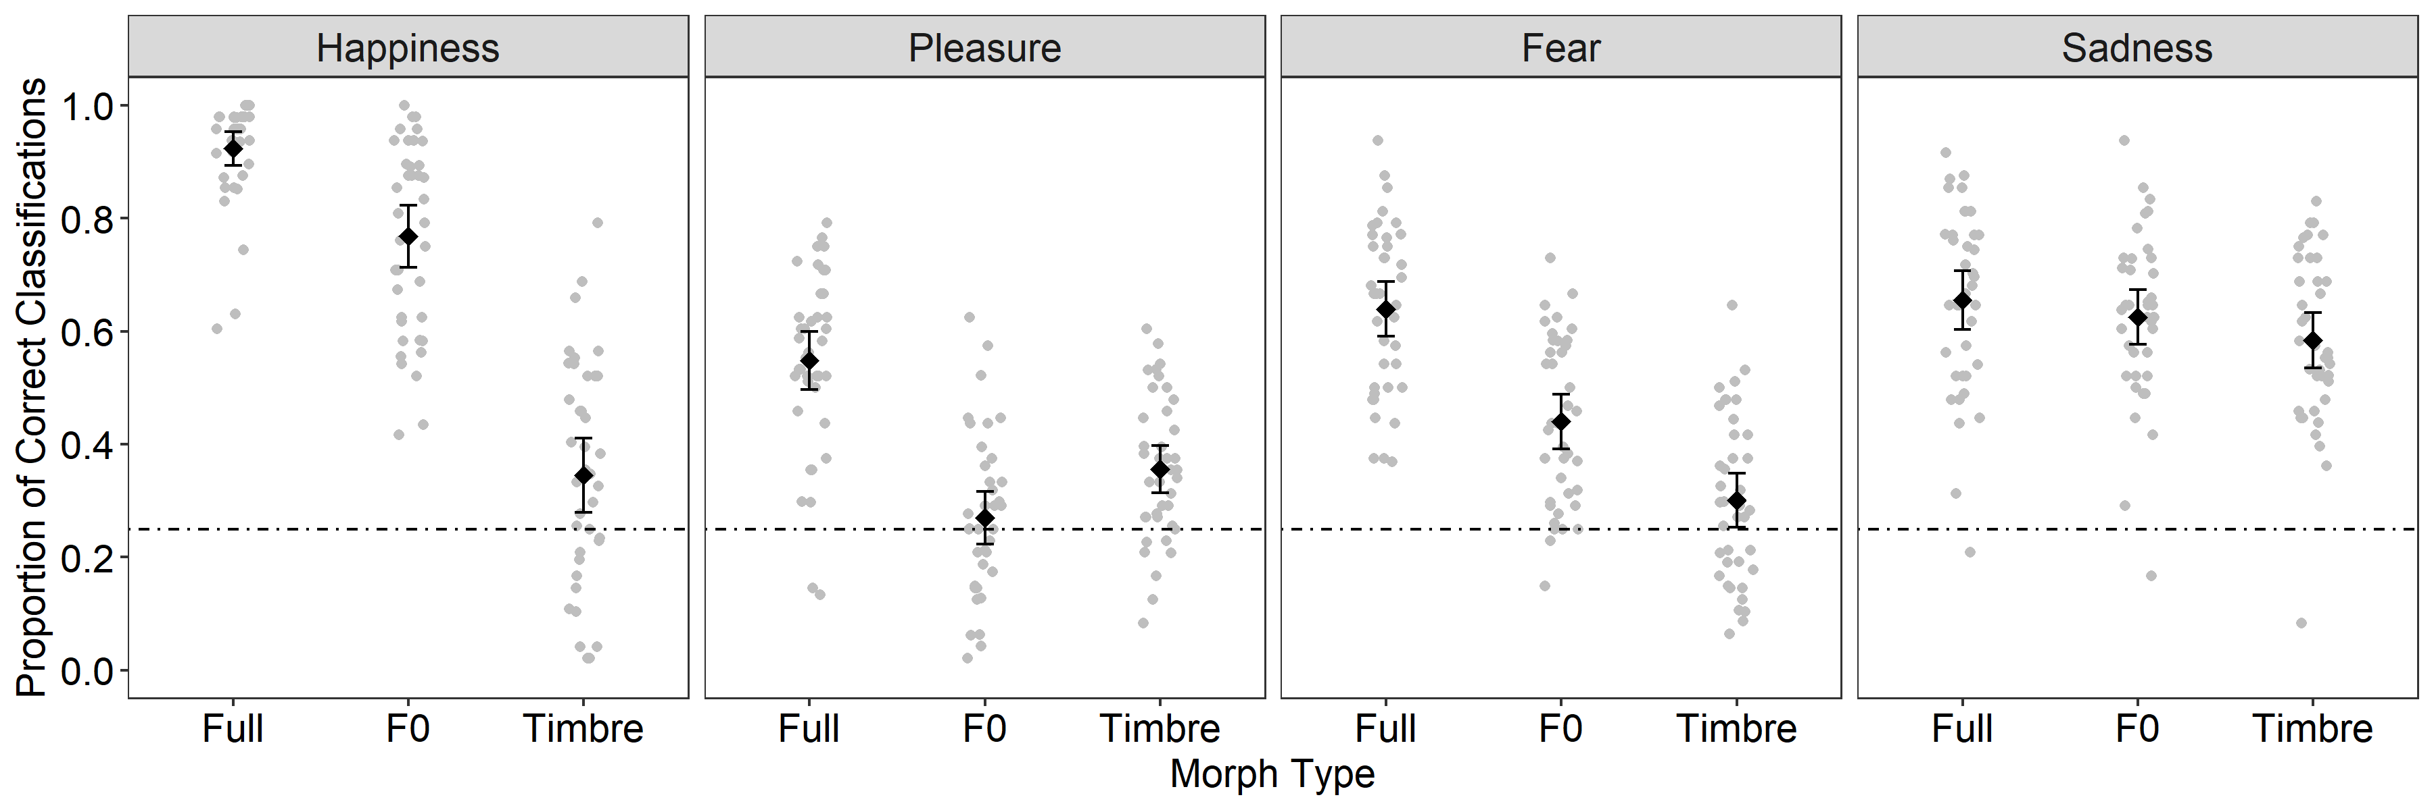
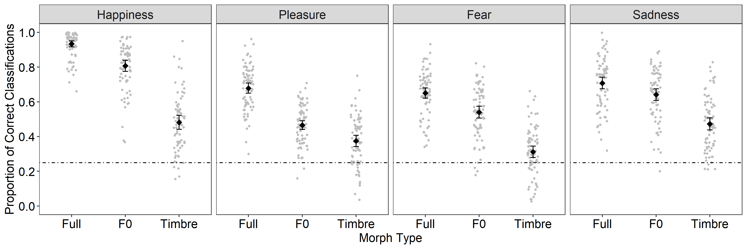
Naturalness my affect emotion recognition performance
F0/Timbre and naturalness confounded
[Nussbaum et al. 2022, SCAN]
F0/Timbre and naturalness NOT confounded
[Nussbaum et al. 2023, BJOP]

Slide 15
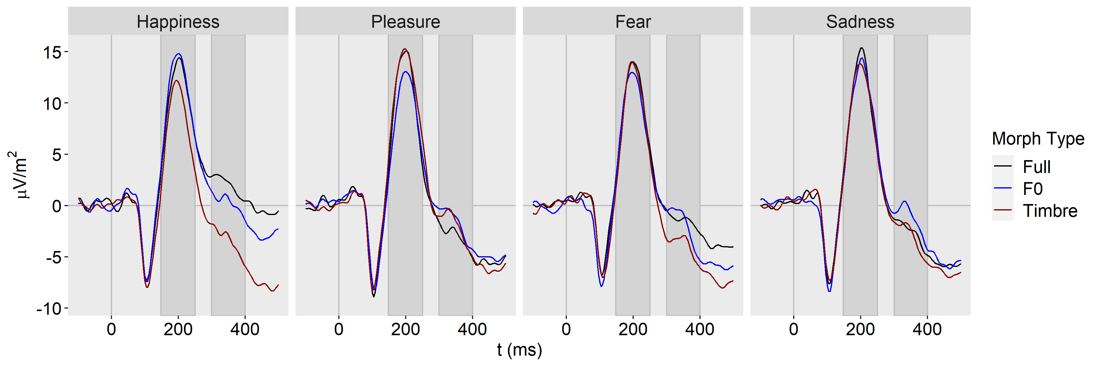
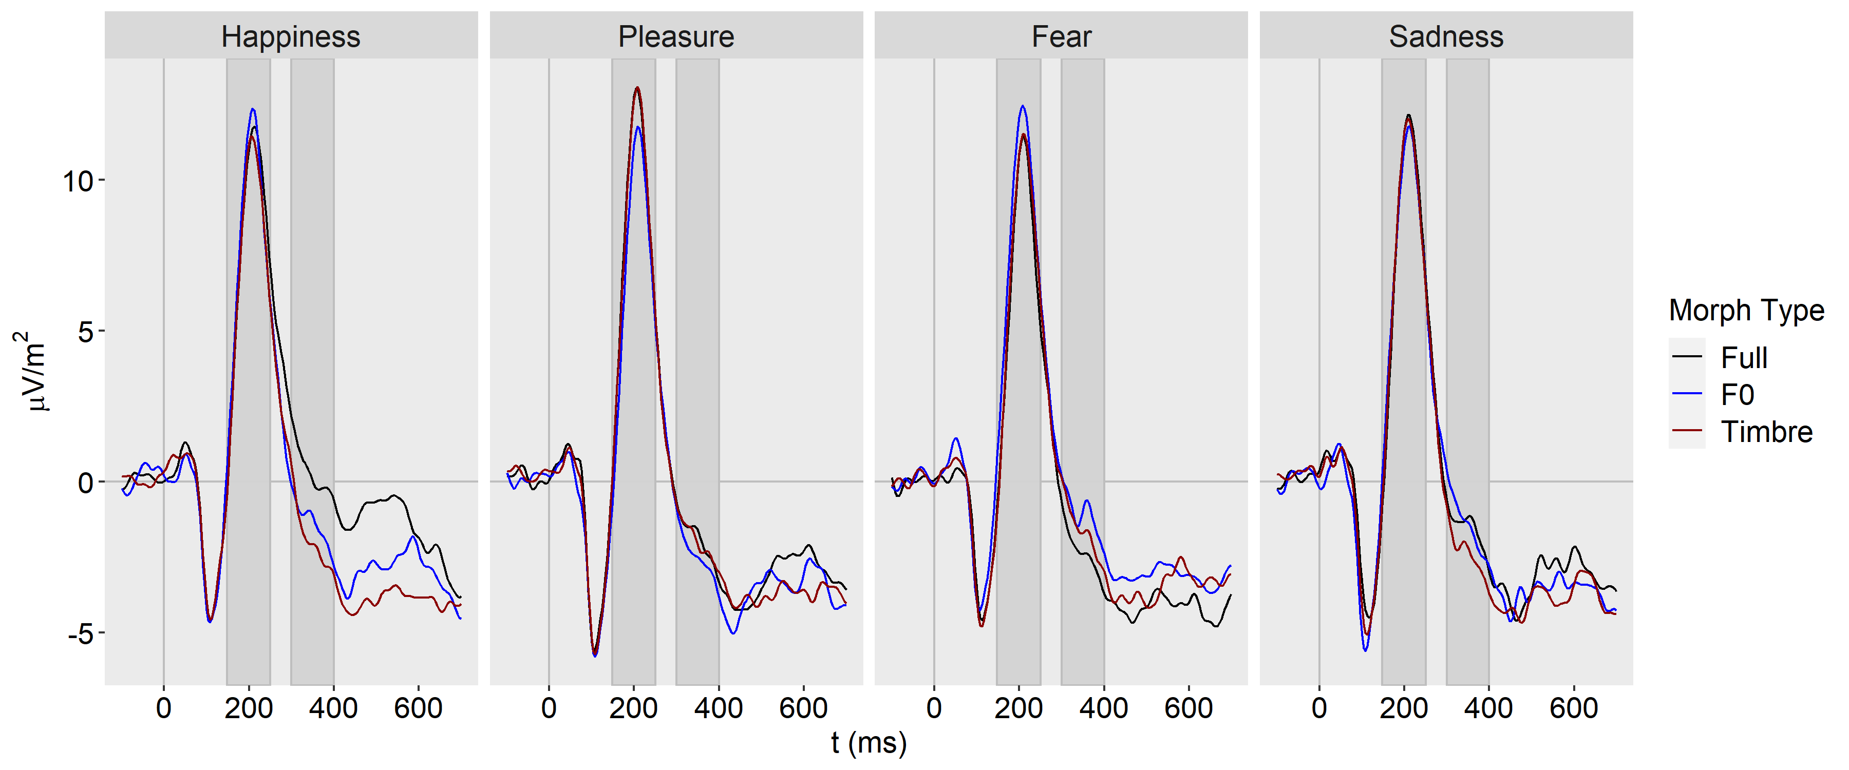
F0/Timbre and naturalness confounded
[Nussbaum et al. 2022, SCAN]
F0/Timbre and naturalness NOT confounded
[Nussbaum et al. 2023, Brain Sciences]

Slide 16
Summary
Listeners form an impression about the naturalness of a voice
Naturalness interacts with the perception of other person characteristics
There is a complex interplay between perceived naturalness and emotionality
Reduced naturalness can reduce ecological validity of emotional stimuli
Naturalness may not affect ratings of perceived emotionality, but emotion recognition and the associated electrophysiological correlates
… there is a lot of work to do!

Slide 17
Thank you for your attention!
Notes:
- Defining naturalness is already a tough challenge

