Slide 1

Simultaneous Opposite Adaptation
WiSe 2022/23 M. Sc. Christine Nussbaum
Department for General Psychology and Cognitive Neuroscience
C. Nussbaum,

Slide 2
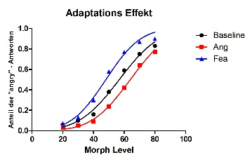
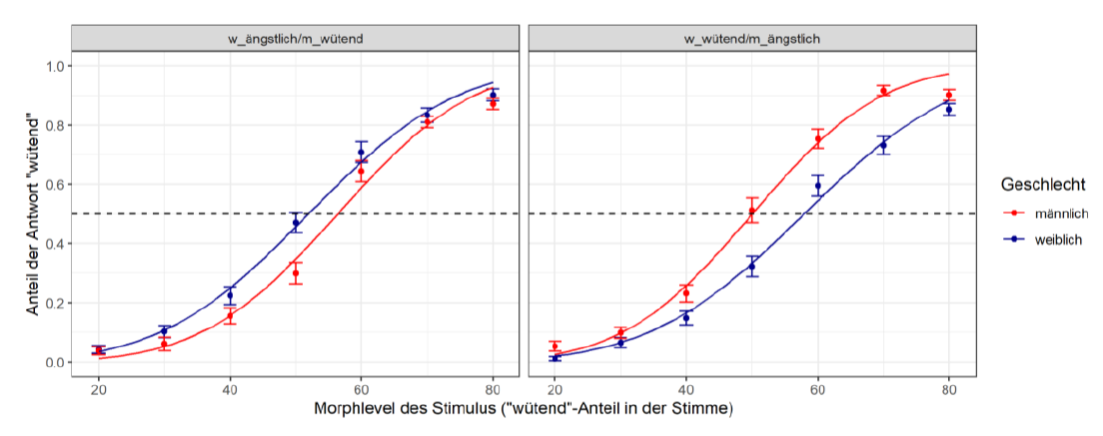
simultaneous opposite aftereffects
simultaneous opposite aftereffects
Bachelorarbeit D. Berges, 2022

Slide 3

Simultaneous Opposite Aftereffects
 | Adaptations-Dimension | Kategorie-Dimension | Ergebnis
Studie 1 | Emotion (Wütend/Ängstlich) | Geschlecht (männlich weiblich)
Studie 2 | Emotion (Wütend/Ängstlich) | Identität | ???
Studie 3 | Emotion (Wütend/Ängstlich) | (Pseudo-) Wort
-> Studie 2 und 3 präregistriert

Slide 4
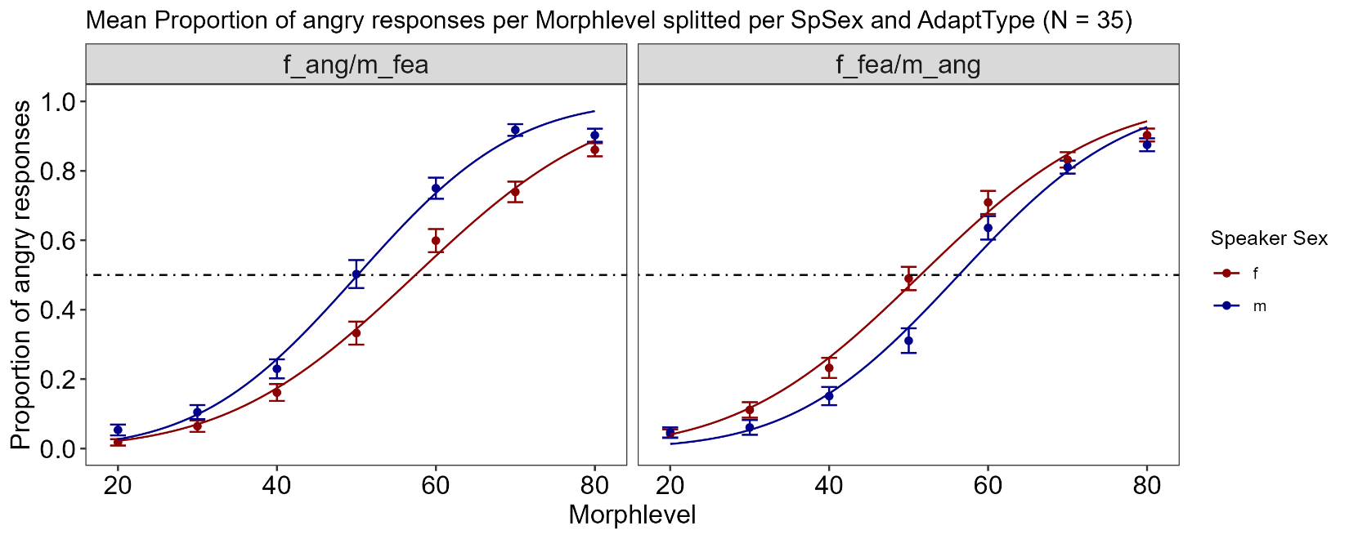
Exp1: Emotion and SpSex

Slide 5
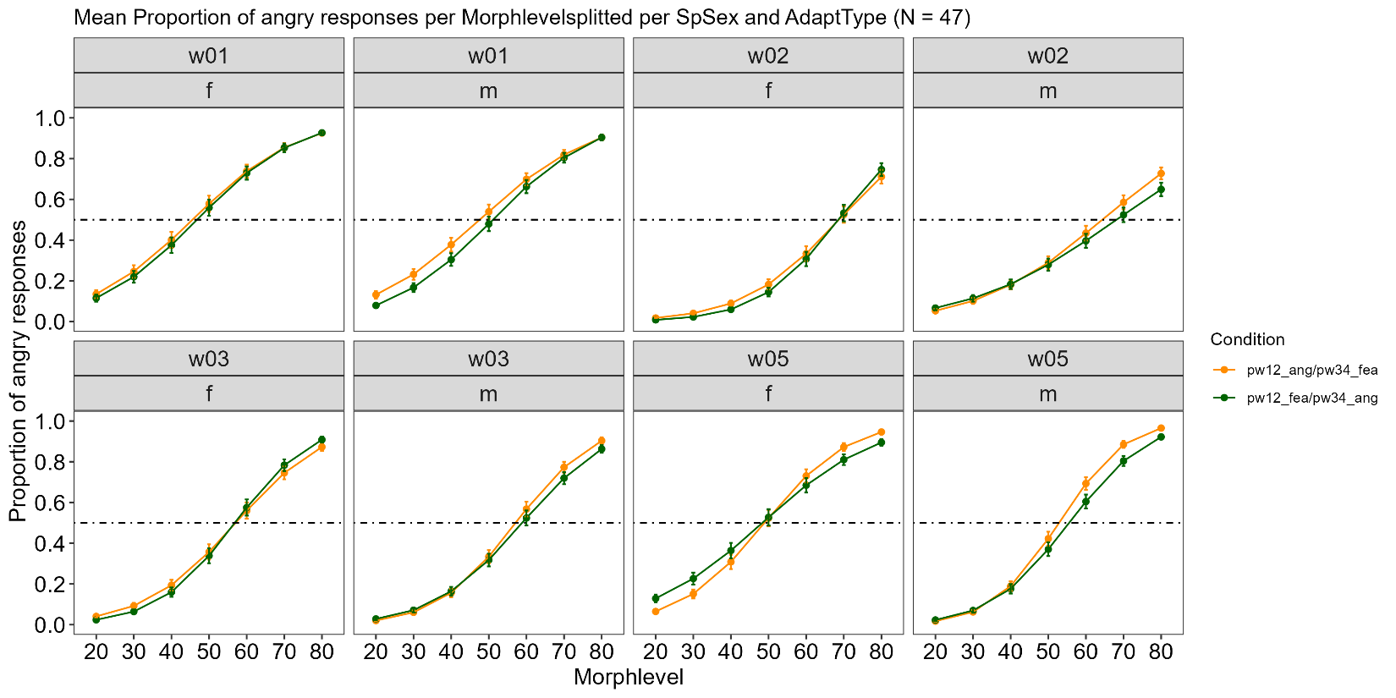
Exp3: Emotion and Pseudoword

Slide 6

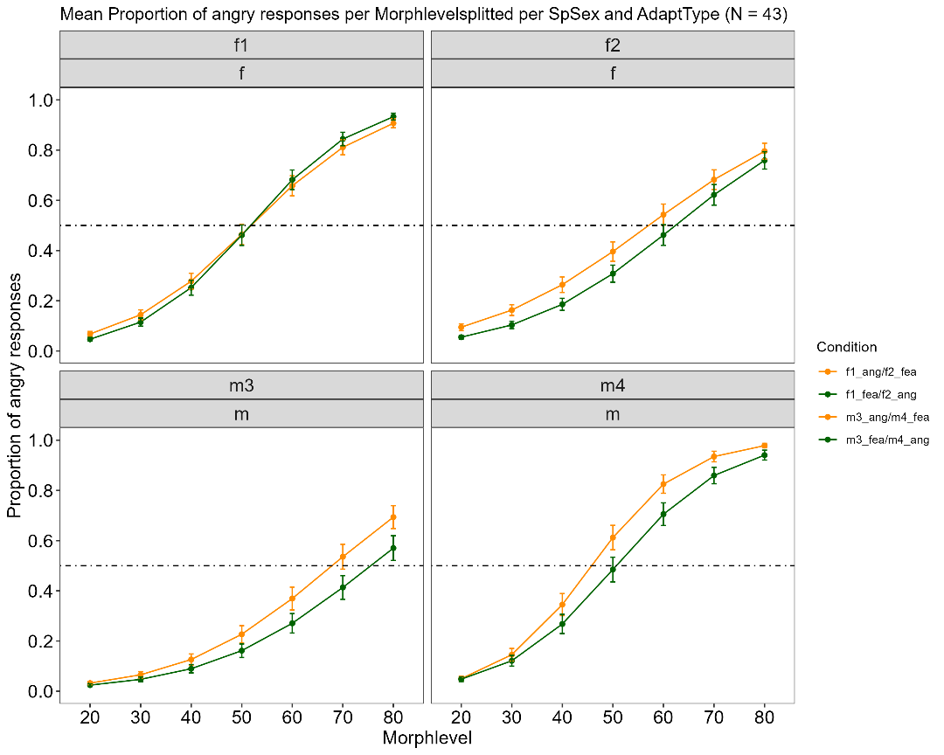
Exp2: Emotion and SpID

Slide 7
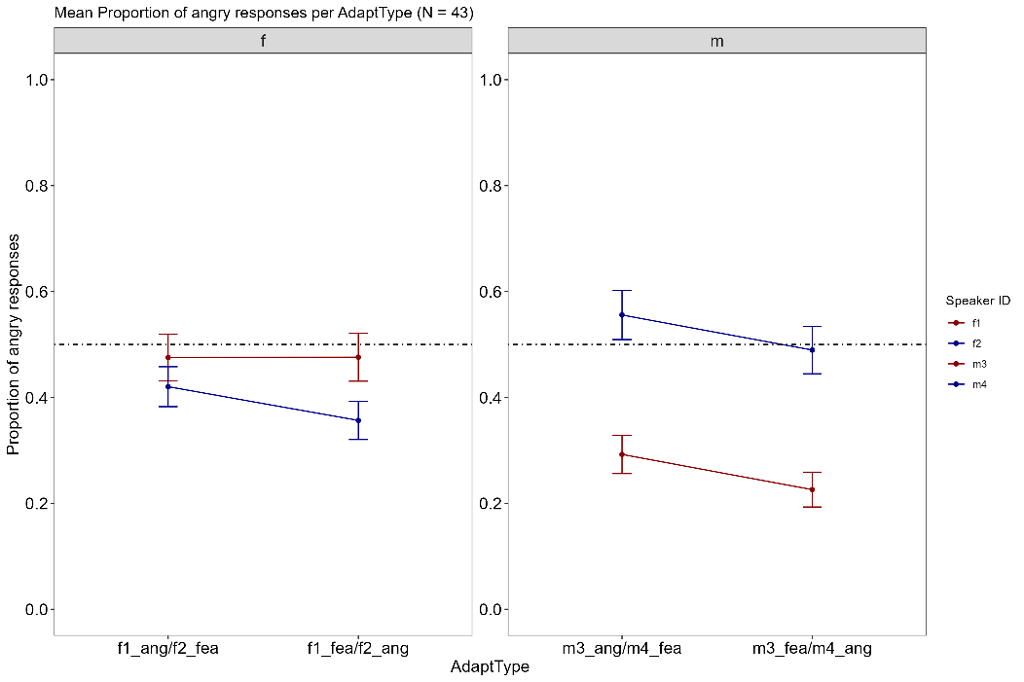
Exp2: Emotion and SpID

Slide 8
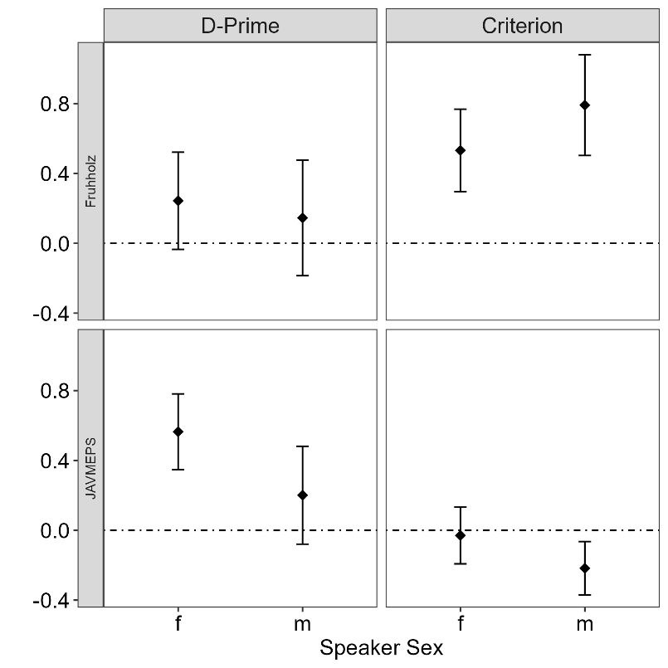
Exp4: Check - Speakerdiscrimination

Slide 9
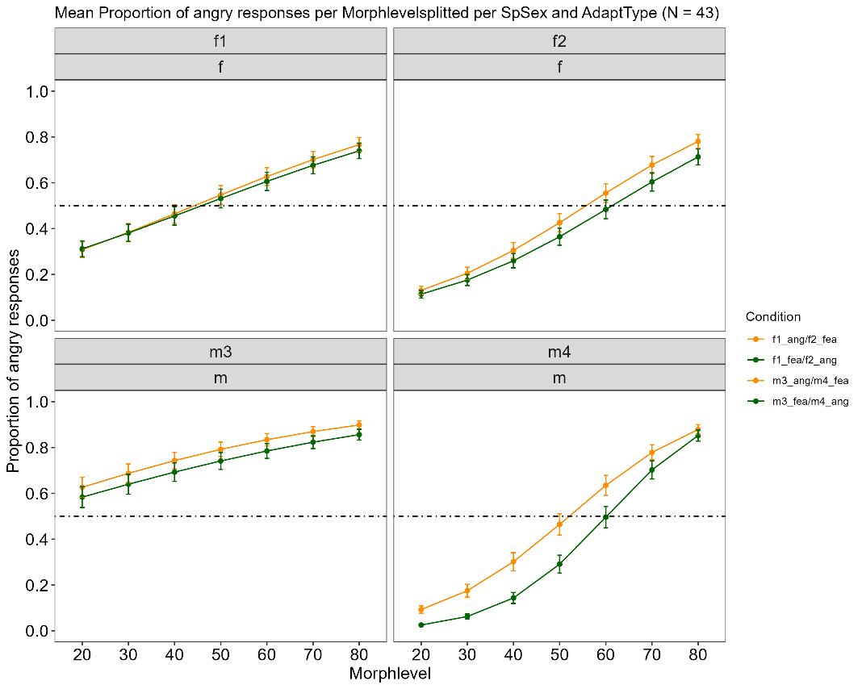
Exp5: Emotion and SpID – different dataset

Slide 10
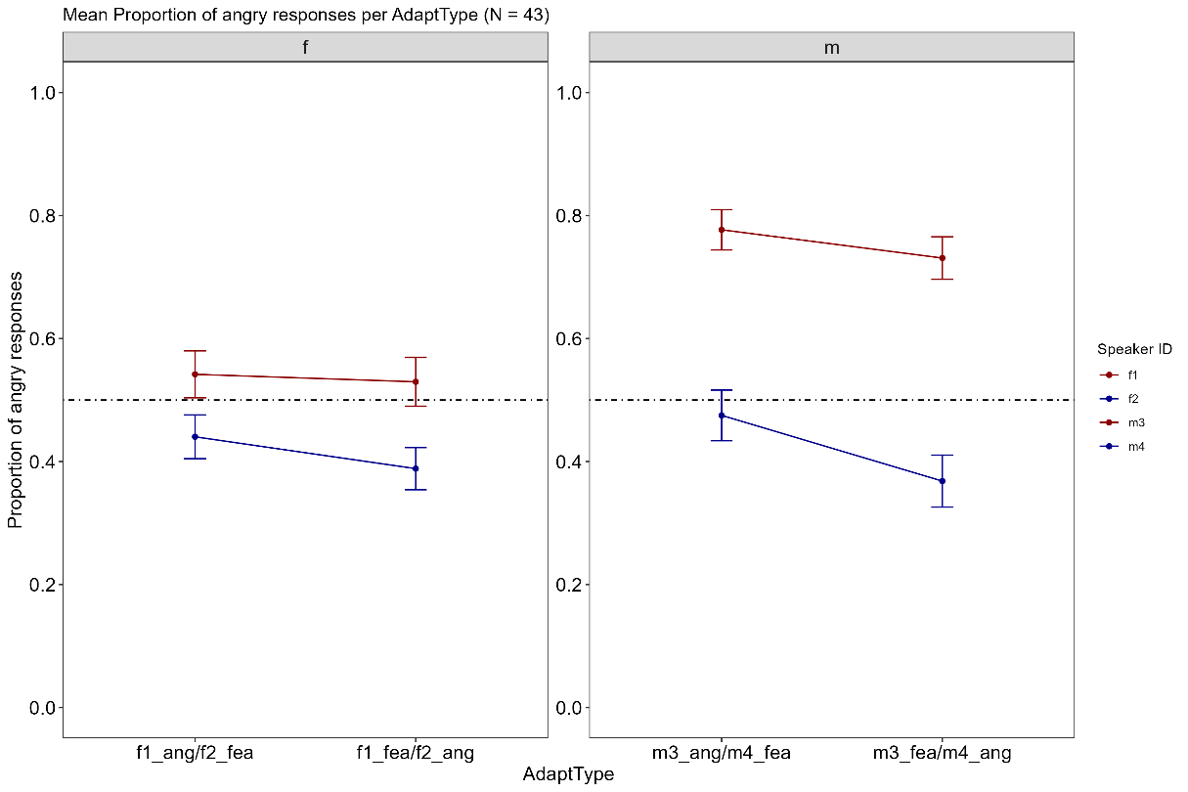
Exp5: Emotion and SpID – different dataset

