Slide 1

Is vocal emotional processing fine-tuned to speaker gender, identity and phonetic content? –
Evidence from simultaneous opposite adaptation
Christine Nussbaum, 27 November 2026
Notes:
Technical term -> I apologize

Slide 3
We infer a lot of information from a voice…
Linguistic cues
Paralinguistic
cues
Extralinguistic cues
e.g. phonetic or
semantic content
e.g. prosody and intonation
EMOTIONS
e.g. identity, gender, age
Notes:
Change within an interactional context or not

Slide 4
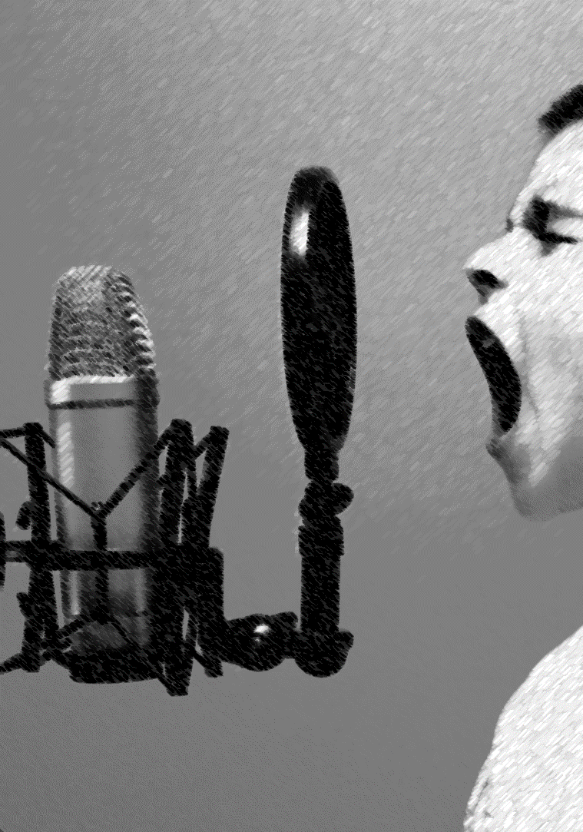
The processing of vocal emotions….
... is a complex task for our perceptual system
It requires real-time monitoring and efficient processing of the auditory input.
Notes:
Pick them up and process them very fast
They can change within a few seconds
Real time monitoring of the auditory input
Very tremendously

Slide 5
How is this degree of efficiency achieved?
Flexibility
Notes:
We tune into contexts and speakers
We use whatever cues are informative
Speaker express emotions very differently, but are equally well recognized

Slide 6
Perceptual Adaptation - a hallmark of perceptual flexibility
Adaptation Phase 1
Response Phase
contrastive aftereffect
Adaptation Phase 2
Response Phase

Slide 7
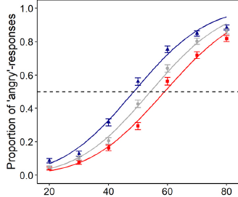

Perceptual Adaptation - a hallmark of perceptual flexibility
Perceptual recalibration of the system
Efficient tracking of emotions
Notes:
Nice paradigm
To study flexibility
That way we study efficient processing

Slide 8
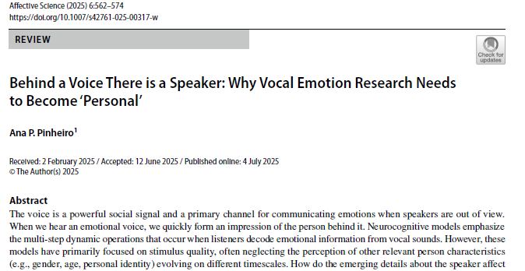

Slide 9
Is vocal emotional processing fine-tuned to characteristics of
the speaker and the speech?

Slide 10
Interaction of different voice processing pathways…
Linguistic cues
Extralinguistic cues
Paralinguistic
cues
But what about fine-tuning?

Slide 11
Is vocal emotional processing fine-tuned to characteristics of
the speaker and the speech?

Slide 12
Simultaneous opposite adaptation – Bestelmeyer et al 2010
Adaptation Phase 1
Response Phase
Simultaneous
opposite
adaptation
Adaptation Phase 2
Response Phase

Slide 13
What would happen WITHOUT gender-specific adaptation?
Adaptation Phase 1
Response Phase
Adaptation would cancel each other out
Adaptation Phase 2
Response Phase

Slide 14
Is vocal emotional processing fine-tuned to characteristics of
the speaker and the speech?
=
Is vocal emotional processing fine-tuned to speaker gender, identity and phonetic content?
=
Do we see evidence from simultaneous opposite adaptation?

Slide 15
Experiments and Predictions
1
2
3
Speaker gender
Speaker identity
Phonetic content
I expected to find simultaneous opposite aftereffects for male and female speakers
I expected to find simultaneous opposite aftereffects
for different speaker identities
I expected to find NO simultaneous opposite aftereffects for different pseudowords
Extralinguistic cues
Linguistic cues

Slide 16
Experiment 1: speaker gender

Slide 17
Experiment 1: Design

Slide 18
Experiment 1: Design
Adaptation Phase 1
Response Phase
Adaptation Phase 2
Response Phase

Slide 19
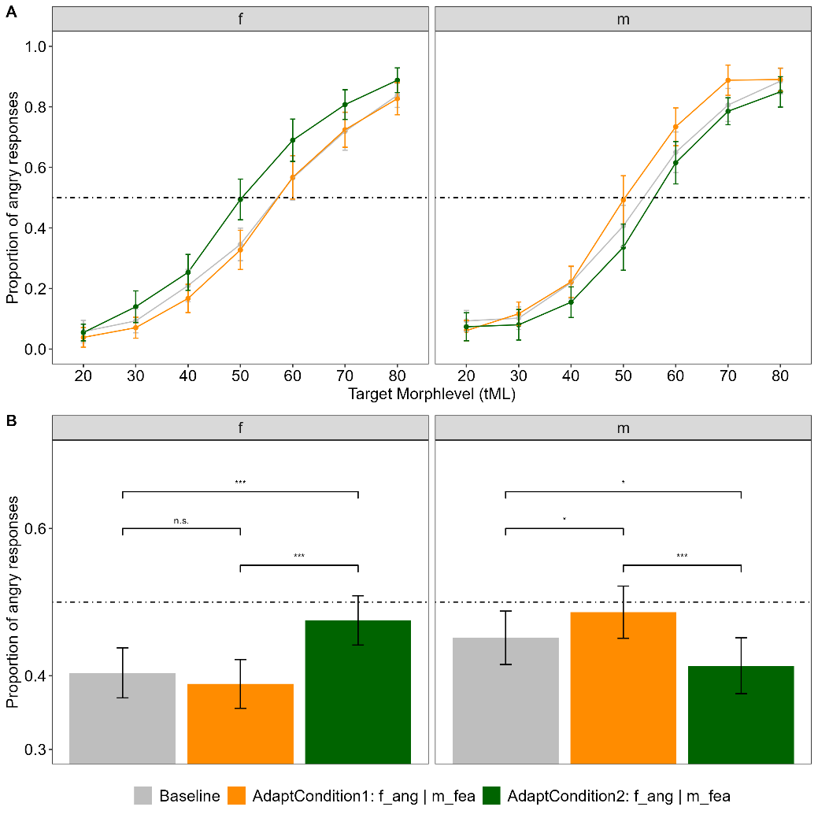
Experiment 1:
Results
Simultaneous
opposite
Adaptation

Slide 20
Experiments and Predictions
1
2
3
Speaker gender
Speaker identity
Phonetic content
I expected to find simultaneous opposite aftereffects for male and female speakers
I expected to find simultaneous opposite aftereffects
for different speaker identities
I expected to find NO simultaneous opposite aftereffects for different pseudowords
Extralinguistic cues
Linguistic cues

Slide 21
Experiment 2: speaker identity

Slide 22
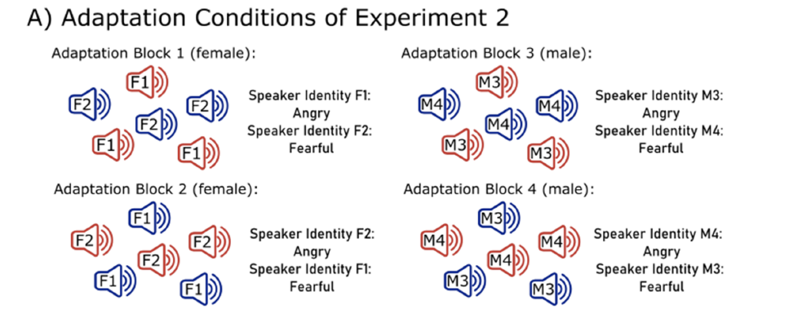
Experiment 2: Design

Slide 23
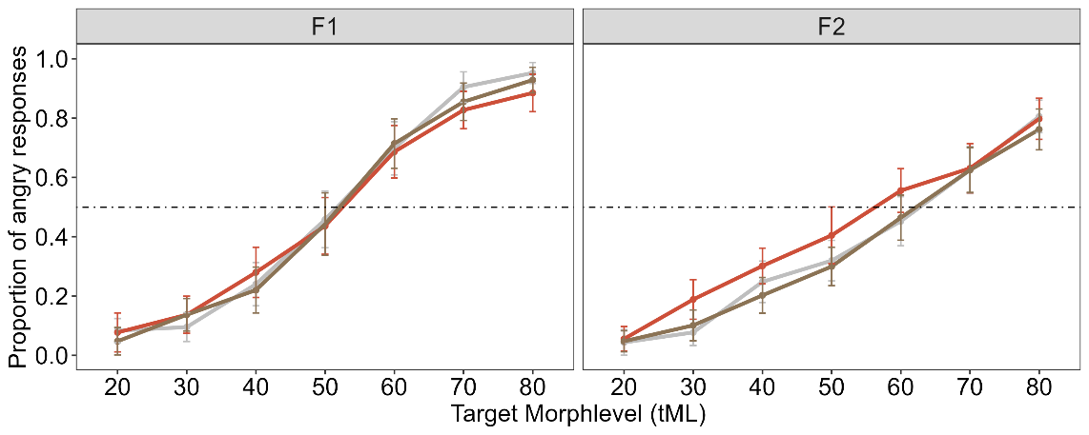
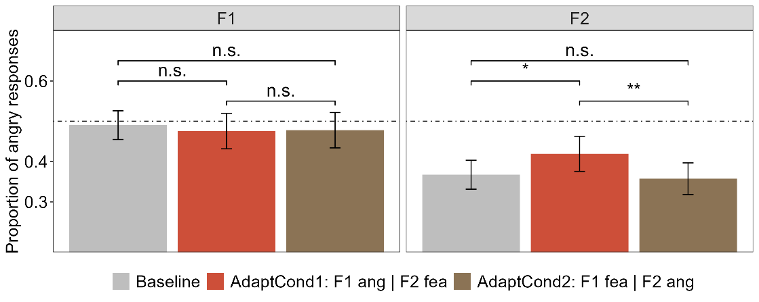
Experiment 2:
Female Identities
Partly evidence,
but overall inconclusive

Slide 24
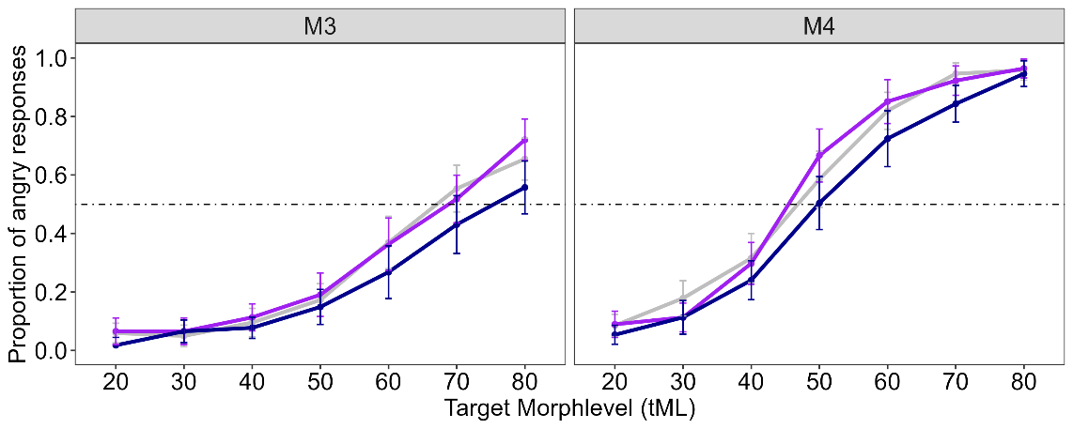
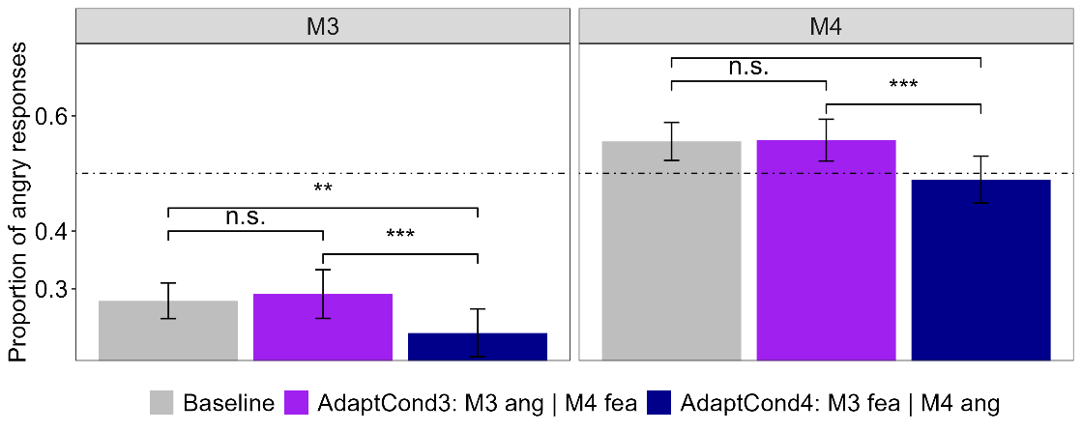
Experiment 2:
Male Identities
NO evidence for
Simultaneous
opposite
Adaptation

Slide 25
Experiments and Predictions
1
2
3
Speaker gender
Speaker identity
Phonetic content
I expected to find simultaneous opposite aftereffects for male and female speakers
I expected to find simultaneous opposite aftereffects
for different speaker identities
I expected to find NO simultaneous opposite aftereffects for different pseudowords
Extralinguistic cues
Linguistic cues

Slide 26
Experiment 3: spoken pseudoword

Slide 27
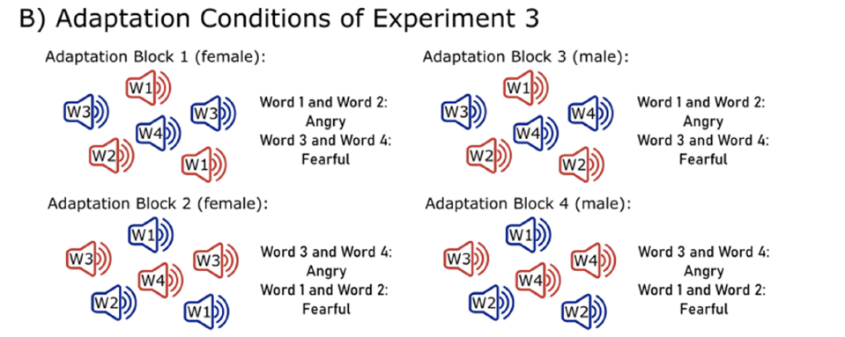
Experiment 3: Design

Slide 28
Experiment 3: Hypothesis

Slide 29
Little excursion into Bayesian inference…

Slide 30
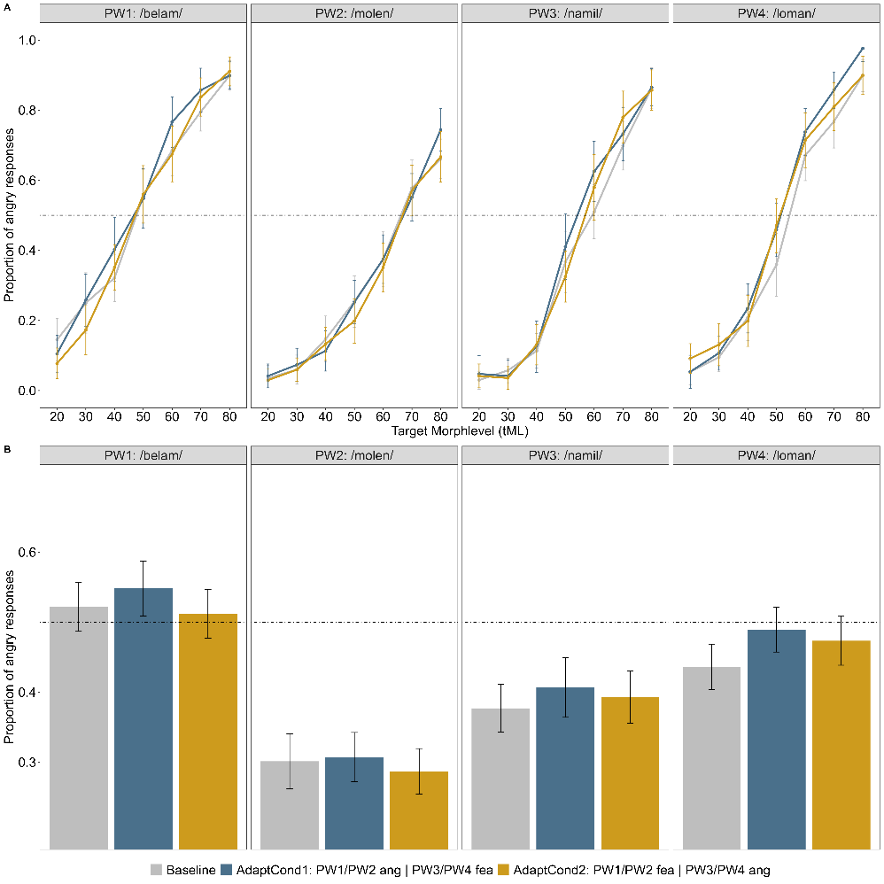
Experiment 3:
Results
Evidence for NO
Simultaneous
opposite
Adaptation

Slide 31
Experiments and Predictions
1
2
3
Speaker gender
Speaker identity
Phonetic content
I expected to find simultaneous opposite aftereffects for male and female speakers
I expected to find simultaneous opposite aftereffects
for different speaker identities
I expected to find NO simultaneous opposite aftereffects for different pseudowords
Extralinguistic cues
Linguistic cues

Slide 32
Discussion

Slide 33
Thank you for your attention!

