Slide 1

The Analytics Template Library
Matthew Supernaw
Scientific Programmer
Sustainable Fisheries, SEFSC
ATL and Higher-Order AD

Slide 2
What is The ATL?
ATL Is A C++ General Purpose Scientific Computing Library Based On Template Metaprogramming
Key Modules:
Automatic Differentiation
Optimization (Constrained and Unconstrained)
Fixed and Mixed Effects Modeling
Containers (Matrices, Vectors, Arrays)
Probability Distributions

Slide 3
What Is Template Metaprograming?
A technique in which templates are used by the compiler to generate temporary source code
Can be used for compile time optimization
Allows for generic programming

Slide 4
Template Metaprogramming
Functions
- Function templates are special functions that can operate with generic types.
- Allows us to write reusable code without having to re-implement a function for every type desired.
A Declaration Has The Form:
template <class identifier> function_declaration;
template <typename identifier> function_declaration;
A Call Has The Form:
function_name <type> (parameters);
Example:
template<class T>
T Max(const T &a, const T &b){
return (a>b?a:b);
}
std::cout<<Max<int>(1,2)<<"\n";
std::cout<<Max<double>(1.0,1.5);

Slide 5
Templates Metaprogramming
Classes
- Template classes are also allowed.
- Allows a class to have members that use template parameters as types.
Has the Form:
template<class T> class class_name {...}
template<typename T> class class_name {...}
Example:
template<class T>
class Vector{
unsigned int size_m;
T *data_m;
public:
//default constructor
Vector():size_m(0), data_m(NULL){}
//constructor
Vector(unsigned int size){
size_m =size;
data_m = new T[size];
for(unsigned int i =0; i < size; i++){data_m[i] = 0.0;}
}
};
Vector<double> dvector(10);
Vector<int> ivector(10);

Slide 6
Expression Templates
A template metaprogramming technique in which templates are used to represent part of an expression.
Considered a source code optimization technique because their use reduces the amount of temporary variables created.

Slide 7
Expression Templates
Example:
template<class T, class A>
struct VectorExpr {
const A & Cast() const {
return static_cast<const A&> (*this);
}
T operator()(int i) const {
return Cast().operator()(i);
}
VectorExpr& operator=(const VectorExpr & exp) const {
return *this;
}
};
Expression template base class for a vector container.

Slide 8
Expression Templates
Example:
template<class T, class LHS, class RHS>
struct VectorAdd : public VectorExpr<T, VectorAdd<T, LHS, RHS> > {
const LHS& lhs;
const RHS& rhs;
VectorAdd(const VectorExpr<T, LHS>& l, const VectorExpr<T, RHS>& r)
: lhs(l.Cast()), rhs(r.Cast()) {
}
T operator()(int i) const {
return lhs(i) + rhs(i);
}
};
template<class T, class LHS, class RHS>
inline const VectorAdd<T, LHS, RHS> operator+(const VectorExpr<T, LHS>& l, const VectorExpr<T, RHS>& r) {
return VectorAdd<T, LHS, RHS>(l.Cast(), r.Cast());
}
Expression template representing addition for a vector.

Slide 9
Expression Templates
Example:
References
template<class T, class LHS, class RHS>
struct VectorAdd : public VectorExpr<T, VectorAdd<T, LHS, RHS> > {
const LHS& lhs;
const RHS& rhs;
VectorAdd(const VectorExpr<T, LHS>& l, const VectorExpr<T, RHS>& r)
: lhs(l.Cast()), rhs(r.Cast()) {
}
T operator()(int i) const {
return lhs(i) + rhs(i);
}
};
template<class T, class LHS, class RHS>
inline const VectorAdd<T, LHS, RHS> operator+(const VectorExpr<T, LHS>& l, const VectorExpr<T, RHS>& r) {
return VectorAdd<T, LHS, RHS>(l.Cast(), r.Cast());
}
Expression template representing addition for a vector.

Slide 10
Expression Templates
Example:
template<class T, class LHS, class RHS>
struct VectorAdd : public VectorExpr<T, VectorAdd<T, LHS, RHS> > {
const LHS& lhs;
const RHS& rhs;
VectorAdd(const VectorExpr<T, LHS>& l, const VectorExpr<T, RHS>& r)
: lhs(l.Cast()), rhs(r.Cast()) {
}
T operator()(int i) const {
return lhs(i) + rhs(i);
}
};
template<class T, class LHS, class RHS>
inline const VectorAdd<T, LHS, RHS> operator+(const VectorExpr<T, LHS>& l, const VectorExpr<T, RHS>& r) {
return VectorAdd<T, LHS, RHS>(l.Cast(), r.Cast());
}
Unique Operator
“+”
Expression template representing addition for a vector.

Slide 11
Expression Templates
Example:
template<class T, class LHS, class RHS>
struct VectorSubtract: public VectorExpr<T, VectorSubtract<T, LHS, RHS> > {
const LHS& lhs;
const RHS& rhs;
VectorSubtract(const VectorExpr<T, LHS>& l, const VectorExpr<T, RHS>& r)
: lhs(l.Cast()), rhs(r.Cast()) {
}
T operator()(int i) const {
return lhs(i) - rhs(i);
}
};
template<class T, class LHS, class RHS>
inline const VectorSubtract<T, LHS, RHS> operator-(const VectorExpr<T, LHS>& l, const VectorExpr<T, RHS>& r) {
return VectorSubtract<T, LHS, RHS>(l.Cast(), r.Cast());
}
Expression template representing subtraction for a vector.

Slide 12
Expression Templates
Example:
template<class T, class LHS, class RHS>
struct VectorSubtract: public VectorExpr<T, VectorSubtract<T, LHS, RHS> > {
const LHS& lhs;
const RHS& rhs;
VectorSubtract(const VectorExpr<T, LHS>& l, const VectorExpr<T, RHS>& r)
: lhs(l.Cast()), rhs(r.Cast()) {
}
T operator()(int i) const {
return lhs(i) - rhs(i);
}
};
template<class T, class LHS, class RHS>
inline const VectorSubtract<T, LHS, RHS> operator-(const VectorExpr<T, LHS>& l, const VectorExpr<T, RHS>& r) {
return VectorSubtract<T, LHS, RHS>(l.Cast(), r.Cast());
}
Unique Operator
“-”
Expression template representing subtraction for a vector.

Slide 13
Expression Templates
Example:
template<class T, int SIZE>
class Vector : public VectorExpr<T, Vector<T, SIZE> > {
T data[SIZE];
public:
Vector() {
}
Vector& operator=(const T& value){
for (int i = 0; i < SIZE; i++) {
data[i] = value;
}
return *this;
}
template<class R, class A>
Vector& operator=(const VectorExpr<R, A>& exp) {
for (int i = 0; i < SIZE; i++) {
data[i] = exp(i);
}
return *this;
}
T operator()(int i) const {
return data[i];
}
size_t Size(){
return SIZE;
}
};
Expression template representing a vector.

Slide 14
Expression Templates
Example:
Unique Operator
“retrieve”
template<class T, int SIZE>
class Vector : public VectorExpr<T, Vector<T, SIZE> > {
T data[SIZE];
public:
Vector() {
}
Vector& operator=(const T& value){
for (int i = 0; i < SIZE; i++) {
data[i] = value;
}
return *this;
}
template<class R, class A>
Vector& operator=(const VectorExpr<R, A>& exp) {
for (int i = 0; i < SIZE; i++) {
data[i] = exp(i);
}
return *this;
}
T operator()(int i) const {
return data[i];
}
size_t Size(){
return SIZE;
}
};
Expression template representing a vector.

Slide 15
Expression Templates
Example:
int main() {
Vector<double, 2> a;
a = 1.0;
Vector<double, 2> b;
b = 2.0;
Vector<double, 2> c;
b = 3.0;
Vector<double, 2> d;
d = a - b + c;
for(int i =0; i < d.Size(); i++){
std::cout<<d(i)<<" ";
}
return 0;
}
Output:
2 2
Expression template representing subtraction for a vector.

Slide 16
Expression Templates
Example:
int main() {
Vector<double, 2> a;
a = 1.0;
Vector<double, 2> b;
b = 2.0;
Vector<double, 2> c;
b = 3.0;
Vector<double, 2> d;
d = a - b + c;
for(int i =0; i < d.Size(); i++){
std::cout<<d(i)<<" ";
}
return 0;
}
Base Data Type
Output:
2 2
Expression template representing subtraction for a vector.

Slide 17
Expression Templates
Example:
int main() {
Vector<double, 2> a;
a = 1.0;
Vector<double, 2> b;
b = 2.0;
Vector<double, 2> c;
b = 3.0;
Vector<double, 2> d;
d = a - b + c;
for(int i =0; i < d.Size(); i++){
std::cout<<d(i)<<" ";
}
return 0;
}
No temporary vectors
are produced
No temporary vectors
are produced
Output:
2 2
Example of using Expression Templates.

Slide 18
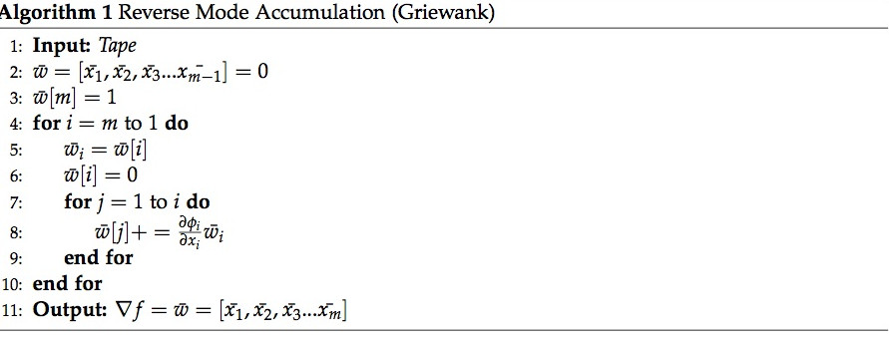
Reverse Mode AD
Base Algorithm:

Slide 19
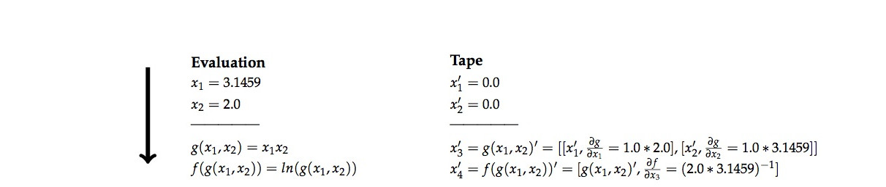
Reverse Mode AD Trace
Evaluate:
g(x₁,x₂) = x₁x₂
f(x₁,x₂) = ln(g(x₁,x₂) )

Slide 20
Reverse Mode AD Trace
Evaluate:
g(x₁,x₂) = x₁x₂
f(x₁,x₂) = ln(g(x₁,x₂) )
Adjoints

Slide 21
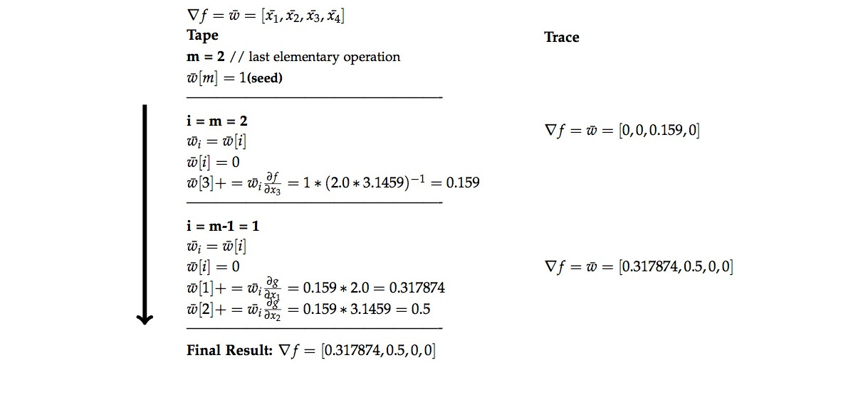
Reverse Mode AD Trace
Compute Gradient:

Slide 22
Higher-Order Reverse Mode AD
We can't just differentiate the first-order algorithm
We have to account for any nonlinear interactions^{[3]}
These variables may be used later in the accumulation and are said to be “live” variables^{[4]}

Slide 23
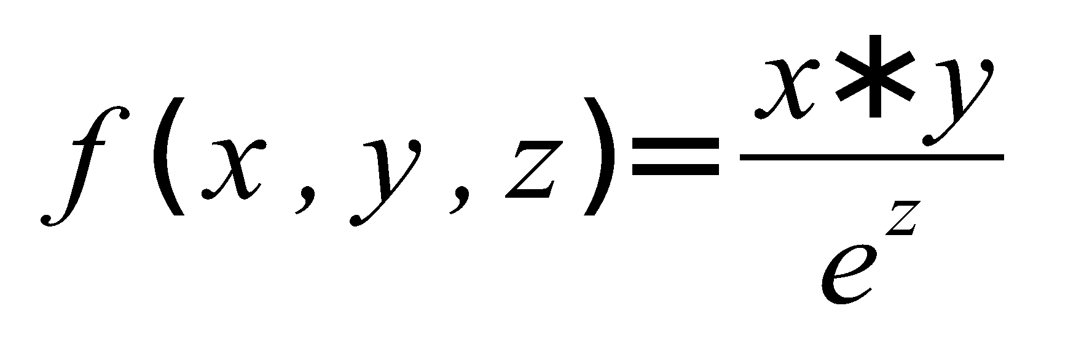
Higher-Order Reverse Mode AD
Nonlinear Interaction
Defined at the expression level as an interaction of variables in the linear portion of an expression with those that are nonlinear
Example:
x and y interact with the nonlinear expression e^{z}, therefore x and y are said to have a nonlinear interaction with z.

Slide 24
Higher-Order Reverse Mode AD
Nonlinear Interaction
We introduce the idea of variable sets at each entry in the "Tape" structure.
These sets not only hold variables that were found in the evaluated statement, but also those that have nonlinear interaction with any of the statement level variables.
Before each entry in the "Tape" is evaluated, we prepare the entry by combining the variables from the expression statement with those that have nonlinear interactions with variables found at the statement level.
The result is a concise list of variable information required to properly accumulate the higher-order derivatives for that entry.
During the accumulation process, “live” variables are pushed to the statement level variable set

Slide 25
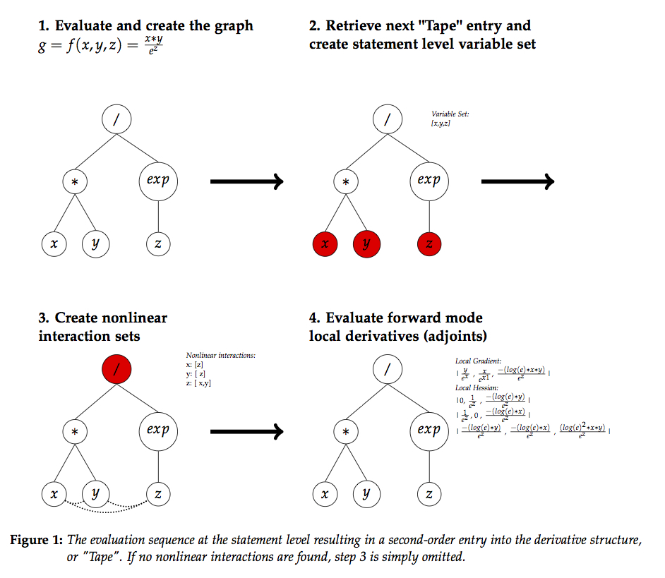
Higher-Order Reverse Mode AD
Assignment Statement For Second-Order

Slide 26
Higher-Order Reverse Mode AD
Assignment Statement For Second-Order
Expression
Tree

Slide 27
Higher-Order Reverse Mode AD
Assignment Statement For Second-Order
“Tape” entry
Local
Derivatives

Slide 28
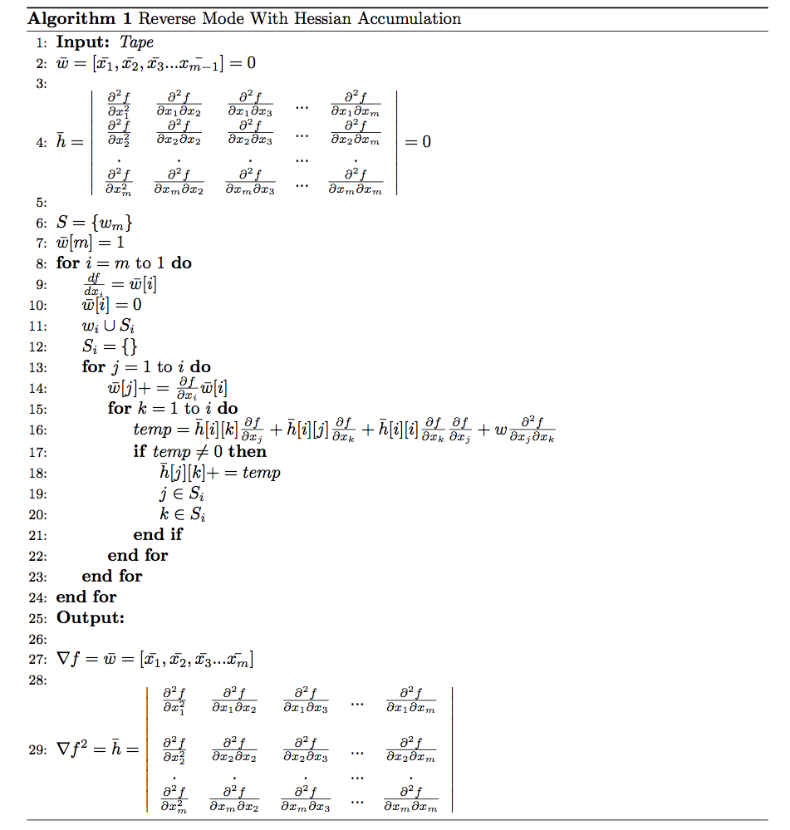
Higher-Order Reverse Mode AD
Second-Order Algorithm

Slide 29
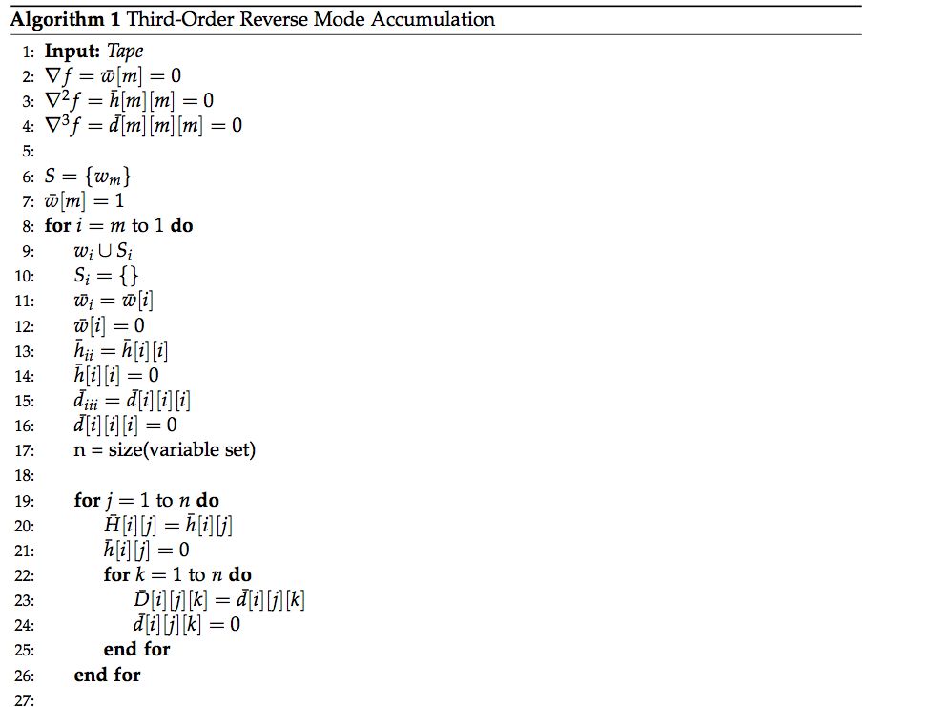
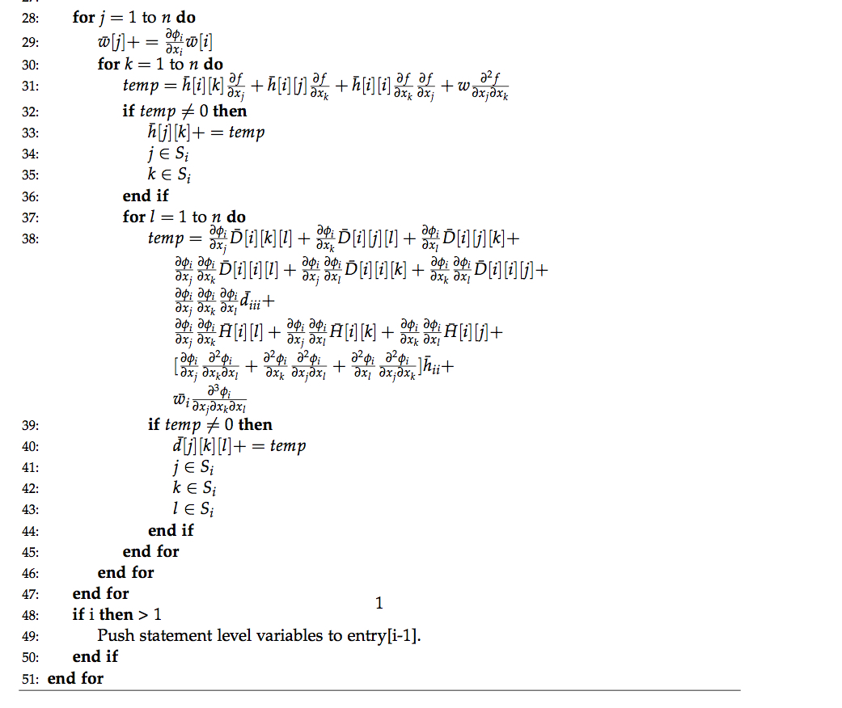
Higher-Order Reverse Mode AD
Third-Order Algorithm

Slide 30

Leveraging Clairaut's Theorem
Clairaut's Theorem
If
has continuous second partial derivatives at any given point in , then
Since AD assumes functions are continuously differentiable, we only need to do half the calculations required. This concept is extended for third order derivatives.

Slide 31
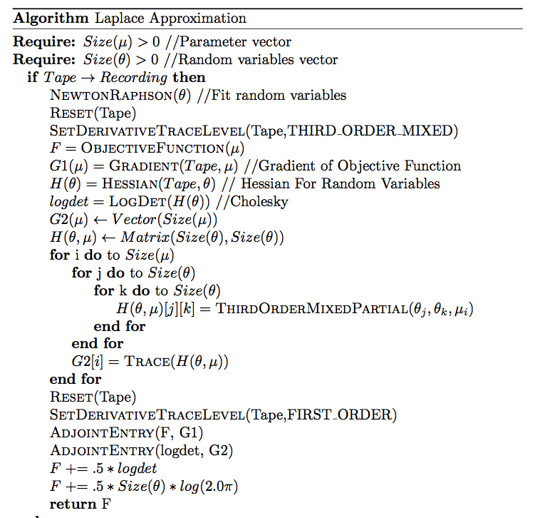

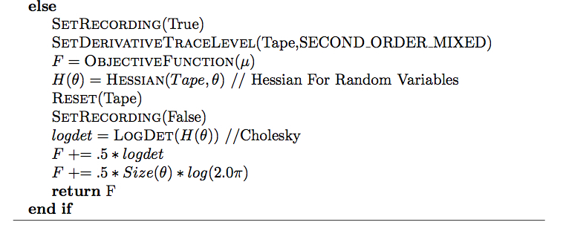
Application to Mixed Effects

Slide 32
Theta Log
ATL- ADMB Port
logr0 -2.43767
logtheta 0.294869
logK 6.89071
logQ -4.53875
LogR -3.1019
ADMB
logr0 -2.43692996275
logtheta 0.294804607840
logK 6.89214371858
logQ -4.53440126076
LogR -3.10333204659
ATL- TMB Port
logr0 -2.43766
logtheta 0.294832
logK 6.8907
logQ -4.53874
logR -3.10191
TMB
logr0 -2.43766
logtheta 0.294832
logK 6.8907
logQ -4.53874
logR -3.10191

Slide 33
Expression templates For AD
template<class REAL_T, class A>
struct ExpressionBase {
typedef REAL_T BASE_TYPE;
typedef A DIFF_EXPRESSION;
ExpressionBase() { }
inline const A & Cast() const {
return static_cast<const A&> (*this);
}
inline void VariableCount(uint32_t& count) const;
inline const REAL_T GetValue() const;
inline void PushIds(IDSet<atl::VariableInfo<REAL_T>* >& ids)const;
inline void PushIds(IDSet<uint32_t >& ids)const;
bool IsNonlinear()const;
bool IsNonLinearFunction()const;
inline void MakeNLInteractions(bool b = false)const;
inline void PushNLInteractions(IDSet<atl::VariableInfo<REAL_T>* >& ids)const;
inline REAL_T EvaluateDerivative(uint32_t a) const;
inline REAL_T EvaluateDerivative(uint32_t a, uint32_t b) const;
inline REAL_T EvaluateDerivative(uint32_t x, uint32_t y, uint32_t z) const;
const ExpressionBase& operator=(const ExpressionBase & exp) const;
};
Expression templates provide
extensibility in the AD System
bool

Slide 34
Expression templates For AD
template<class REAL_T, class A>
struct ExpressionBase {
typedef REAL_T BASE_TYPE;
typedef A DIFF_EXPRESSION;
ExpressionBase() { }
inline const A & Cast() const {
return static_cast<const A&> (*this);
}
inline void VariableCount(uint32_t& count) const;
inline const REAL_T GetValue() const;
inline void PushIds(IDSet<atl::VariableInfo<REAL_T>* >& ids)const;
inline void PushIds(IDSet<uint32_t >& ids)const;
bool IsNonlinear()const;
bool IsNonLinearFunction()const;
inline void MakeNLInteractions(bool b = false)const;
inline void PushNLInteractions(IDSet<atl::VariableInfo<REAL_T>* >& ids)const;
inline REAL_T EvaluateDerivative(uint32_t a) const;
inline REAL_T EvaluateDerivative(uint32_t a, uint32_t b) const;
inline REAL_T EvaluateDerivative(uint32_t x, uint32_t y, uint32_t z) const;
const ExpressionBase& operator=(const ExpressionBase & exp) const;
};
Expression templates provide
extensibility in the AD System
Highlighted functions
were added for
higher-order derivatives
bool

Slide 35
Simple Example
#include <ATL.hpp>
using namespace std;
int main(int argc, char** argv) {
//initialize the system for second-order derivatives
typedef atl::Variable<double> variable;
variable::gradient_structure_g.derivative_trace_level = atl::SECOND_ORDER_MIXED_PARTIALS;
//evaluate
variable x1 = M_PI;
variable x2 = 2.0;
variable f = atl::log(x1 * x2);
//initialize containers
std::vector<variable*> parameters;
parameters.push_back(&x1);
parameters.push_back(&x2);
std::vector<double> gradient(parameters.size());
std::vector<std::vector<double> > hessian(parameters.size(),std::vector<double>(parameters.size()));
//extract derivatives
variable::ComputeGradientAndHessian(variable::tape,
parameters, gradient, hessian);
//show
std::cout<<"Gradient:\n";
for (int i = 0; i< parameters.size(); i++) {
std::cout <<std::left<<std::setw(10)<< gradient[i];
}
std::cout<<"\n\nHessian:\n";
for (int i = 0; i < parameters.size(); i++) {
for (int j = 0; j< parameters.size(); j++) {
std::cout<<std::left<<std::setw(10) << hessian[i][j];
}
std::cout<<"\n";
}
return 0;
}
Output:
Gradient:
0.31831 0.5
Hessian:
-0.101321 0
0 -0.25

Slide 36
Known issues
Container classes returning AD types can be slow.
Original design had ET's returning ET's, caused stack overflow for large container expressions (considering ET iterators using traits)
Distribution library is lousy(needs review and vectorization, template specification)
Documentation is weak
BigFloat is broken

Slide 37
Future Work
Fourth-Order derivatives
Expanded minimizer algorithms
ET optimization
Faster Associative Container (Judy Arrays?)
Container Iterators for AD types(ETs returning ETs)

Slide 38
References
[1] Andreas Griewank, Andrea Walther [Introduction to Automatic Differentiation]. PAMM u ̊ Proc. Appl. Math. Mech. 2, 45?49 (2003).
[2] Andreas Griewank [On Automatic Differentiation]. Center for Research on Parallel Computation, 1989.
[3] Robert Mansel Gower, Margarida P. Mello Hessian Matrices via Automatic Differentiation. Institute of Mathematics, Statistics and Scientific Computing,State University of Campinas, September 29, 2010.
[4] Mu Wang, Assefaw Gebremedhin, Alex PothenHessian Capitalizing on Live Variables: New Algorithms for Efficient Hessian Computation via Automatic Differentiation

