Slide 1

Intro to Git!
Christine Stawitz and Celine Pastore
1/18/2017

Slide 2
What is version control?
Source code management or version control
Generally: “management of changes to documents, computer programs, large web sites, and other collections of information”
Specifically: refers to a way of managing, tracking, and modifying changes to a piece of computer code across a group of individuals

Slide 3
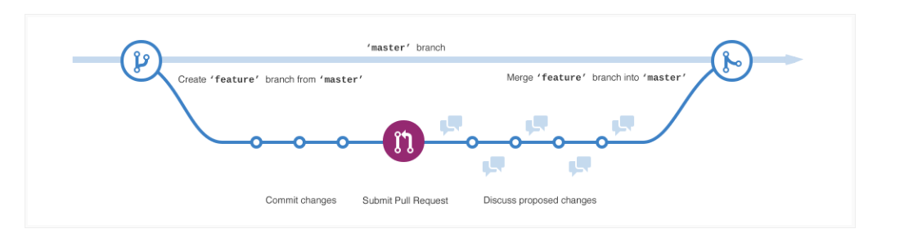
What makes Github so good?
Unlike traditional version control, Git does not require you to “check out” code
Git instead it tracks snapshots at every point
AAHHHH!
1
2
3
1+3
Time

Slide 4
Key components of Github
Repository: where files for a project are stored; has unique URL
Cloning: create and/or sync a local copy on your computer of a remote repository
Fork: a copy of a repository – when you don’t want to impact the original
Branch: an independent line of development within a repository. Default branch is “master”
Pull request: tell others about changes you’ve pushed to a Git repository.

Slide 5

The basics
Handling local vs. server code; pulls, commits, and pushes

Slide 6
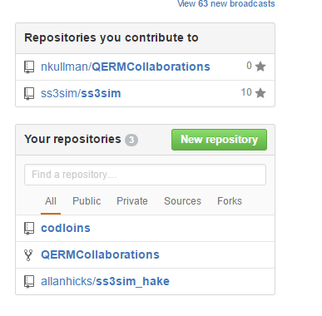
Creating a repository
Default, free repositories are public
Free private repositories for students
https://education.github.com/pack/join

Slide 7

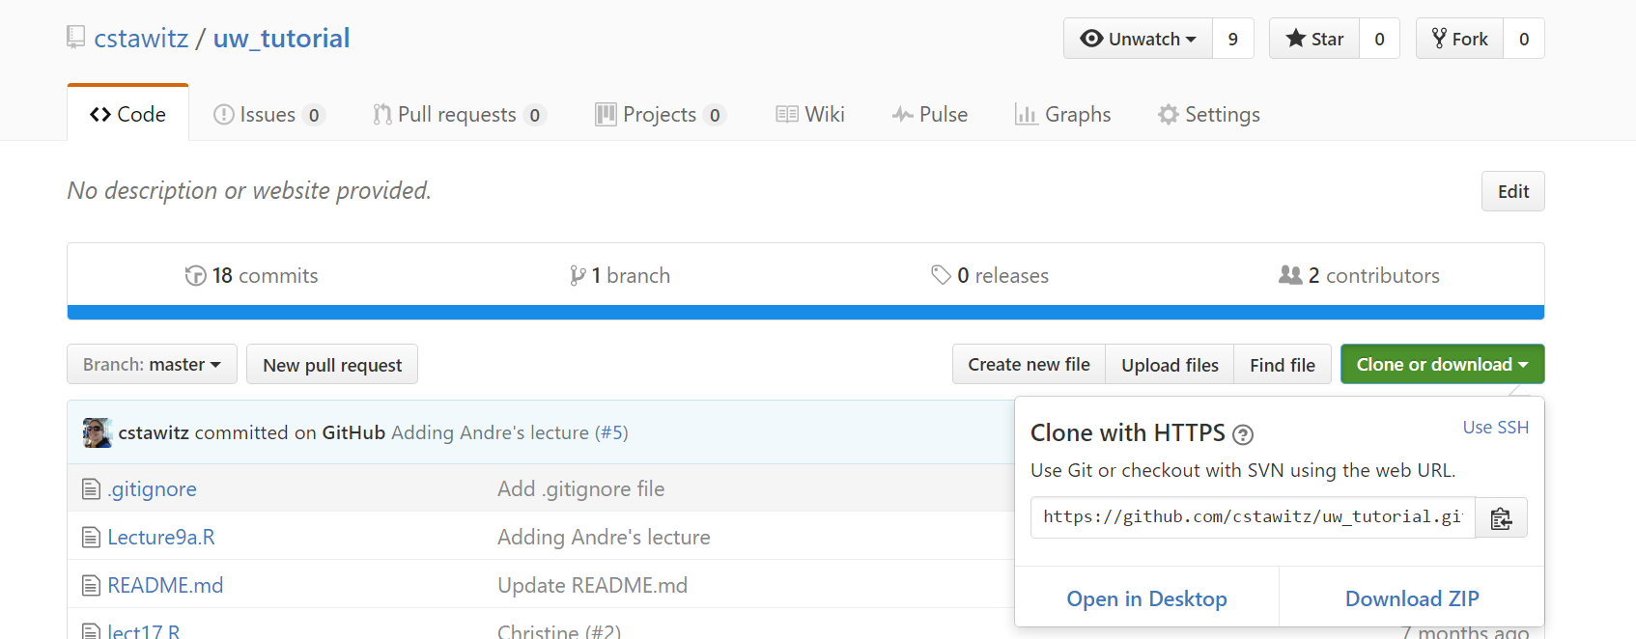
“Cloning”
In the terminal: “git clone <link>”

Slide 8
Local vs. server code
Computer folder is now a snapshot of code
To update the code on your machine, you “pull” from the remote repository
To update the code on the server with the code on your machine, you “push”
You can always start over from the remote repository by deleting and re-cloning

Slide 9
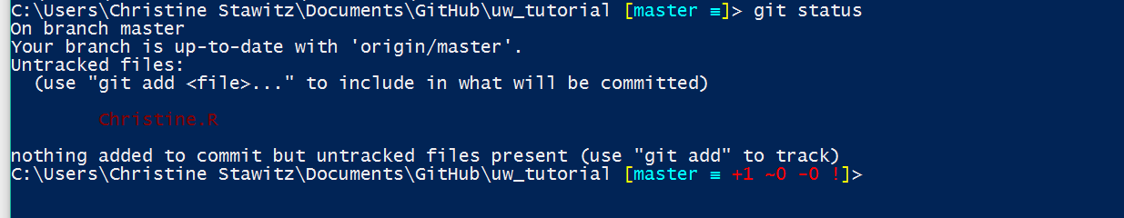
Making and committing changes
Add an <yourname>.R file to your local repository
OK! You now have local changes and you want to update the server version
Use “git status” to see which files need to be added
Notes:
Add some files!

Slide 10
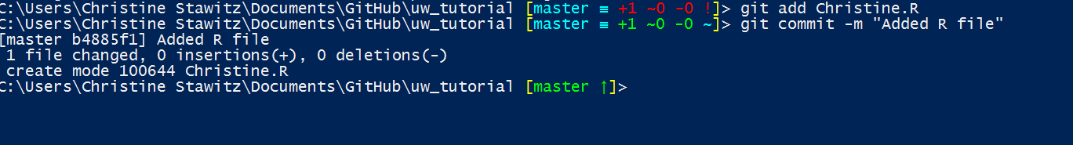
Making and committing changes
To add a file to tracking, or “stage”, use “git add <filename>”
To remove, “git rm <filename>”
To commit changes, use “git commit –m “”<Message detailing what you changed>”
Notes:
Add some files!

Slide 11
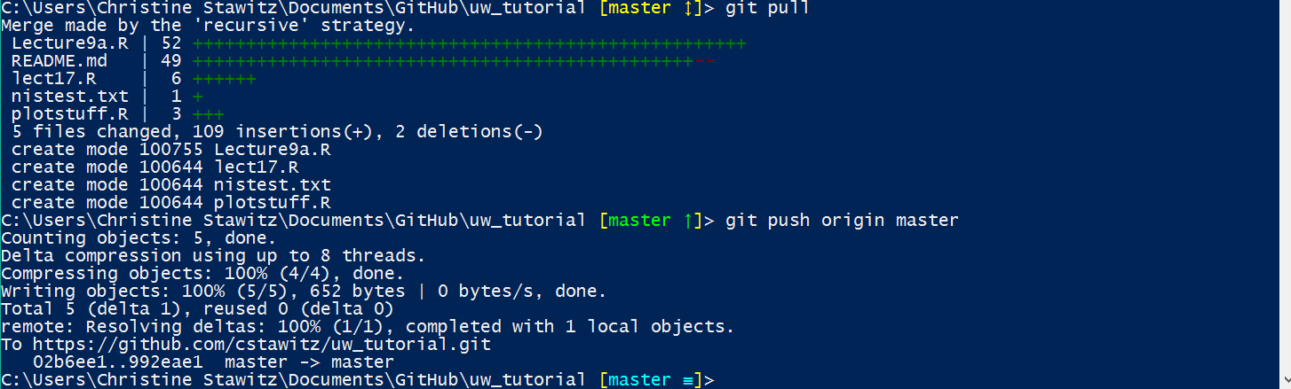
Making and committing changes
To push to the remote repository, “git push origin master”
Notes:
Add some files!

Slide 12
Skipping staging
If “git add” seems like a useless step, you can commit and add in one step using “-a” argument

Slide 13
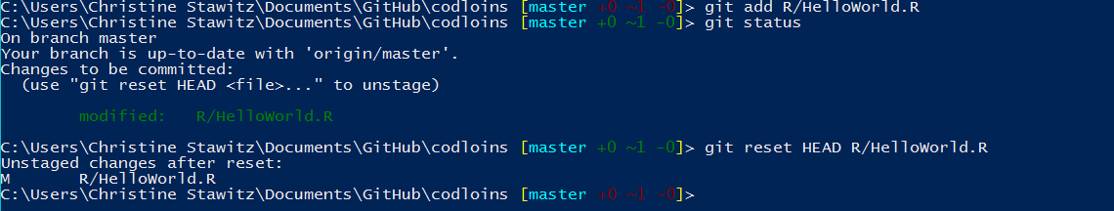

What if you mess up?
In the “add” phase – git reset HEAD <filename>

Slide 14
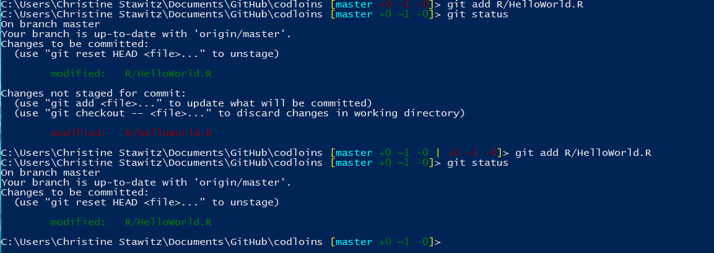
What if you mess up?
OR “git add” again if you changed something

Slide 15
What if you mess up?
At the commit stage
Use git commit --amend
$ git commit -m 'initial commit'
$ git add forgotten_file
$ git commit --amend

Slide 16
What if you mess up?
Reverting to previous version
$ git checkout –- R/HelloWorld.R

Slide 17
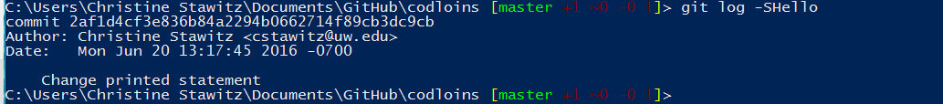
“git log”
Default shows all changes (information overload!)
Arguments
–p shows diff
–S<text> searches all edits for “text”
–grep “” searches commits for “”
-n shows n last commits

Slide 18
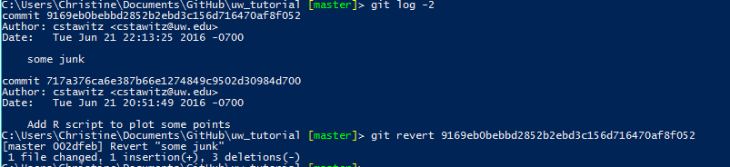
Undoing a commit
Git log shows you the unique hash value corresponding to each commit
If you want to undo one commit, run “git revert <hash>”

Slide 19
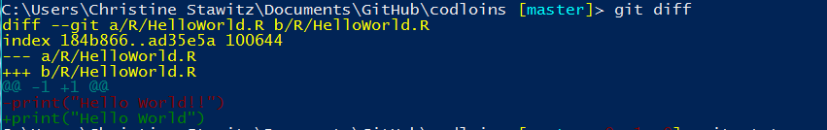
“git diff” is also helpful
Shows you exactly which lines changed

Slide 20
Git stash
“git stash” allows you to save changes in your local working directory without committing them
Useful if you want to switch to a different branch and work on something else, but your code is in a bit of a messy state

Slide 21
Wrapping up basics
Clone -> Move/create/edit/delete files -> git add -> git commit -> git push origin master
“git pull” instead of clone if it is an existing repository
Important note: “commit” is key to take advantage of version tracking. Without “commit”, you can lose your changes!
“push” makes your changes available on different computers

Slide 22

Collaboration
Organizations, workflows, branching, pull requests

Slide 23
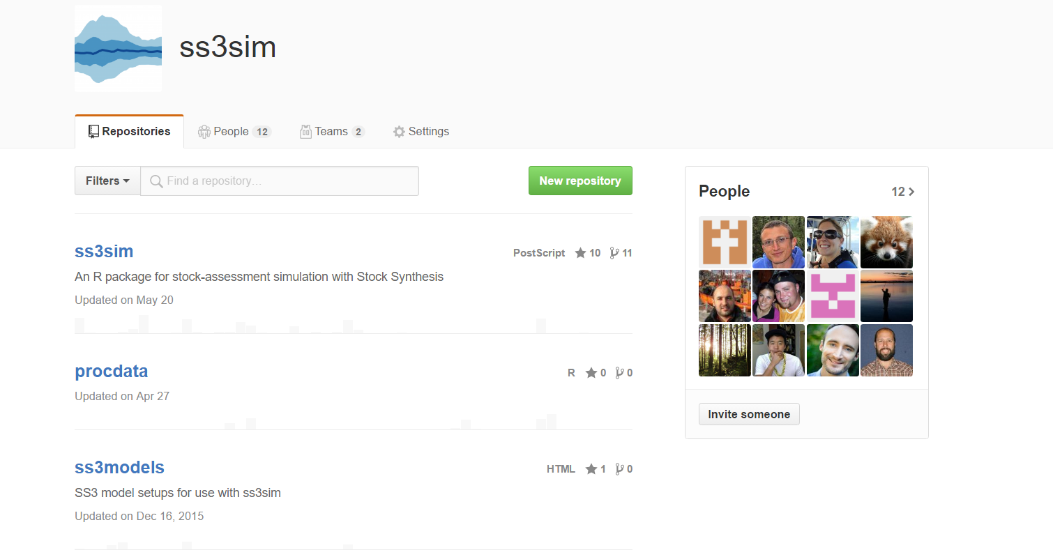
Organizations
Allow changes in permissions
Multiple repositories for different things
Teams

Slide 24

Tools for collaboration
Once you have more than 2 or 3 people collaborating, it is helpful to establish some sort of workflow
Ensures there is always a working copy of the code for your collaborators to work with
Allows simultaneous work on multiple edits/projects
Makes it easier to review others’ code/ask for feedback
Cuts down on likelihood of merge conflicts

Slide 25

Branches
So far, we have been working in the ”master” branch
Branch: an independent line of development within a repository.
For the nerds: a branch is a pointer to the version of the repository you are working with.

Slide 26
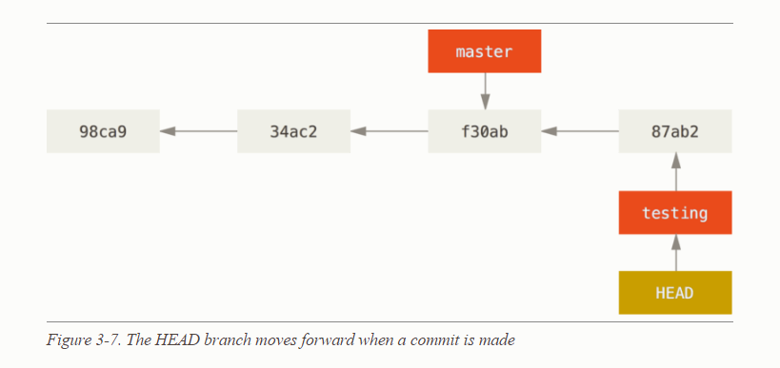
Making a branch
To do this, just do “git branch <branchname>”
This command creates a branch but doesn’t switch to it
To create and switch to a branch, or (without -b) just switch to an existing branch use “git checkout –b <branchname>”
Your working directory is now operating in that branch

Slide 27
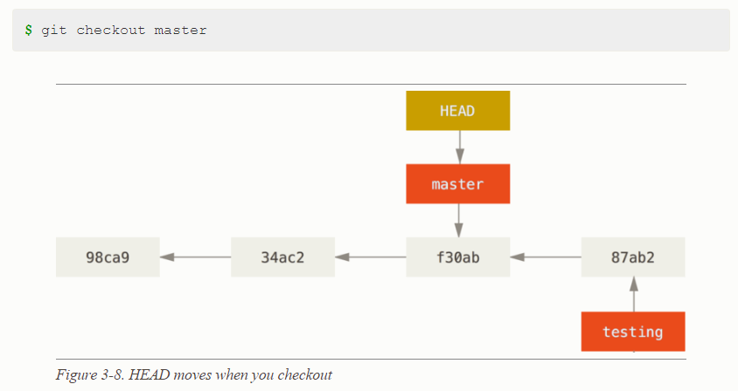
Switching between branches
Switching between branches changes the files in your local working directory, but branch changes are preserved on the server

Slide 28
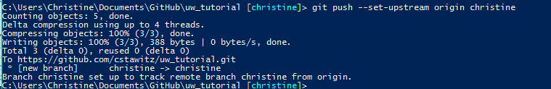
Sharing the branch with others
Creating and checking out a branch just creates it locally
To let others collaborate on it, you need to run “git push --set-upstream origin <branchname>”

Slide 29

OK, so how do you integrate changes?
git fetch: syncs changes to local without merging
git merge: does merge with pulled changes (pull merges)
git rebase: puts your changes on top of master (if someone else has made changes)
git branch -d: deletes branch specified after -d
Fetch and rebase the master branch with yours
Test your code with the changes from master before merging

Slide 30
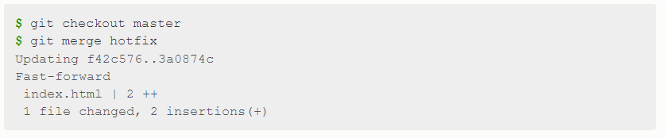
Integrating changes, continued
Now merge!
Checkout master branch
git merge <your branch>
Delete branch with git branch –d <branchname>

Slide 31

Forks
A fork is a copy of an existing Git repository
You might want to fork a repository, rather than branch it, if
You want to make specific code modifications to a repository you’re not an author of
A project you are involved with is diverging into multiple projects
You might want to merge a fork if your changes become useful to others

Slide 32
Formalizing merges
At some point in a collaboration size (i.e., large working group), freely merging can cause problems
Having an administrator and pull requests become super helpful
A pull request is a formal documentation of merging your changes into the master branch or fork
Other collaborators can see your request and approve or disapprove it
Git auto-checks if there are likely to be merge conflicts

Slide 33
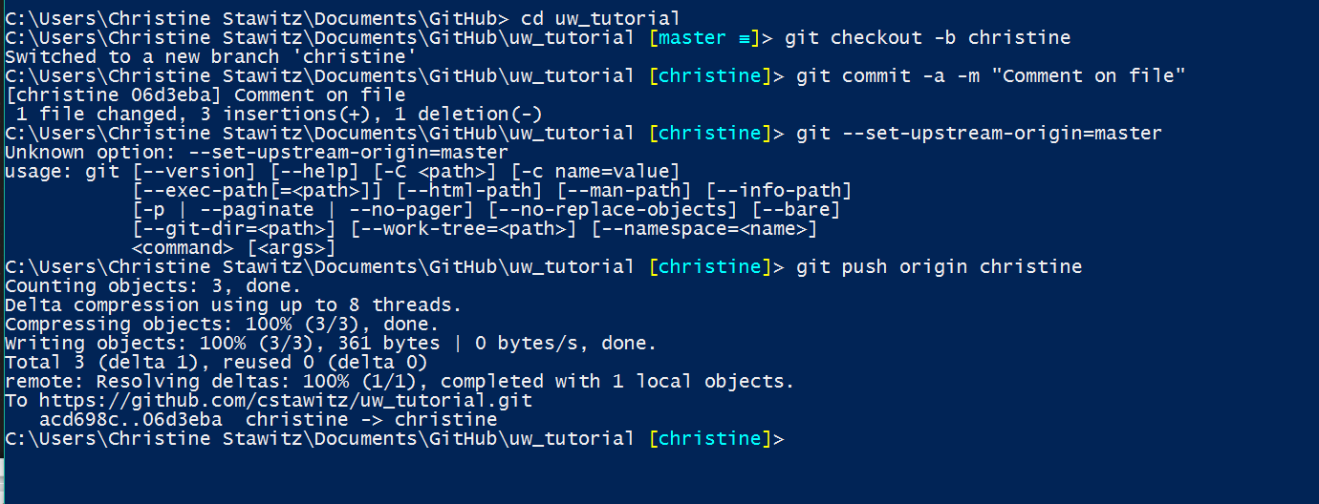
First, checkout a branch and make some changes

Slide 34
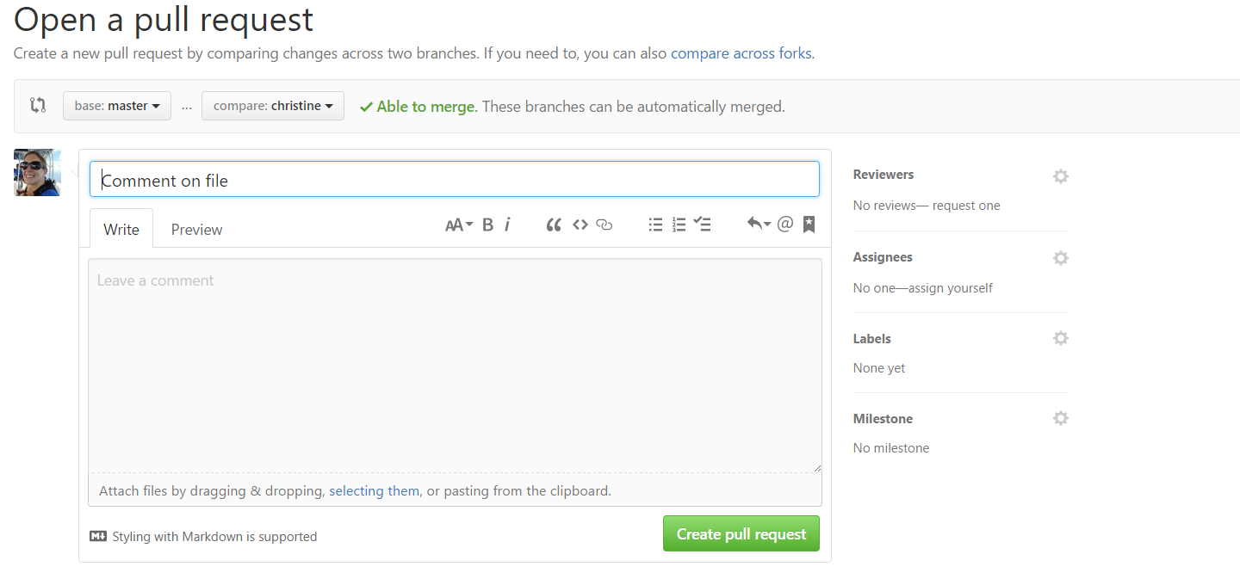
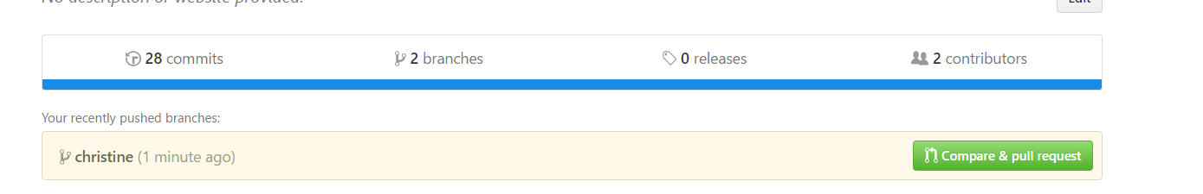
Creating a pull request
Write in some informative text!

Slide 35
Creating a pull request
Git will tell you if it can be auto-merged, and these drop downs allow you do to a diff!

Slide 36
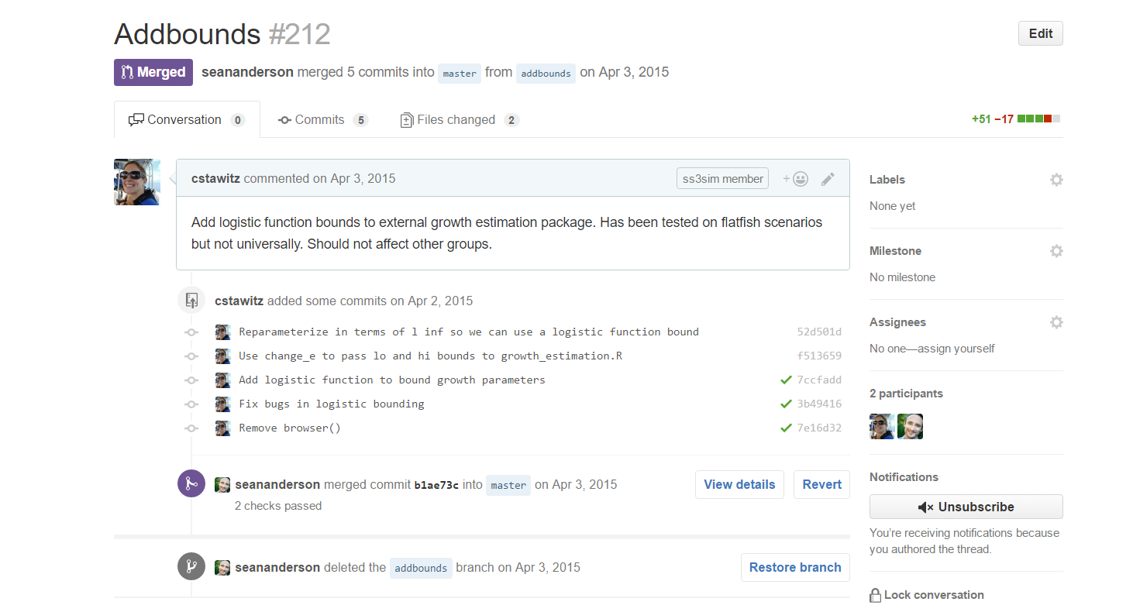

Slide 37
Issues
Method to track to-dos or bugs
You can assign to yourself or others
Create deadlines
Close when the issues are fixed!

Slide 38
Being an administrator
Protect branches
Provide issue and pull request templates
Enable auto-checks before merging
Create a CONTRIBUTING.md file that defines a workflow and other procedures

Slide 39

Advanced stuff!
Documentation, .Gitignore files, Rstudio integration

Slide 40
Git will auto-track everything in the directory!
Sometimes this is not optimal
Figures
Any output (.csv, .log)
To stop tracking certain types of files, a .gitignore file is useful
Tells git to ignore filenames matching any regular expression
..(you can also move or delete the file)

Slide 41

Creating a .gitignore file
On Windows:
create my.txt in your working directory
Rename it in the command line using “ren”
Edit in a standard .txt editor
On Mac terminal in your working directory:
touch .gitignore
defaults write com.apple.finder AppleShowAllFiles YES.
Edit in standard .txt editor

Slide 42
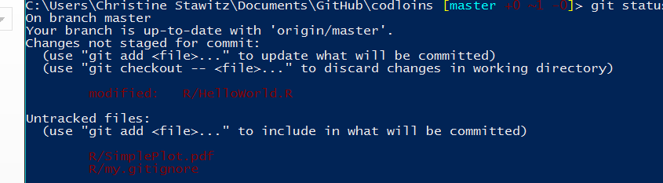
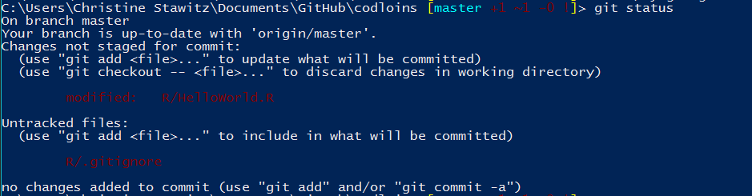
Voila!
After creating .gitignore:

Slide 43
Documentation
The sweet documentation you see on git repository homepages is created in Markdown
Git creates README.Rmd when you create a repository
Just edit that file and push the changes to create documentation
Or edit the file on the git website
If you want to get fancier (math, citations, figures) use Pandoc (http://pandoc.org/)

Slide 44
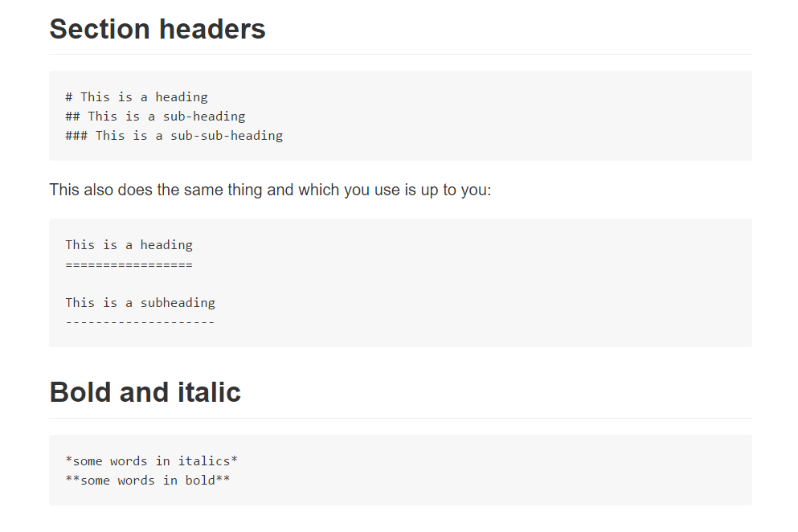
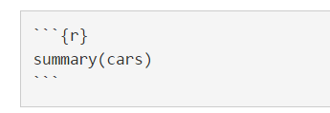
Markdown syntax
Code chunks

Slide 45
Installing from GitHub
The devtools R package allows you to install and update code directly from GitHub OR from a local folder

Slide 46
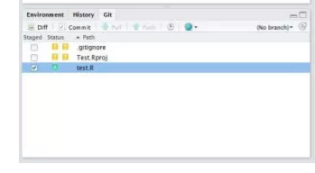
Rstudio integration
You can work directly with Git projects inside of Rstudio
More: https://www.r-bloggers.com/rstudio-and-github/

Slide 47
References
Ebook tutorial! https://git-scm.com/
Useful .gitignore files https://github.com/github/gitignore
Git guides: https://guides.github.com/

Slide 48

Merge conflicts
The only thing in Git that is hard
If you can bear it, you should probably just move a change out then re-copy it in rather than try to resolve conflicts
If you HAVE TO you can try to resolve

Slide 49
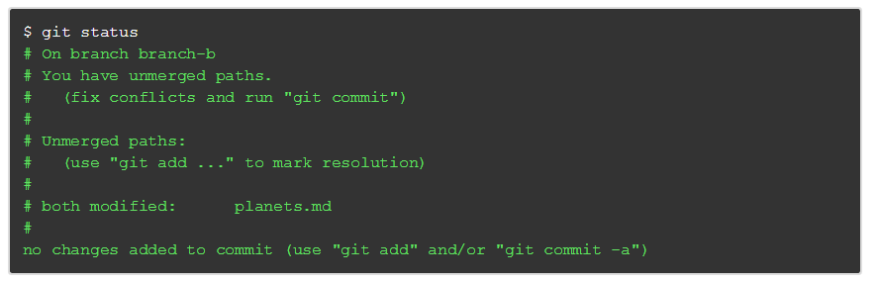
More merge conflicts
If a change you are trying to merge in directly conflicts with someone else’s (usually happens if you don’t fetch or pull)

Slide 50
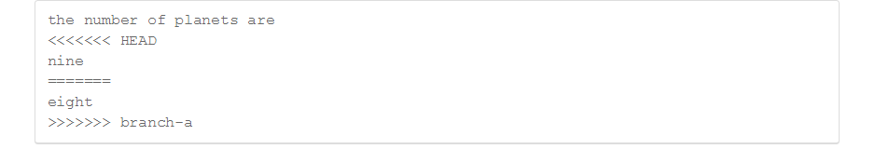
More merge conflicts
Git will create a local file which shows the conflict
Theoretically, you just fix the file and commit again, but it is rarely that easy

