Slide 1
Electronic Commerce and the Consumer
Chris Tham
Hewlett-Packard Australia
H

Slide 2
Agenda
The evolution of electronic commerce
New trends and development in electronic delivery
Future and shape of delivery system
The death of privacy?
How to avoid pitfalls
Implementation considerations

Slide 3
Evolution of Commercial
Use of the Internet
1994: Corporate presence
1995: Sales and marketing channel
1996: Target marketing
1997: Electronic commerce/banking
2000: New delivery channel?

Slide 4
Electronic Commerce
“Electronic commerce is a lot like teenage romance - everyone says they are doing it, but no one really is.”
Reality: three distinct segments
  EDI
  Intranet (expense/medical reimbursements, stock purchases)
  Selling goods and services

Slide 5
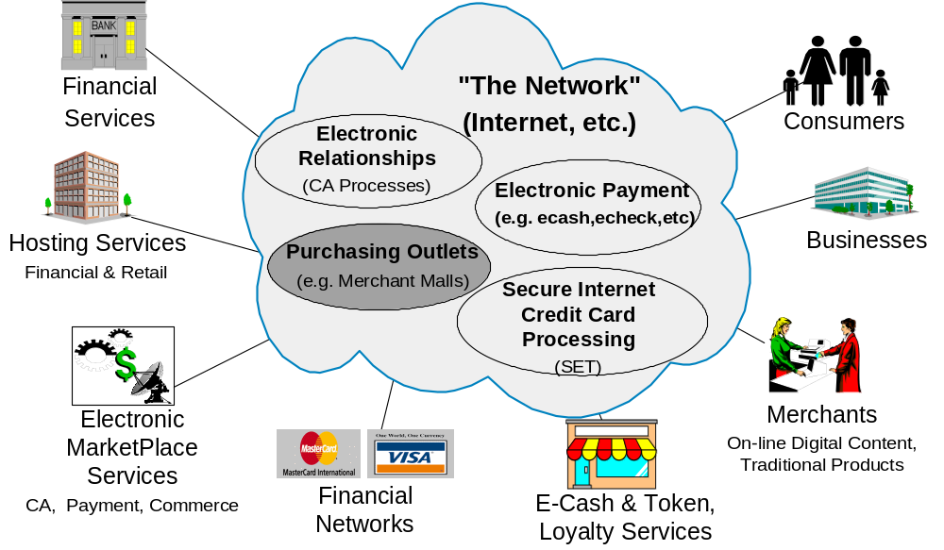
Evolving Electronic Marketplace

Slide 6
The Hesitant Electronic consumer
Driving force
  have less time, but want higher levels of service/interactivity
30% of online users have made electronic purchases (Dataquest 1995)
  but the percentage is not increasing rapidly
Tend to buy products suitable for online shopping
Top reason for holding back is usually fear of credit card security
  yet it is the most common method of electronic payment
Notes:
(e.g. books, CDs) that does not require ‘touch and feel’, low in transaction value and easy to ship

Slide 7
Implications for Financial Institutions
Consumers need a compelling reason for electronic commerce
  Save time / money
  Unique product / service / experience
  Customisation
  Reward for continual usage
Online Financial Services is promising ...
  60% of online users have done online banking
  Link with use of personal finance software
  Automation and better access to information
- Inteco (Spring 1996)

Slide 8
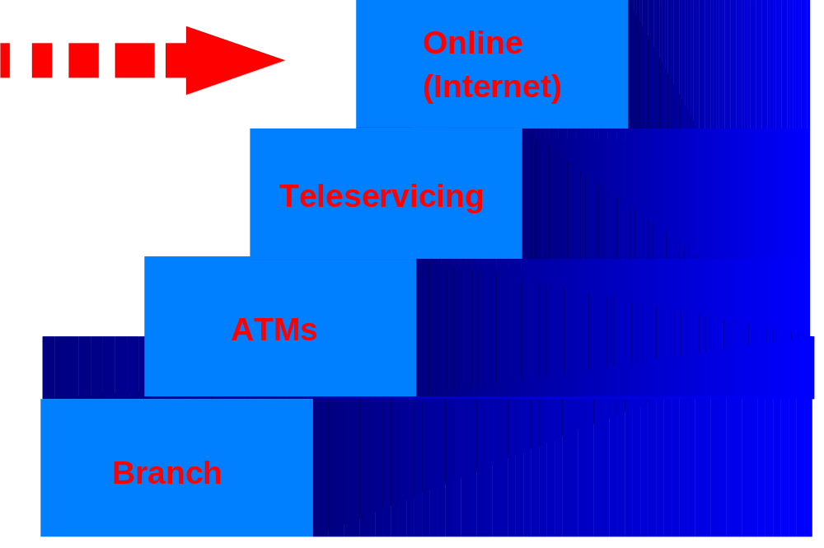
Implications for Financial Delivery Channels

Slide 9
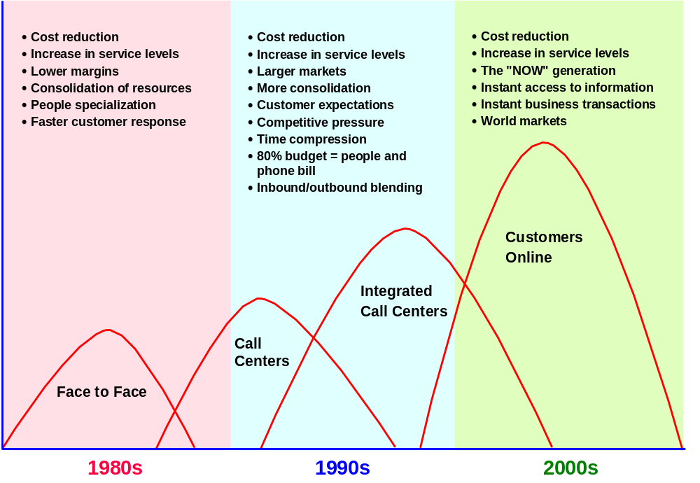
Driving Forces
Notes:
Non-Bank Competition, Rapid Channel Shift
Focus on Relationship Banking and Fee Generation
The Branch Office is the Workplace to Serve and to Sell
Shifting of Routine Transactions to Self-Service Delivery
Introduction of New Retail Products and Services
New Sales Tools and Information Support for Retail
Products and Services
Integrated Sales and Service Delivery
- a Common Interface to the Customer

Slide 10
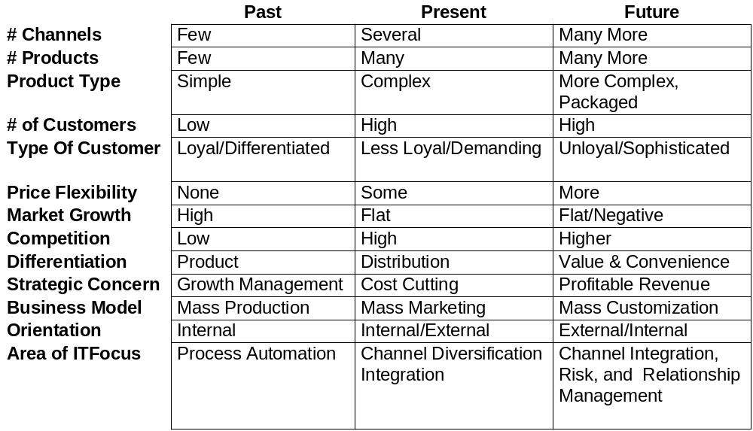
Trends in Financial Services

Slide 11
Supporting Statistics
Non-branch transactions > 50%
Non-branch activity growing at 15% per year
By the year 2000, US$46 billion will be mananged via self-service channels [Source: Tower Group]
Branch transaction costs are 50 times that of on-line banking [Source: Gartner Group]
By the year 2000, it is estimated that 150 million people will be Internet/Web users.
By 2005, over 75% of households will use on-line banking, and by 2010, over 95%.

Slide 12
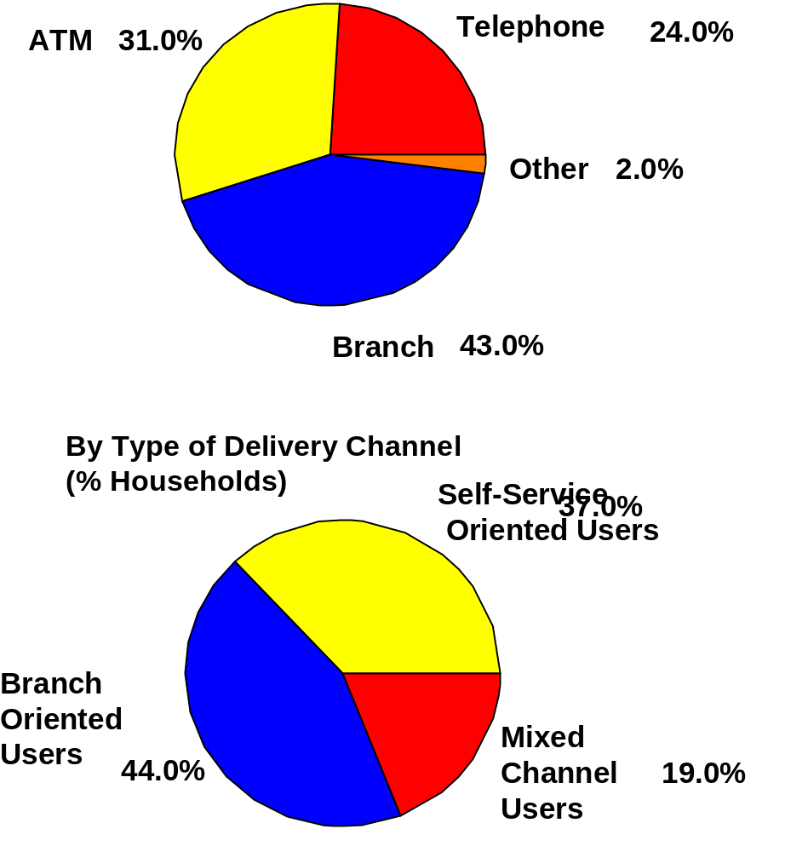
Retail Delivery Channel Usage

Slide 13
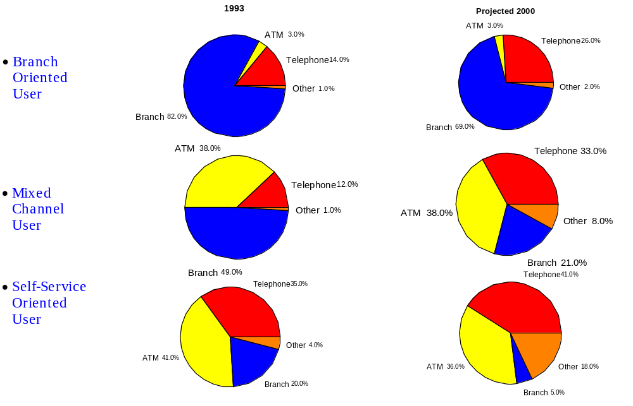
Trends in Delivery Channel Usage

Slide 14
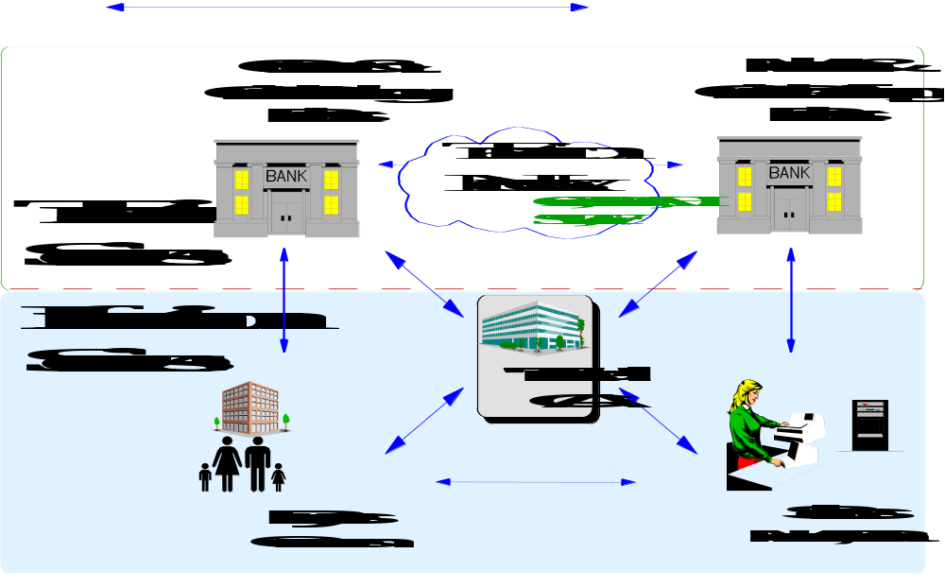
Electronic Marketplace Model

Slide 15
The Death of Privacy?
No national privacy law for private sector
Increasing capture of personal information from electronic commerce
Used for “profiling” and “segment of one” marketing

Slide 16
Australian Consumer
Attitudes to Privacy
Australians concerned about privacy
… Threatened by use of personal information captured on computers
… Want control over such information, and legislated safeguards
… Not sure how to protect against privacy
- Privacy Commissioner
- public polling 1990-1994

Slide 17
Define and Implement a
Privacy Policy
Disclose what is being collected & purpose of use
Ask for consent before using information
Allow user to view/modify information
Avoid ‘spamming’ (unsolicited emails and contacts)
Do not penalise users who want to be anonymous
Provide value back to user in exchange for collecting information
  “Thank you” gifts and special offers
  Customise information displayed based on preferences

Slide 18
How to Avoid Pitfalls
Lesson 1: You shouldn’t avoid pitfalls
  Better to be first (>40% market share) than locked out
  Be prepared to change quickly when things are not working
Have a valid business case and strategic focus
  Don’t do it just because everyone else is on the Internet
  Define target market, strategy and value proposition
Don’t ignore security, but don’t let it scare you
  Implement adequate security measures
  Develop mitigation strategies

Slide 19
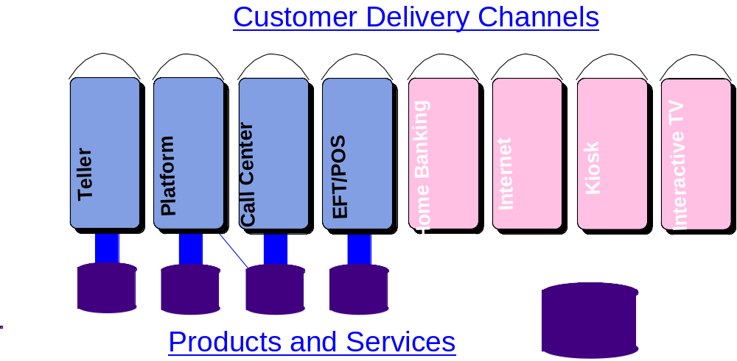
Challenge: How to Add New
Channels to IT Infrastructure

Slide 20
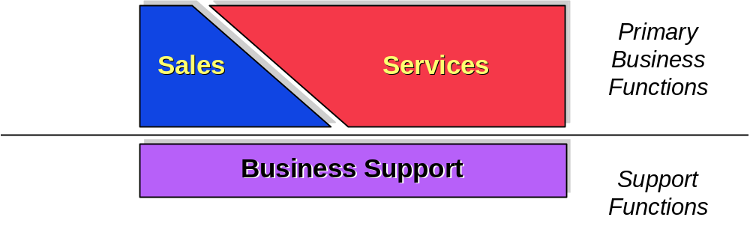
The (Obvious?) Solution
Re-deploy all the distribution channels around the two main business functions: Selling and servicing
Implement one single integrated IT infrastructure to enable and support both business functions
Isolate business support activities from primary business functions

Slide 21
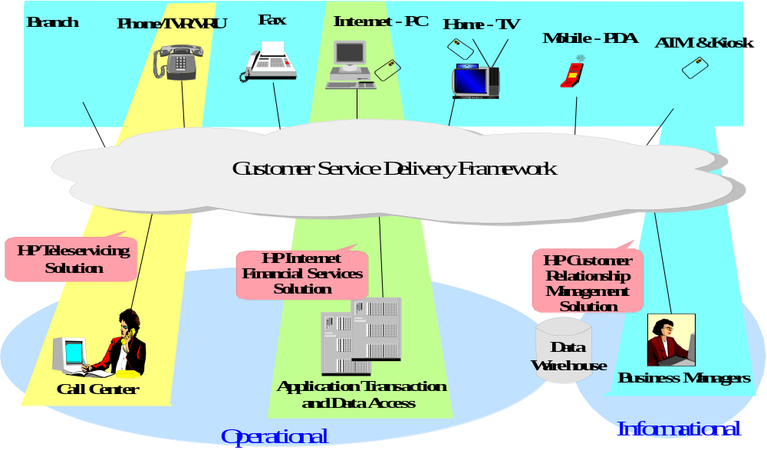
Any Customer, Any Product,
Any Channel, Any Time

Slide 22
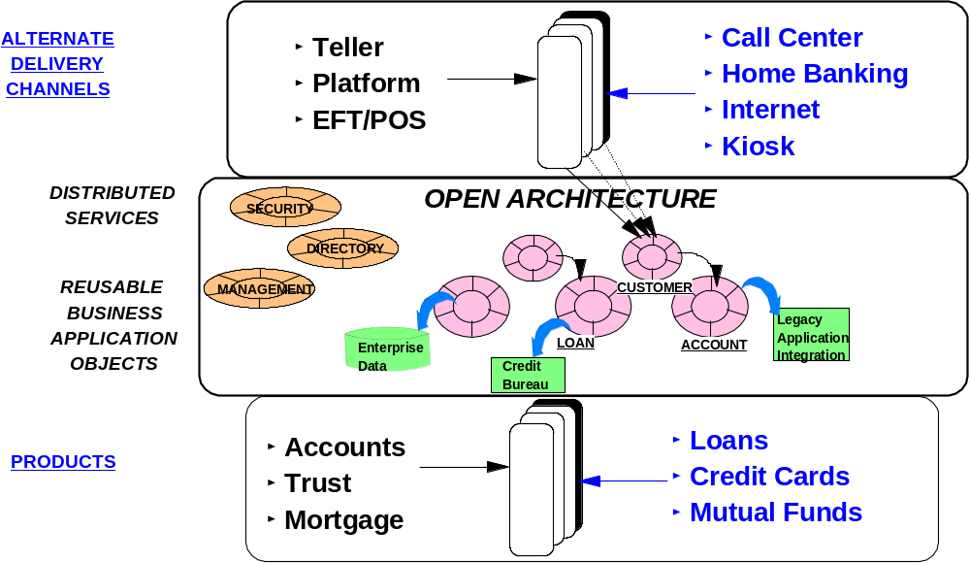
Customer Services
Delivery Framework

Slide 23
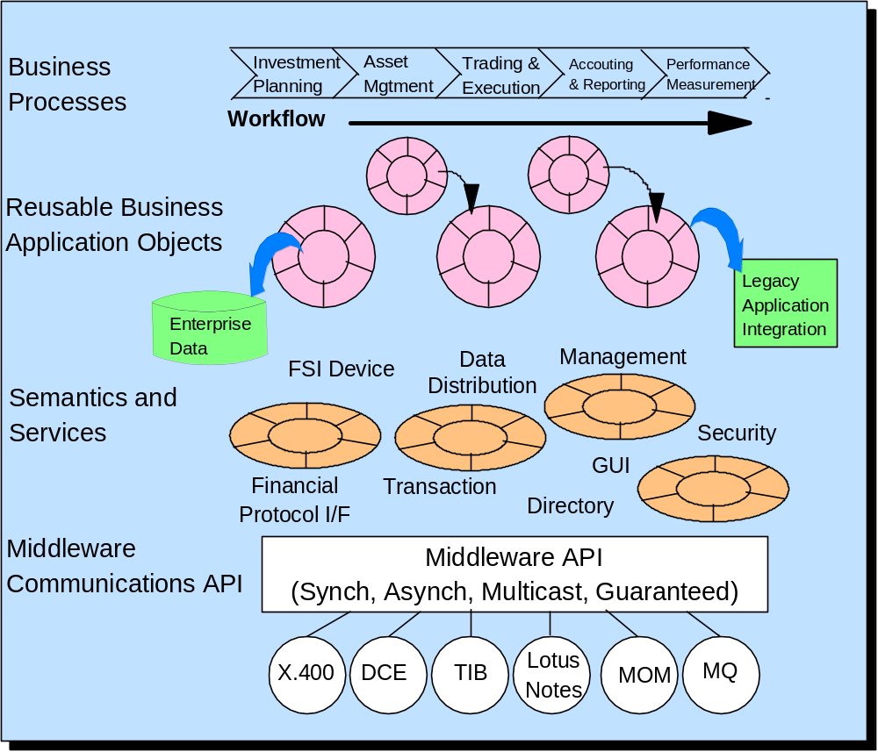
HP Financial Services
Framework Architecture

Slide 24
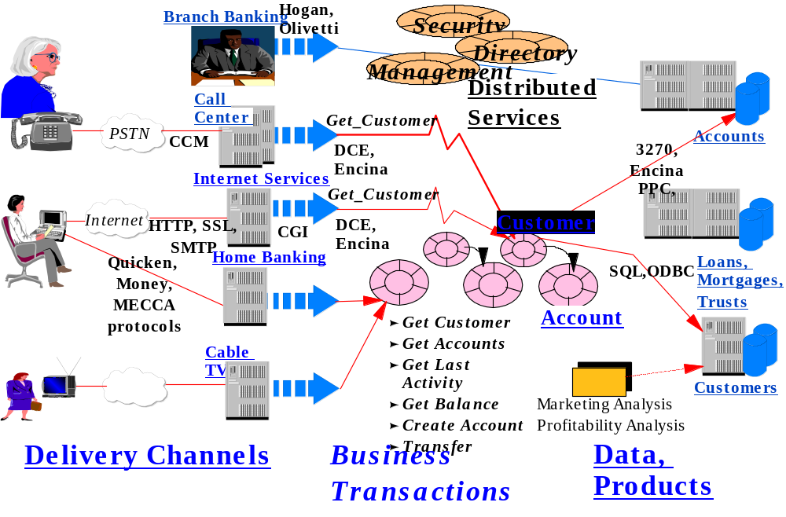
A Sample Implementation

Slide 25
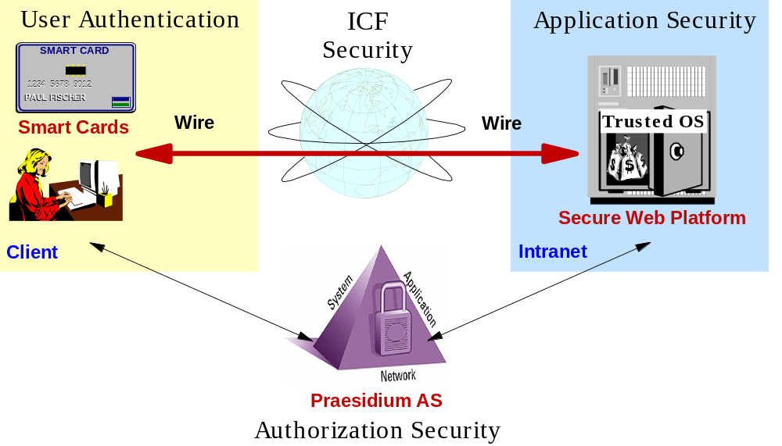
HP Internet Security Vision

Slide 26
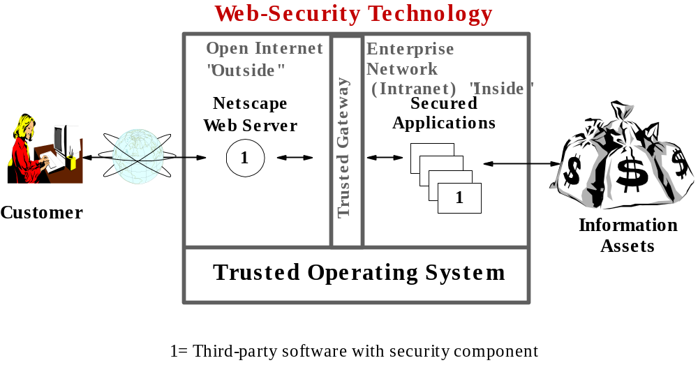
Web Security Technology

Slide 27
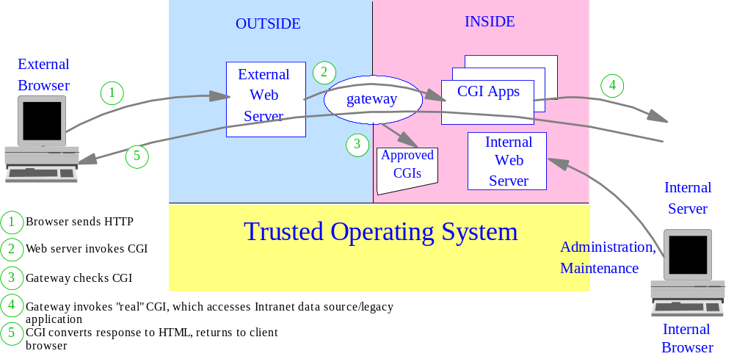
VirtualVault Security

