Slide 1
Getting technology right for advisers
Geoff Wenborn, CIO National Wealth Management

Slide 2
The National Group
Finance
Financial Services Australia
Financial Services
New Zealand
Financial Services
Europe
Corporate & Institutional Banking
National Wealth Management
Corporate Development
People & Culture
National Wealth Management has
5,500 Employees across
Australia, Europe, Asia and New Zealand
Risk Mgmt
National Technology
Notes:
As you are all probably aware, the National is a global business with a significant presence Australia, the United Kingdom and the Asia-Pacific region including New Zealand.
Key Points
Our Australian business is well developed
Asia business is small and developing within the region
UK - there is a fantastic growth opportunity
The National consists of 5 <Click> Corporate Centre Divisions - Finance, Corporate Development, People & Culture, Risk Management and National Technology
...and there are 5 Operating Divisions: <Click>
3 Retail Banking arms across regional lines in Australia, New Zealand and Europe
<Click>
and 2 global lines of business - Corporate & Institutional Banking and Wealth Management, where Wealth Management Technology operates.
National Wealth Management’s core services
Through our network of aligned self-employed, salaried and external financial advisers, we provide financial planning and quality advice services, wealth creation (investments, financial planning, private banking), wealth protection (insurance) and superannuation solutions to retail and corporate customers. We also provide corporate and institutional clients with outsourced investment, superannuation and employee benefit solutions.
In Australia, National Wealth Management offers a range of financial solutions under its two investment platforms, MLC MasterKey and MasterKey Custom (formerly FlexiPlan) as well as a complete range of Wealth Protection (insurance) solutions.
Next Slide (Click)

Slide 3
Overview of National Wealth Management
Broad portfolio of Financial Services across:
  Australia
  New Zealand
  Europe
  Asia
Products for Retail and Corporate customers:
  Financial planning & advice services
  Wealth creation (Investments, financial planning, private bank)
  Wealth Protection (Insurance)
  Succession solutions (Superannuation)
Products for Corporate and Institutional Customers:
  Outsourced investment
  Superannuation
  Employee benefit solutions
Created through the integration of:
  National’s financial service and funds management businesses
  MLC Group
Internationally, as at 31 March 2003, Wealth Management had over:
  2.8 million customers worldwide;
  $65.1 billion funds under management – for both retail and corporate customers;
  3,300 aligned and salaried advisers, in addition to external advisers who choose to partner with Wealth Management; and
  5,500 permanent employees

Slide 4
Building professional technology services in National Wealth Management
1994 , the MLC IT function outsourced to IBM GSA
1999 , MLC re-established strategy control and management of IT
  Architecture was seen as one of the key areas to be in sourced
Now in Business Technology
  More than 550 people, excluding our outsourced functions and external service providers
  Infrastructure largely outsourced
  Applications development done through a combination of internal resources and external partners

Slide 5




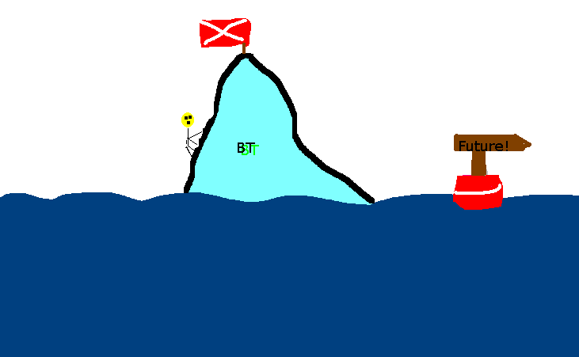
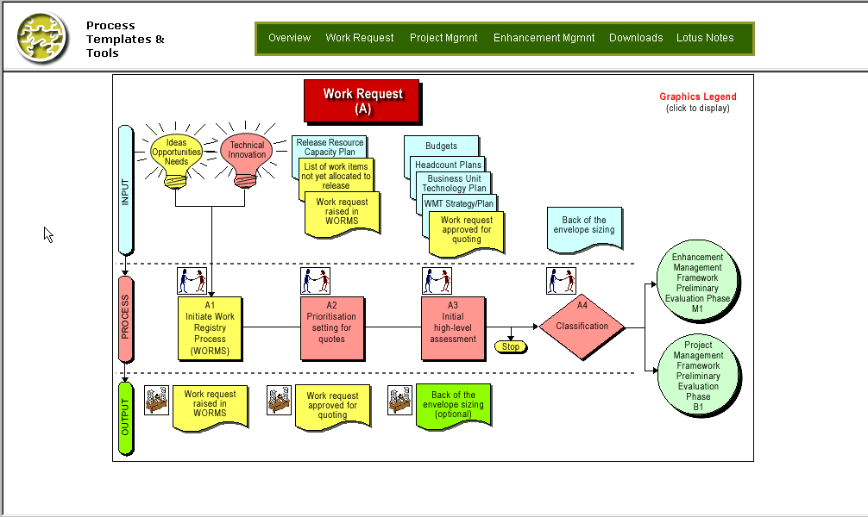



Our journey so far
Digging deeper
It’s the Journey of …
Continuous
Improvement
Innovation
& Leadership
Transforming
the iceberg
Standardisation
20%
each
Year
Operations
Focus
Refine
Process
BT
Operating
Model
Lessons Learned
Feedback
2000
2001
2002
2003
2004
2005
Notes:
Our technology team is a successful IT department with strong culture, process and practice that is highly regarded by many in our industry.
We are continually challenging ourselves to add more value to our business by improving our services and building on our relationships. While our goals and objectives are refined every year our focus continues to be on culture, operational efficiency, value adding, deepening relationships with our business and vendors, plus developing our business through innovation.
Next Slide (Click)

Slide 6


Our continual ‘stretch’
Cost, Effort
Value, Skills
Whilst our goals & objectives are refined every year, they focus on...
Vision: Partner of Choice
Culture
Operational
Efficiency
Value
Add
Relationships
Innovation
Getting more value from the same or less investment
Reducing the effort required for non-discretionary work
Doing more discretionary work from
the same pool of resources
Skills development
Efficiency improvement
Empowerment and growth
Releasing capability
Creating bandwidth
Notes:
Adding Value: One of our greatest challenges is to get more value from technology from the same or less investment. Each year we look to reduce our overall development costs while maintaining the same, or better, level of service. We also channel our expenditure towards activities that will significantly add value to our business.
Deepening relationships: We are continuely focused on extending our valued business relationships, by bringing technology closer to the business to have common ownership and shared goals. An integral role for BT is our Business Solutions Managers or BSMs. The BSM is a key relationship manager responsible working with the business and BT to align technology goals with the business' strategic direction. This way of working is key to our success.
We also foster relationships with a number of strategic IT vendors and consultants, generating value for the business through improved service quality and lower costs. (Click)
Developing culture through leadership and innovation: In BT we are developing our culture and helping our people realise their best potential. It's a fact that in successful companies, culture drives performance and through knowledge and experience our people are central to our future. For us leadership and innovation is a specific, deliberate and positive focus and we are looking at how to encourage leadership at all levels and implement creativity and innovation in the environment we work in everyday. We are also looking to add value to our business by providing innovative solutions through the deployment of emerging technologies.
Next Slide (Click)

Slide 7
So what makes technology in Wealth Management different?
Business relationship model
Culture
More to come - from the strategy

Slide 8
How does technology help drive our organisation's success?
Notes:
Next Slide (Click)

Slide 9
Like it or not this industry is under scrutiny
3 years of negative investment returns
ACA/ASIC survey + media attention
Senate Select Committee investigation
Regulators becoming more active - FSRA
On the “war path” IFSA, APRA, ASIC, ACA, FPA
Political lobbying re: Choice legislation
Notes:
Our industry is in the spotlight more than ever before.
Our Regulators are becoming more involved than ever in how we do business
Organisations such as APRA and ASIC are increasing their attention on us
And there is a significant amount of legislative change impacting our business
there has been something like 20,000 pages of legislation, regulations and policy statements reviewed by our business in the last 12 months
the introduction of FSRA, for example, has wide implications for our business
The media and consumers are becoming more and more vocal about issues such as:
the quality and independence of financial advice,
what organisations such as ours are doing to protect customers savings

Slide 10
Wealth Management’s strategic intent
“To be a leading international financial services company which is trusted by you and renowned for getting it right.”
Leveraging our
core capabilities into
selected international
markets
Leading the evolution towards holistic advice
Leading the evolution towards holistic advice
Delivering an
Integrated
Financial Services
experience for
our customers
How will we do this?
Notes:
In National Wealth Management we are clear on our strategic intent. We aim to be a leading financial services company which is trusted by you and renowned for getting it right. (Click) and we are looking to achieve this by:
Leading the evolution towards holistic advice in Australia; (Click)
Delivering an Integrated Financial Services experience for our customers; and (Click)
Leveraging our core capabilities into selected international markets.
In Australia Wealth Management has a major focus on holistic advice. (Click) Today we will be talking about how we as a business are planning to achieve this and how technology will enable us.
Next Slide (Click)

Slide 11

The [trend] to holistic advice
Industry Now
Industry Future
Holistic Financial Planning
> Holistic advice means delivering appropriate financial solutions to clients depending on their current needs and goals
< 5%
40%+
20%
Strategic Advice
35%
35%
Investment Advice
20%
Product Recommendations
40%+
< 5%
Notes:
Over the last few years, more and more advisers have started to deliver holistic advise. So what is holistic advice? Holistic advice means delivering appropriate financial solutions to clients depending on their current needs and goals.
Holistic Financial Planning is about
Focussing on your clients goals & aspirations
Using integrated financial services to achieve depth of strategy
Long-term relationships
and results in a more consistent, meaningful and satisfying experience for clients throughout their lifetime.
Next Slide (Click)

Slide 12




Our enterprise goal is to be the preferred business partner for quality advice practices
Business Partner and Outsourcing Provider - ‘B2B’
integrated financial solutions
practice management
A complete and integrated business system where each component is market competitive and sustainable in the long term
dealership infrastructure
business platforms
Sets us apart from our competitors who only offer some parts
Enhancing the Adviser to Client Experience - ‘A2C’
COOL
COOL
COOL
COOL
COOL
COOL
Focused on improving our business system to support advisers in the delivery of an enhanced Adviser to Client Experience
Prospecting
1st Appointment
Plan Preparation
Implementation
Client Review
Ongoing Service
Everything we do helps advisers deliver better client outcomes
Move towards Holistic Financial Planning model - ‘HFP’
Strategy
Planner
Building and integrating our business system to lead the evolution to holistic financial planning
Our unique and market leading value proposition
Notes:
To compete in the future, advisers will need to provide quality advice to meet the increasingly sophisticated needs of clients and deliver a complete range of financial planning solutions.
Our Enterprise medium-term Vision is to be the preferred business partner for quality advice practices and there are three overarching themes or areas that we will focus on as a whole business to achieve this vision - The target business system, the ‘adviser to client’ process and the Holistic Financial Planning model.
The target business system is the proposition that we offer to advisers -a proposition which sets us apart from our competitors. Our advantage is the completeness of this system where most competitors only offer some parts. So, we encourage advisers to utilise each of these components to extract the most value out of their relationship with MLC.
The ‘adviser to client’ experience (A2C) - this is the identified six-step process that an adviser goes through in dealings with their clients. We need to ensure that as their business partner, we are supporting them with tools and efficient service at every step.
Holistic Financial Planning - is the future of the industry, where the market is heading. It is a new way for advisers to provide service to their clients, that focuses on lifestyle goals and addresses the full range of clients financial needs. We have the opportunity to lead the market and evolve this model - to really bring it to life for our advisers.

Slide 13
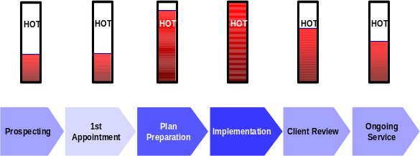
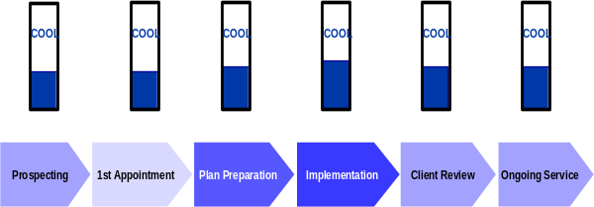
We are committed to delivering continued improvements
Enhance the pieces and improve the integration of our target business system
integrated financial solutions
practice management
business platforms
dealership infrastructure
Enhance the “Adviser to Client Experience” and address current ‘hotspots’
Evolve the Holistic Financial Planning Advice model
Strategy
Planner
Strategy
Planner
Notes:
So, the journey we are taking over the next few years is to enhance the pieces of the target business system and improve their integration, so that we can present a seamless offer to the adviser market.
We want to enhance the ‘adviser to client’ experience and make that process as seamless as possible, with a more immediate focus on addressing the hotspots advisers have identified around plan preparation, implementation and review.
And thirdly, to evolve the HFP model and bring it to life for advisers, making sure we can support this advice model as a business and to fill in any existing gaps.

Slide 14
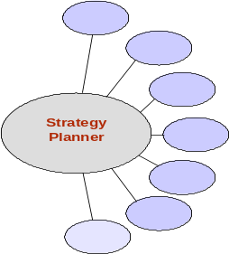



Business Partner & Outsourcing Provider
WM goal
Move towards Holistic Financial Planning model
“To be the preferred business partner for quality advice practices”
Enhancing the ‘Adviser to Client Experience’
Prospecting
1st
Plan
Implementation
Client Review
Ongoing
Appointment
Preparation
Service
Adviser
Client(s)
Integrated financial planning tools for advisers
Strategic Advice Platform
Market competitive investment offer
Enhanced Investment Offer
Adviser force supported by motivated and skilled WM People
Foundations
Journey
Robust and secure supporting technology infrastructure
Common Technology Enablers
Consolidated and comprehensive adviser and client information
WM People
Notes:
Next Slide (Click)
Advisers who are moving towards the holistic model want to partner with a business that can provide not only a complete and integrated range of financial solutions (across investments, insurance and bank/lending solutions), but that also provides robust business platforms so they can outsource things like administration, reporting and even portfolio management and spend their time on strategy.
That really only touches on two of the areas where WM helps advisers, by providing outsourcing solutions through our business platforms and providing integrated financial solutions to enable advisers to offer an holistic solution to their clients. Using the business platforms frees up the adviser’s time to deliver the integrated solutions.
We also help advisers in the area of practice management. Our practice developers and dealership managers are like business coaches to advisers, helping them to grow and manage successful and profitable financial planning practices.
Advisers can also access the resources and expertise of our multi-branded dealership infrastructure - for example Garvan, Apogee, Godfrey Pembroke, MLCPCS and the National. This gives advisers access to technical, compliance, para-planning and marketing resources, and once again makes it easier for advisers to offer holistic advice to their clients.
As you can see from the diagram, WM helps advisers to provide holistic financial planning advice in four integrated ways. We’re offering a greater suite of advice services to advisers and their clients. We’re positioning ourselves as the adviser’s business and outsourcing partner and we’re helping them to re-engineer their businesses in line with our platforms and solutions. When we combine all those things, we think this model opens up all kinds of opportunities to generate revenue for Wealth Management.

Slide 15
A positive impact on the key drivers of WM performance
Four core work areas delivering a collection of interdependent projects
Impacting key performance drivers
Adviser productivity
Number of advisers
% of adviser’s business on our Platforms
Business retention
Impact on expenses
Prospecting
1st
Plan
Implementation
Client Review
Ongoing
Appointment
Preparation
Service
Adviser
Client(s)
SHAPE
Journey
Enhanced Investment Offer
Foundations:
Single Adviser/
Client View
Holistic Reporting
Common Technology Enablers
WM People
Notes:
Over 2-3 years our business has consolidated a major investment into a program of work, we have collectively called Amazon. we will have a positive impact on the key value drivers for the business. We are aiming to:
Increase the productivity of advisers - the more clients they see, the more business they can write.
Increase adviser attraction and retention - keeping the advisers we do have, satisfied, and attracting more to partner with us.
Increase the amount of business they place on our platforms - and the only way to do that is by making the platforms as attractive as possible through efficient processes and value for money.
In National Wealth Management we are helping our advisers to provide holistic advice and we are supporting them in the journey along the entire adviser-to-client process by providing efficient lifestyle goal based customer facing, modelling and plan preparation tools, investment flexibility / transparent, simpler and more competitive pricing and single point access to consolidated client information
In Technology we are playing a key role to help our advisers by providing the technology enablers, supporting infrastructure and people to develop the necessary applications and solutions.
Talk about the projects -
Example: Foundations - AKM
Managing adviser relationships is paramount to our business. Mid this year we launched our adviser relationship management system, which is used by our adviser facing people to help develop and support relationships with our advisers.
The technology tool enables a single consolidated view of our adviser information, amalgamating five different systems.
The development of this system has seen the first step in the strategic implementation of Siebel technology, and a journey to achieving consolidated adviser and customer information.
Next Slide (Click)

Slide 16

Our new Advice Platform - Adviser Central
Financial planning tools to assist our advisers to:
  capture their clients details
  carry out lifestyle modelling
  conduct client reviews
  write financial plans
  select products
Notes:
Our new Advice Platform - Adviser Central will be central to an adviser business - from advice provision through to managing their business, providing a one stop shop of solutions central in the role advisers play with their clients.
The Advice Platform will provide core financial planning tools to assist our advisers capture their clients details, write financial plans, select products, conduct client reviews and carry out lifestyle modelling.
To achieve this we need to extend the capability to receive information from MLC over the internet - like client transactions, new and amended financial planning templates and share and fund prices. The desktop application is currently being built in VB net, J2EE and web services and is due to be launched in mid 2004.
Adviser Central will be built around the …..
Adviser Veneer will provide a single point of access to Wealth Management financial planning support; aligned to an Adviser to Client business process and easy access to non-platform tools.
Financial Planning Tool(s) will be the single source of truth for basic client data, provide strategy modelling capability and access to calculators to support strategy development.
Planning tools will support LifeStyle Goals based Holistic Financial Planning. Output will transfer to Financial Planning Tool to support Financial Plan and Progress Reports preparation.
Chassis will provide information exchange between the Financial Planning Tool(s) and other planning tools (horizontal integration). Fund data and transactions will be provided through chassis (vertical integration).
Next Slide (Click)

Slide 17
Transitioning our salaried advice channels
Streamline the NAFP financial planning process for customers of the Bank
Move to the holistic advice model
Offer Lifestyle financial planning
More to come
Notes:
In line with our journey towards holistic financial planning advice, WM also introduced a new financial planning model for our salaried advice channels and the National’s customers. The new model focuses on delivering advice through our Lifestyle Financial Planning process.
The overall intent of Lifestyle Financial Planning is to create holistic advice outcomes for customers and meet their long term lifestyle aspirations.
A transition to this advice model in the National Australia Financial Planning - Personal (NAFP-P) channel was completed in the June 2003 quarter. The aim of this project was to provide a solid platform to build a world class, holistic advice based financial planning business.
This project included the integration of the NAFP and the National Private Client Services channel, the creation of a new business model based on the provision of advice, clarification of roles and responsibilities and the clear segmentation of client servicing for the financial planners in the integrated channel.
Further, instead of single, transaction based client relationships, the financial planners are focused on providing ongoing service and encouraged to write more fee for service business.
Establish a more deliberate management of client referrals from Bank's customer base
The T2A project for NAFP-Personal (in PFS) has completed - some technology work is still underway. The T2A project for NAFP-Business (in BFS) is well underway.
Not just integrating technology, but getting the right tools to suit the business model
Using integrated tools - CRM and lead generation

