Slide 1

树之 习题选讲
浙江大学 陈 越

Slide 2
Tree Traversals Again

Slide 3
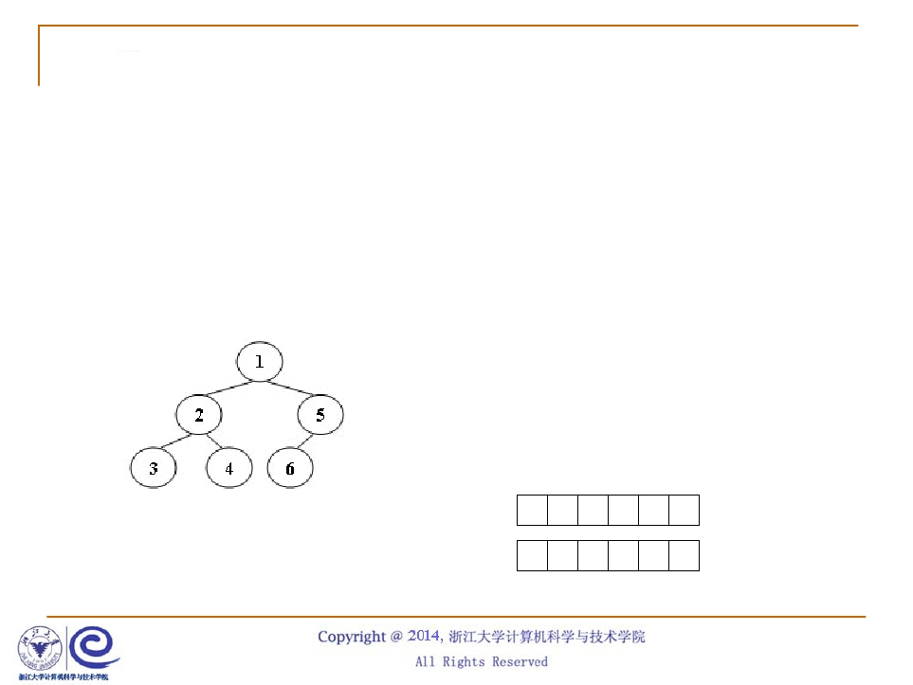
题意理解
■
非递归中序遍历
❑ Push的顺序为先序遍历
Sample Input:
6
Push 1
Push 2
❑
Pop的顺序给出中序遍历
Push
Pop
3
Pop
Push
Pop
Pop
Push
Push
4
5
6
Pop
Pop
pre 1 2 3 4 5 6
in 3 2 4 1 6 5

Slide 4
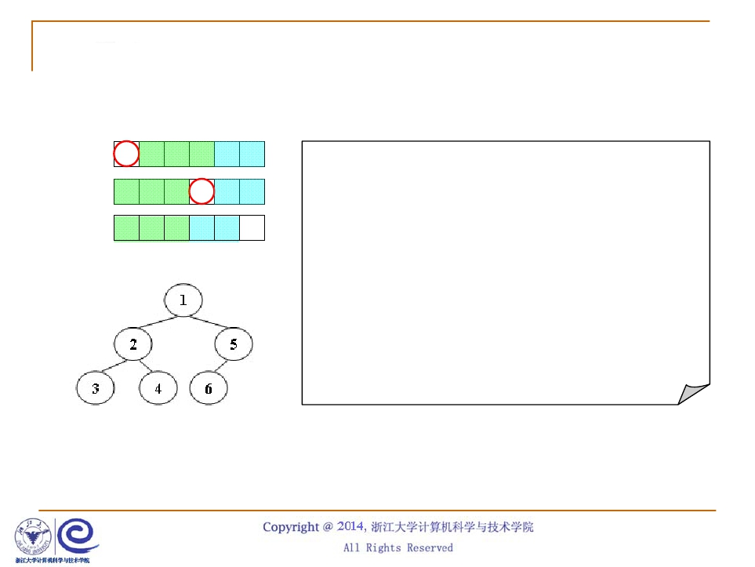
核心算法
pre 1 2 3 4 5 6
void solve( int preL, int inL, int postL, int n )
in 3 2 4 1 6 5
post 3 4 2 6 5 1
{
if (n==0) return;
if (n==1) {post[postL] = pre[preL]; return;}
root = pre[preL];
post[postL+n-1] = root;
for (i=0; i<n; i++)
if (in[inL+i] == root) break;
L = i; R = n-L-1;
solve(preL+1, inL, postL, L);
solve(preL+L+1, inL+L+1, postL+L, R);
}

