Slide 1

第六讲 图（上）
浙江大学 陈 越

Slide 2

6.3 应用实例：拯救

Slide 3
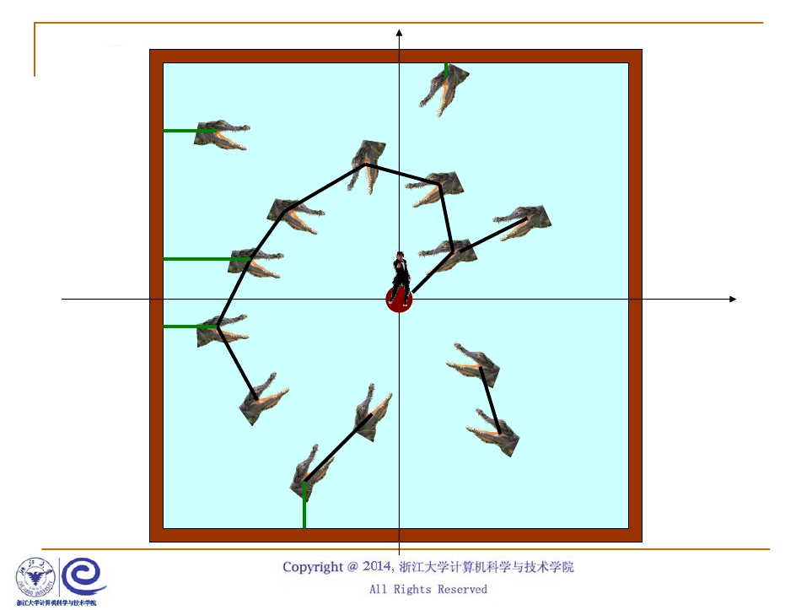
(-50,50)
(-50,-50)
(50,50)
(50,-50)
(0,0)

Slide 4
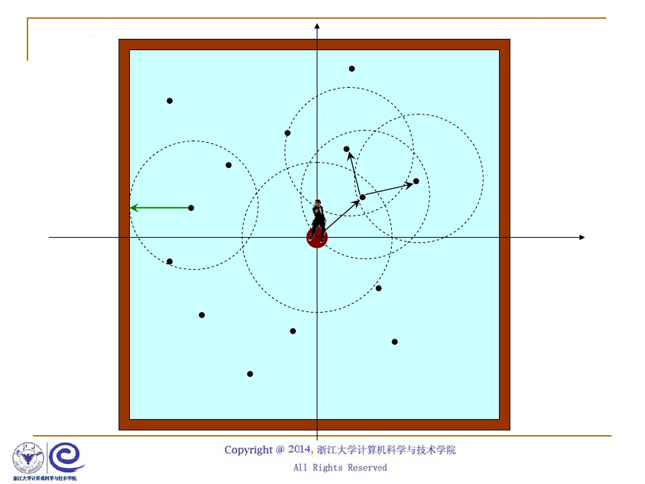
(-50,50)
(-50,-50)
(50,50)
(50,-50)
(0,0)

Slide 5

总体算法
void ListComponents ( Graph G )
{ for ( each V in G )
if ( !visited[V] ) {
DFS( V );
}
}
void Save007 ( Graph G )
{ for ( each V in G ) {
if (!visited[V] && FirstJump(V)) {
answer = DFS( V );
if (answer==YES) break;
}
}
if (answer==YES) output(“Yes”);
else output(“No”);
}

Slide 6

DFS算法
void DFS ( Vertex V )
{ visited[V] = true;
for ( V 的每个邻接点 W )
if ( !visited[W] )
DFS(W);
}
int DFS ( Vertex V )
{ visited[V] = true;
if ( IsSafe(V) ) answer = YES;
else {
V 的 W G in
for ( each 每个邻接点)W )
if (!visited[W] && Jump(V,W)) {
) {
answer = DFS(W);
if (answer==YES) break;
}
}
return answer;
}

