Slide 1
Design and Implementation of a water leakage sensor node and data analytics platform

Slide 2
Outline
Background of Project
Problem Statement
Objectives
Project Significance
Review of related works
Methodology & Project Design
Simulations & Prototype Presentation

Slide 3
Background of Project
1

Slide 4
“ A drop of water is worth more than a sack of gold to a thirsty man.”

Slide 5
70%
Of the Earth’s surface is covered by water
2.5% only
Is used for consumption, agricultural and industrial purposes
Water is fast depleting
Due to population growth, increase in agricultural irrigation, pollution and water loss due to leaks

Slide 6
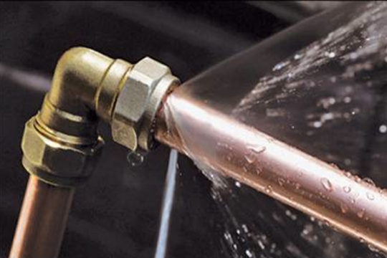
Water Leaks
A major challenge faced by many water utilities.

Slide 7
Problem Statement

Slide 8
Economic loss due to cost of water treatment and transportation
Wastage of money and precious natural resources
Inflation of water utility production cost
EFFECTS
Pollution through leak point
Damage to roads
Reduction in lifespan of pipes
Sinkholes
PROBLEM
LOSS IN REVENUE DUE TO WATER LOSS THROUGH LEAKAGES
Aging pipes, accidental damages
Fluctuations in water pressure
CAUSES
Late detection of water leakages

Slide 9
3,300,000,000
Litres of water are lost every single day due to leaks

Slide 10
Objectives

Slide 11
Objectives
General
To minimise cost in production and distribution of water due to leaks in water distribution networks.
Specific
To design a sensor node to monitor and analyse water pressures in pipelines and detect water leakages.
Detect and predict anomalies in water pressures and leakages in pipelines in real time.
Design a data analytics platform for viewing and analysing pressure data.

Slide 12
Project Significance

Slide 13
Project Significance
Pressure Management
Reduction in amount of leakage to help meet water conservation targets through pressure management.
Leak Run Times
Reduction in leak run times – awareness time, location time and repair time.
Reliability of Supply
Improvement in the reliability and continuity of supply by reducing pipe breaks.
Lifespan of pipes
Extending the life of water supply pipes and assets.
Pressure Fluctuations
Reduction in pressure fluctuations to achieve more consistent water pressure.

Slide 14
$2.9 billion
90 million people
Less than 20%
Can be generated in cash annually by reducing water loss
Can be served without additional investment
Ideal percentage of NRW

Slide 15
Review of related works
Authors | Existing Literature | Contributions | Weaknesses
Bubaker Shakmak et al | Infrared Camera Water Sensing Solution | Accurate leakage detection with minimal labour | Leakage detection is not real-time Method is expensive
Abdullah Kadri et al | Acoustic Method Solution | Cheap method of detection | Can’t detect large leaks Method fails in noisy environment
A. Agathokleous et al | Real time Monitoring of Water Distribution Networks | The exact point of leakage could be determined. | Soil moisture sensors were not a reliable choice
Shailesh Porwal et al. | Detection and prediction using SVM | Ability to make leak predictions | No remote access to data

Slide 16
Methodology & Project Design
Read pressures through sensors
Transmit to base station
Display readings
Run analytics, view trends & predictions

Slide 17
Hardware Diagrams

Slide 18
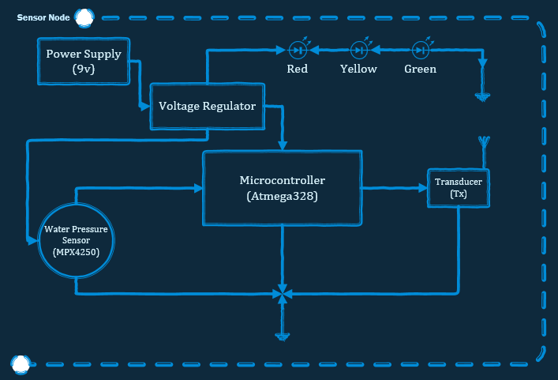
Sensor Node

Slide 19
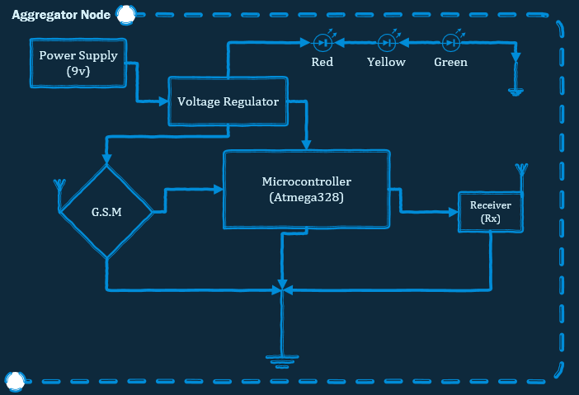
Base Station Node

Slide 20
Software Diagrams

Slide 21
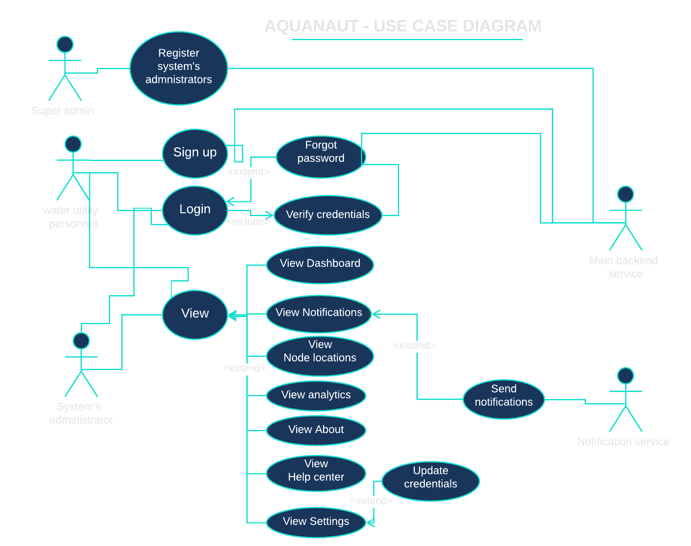

Slide 22
Thanks!
Any questions?

