Slide 1
ELECTRONIC TOLL COLLECTION
KWAME NKRUMAH UNIVERSITY OF SCIENCE AND TECHNOLOGY
Supervisor:
Dipl. Ing Benjamin Kommey
Project Members:
Abeka Ama Tabitha
Acquaye Christabel

Slide 2
PRESENTATION OUTLINE
INTRODUCTION
LITERATURE REVIEW
SYSTEM ARCHITECTURE
BLOCK DIAGRAM
PROJECT TIMELINE
CONCLUSION

Slide 3
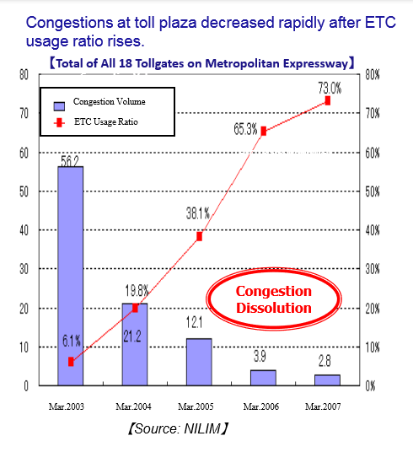
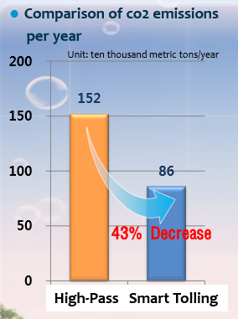
INTRODUCTION

Slide 4
OBJECTIVES
Ensure accountability on toll roads.

Slide 5
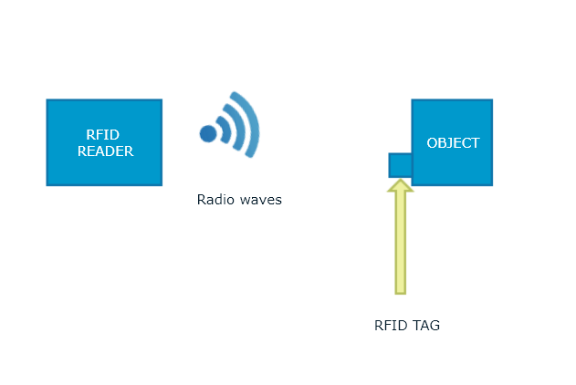
LITERATURE REVIEW: Toll Collection in United States of America
Harris County Toll Road Authority (EZ Tag) in Houston.
Open tolling developed in the late 2003.
RFID technology used.
FLAWS:
Interference with tag
Costly implementation and enforcement
Specified range communication only.
Damaged tags cannot be tracked and replaced.

Slide 6
LITERATURE REVIEW: Toll Collection in Germany
Toll Collect for trucks on highways.
Open Tolling developed in September 2002 but used in January 1, 2005.
Odometer and GPS used.
Payment in three forms: Pre booking, Terminal Payment, Using Web site
FLAWS:
High Cost of OBU ($350)
Interference when signal is lost
Issues with user privacy
Using defective devices

Slide 7
LITERATURE REVIEW: Toll Collection in England
DartCharge by UK Government
Open tolling Introduced in November 2014
Automatic Number Plate Recognition System Used.
Payment: Online Payment, Phone advance before or by midnight.
FLAWS:
Poor image resolution
Poor lightening and contrast
Blurry images

Slide 8
LITERATURE REVIEW: Toll Collection in South Africa
South Africa Roads Agency Sanral.
Developed in 2014 on selected roads.
Boom Down ETC (eTag used)
Open Road Tolling (No stopping with OCR)
FLAWS:
High Cost
Interference when signal is lost
Issues with user privacy
Using defective devices

Slide 9
LITERATURE REVIEW: Toll Collection in Japan
ETC began in March 2001, Mitsubishi Heavy Industries, LTD
5.8 GHz Active Technology
System:
FLAWS:
In-Vehicle Devices
Roadside Equipment
High Cost
In effective post payment option

Slide 10
LITERATURE REVIEW: Toll Collection in India
Passive RFID called FASTag with linked prepaid account.
Working Principle:
FLAWS:
Vehicle Identification
Vehicle Classification
Transaction Processing
Violation Handling
High Cost of tag
Vehicle Separation
Delay

Slide 11
LITERATURE REVIEW: Toll Collection in Australia
eTag System used on all tollways
Based on RFID transponders using DSRC technology
Smart Card
On Board Unit and ANPR for enforcement
Technology : Active DSRC 5.8GHz
FLAWS:
Users can avoid payment
Initial implementation cost

Slide 12
LITERATURE REVIEW: Toll Collection in Poland
OBU’s on vehicles eligible to be tolled
Control system based on:
Built on DSRC and free flowing in nature
Mobile App in November 23, 2015 for both IOS and Android.
FLAWS:
Laser scanning profiling
Automatic Number Plate Recognition

Slide 13
LITERATURE REVIEW: Toll Collection in Czech Republic
Myto CZ on highways and motorways.
Operational since January 1, 2007.
Microwave (DSRC Technology) allows for Multilane free flow.
Working Principle
FLAWS
Vehicle Detection
DSRC communication
Manual validation Center
Image Generation
Classification

Slide 14
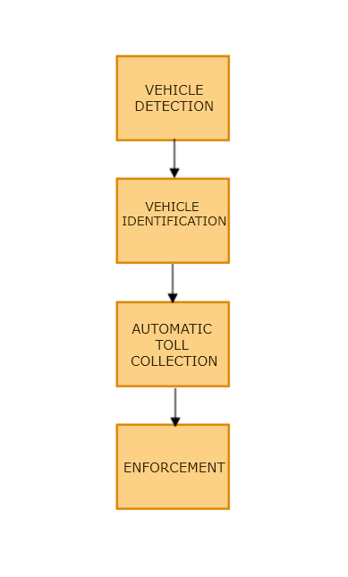
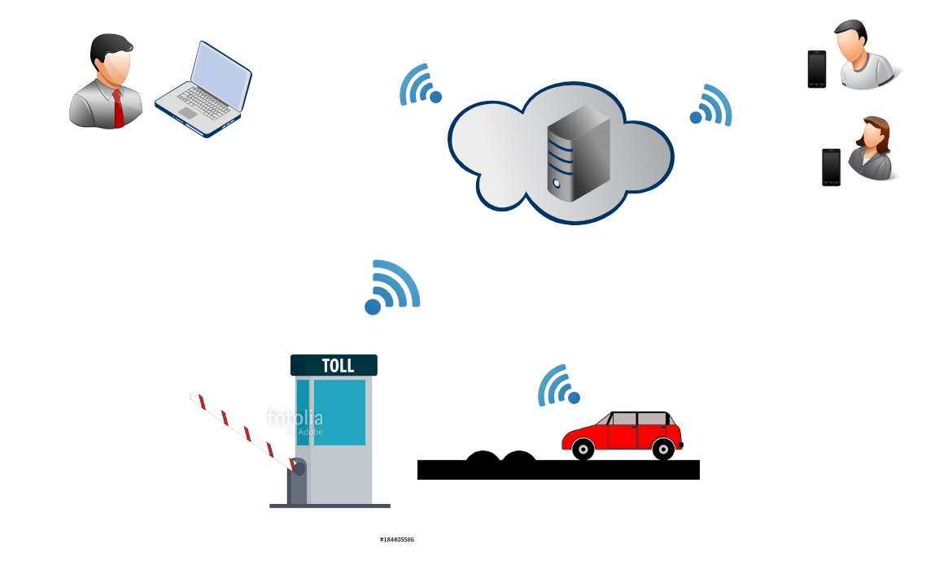
SYSTEM ARCHITECTURE

Slide 15
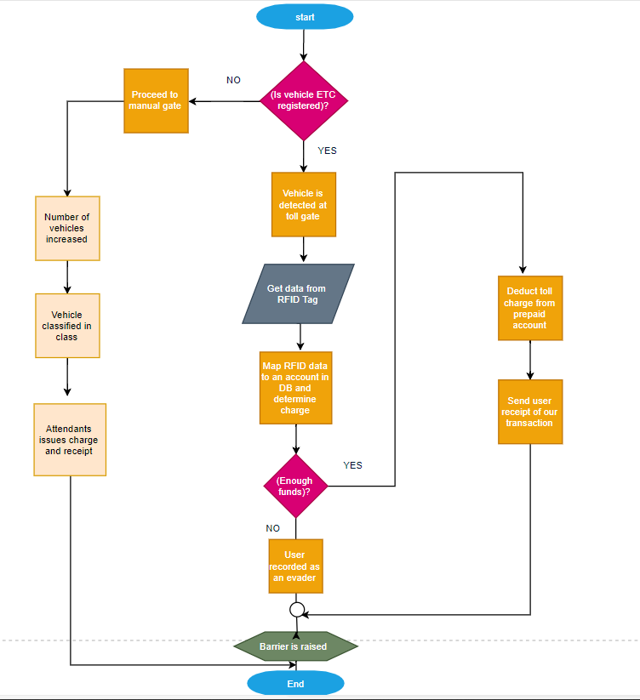
FLOWCHART DIAGRAM

Slide 16
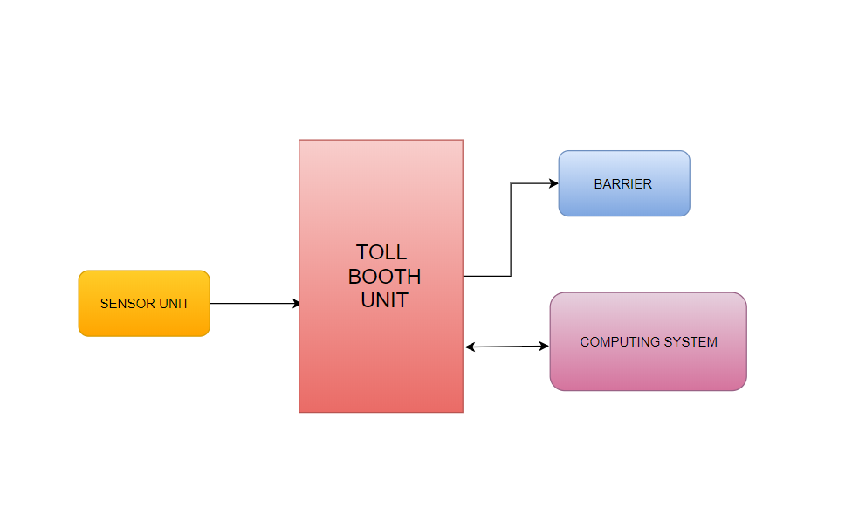
FLOWCHART DIAGRAM

Slide 17
PROJECT TIMELINES

Slide 18
THANK YOU
Any Questions?

