Slide 1

ELDERSHIELD
Know the risk
before you respond
A simple way to check suspicious messages,
understand the warning signs, and choose a safe next step.
HACKATHON PROJECT | TRUSTLENS · PROBLEM STATEMENT 03
Notes:
ElderShield is our entry for TrustLens, Problem Statement 03 in the PARALLAX hackathon brochure. The brief asks for a defensive assistant that assesses suspicious messages or identity claims, explains risk signals, and recommends safe verification steps. Photo source: https://www.mcmastervieillissementoptimal.org/blog/detail/blog/2021/04/14/l-isolement-social-la-technologie-au-service-de-notre-bien-%C3%AAtre-mental

Slide 2

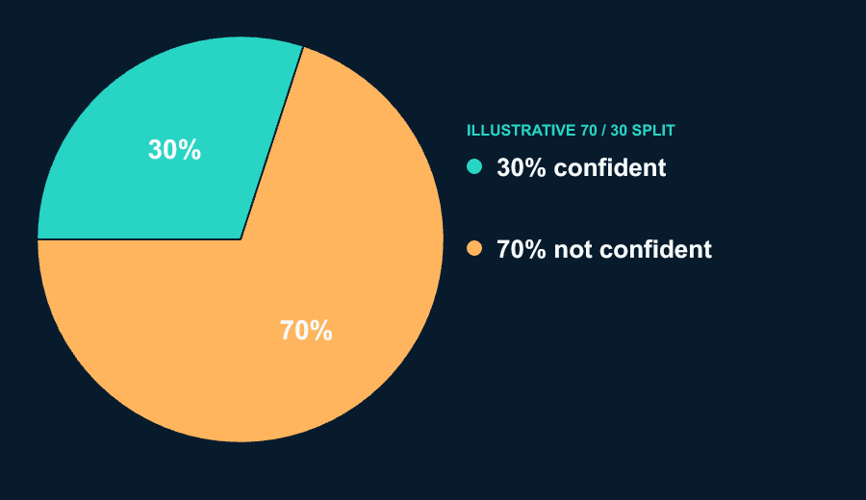
Scam messages can feel real
under pressure
A survey of Indian seniors found a confidence gap around spotting fraud.
SURVEY CONFIDENCE
70%
of surveyed seniors were not confident
they could identify online fraud
2025 INDIA REPORTS
1,03,488
senior-citizen financial cyber-fraud complaints
₹4,005 crore reported across those complaints
30% confident
70% not confident
02
Notes:
The user's requested 75+ phishing-loss breakdown is not available in the cited India sources. This slide therefore labels the available evidence precisely. Confidence pie: Safer Internet India Consortium / Koan Advisory Group, Understanding Senior Citizens' Experience with Online Fraud: A Survey Based Assessment (2025), Graphs 11–12. The exploratory dipstick surveyed 100 people aged 60+ in Jan–Feb 2025; respondents were urban internet users who already had email addresses, so the sample is not nationally representative. 45% said they were not confident in their ability to identify fraud (55% were confident). The report does not publish this measure by age subgroup and does not say that 45% lost money. Report: https://saferinternetindia.com/wp-content/uploads/2025/03/Digital_Understanding-Senior-Citizens-Experience-with-Online-Fraud-A-Survey-Based-Assessment_compressed-1-2.pdf. Government-reported complaints: Ministry of Home Affairs reply to Rajya Sabha, 5 Aug 2026, as reported by Economic Times/ANI: 103,488 senior-citizen financial cyber-fraud complaints in 2025, associated with ₹4,005.12 crore reported loss. The MHA figure covers senior citizens overall, not people aged 75+ specifically or phishing only. Source: https://economictimes.indiatimes.com/news/india/financial-cyber-fraud-in-india-over-1-lakh-senior-citizens-and-463-lakh-women-lodged-financial-cyber-fraud-complaints-amounting-to-rs-7769-crore-in-2025/articleshow/132944872.cms. Photo source: https://www.semana.com/tecnologia/articulo/la-peligrosa-senal-de-alerta-que-no-debe-ignorar-en-su-celular-para-evitar-ser-victima-de-robos-de-grandes-sumas-de-dinero/202510/

Slide 3
One message in. A clear risk explanation out.
Review the content before deciding what to do next.
1
2
3
4
Add a message
See the risk
Read the evidence
Verify safely
Paste or upload
message content
Simple risk meter
and risk tier
Specific phrases
that raised concern
Can send the message to a known person to confirm the claim
Built for real-world messages
SMS, WhatsApp, email, chat, or another source. ElderShield highlights urgency,
identity mismatch, suspicious links, and requests for money or credentials.
03
Notes:
The feature flow reflects the team's description: upload or paste message content from a source, view a risk meter, and read why the message was flagged. The TrustLens brief names signals such as sender/domain inconsistency, URL obfuscation, suspicious urgency, and requests for credentials or financial action. Safe verification means contacting the claimed organization through a known, independently obtained channel. Do not imply that ElderShield has verified a sender's identity or guarantees detection.

Slide 4
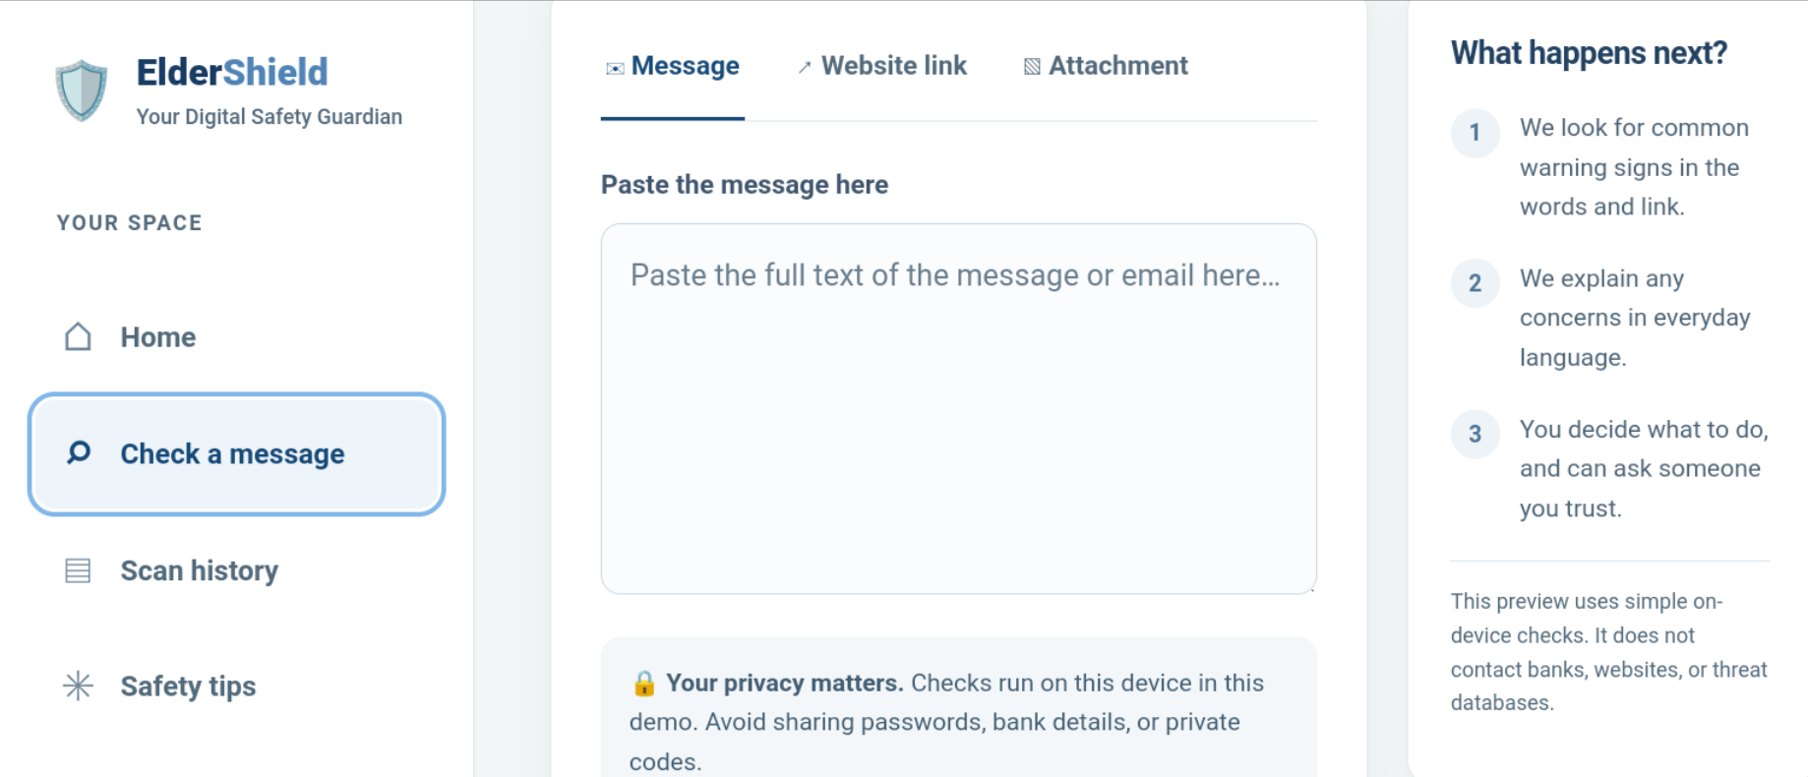
ElderShield in action
A quick walkthrough of the message check
DEMO FLOW
01
Upload a suspicious message
02
Show the risk tier
03
Point to the exact red flags
04
Notes:
This slide intentionally reserves a large area for the actual product screenshot. Replace the marked frame and update the demo sequence once the team provides screenshots or a demo link. Do not present this placeholder as a shipped interface.

Slide 5
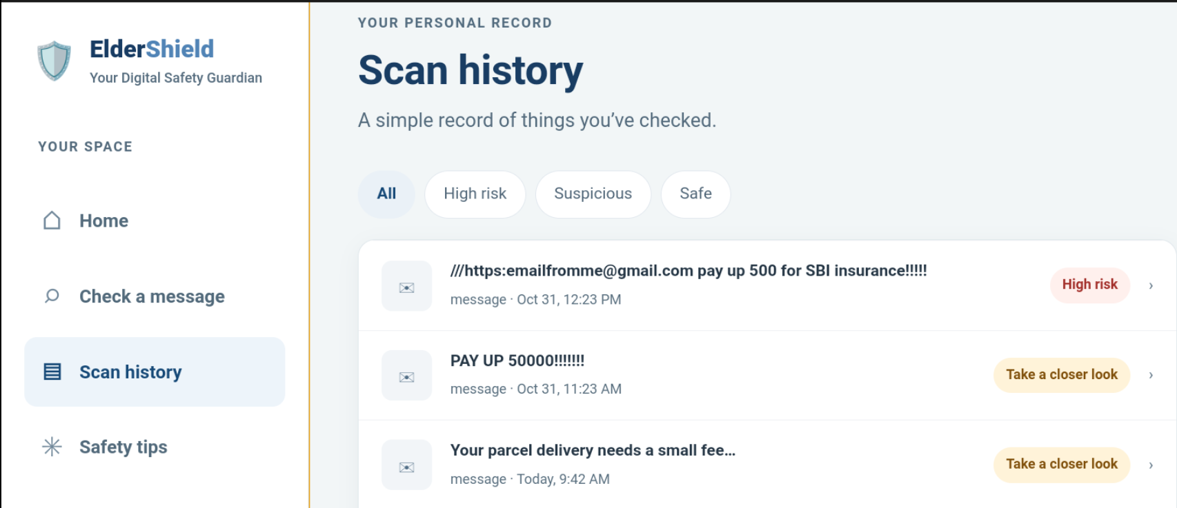
ElderShield in action
A quick walkthrough of the message check
04
Notes:
This slide intentionally reserves a large area for the actual product screenshot. Replace the marked frame and update the demo sequence once the team provides screenshots or a demo link. Do not present this placeholder as a shipped interface.

Slide 6
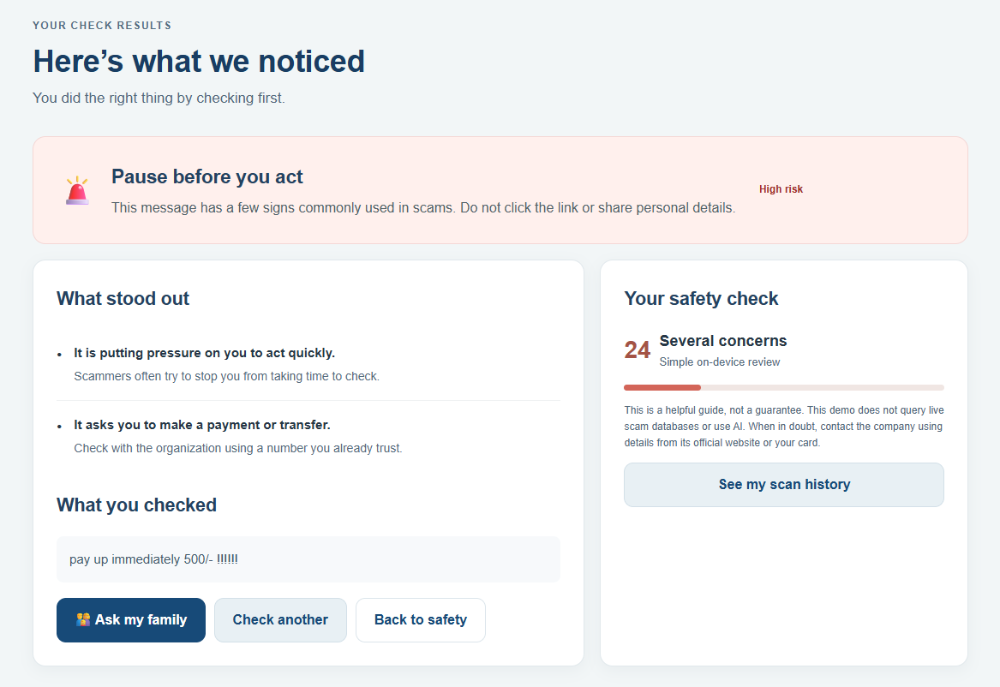
ElderShield in action
A quick walkthrough of the message check
04
Notes:
This slide intentionally reserves a large area for the actual product screenshot. Replace the marked frame and update the demo sequence once the team provides screenshots or a demo link. Do not present this placeholder as a shipped interface.

Slide 7
ELDERSHIELD
Thank you
Questions?
Safer decisions start with understanding the message.

