Slide 1
Helm Masterclass
Kalyan Reddy Daida

Slide 2

AWS EKS Kubernetes
DevOps on
AWS & Azure
Jenkins
Azure AKS
Part-2
Ansible
Azure AKS Kubernetes
HELM Masterclass
40+ Concept Demos
Azure Certs
AZ-900, 104, 204, 400
DevOps &
SRE
Roadmap
AWS ECS
Docker on AWS
Kubernetes Certifications
CKAD, CKA, CKS
Google Cloud
Associate & Professional Certs
AWS
CloudFormation
HashiCorp Certified Terraform Associate on AWS with 50 Practical Demos
Terraform on AWS with SRE and IaC DevOps with 20 Real-World Demos
HashiCorp Certified Terraform Associate on Azure with 75 Practical Demos
Terraform on Azure with IaC DevOps SRE with 25 Real-World Demos
Terraform on AWS EKS Elastic Kubernetes Service with 50+ Real-World Demos
Google Kubernetes Engine with DevOps - 75+ Real-World Demos
LIVE

Slide 3
Google Cloud Certifications
Road Map
Google Cloud Real-World
Courses Road Map
Digital Cloud Leader
GKE Google Kubernetes Engine with DevOps - 75+ Real-World Demos
Associate Cloud Engineer
Terraform on Google Cloud
with DevOps SRE - 50+ Real-World Demos
Professional Cloud Architect
AWS EKS Kubernetes
Professional Cloud Developer
Azure AKS Kubernetes
Professional Cloud DevOps Engineer
AWS ECS Docker on AWS
Professional Cloud Network Engineer
Terraform on AWS Cloud
Professional Cloud Security Engineer
Terraform on Azure Cloud
Professional Cloud Data Engineer
Terraform on AWS EKS
LIVE

Slide 4
Google Cloud Certifications
Road Map
Google Cloud Real-World
Courses Road Map
Digital Cloud Leader
GKE Google Kubernetes Engine with DevOps - 70+ Real-World Demos
Associate Cloud Engineer
Terraform on Google Cloud
with DevOps SRE - 50+ Real-World Demos
Professional Cloud Architect
Professional Cloud Developer
AWS EKS Kubernetes
Professional Cloud DevOps Engineer
Azure AKS Kubernetes
Best Selling
Courses
AWS ECS Docker on AWS
Professional Cloud Network Engineer
Terraform on AWS Cloud
Professional Cloud Security Engineer
Terraform on Azure Cloud
Professional Cloud Data Engineer
Terraform on AWS EKS
LIVE

Slide 5
Helm Masterclass: 50 Practical Demos for Kubernetes DevOps
Kalyan Reddy Daida

Slide 6
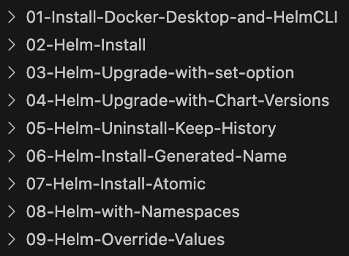
helm create
helm lint
helm test
24
Helm
Commands
helm install
helm template
helm verify
helm upgrade
helm get
helm version
Also covered many
Sub Commands and Flags
helm rollback
helm history
helm env
helm package
helm pull
helm dependency
helm list
helm plugin
helm push
helm repo
helm show
helm uninstall
helm search
helm status
helm help

Slide 7
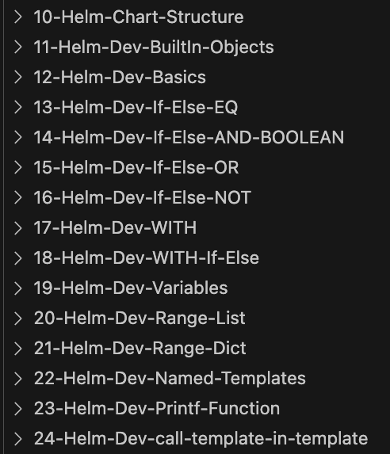
15
Helm
Development
Demos
Built-in Objects
(.Release, .Chart, .Files, .Values)
Helm Development Basics
(Template Actions, Control White Spaces, default, lower, nindent)
Flow Control Actions
(If-Else, With, Range)
Template Functions
EQ, AND, NOT, OR, toYaml
Named Templates
(_helpers.tpl)

Slide 8
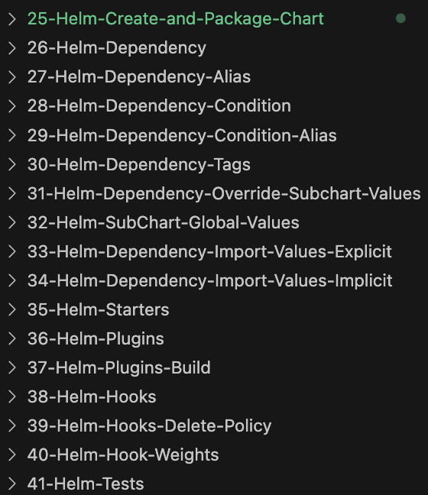
Helm Important Concepts
Create and Package
Helm Charts
Dependency
(Alias, Condition, Tags)
Sub Charts
(Global Values, Override Subchart Values, Import Values)
Starters, Plugins
Hooks
(Types, Deletion Policy, Weight, Tests)

Slide 9
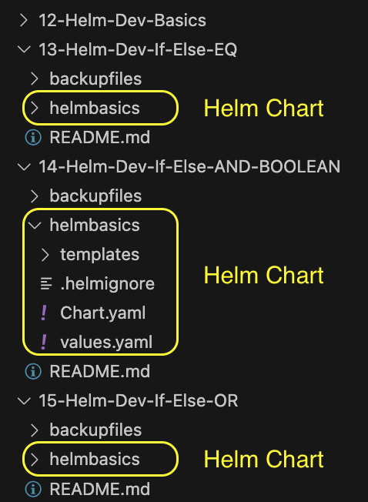
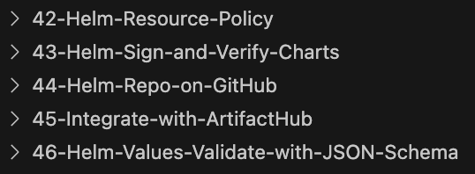
Sign and Verify Charts
Each demo will have its own Helm Chart
Host Helm Repository on GitHub with GitHub Pages
Helm Important Concepts
Integrate GitHub Helm Repository with Artifact Hub
Helm Values
Validate JSON Schema

Slide 10

GitHub Repositories
Repository Used For | Repository URL
Course Main Repository with step-by-step documentation | https://github.com/stacksimplify/helm-masterclass
Course Presentation | https://github.com/stacksimplify/helm-masterclass/tree/main/course-presentation
Helm Charts Repo 1 | https://github.com/stacksimplify/helm-charts
Helm Charts Repo 2 | https://github.com/stacksimplify/helm-charts-repo
130+ presentation slides outlining various Helm concepts we have implemented

Slide 11

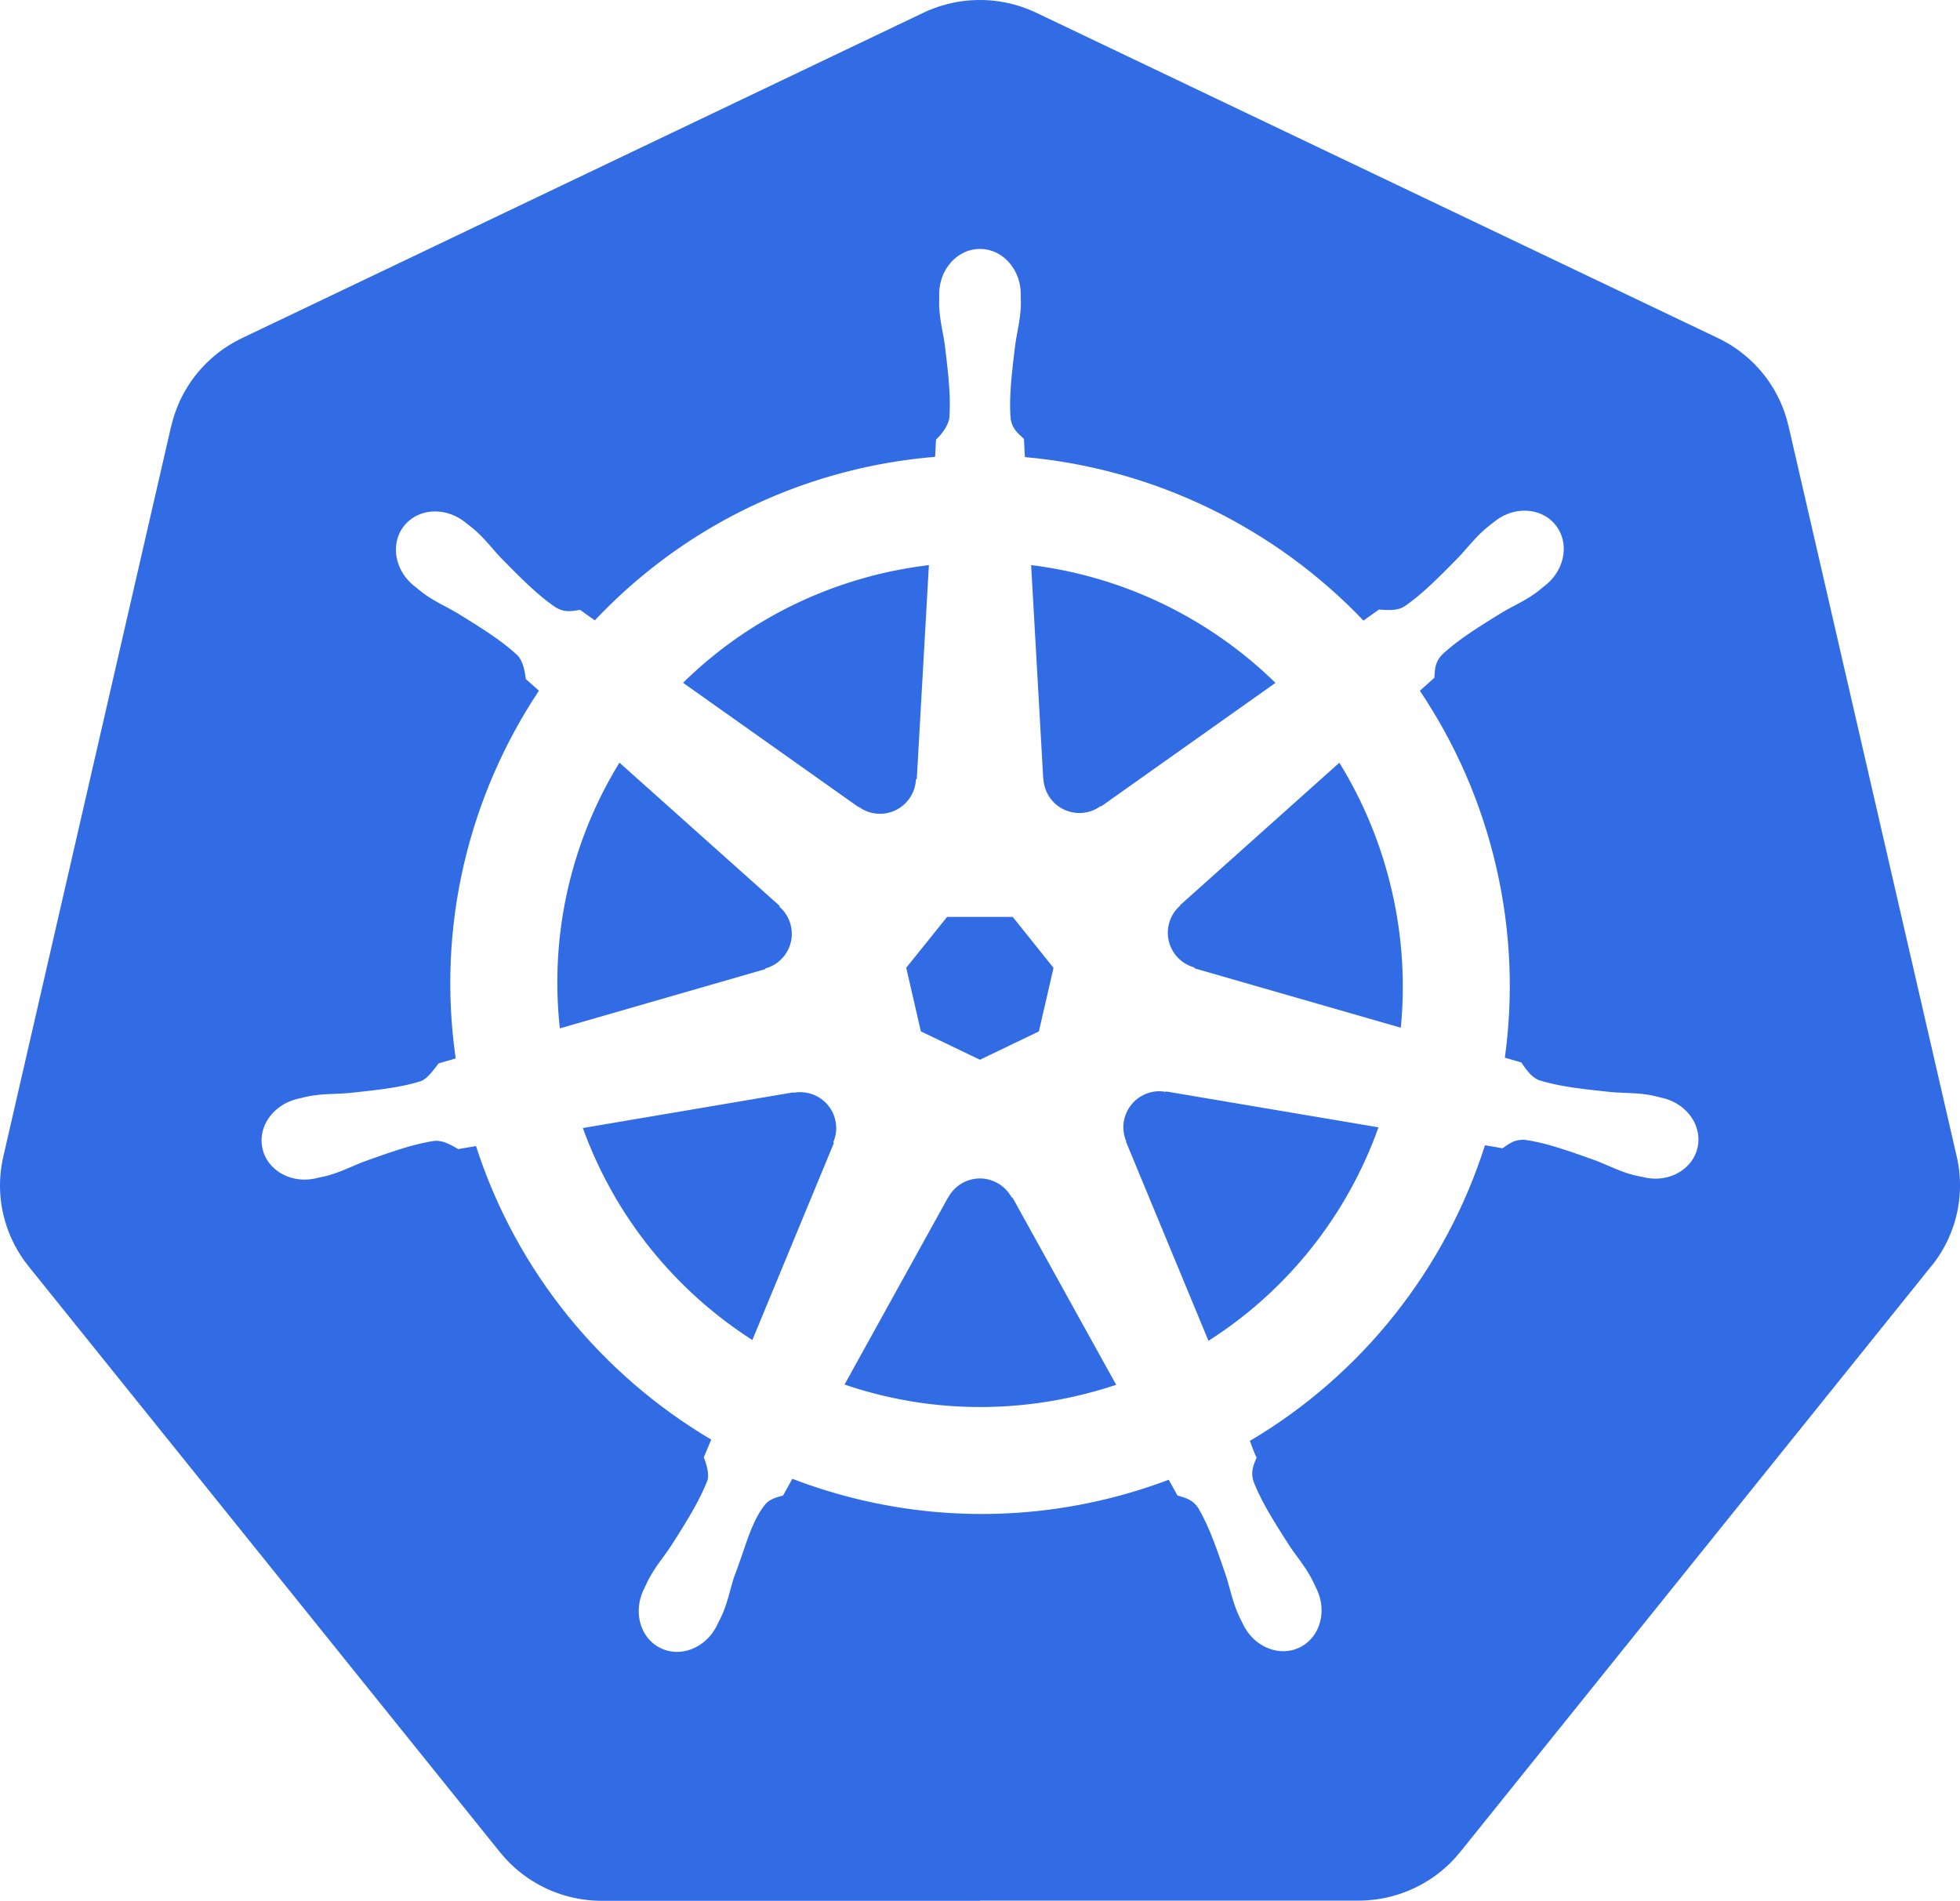
HELM Learning
Environment Setup
Docker Hub
Docker Desktop
Helm CLI
Demo-01

Slide 12
HELM Learning Environment Setup
Docker Hub
(Sign Up)
Docker Desktop
(Download and Install)
Kubernetes Cluster
(Enable in Docker Desktop)
Helm CLI
(Download and Install)
Deploy k8s Manifests
(Test k8s Cluster)

Slide 13
HELM Install Commands
helm install helm repo helm search helm list helm uninstall
Demo-02

Slide 14

Helm Install
Bitnami
helm repo
1
helm repo <COMMANDS>
Helm Repo
helm search
helm repo list
helm install
helm repo add REPO-NAME REPO-URL
helm list
2
helm search repo <COMMANDS>
helm uninstall
helm search repo nginx
3
helm install RELEASE-NAME CHART-NAME
4
helm list
5
helm uninstall RELEASE-NAME
Helm CLI
k8s Cluster
Local Desktop

Slide 15
HELM Upgrade Commands
helm upgrade helm status helm history
Demo-03

Slide 16
Helm Upgrade with --set Option
StackSimplify
Helm Repo
1
helm repo <COMMANDS>
(Hosted on GitHub)
helm repo list
helm upgrade
helm repo add REPO-NAME REPO-URL
helm history
2
helm search repo <COMMANDS>
helm status
helm search repo stacksimplify/mychart1
3
helm install RELEASE-NAME CHART-NAME
4
helm upgrade –set image.tag=2.0.0
5
helm upgrade –set image.tag=3.0.0
Helm CLI
6
helm upgrade –set image.tag=4.0.0
k8s Cluster
Local Desktop

Slide 17
HELM Upgrade with Chart Version
helm rollback
Demo-04

Slide 18
Helm Install & Upgrade with Chart Version
StackSimplify
Helm Repo
1
helm repo <COMMANDS>
(Hosted on GitHub)
helm repo list
helm repo add REPO-NAME REPO-URL
helm rollback
2
helm search repo <COMMANDS>
helm search repo stacksimplify/mychart2 --versions
helm search repo stacksimplify/mychart2 --version “0.3.0”
3
helm install REL-NAME CHART-NAME --version “0.1.0”
4
helm upgrade REL-NAME CHART-NAME --version “0.2.0”
5
helm upgrade REL-NAME CHART-NAME
Helm CLI
6
helm rollback
k8s Cluster
Local Desktop

Slide 19
HELM Uninstall
--keep-history flag
Demo-05

Slide 20
Helm Uninstall with --keep-history flag
StackSimplify
helm uninstall REL-NAME --keep-history
Helm Repo
Removes all associated resources and marks the release as deleted
1
helm repo <COMMANDS>
(Hosted on GitHub)
helm repo list
helm repo add REPO-NAME REPO-URL
In addition, also retains the release history which helps us to rollback to deleted release
2
helm search repo <COMMANDS>
helm search repo stacksimplify/mychart2 --versions
--keep-history flag
helm search repo stacksimplify/mychart2 --version “0.3.0”
3
helm install REL-NAME CHART-NAME --version “0.1.0”
4
helm upgrade REL-NAME CHART-NAME --version “0.2.0”
5
helm upgrade REL-NAME CHART-NAME
Helm CLI
6
helm rollback
k8s Cluster
Local Desktop

Slide 21
HELM Install
--generate-name flag
Demo-06

Slide 22

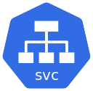
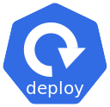

Helm Install with --generate-name flag
helm install CHART-NAME --generate-name
StackSimplify
Helm Repo
It auto-generates the RELEASE-NAME
(Hosted on GitHub)
When we are implementing DevOps Pipelines, if we want to generate the names of our releases without throwing duplicate release errors, we can use this setting.
1
helm repo <COMMANDS>
helm repo list
helm repo add REPO-NAME REPO-URL
User
--generate-name flag
2
helm search repo <COMMANDS>
helm search repo stacksimplify/mychart1
http://localhost:31231
3
helm install CHART-NAME --generate-name
NodePort
Service
helm install stacksimplify/mychart1 --generate-name
Helm CLI
k8s Cluster
Local Desktop

Slide 23
HELM Install
--atomic flag
Demo-07

Slide 24
Helm Install with --atomic flag
helm install REL-NAME CHART-NAME --atomic
StackSimplify
Helm Repo
when --atomic flag is set, the installation process deletes the installation (release) on failure.
(Hosted on GitHub)
The --wait flag will be set automatically if --atomic is used
1
helm repo <COMMANDS>
--wait will wait until all until all k8s resources (pods, deployments, svc) are in a ready state before marking the release as successful. It will wait for as long as --timeout
helm repo list
helm repo add REPO-NAME REPO-URL
--timeout time to wait for any individual Kubernetes operation (like Jobs for hooks) (default 5m0s)
User
2
helm search repo <COMMANDS>
--atomic flag
helm search repo stacksimplify/mychart1
http://localhost:31231
3
helm install REL-NAME CHART-NAME
helm install dev101 stacksimplify/mychart1
This will create a failed release due to NodePort conflict
NodePort
Service
helm install qa101 stacksimplify/mychart1
helm install qa101 stacksimplify/mychart1 --atomic
This will delete the release as soon as the release is failed
Helm CLI
k8s Cluster
Local Desktop

Slide 25
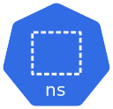
HELM
Kubernetes Namespaces
Demo-08

Slide 26
Helm with Kubernetes Namespaces
helm install REL-NAME CHART-NAME --namespace dev --create-namespace
StackSimplify
Helm Repo
--create-namespace: Create the release namespace if not present
(Hosted on GitHub)
--namespace or –n : In which namespace our k8s resources should be deployed using HELM
1
helm repo <COMMANDS>
By default, Kubernetes deploys resources in default namespace, so we didn’t use the -n or --namespace in our previous demos with HELM Commands.
helm repo list
helm repo add REPO-NAME REPO-URL
Important Note: During helm uninstall, the created namespace will not get deleted, only k8s resources deployed in that namespace will be deleted.
User
2
helm search repo <COMMANDS>
--namespace or –n and --create-namespace flag
helm search repo stacksimplify/mychart2
http://localhost:31232
k8s Cluster
dev Namespace
3
helm install REL-NAME CHART-NAME --namespace dev --create-namespace
NodePort
Service
helm install dev101 stacksimplify/mychart2 --namespace dev --create-namespace
Helm CLI
Local Desktop

Slide 27
HELM
Override Values
helm install --dry-run
helm install --debug
helm upgrade --dry-run
helm install --debug
helm get
Demo-09

Slide 28
Helm - Override Values --set, -f and get
Override with
--set
helm install myapp901 stacksimplify/mychart1 --set service.nodePort=31240
Already covered in Demo-3, here we are going to use to learn --dry-run and --debug flags
Override with
--values or -f
helm install myapp901 stacksimplify/mychart1 -f myvalues.yaml
helm install myapp901 stacksimplify/mychart1 --values myvalues.yaml
helm get: Downloads information from a named release. Can extract info from releases like myapp1, myapp101 etc
helm get values RELEASE_NAME
helm get notes RELEASE-NAME
helm get all RELEASE-NAME
helm get manifest RELEASE-NAME
helm get hooks RELEASE-NAME

Slide 29
Helm --dry-run and --debug
--dry-run
(Simulate)
helm install myapp901 stacksimplify/mychart1 --dry-run
helm upgrade myapp901 stacksimplify/mychart1 --dry-run
helm uninstall myapp901 --dry-run
helm template myapp901 --dry-run
--debug
--debug: enables verbose output (Will be present in most of the HELM commands)
helm install myapp901 stacksimplify/mychart1 --debug
helm upgrade myapp901 stacksimplify/mychart1 --debug
helm uninstall myapp901 --debug
--dry-run
&
--debug
helm install myapp901 stacksimplify/mychart1 --dry-run --debug
helm upgrade myapp901 stacksimplify/mychart1 --dry-run --debug
helm uninstall myapp901 --dry-run --debug
helm template myapp901 --dry-run --debug

Slide 30
HELM Create
Understand
HELM Chart Folder Structure
Demo-10

Slide 31
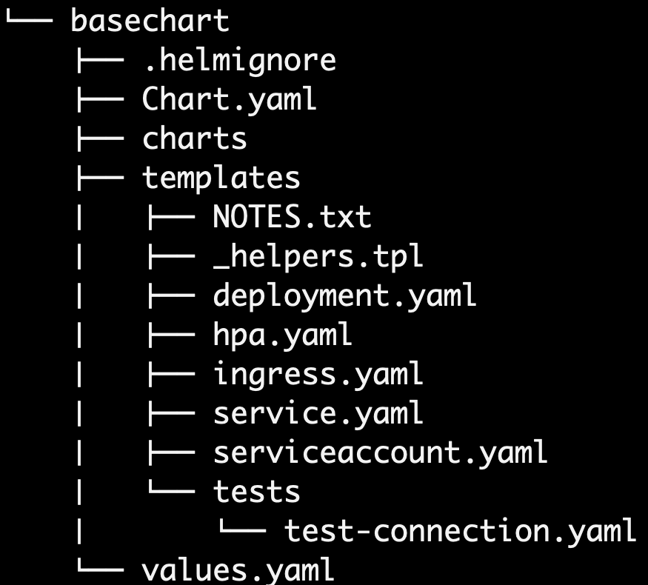
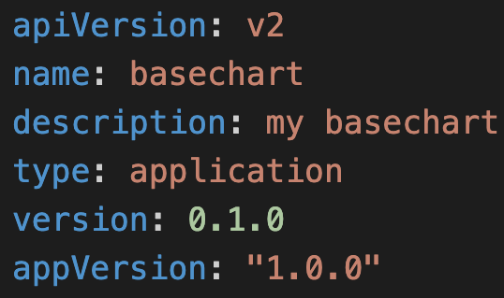
Helm Chart - Folder Structure
.helmignore
Contains patterns to ignore when packaging helm charts
Chart.yaml
Contains all important chart information (chart metadata)

Slide 32
Helm Chart - Folder Structure
values.yaml
The default configuration values for this chart
We have implemented multiple demos by overriding values from values.yaml using –f myvalues.yaml and --set
charts folder
A directory containing any charts upon which this (parent chart) chart depends
Example:
Parent Chart: UMS App
Sub Chart (charts folder): mysql db chart

Slide 33
Helm Chart - Folder Structure
templates folder
A directory of templates that, when combined with values, will generate valid Kubernetes manifest files.
This is where Helm finds the YAML manifests for our Services, Deployments and other Kubernetes objects.
If we already have Kubernetes resources for our application, we just to need to convert them to Helm equivalent and put them in templates folder so that we can deploy them using helm install command
Helm runs each file in this directory through a Go template rendering engine.

Slide 34
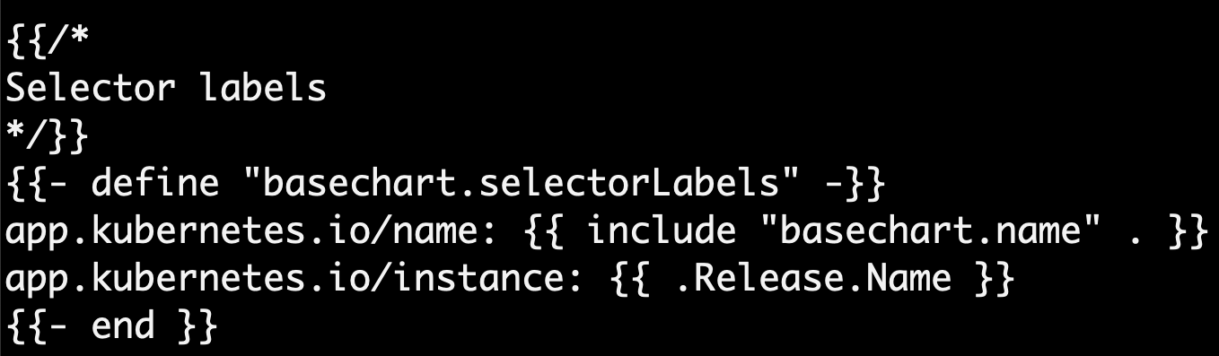
Helm Chart - Folder Structure
templates/_helpers.tpl
Sometimes you want to create some reusable parts in your chart then we can use this file.
In the templates/ directory, any file that begins with an underscore(_) is not expected to output a Kubernetes manifest file.

Slide 35
Helm Chart - Folder Structure
Why do we need templates/NOTES.txt ?
This is an optional file which provides important information about our Helm Chart
Example: How to access the Application deployed using this Helm Chart?
How does templates/NOTEST.txt work?
NOTES.txt file is rendered same as regular template file (deployment.yaml, service.yaml) by Helm
The main difference is after NOTES.txt rendered, it’s not sent to Kubernetes Cluster, but the output is displayed in the command line window.
As it behaves same as regular Helm Templates, we can fetch values from the values.yaml file, we can fetch values from the built-in objects .Chart, .Release, add if conditional blocks, use flow control, functions, pipelines, and so on.

Slide 36
Helm Chart - Folder Structure
tests folder
We write tests that validate our chart works as expected when it is installed.
These tests also help the chart consumer understand what this Helm chart is supposed to do.
Example Tests
Verify k8s services in chart are up and correctly load balancing
Verify if application is up and running after deploying the Chart
helm test RELEASE-NAME

Slide 37
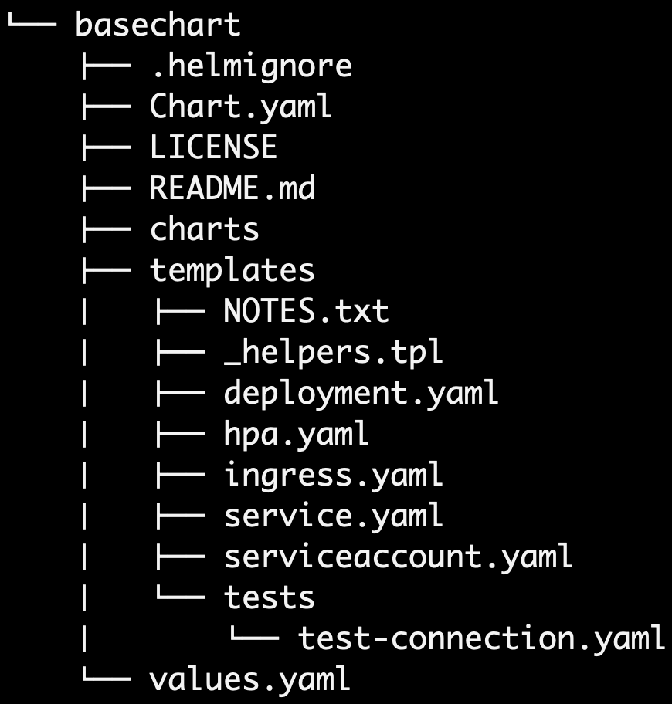
Helm Chart - Folder Structure
README.md
We will document on how to use this HELM Chart in this file
LICENSE
License file about usage of HELM Chart

Slide 38
HELM Built-In Objects
Root Object dot (.)
.Release
.Chart
.Values
.Capabilities
.Template
.Files
Demo-11

Slide 39
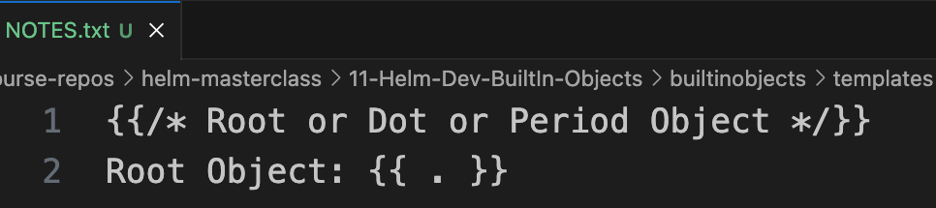
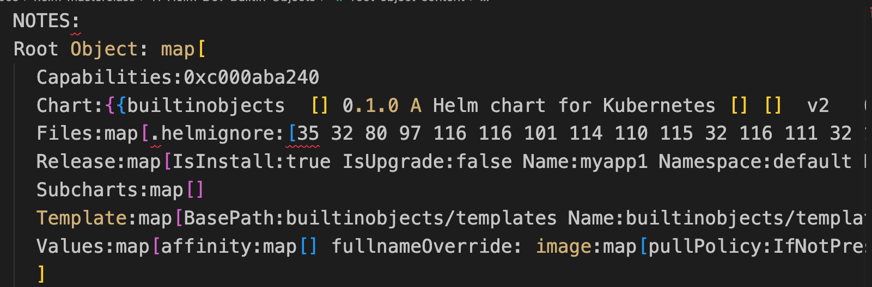
Helm Built-In Object - Root Object (.)
Helm Objects
Root Object dot or Period (.)
Top level Helm Object
At the top-level Helm initializes dot (.) to an object with keys like
.Release
.Values
.Chart
.Capabilities
.Template
.File
Very Very Important Note: If we use dot (.) inside range and with actions, it is going to be current context in that respective block and not the Root Helm Object.
Objects are passed into a template from the template engine
Objects can be simple, and have just one value or they can contain other objects or functions
Input:
Output:

Slide 40
Helm Chart - Folder Structure
Why do we need templates/NOTES.txt ?
This is an optional file which provides important information about our Helm Chart
Example: How to access the Application deployed using this Helm Chart?
How does templates/NOTEST.txt work?
NOTES.txt file is rendered same as regular template file (deployment.yaml, service.yaml) by Helm
The main difference is after NOTES.txt rendered, it’s not sent to Kubernetes Cluster, but the output is displayed in the command line window.
As it behaves same as regular Helm Templates, we can fetch values from the values.yaml file, we can fetch values from the built-in objects .Chart, .Release, add if conditional blocks, use flow control, functions, pipelines, and so on.

Slide 41
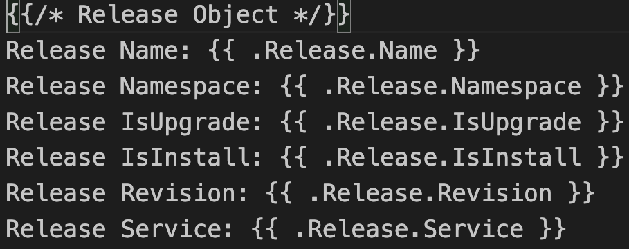
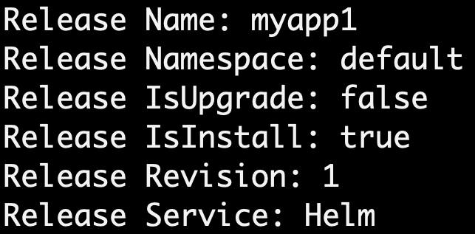
Helm Built-In Objects - .Release Object
Input:
.Release Object
Contains Helm Release Information
Example: We can put our k8s deployment name in combination with release name using .Release.Name object by accessing it in deployment.yaml helm template.
Output:

Slide 42
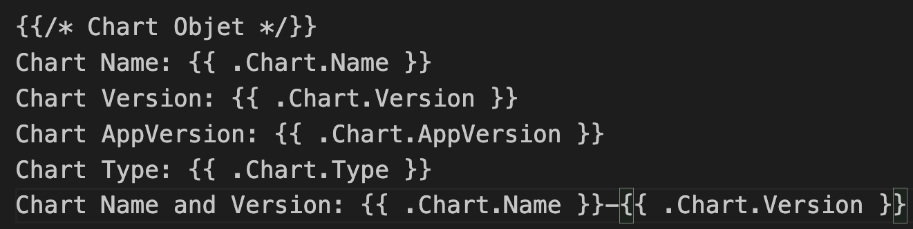
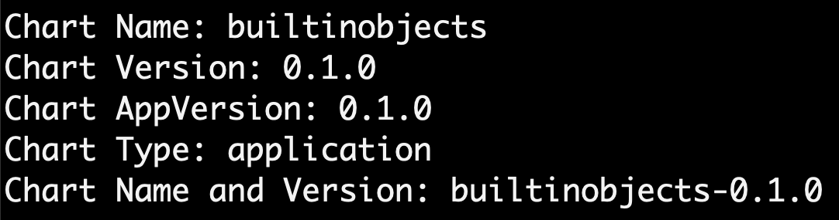
Helm Built-In Objects - .Chart Object
.Chart Object
Contains Helm Chart Information
We can access any data from Chart.yaml file
Chart.yaml fields for reference: https://helm.sh/docs/topics/charts/#the-chartyaml-file
Input:
Output:

Slide 43
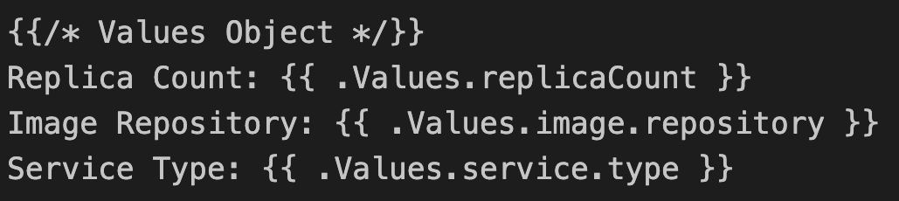
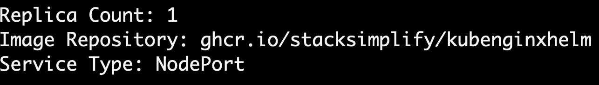
Helm Built-In Objects .Values Object
.Values Object
Values Object contains values from the values.yaml file and if any user-supplied values (-f or --set) that can be passed to templates
Input:
Output:

Slide 44
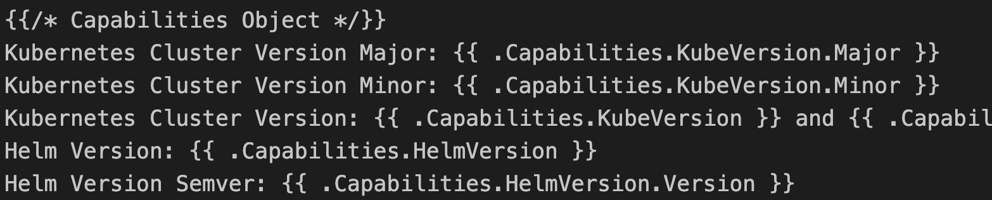
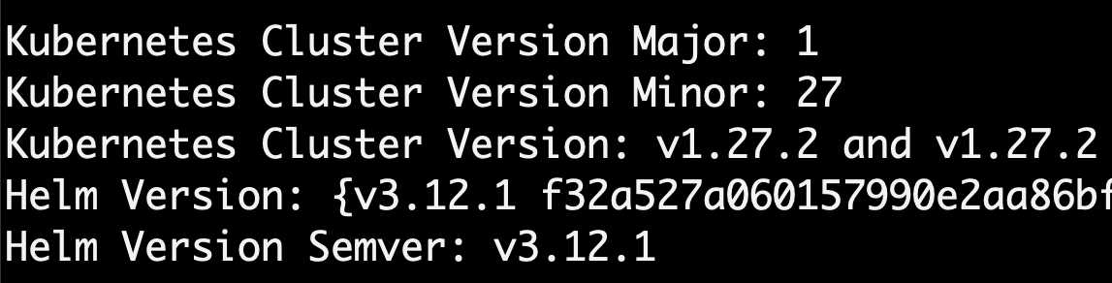
Helm Built-In Objects - .Capabilities Object
.Capabilities Object
This provides information about what capabilities the Kubernetes cluster supports
Input:
Output:

Slide 45
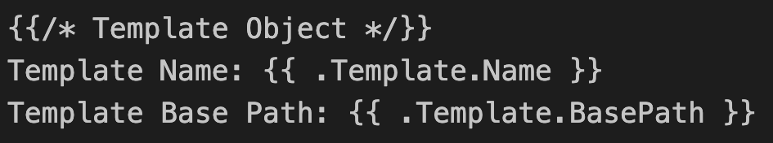
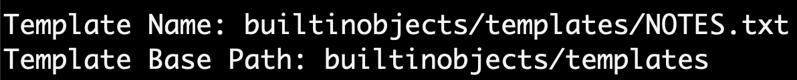
Helm Built-In Objects - .Template Object
.Template Object
Contains information about the current template that is being executed
Input:
Output:

Slide 46
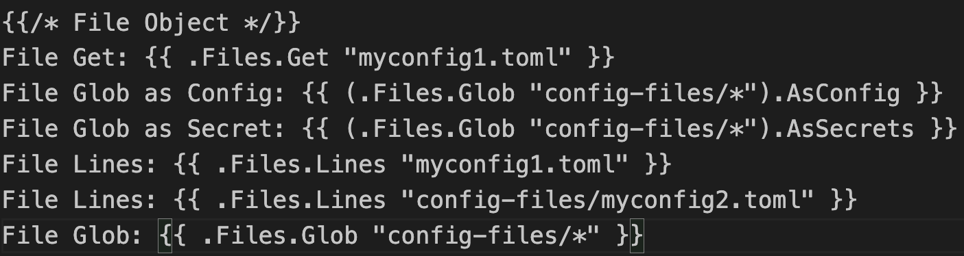
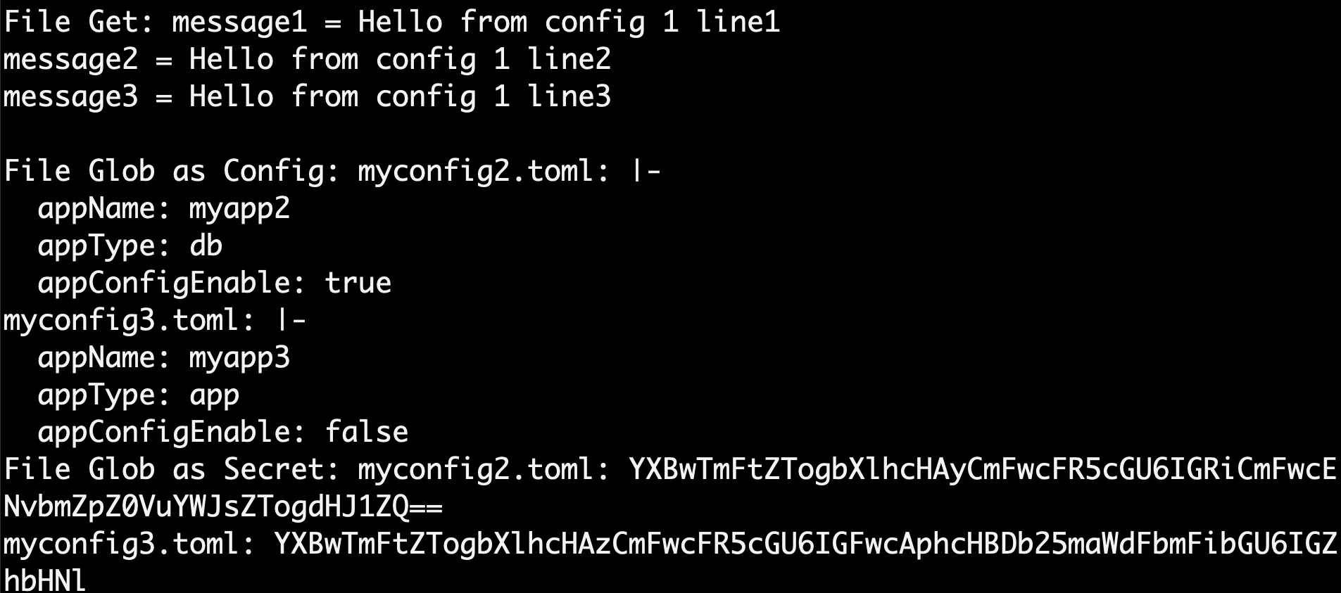
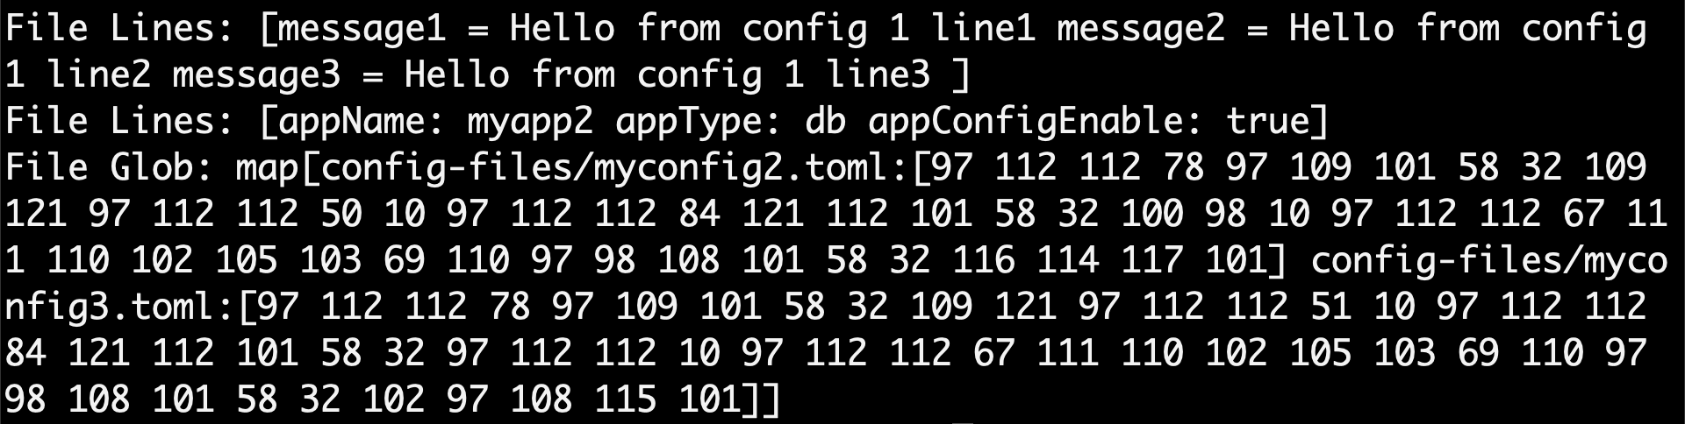
Helm Built-In Objects - .Files Object
.Files Object
This provides access to all non-special files in a chart
We cannot use it to access templates
We can use it to access other files in the chart.
Input:
Output:

Slide 47
HELM Development
Basics
Template Action {{ }}
Quote Function
Pipeline
default Function
Manage Whitespaces
indent
nindent
toYaml
Demo-12

Slide 48
Helm Development Basics
Template Actions
lower function
Action Elements
default function
Controlling Whitespaces
indent function
Pipeline
nindent function
quote Function
toYaml function

Slide 49
HELM Development
Flow Control if, else if, else
EQ Function
Demo-13

Slide 50
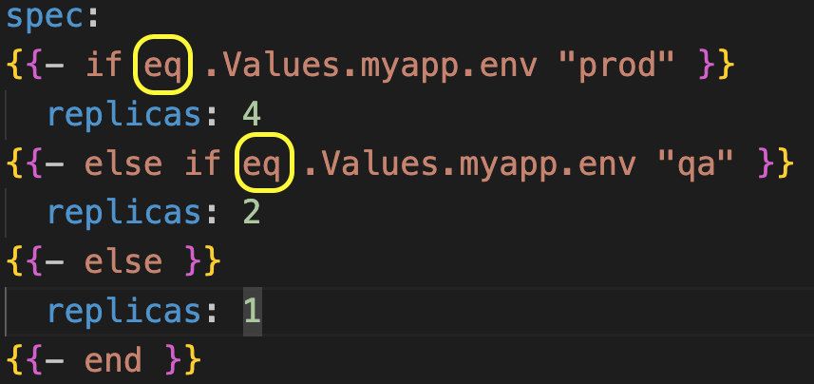
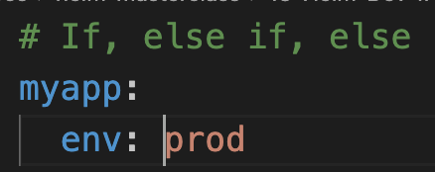
Helm Flow Control - If Else, eq Function
If / Else: helps us to create Conditional blocks
eq Function: Returns the boolean equality of the arguments (e.g., Arg1 == Arg2).
deployment.yaml
eq .Arg1 .Arg2
values.yaml

Slide 51
HELM Development
Flow Control if, else if, else
AND Function
Boolean Check
Demo-14

Slide 52
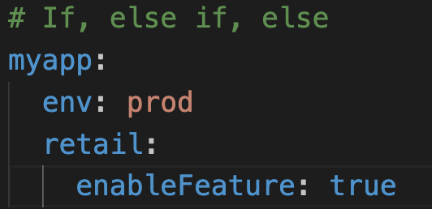
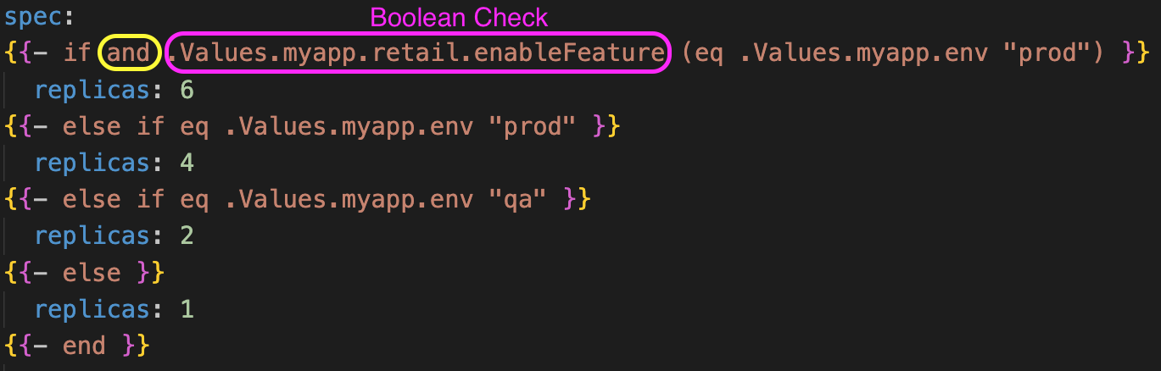
Helm Flow Control - If Else, AND, Boolean
and Function: Returns the boolean AND of two or more arguments
values.yaml
and .Arg1 .Arg2
deployment.yaml

Slide 53
HELM Development
Flow Control if, else if, else
OR Function
Demo-15

Slide 54
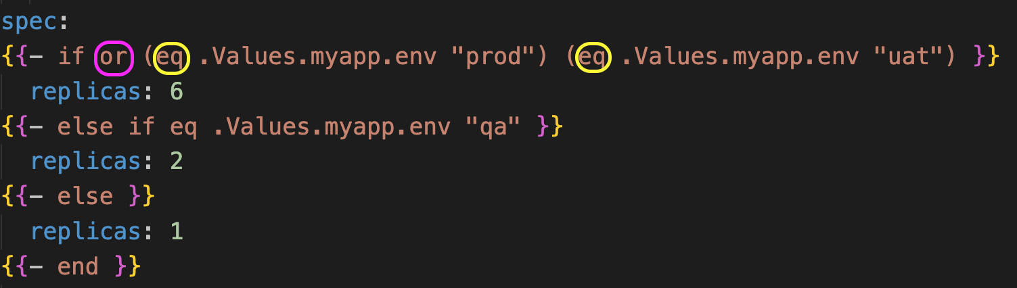
Helm Flow Control - If Else, or
or Function: Returns the boolean OR of two or more arguments
values.yaml
or .Arg1 .Arg2
deployment.yaml

Slide 55
HELM Development
Flow Control if, else if, else
not Function
Demo-16

Slide 56
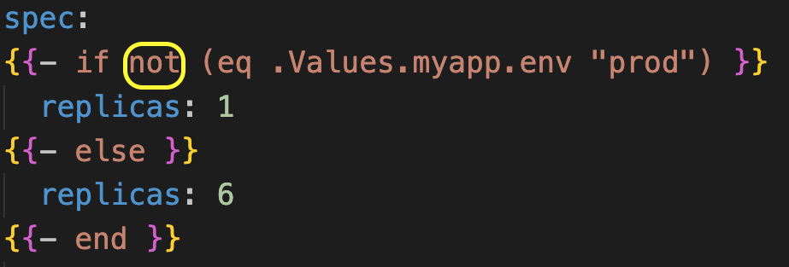
Helm Flow Control - If Else, not
not Function: Returns the boolean negation of its argument.
values.yaml
not .Arg1
deployment.yaml

Slide 57
HELM Development
Flow Control with
Demo-17

Slide 58
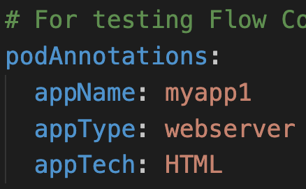
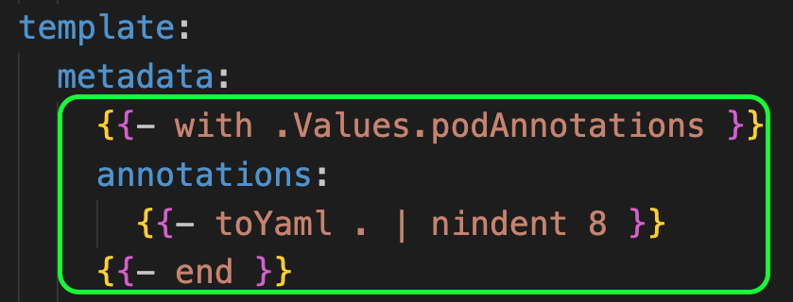
Helm Flow Control - with
with Action: Controls variable scoping
It can allow you to set the current scope (.) to a particular object.
Example: Pod Annotations
Inside the with action, dot "." always refers to .Values.podAnnotations
Outside the with action, dot "." refers to Root Object
values.yaml
deployment.yaml

Slide 59
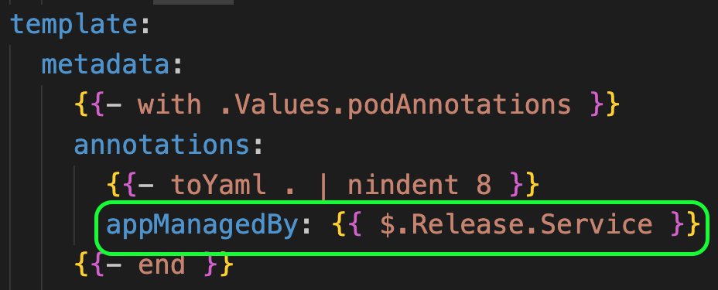
Helm Flow Control - with
How to access Root Objects inside WITH or RANGE Action?
To access Root Objects inside WITH action we need to prepend that Root object with $
deployment.yaml
Prepend with $

Slide 60
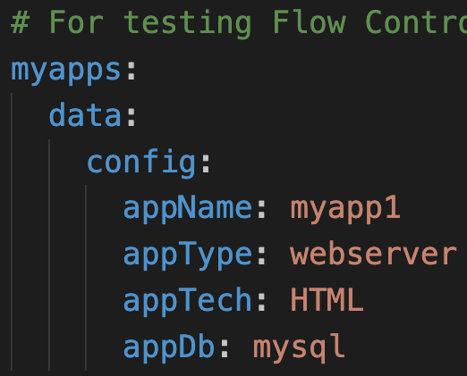
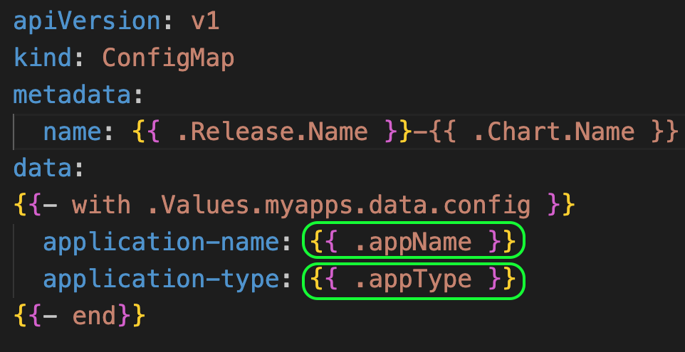
Helm Flow Control - with
Access Single Object from Dictionary
How to retrieve a single object from .Values.myapps.data.config ?
What if there is only need for 1 or 2 values from .Values.myapps.data.config ?
How to access each key value from .Values.myapps.data.config ?
values.yaml
deployment.yaml

Slide 61
HELM Development
Flow Control with & if-else
Demo-18

Slide 62
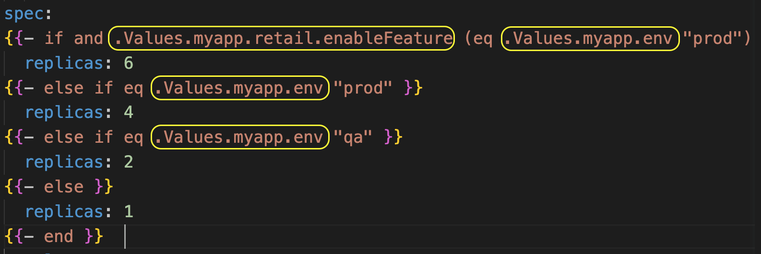
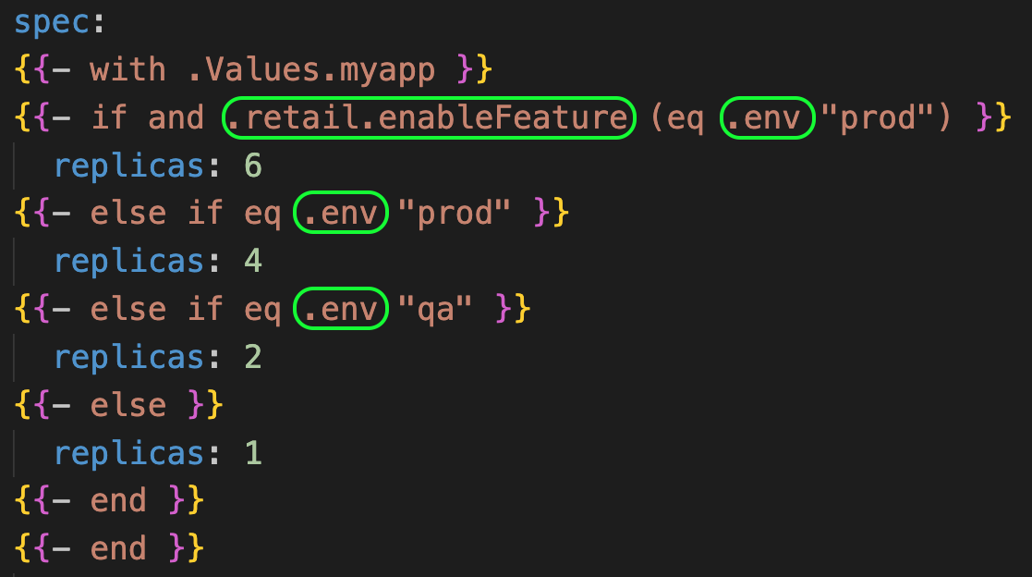
Helm Flow Control - If Else, AND, Boolean, With
We are going to use WITH Action and If-Else in combination in this demo
We are going to re-implement Demo-14: Flow Control If-Else with Boolean Check and AND Function in combination with WITH Action.
WITH simplifies the template code.
Demo-14: deployment.yaml
WITH Action - deployment.yaml

Slide 63
HELM Development
Variables
Demo-19

Slide 64
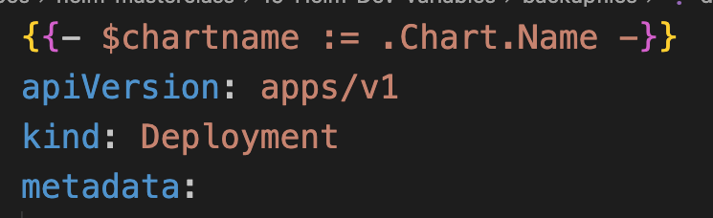
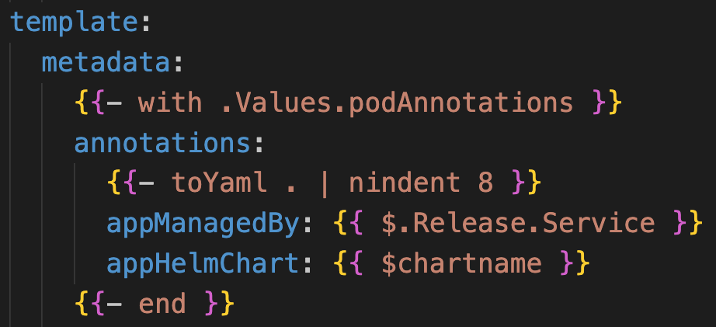
Helm Variables
deployment.yaml
Variables are used to simplify code
Primarily used in WITH, RANGE Actions and Named Templates
Variables are assigned with a special assignment operator :=
How to define a Variable ?
How to reference a Variable ?

Slide 65
HELM Development
Flow Control- Range Action
List
Demo-20

Slide 66
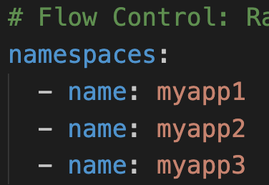
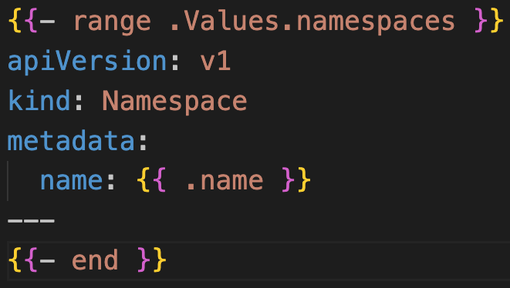
Helm Flow Control - Range Action
values.yaml
Range in Helm is equivalent to for, foreach from other programming languages
In Helm, we can iterate over a collection using Range Operator
Range Demos
Lists
Demo-1: Range with Lists
Demo-2: Range with Lists in combination with Helm Variables
Dictionaries
Demo-1: Range with Dictionary / Map
Demo-2: Range with Dictionary in combination with Helm Variables
Range with List
Demo-1
namespace.yaml

Slide 67
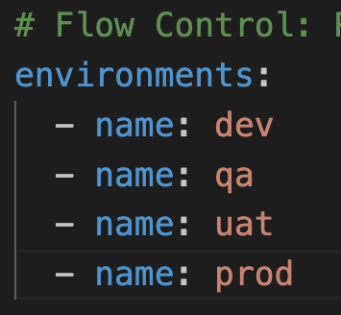
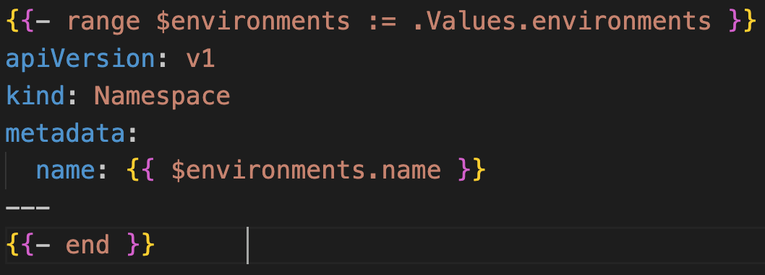
Helm Flow Control - Range Action + Helm Variables
Range with List
Demo-2
values.yaml
namespace-with-variable.yaml

Slide 68
HELM Development
Flow Control - Range Action
Dictionary
Demo-21

Slide 69
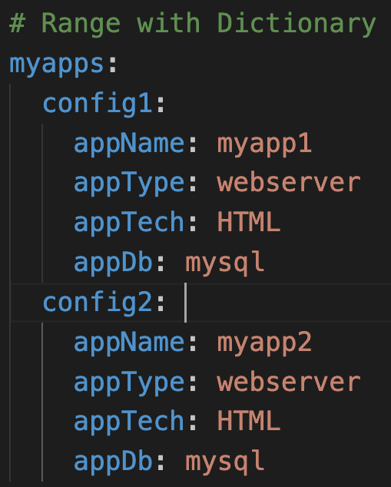
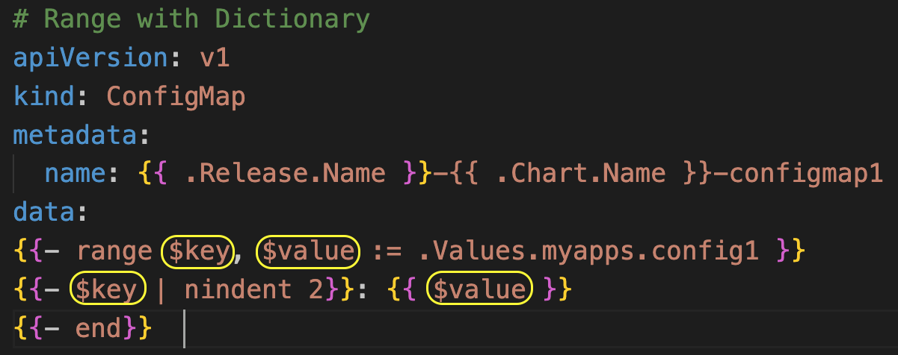
Helm Flow Control - Range Action with Dict
values.yaml
Demo-1
Range Action with Dictionary
configmap.yaml

Slide 70
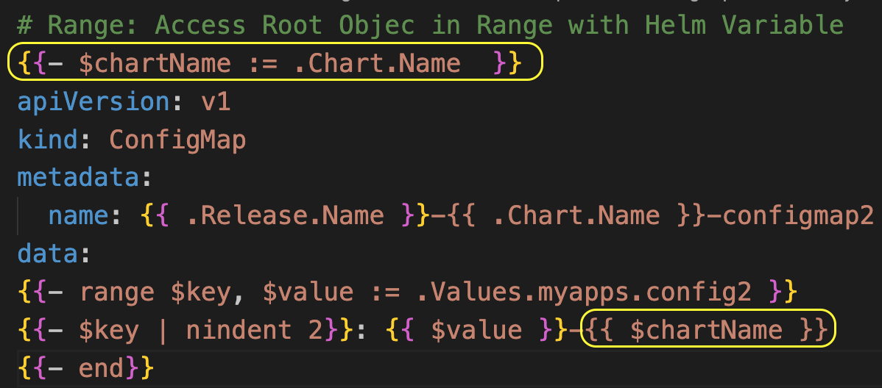
Helm Flow Control - Range Action with Dict
values.yaml
Demo-2
Range Action with Dictionary with Variable
configmap-with-variable.yaml

Slide 71
HELM Development
Named Templates
Demo-22

Slide 72


HELM Named Templates
What is named template ?
A template defined inside a file (_helpers.tpl) and given a name
How to declare a named template ?
We can declare it using define action
What is the naming convention for named templates ?
Template names are global
If you declare two templates with the same name, whichever one is loaded last will be the one used.
Template name: <chartname>.<relevant-template-name>
Example: helmbasics.labels
File:

Slide 73



HELM Named Templates
How to call a named template ?
We can call a named template using template
If we want to access any built-in objects in our named template, what should we do ?
We should pass the Root Object (.) as scope to template call
How to use Helm Pipelines in a template call ?
template action doesn’t allow pipelines
Using special purpose function named include, we can use pipelines

Slide 74
Helm Chart - Folder Structure
templates/_helpers.tpl
Sometimes you want to create some reusable parts in your chart then we can use this file.
In the templates/ directory, any file that begins with an underscore(_) is not expected to output a Kubernetes manifest file.
In short, _helpers.tpl file contains the re-usable named templates required for our Helm Charts

Slide 75
HELM Development
Named Templates
Create Resource Names
printf Function
Demo-23

Slide 76



Helm Named Templates - printf Function
deployment.yaml - Before Change
We will create a reusable named template for Resource Names
printf Function
Very very important function
It returns a string based on a formatting string
We need to pass the arguments in the formatting string order
Named Template
deployment.yaml - After Change

Slide 77
HELM Development
Named Templates
Template in Template
Demo-24

Slide 78

Helm Named Template - Template in Template
We are going to call one named template in other named template and test it
File: _helpers.tpl

Slide 79
HELM
Create & Package
Demo-25

Slide 80
Helm Create & Package
1.0.0
helm create
2.0.0
Make changes to Chart
(Image Tag, NodePort)
Make changes
(version and appVersion in Chart.yaml)
3.0.0
helm install from chart folder and verify
helm package from chart folder
helm package using
--version and ---app-version flags
helm package from chart folder
helm install from package file (myfirstchart-2.0.0.tgz) and verify
helm install from package file (myfirstchart-3.0.0.tgz) and verify

Slide 81
HELM
Dependency
Demo-26

Slide 82


Helm Dependency
Chart dependencies refer to the mechanism by which a Helm chart can declare and manage its external dependencies on other charts
Parent Chart or Main Helm Chart
Sub Charts or Child Charts
This feature is particularly useful when we are building complex applications that consist of multiple components or services, and we want to manage their deployment as a single unit.

Slide 83

Helm Dependency - Chart.yaml
Parent Chart: Chart.yaml

Slide 84
HELM
Dependency
Alias
Demo-27

Slide 85

Helm Dependency - Alias
Parent Chart: Chart.yaml
Useful when you have to add the same chart multiple times

Slide 86
HELM
Dependency
Condition
Demo-28

Slide 87


Helm Dependency - Condition
Parent Chart: Chart.yaml
Parent Chart: values.yaml
Define a YAML path in values.yaml, which will be used for enabling/disabling charts

Slide 88
HELM
Dependency
Condition + Alias
Demo-29

Slide 89


Helm Dependency - Condition + Alias
Parent Chart: Chart.yaml
Parent Chart: values.yaml

Slide 90
HELM
Dependency
Tags
Demo-30

Slide 91


Helm Dependency - Tags
Parent Chart: Chart.yaml
Parent Chart: values.yaml
Tags can be used to group charts for enabling/disabling together

Slide 92
Helm Dependency - Tags
When it is 2 to 3 charts it will be easy to manage with “condition: chartname.enabled” approach but if we are dealing with 10’s of charts then its good to use Tags appraoch
Parent Chart: values.yaml
When tags are used we can see how simple it is easy to group and enable / disable them as a group
Parent Chart: values.yaml

Slide 93
HELM
Dependency
Override Sub chart values from Parent Chart
Demo-31

Slide 94


Helm Dependency - Override Sub chart Values
Parent Chart: Chart.yaml
Parent Chart: values.yaml
Both Sub chart
k8s deployments will create
3 replicas each

Slide 95
HELM
Sub Charts
Use Global Values in Sub Charts
Demo-32

Slide 96


Helm Parent Chart
Parent Chart: Chart.yaml
Parent Chart: values.yaml
Define Global value in parent chart values.yaml
and use it in Sub Charts

Slide 97


Helm Sub Chart - Changes
Child Chart: mychart2 deployment.yaml
Child Chart: mychart4 deployment.yaml

Slide 98

Helm Sub Chart - Changes
Parent Chart: deployment.yaml

Slide 99
HELM
Dependency
Import Values Explicit
Demo-33

Slide 100


Helm Dependency - Import Values Explicit
Parent Chart: Chart.yaml
Child Chart: mychart1: values.yaml
ImportValues holds the mapping of child chart values to parent key (mychart1Data) to be imported.

Slide 101

Helm Dependency - Import Values Explicit
Parent Chart: configmap.yaml
The value which we have exported from child chart (mychart1) and which we have imported in parent chart is used in above configmap for testing

Slide 102
HELM
Dependency
Import Values Implicit
Demo-34

Slide 103


Helm Dependency - Import Values Implicit
Parent Chart: Chart.yaml
We don’t need to explicitly define the exports in Sub Chart values as part of this approach
Parent Chart: configmap.yaml
The value which we which we have imported in parent chart is used in above configmap for testing

Slide 104
HELM
Starter Charts
Demo-35

Slide 105


Helm Starters
What are Helm Starter charts ?
Starter charts are same as regular Helm Charts
They are reusable templates that helps us in building new charts.
A new developer don't need to start from scratch in your organization if you already have starter charts, he can use them and build on top of it.
We can also enforce certain resources that needs to be available in the charts created using Helm Starters.
Starter Chart Template
Create a Helm Chart using Starter Chart

Slide 106

Helm Starters
Where do we place the Helm Starter charts ?
We need to place starter charts in folder $HELM_DATA_HOME/starters folder

Slide 107


Helm Starters
Are there any drawbacks ?
The Chart.yaml will be overwritten by the generator.
Due to that we don't get the chart version, appversion or dependencies info in Chart.yaml from the starter chart template.
If you have any sub charts in your starter chart in “charts” directory those will copied as packaged tgz files to new chart. We manually need to update Chart.yaml dependencies accordingly
Starter Chart Template: Chart.yaml
Chart created using Starter Chart: Chart.yaml

Slide 108
HELM
Plugins
Demo-36

Slide 109
Helm Plugins
Helm Plugin Commands:
helm plugin <list, install, uninstall, update>
Helm Plugins are add-on tools to existing HELM CLI
Helm Plugins are not part of Helm codebase.
Helm is built on GO programming language
Helm Plugins provide a way to extend the core feature set of Helm by providing flexibility to develop plugins in any programming language
We can access Helm Plugins using HELM CLI
helm plugin install <PLUGIN-URL>
helm plugin install https://github.com/salesforce/helm-starter.git
helm plugin install https://github.com/komodorio/helm-dashboard.git
Helm Plugin usage using Helm CLI:
helm <PLUGIN-NAME> <PLUGIN-COMMAND>
helm starter list
helm dashboard
Popular Helm Plugins: https://helm.sh/docs/community/related/#helm-plugins

Slide 110
HELM
Build Plugins
Demo-37

Slide 111




Helm - Build Plugin – myplugin1
Plugin Folder Structure
myplugin1 : plugin.yaml
myplugin3: Folder Structure
myplugin3 – plugin.yaml

Slide 112

Helm - Build Plugin - myplugin2
myplugin2: plugin.yaml
Commands might differ based on OS Platform.
We can define platform specific commands during plugin build process

Slide 113
HELM
Chart Hooks
Demo-38

Slide 114

Helm Chart Hooks
helm install
helm upgrade
pre-install
post-install
pre-upgrade
post-upgrade
Using Hooks we can create k8s objects at certain point in release life cycle
Chart
Hooks
Hook is just an annotation to be added to any k8s object so that it can be executed at that point of release life cycle
Example-1: Taking a database backup before helm upgrade
Example-2: Create a pre-install configmap, secret that will be used in main pod
helm rollback
helm test
helm delete
pre-rollback
post-rollback
test
pre-delete
post-delete

Slide 115
HELM
Hooks Deletion Policy
Demo-39

Slide 116
Helm Hooks Deletion Policy
Hooks Deletion Policy annotation will determine when to delete hook resources
before-hook-creation
Delete the previous resource before a new hook is launched (default)
Hook
Deletion Policy
hook-succeded
Delete the resource after the hook is successfully executed
hook-failed
Delete the resource if the hook failed during execution

Slide 117
HELM
Hook Weight
Demo-40

Slide 118

Helm Hook Weight
Helm allows defining multiple hooks of the same type within a chart
The order of execution is determined by the “hook-weight” attribute assigned to each hook.
Hooks with lower weight values are executed before those with higher weight values.
Default weight is 0 if not specified.
"helm.sh/hook-weight": ”-2"
A
SCEND
I
N
G
O
R
D
E
R
"helm.sh/hook-weight": ”0"
"helm.sh/hook-weight": ”1"
"helm.sh/hook-weight": ”2"
"helm.sh/hook-weight": ”3"
"helm.sh/hook-weight": ”4"
Helm Hook Weight

Slide 119
HELM
Tests
Test Hook
Demo-41

Slide 120


Helm Tests
Helm Tests feature enables automated testing of Kubernetes applications deployed using Helm charts.
These tests ensure that the deployed application is functioning as expected.
They provide confidence in the application's health and functionality
Command:
helm test <RELEASE-NAME>

Slide 121
HELM
Resource Policy
Demo-42

Slide 122

Helm Resource Policy
Sometimes there are resources that should not be uninstalled when Helm runs a helm uninstall.
We can can add an annotation to a resource to prevent it from being uninstalled.
This annotation, "helm.sh/resource-policy": keep, tells Helm not to delete the resource when using Helm operations like uninstall, upgrade, or rollback that would normally delete it.
Resource becomes orphaned, Helm will no longer manage it in any way.
Note: Quotations are mandatory

Slide 123
HELM
Sign and Verify Charts
Demo-43

Slide 124
Helm Sign and Verify Charts
Why do we need to sign Helm Charts ?
Integrity
It prevents attackers from injecting malicious code
Authentication
When a Helm chart is signed, it comes with a digital signature generated using a private key held by the chart maintainer.
Users can verify the authenticity of the chart using the corresponding public key.
This provides a way to verify that the chart was indeed created by the expected source or maintainer.

Slide 125

Helm Sign and Verify Charts
What happens when we sign Helm Charts ?
When we sign Helm charts, it creates a provenance record in a provenance file (myfirstchart-0.1.0.tgz.prov)
We can verify the integrity of our Helm Chart by comparing a chart to a provenance record

Slide 126
Sign and Verify Helm Charts
Sign
Verify
Generate private/public keys with gpg
Helm doesn’t support latest gnupgv2 (kbx format), so we need to export the public key to gpg format
Helm doesn’t support latest gnupgv2 (kbx format), so we need to export the private key to gpg format
Verify Helm Chart using
helm verify command
Package and Sign the Helm Chart using
helm package--–sign command

Slide 127



Sign and Verify Helm Charts
helm verify command:
helm install command:
helm upgrade command:

Slide 128
HELM
Host Helm Repository on GitHub
Demo-44

Slide 129

Host Helm Repository on GitHub
Chart Releaser
Actions
(CRA)
gh-pages
branch
5
Updates
index.yaml
Check-In Code
1
Local
Git Repo
3
4
Triggers CRA
Publish Packages
to Releases
Chart
Developer
Local Desktop
main
branch
Releases / Tags
Chart Versions
2
git push
0.1.0
0.2.0
0.3.0
Remote GitHub Repository

Slide 130
HELM
Artifact Hub
Demo-45

Slide 131

Helm Artifact Hub

Slide 132
HELM
Values
Validate with JSON Schema
Demo-46

Slide 133



Helm Values - Validate with JSON Schema
Helm3 added support to validate values in values.yaml using Json schema
Requirement checks:
Example: Required fields in values.yaml
Constraint Validation:
Example: pullPolicy should contain only values from below 3 items
IfNotPresent,
Always, or
Never

Slide 134


Helm Values - Validate with JSON Schema
Type validation:
Example-1: Replica Count is a number or integer and not a string
Example-2: Image Tag is a string such as “0.1.0" and not the number 0.1.0
Range validation:
Example: The value for a CPU utilization percentage key is between 1 and 100
In short, we can add restrictions in our values.yaml using values.schema.json file

Slide 135
HELM
How to use OCI Registries
to store Helm Charts ?
Demo-47

Slide 136
OCI Registry
What are OCI Registries ?
OCI means Open Containers Initiative.
An OCI Registry is like a special storage place for containers that follow specific rules created by the Open Container Initiative
In short, the place where we store our Docker Container Images
Docker Hub
Amazon ECR (Elastic Container Registry)
Azure Container Registry
Google Artifact Registry
IBM Cloud Container Registry
JFrog Artifact Registry
Helm supports the above OCI registries for storing Helm Charts

