Slide 1
f2
b2
b1
p1
n1
legend:
n2
Positive triple
Negative triple
f1

Slide 2
positives
negatives
-12
-10
-8
-6
-4
-2
0
2
4
6
8
10
12
Uncertainty of the model

Slide 3
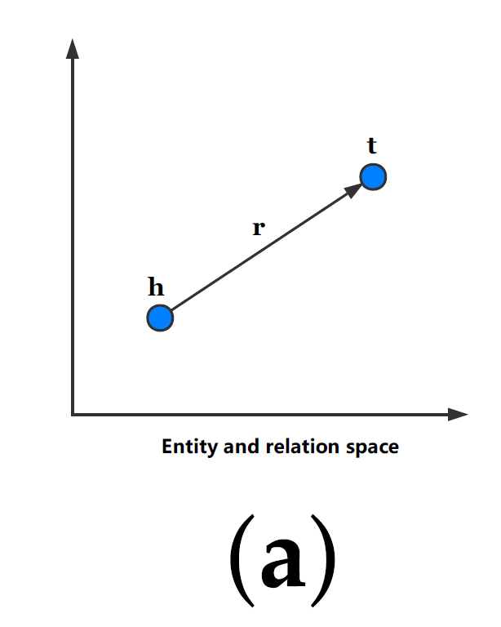
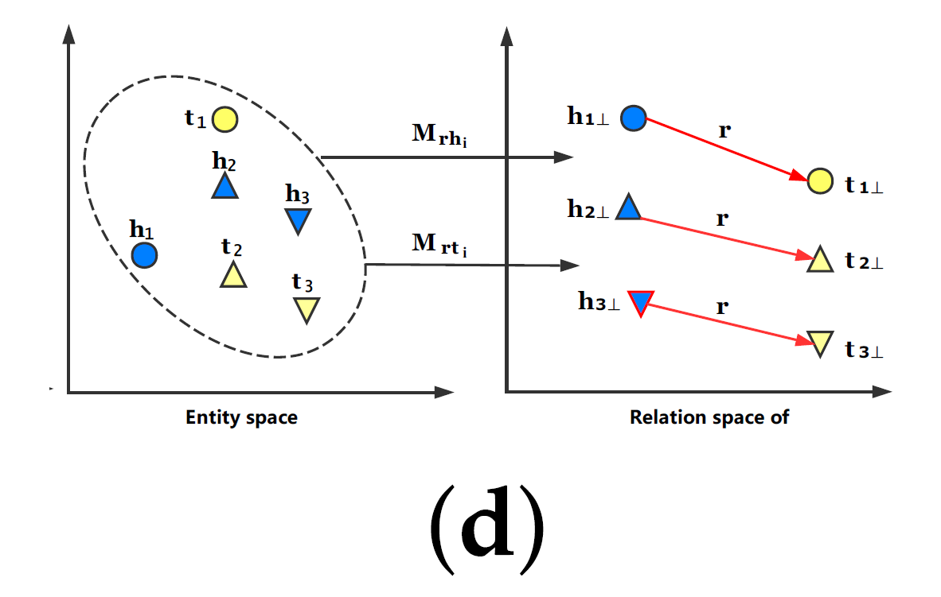

Slide 4
positives
negatives
-12
-10
-8
-6
-4
-2
0
2
4
6
8
10
12
P(y = negative) = 0.5
min_score
max_score
P(y = negative) = 0
P(y = negative) = 1

Slide 5
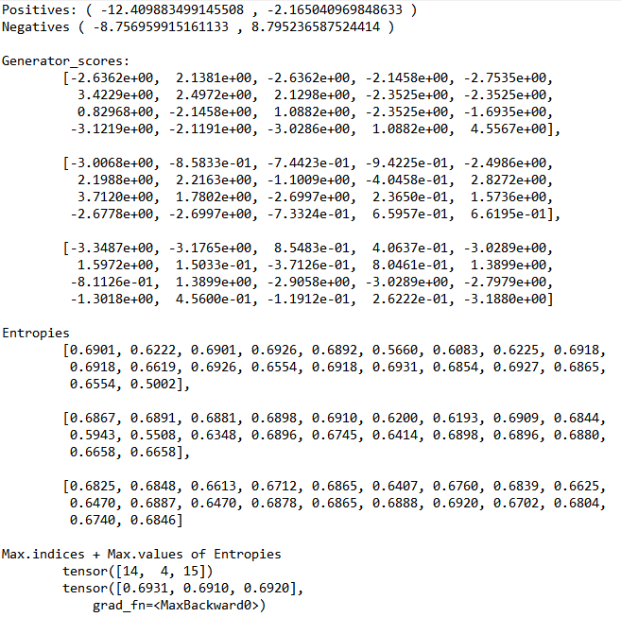
Uncertainty Sampling Example
Min Positive Score and Max Negative Score
Mid is around -1.80732

Slide 6
positives
negatives
-12
-10
-8
-6
-4
-2
0
2
4
6
8
10
12
P(y = negative) = 0.5
min_score
max_score
P(y = negative) = 0
P(y = negative) = 1

Slide 7
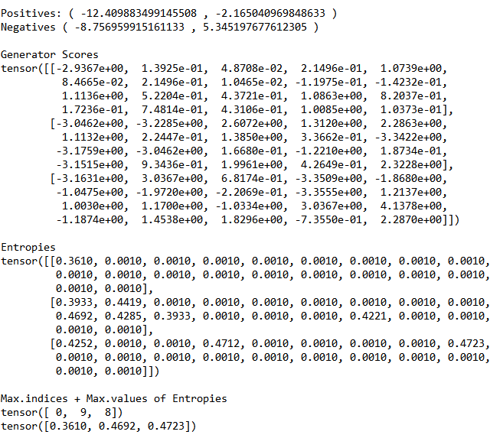
Uncertainty Sampling Example
Max Positive Score and Min Negative Score
Mid is around -5.4610

