Slide 1
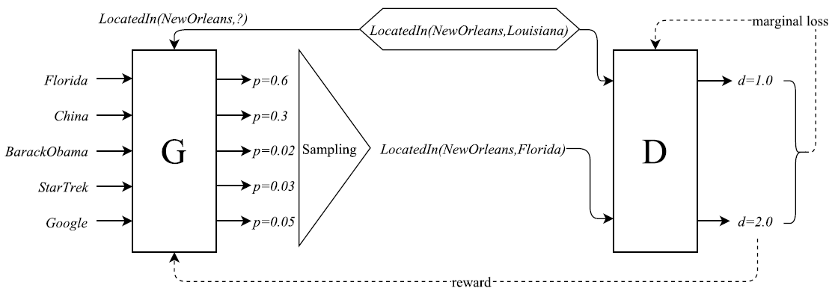




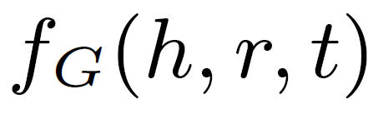
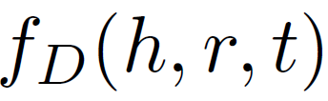




Original KBGAN
Neg
→ uniformly sampling of N_{s} entities (small number) from E to replace h or t.
Generator
Scoring function:
Sampling: (according to probability distribution)
Gradient:
Objective (maximizing expectation of negative distances):
Discriminator
Scoring function:
gradient:
objective (minimizing marginal loss function):

Slide 2
1) Improve quality of negatives in Negative Sample set Neg
Neg
Neg creator
KG
→ Based on peer groups
Collect entities that set expectations for statements that e could have, the so-called peer groups of e.
Peer groups can be based
on structured facets of the subject (such as occupation, nationality, or eld of work for humans, or classes/types for other entities)
graph-based measures such as distance or connectivity or
entity embeddings

Slide 3
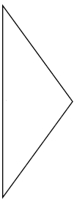

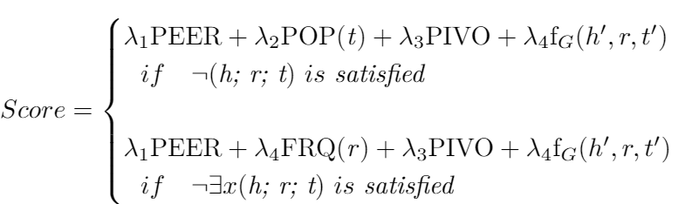



2.1) Improve Sampling of generator (by new scoring function)
Neg
Score → p
Score → p
Score → p
Sampling
Score → p
Score → p
→ uniformly sampling of N_{s} entities (small number) from E to replace h or t.
Generator
Scoring function:
Sampling:
(according to probability distribution with new scoring function)
Gradient:
Objective:
PEER (peer frequency): relative frequency of relations to tails peers have
POP (Object popularity): tail appears more frequently in KG
FRQ (Frequency of the property): frequency of the relation r in KG
PIVO (Pivoting likelihood): textual background information about entities
: Embedding with softmax probabilities

Slide 4



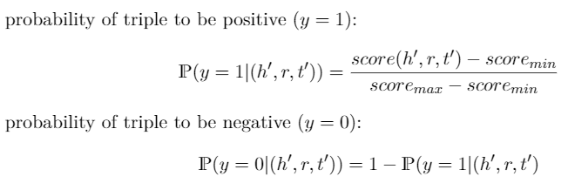
2.2) Improve Sampling of generator (by Uncertainty Sampling)
Neg
Score
Score
Uncertainty Sampling
Score
Score
Score
→ uniformly sampling of N_{s} entities (small number) from E to replace h or t.
Generator
Scoring function:
Sampling:
(uncertainty)
y = 0 if it is a bad negative triple
y = 1 it it is a good positive triple

Slide 5

2.2) Improve Sampling of generator (by Uncertainty Sampling)
Neg
Score → p
Score → p
Uncertainty Sampling
Score → p
Score → p
Score → p
→ uniformly sampling of N_{s} entities (small number) from E to replace h or t.
Consequences:
Triples are sampled with p~0.5 (least certain if it is a good negative or a bad positive triple)
we want to have instances next to 0.5, a bit smaller

