Slide 1

GETTING STARTED WITH AWS
The proper way - No more IAM users
May 2024

Slide 2
OKTA SAML WITH AWS
Agenda
About the presenter
Introduction
Step-by-step setup
Adding other accounts and setting CLI
Summary
2024 / brainly.com
‹#›

Slide 3

PRESENTER
Krzysztof Szyper
Solutions Architect, Production Infrastructure team, Brainly
Wrote first programs at 6yo with C-64.
Using AWS since 2012.
SysOps and DevOps background.
Everything-as-Code enthusiast.
Managing low-level cloud infrastructure.
After work doing some portrait and aviation photography.
2024 / brainly.com
‹#›
‹#›

Slide 4

#1 AI EDU APP IN THE WORLD
AI Learning Companion^{tm}
15M daily active users
250M+ answers in Knowledge Base

Slide 5
OKTA SAML WITH AWS
QUICK COMPARISON
IAM USERS
SAML WITH IAM ROLES
Simple solution to start with
Complex to maintain with more than one user or AWS account
Long-lived keys pose security risk
Not straightforward, needs 3rd party service
Scales easily with users and accounts
RBAC out of the box
Session token live for only few hours

Slide 6
IT CAN BE FAMILIAR If you’re working in a company with many AWS accounts you may already be using this approach.
2021 / brainly.com
‹#›

Slide 7
IS IT WORTH THE EFFORT Splitting your personal AWS account to many and using SAML will let you learn about workloads, cross-account access, etc.
2021 / brainly.com
‹#›

Slide 8
Step-by-step guide
This is simplified setup to demonstrate idea and initial setup
2024 / brainly.com
‹#›

Slide 9

PREREQUISITES
What is needed in this example?
Unix-like OS
Terraform
Okta account
At least one AWS account
2024 / brainly.com
‹#›

Slide 10
OKTA API TOKEN Token will be used by Terraform to provision Okta resources.
2024 / brainly.com
‹#›

Slide 11

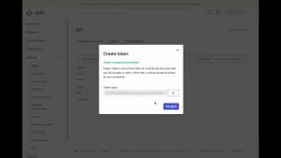
OKTA SAML WITH AWS
CREATE OKTA API TOKEN FOR TERRAFORM

Slide 12
IAM USER FOR TERRAFORM IAM user for initial provisioning of AWS resources. Can be deleted afterwards.
2024 / brainly.com
‹#›

Slide 13
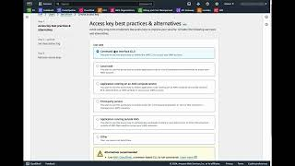
OKTA SAML WITH AWS
CREATE AWS IAM USER FOR TERRAFORM

Slide 14
SET LOCAL ENVIRONMENT Okta token and AWS credentials for Terraform providers.
2024 / brainly.com
‹#›

Slide 15
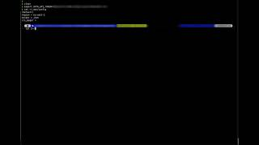
OKTA SAML WITH AWS
SET CREDENTIALS IN TERMINAL

Slide 16
PREPARE TERRAFORM CODE User access assignment and initial configuration, e.g. Okta organization.
2024 / brainly.com
‹#›

Slide 17
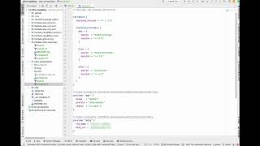
OKTA SAML WITH AWS
PREPARE TERRAFORM CODE

Slide 18
PROVISION RESOURCES SAML app and access groups in Okta, IAM user and roles for Okta in AWS.
2024 / brainly.com
‹#›

Slide 19
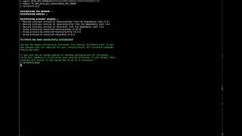
OKTA SAML WITH AWS
RUN TERRAFORM APPLY

Slide 20
IAM ACCESS KEYS FOR OKTA Keys will be used to read IAM roles and assume them in all AWS accounts.
2024 / brainly.com
‹#›

Slide 21
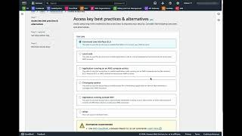
OKTA SAML WITH AWS
GET KEYS FOR OKTA IAM USER

Slide 22
CONFIGURE OKTA AND TEST LOGIN Enter those IAM access keys in Okta provisioning configuration.
2024 / brainly.com
‹#›

Slide 23
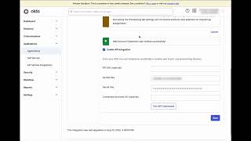
OKTA SAML WITH AWS
UPDATE OKTA PROVISIONING

Slide 24
ADDING OTHER ACCOUNTS For each AWS account IAM user is needed to provision initial AWS resources. User can be deleted later.
2024 / brainly.com
‹#›

Slide 25
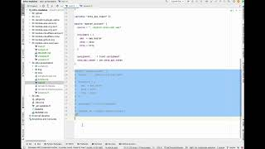
OKTA SAML WITH AWS
ADD ANOTHER ACCOUNT

Slide 26
SETUP CLI FOR AWS Setup gimme-aws-creds (presenters’s favorite) to assume IAM roles in terminal.
Will require updating profiles for AWS providers in Terraform, but IAM users can be deleted.
2024 / brainly.com
‹#›

Slide 27
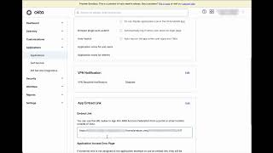
OKTA SAML WITH AWS
CLI FOR TERRAFORM AND TERMINAL

Slide 28
Summary
Some bonus tips to grow faster
2024 / brainly.com
‹#›

Slide 29
BONUS TIPS
That’s only a beginning, now…
Scale with Terragrunt
With it you don’t need to create IAM users in AWS sub-accounts. It will create IAM role for each one under the hood and use it.
Use auto-provisioning
Assigning to Okta groups can be easily automated, so every new user having specified attribute can gain access to roles and accounts on creation.
Use CI/CD tools
Automating low-level infrastructure and configuration can make any change easier. For example native AWS CodeBuild and CodePipeline.
2024 / brainly.com
‹#›

Slide 30
THANK YOU
Krzysztof Szyper

Slide 31

MORE INFORMATION github.com/ChristophShyper/presentation-okta-saml-aws
2024 / brainly.com
‹#›

Slide 32
