Slide 1
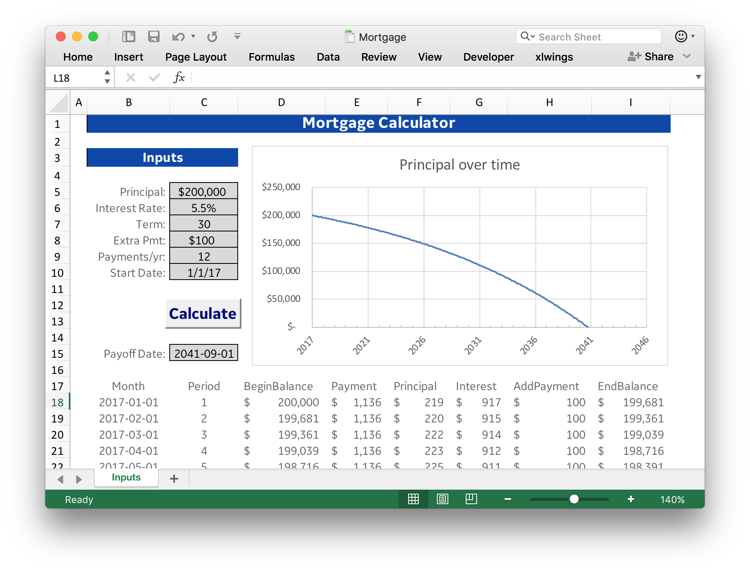
Excel chart
Inputs
Macro
Outputs

