Slide 1
Collective Memory inference from Wikipedia
MLNS Final Project Presentation
HUSSON Christophe

Slide 2


Introduction

Slide 3


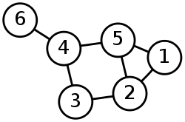
Project

Slide 4
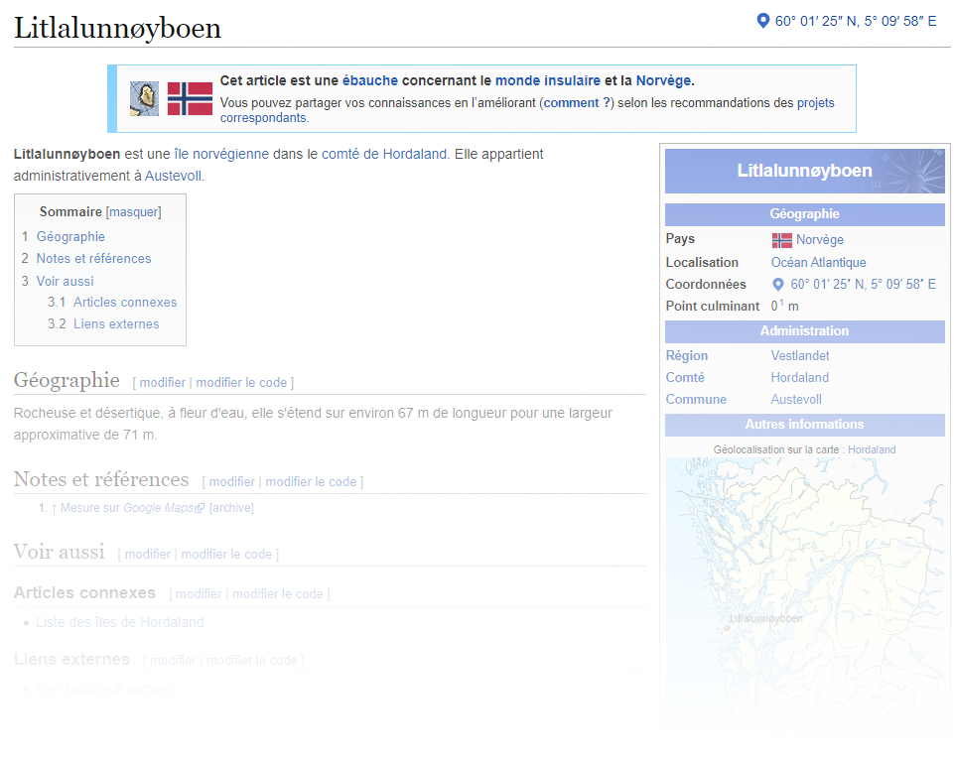
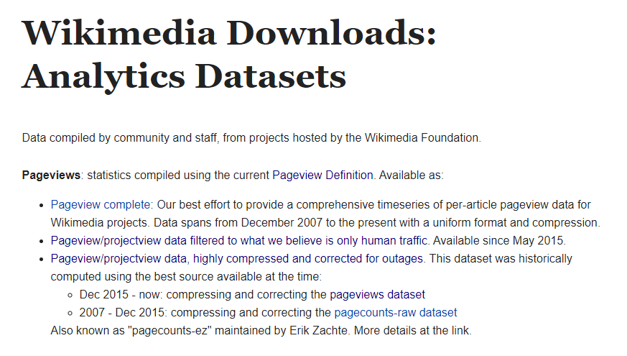
Dataset : PageViews

Slide 5
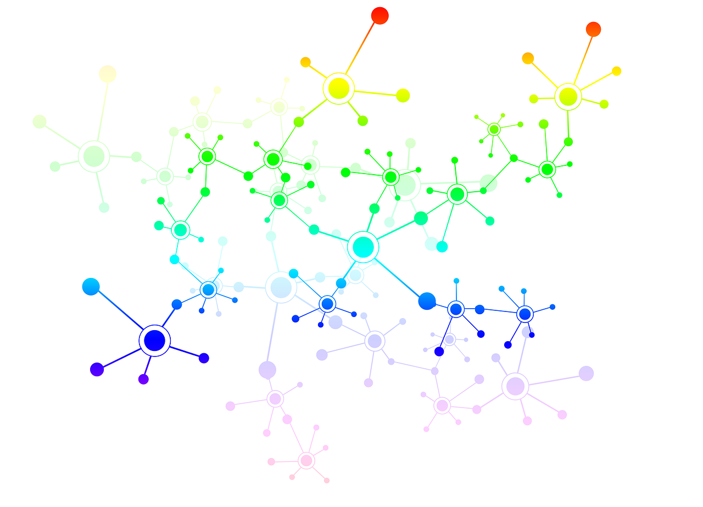
Dataset : Hyperlinks

Slide 6
Preprocessing
Matching both datasets
A
B
C
D
E
H
I
A
B
D
E
H
A
B
D
E
F
G
H

Slide 7
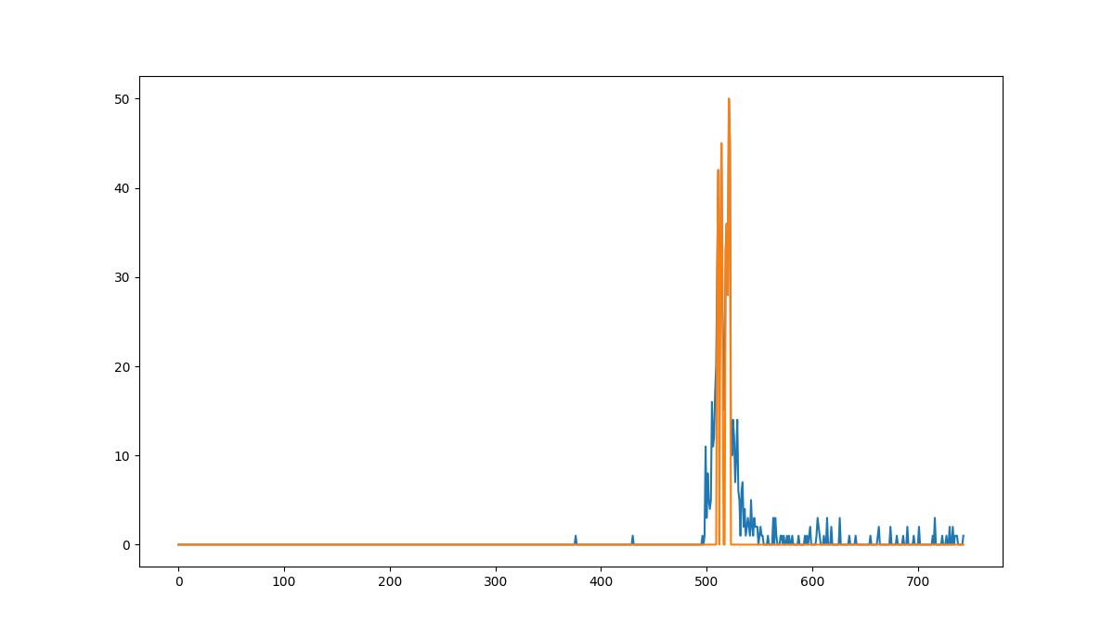
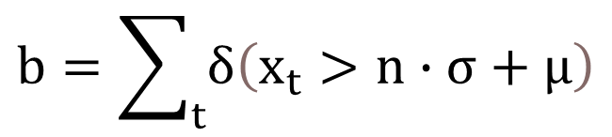
Preprocessing
Burstiness
$$b=\sum_{t}{δ\left(x_{t}>n∙σ+μ\right)}$$

Slide 8
Algorithm
Learn a new graph with a Hopfield Network
Detect Communities

Slide 9
Hopfield Networks

Slide 10
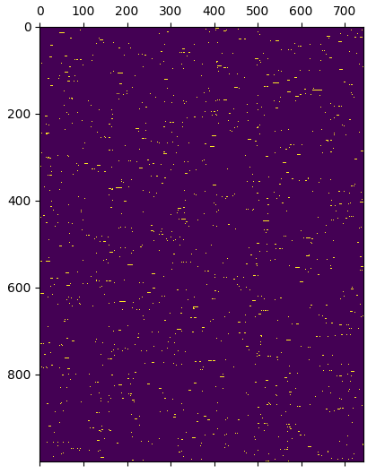
Hopfield Networks
Input

Slide 11
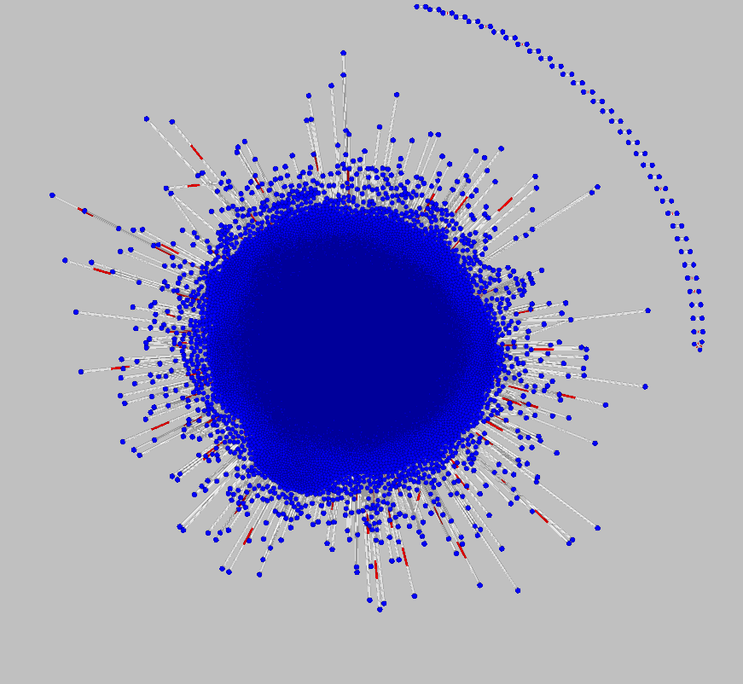
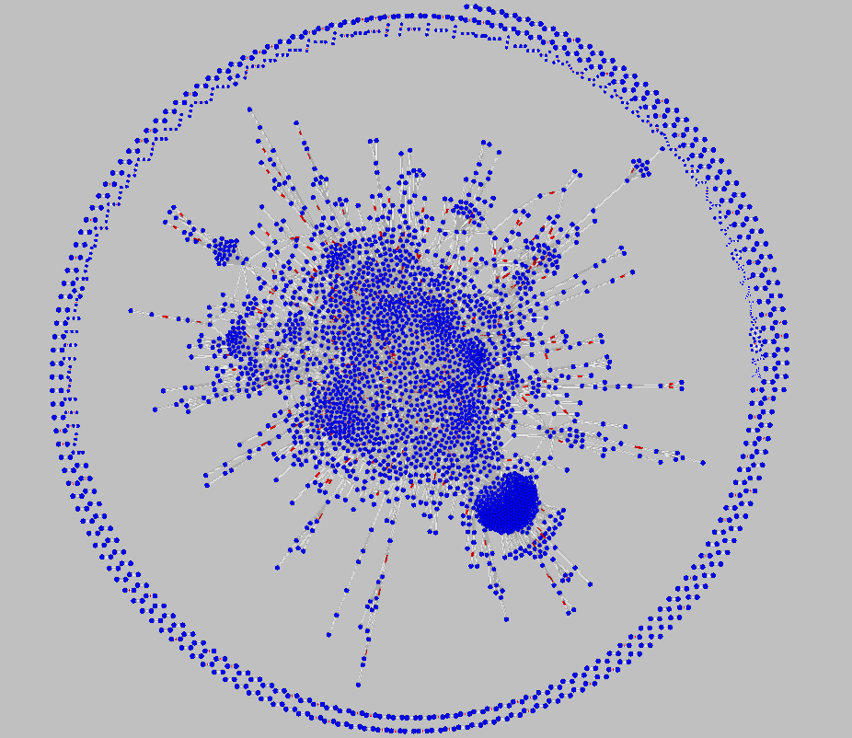
Hopfield Networks
Output

Slide 12
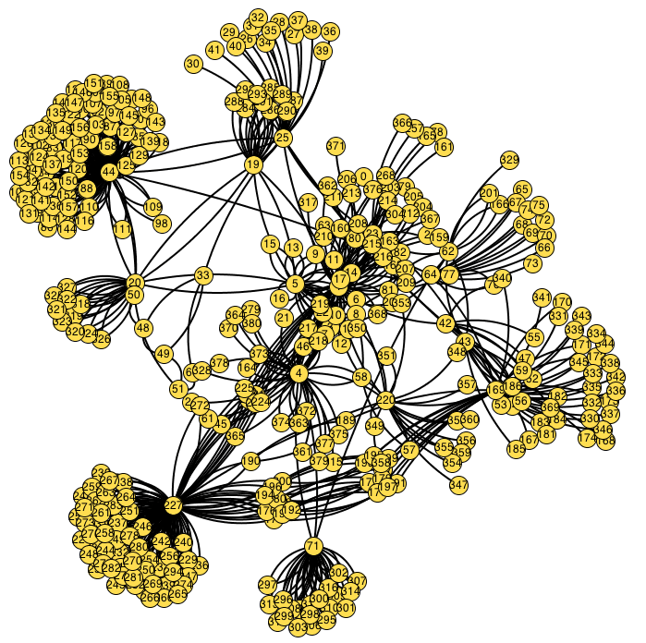
Communities detection
Girvan Newman

Slide 13
Examples
National Basketball Association -----------------------
Cultural Communication --------------------------------
Video game genres ---------------------------------------
---------------------------------------------- Dino Menoghin
----------------------------------------------- Gierson’s Raid
-------------------------------------- USS Becuna (SS-319)

Slide 14
Conclusion

Slide 15
To go further

