Slide 1

The Effect of Weather on Runs Scored in the MLB
MLB
Is there a situation gamblers could exploit to gain an edge?

Slide 2
Hypotheses
MLB
H0₁: The wind has no effect on the number of runs scored (RS) in a game
H0₂: The temperature has no effect on the number of runs scored (RS) in a game

Slide 3
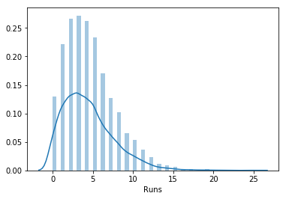
Run Distribution & Feature Significance
MLB
Is RS a Normal Distribution?
No
Skews Right
Shapiro P-value = 3.92 x 10⁴⁴
Statistical Significance Tests:
Mann-Whitney:
Independent Samples
Non-Parametric
Linear Regression

Slide 4
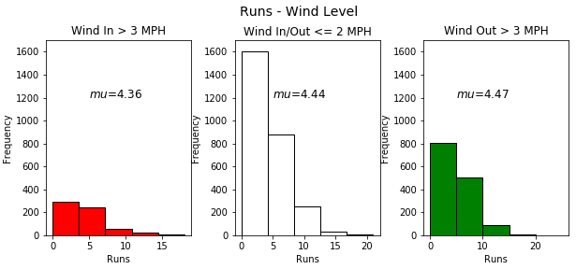
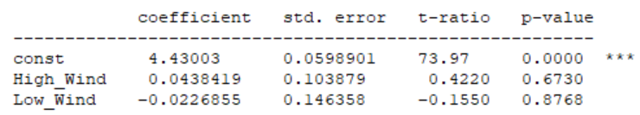
Wind Out vs Wind In (MPH)
MLB
Appears to be small increase in RS when wind is blowing out
Winds above 3 MPH
Mann-Whitney p-value: 0.19
Linear Regression
P-Values:
Wind Out (High) : 0.673
Wind In (Low) : 0.8768
Coefficients:
Wind Out: 0.0438
Wind In: -0.0227
RS increase with wind blowing out & decrease when blowing in is expected but p-values too high to assign meaning

Slide 5
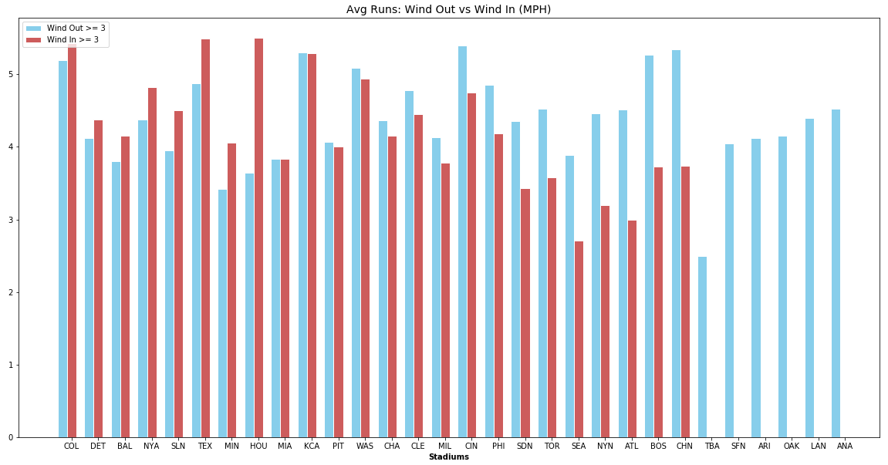
Wind Out (▪) vs Wind In (▪) (MPH)
MLB
RS are higher with the wind blowing out in more stadiums than not
Potential effect present
Some stadiums rarely have wind blowing in at 3 MPH or more
Large increase in RS with wind blowing in at HOU
Trend or small sample size?
*No differentiation between Left, Right and Center Field in regards to wind direction

Slide 6
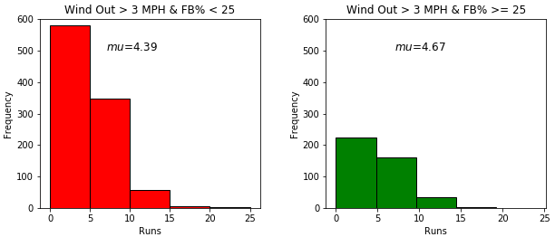
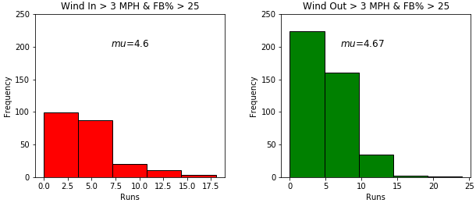
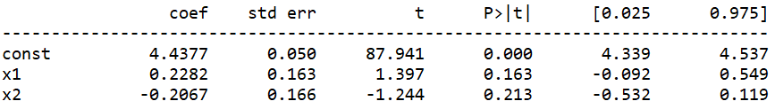
Wind vs Runs for High Fly Ball Percentage Pitchers
MLB
Wind Out: (FB% < 25 vs FB% ≥ 25)
Small increase in RS
Mann-Whitney
P-value = 0.065
Likely significant difference in RS
Linear Regression
FB% > 25: 0.228 run increase
FB% < 25: -0.207 run decrease
P-values indicate strong chance effect is just noise
R² < 0.01: Less than 1% of variance explained by Wind/FB
FB% > 25: (Wind In vs Wind Out)
Nearly identical mean values
Wind Out
(FB > 25)
(FB < 25)

Slide 7
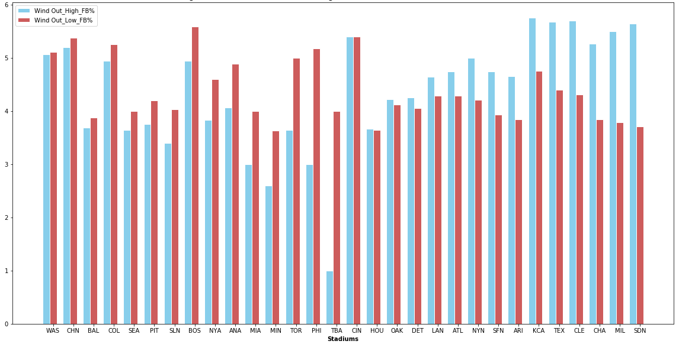
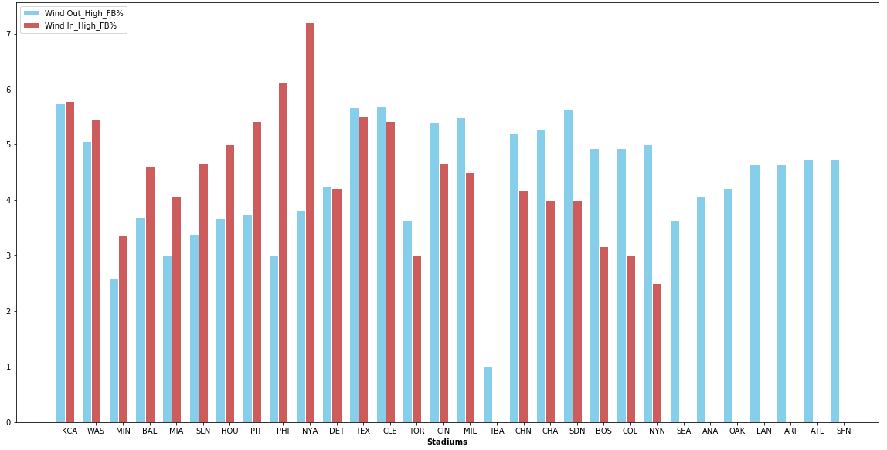
Wind with High Fly Ball Percentages by Stadium
MLB
Avg. Runs: Wind Out(≥ 3 MPH) – High FB(▪) vs Low FB(▪)
Avg. Runs: High FB - Wind Out(▪) vs Wind In(▪) (≥ 3 MPH)
Increase in RS at several stadiums
Lowest Mann-Whitney p-value: 0.07 (CLE)
Stadium sample sizes too small to assess significance with high confidence
No clear trend
8 Stadiums without any games with wind blowing in above 3 MPH
Stadium sample sizes too small to assess significance (NYA Wind In: 6 games )

Slide 8
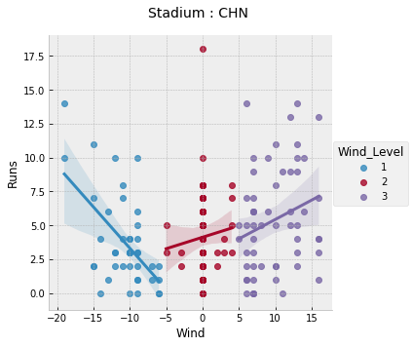
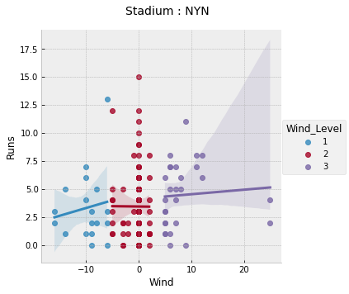
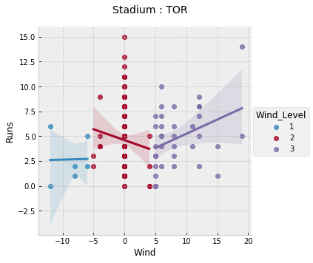
Runs vs Wind Level by Stadium (Top P-Values)
MLB
Mann-Whitney:
P = 0.016
Mann-Whitney:
P = 0.059
Mann-Whitney:
P = 0.054
The wind appears to have a significant effect on runs scored at select stadiums

Slide 9
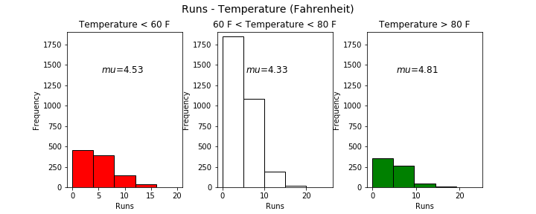
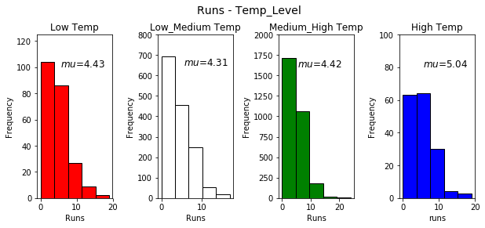
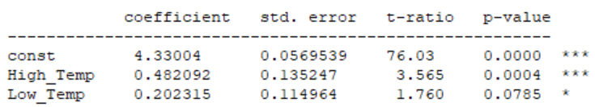
Runs Scored in High vs Low Temperatures
MLB
Significant RS increase above 80°F
Mann-Whitney: p = 0.026
RS increase at 4th quantile temps
Linear Regression
pvalue of 0.0785 and 0.0004
0.48 more RS at temps above 80°F
R² < 0.01: Less than 1% of variance explained by temp

Slide 10
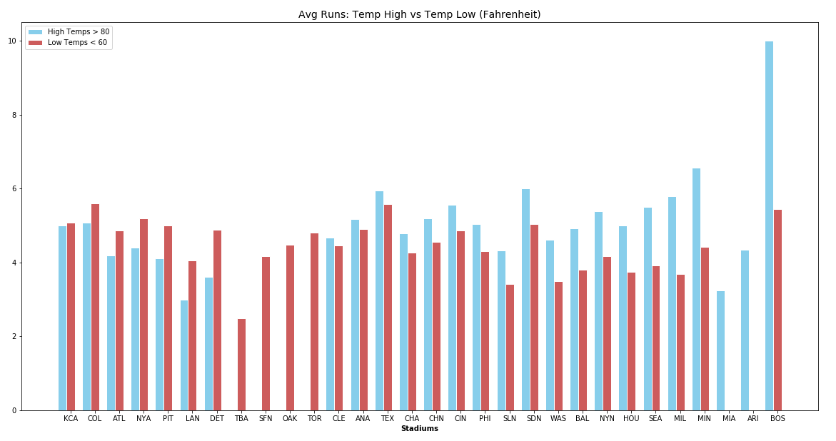
Runs Scored – High (▪) vs Low (▪) Temperatures
MLB
Mann-Whitney
P-value = 0.026
RS increase is significant
BOS is an outlier that may be skewing results
Must be careful in assigning causality

Slide 11
Run Prediction – Runs Scored/Game
MLB
Methods:
Multiple Regression
ANN (Neural Network)
XGBoost
CatBoost
Decision Trees
Stacking (ANN, XGBoost, CatBoost) with a SVM
Statistics:
Starting Pitcher (SP)
Standard season stats
R/L split stats averaged based on projected lineup
Batters
Standard season stats
R/L split stats against SP hand
Bullpen
Weighted based on SP average innings/game
Stadium (Park Factor)
Weather
Temp
Wind
Humidity
Prediction Method | Mean Average Error
Stacking | 2.35 (Best)
ANN | 2.41
XGBoost | 2.61
CatBoost | 2.62
Predict 4 Runs/Game | 2.45
4 RS/game yields MAE of 2.45
results aren’t very impressive
Best online predictions found yielded a MAE of 2.1

Slide 12
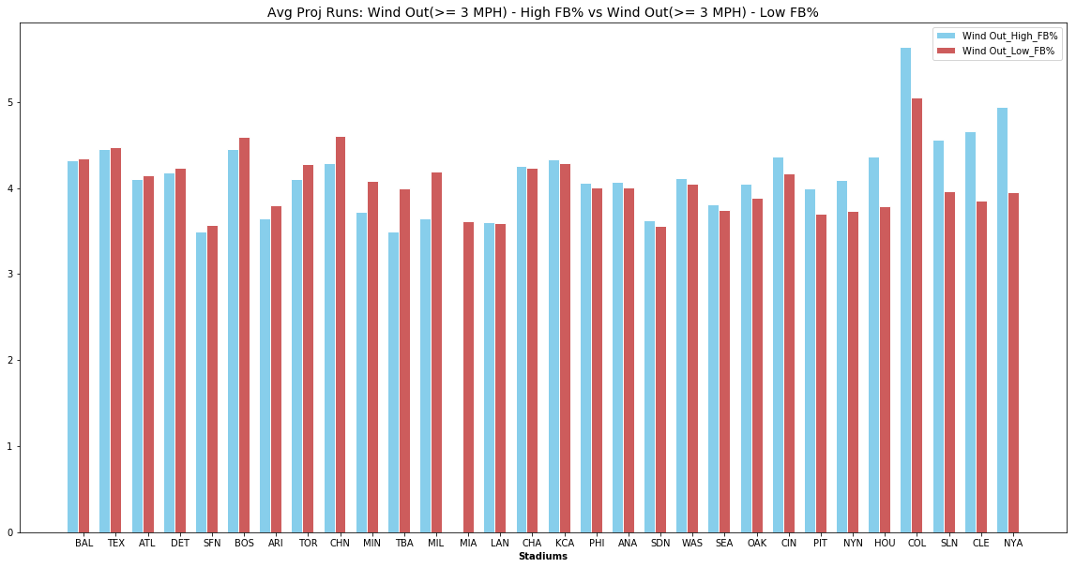
Results & Analysis
MLB
Wind Level:
No significant change in RS for all stadiums (Null Accepted)
Fly-ball pitcher & wind out averages slightly more RS
Wind in & fly-ball pitcher had no significant decrease in runs
Expect opposite effect of previous example. False positive?
Significant increase in RS at select stadiums (Null Rejected)
Several stadiums more likely to experience extreme wind conditions
Larger sample size necessary
Small R² indicates a small percentage of RS variance from wind
Run Prediction:
Small improvement over guessing 4 runs/game
Small weather effect sizes & a MAE 0.25 runs larger than Vegas make winning big unlikely, but Vegas predictions(below) assign little weight to weather
Hot, windy days with high FB% pitchers at the right stadiums should avg. near a run more per game and provide some value
Proj. Avg. Runs: Wind Out – High FB% (▪) vs Low FB% (▪)
Temperature Level:
Significant increase in RS at high temps (Null Rejected)
Doesn’t establish causality
Hitters might improve throughout the season as summer temps rise
Pitchers may be worn down later in the season
Traded or players lost to injury possibly replaced with lesser talent
Small R² indicates temp accounts for a small percentage of run variance

Slide 13
Thoughts
MLB
Weather conditions likely effect RS but a larger sample size is needed to increase our confidence
Wind out to RF and LF were treated only as wind out. Analysis that factors in wind direction more accurately may lead to different results
End of year statistics likely less accurate than real-time statistics.
Ex. A pitcher with a high FB%, due to the inability to keep their change-up down, could make small corrections that lead to a sustained decrease in FB% and skew results
Small margins in RS and FB% likely make the above especially important
A Time Series could be used to account for team trends, player advancement and trades later in the year
Starter pitch count from previous games may effect future games and could be added

