Slide 1



Beyond
SVN:
Harnessing the power of git and github for agile development
Notes:
Good morning/afternoon everyone. Thank you for joining us today. For those who don’t know me, my name is Christopher Deo and I’m the one responsible for migrating our code from SVN to GitHub. Since some of us may not have used github before I put together this presentation to help bring everyone up to speed. In the first part of this presentation, we will be delving into the world of version control systems and specifically comparing Subversion (SVN) and Git/GitHub.

Slide 2
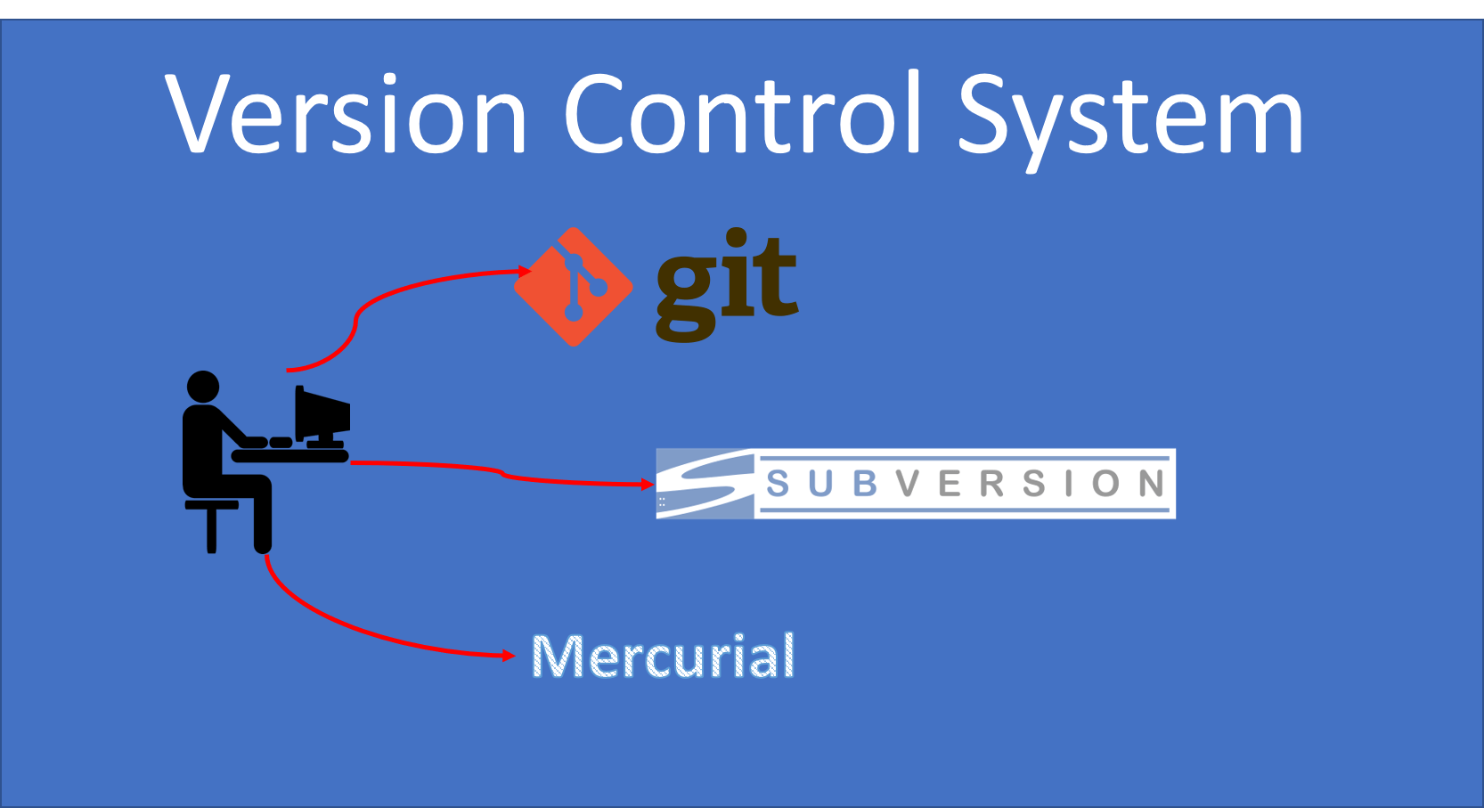
Notes:
As an experience developer, you already know the value of a quality version control system. Version control is an essential tool for managing changes to source code, documents, and other files in collaborative projects. They allow teams to track modifications, maintain a history of changes, and facilitate collaboration among team members. Perhaps most importantly, they give you an easy way to roll back changes if/when things go amiss, not that that ever happens here, right? The two most commonly used version control systems are SVN and Git, each with its own unique characteristics and advantages.

Slide 3
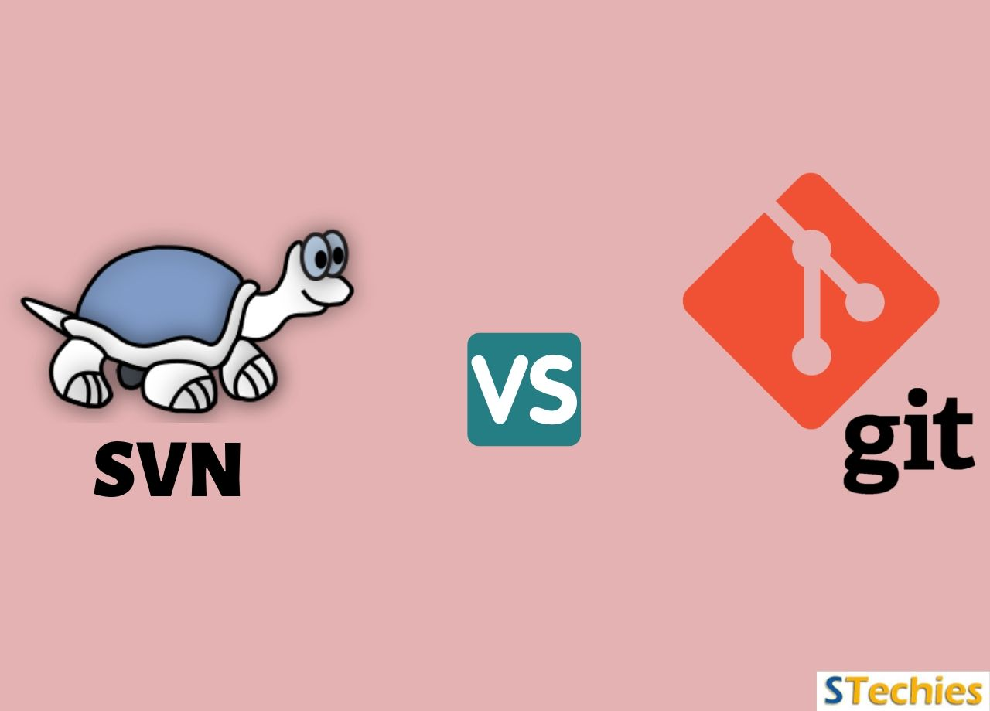
Notes:
Throughout this presentation, we will explore the differences between SVN and Git, their respective workflows, collaboration features, and the benefits they offer to development teams. So, let's dive in and discover what sets these version control systems apart.

Slide 4


Version Control
Manage changes
Collaborative Environment
Revision History
Notes:
Before we delve into the differences between SVN and Git/GitHub, let's start with a brief overview of version control systems.
A version control system is a software tool that helps teams manage changes to source code, documents, and other files in a collaborative environment. It acts as a centralized repository, keeping track of all modifications made to files and providing a historical record of changes.
An effective version control system allows teams to work simultaneously on the same files without conflicts.

Slide 5



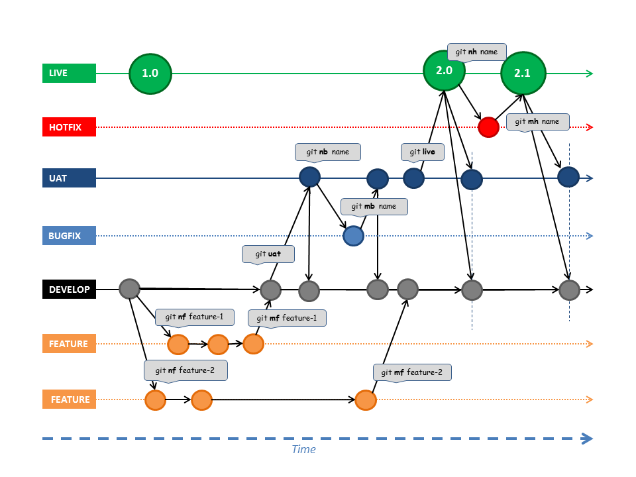

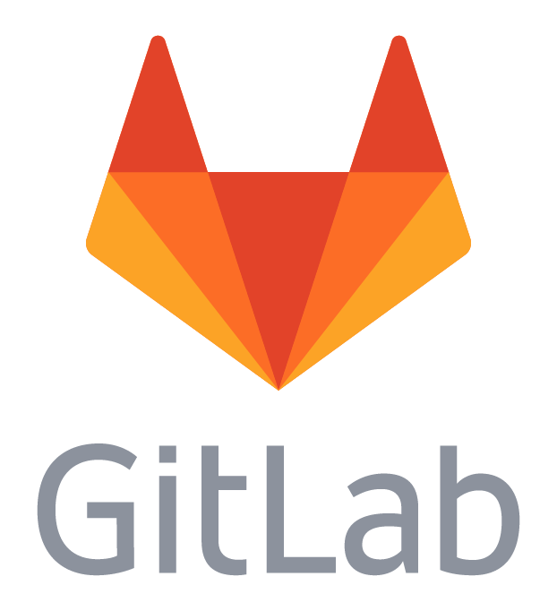
Git based VCS
Github
Bitbucket
GitLab
Notes:
In today's presentation, we will be focusing on two popular VCS options: Subversion, commonly known as SVN, and Git. Git can be used with a number of cloud-based repository storage solutions such as GitHub, BitBucket, Gitlab, and AWS CodeCommit. Here at CRL, we are using GITHUB so that is the focus of this presentation. While both SVN and GIT serve the same purpose of version control, they differ in their underlying architecture and workflows.

Slide 6

SVN:
Centralized vcs
Notes:
SVN is a centralized version control system.
In SVN, all files and their versions are stored in a central repository. This means that there is a single, authoritative source of truth for the project. When team members want to access files or make changes, they need to connect to the central repository.
This centralized architecture in SVN offers certain benefits. It provides a clear hierarchy of project files and allows for controlled access and permissions. Additionally, it facilitates a linear history of changes, making it easier to track modifications and understand the progression of the project.

Slide 7



Challenges of svn
Centralized Server
No Atomic Commit Support
Poor Branch & Tag Support
Notes:
Centralized Architecture: SVN follows a centralized model where the repository resides on a central server. This means that every operation (commit, update, etc.) requires communication with the central server. This can introduce a single point of failure and dependency on network connectivity.
Lack of Atomic Commits: SVN does not provide atomic commits by default. In SVN, a commit can be a combination of multiple changes, and if the commit fails midway, it can leave the repository in an inconsistent state. This can be problematic when dealing with large codebases or when multiple developers are working on the same project simultaneously.
Limited Branch and Tag Support: SVN's branch and tag mechanisms are not as lightweight and flexible as those in Git. Creating branches and tags in SVN involves creating physical copies of directories, which can impact repository size and performance.

Slide 8
SVN Workflow
Make Changes:
Resolve Conflicts:
Commit Changes:
Update Local Copy
Notes:
1. Update Local Copy:
- Team members start by updating their local copies to the latest version from the central repository.
- This ensures that they have the most up-to-date code and can work on the latest changes made by other team members.
- The update command synchronizes the local copy with the central repository, pulling in any new changes.
2. Make Changes:
- After updating their local copy, team members can make changes to the files they are working on.
- They can modify existing code, add new files, or delete unnecessary files as needed.
- SVN allows developers to work on multiple files simultaneously, maintaining a consistent project structure.
3. Resolve Conflicts:
- Conflicts may arise when multiple team members try to modify the same file simultaneously.
- A conflict occurs when SVN cannot automatically merge the changes due to conflicting modifications in the same part of a file.
- Team members need to resolve these conflicts manually by carefully reviewing the conflicting sections and making necessary adjustments.
- SVN provides tools to help identify and resolve conflicts, allowing team members to collaborate effectively.
4. Commit Changes:
- Once the changes are made and any conflicts are resolved, team members can commit their changes to the central repository.
- The commit operation sends the modified files and related metadata to the central repository, recording the changes made.
- It's essential to provide a meaningful commit message that describes the changes made, aiding in future reference, and understanding.

Slide 9
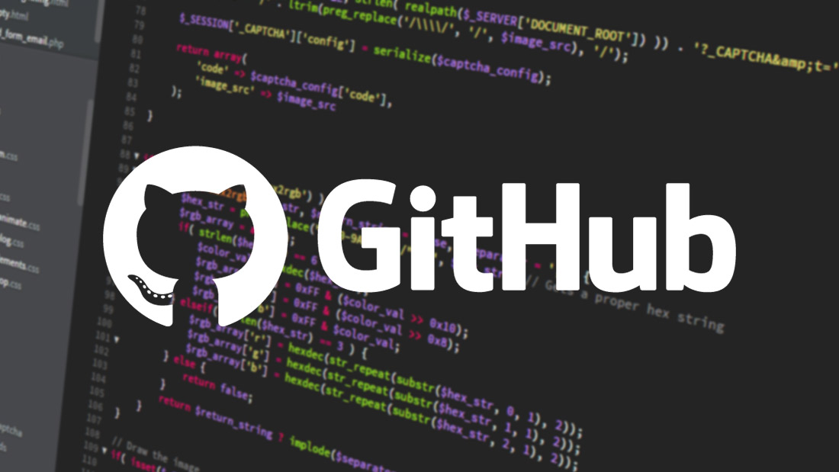
Git: distributed vcs
Notes:
Now let’s talk about git and github.
Git is a distributed version control system that allows each team member to have their own local copy of the entire repository, including the full history of the project.
With Git, team members can work independently on their local copies, making it easier to experiment, make changes, and iterate without impacting others. This decentralized approach gives developers greater flexibility and freedom.
To facilitate collaboration and remote team workflows, Git is often paired with platforms like GitHub. GitHub acts as a centralized remote repository that enables team members to share and synchronize their local changes, collaborate on code reviews, and manage project workflows.

Slide 10


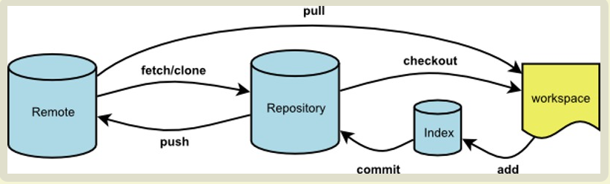
Clone project repository
Notes:
In Git/GitHub, team members start by cloning the repository, which creates a complete local copy of the project, including its entire history. This allows each team member to work independently on their local copy.
Once team members have their local copies, they can make changes, such as adding new features or fixing bugs, directly within their local environment. This independence allows for parallel development, with team members working on different features simultaneously.

Slide 11
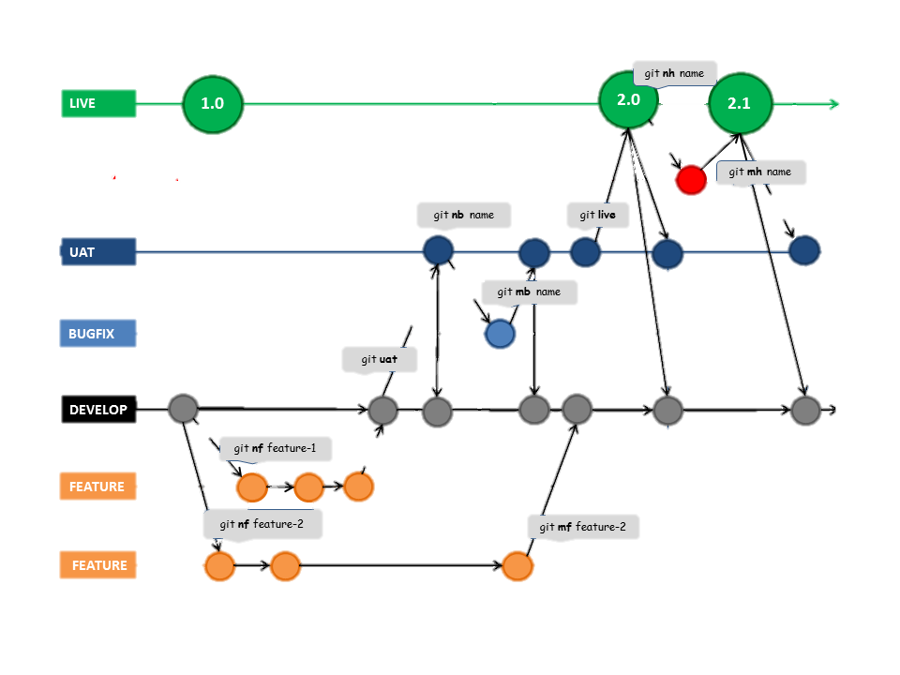
Create branches
Notes:
To organize their work and maintain a clean codebase, team members can create branches. Branches act as separate workspaces where specific features or bug fixes can be developed without impacting the main branch.

Slide 12
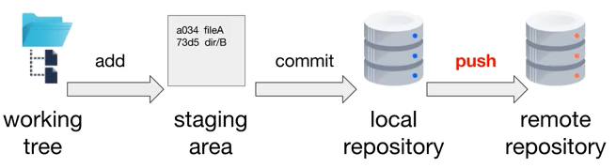
Merge Changes
Notes:
After completing their changes on a branch, team members can merge their work back into the main branch, often referred to as the "master" or "main" branch. This merging process combines the changes made in the branch with the main branch, ensuring that the latest features and bug fixes are incorporated into the project.

Slide 13
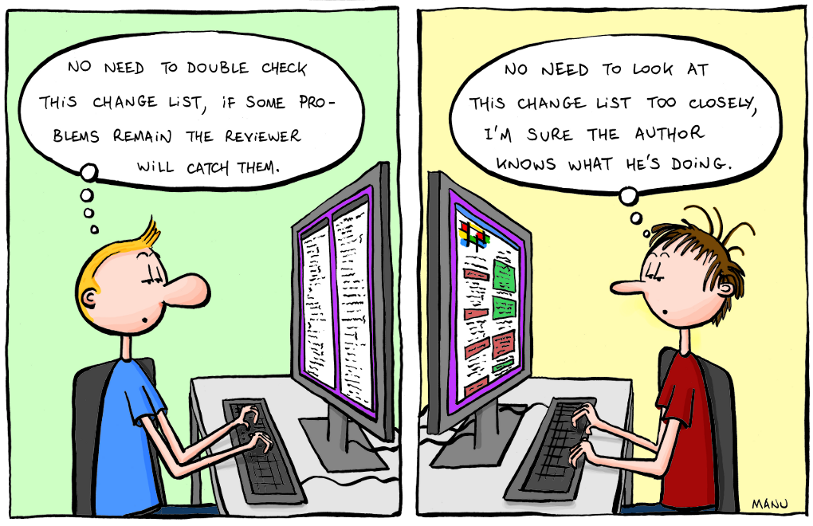
Create a PR and code review
Notes:
Git/GitHub provides powerful collaboration features, such as pull requests, which allow team members to propose and review changes before merging them into the main branch. This facilitates code review and helps maintain code quality and consistency.

Slide 14

Collaboration and Branching in Git/GitHub
Notes:
One of the key strengths of Git and GitHub lies in their collaboration and branching capabilities.
[Transition to next slide]
Git/GitHub allows multiple team members to work on different branches simultaneously without conflicts. Each branch represents a separate workspace where team members can make changes independently.
[Transition to next slide]
This branching approach provides several benefits. Firstly, it allows developers to isolate their changes within a specific branch, preventing interference with the main codebase until the changes are fully tested and approved.

Slide 15
Benefits of branching and collaboration in github
Increased Productivity
Code Isolation
Parallel Development
Notes:
Additionally, branching enables parallel development, allowing team members to work on different features or bug fixes concurrently. This can significantly increase productivity and reduce development time.

Slide 16

This Photo by Unknown Author is licensed under CC BY
Notes:
Let's recap the main points we've discussed today regarding SVN and Git/GitHub.
Both SVN and Git/GitHub are popular version control systems used by development teams worldwide. However, they differ in their architectures, workflows, and collaboration features.
SVN operates on a centralized model, with a central repository storing all files and their versions. On the other hand, Git/GitHub utilizes a distributed model, allowing each team member to have their own complete local copy of the repository.
We explored the workflows in SVN, where team members update their local copies, make changes, and commit them to the central repository. In Git/GitHub, team members clone the repository, create branches for independent work, and merge changes back into the main branch.
In conclusion, both SVN and Git/GitHub have their strengths and suitability depending on the project and team dynamics. Understanding these differences will enable you to make an informed decision and choose the most suitable version control system for your specific needs.

