Slide 1
Feature Toggling With FF4J By Sasi Peri
October 7–10, 2019
Austin Convention Center

Slide 2
Agenda
Why I am doing this presentation?
Use cases
Demo
Pitfalls
Reference links, source code (GIT)
Q & A

Slide 3
Safe Harbor Statement
The following is intended to outline the general direction of my findings and is intended for information purposes only. You are encouraged to do your own thorough analysis and research before the use of the technology in your production grade applications.

Slide 4
Definitions
What’s a feature?
A user story that’s visible OR a requirement resulting in backend code(logic).
Also known as “feature flip”, “feature flags” or “feature bits”
What’s feature toggling?
Feature toggling is a technique used to enable or disable certain behavior of the system (typically at runtime) to gradually release and test new features.
What’s FF4J? (Cedrick Lunven)
FF4J stands for “feature flipping for java”. This open source framework in Java (licensed under Apache-V2), works very well with any Java and(or) Spring/SpringBoot based applications.
Note: Other frameworks in java/other-technologies are in the reference section
Notes:
Spring Cloud Config Server and ACTUATOR

Slide 5
Technology
Java, open source
Apache-v2 license
Spring, SpringBoot, Non-Web, DeskTop and any such applications
REST-API available for non-java.
AOP based and Non-AOP (IOC) toggles available.
JSP Tag libs and ThymeLeaf Dialects available.
Can integrate with rules engines like Drools

Slide 6
Uses (cont’d…)
Release and deploy based feature toggles (short lived). Examples include
Hide feature that are not “complete”, business changed the mind last minute, bug identified right after deploy in a feature.
Canary releases
Blue-green deployments
A/B testing
Business feature toggles (usually long lived). Examples include
Dark Launch
Business functionality flip on the fly
Business rule-based feature enabling
Many other strategies to gradually release functionality into production (Role/Group, Region, Clients/Servers) .

Slide 7
Flipping strategies
Simple flip & group (release) flip
Role based flip
Client & Server Filters & Region based
Blacklist
Whitelist
Release date based
Office hour strategy
Week timetable
Public holidays
Special openings
Ponderation & Dark Launch Strategy (% of requests based, Dark Launch zero downtime deployment pattern)
AOP-Based flipping (that can be integrated with Circuit Breaker)
Custom Strategies

Slide 8
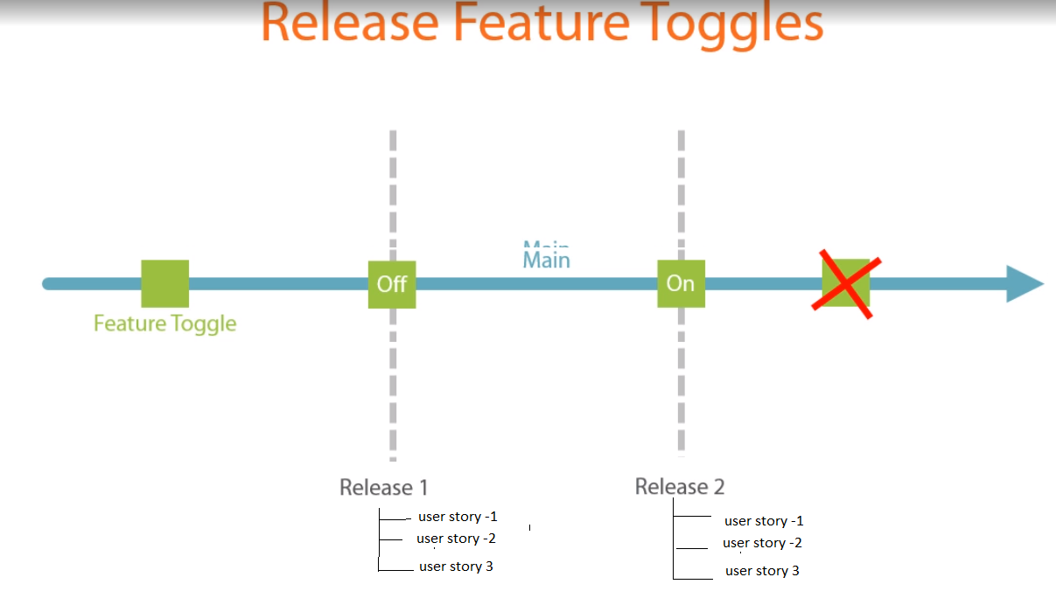
Uses
Release and deploy based feature toggles (short lived)
Hide feature that are not “complete”.
CI & CD made easier
Reduce the cost of long-lived branches
Avoid merging hassle
Short lived (must be removed as soon as release is ready)

Slide 9
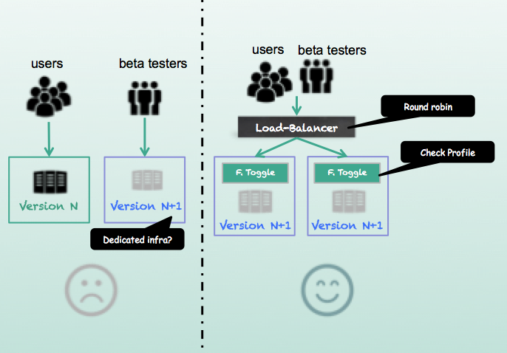
Canary release
Canary release is a technique to reduce the risk of introducing a new software version in production by slowly rolling out the change to a small subset of users before rolling it out to the entire infrastructure and making it available to everybody.

Slide 10
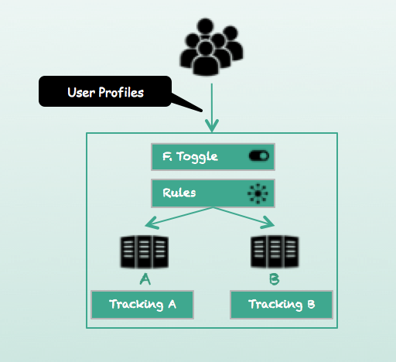
A/B test
A/B testing (also known as split testing or bucket testing) is a method of comparing two versions of a webpage or app against each other to determine which one performs better.

Slide 11
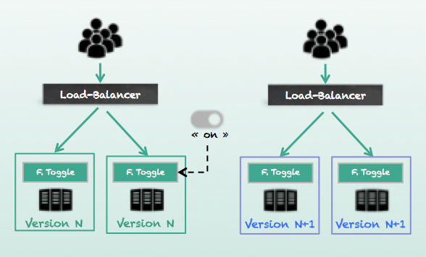
Blue-green deploy
Blue-green deployment is a technique that reduces downtime and risk by running two identical production environments called Blue and Green. At any time, only one of the environments is live, with the live environment serving all production traffic. For this example, Blue is currently live and Green is idle.

Slide 12
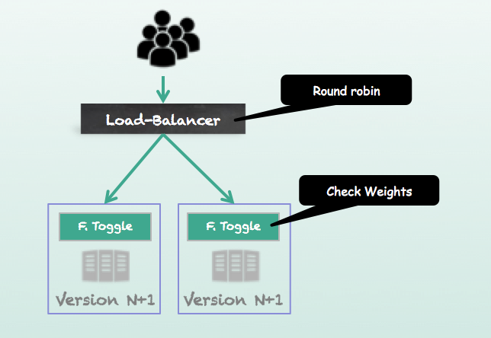
Dark Launch
The Dark Launch develop pattern is the capacity for a system to enable a new feature for a subset of incoming requests and measure if the new feature introduce some overhead. Without feature toggle you must deploy your new package on a node of the cluster and measure. With this strategy all nodes of the cluster have the new version and execute new behavior for a subset of requests.

Slide 13
DEMO (SpringBoot & FF4J)

Slide 14
Feature and property stores
Feature
Simple XML based
Caching
JCahce
Redis
EHCache
…and more
RDBMS (supports any DB via JDBC)
NoSQL
Cassandra
Mongo
Elastic search as NoSQL
Neo4j (Graph DB)
Property
Spring Config Srv
Archaius/CommonsConfig
..and more

Slide 15
Audit and monitor
Auditing
All CRUD operations on features and properties can be audited.
Monitoring
Able to record all features usage (hits) and compute metrics based on different KPI like users, sources or hosts. Dashboards allow to search and filter in history, asynchronously with no blocking.

Slide 16
Administration
Embedded web-gui
Stand alone GUI
Command Line Interface
MBeans are provided to operate via JMX.

Slide 17
Pitfalls
“Release toggles” particularly are the last thing you should do, first choice should be to break the feature down so you can safely introduce parts of the feature into the product.
- Martin Fowler
Design & Develop
Feature toggle requires
A robust engineering process
Solid technical design (including test strategy with on/off)
A mature toggle life-cycle management
If not
They will become largest and worst technical debt.
Testing
Need to develop test cases with features ON & OFF.

Slide 18
Thank you
Jim Shingler - Director, Platform Architecture & DevOps @ Cardinal health
Ralph Meira – Platform Architect, Pivotal
Tech Elevator - Cleveland

Slide 19
Links and references
References
KNightmare devops cautionary tale(Knight Capital story) https://dougseven.com/2014/04/17/knightmare-a-devops-cautionary-tale/
Some feature toggle frameworks list in different technologies http://enterprisedevops.org/feature-toggle-frameworks-list/
Feature toggle the worst Tech Debt http://swreflections.blogspot.com/2014/08/feature-toggles-are-one-of-worst-kinds.html
https://martinfowler.com/bliki/FeatureToggle.html
Other Links
FFJ – Home : https://ff4j.github.io/
Source code for this demo(and more free code) is available on my Git Gub: https://github.com/sasiperi/FeatureToggle-Boot2

Slide 20
Q&A

