Slide 1
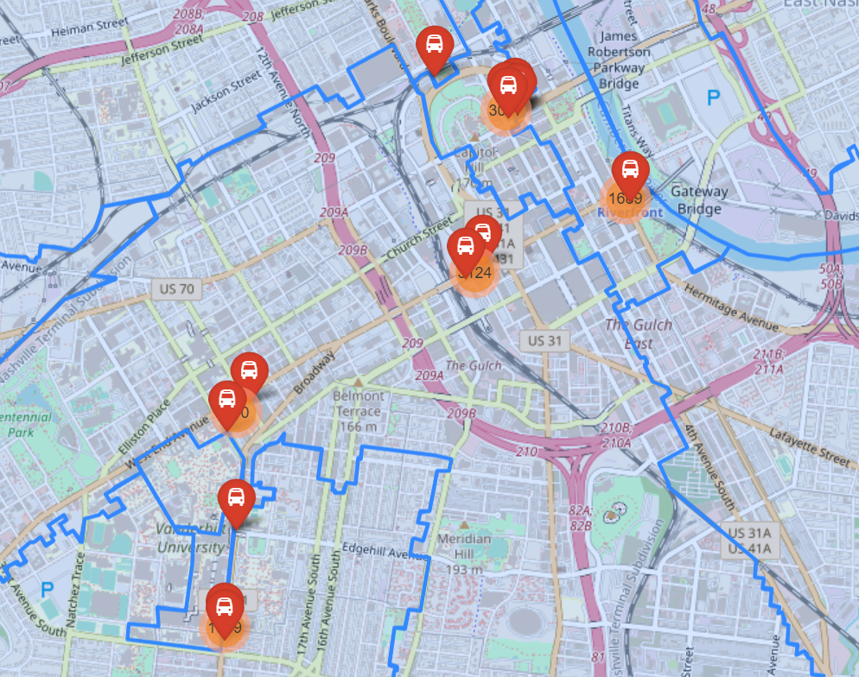
Are scooters used to provide transportation from public transit hubs to work or school?
Map of Trips that started 250 feet of less from Regional Transit Authority bus stop and went a mile of less.
7026 trips started near RTA bus stops.

Slide 2
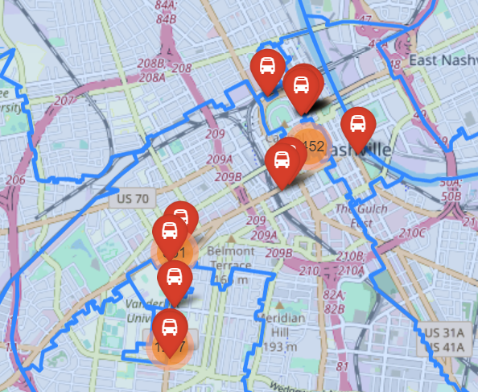
Are scooters used to provide transportation from public transit hubs to work or school?
Map of Trips that ended 250 feet of less from Regional Transit Authority bus stop and went a mile or less.
6505 trips ended near RTA bus stops.
Scooters were used 13531 times as “last mile” transportation.
Given a total of 485,222 trips provided in the data, “last mile” transportation accounted for only 2.8%

