Slide 1
Chapter 3
Consumer Behavior

Slide 2
Consumer Behavior
There are three steps involved in the study of consumer behavior
Consumer Preferences
  To describe how and why people prefer one good to another
Budget Constraints
  People have limited incomes
Notes:
8

Slide 3
Consumer Behavior
Given preferences and limited incomes, what amount and type of goods will be purchased?
  What combination of goods will consumers buy to maximize their satisfaction?
Notes:
9

Slide 4
Budget Constraint
Describe budget constraint
  Algebra
  Graph
Describe changes in budget constraint
Government programs and budget constraints
Non-linear budget lines

Slide 5
Consumption Bundle
A consumption bundle containing x₁ units of commodity 1, x₂ units of commodity 2 and so on up to x_{n} units of commodity n is denoted by the vector (x₁, x₂, … , x_{n}).

Slide 6
Physical Constraints
Non-negative:
Consumption set:
X={ (x₁, … , x_{n}) | x₁ ≥ 0, … , x_{n} ≥ 0 }
A consumption set is the collection of all physically possible consumption bundles to the consumer
You only have 24 hours a day
Subsistence need

Slide 7
Budget Constraints
Commodity prices are p₁, p₂, … , p_{n}.
Q: When is a bundle (x₁, … , x_{n}) affordable at prices p₁, … , p_{n}?
A: When
p₁x₁ + … + p_{n}x_{n} ≤ m
where m is the consumer’s (disposable) income.

Slide 8
Budget Constraints
The bundles that are only just affordable form the consumer’s budget constraint. This is the set
{ (x₁,…,x_{n}) | x₁ ≥ 0, …, x_{n} ≥ 0 and
p₁x₁ + … + p_{n}x_{n} = m }.

Slide 9
Budget Set and Constraint for Two Commodities
x₂
Budget constraint is
p₁x₁ + p₂x₂ = m.
m /p₂
m /p₁
x₁

Slide 10
Budget Set and Constraint for Two Commodities
x₂
Budget constraint is
p₁x₁ + p₂x₂ = m.
m /p₂
m /p₁
x₁

Slide 11
Budget Set and Constraint for Two Commodities
x₂
Budget constraint is
p₁x₁ + p₂x₂ = m.
m /p₂
Just affordable
m /p₁
x₁

Slide 12
Budget Set and Constraint for Two Commodities
x₂
Budget constraint is
p₁x₁ + p₂x₂ = m.
m /p₂
Not affordable
Just affordable
m /p₁
x₁

Slide 13
Budget Set and Constraint for Two Commodities
x₂
Budget constraint is
p₁x₁ + p₂x₂ = m.
m /p₂
Not affordable
Just affordable
Affordable
m /p₁
x₁

Slide 14
Budget Set and Constraint for Two Commodities
x₂
Budget constraint is
p₁x₁ + p₂x₂ = m.
m /p₂
the collection
of all affordable bundles.
Budget
Set
m /p₁
x₁

Slide 15
Budget Set and Constraint for Two Commodities
x₂
p₁x₁ + p₂x₂ = m is
x₂ = -(p₁/p₂)x₁ + m/p₂
so slope is -p₁/p₂.
m /p₂
Budget
Set
m /p₁
x₁

Slide 16
Budget Constraints
x₂
Slope is -p₁/p₂
-p₁/p₂
+1
x₁

Slide 17
Budget Constraints
x₂
Opp. cost of an extra unit of
commodity 1 is p₁/p₂ units
foregone of commodity 2.
-p₁/p₂
+1
x₁

Slide 18
Budget Constraints
x₂
Opp. cost of an extra unit of
commodity 1 is p₁/p₂ units
foregone of commodity 2.
Opp. cost of an extra
unit of commodity 2 is
p₂/p₁ units foregone
of commodity 1.
+1
-p₂/p₁
x₁

Slide 19
Budget Sets & Constraints; Income and Price Changes
The budget constraint and budget set depend upon prices and income. What happens as prices or income change?

Slide 20
How do the budget set and budget constraint change as income m increases?
x₂
Original
budget set
x₁

Slide 21
Higher income gives more choice
x₂
New affordable consumption
choices
Original and
new budget
constraints are
parallel (same
slope).
Original
budget set
x₁

Slide 22
How do the budget set and budget constraint change as income m decreases?
x₂
Original
budget set
x₁

Slide 23
How do the budget set and budget constraint change as income m decreases?
x₂
Consumption bundles
that are no longer
affordable.
Old and new
constraints
are parallel.
New, smaller
budget set
x₁

Slide 24
Budget Constraints - Income Changes
Increases in income m shift the constraint outward in a parallel manner, thereby enlarging the budget set and improving choice.
Decreases in income m shift the constraint inward in a parallel manner, thereby shrinking the budget set and reducing choice.

Slide 25
Budget Constraints - Income Changes
No original choice is lost and new choices are added when income increases, so higher income cannot make a consumer worse off.
An income decrease may (typically will) make the consumer worse off.

Slide 26
Budget Constraints - Price Changes
What happens if just one price decreases?
Suppose p₁ decreases.

Slide 27
How do the budget set and budget constraint change as p₁ decreases from p₁’ to p₁”?
x₂
m/p₂
-p₁’/p₂
Original
budget set
m/p₁’
m/p₁”
x₁

Slide 28
How do the budget set and budget constraint change as p₁ decreases from p₁’ to p₁”?
x₂
m/p₂
New affordable choices
-p₁’/p₂
Original
budget set
m/p₁’
m/p”
x₁

Slide 29
Budget Constraints - Price Changes
Reducing the price of one commodity pivots the constraint outward. No old choice is lost and new choices are added, so reducing one price cannot make the consumer worse off
Similarly, increasing one price pivots the constraint inwards, reduces choice and may (typically will) make the consumer worse off.

Slide 30
Uniform Ad Valorem Sales Taxes
An ad valorem sales tax （从价营业税）levied at a rate of 5% increases all prices by 5%, from p to (1+0.05)p = 1.05p.
An ad valorem sales tax levied at a rate of t increases all prices by tp from p to (1+t)p.
A uniform sales tax is applied uniformly to all commodities.

Slide 31
Uniform Ad Valorem Sales Taxes
A uniform sales tax levied at rate t changes the constraint from
p₁x₁ + p₂x₂ = m
to
(1+t)p₁x₁ + (1+t)p₂x₂ = m

Slide 32
Uniform Ad Valorem Sales Taxes
A uniform sales tax levied at rate t changes the constraint from
p₁x₁ + p₂x₂ = m
to
(1+t)p₁x₁ + (1+t)p₂x₂ = m
i.e.
p₁x₁ + p₂x₂ = m/(1+t).

Slide 33
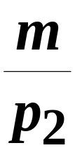
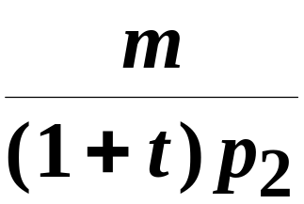
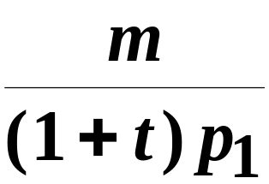

Uniform Ad Valorem Sales Taxes
x₂
p₁x₁ + p₂x₂ = m
p₁x₁ + p₂x₂ = m/(1+t)
x₁

Slide 34
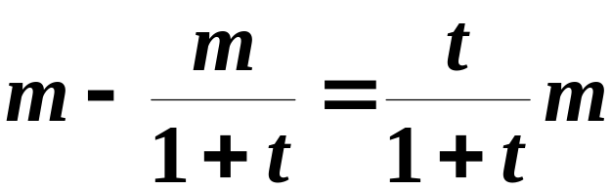
Uniform Ad Valorem Sales Taxes
x₂
Equivalent income loss
is
x₁

Slide 35
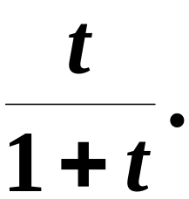
Uniform Ad Valorem Sales Taxes
x₂
A uniform ad valorem
sales tax levied at rate t
is equivalent to an income
tax levied at rate
x₁

Slide 36
The Food Stamp Program
Food stamps are coupons that can be legally exchanged only for food.
How does a commodity-specific gift such as a food stamp alter a family’s budget constraint?

Slide 37
The Food Stamp Program
Suppose m = $100, p_{F} = $1 and the price of “other goods” is p_{G} = $1
“Other goods” is a composite good
  It simplifies the analysis to a 2-good model
The budget constraint is then
F + G =100.

Slide 38
The Food Stamp Program
G
F + G = 100: before stamps.
100
100
F

Slide 39
The Food Stamp Program
G
F + G = 100: before stamps.
100
Budget set after 40 food
stamps issued.
40
100
140
F
(F-40) + G = 100 for F≥40
G=100 for F<40

Slide 40
The Food Stamp Program
G
F + G = 100: before stamps.
100
Budget set after 40 food
stamps issued.
The family’s budget
set is enlarged.
40
100
140
F
(F-40) + G = 100 for F≥40
G=100 for F<40

Slide 41
The Food Stamp Program
What if food stamps can be traded on a black market for $0.50 each?
G=100+0.5×(40-F) for F<40
(F-40)+G=100 for F ≥ 40

Slide 42
The Food Stamp Program
G
F + G = 100: before stamps.
120
Budget constraint after 40
food stamps issued.
100
Budget constraint with
black market trading.
40
100
140
F
G=100+0.5×(40-F) for F<40
(F-40)+G=100 for F ≥ 40

Slide 43
The Food Stamp Program
G
F + G = 100: before stamps.
120
Budget constraint after 40
food stamps issued.
100
Black market trading
makes the budget
set larger again.
40
100
140
F

Slide 44
Announcement
Problem Set 1: due on Oct. 9
Chapters 1-3 listed on the Web

Slide 45
Shapes of Budget Constraints
Q: What makes a budget constraint a straight line?
A: A straight line has a constant slope and the constraint is
p₁x₁ + … + p_{n}x_{n} = m
so if prices are constants then a constraint is a straight line.

Slide 46
Shapes of Budget Constraints
But what if prices are not constants?
E.g. bulk buying discounts, or price penalties for buying “too much”.
Then constraints will be curved.

Slide 47
Shapes of Budget Constraints - Quantity Discounts
Suppose p₂ is constant at $1 but that p₁=$2 for 0 ≤ x₁ ≤ 20 and p₁=$1 for x₁>20.

Slide 48
Shapes of Budget Constraints - Quantity Discounts
Suppose p₂ is constant at $1 but that p₁=$2 for 0 ≤ x₁ ≤ 20 and p₁=$1 for x₁>20.
Then the constraint’s slope is
2, for 0 ≤ x₁ ≤ 20
p₁/p₂ =
1, for x₁ > 20

Slide 49
Shapes of Budget Constraints with a Quantity Discount
x₂
m = $100
100
Slope = - 2 / 1 = - 2
(p₁=2, p₂=1)
Slope = - 1/ 1 = - 1
(p₁=1, p₂=1)
20
50
80
x₁

Slide 50
Shapes of Budget Constraints with a Quantity Discount
x₂
m = $100
100
Slope = - 2 / 1 = - 2
(p₁=2, p₂=1)
Slope = - 1/ 1 = - 1
(p₁=1, p₂=1)
20
50
80
x₁

Slide 51
Budget Constraints with a Quantity Discount
The constraint is
2x₁+x₂=m for 0 ≤ x₁ ≤ 20
2×20+(x₁-20)+x₂=m for x₁ > 20

Slide 52
Shapes of Budget Constraints with a Quantity Discount
x₂
m = $100
100
Budget Constraint
Budget Set
20
50
80
x₁

Slide 53
Shapes of Budget Constraints with a Quantity Penalty
x₂
Budget Constraint
Budget Set
x₁

Slide 54
Consumer Preferences
Describe preferences
Indifference curves (无差异曲线)
Well-behaved preferences
Marginal rate of substitution (边际替代率)

Slide 55
Rationality in Economics
Behavioral Postulate:
A decision-maker always chooses its most preferred alternative from its set of available alternatives
So to model choice we must model decision-makers’ preferences.

Slide 56
Preference Relations
Comparing two different consumption bundles, x and y:
  strict preference (严格偏好): x is more preferred than y
  Indifference (无差异): x is exactly as preferred as y
  weak preference (弱偏好): x is as at least as preferred as is y

Slide 57
Assumptions about Preference Relations
Completeness (完备性): For any two bundles x and y it is always possible to make the comparison between x and y
Reflexivity (反身性): Any bundle x is always at least as preferred as itself

Slide 58
Assumptions about Preference Relations
Transitivity (传递性): If
x is at least as preferred as y, and
y is at least as preferred as z, then
x is at least as preferred as z.

Slide 59
Indifference Curves
Take a reference bundle x’. The set of all bundles equally preferred to x’ is the indifference curve containing x’; the set of all bundles y ∼ x’.

Slide 60
Indifference Curves
x₂
x’ ∼ x” ∼ x”’
x’
x”
x”’
x₁

Slide 61
Indifference Curves
x₂
z x y
❐
❐
x
z
y
x₁

Slide 62
Indifference Curves
I₁
All bundles in I₁ are
strictly preferred to all in I₂.
x₂
x
z
I₂
All bundles in I₂ are strictly preferred to
all in I₃.
y
I₃
x₁

Slide 63
Weakly Preferred Set (弱偏好集)
x₂
WP(x), the set of
bundles weakly
preferred to x.
x
I(x)
I(x’)
x₁

Slide 64
Weakly Preferred Set (弱偏好集)
x₂
WP(x), the set of
bundles weakly
preferred to x.
x
WP(x)
includes
I(x).
I(x)
x₁

Slide 65
Strictly Preferred Set (严格偏好集)
x₂
SP(x), the set of
bundles strictly
preferred to x,
does not
include
I(x).
x
I(x)
x₁

Slide 66
Indifference Curves Cannot Intersect
x₂
I₂
I₁
x
y
z
x₁

Slide 67
Slopes of Indifference Curves
When more of a commodity is always preferred, the commodity is a good.
If every commodity is a good then indifference curves are negatively sloped.

Slide 68
Slopes of Indifference Curves
Good 2
Two goods
a negatively sloped indifference curve.
Better
Worse
Good 1

Slide 69
Slopes of Indifference Curves
If less of a commodity is always preferred then the commodity is a bad.

Slide 70
Slopes of Indifference Curves
Good 2
One good and one
bad a positively sloped indifference curve.
Better
Worse
Bad 1

Slide 71
Examples
Perfect substitutes (完全替代)
Perfect complements (完全互补)
Satiation (餍足)

Slide 72
Extreme Cases of Indifference Curves: Perfect Substitutes
x₂
Slopes are constant at - 1.
15
  I₂
Bundles in I₂ all have a total
of 15 units
x₁
15

Slide 73
Extreme Cases of Indifference Curves: Perfect Complements
x₂
45º
Each of (5,5), (5,9) and (9,5) contains
5 pairs so each is equally preferred.
9
5
I₁
x₁
5
9

Slide 74
Indifference Curves Exhibiting Satiation
x₂
Better
Better
Satiation
(bliss)
point
Better
x₁

Slide 75
Well-Behaved Preferences
Convexity: Mixtures of bundles are (at least weakly) preferred to the bundles themselves.
E.g., the 50-50 mixture of the bundles x and y is
z = (0.5)x + (0.5)y.
z is at least as preferred as x or y.

Slide 76
Well-Behaved Preferences -- Convexity.
x
x₂
x+y
is strictly preferred to both x and y.
x₂+y₂
z =
2
2
y
y₂
x₁
x₁+y₁
y₁
2

Slide 77
Well-Behaved Preferences -- Convexity.
x
x₂
z =(tx₁+(1-t)y₁, tx₂+(1-t)y₂)
is preferred to x and y for all 0 < t < 1.
y
y₂
x₁
y₁

Slide 78
Well-Behaved Preferences -- Convexity.
Preferences are strictly convex
when all mixtures z
are strictly
preferred to their
component
bundles x and y.
x
x₂
z
y
y₂
x₁
y₁

Slide 79
Well-Behaved Preferences -- Weak Convexity.
Preferences are weakly convex if at least one mixture z is equally preferred to a component bundle.
x’
z’
x
z
y
y’

Slide 80
Non-Convex Preferences
x₂
Better
The mixture z
is less preferred
than x or y.
z
y₂
x₁
y₁

Slide 81
More Non-Convex Preferences
x₂
Better
The mixture z
is less preferred
than x or y.
z
y₂
x₁
y₁

Slide 82
Marginal Rate of Substitution
x₂
MRS at x’ is
lim -{Δx₂/Δx₁}
Δx₁ 0
= -dx₂/dx₁ at x’
Δx₂
x’
Δx₁
x₁

Slide 83
Marginal Rate of Substitution
dx₂ = MRS*dx₁ so, at x’, MRS is the rate at which the consumer is only just willing to exchange commodity 2 for a small amount of commodity 1.
Marginal willingness to pay.
x₂
x’
dx₂
dx₁
x₁

Slide 84

Marginal Rate of Substitution
Clothing
16
A
MRS = 6
14
12
-6
10
B
1
8
-4
MRS = 2
D
6
1
-2
E
4
G
1
-1
2
1
Food
1
2
3
4
5
Notes:
32

Slide 85
MRS & Ind. Curve Properties
x₂
MRS increases
as x₁ increases
nonconvex preferences
MRS = 0.5
MRS = 5
x₁

Slide 86
MRS & Ind. Curve Properties
MRS is not always increasing as x₁ increases nonconvex
preferences.
x₂
MRS = 1
MRS
= 0.5
MRS = 2
x₁

Slide 87
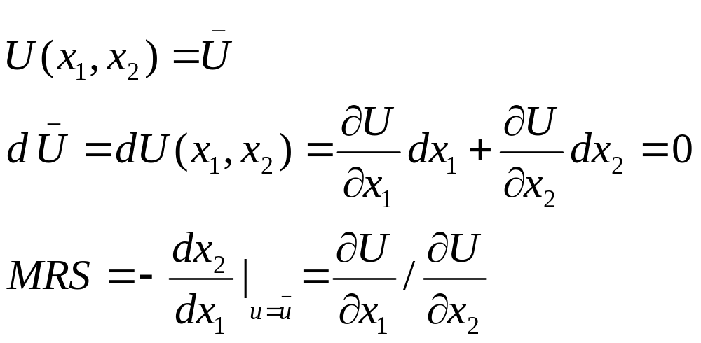
MRS and Utility Function

Slide 88
Utility Function and Preferences
A consumer’s preferences can be represented by a utility function
The “perfect substitutes” preference can be represented by U(x, y)=x+y
The “perfect complements” preferences:
U(x, y)= min {x, y}
Is the utility function representation unique for a given preference?

Slide 89
Utility Function and Preferences
The utility representation is not unique
A positive monotonic transformation of a utility function represents the same preference as the original utility function
As long as the utility functions give the same ordering of the consumption bundles, we say they represent the same preference
The utility is ordinal, rather than cardinal

Slide 90
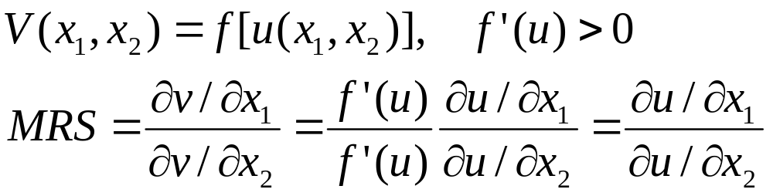
Positive monotonic transformation

Slide 91
Consumer Choice
Rational constrained choice
Computing ordinary demands
  Interior solution （内在解）
  Corner solution （角点解）

Slide 92
Economic Rationality
The principal behavioral postulate is that a decision-maker chooses its most preferred alternative from those available to it.
The available choices constitute the choice set.
How is the most preferred bundle in the choice set located?

Slide 93
Rational Constrained Choice
x₂
More preferred
bundles
Affordable
bundles
x₁

Slide 94
Rational Constrained Choice
x₂
(x₁*,x₂*) is the most
preferred affordable
bundle.
x₂*
x₁*
x₁

Slide 95
Rational Constrained Choice
The most preferred affordable bundle is called the consumer’s ORDINARY DEMAND （or DEMAND）at the given prices and budget.
Ordinary demands will be denoted by
x₁*(p₁,p₂,m) and x₂*(p₁,p₂,m).

Slide 96
Rational Constrained Choice
When x₁* > 0 and x₂* > 0 the demanded bundle is INTERIOR.
If buying (x₁*,x₂*) costs $m then the budget is exhausted.

Slide 97
Rational Constrained Choice
x₂
(x₁*,x₂*) is interior.
(x₁*,x₂*) exhausts the
budget.
x₂*
x₁*
x₁

Slide 98
Rational Constrained Choice
x₂
(x₁*,x₂*) is interior.
(a) (x₁*,x₂*) exhausts the
budget; p₁x₁* + p₂x₂* = m.
x₂*
x₁*
x₁

Slide 99
Rational Constrained Choice
x₂
(x₁*,x₂*) is interior .
(b) The slope of the indiff.
curve at (x₁*,x₂*) equals
the slope of the budget
constraint.
x₂*
x₁*
x₁

Slide 100
Rational Constrained Choice
(x₁*,x₂*) satisfies two conditions:
(a) the budget is exhausted;
p₁x₁* + p₂x₂* = m
(b) tangency: the slope of the budget constraint, -p₁/p₂, and the slope of the indifference curve containing (x₁*,x₂*) are equal at (x₁*,x₂*).

Slide 101
Meaning of the Tangency Condition
Consumer’s marginal willingness to pay equals the market exchange rate.
Suppose at a consumption bundle (x₁, x₂),
  MRS= 2, P₁/P₂=1
  The consumer is willing to give up 2 unit of x₂ to exchange for an additional unit of x₁
  The market allows her to give up only 1 unit of x₂ to obtain an additional x₁
(x₁, x₂) is not optimal choice
She can be better off increasing her consumption of x₁.

Slide 102
x₂
x₁
x₁

Slide 103
Computing Ordinary Demands
Solve for 2 simultaneous equations.
  Tangency
  Budget constraint
The conditions may be obtained by using the Lagrangian multiplier method, i.e., constrained optimization in calculus.

Slide 104
Computing Ordinary Demands
How can this information be used to locate (x₁*,x₂*) for given p₁, p₂ and m?

Slide 105
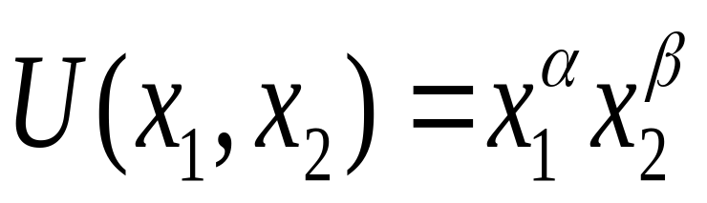
Computing Ordinary Demands - a Cobb-Douglas Example.
Suppose that the consumer has Cobb-Douglas preferences.

Slide 106
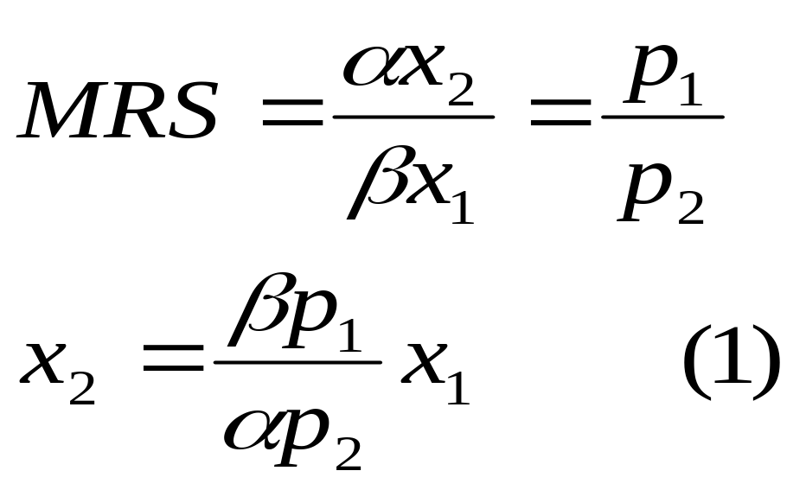
Computing Ordinary Demands - a Cobb-Douglas Example.
At (x₁*,x₂*), MRS = p₁/p₂ so the tangency condition (MRS = p₁/p₂) is

Slide 107
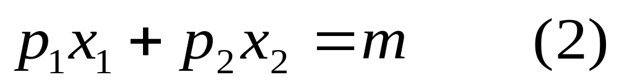
Computing Ordinary Demands - a Cobb-Douglas Example.
(x₁*,x₂*) also exhausts the budget so

Slide 108
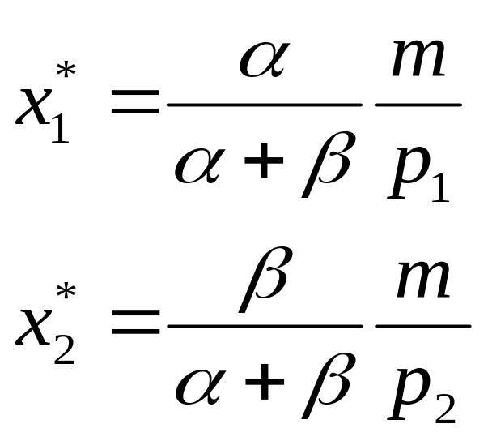
Computing Ordinary Demands - a Cobb-Douglas Example.
The solution to the simultaneous equations (1) and (2) is:

Slide 109
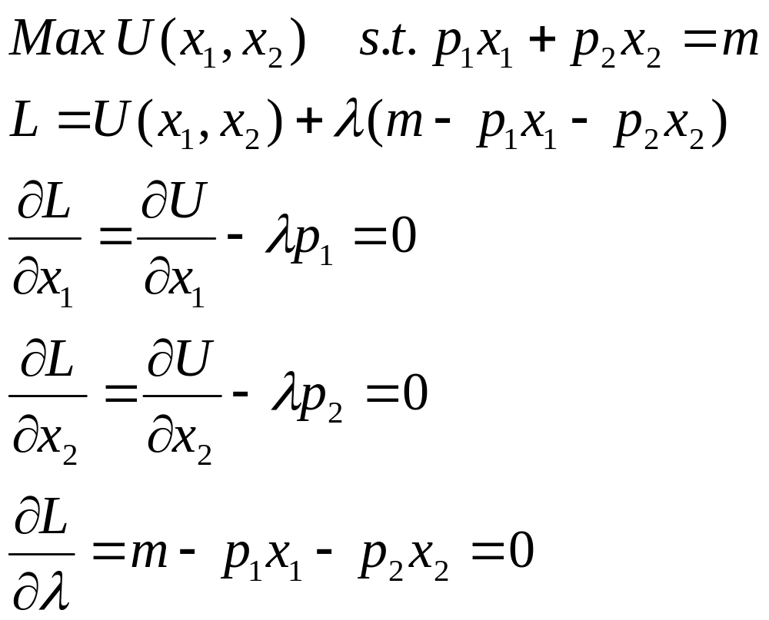
Lagrange Multipliers

Slide 110
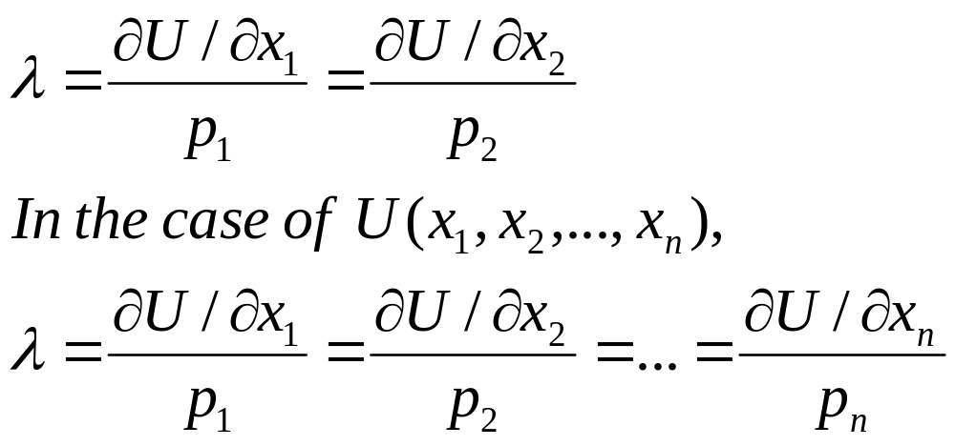
Equal Marginal Principle

Slide 111
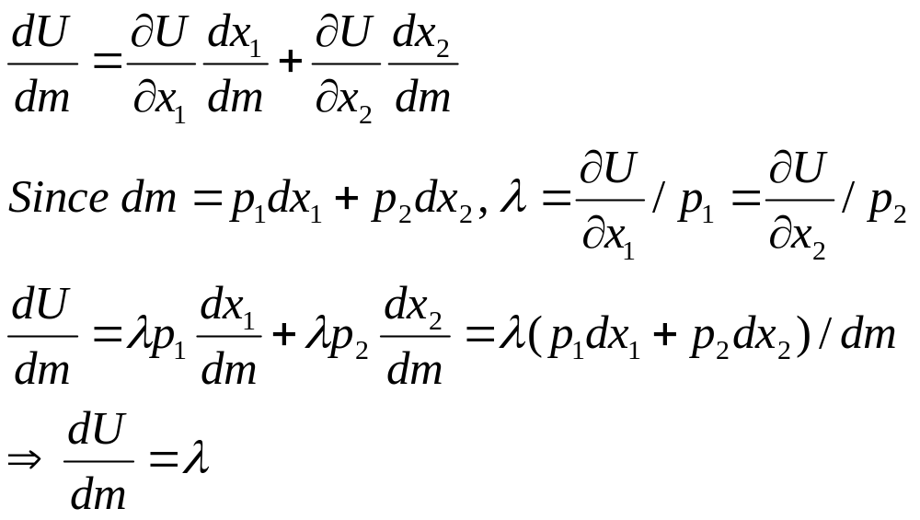
Understanding lamda

Slide 112
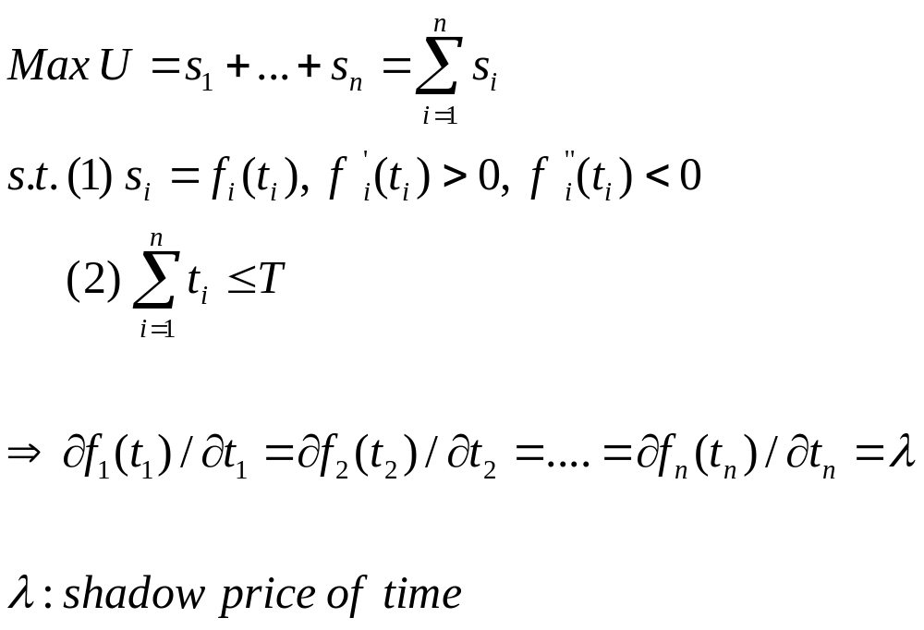
How to Allocate Time Efficiently?

Slide 113
Rational Constrained Choice: Summary
When x₁* > 0 and x₂* > 0
and (x₁*,x₂*) exhausts the budget,
and indifference curves have no
‘kinks’, the ordinary demands are obtained by solving:
(a) p₁x₁* + p₂x₂* = y
(b) the slopes of the budget constraint, -p₁/p₂, and of the indifference curve containing (x₁*,x₂*) are equal at (x₁*,x₂*).

Slide 114
Rational Constrained Choice
But what if x₁* = 0?
Or if x₂* = 0?
If either x₁* = 0 or x₂* = 0 then the ordinary demand (x₁*,x₂*) is at a corner solution (角点解) to the problem of maximizing utility subject to a budget constraint.

Slide 115
Examples of Corner Solutions -- the Perfect Substitutes Case
x₂
MRS = -1
x₁

Slide 116
Examples of Corner Solutions -- the Perfect Substitutes Case
x₂
MRS = -1
Slope = -p₁/p₂ with p₁ > p₂.
x₁

Slide 117
Examples of Corner Solutions -- the Perfect Substitutes Case
x₂
MRS = -1
Slope = -p₁/p₂ with p₁ > p₂.
x₁

Slide 118
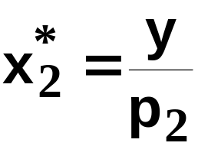
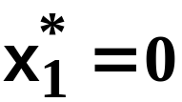
Examples of Corner Solutions -- the Perfect Substitutes Case
x₂
MRS = -1
Slope = -p₁/p₂ with p₁ > p₂.
x₁

Slide 119
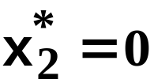
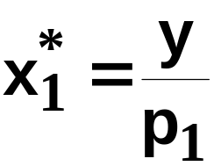
Examples of Corner Solutions -- the Perfect Substitutes Case
x₂
MRS = -1
Slope = -p₁/p₂ with p₁ < p₂.
x₁

Slide 120


Examples of Corner Solutions -- the Perfect Substitutes Case
x₂
MRS = -1
Slope = -p₁/p₂ with p₁ = p₂.
x₁

Slide 121
Is Tangency Condition Sufficient?
Tangency condition is sufficient and necessary if
(1) Preferences are convex
(2) Solutions are interior

