Slide 1
Income and Substitution Effects
A change in the price of a good has two effects:
  Substitution Effect
  Income Effect

Slide 2
Income and Substitution Effects
Substitution Effect
  The substitution effect is the change in an item’s consumption associated with a change in the price of the item, with the level of utility held constant
  When the price of an item declines, the substitution effect always leads to an increase in the quantity demanded of the good
  Why is substitution effect always nonpositive?

Slide 3
Income and Substitution Effects
Income Effect
  The income effect is the change in an item’s consumption brought about by the increase in purchasing power, with the price of the item held constant
  When a person’s income increases, the quantity demanded for the product may increase or decrease

Slide 4
Income and Substitution Effects
Income Effect
  Even with inferior goods, the income effect is rarely large enough to outweigh the substitution effect

Slide 5
Income and Substitution
Effects: Normal Good
Clothing
(units per
month)
When the price of food falls, consumption increases by F₁F₂ as the consumer moves from A to B.
R
The substitution effect, F₁E,
(from point A to D), changes the
relative prices but keeps real income
(satisfaction) constant.
C₁
A
The income effect, EF₂,
(from D to B) keeps relative
prices constant but
increases purchasing power.
D
B
C₂
U₂
Substitution
Effect
U₁
Food (units
per month)
O
F₁
E
S
F₂
T
Total Effect
Income Effect

Slide 6
The Law of Demand
The demand for a normal good (i.e., the income effect is positive) increases when its price decreases

Slide 7
Income and Substitution
Effects: Inferior Good
Clothing
(units per
month)
Since food is an
inferior good, the
income effect is
negative. However,
the substitution effect
is larger than the
income effect.
R
A
B
U₂
D
Substitution
Effect
U₁
O
F₁
E
S
F₂
T
Food (units
per month)
Total Effect
Income Effect

Slide 8
Income and Substitution Effects
A Special Case: The Giffen Good
  The income effect may theoretically be large enough to cause the demand curve for a good to slope upward
  This rarely occurs and is of little practical interest

Slide 9
Giffen Goods
x₂
A decrease in p₁ causes
quantity demanded of
good 1 to fall.
x₂’’’
x₂’
x₁’’’
x₁’
x₁

Slide 10
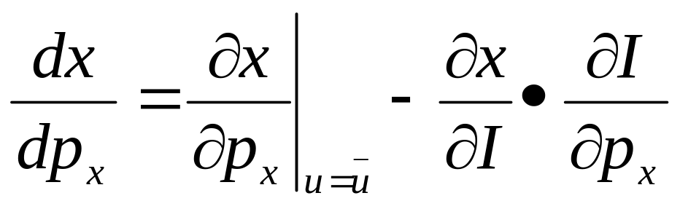
Slutsky Equation
The formal expression of the price effect is the following:

Slide 11
Another Way of Decomposing Price Effect
Hicksian substitution effect: holding the utility constant
Slutsky substitution effect: holding the purchasing power constant

Slide 12
Slutsky Substitution Effect
x₂
x₂’
x₂’’
x₁’
x₁’’
x₁

Slide 13
And Now the Income Effect
x₂
x₂’
(x₁’’’,x₂’’’)
x₂’’
x₁’
x₁’’
x₁

Slide 14
Market Demand
Market Demand Curves
  A curve that relates the quantity of a good that all consumers in a market buy to the price of that good
  The sum of all the individual demand curves in the market

Slide 15
Determining the Market Demand Curve
Price | A | B | C | Market Demand
1 | 6 | 10 | 16 | 32
2 | 4 | 8 | 13 | 25
3 | 2 | 6 | 10 | 18
4 | 0 | 4 | 7 | 11
5 | 0 | 2 | 4 | 6

Slide 16
Summing to Obtain a
Market Demand Curve
Price
5
The market demand
curve is obtained by
summing the consumer’s
demand curves
4
3
Market Demand
2
1
D_{A}
D_{B}
D_{C}
0
5
10
15
20
25
30
Quantity

Slide 17
Market Demand
From this analysis one can see two important points:
  The market demand will shift to the right as more consumers enter the market
  Factors that influence the demands of many consumers will also affect the market demand

Slide 18
Market Demand
Aggregation is important to be able to discuss regarding demand for different groups
  Households with children
  Consumers aged 20 – 30, etc.

Slide 19
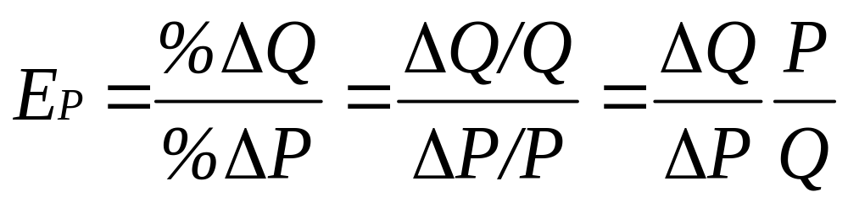
Market Demand
Price Elasticity of Demand
  Measures the percentage change in the quantity demanded resulting from a percent change in price

Slide 20
Price Elasticity of Demand
Inelastic Demand
  E_{p} is less than 1 in absolute value
  Quantity demanded is relatively unresponsive to a change in price
  |%ΔQ| < |%ΔP|
  Total expenditure (P*Q) increases when price increases

Slide 21
Price Elasticity of Demand
Elastic Demand
  E_{p} is greater than than 1 in absolute value
  Quantity demanded is relatively responsive to a change in price
  |%ΔQ| > |%ΔP|
  Total expenditure (P*Q) decreases when price increases

Slide 22
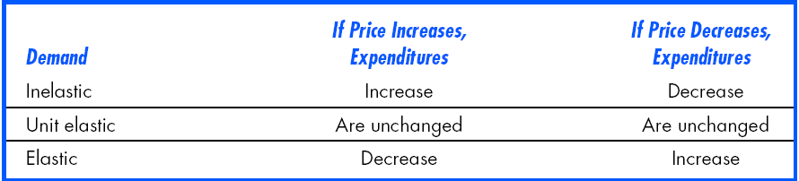
Price Elasticity and
Consumer Expenditure

Slide 23
Price Elasticity of Demand
Isoelastic Demand
  When price elasticity of demand is constant along the entire demand curve
  Demand curve is bowed inward (not linear)

Slide 24
Revenue and Own-Price Elasticity of Demand
If raising a commodity’s price causes little decrease in quantity demanded, then sellers’ revenues rise.
  Hence own-price inelastic demand causes sellers’ revenues to rise as price rises.
If raising a commodity’s price causes a large decrease in quantity demanded, then sellers’ revenues fall.
  Hence own-price elastic demand causes sellers’ revenues to fall as price rises.

Slide 25
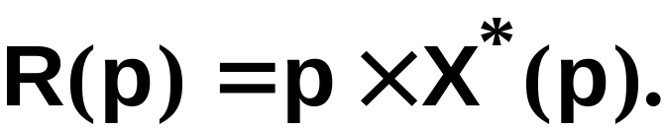
Revenue and Own-Price Elasticity of Demand
Sellers’ revenue is

Slide 26
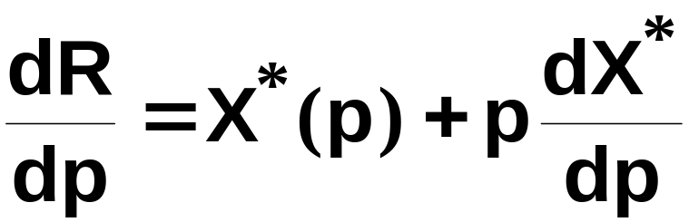
Revenue and Own-Price Elasticity of Demand
Sellers’ revenue is
So

Slide 27
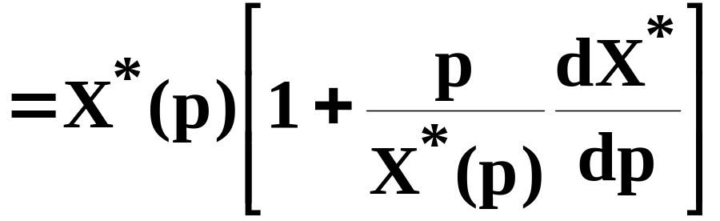
Revenue and Own-Price Elasticity of Demand
Sellers’ revenue is
So

Slide 28
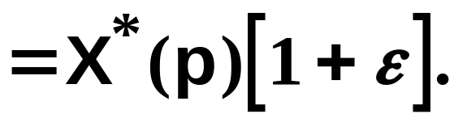
Revenue and Own-Price Elasticity of Demand
Sellers’ revenue is
So

Slide 29
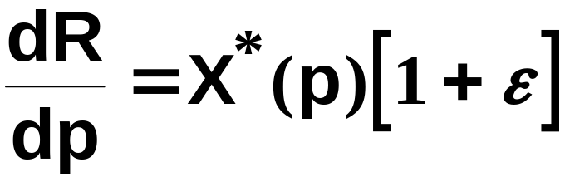
Revenue and Own-Price Elasticity of Demand

Slide 30
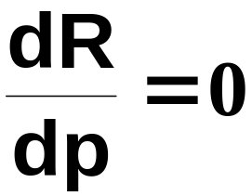

Revenue and Own-Price Elasticity of Demand
so if
then
and a change to price does not alter
sellers’ revenue.

Slide 31
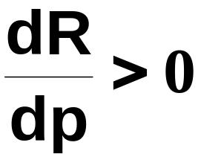

Revenue and Own-Price Elasticity of Demand
but if
then
and a price increase raises sellers’
revenue.

Slide 32
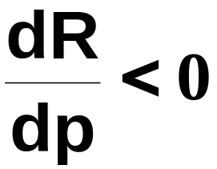

Revenue and Own-Price Elasticity of Demand
And if
then
and a price increase reduces sellers’
revenue.

Slide 33
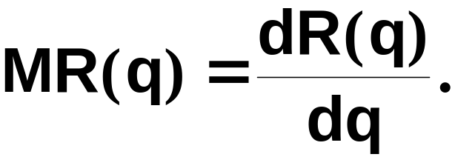
Marginal Revenue and Own-Price Elasticity of Demand
A seller’s marginal revenue is the rate at which revenue changes with the number of units sold by the seller.

Slide 34

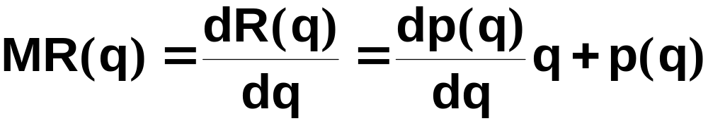
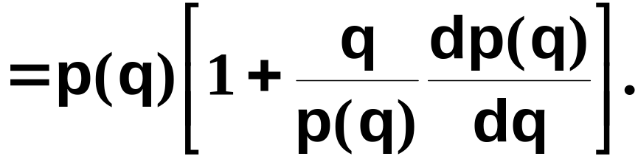
Marginal Revenue and Own-Price Elasticity of Demand
p(q) denotes the seller’s inverse demand function; i.e. the price at which the seller can sell q units. Then

Slide 35
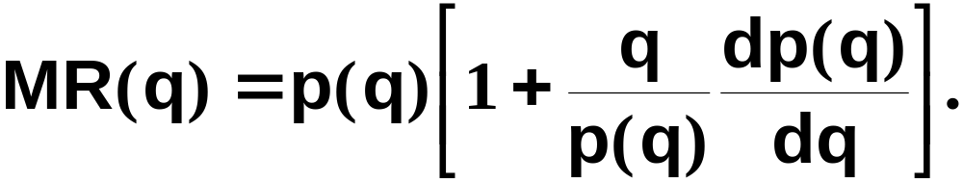
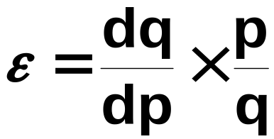
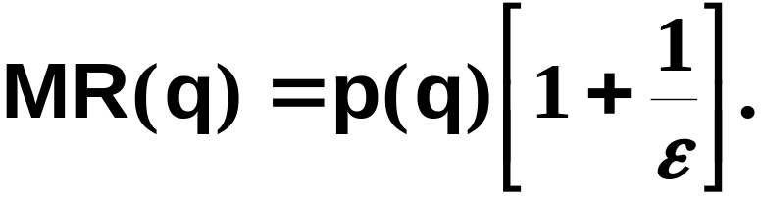
Marginal Revenue and Own-Price Elasticity of Demand
and
so

Slide 36
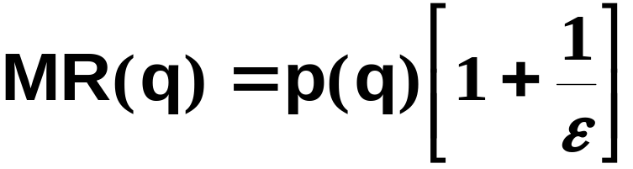
Marginal Revenue and Own-Price Elasticity of Demand
says that the rate
at which a seller’s revenue changes
with the number of units it sells
depends on the sensitivity of quantity
demanded to price; i.e., upon the
of the own-price elasticity of demand.

Slide 37
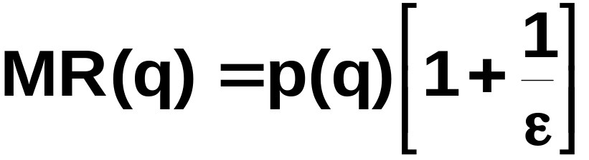






Marginal Revenue and Own-Price Elasticity of Demand
If
then
If
then
If
then

Slide 38


Marginal Revenue and Own-Price Elasticity of Demand
An example with linear inverse demand.
Then
and

Slide 39


Marginal Revenue and Own-Price Elasticity of Demand
p
a
a/2b
a/b
q

Slide 40
Marginal Revenue and Own-Price Elasticity of Demand
p
a
$
a/2b
a/b
q
R(q)
q
a/2b
a/b

Slide 41
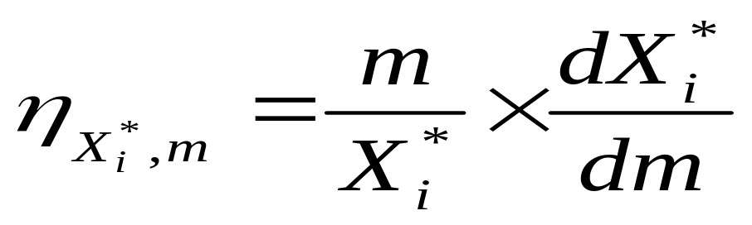
Income Elasticity
Normal good: η>0
Inferior good: η<0
Luxury good: η>1
Necessary good: 0<η<1

Slide 42
Consumer Surplus
Consumers buy goods because it makes them better off
Consumer Surplus measures how much better off they are

Slide 43
Consumer Surplus
Consumer Surplus
  The difference between the maximum amount a consumer is willing to pay for a good and the amount actually paid
  Can calculate consumer surplus from the demand curve

Slide 44
Consumer Surplus - Example
Student wants to buy concert tickets
Demand curve tells us willingness to pay for each concert ticket
  1st ticket worth $20 but price is $14 so student generates $6 worth of surplus
  Can measure this for each ticket
  Total surplus is addition of surplus for each ticket purchased

Slide 45
Consumer Surplus - Example
Price
($ per
ticket)
The consumer surplus
of purchasing 6 concert
tickets is the sum of the
surplus derived from
each one individually.
20
19
18
17
16
15
Consumer Surplus
6 + 5 + 4 + 3 + 2 + 1 = 21
14
Market Price
13
Will not buy more than 7 because surplus is negative
0
1
2
3
4
5
6
Rock Concert Tickets

Slide 46
Consumer Surplus
The stepladder demand curve can be converted into a straight-line demand curve by making the units of the good smaller
Consumer surplus is the area under the demand curve and above the price

Slide 47
Consumer Surplus
Price
($ per
ticket)
Consumer Surplus
for the Market Demand
20
19
18
CS = ½ ($20 - $14)*(1600) = $19,500
17
16
Consumer
Surplus
15
14
Market Price
13
Demand Curve
Actual
Expenditure
0
1
2
3
4
5
6
Rock Concert Tickets

Slide 48
Chapter 5
Choice under Uncertainty

Slide 49
Topics to be Discussed
Describing Risk
Preferences Toward Risk
Reducing Risk
Notes:
2

Slide 50
Introduction
Choice with certainty is reasonably straightforward
How do we make choices when certain variables such as income and prices are uncertain (making choices with risk)?
Notes:
3

Slide 51
Describing Risk
To measure risk we must know:
  All of the possible outcomes
  The probability or likelihood that each outcome will occur
Notes:
4

Slide 52
States of Nature
Possible states of Nature:
  “car accident” (a)
  “no car accident” (na).
Accident occurs with probability π_{a}, does not with probability π_{na} ;
π_{a} + π_{na} = 1.
Accident causes a loss of $L.

Slide 53
Contingencies
A contract implemented only when a particular state of Nature occurs is state-contingent
  E.g. the insurer pays only if there is an accident.

Slide 54
Contingencies
A state-contingent consumption plan is implemented only when a particular state of Nature occurs.
  E.g. take a vacation only if there is no accident.

Slide 55
Describing Risk
Interpreting Probability
  Objective Interpretation
    Based on the observed frequency of past events
  Subjective Interpretation
    Based on perception that an outcome will occur
Notes:
5

Slide 56
Interpreting Probability
Subjective Probability
  Different information or different abilities to process the same information can influence the subjective probability
  Based on judgment or experience
Notes:
6

Slide 57
Describing Risk
With an interpretation of probability, we must determine 2 measures to help describe and compare risky choices
  Expected value
  Variability

Slide 58
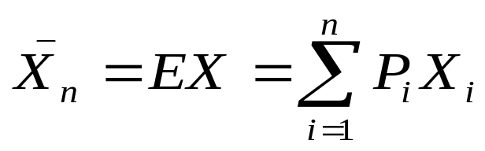
Expected Value: Definition
Expected Value
  The weighted average of the payoffs or values resulting from all possible outcomes
    Expected value measures the central tendency; the payoff or value expected on average
Notes:
7

Slide 59
Expected Value – An Example
Investment in offshore drilling exploration:
Two outcomes are possible
  Success – the stock price increases from $30 to $40/share
  Failure – the stock price falls from $30 to $20/share
Notes:
8

Slide 60
Expected Value – An Example
Objective Probability
  100 explorations, 25 successes and 75 failures
  Probability (Pr) of success = 1/4 and the probability of failure = 3/4
Notes:
9

Slide 61
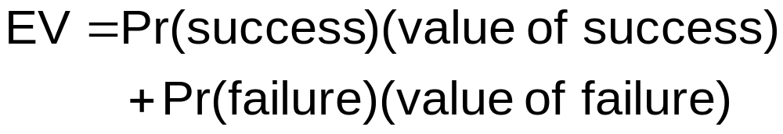

Expected Value – An Example

Slide 62
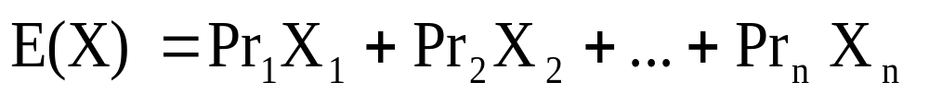
Expected Value
In general, for n possible outcomes:
  Possible outcomes having payoffs X₁, X₂, …, X_{n}
  Probabilities of each outcome is given by Pr₁, Pr₂, …, Pr_{n}
Notes:
11

Slide 63
Describing Risk
Variability
  The extent to which possible outcomes of an uncertain event may differ
  How much variation exists in the possible choice
Notes:
12

Slide 64
Variability – An Example
Suppose you are choosing between two part-time sales jobs that have the same expected income ($1,500)
The first job is based entirely on commission
The second is a salaried position
Notes:
12

Slide 65
Variability – An Example
There are two equally likely outcomes in the first job: $2,000 for a good sales job and $1,000 for a modestly successful one
The second pays $1,510 most of the time (.99 probability), but you will earn $510 if the company goes out of business (.01 probability)
Notes:
13

Slide 66
Variability – An Example
 | Outcome 1 |  | Outcome 2
 | Prob. | Income | Prob. | Income
Job 1: Commission | .5 | 2000 | .5 | 1000
Job 2: Fixed Salary | .99 | 1510 | .01 | 510
Notes:
14

Slide 67
Variability – An Example
Income from Possible Sales Job
Job 1 Expected Income
Job 2 Expected Income
Notes:
15

Slide 68
Variability
While the expected values are the same, the variability is not
Greater variability from expected values signals greater risk
Variability comes from deviations in payoffs
  Difference between expected payoff and actual payoff
Notes:
16

Slide 69
Variability – An Example
Deviations from Expected Income ($)
 | Outcome 1 | Deviation | Outcome 2 | Deviation
Job 1 | $2000 | $500 | $1000 | -$500
Job 2 | 1510 | 10 | 510 | -990
Notes:
17

Slide 70
Variability
We can measure variability with standard deviation
  The square root of the average of the squares of the deviations of the payoffs associated with each outcome from their expected value
Notes:
19

Slide 71
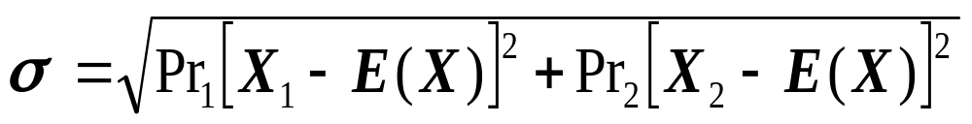
Variability
The standard deviation is written:
Notes:
20

Slide 72
Variability
Standard deviation is a measure of risk
  Measures how variable your payoff will be
  More variability means more risk
  Individuals generally prefer less variability – less risk

Slide 73
Standard Deviation – Example 1
Deviations from Expected Income ($)
 | Outcome 1 | Deviation | Outcome 2 | Deviation
Job 1 | $2000 | $500 | $1000 | -$500
Job 2 | 1510 | 10 | 510 | -990

Slide 74
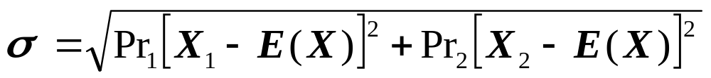
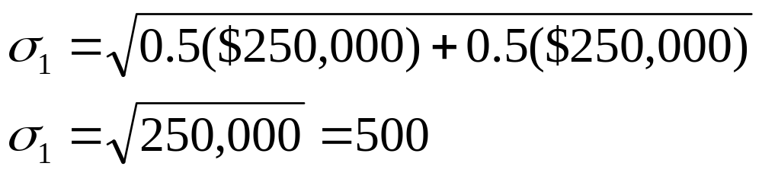
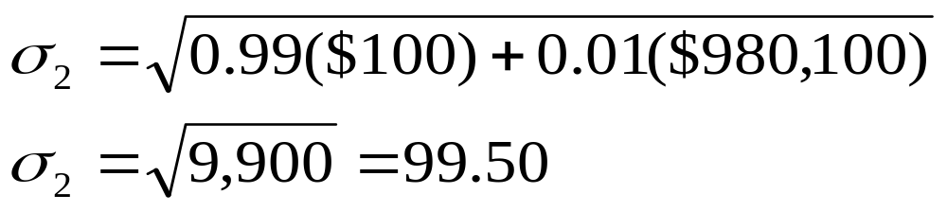
Standard Deviation – Example 1
Standard deviations of the two jobs are:
Notes:
22

Slide 75
Standard Deviation – Example 1
Job 1 has a larger standard deviation and therefore it is the riskier alternative
The standard deviation also can be used when there are many outcomes instead of only two
Notes:
23

Slide 76
Preferences Toward Risk
Can expand evaluation of risky alternative by considering utility that is obtained by risk
  A consumer gets utility from income
  Payoff measured in terms of utility
Notes:
34

Slide 77
Preferences Toward Risk - Example
A person is earning $15,000 and receiving 13.5 units of utility from the job
She is considering a new, but risky job
  0.50 chance of $30,000
  0.50 chance of $10,000
Notes:
35

Slide 78
Preferences Toward Risk - Example
Utility at $30,000 is 18
Utility at $10,000 is 10
Must compare utility from the risky job with current utility of 13.5
To evaluate the new job, we must calculate the expected utility of the risky job
Notes:
35

Slide 79
Preferences Under Uncertainty
2 states of nature:
  At probability π_{a} , consumption is c_{a}
  At probability π_{na} , consumption is c_{na}
  π_{a} + π_{na} = 1.
Utility is U(c_{a}, c_{na}, π_{a}, π_{na}).

Slide 80
Preferences Toward Risk
The expected utility of the risky option is the sum of the utilities associated with all her possible incomes weighted by the probability that each income will occur
E(u) = (Prob. of Utility 1) *(Utility 1)
+ (Prob. of Utility 2)*(Utility 2)
Notes:
36

Slide 81
Preferences Toward Risk – Example
The expected is:
  E(u) = (1/2)u($10,000) + (1/2)u($30,000)
  = 0.5(10) + 0.5(18)
  = 14
  E(u) of new job is 14, which is greater than the current utility of 13.5 and therefore preferred
Notes:
37

Slide 82
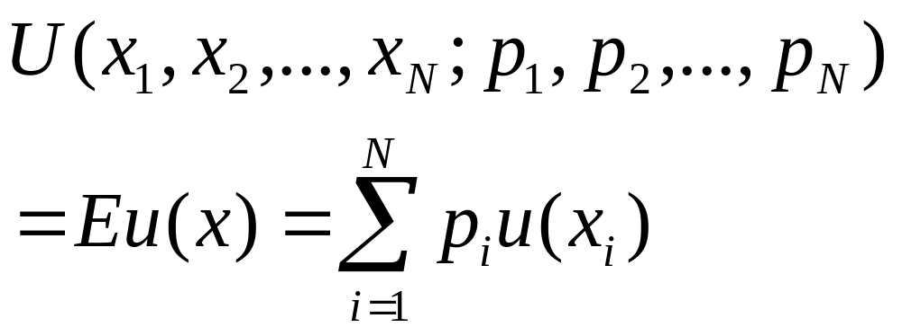
Expected Utility Theorem

Slide 83
Preferences Toward Risk
People differ in their preference toward risk
People can be risk averse, risk neutral, or risk loving
Notes:
38

Slide 84
Preferences Toward Risk
Risk Averse
  A person who prefers a certain given income to a risky income with the same expected value
  U(EX) > Eu(x)
  The person has a diminishing marginal utility of income
  Most common attitude towards risk
    Ex: Market for insurance
Notes:
39

Slide 85
Risk Averse Utility Function
Utility
E
18
D
16
The consumer is risk averse because she would prefer a certain income of $20,000 to an uncertain expected income = $20,000
C
14
F
A
10
0
Income ($1,000)
10
16
20
30
Notes:
46

Slide 86
Risk Averse - Example
A person can have a $20,000 job with 100% probability and receive a utility level of 16
The person could have a job with a 0.5 chance of earning $30,000 and a 0.5 chance of earning $10,000
Notes:
40

Slide 87
Risk Averse – Example
Expected Income of Risky Job
  E(I) = (0.5)($30,000) + (0.5)($10,000)
  E(I) = $20,000
Expected Utility of Risky Job
E(u) = (0.5)(10) + (0.5)(18)
E(u) = 14
Notes:
40

Slide 88
Risk Averse – Example
Expected income from both jobs is the same – risk averse may choose current job
Expected utility is greater for certain job
  Would keep certain job
Risk averse person’s losses (decreased utility) are more important than risky gains
Notes:
40

Slide 89
Implication of Risk Aversion
A risk-averse person will always prefer a certain amount of income to a gamble with the same expected value
This is supported by the so-called Jensen Inequality: for any strictly concave function u(.), U(EX)> Eu(x) (X is a random variable)
A risk averse person will never take a fair gamble (i.e., a game with zero expected income)

Slide 90
Risk Neutral
E
Utility
18
The consumer is risk
neutral and is indifferent
between certain events
and uncertain events
with the same
expected income.
C
12
A
6
Income ($1,000)
0
10
20
30
Notes:
49

Slide 91
Preferences Toward Risk
A person is said to be risk loving if they show a preference toward an uncertain income over a certain income with the same expected value
  Examples: Gambling, some criminal activities
  U(EX)<Eu(x)
Increasing marginal utility of income
Notes:
50

Slide 92
Risk Loving
Utility
E
18
The consumer is risk
loving because she
would prefer the gamble
to a certain income.
F
10.5
8
C
A
3
Income ($1,000)
0
10
20
30
Notes:
52

Slide 93
Preferences Toward Risk
The risk premium is the maximum amount of money that a risk-averse person would pay to avoid taking a risk
The risk premium depends on the risky alternatives the person faces
Notes:
53

Slide 94
Risk Premium – Example
From the previous example
  A person has a .5 probability of earning $30,000 and a .5 probability of earning $10,000
  The expected income is $20,000 with expected utility of 14
Notes:
54

Slide 95
Risk Premium – Example
Point F shows the risky scenario – the utility of 14 can also be obtained with certain income of $16,000
This person would be willing to pay up to $4000 (20,000 – 16,000) to avoid the risk of uncertain income
Can show this graphically by drawing a straight line between the two points – line CF
Notes:
54

Slide 96
Risk Premium – Example
Risk Premium
Here, the risk premium is $4,000 because a certain income of $16,000 gives the person the same expected utility as the uncertain income with expected value of $20,000.
Utility
G
20
18
E
C
14
F
A
10
Income ($1,000)
0
10
16
20
30
40
Notes:
57

Slide 97
Risk Aversion and Income
Variability in potential payoffs increases the risk premium
Example:
  A job has a .5 probability of paying $40,000 (utility of 20) and a .5 chance of paying 0 (utility of 0).
Notes:
58

Slide 98
Risk Aversion and Income
Example (cont.):
  The expected income is still $20,000, but the expected utility falls to 10
    E(u) = (0.5)u($0) + (0.5)u($40,000)
    = 0 + .5(20) = 10
  The certain income of $20,000 has utility of 16
  If person must take new job, their utility will fall by 6
Notes:
58

Slide 99
Risk Aversion and Income
Example (cont.):
  They can get 10 units of utility by taking a certain job paying $10,000
  The risk premium, therefore, is $10,000 (i.e. they would be willing to give up $10,000 of the $20,000 and have the same E(u) as the risky job
Notes:
59

Slide 100
Risk Aversion and Indifference Curves
Can describe a person’s risk aversion using indifference curves that relate expected income to variability of income (standard deviation)
Since risk is undesirable, greater risk requires greater expected income to make the person equally well off
Indifference curves are therefore upward sloping
Notes:
60

Slide 101
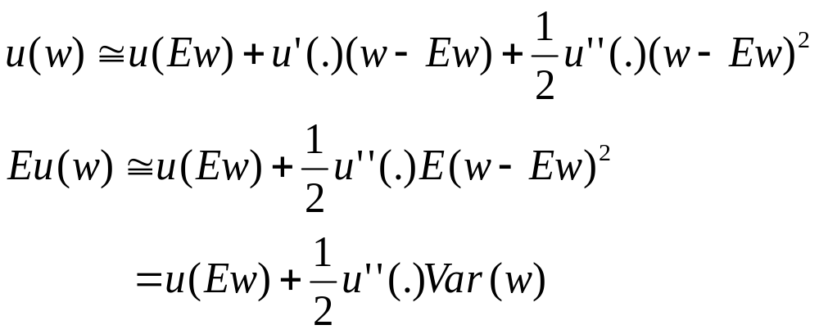
Mean-Variance Approach
Given u(w), the second-order Taylor series expansion of u(w) at w=Ew

Slide 102
Risk Aversion and Indifference Curves
Expected
Income
U₃
Highly Risk Averse: An
increase in standard
deviation requires a
large increase in
income to maintain
satisfaction.
U₂
U₁
Standard Deviation of Income

Slide 103
Risk Aversion and Indifference Curves
Expected
Income
Slightly Risk Averse:
A large increase in standard
deviation requires only a
small increase in income
to maintain satisfaction.
U₃
U₂
U₁
Standard Deviation of Income

Slide 104
Risk and Crime Deterrence
Attitudes toward risk affect willingness to break the law
Suppose a city wants to deter people from double parking
Monetary fines may be better than jail time
Notes:
63

Slide 105
Risk and Crime Deterrence
Costs of apprehending criminals are not zero, therefore
  Fines must be higher than the costs to society
  Probability of apprehension is actually less than one

Slide 106
Risk and Crime Deterrence - Example
Assumptions:
  The crime brings R to the criminal
  He is facing a penalty of C if being caught
  The probability of catching the criminal is p
  The criminal is risk neutral
Notes:
64

Slide 107
Risk and Crime Deterrence - Example
A rational criminal will not commit a crime if
(1-p) R < pC or R/C < p/(1-p)
So raising p or raising C will get the same deterrence effect
A similar result will be obtained if assuming risk aversion
Notes:
65

Slide 108
Risk and Crime Deterrence - Example
The same deterrence effect is obtained by either
  A $50 fine with a 0.1 probability of being caught resulting in an expected penalty of $5
  or
  A $500 fine with a 0.01 probability of being caught resulting in an expected penalty of $5
Notes:
66

Slide 109
Risk and Crime Deterrence - Example
Enforcement costs are reduced with high fine and low probability
Most effective if criminals don’t like to take risks
Questions:
  Why not set an excessively high penalty?
  Why is the penalty so low in China?
Notes:
66

Slide 110
Reducing Risk
Consumers are generally risk averse and therefore want to reduce risk
Three ways consumers attempt to reduce risk are:
  Diversification
  Insurance
  Obtaining more information
Notes:
67

Slide 111
Reducing Risk
Diversification
  Reducing risk by allocating resources to a variety of activities whose outcomes are not closely related
Example:
  Suppose a firm has a choice of selling air conditioners, heaters, or both
  The probability of it being hot or cold is 0.5
  How does a firm decide what to sell?
Notes:
68

Slide 112
Income from Sales of Appliances
 | Hot Weather | Cold Weather
Air conditioner sales | $30,000 | $12,000
Heater sales | 12,000 | 30,000
Notes:
69

Slide 113
Diversification – Example
If the firm sells only heaters or air conditioners their income will be either $12,000 or $30,000
Their expected income would be:
  1/2($12,000) + 1/2($30,000) = $21,000
Notes:
70

Slide 114
Diversification – Example
If the firm divides their time evenly between appliances, their air conditioning and heating sales would be half their original values
If it were hot, their expected income would be $15,000 from air conditioners and $6,000 from heaters, or $21,000
If it were cold, their expected income would be $6,000 from air conditioners and $15,000 from heaters, or $21,000
Notes:
71

Slide 115
Diversification – Example
With diversification, expected income is $21,000 with no risk
Better off diversifying to minimize risk
Firms can reduce risk by diversifying among a variety of activities that are not closely related
Notes:
72

Slide 116
Reducing Risk – The Stock Market
If invest all money in one stock, then take on a lot of risk
  If that stock loses value, you lose all your investment value
Can spread risk out by investing in many different stocks or investments
  Ex: Mutual funds
Notes:
73

Slide 117
Reducing Risk – Insurance
Risk averse are willing to pay to avoid risk
  Risk premium
If the cost of insurance equals the expected loss, risk averse people will buy enough insurance to recover fully from a potential financial loss
Notes:
74

Slide 118
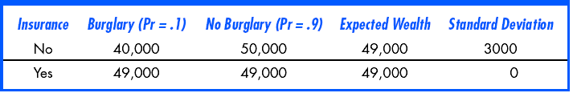
The Decision to Insure
Notes:
75

Slide 119
Reducing Risk – Insurance
For the risk averse consumer, guarantee of same income regardless of outcome has higher utility than facing the probability of risk
Expected utility with insurance is higher than without
Notes:
76

Slide 120
The Law of Large Numbers
Insurance companies know that although single events are random and largely unpredictable, the average outcome of many similar events can be predicted
When insurance companies sell many policies, they face relatively little risk
Notes:
77

Slide 121
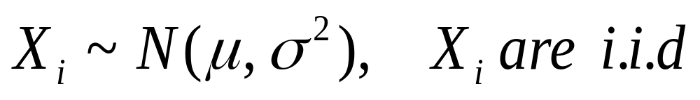
The Law of Large Numbers: An Example
Why pooling individual and independent random outcomes will reduce risk substantially?
Suppose N farmers and each faces a random yearly output; they agree to pool their outputs and each gets the mean

Slide 122
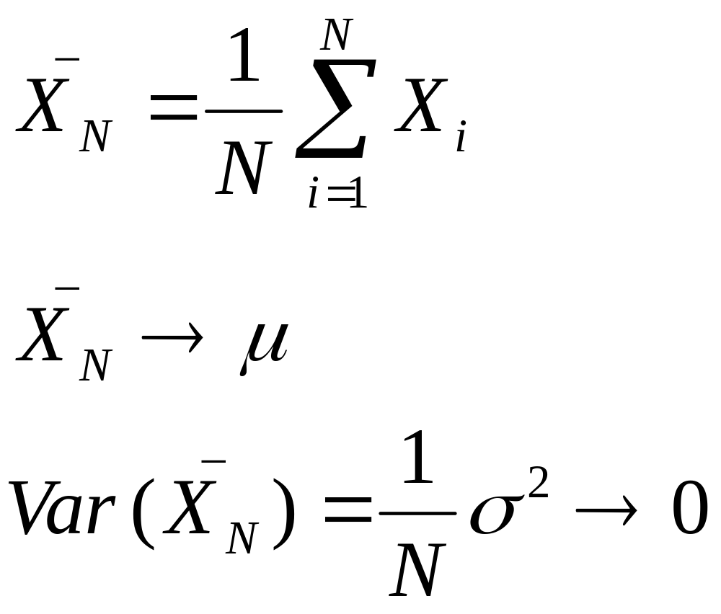
Risk Spreading

Slide 123
How Insurance Works
Insurance companies can be sure total premiums paid will equal total money paid out
Companies set the premiums so money received will be enough to pay expected losses
Notes:
77

Slide 124
How Insurance Works
Some events with very little probability of occurrence such as floods and earthquakes are no longer insured privately
  Cannot calculate true expected values and expected losses
  Governments have had to create insurance for these types of events
    Ex: National Flood Insurance Program
Notes:
77

Slide 125
Chapter 6
Production

Slide 126
Topics to be Discussed
The Technology of Production
Production with One Variable Input
Isoquants
Production with Two Variable Inputs
Returns to Scale
Notes:
2

Slide 127
Introduction
Our study of consumer behavior was broken down into 3 steps:
  Describing consumer preferences
  Consumers face budget constraints
  Consumers choose to maximize utility
Production decisions of a firm are similar to consumer decisions
  Can also be broken down into three steps
Notes:
3

Slide 128
Production Decisions of a Firm
Production Technology
  Describe how inputs can be transformed into outputs
    Inputs: land, labor, capital and raw materials
    Outputs: cars, desks, books, etc.
  Firms can produce different amounts of outputs using different combinations of inputs
Notes:
4

Slide 129
Production Decisions of a Firm
Cost Constraints
  Firms must consider prices of labor, capital and other inputs
  Firms want to minimize total production costs partly determined by input prices
  As consumers must consider budget constraints, firms must be concerned about costs of production

Slide 130
Production Decisions of a Firm
Input Choices
  Given input prices and production technology, the firm must choose how much of each input to use in producing output
  Given prices of different inputs, the firm may choose different combinations of inputs to minimize costs
    If labor is cheap, firm may choose to produce with more labor and less capital

Slide 131
Production Decisions of a Firm
If a firm is a cost minimizer, we can also study
  How total costs of production vary with output
  How the firm chooses the quantity to maximize its profits
We can represent the firm’s production technology in the form of a production function

Slide 132
The Technology of Production
Production Function:
  Indicates the highest output (q) that a firm can produce for every specified combination of inputs
  For simplicity, we will consider only labor (L) and capital (K)
  Physical vs. financial capital
  Shows what is technically feasible when the firm operates efficiently
Notes:
5

Slide 133
The Technology of Production
The production function for two inputs:
q = F(K,L)
  Output (q) is a function of capital (K) and labor (L)
  The production function is true for a given technology
    If technology increases, more output can be produced for a given level of inputs
Notes:
6

Slide 134
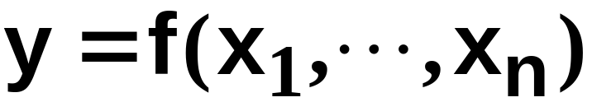
Production Functions
y denotes the output level.
The technology’s production function states the maximum amount of output possible from an input bundle (assuming technical efficiency)

Slide 135
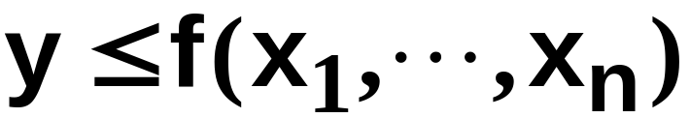
Technology Sets
A production plan is an input bundle and an output level; (x₁, … , x_{n}, y).
A production plan is feasible if
The collection of all feasible production plans is the technology set.

Slide 136
The Technology of Production
Short Run versus Long Run
  It takes time for a firm to adjust production from one set of inputs to another
  Firms must consider not only what inputs can be varied but over what period of time that can occur
  We must distinguish between long run and short run
Notes:
16

Slide 137
The Technology of Production
Short Run
  Period of time in which quantities of one or more production factors cannot be changed
  These inputs are called fixed inputs
Long Run
  Amount of time needed to make all production inputs variable
Short run and long run are not time specific

Slide 138
Production: One Variable Input
We will begin looking at the short run when only one input can be varied
We assume capital is fixed and labor is variable
  Output can only be increased by increasing labor
  Must know how output changes as the amount of labor is changed

Slide 139
Production Functions
One input, one output
Output Level
y = f(x) is the
production
function.
y’
y’ = f(x’) is the maximal output level obtainable from x’ input units.
x’
x
Input Level

Slide 140
Production Sets
One input, one output
Output Level
y’
The technology
set
y”
x’
x
Input Level

Slide 141
Technology Sets
One input, one output
Output Level
Technically
efficient plans
y’
The technology
set
Technically
inefficient
plans
y”
x’
x
Input Level

Slide 142
Production: One Variable Input
Firms make decisions based on the benefits and costs of production
Sometimes useful to look at benefits and costs on an incremental basis
  How much more can be produced when at incremental units of an input?
Sometimes useful to make comparison on an average basis
Notes:
19

Slide 143
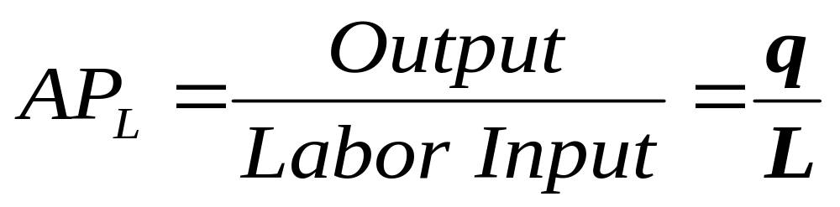
Production: One Variable Input
Average product of Labor - Output per unit of a particular product
Measures the productivity of a firm’s labor in terms of how much, on average, each worker can produce

Slide 144
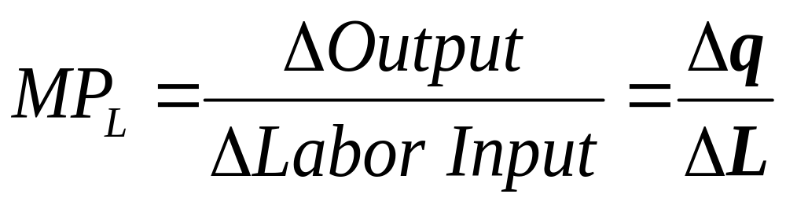
Production: One Variable Input
Marginal Product of Labor – additional output produced when labor increases by one unit
Change in output divided by the change in labor
Notes:
20

Slide 145
Production: One Variable Input
Output
per
Month
D
112
C
Total Product
At point D, output is maximized.
60
B
A
0
1
2
3
4
5
6
7
8
9
10
Labor per Month
Notes:
23

Slide 146
Production: One Variable Input
Output
per
Worker
30
Marginal Product
E
20
Average Product
10
0
1
2
3
4
5
6
7
8
9
10
Labor per Month
Notes:
27

Slide 147
Production: One Variable Input
From the previous example, we can see that as we increase labor the additional output produced declines
Law of Diminishing Marginal Returns: As the use of an input increases with other inputs fixed, the resulting additions to output will eventually decrease
Note that this law occurs when other inputs are fixed
Notes:
31

Slide 148
Law of Diminishing Marginal Returns
Typically applies only for the short run when one variable input is fixed
Can be used for long-run decisions to evaluate the trade-offs of different plant configurations
Assumes the quality of the variable input is constant
Notes:
33

Slide 149
Law of Diminishing Marginal Returns
Assumes a constant technology
  Changes in technology will cause shifts in the total product curve
  More output can be produced with same inputs
  Labor productivity can increase if there are improvements in technology, even though any given production process exhibits diminishing returns to labor

Slide 150
The Effect of Technological Improvement
Output
Moving from A to B to C, labor productivity is increasing over time
C
100
O₃
B
A
O₂
50
O₁
Labor per
time period
0
1
2
3
4
5
6
7
8
9
10
Notes:
37

Slide 151
Malthus and the Food Crisis
Malthus predicted mass hunger and starvation as diminishing returns limited agricultural output and the population continued to grow
Why did Malthus’ prediction fail?
  Did not take into account changes in technology
  Although he was right about diminishing marginal returns to labor
Notes:
38

Slide 152
Production: Two Variable Inputs
Firm can produce output by combining different amounts of labor and capital
In the long run, capital and labor are both variable
We can look at the output we can achieve with different combinations of capital and labor
Notes:
53

Slide 153
Production: Two Variable Inputs
The information can be represented graphically using isoquants
  Curves showing all possible combinations of inputs that yield the same output
Curves are smooth to allow for use of fractional inputs
  Curve 1 shows all possible combinations of labor and capital that will produce 55 units of output

Slide 154
Isoquant Map
Capital
per year
5
E
4
3
A
B
C
2
q₃ = 90
D
q₂ = 75
1
q₁ = 55
1
2
3
4
5
Labor per year
Notes:
14

Slide 155
Production: Two Variable Inputs
Diminishing Returns to Labor with Isoquants
Holding capital at 3 and increasing labor from 0 to 1 to 2 to 3
  Output increases at a decreasing rate (0, 55, 20, 15) illustrating diminishing marginal returns from labor in the short run and long run
Notes:
55

Slide 156
Production: Two Variable Inputs
Substituting Among Inputs
  Slope of the isoquant shows how one input can be substituted for the other and keep the level of output the same
  The negative of the slope is the marginal rate of technical substitution (MRTS)
    Amount by which the quantity of one input can be reduced when one extra unit of another input is used, so that output remains constant
Notes:
58

Slide 157
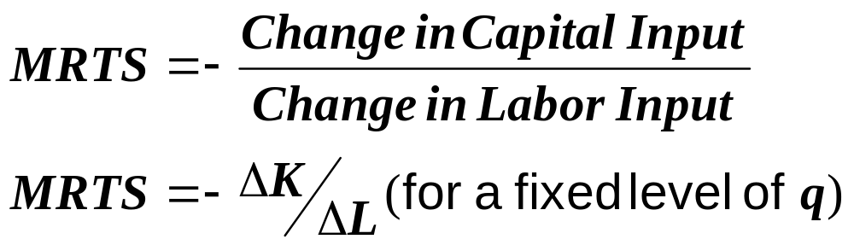
Production: Two Variable Inputs
The marginal rate of technical substitution equals:
Notes:
59

Slide 158
MRTS and Isoquants
We assume there is diminishing MRTS
  Increasing labor in one unit increments from 1 to 5 results in a decreasing MRTS from 1 to 1/2
  Productivity of any one input is limited
Diminishing MRTS occurs because of diminishing returns and implies isoquants are convex
There is a relationship between MRTS and marginal products of inputs
Notes:
61

Slide 159
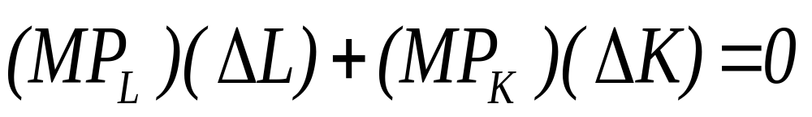
MRTS and Marginal Products
If we are holding output constant, the net effect of increasing labor and decreasing capital must be zero
Using changes in output from capital and labor we can see
Notes:
63

Slide 160
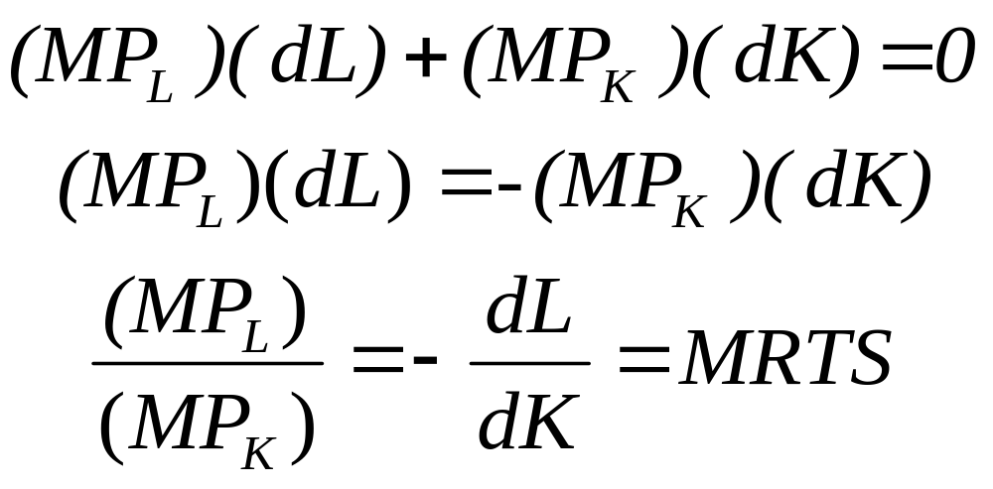
MRTS and Marginal Products
Rearranging equation, we can see the relationship between MRTS and MPs

Slide 161
Perfect Substitutes
Capital
per
month
A
B
C
Q₁
Q₂
Q₃
Labor
per month
Notes:
64

Slide 162
Fixed-Proportions
Production Function
Capital
per
month
Q₃
C
Q₂
B
K₁
Q₁
A
Labor
per month
L₁
Notes:
66

Slide 163
Well-behaved Technology
Monotonicity: if we increase the amount of at least one of the inputs, it should be possible to produce at least as much output as we producing originally
This is sometimes referred to as the property of free disposal

Slide 164




Well-Behaved Technologies - Convexity
x₂
y≡100
x₁

Slide 165
Returns to Scale
In addition to discussing the tradeoff between inputs to keep production the same
How does a firm decide, in the long run, the best way to increase output?
  Can change the scale of production by increasing all inputs in proportion?
  If double inputs, output will most likely increase but by how much?
Notes:
74

Slide 166
Returns to Scale
Rate at which output increases as inputs are increased proportionately
  Increasing returns to scale
  Constant returns to scale
  Decreasing returns to scale

Slide 167
Constant Return to Scale

Slide 168
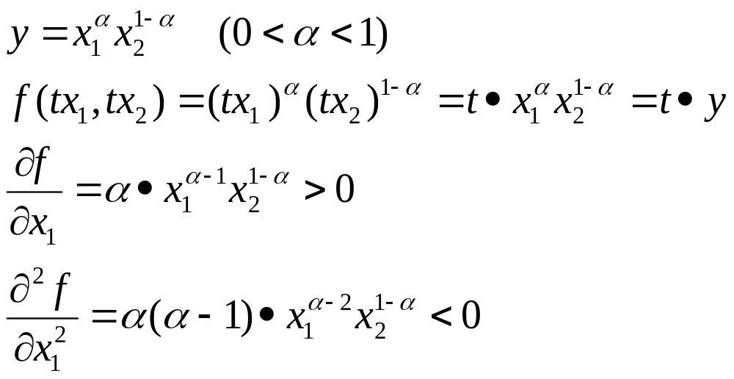
Diminishing MP and CRTS

Slide 169
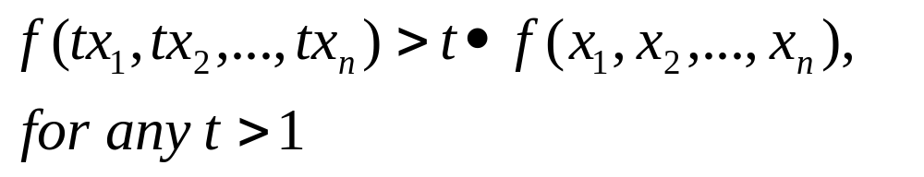
Increasing Return to Scale

Slide 170
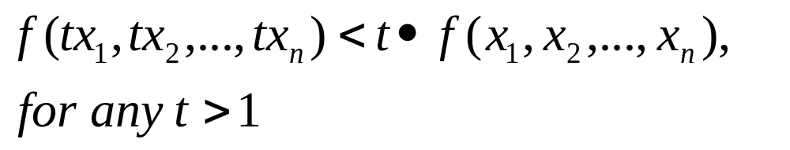
Decreasing Return to Scale

Slide 171
Returns-to-Scale
One input, one output
Output Level
y = f(x)
2y’
Constant
returns-to-scale
y’
x’
2x’
x
Input Level

Slide 172
Returns-to-Scale
One input, one output
Output Level
2f(x’)
y = f(x)
f(2x’)
Decreasing
returns-to-scale
f(x’)
x’
2x’
x
Input Level

Slide 173
Returns-to-Scale
One input, one output
Output Level
Increasing
returns-to-scale
y = f(x)
f(2x’)
2f(x’)
f(x’)
x’
2x’
x
Input Level

Slide 174
Returns-to-Scale
One input, one output
Output Level
y = f(x)
Increasing
returns-to-scale
Decreasing
returns-to-scale
x
Input Level

Slide 175
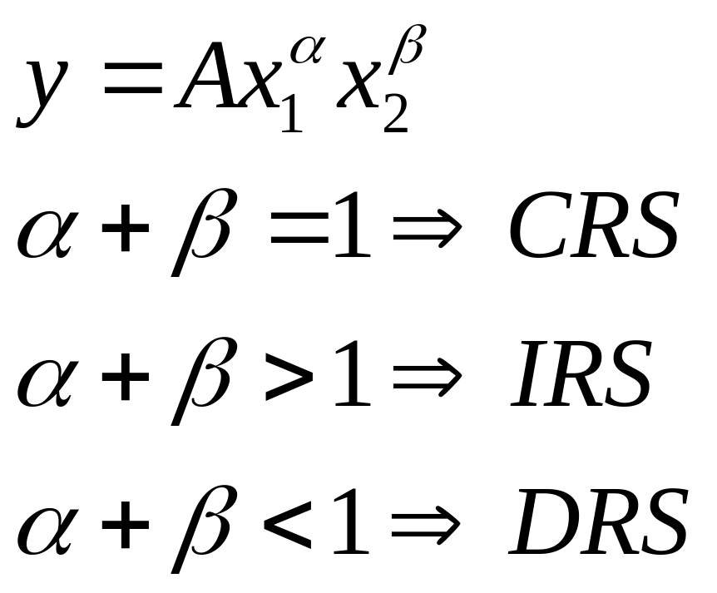
Examples of RTS: Cobb-Douglas Function

Slide 176
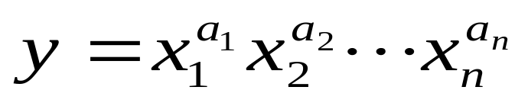
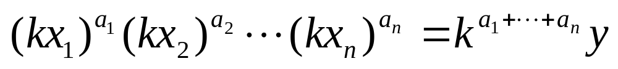
Examples of Returns-to-Scale
The Cobb-Douglas production function is
The Cobb-Douglas technology’s returns-
to-scale is
constant if a₁+ … + a_{n} = 1
increasing if a₁+ … + a_{n} > 1
decreasing if a₁+ … + a_{n} < 1.

