Slide 1
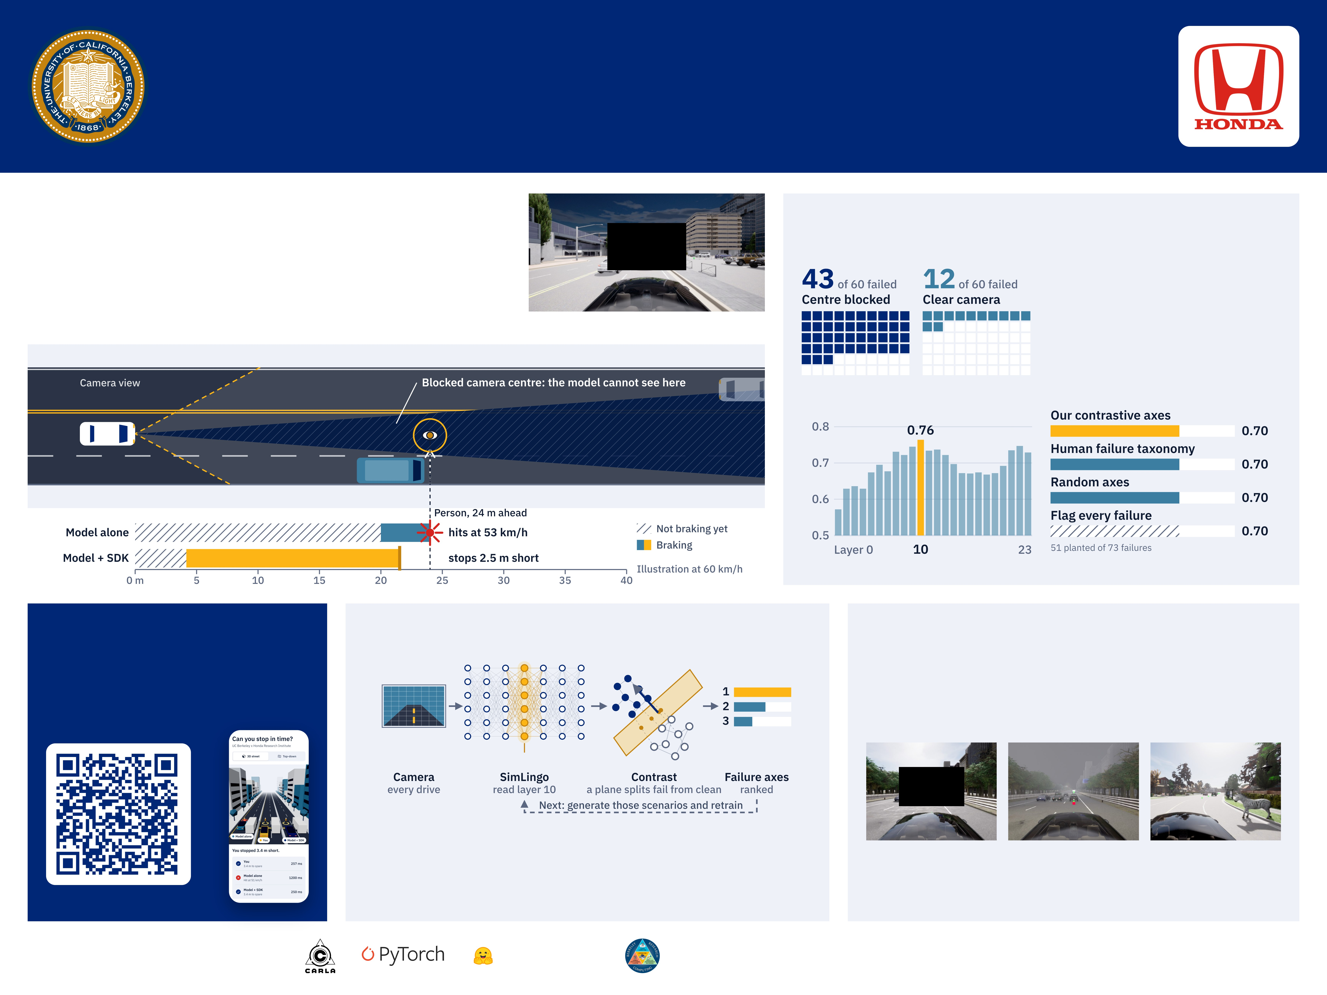
Finding the Edge Cases That Crash Self-Driving Cars
Failure discovery read from inside a vision-language-action driving model, built to work with any VLA
Catherine Wang, Christopher Vu, Jason He, Hiram Lannes, Jerry Yan Mentor: Ryan Lingo
Test lists only catch the crashes someone imagined
Results
Driving models are checked against failures people already thought of. We find new ones by reading the model’s own internal signals, with no list. To prove it works, we plant a failure on purpose: we block the centre of the camera.
Blocking the camera centre is a real failure
31:0
What the model sees with the planted patch
paired routes that failed only blocked, against only clear (p = 9 × 10⁻¹⁰)
Layer 10 flags failures best
Every method finds the easy control
Measured in CARLA simulation on Bench2Drive routes. Repair by targeted training is next and not measured yet.
Can you stop in time?
How discovery works
Planted failures must really fail
Scan, then hold Brake when someone steps out. Compare yourself with the model alone and with our SDK.
We plant failures whose identity is sealed in an answer key, and keep only those that raise failures. Fog and animals look unusual but did not, so they are decoys that discovery must not flag.
We run SimLingo on Bench2Drive routes and record layer 10 on every drive; our two reproductions scored 88.3 and 88.6 of 100 over 220 routes. A plane that separates failing drives from clean ones in those signals is a failure axis, and it names the scenarios to train on next.
Centre blocked: a real gap
43 of 60 failed, against 12 of 60
Dense fog: a decoy
15 of 59 failed, against 18 of 60
Animals crossing: a decoy
1 of 9 failed, against 2 of 10
failure-axis-status.vercel.app/drive
Built with
SimLingo
Bench2Drive
Hugging Face
Savio
SimLingo: Renz et al., CVPR 2025. Bench2Drive: Jia et al., NeurIPS 2024. CARLA: Dosovitskiy et al., CoRL 2017. Overlap is Jaccard similarity: shared failures over combined failures.

