Slide 1
Shrink Your Life with TMux
Chris wolf
Ibm backend engineer (cloud)

Slide 2
GitHub Repo
https://github.com/Christopher-Wolf-ibm/SYL-TMUX

Slide 3
Shrink Your Life
Shrink the number of objectives that warrant your attention
Shrink the amount of effort needed to influence your objectives
This is where TMux is helpful

Slide 4
What is TMux?
Terminal MUltipleXer
First created by Nicholas Marriot in 2007
Most recent stable release 3.3 (June 2022)
Permits a user to organize, manage, and manipulate a virtually limitless number of terminal instances in one convenient place
But why use TMux?

Slide 5
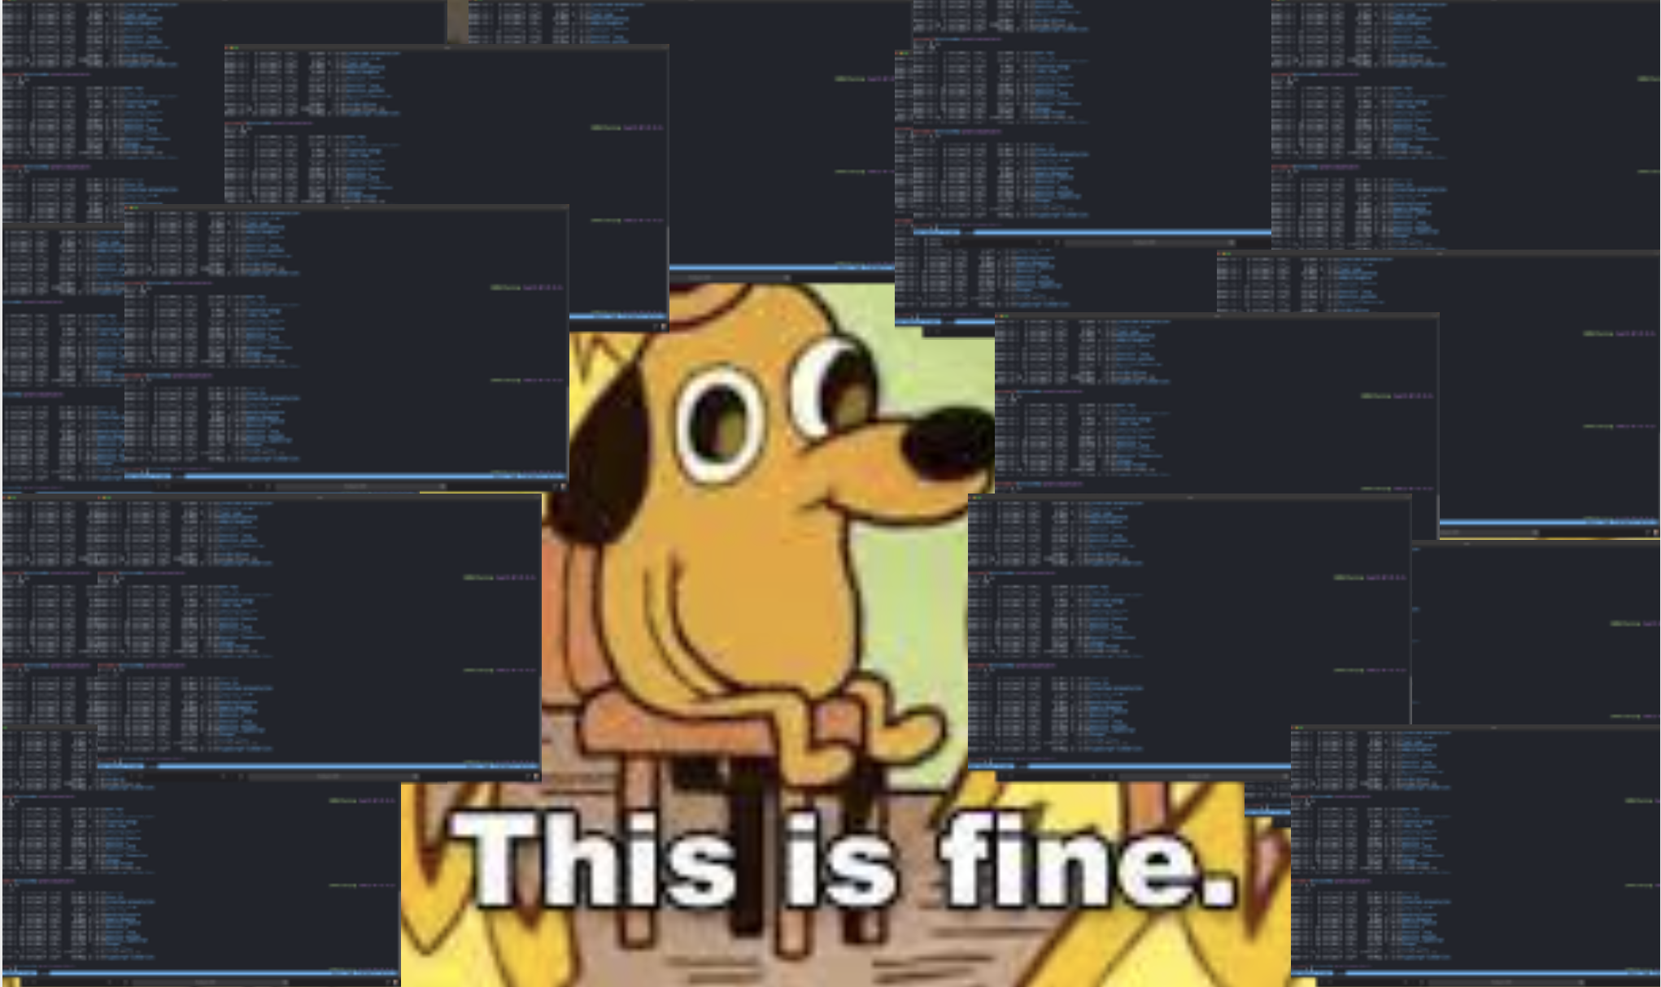
Actual footage of Chris in 2013

Slide 6

TMux Components
TMux is broken down into three components
Sessions
Windows
Panes

Slide 7
Sessions
A "bundle" of terminal windows with a common purpose
You can see a list of all of your current sessions:
tmux ls
To create a new session
tmux new-session –s <session_name>
To attach to an existing session
tmux attach –t <session_name>
To detach from current session
Prefix (Ctrl+b) + d
To switch current session from inside tmux
Prefix (Ctrl+b) + s

Slide 8
Windows
A "screen" that you can see take up your entire terminal
Create a new window
Prefix + c
Rename current window
Prefix + ,
Navigate between windows
Next window: Prefix + n
Previous window: Prefix + p
Specific window: Prefix + <number> (windows can be seen listed at bottom of terminal)

Slide 9
Panes
An instance of a terminal existing inside of a window
Create a new window
Split horizontal: Prefix + %
Split vertical: Prefix + "
There are ways to edit these to be more intuitive
Navigate between windows:
Move to the left: Prefix + j
Move up: Prefix + k
Move down: Prefix + l
Move right: Prefix + ;
This is blasphemous and should be remapped to something more logical *cough*vim*cough*

Slide 10
Panes (cont.)
Toggle zoom of windows:
Prefix + z
Scroll through a pane
Prefix + [
Use vim style movements (hjkl) to move
Use q to exit pane scroll
Resize window (move border):
Prefix + : (to enter command mode)
resize-pane –D | -U | -L | -R <num>
This can also be remapped

Slide 11
Configuring TMux
Like all great Unix tools, TMux can be modified and configured to fit your specific needs
Settings are stored in ~/.tmux.conf
Use vim based navigation
Set-window-option –g mode-keys vi
Automatically renumber windows when closed
Set-option –g renumber-windows on
Start numbering windows at 1
Set –g base-index 1

Slide 12
Configuring TMux (cont.)
Change color of tmux control bar
set –g status-bg <color>
set –g status-fg <color>
You are welcome to borrow my tmux config file as a starting place:
https://github.com/Christopher-Wolf-ibm/SYL-TMUX/blob/main/tmux.conf

Slide 13
TMux Plugins
TMux has plugins available through its plugin manager: TPM
Plugins allow you to further customize and optimize your work environment
Instructions on installing and TPM can be found here:
https://github.com/Christopher-Wolf-ibm/SYL-TMUX
Recommended plugins:
Resurrect: save/load instances of your TMux server to be recreated
Continuum: causes Resurrect to save at set intervals (15 min default)
Battery: show the battery life in your tmux command line

Slide 14
Helpful script
The commands for creating and attaching to TMux sessions can be very verbose and annoying
Feel free to use this script to make the process easier
https://github.com/Christopher-Wolf-ibm/SYL-TMUX/blob/main/tm.sh

Slide 15
Workflow Demonstration

Slide 16
Closing Thoughts
We spend roughly 25% of our weekly time at work, make it as smooth and painless as possible
If you find yourself doing the same thing all the time, automate it and get it out of your way
Keep everything you need to be successful within "arms reach" (Shrink Your Life!)
The beauty of Unix tools is that all of us will use them differently; experiment with TMux (and anything else) and find the workflow that will make YOU successful
If you're not having fun, you're doing it wrong!

Slide 17
Additional Resources
TMux GitHub Repo:
https://github.com/tmux/tmux/wiki
Ham Vocke "Quick and Easy Guide to TMux":
https://www.hamvocke.com/blog/a-quick-and-easy-guide-to-tmux/
Dev Community "TMux Tutorial for Beginners"
https://dev.to/iggredible/tmux-tutorial-for-beginners-5c52
Me!
Christopher.Wolf@ibm.com
Christopher Wolf on slack

Slide 18
Questions, Comments, Concerns
Thank you for spending your lunch break with me letting me nerd out about one of my favorite tools!

