Slide 1
Lecture notes Chapter 4: Function

Slide 2
Welcome!!
“
Computing is not about computers anymore. It is about living.
”
Nicholas Negroponte

Slide 3
Chapter Overview
What is function?
01
Including why we need functions and what is function, library functions.
Function Declarations
02
Including how to define a function and the syntaxes.
Defining a function
03
Including how to define a function and the syntaxes, return statement.
Calling of function
04
Including how we call the function, flow of function, call by value, call by reference.

Slide 4
Why we need function?
In the previous lecture notes, we do all our programs inside the main( ), which the real name is main function. Some of the programs we did have already been quite tedious. What if we want to execute more jobs and we want to ”re-use” certain jobs in various locations?
In C++, we are able to build functions to solve the above problem. A function is basically lines of code that enable us to do specific tasks. We can declare, define and call them when we are implementing the code. It is easier to read and follow than pilling up all lines of codes together. By the idea of divide-and-conquer, we can design a structural and clear codes.

Slide 5
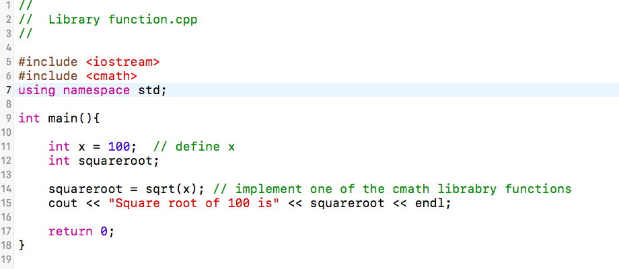
What is function?
There are two kinds of functions. They are the library functions and user-defined functions. Have you ever wondered why we need to #include <iostream> ? It is actually a header file for input and output things including cin and cout. It tells the computer to identify those library functions and enable us to implement them.
We can also include other header files, for example, we can #include <cmath> to call functions in cmath library to do various calculations. What is the output for the following example?
More C++ library reference in http://www.cplusplus.com/reference/clibrary/

Slide 6
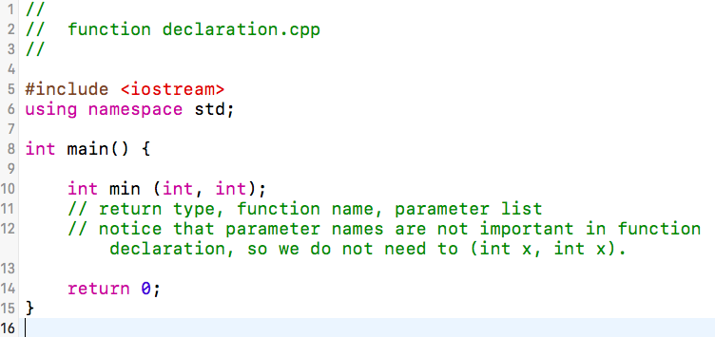
Function Declarations
A function declaration tells the compiler about a function name and how to call the function. The actual body of the function can be defined separately. In other words, we can declare a function without defining it (will talk about defining in the following). Declaring a function only tells the computer the name, return type and parameters of the function.
The syntax of function declaration is:
return_type function_name( parameter list );

Slide 7
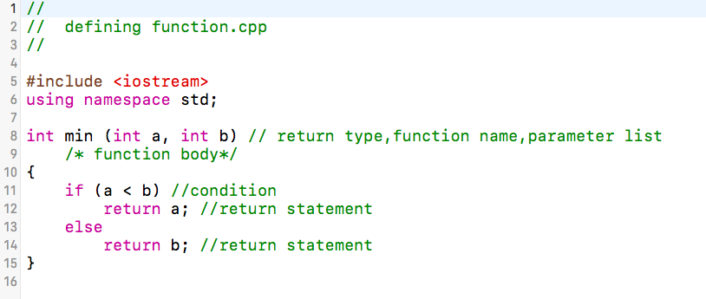
Defining functions
When we define a function, similar to function declaration, we need to have the return type, function name, formal parameter list with identifiers and one more thing which is the function body. The body is implementing what we want to do with the parameters.
The syntax of defining a function is:
return_type function_name( formal parameter list ){ function body }
You can not get any result just by defining a function, there is one more step you need to go through!!!

Slide 8
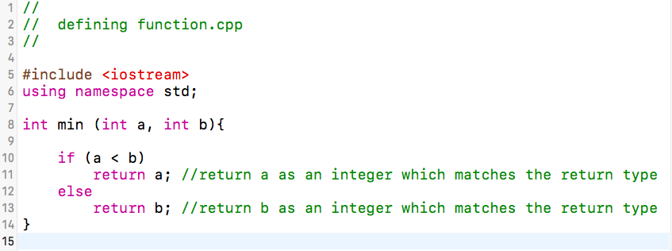
Return statement
After all those examples above, you may wonder what and why there are always return types and statements. Return statements are actually used for two things:
1) It stop the calling function and the caller take back control.
2) It return an object that equals to the return type when you define/ declare the function.
Please be reminded that the return statement must have the same type with return type, otherwise, error will occur.

Slide 9
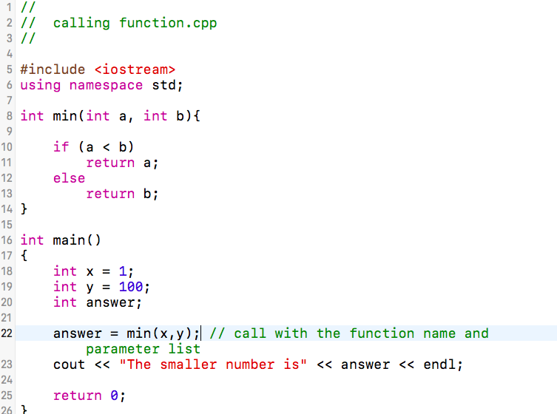
Calling functions
Calling the function is the final step that enable us to use the function we defined before. We can “re-use” the function as long as we are calling it. To call a function, you need to pass the required actual parameters along with function name.
The syntax of calling a function is:
function name (actual parameter list);
What is the result after running the code?

Slide 10
Flow of function
After we finished defining and calling the function, we can obtain the result we want and the control is back to the caller function.
Using the previous example, after we execute the main function,
1. Called the min function when running the code.
2. The codes of min function will be executed.
3. The control will be returned back to the caller (in this case is the main function) along with the return type.
4. The next line of the caller function will carry on the flow.
2
1
3
4

Slide 11

Function Arguments
In programming, argument (parameter) refers to the data which is passed to a function (function body) while calling it. There are two methods which is pass-by-value and pass-by-reference.
Pass-by-value
Pass-by-reference
Pass-by-value copies the actual value of an argument into the formal parameter of the function. In this case, modification made to the parameter inside the function have no effect on the argument.
Pass-by-reference
copies the reference of an argument into the formal parameter. Inside the function, the reference is used to access the actual argument used in the call. This means that changes made to the parameter affect the argument.

Slide 12
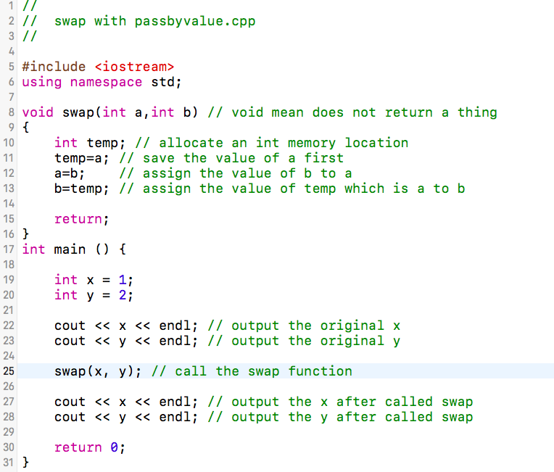
Pass-by-value
In this calling technique we pass the values of arguments which are stored or copied into the formal parameters of functions. Hence, the original values are unchanged only the parameters inside function changes. By default, C++ use the pass-by-value method when calling function.
Consider the following example:
What is the outputs of the first x and y?
What is the output of x and y after the swap was called? Why?

Slide 13
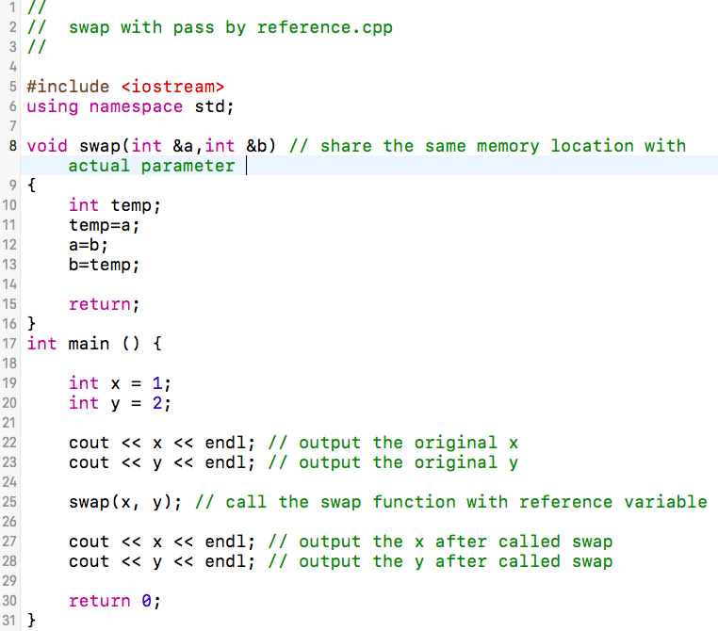
Pass-by-reference
In pass-by-reference, we pass the address of the variable as arguments rather than the value only. In this case the formal parameter can be taken as a reference, in this case it will change the values of the original variable.
Consider the following example:
What is the outputs of the first x and y?
What is the output of x and y after the swap was called? Why?

Slide 14
Want to know more? Go to the next chapter!

