Slide 1
Lecture notes Chapter 5 Array

Slide 2
Welcome!!
“
”
Everyone should know how to program a computer, because it teaches you how to think.
Steve Jobs

Slide 3
Chapter Overview
A
What is array?
Introducing what is array.
B
Declaring array
Include how to declare an array
C
Initializing array
Include how to initialize an array
D
Accessing array elements
Include getting the members from an array
E
Multi-dimensional array
Introduce the 2-D array

Slide 4
What is array?
In the previous notes, we usually only deal with a small number of data no more than 4. But what if we want to handle more data in our program? In C++, array can help us handle numerous data of the same type by using array. An array is used to store a collection of data, but we can also think of an array as a collection of variables of the same type.
We used to declare variable one by one in the previous notes which is quite tedious. Instead of declaring and initializing the same type of data again and again, we can use array to help us allocate memory by only one line of code. We only need one identifier name to address all the data with same type, and we can reach each of them to implement our tasks.

Slide 5
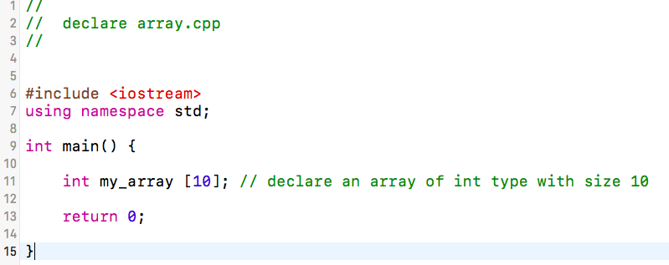
Declaring array
To declare an array we need to specifies the type of the elements and the number of elements required by an array. We can declare an array with only one type but can be any type. It means that we can declare arrays of int or ch or double etc. Like declaring function, we only tell the compiler the size of the array without telling what is inside the array.
The syntax of declaring an array is
data_type array_name [array_Size] ;
Please be reminded that the above example array can hold 10 int-size data!!!

Slide 6
Initializing array
To tell the compiler what’s inside the array, we need to initialize the array. By default, regular arrays are uninitialized. This means that none of the array’s elements are given any particular value; their contents are undetermined when the array is declared. However, the elements in an array can be initialized to particular values when it is declared.
The syntax of initializing array is
data_type array_name [array_Size] = {element0, element1, …};
In array, we call the first slot as 0, the second slot as 1 and so on.
0
1
2
3
n-1
……

Slide 7
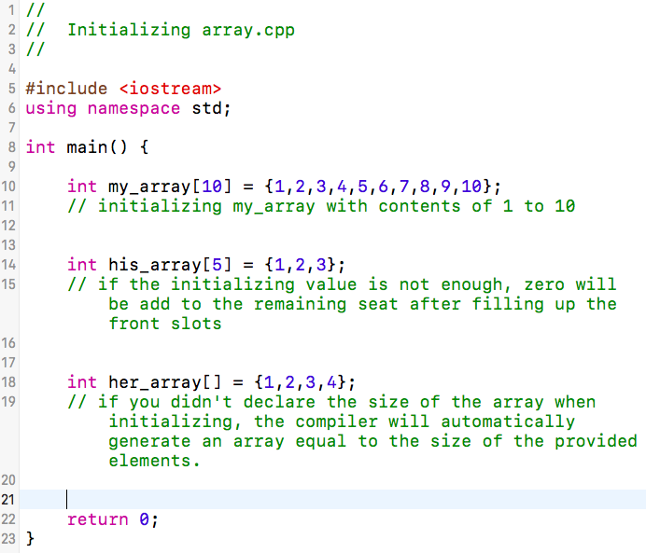
initializing array.cpp
0
1
2
3
9
my_array
1
2
3
4
10
…
0
1
2
3
4
his_array
1
2
3
0
0
0
1
2
3
her_array
1
2
3
4

Slide 8
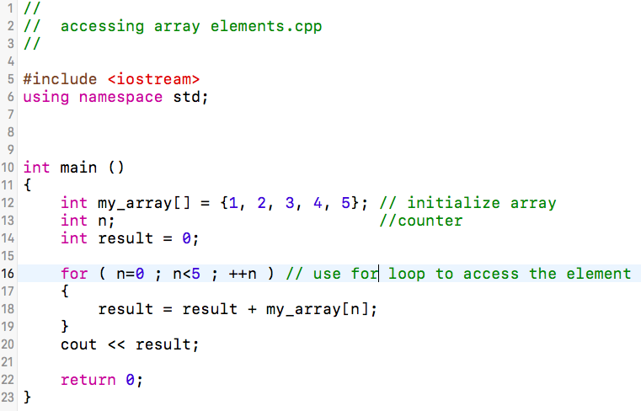
Access array elements
We have already learnt how to declare and initialize an array, but how we can actually use the array rather than just build it. In C++, we can access an element by indexing the array name. This is done by placing the index of the element within square brackets after the name of the array.
The syntax of accessing array element is:
array_name [position_of_element];

Slide 9
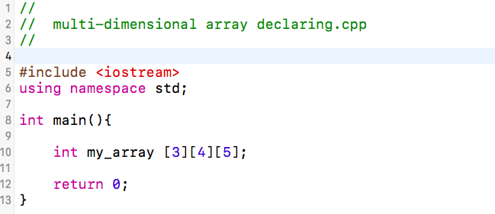
Multi-dimensional array
C++ allows multidimensional arrays. Multidimensional arrays can be described as "arrays of arrays". For example, a bi-dimensional array can be imagined as a two-dimensional table made of elements, all of them of a same uniform data type.
The syntax of declaring a multi-dimensional array is:
type name [size1][size2]...[sizeN];

Slide 10
Two-dimensional array
The simplest form of the multidimensional array is the two-dimensional (2-D) array. A two-dimensional array is actually a list of one-dimensional arrays (matrix). To declare a two-dimensional integer array of size x, y, and its name is my_array you would write something as follows:
int my_array[ x ][ y ];
A two-dimensional array can be think as a table, which will have x number of rows and y number of columns. Thus, every element in array a is identified by an element name of the form a[ i ][ j ], where a is the name of the array, and i and j are the subscripts that uniquely identify each element in a.

Slide 11
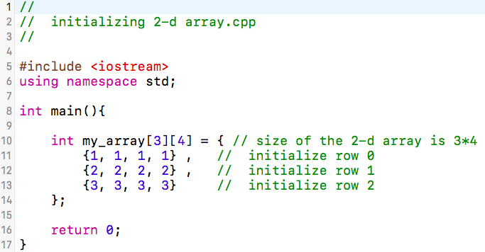
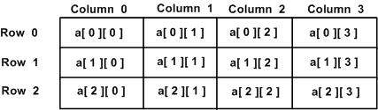
Initializing 2-D array
Two-dimensioned arrays may be initialized by specifying bracketed values for each row. Following is an array with 3 rows and each row have 4 columns.

Slide 12
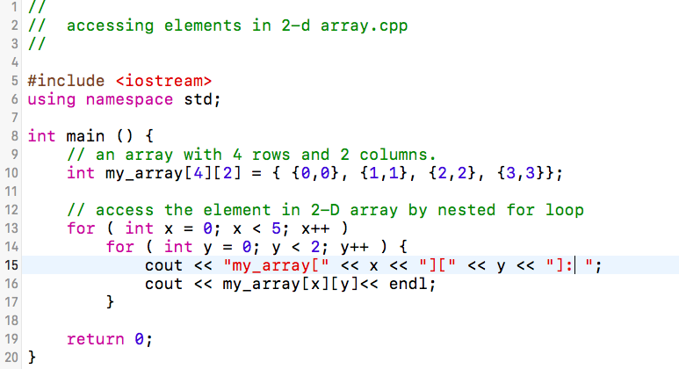
Accessing 2-D Array Elements
Just like dealing with a common array, an element in 2-dimensional array is accessed by using the subscripts, i.e., row index and column index of the array.
The syntax of accessing elements is:
array_name[position of element x][position of element y];

Slide 13
Want to know more?
Go to the next chapter!

