Slide 1
Lecture notes Chapter 6:
Recursion

Slide 2

Welcome!!
“
”
To understand recursion, one must first understand recursion.
Steven Hawking

Slide 3
Chapter Overview
01
What is recursion?
Include what is recursion.
02
How to think recursively?
Concepts and steps of recursion.
03
How we implement recursion?
Syntax and how to implement recursion in C++
04
Practical examples
More examples and how they are related to our lives.

Slide 4
What is recursion?
Recursion is a process by which a method calls itself over again until some process is complete or some condition is met. we need recursion for solving those problem whose end is infinite like in case of Fibonacci series generation. You may want to ask then what the differences between recursion and loops are. The main difference is recursion is defined in terms of itself but loops aren’t.
One of the classic example of introducing recursion is the factorial function in mathematics (!).
For example, we want to calculate the result of 10!. Which equals to 10*9*8*…2*1. At this time you may think using loop to solve it. However, there is an other way to think and solve with recursion

Slide 5
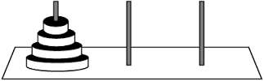
Tower of Hanoi
The Tower of Hanoi is a mathematical game that can use the concept of recursion to solve. It consists of three rods and a number of disks of different sizes, which can be slide onto any rod. The goal of the puzzle is to move the entire stack to another rod, obeying the following several rules:
Only one disk can be moved at a time.
You can only move the upper most disc each time.
No disk may be placed on top of a smaller disk.
Click the link to try out the game:
https://www.mathsisfun.com/games/towerofhanoi.html
What is the smallest number of moves you can successfully solve the game(with three disc)? What if more discs is add? Can you also solve them? Are they similar?

Slide 6
Factorial Function
From the above example, we can tell that if we know how to solve the base case (which is the 3-discs case), we can solve the cases with more discs. The minimal number of moves required to solve a Tower of Hanoi puzzle is 2^{n} − 1, where n is the number of disks (for reference).
Similar to Tower of Hanoi game, we can also solve factorial function if we know how to solve the underlying principle and base case of it (which is 1!).
For example we want to solve 4! ,
We can change 4! to 4 * 3!,
we can then change 3! to 3 * 2!,
we can then change 2! to 2 * 1!,
we can then change 1! to … Wait! Even we change it to 1 * 0!, there is no difference at all.
(BASE CASE REACHED)

Slide 7
Fibonacci Number
Fibonacci number and sequence can also be solved by recursion. Fibonacci sequence is referred to the following sequence of numbers:
0, 1, 1, 2, 3, 5, 8, 13, 21, 34, 55, 89, 144, 233, …
The two rules of the Fibonacci Sequence is:
Each subsequent number is the sum of the previous two.
The sequence starts with 0 and 1. (Base case)
Similar to the previous examples, we need to find out the underlying principle and the base case in order to fulfil the requirement of recursion.
For example, we want to print out 5 terms of Fibonacci Sequence,
To find the 5th term, we can change it to the sum of 3rd and 4th term, i.e. 3rd + 4th.
To find the 4th term, we can change it to the sum of 2nd and 3rd term, i.e. 2nd + 3rd.
To find the 3rd term, we can change it to the sum of 1st and 2nd term, i.e. 1st + 2nd.
To find the 2rd term, we can change it to the sum of … wait!!! We know the first two terms are 0 and 1 and we can’t go further to the 0th term!!!
(BASE CASE REACHED)

Slide 8
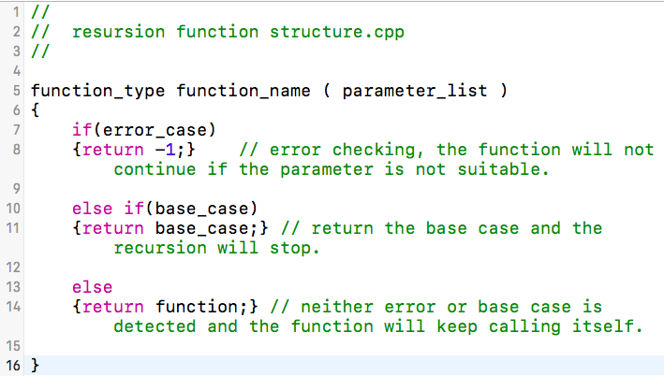
How to implement recursion
We have just mentioned a few examples that can be solved by recursion. But how can we actually tell the computer to execute recursion?
However, before we start, we need to bare in mind that the underlying principle and the base case is the core of recursion.
The structure of recursion is actually a function that keep calling itself until the base case of the it has reached. We also need to use if-statement to prevent us from falling into infinite recursive call.

Slide 9
How to implement recursion
The above code is not the actual code, but only a brief structure of a recursive function!
From the above code, we can see that a recursive function usually consist of three parts, the error checking, base case and the function itself. We used if-else statement to control the flow of the recursive function.
The error checking is to checking whether the parameter passed in is suitable. If the parameter is not suitable, the recursive will be stopped (return -1).
The base case is the destination of the recursion. It is essential in recursive function. Otherwise, we will fall into infinite recursive call of the function.
The function itself let us keep recursively calling it and do iterations until base case is reached.

Slide 10
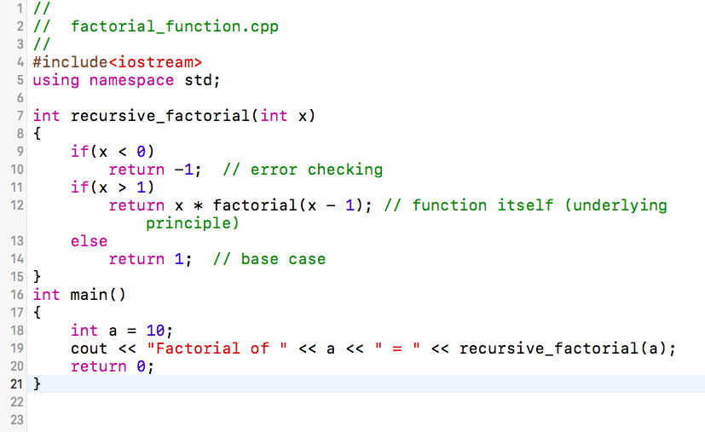
factorial_function.cpp
What is the result of the recursion? What if you change the a into other values? Try replace 10 by 100000000, what will happened?
Notice that whenever you call a function, including recursively, the return address and often the arguments are pushed onto the call stack. The stack is finite, so if the recursion is too deep you'll eventually run out of stack space.
The answer of 10! Is equal to 3628800.

Slide 11
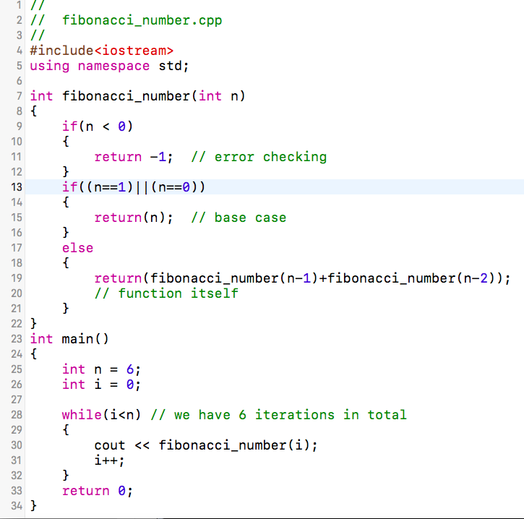
fibonacci_number.cpp
From the previous explanation, we know that the number we looking for is the sum of the previous two numbers. That’s why we call the function fibonacci_number with both n-1 and n-2.
What is the answer of the example? What if you change the number of iteration to the other number?
The answer of this example is:
0, 1, 1, 2, 3, 5
Recursion is all about understanding but not memorizing! Practice more in order to understand the concept of recursion!

Slide 12
Want to know more? Expect more from us later!

