Slide 1

Voice Streaming
Demo Application
Krzysztof Abram,
Jukrapop Kongkaew
Notes:
Introducing ourselves, names and where we come from, what is our topic. <Just a few seconds>

Slide 2
Contents
What is voice streaming?
Examples of popular mobile applications.
Our approach.
Sinch API.
What can be done with Sinch.
Get started with Sinch.
Code example.
Screenshots from demo application.
Live demonstration!

Slide 3
What is voice streaming?
Streaming is the quickest way to access internet-based content.
Transmitting and delivering sound over the internet.
Live streaming is used for real time content delivery.
Streaming requires a relatively fast internet connection.

Slide 4









Examples of popular mobile applications

Slide 5


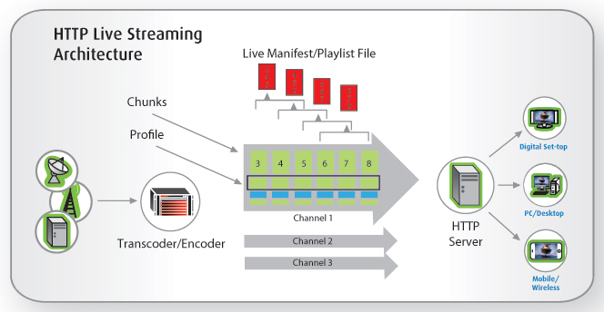
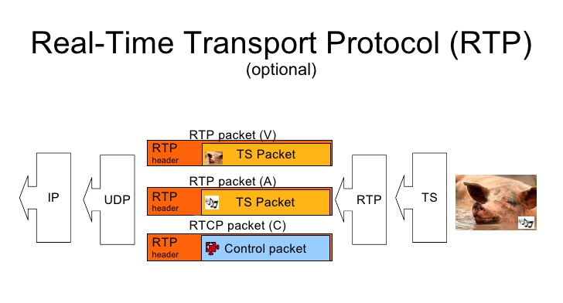
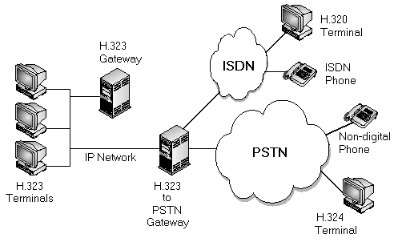
Our approach
RTP
HTTP Live Streaming
H.323
Android SIP
Sinch

Slide 6






Sinch API
Powering voice, verification & video for mobile apps,
CLX leading global provider of cloud-based communications,
Powers communications in all 196 countries across the globe,
www.sinch.com

Slide 7
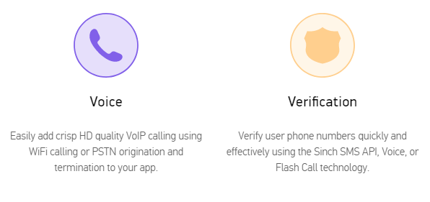
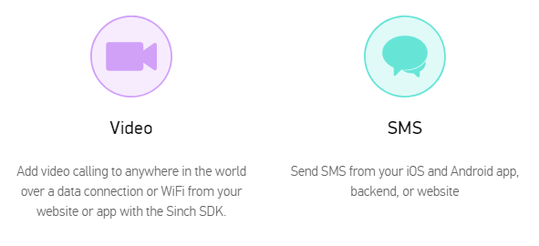
What can be done with Sinch
App to app calling
App to phone calling
Phone to phone calling

Slide 8
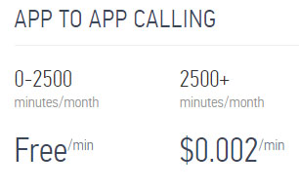
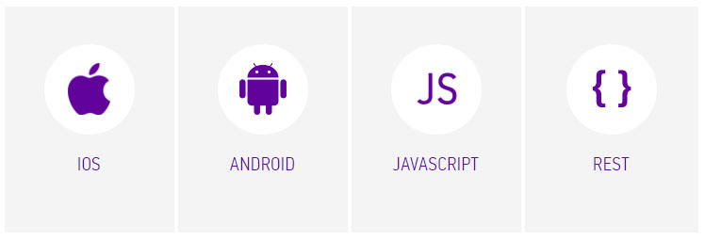
Get started!
Extensive documentation for each platform.
Different tutorials and samples applications.
IOS, Android, JavaScript, REST
Create developer account on Sinch web.
Download Sinch SDK – first select platform.
Generate API key and secret code – do it in dashboard, you will need this during programming.
Extract downloaded library and add it to your project dependencies.
Save your time!

Slide 9
// TODO: Write kick-off application!!!
// To make a call, you first need to create an instance of SinchClient:
SinchClient sinchClient = Sinch.getSinchClientBuilder()
.context(this)
.userId("current-user-id")
.applicationKey("app-key")
.applicationSecret("app-secret")
.environmentHost("sandbox.sinch.com")
.build();
// Then, tell the SinchClient that you want to have
// calling in your app, and finally, start the client:
sinchClient.setSupportCalling(true);
sinchClient.start();
// Inside the OnClickListener, you will make the call:
sinchClient.getCallClient().callUser("call-recipient-id");
// Don't forget to be creative :D

Slide 10
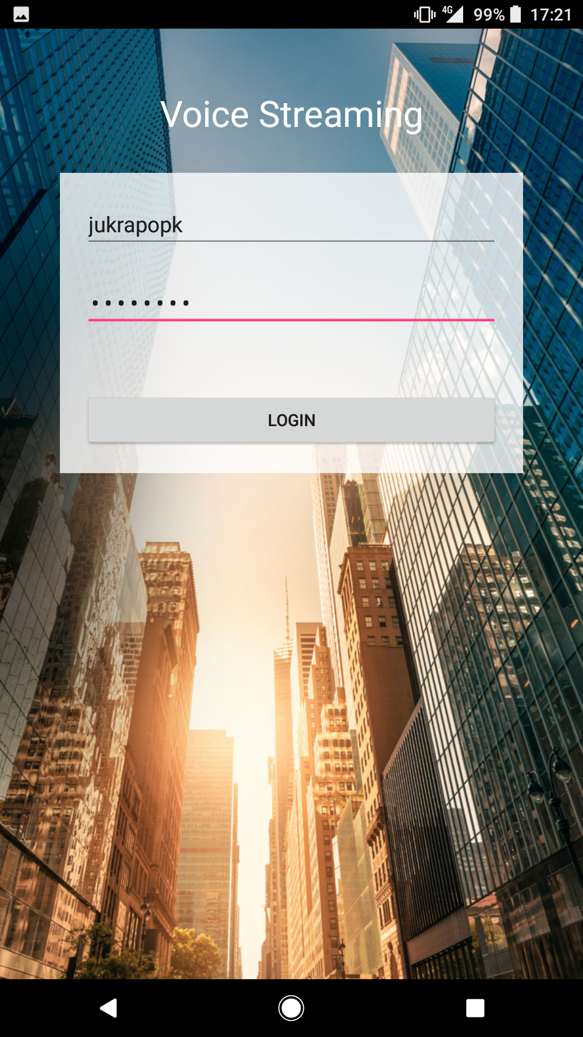
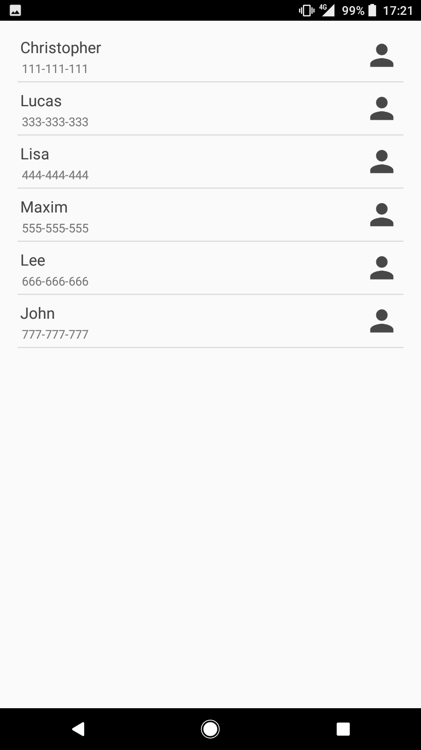
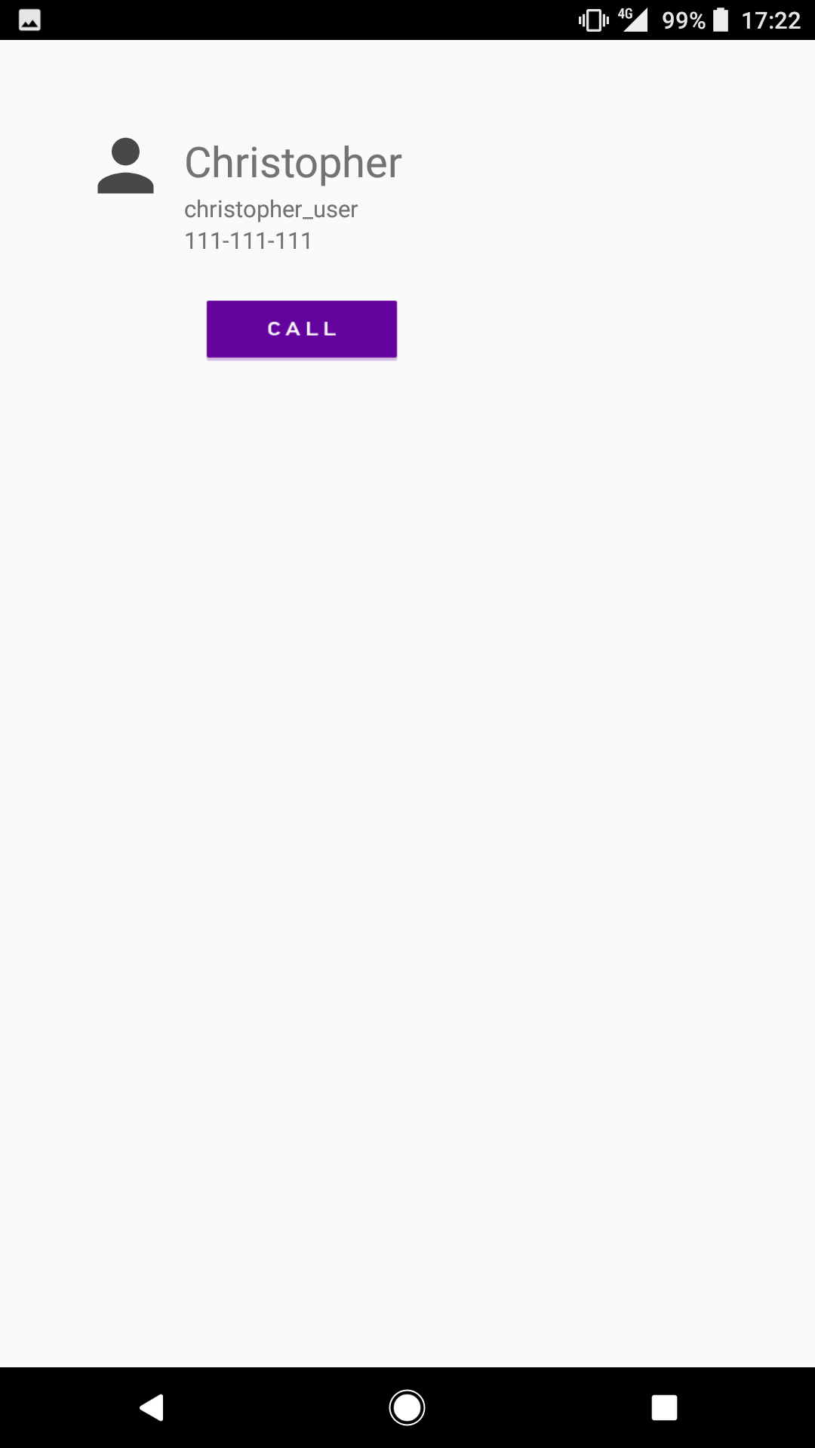

Slide 11
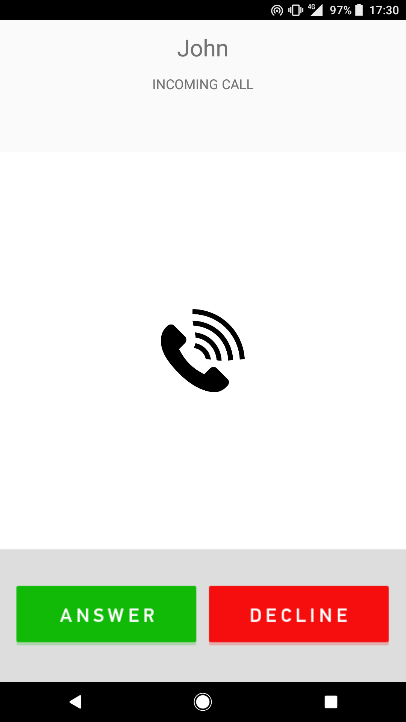
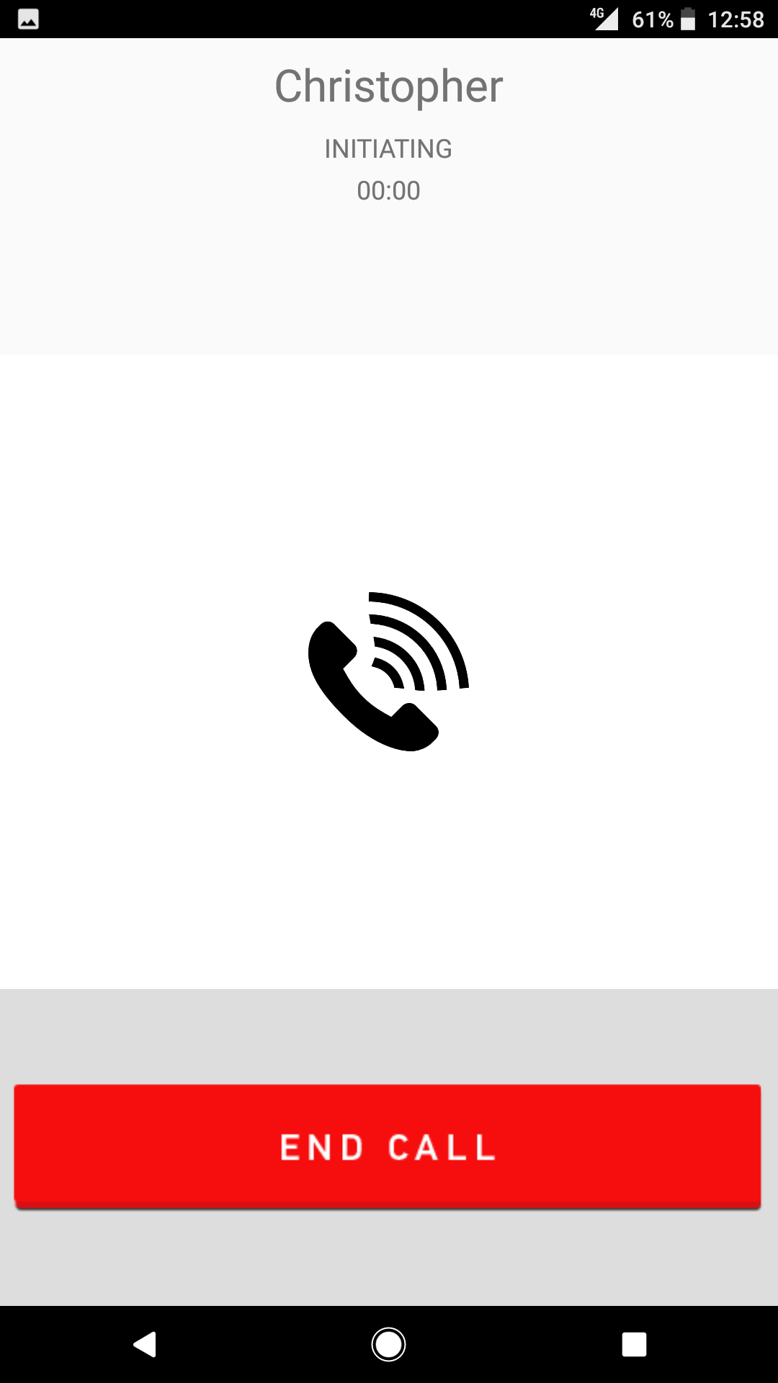


Slide 12

Live Demo

Slide 13


Slide 14
THE END
Krzysztof Abram,
Jukrapop Kongkaew

