Slide 1

Student Dropout Prediction Final Presentation September 15, 2024
Padmaja Kurumaddali, La Monte Yarroll, Christopher Murphy
Notes:
Project focuses on student dropout prediction.

Slide 2
BACKGROUND
The project focuses on student dropout prediction
Dataset of student enrollment from various undergraduate and higher education institutions.
The data tracks student outcomes in three categories:
Enrolled
Graduated
Drop-Out
The data is combined with other information about the student and their academic progress.
3
Notes:
2021 study from UCI via Kaggle
I’ll talk about the data in later slides

Slide 3
Motivation and problem statement
Problem Statement
Motivation
When students fail to succeed in higher education, it can directly impact the economic growth of that individual, their families, and the broader economy.
Can we use data mining techniques to accurately identify key predictors, their interactions, and parameter ranges of concern?
3
Notes:
Ultimately. We want to
highlight the factors affecting student success and form recommendations to educators regarding interventions and policies that can lower drop-out rate and drive retention.

Slide 4
OVERVIEW
About the Data
The Attributes
Data Transformation
Exploratory Data Analysis
Models & Prediction Accuracy
Insights to Research Questions
Notes:
The following project topics will be covered today.

Slide 5

RESEARCH QUESTIONS
What factors influence a student to drop-out?
What distinguishable combination of factors could predict a drop out event?
Which machine learning models provide accurate predictions?

Slide 6
Model Summary
Checkpoint #1:
Final Update:
Association Rule Mining:
Dropout Rules
Graduate Rules
Classification Models:
Decision Tree
Clustering:
K-means
Base Models:
Random Guess
Most Common Value
Classification
Naive Bayes *
Support Vector Machines
Lazy Learning Models
K Nearest Neighbors *
Ensemble Methods:
Random Forest *
Regression:
Logistic - Multinomial
Logistic - Binomial
Models marked with (*) were created with and without PCA.
Notes:
The following project topics will be covered today.

Slide 7
About the Data
Robust data:
4424 observations
37 attributes
Robust Measures:
Demographics
Social-Economic data
Academic progress tracking
External Macro-economic environment
Academic progress tracking is measured through a multi-step process of credit attainment.
The data spans the first and second semesters of student higher education history.
Notes:
Academic progress tracking is measured through a multi-step process of credit attainment.
Evaluations, Approval, Enrollment and Credited
In following slides, we’ll reference Curricular Units which we can think of like Course Credits.

Slide 8
SPECIFIC DATA ATTRIBUTES
DEMOGRAPHICS
Age at enrollment​
Marital Status​
Gender​
Course of study​
Daytime / Evening attendance​
Nationality​
Displaced​
Special Needs​
International​
SOCIAL-ECONOMIC DATA​
Tuition fees up to date​
Debtor​
Scholarship holder​
Parental qualifications
Parental occupations
ACADEMIC PROGRESS TRACKING​
Admission grade​
Curricular units
With evaluations
Without evaluations
Approved
Enrolled
credited
MACRO-ECONOMIC ENVIRONMENT
GDP
Inflation Rate
Unemployment Rate
Notes:
The following project topics will be covered today.

Slide 9
Data Transformation
Data is converted to numeric for correlations
Characters converted to factors
Data Split into Train and Test via sampling (70/30 random split)
Data is discretized for association rule mining
Notes:
Next Steps:
Factor values replaced with meaningful descriptions from the data dictionary.
Factors, discretized to prepare for running our machine learning models.
70/30 random split

Slide 10
Exploratory Data analysis

Slide 11
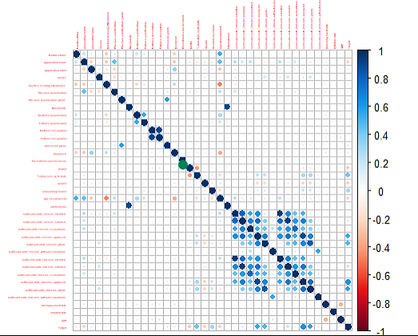
Exploratory Data Analysis: CORRELATION
Correlations
Some potential correlations begin to emerge for credit progress related attributes.
These attributes are investigated further with association rule mining.
11

Slide 12
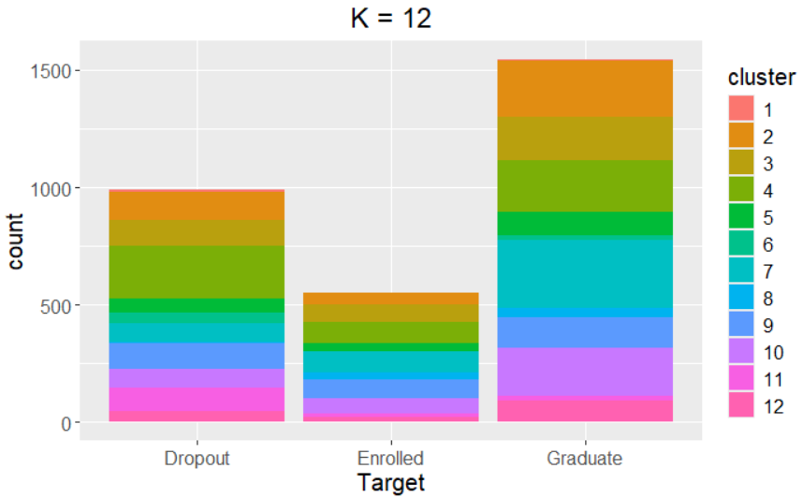
Exploratory Data Analysis: CLUSTERING
K-Means Clustering
12 Clusters
Hartigan-Wong
No appreciable differentiation among Target outcomes
12

Slide 13
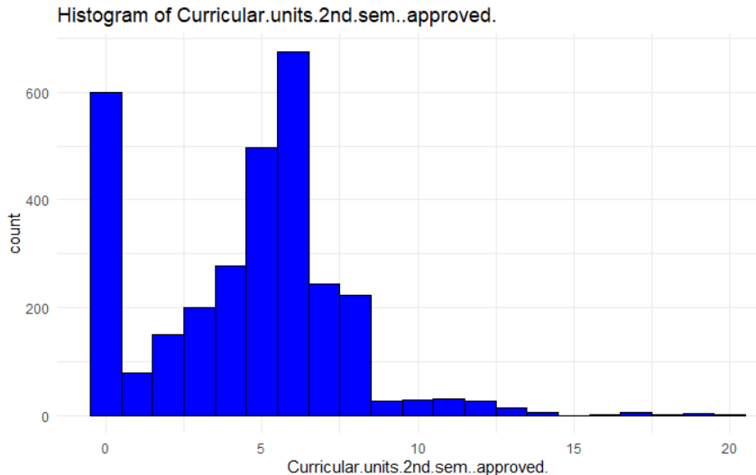
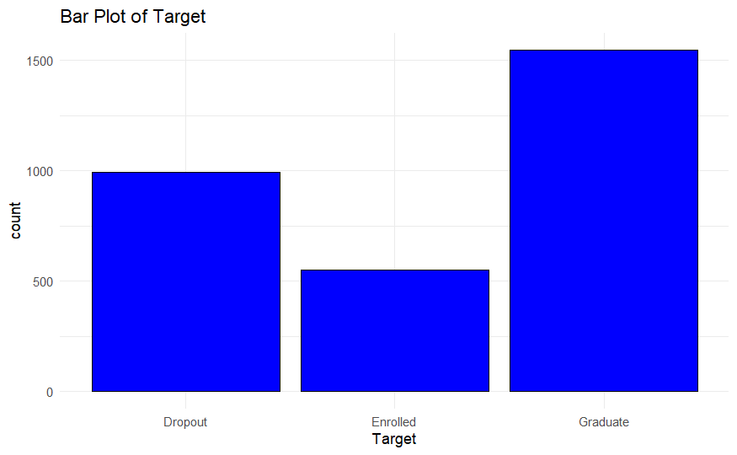
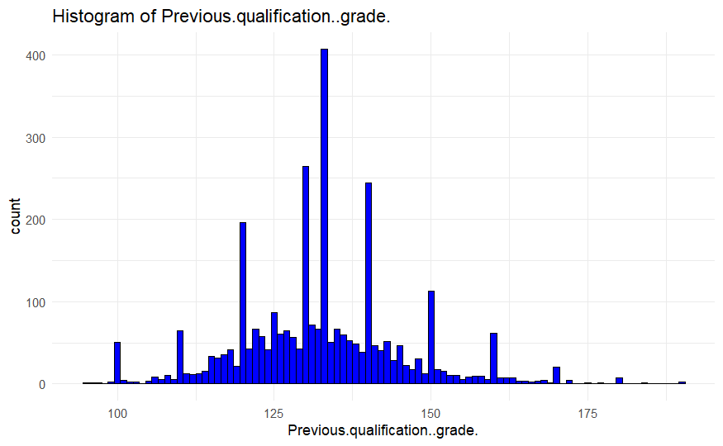
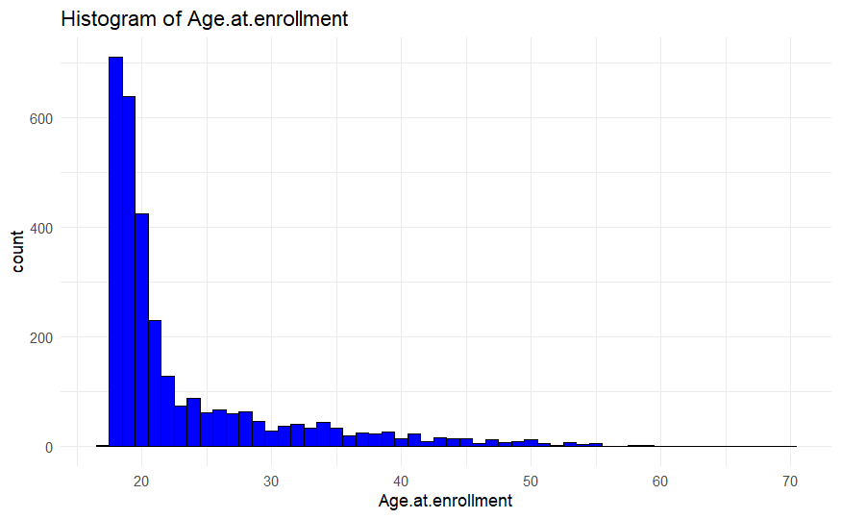
Exploratory Data Analysis: UNVARIATE
13

Slide 14
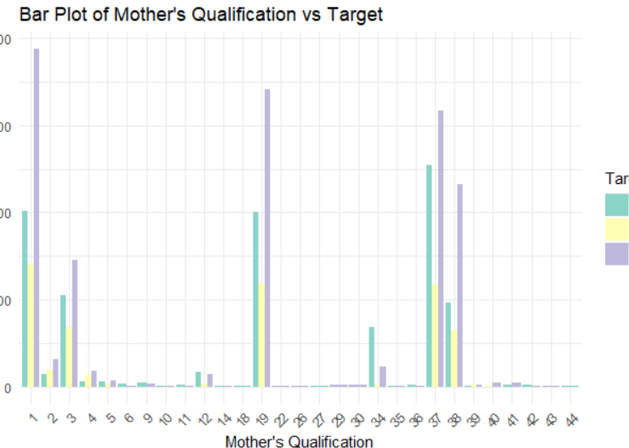
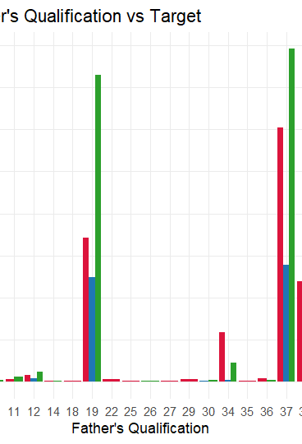
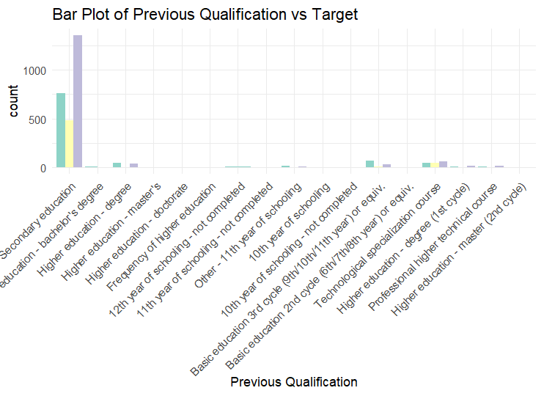
Exploratory Data Analysis: MULTIVARIATE
14

Slide 15
MODELS

Slide 16
DROP-OUT Rules: Top 6 RULES by Lift
LHS | Support | Confidence | Lift
Previous.qualification=Higher education – degree Curricular.units.2nd.sem..approved.=[0,4) | 0.01229773 | 1 | 3.114919
Father.s.qualification=[26.8,35.4) Curricular.units.2nd.sem..grade.=[0,3.71) | 0.01197411 | 1 | 3.114919
Application.mode=Holders of other higher courses Curricular.units.2nd.sem..grade.=[0,3.71) | 0.01003236 | 1 | 3.114919
Age.at.enrollment=[38.2,48.8) Curricular.units.2nd.sem..grade.=[0,3.71) | 0.01035599 | 1 | 3.114919
Course=Agronomy Tuition.fees.up.to.date=[0,0.2) | 0.01003236 | 1 | 3.114919
Course=Tourism Curricular.units.2nd.sem..grade.=[0,3.71) | 0.01035599 | 1 | 3.114919
Notes:
The following table provides some insight into rules for a drop-out outcome.
Also sorted by confidence (not shown).
Note: Curricular units in the second semester begins to surface with regularity in each rule.

Slide 17
GRADUATE RULES: TOP 3 by Lift
LHS | Support | Confidence | Lift
Application.order = 1st Course=Nursing Curricular.units.2nd.sem..grade.=[14.9,18.6 | 0.01035599 | 1 | 1.997414
Scholarship.holder=[0.8,1] Curricular.units.2nd.sem..approved GDP=[-4.06,-2.55) | 0.01262136 | 1 | 1.997414
Scholarship.holder=[0.8,1] Curricular.units.2nd.sem..approved.=[8,12) Inflation.rate=[-0.8,0.1) | 0.01197411 | 1 | 1.997414
Notes:
The following table provides some insight into rules for a graduate outcome.
Also sorted by confidence (not shown).
Students exhibiting changes in key attributes for graduate rules may require cross reference to drop out rules to surface early indicators.

Slide 18
Base Model Random Guessing Accuracy: 38%
test$Target
Predictions | Dropout | Enrolled | Graduate
Dropout | 149 | 75 | 255
Enrolled | 70 | 39 | 121
Graduate | 183 | 126 | 315

Slide 19
Base Model Most Common Accuracy: 52%
test$Target
Predictions | Dropout | Enrolled | Graduate
Dropout | 0 | 0 | 0
Enrolled | 0 | 0 | 0
Graduate | 402 | 240 | 691

Slide 20
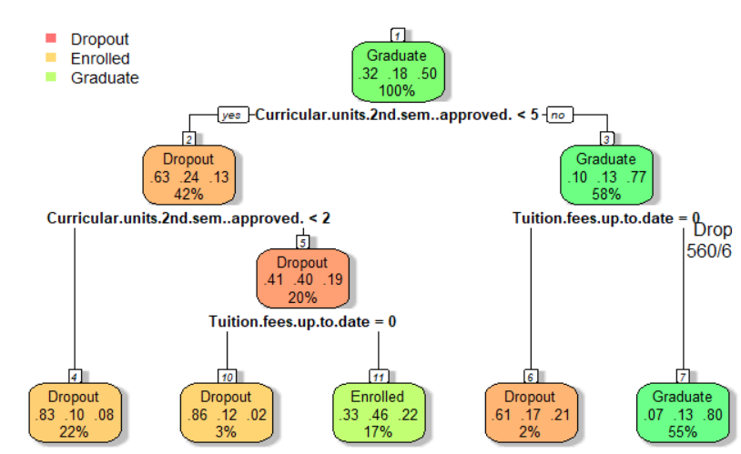
DECISION TREE
OVERALL STATISTICS
Accuracy : 0.7256 95% CI : (0.7008, 0.7494)
No Information Rate : 0.4963 P-Value [Acc > NIR] : < 2.2e-16 Kappa : 0.5484 Parameters:
Support = 0.01
Confidence = .05
Notes:
Curricular units (i.e. credits) in the second semester begins to emerge as a powerful classifier.
In addition, falling behind on tuition, coupled with failing to meet credit schedule, seems to be a primary indicator.

Slide 21
DECISION TREE CONFUSION MATRIX
test$Target
Predictions | Dropout | Enrolled | Graduate
Dropout | 296 | 41 | 31
Enrolled | 65 | 106 | 65
Graduate | 68 | 96 | 566

Slide 22
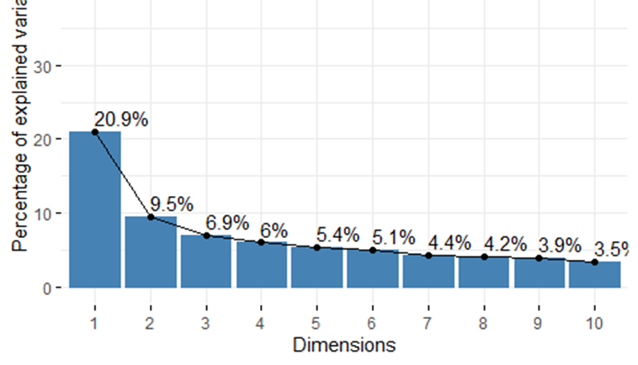
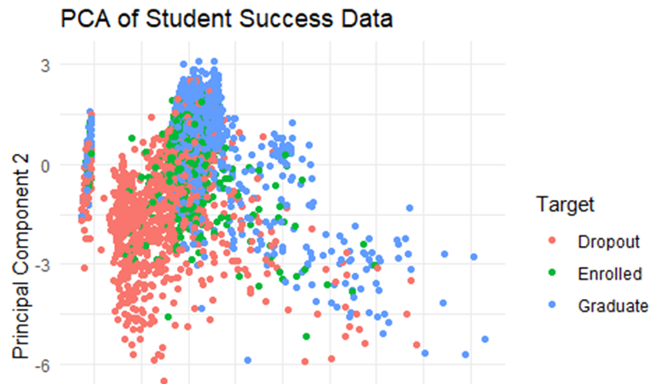
PCA
Principal Component Analysis (PCA) is a statistical technique used to transform correlated variables into linearly uncorrelated dimensions.
The first dimension explains 29.9% of the variance.
Points are colored to represent different categories of Target such as 'Dropout', 'Enrolled', and 'Graduate'.
Notes:
Curricular units (i.e. credits) in the second semester begins to emerge as a powerful classifier.
In addition, falling behind on tuition, coupled with failing to meet credit schedule, seems to be a primary indicator.

Slide 23
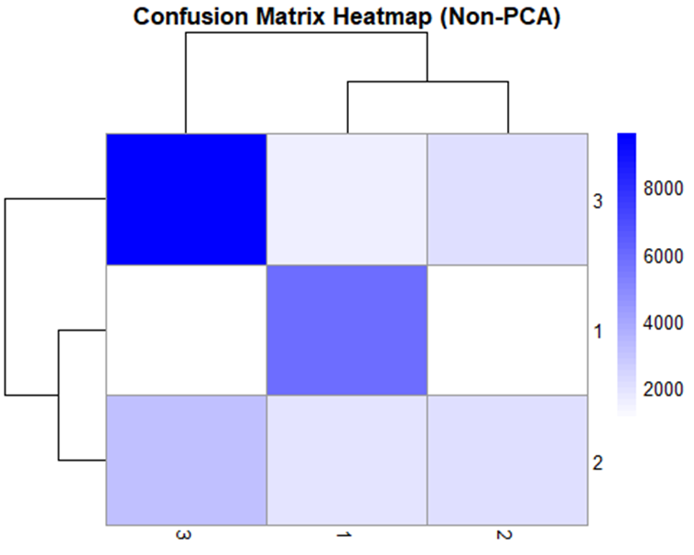
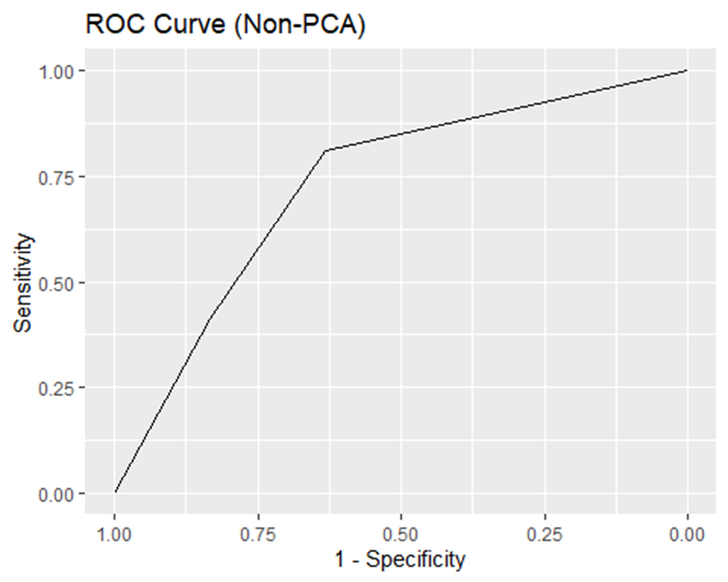
Naïve Bayes – Non PCA
Category | Details
Statistics | 65.48% Accuracy
Training | 10-fold cross validation
Hyperparameter Tuning | No Explicit tuning
Pre-processing | Data is used as-is without dimensionality reduction.
Notes:
Curricular units (i.e. credits) in the second semester begins to emerge as a powerful classifier.
In addition, falling behind on tuition, coupled with failing to meet credit schedule, seems to be a primary indicator.

Slide 24
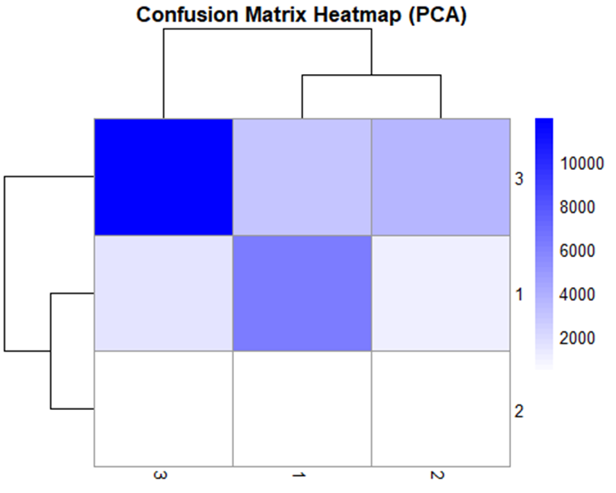
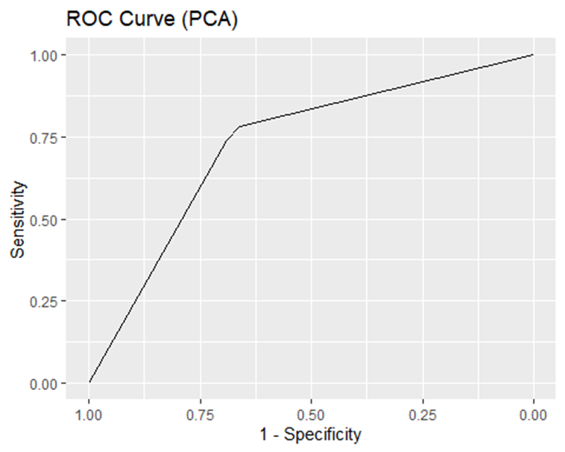
Naïve Bayes – PCA
Category | Details
Statistics | 65.48% Accuracy
Training | 10-fold cross validation
Hyperparameter Tuning | No Explicit tuning
Pre-processing | PCA for dimensionality reductions, centering and scaling.
Notes:
Curricular units (i.e. credits) in the second semester begins to emerge as a powerful classifier.
In addition, falling behind on tuition, coupled with failing to meet credit schedule, seems to be a primary indicator.

Slide 25
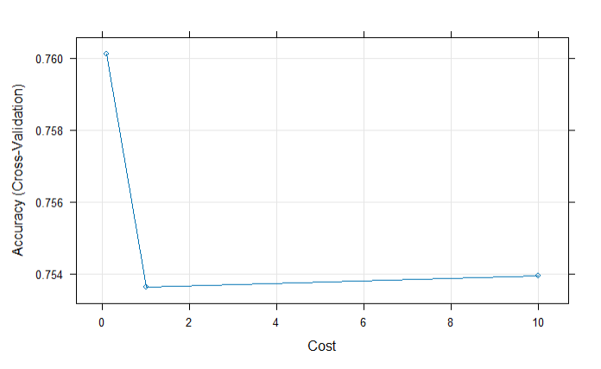
Support Vector Machine – Linear Kernel
Category | Details
Statistics | 77.87% Accuracy(p <1.798e-13)
Training | 2-fold cross validation
Hyperparameter Tuning | C = 0.1, 1.0, 10
Pre-processing | Centering & 0-variance removal
test$Target
Predictions | Dropout | Enrolled | Graduate
Dropout | 309 | 61 | 17
Enrolled | 34 | 86 | 33
Graduate | 59 | 93 | 643
Notes:
Classification Model
C is a regularization parameter that controls the balance between achieving a low error and minimizing the model complexity.
The model preprocessing removes attributes with 0 variance, and apply centering across all of the samples. This centers the predictors by subtracting the mean of each predictor from the data, standardizing the data so that the mean of each predictor is zero.

Slide 26
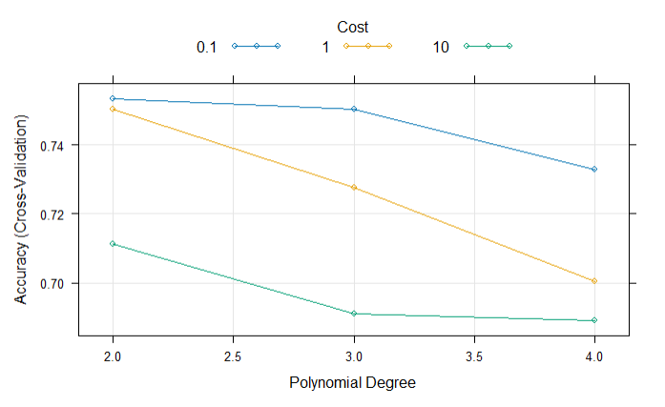
Support Vector Machine – Polynomial Kernel
Best Tune:
C = 0.1
Degree = 2
Scale = 0.28
Category | Details
Statistics | 74.04% (p<2.2e-16)
Training | 2-fold cross validation
Hyperparameter Tuning | C = 0.1, 1.0, 10 Degree = 2, 3, 4 Scale = 0.28
Pre-processing | Centering & 0-variance removal
test$Target
Predictions | Dropout | Enrolled | Graduate
Dropout | 303 | 60 | 14
Enrolled | 37 | 69 | 32
Graduate | 62 | 111 | 645
Notes:
Classification Model:
A Support Vector Machine with a polynomial kernel is trained on the training data using 2-fold cross validation. The model is configured to leverage the following multiple hyperparameters: C, Degree, and Scale.
The C hyperparameter is a regularization parameter that controls the balance between achieving a low error and minimizing the model complexity.
The Degree hyperparameter controls the dimensionality of the feature space after transformation.
A low Degree (e.g., 2): A lower degree polynomial kernel creates simpler decision boundaries.
With a degree of 2, the polynomial kernel generates interaction terms and quadratic features making the model capable of capturing more complex relationships than a linear model.
Degree 3 and Above: These degrees add even higher-order terms, which increases the model’s ability to fit intricate patterns in the training data but risks overfitting.
The Scale value used is calculated as a ratio of the number of features in the dataset (1 / number of features = 0.0278). If scale is a small value, it effectively makes the polynomial transformation more sensitive to variations in input features.

Slide 27
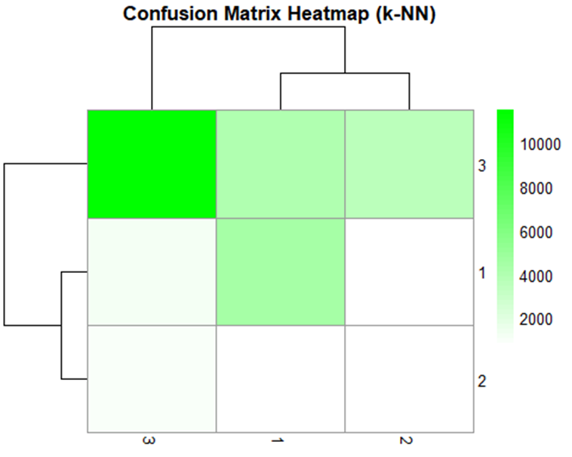
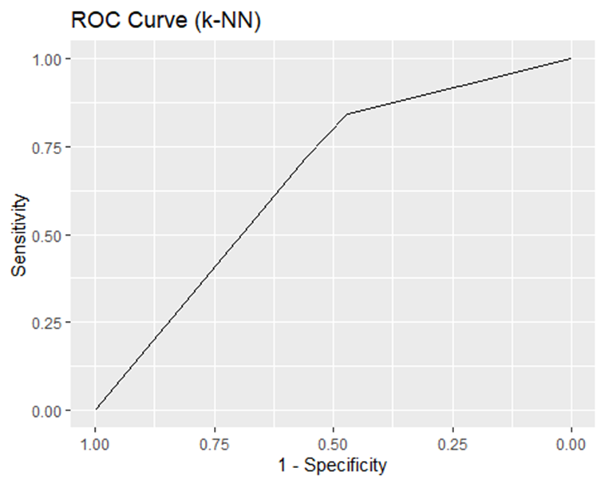
K-NN – Non PCA
Category | Details
Statistics | 59.15% Accuracy
Training | 10-fold cross validation
Hyperparameter Tuning | No Explicit tuning
Pre-processing | PCA for dimensionality reductions, centering and scaling.
Notes:
Curricular units (i.e. credits) in the second semester begins to emerge as a powerful classifier.
In addition, falling behind on tuition, coupled with failing to meet credit schedule, seems to be a primary indicator.

Slide 28
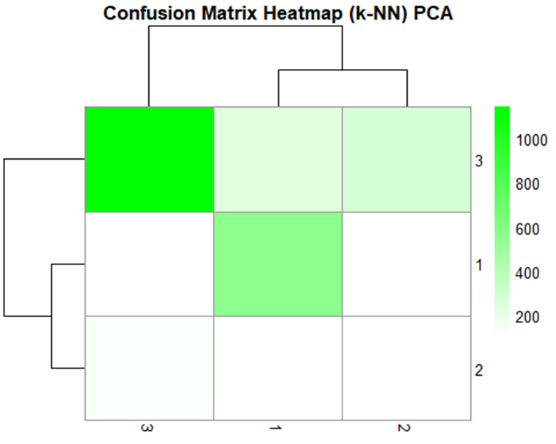
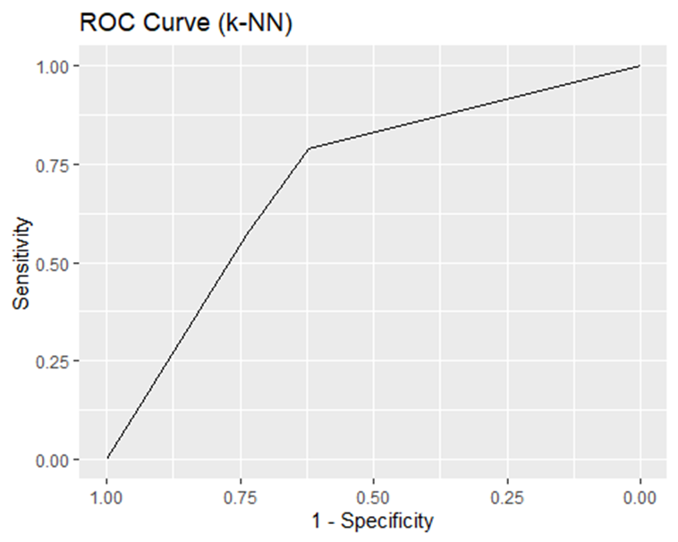
K-NN – PCA
Category | Details
Statistics | 65.48% Accuracy
Training | 10-fold cross validation
Hyperparameter Tuning | No Explicit tuning
Pre-processing | PCA for dimensionality reductions, centering and scaling.
Notes:
Curricular units (i.e. credits) in the second semester begins to emerge as a powerful classifier.
In addition, falling behind on tuition, coupled with failing to meet credit schedule, seems to be a primary indicator.

Slide 29
Random Forest
Category | Details
Statistics | 77.49% Accuracy
Training | 10-fold crossvalidation
Hyperparameter Tuning | No tuning
Pre-processing | Non PCA
Category | Details
Statistics | 76.74% Accuracy
Training | 10-fold cross validation
Hyperparameter Tuning | mtry = c(2, 4, 6, 8, 10)
Pre-processing | No PCA
Category | Details
Statistics | 76.44% Accuracy
Training | 10-fold cross validation
Hyperparameter Tuning | No tuning
Pre-processing | PCA
Category | Details
Statistics | 66.54% Accuracy
Training | 10-fold crossvalidation
Hyperparameter Tuning | mtry = c(2, 4, 6, 8, 10)
Pre-processing | PCA
Notes:
Curricular units (i.e. credits) in the second semester begins to emerge as a powerful classifier.
In addition, falling behind on tuition, coupled with failing to meet credit schedule, seems to be a primary indicator.

Slide 30
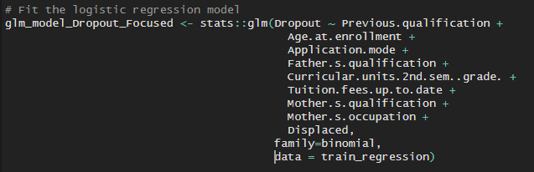
Binomial Logistic Regression
Category | Details
Statistics | Accuracy: 85.22% (p < 2.2e-16)
Training | Attributes (frequent items) from ARM.
Hyperparameter Tuning | N/A
Pre-processing | N/A
test$Dropout
Prediction | Not Dropout | Dropout
Not Dropout | 874 | 140
Dropout | 57 | 262
ADDITIONAL MODELS:
Using all attributes was not successful.
Some predictors with collinearity or singularities.
Notes:
Logistic Regression:
To run a binary logistic regression, additional data transformation is required. First, a copy of the dataset is created. A new binary outcome variable titled "Dropout" is added to the dataset to represent contain the value 1 if Target=Dropout. This attribute will contain a value of 0 when the Target attribute contains "Graduate" or "Enrolled". In addition, the Target attribute is removed.
The binomial logistic regression model is built to fit the outcome "Dropout" attribute using predictor attributes present in strong and significant rules found during association rule mining above.
NOTE: using all attributes with a Binary Logistic Regression model does not successfully converge to a solution for the generalized linear model (GLM). The model created aliased coefficients indicating that some predictors are colinear with other predictors, or there are redundant predictors in the model leading to singularities. To address this, an additional and simplified binomial logistic regression model is needed. The next section builds and tests the simplified model.

Slide 31
Multinomial Logistic Regression
Category | Details
Statistics | Accuracy: 77.64 (< 2.2e-16)
Training | All dataset attributes
Hyperparameter Tuning | N/A
Pre-processing | N/A
test$Target
Predictions | Dropout | Enrolled | Graduate
Dropout | 325 | 73 | 19
Enrolled | 22 | 78 | 40
Graduate | 55 | 89 | 632
ADDITIONAL MODELS:
Limiting Attributes to frequent items from ARM yielded 69.62%.
Notes:
Logistic Regression:
The second multinomial logistic regression model is built to fit the outcome "Target" attribute using predictor attributes present in strong and significant rules found during association rule mining above.
The model is created using the nnet::multinom() function and used to generate predictions using the test data.

Slide 32
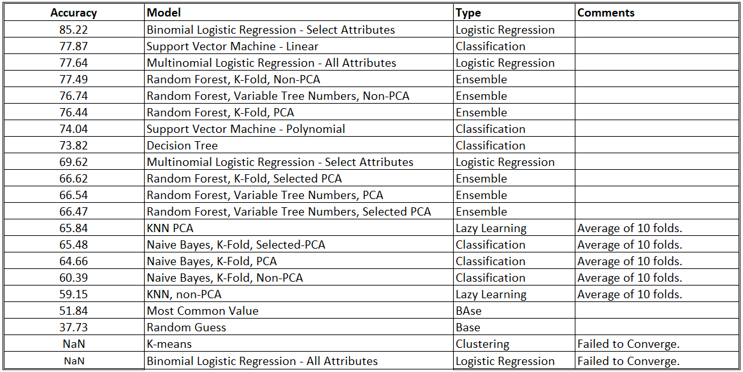
Model Summary

Slide 33

Research Questions (Reprised)
Combinations that predict Dropout
What distinguishable combination of factors could predict a drop-out event?
Best Models to Predict Dropout
Which machine learning algorithms give the best predictions?
Factors That influence Dropout
What factors influce a student to drop out?

Slide 34
Key Findings about the Research Questions
Age.at.enrollment=[38.2,48.8)
Combinations that predict Dropout
Curricular.units.2nd.sem..grade.=[0,3.71)
Curricular.units.2nd.sem..grade.=[0,3.71)
Father.s.qualification=[26.8,35.4)
Curricular.units.2nd.sem..approved.=[0,4)
Previous.qualification=Higher education – degree
Tuition.fees.up.to.date=[0,0.2)
Best Models to Predict Dropout
ARM Rules
Decision Tree
Factors That influence Dropout
Age.at.Enrollment
Father.s.qualification
Curricular.units.2nd.sem
Tuition.Fees.up.to.date
Mother.s.qualification
Mother.s.occupation
Binomial Regression (best)

Slide 35

THANK YOU
Padmaja Kurumaddali | pkurumad@syr.edu
La Monte Henry Piggy Yarroll | piggy.yarroll@gmail.com
Christopher Murphy | cmurph66@syr.edu

Slide 36
Appendix​
Supplemental Information

Slide 37
Citations
Source:
M.V.Martins, D. Tolledo, J. Machado, L. M.T. Baptista, V.Realinho. (2021) "Early prediction of student’s performance in higher education: a case study" Trends and Applications in Information Systems and Technologies, vol.1, in Advances in Intelligent Systems and Computing series. Springer. DOI: 10.1007/978-3-030-72657-7_16
https://scholar.harvard.edu/files/zmabel/files/leaving_late_aug_2017.pdf

Slide 38
Data source Locations
DATA AVAILABLE AT THE FOLLOWING URL
https://www.kaggle.com/code/mdismielhossenabir/student-s-dropout-and-academic-success
DATA DICTIONARY
https://archive.ics.uci.edu/dataset/697/predict+students+dropout+and+academic+success

Slide 39
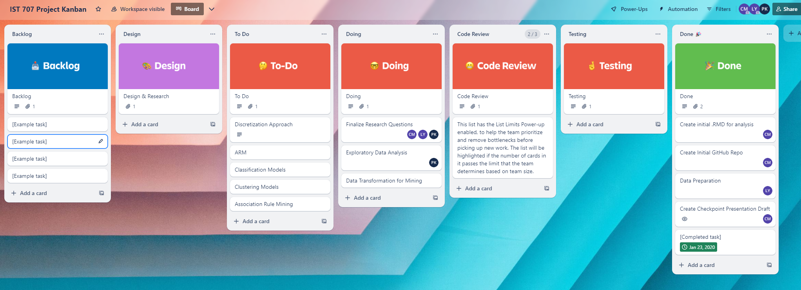
Project KANBAN

Slide 40

GitHub Repo

Slide 41
Progress
Summary
Progress to Date: GitHub repository & R Studio integration Data Retrieval Data Transformation Training/Testing Data | Lessons Learned: Select a well-annotated data set with a robust data dictionary.
Plans for Next Phase: Complete Data Mining for ARM, Clustering and Classification. Draft Final Report | Issues Identify opportunities for text mining Normalizing collaboration using remote GitHub repo

