Slide 1
Enabling TensorFlow GPU on Windows 11 with the Windows Subsystem for Linux 2
Notes:
Welcome! This content is geared toward data science students who are new to hardware acceleration and want to leverage their GPU for processing TensorFlow workloads directly on their laptops. This guide assumes a recent NVIDIA GPU is installed on the Windows 11 laptop. In this session, we’ll create a Linux development environment on your Windows 11 laptop. Creating the Linux development environment provides a straightforward path to current TensorFlow GPU support and avoids some serious complexity in trying to set up TensorFlow directly on Windows. We’ll enable GPU acceleration for TensorFlow on Windows 11 using Ubuntu and the Windows Subsystem for Linux. We’ll refer to the Windows Subsystem for Linux as “WSL2“ moving forward. We’ll install the latest NVIDIA driver on Windows, install WSL2, install Linux via Ubuntu, install CUDA inside Linux, create a Python environment, install TensorFlow with GPU support, and verify the environment with a simple script.

Slide 2
TensorFlow No Longer supports windows natively
Notes:
So, why do we need to use Linux on Windows? TensorFlow versions 2.11 and newer no longer provide native, direct GPU support for Windows. TensorFlow has phased out native Windows GPU "wheels“… meaning they no longer produce pre-compiled software packages for TensorFlow to work natively on Windows.

Slide 3
Benefits
Linux-first support for modern TensorFlow GPU builds
Near-native performance with simple setup
NVIDIA GPU passthrough from Windows to WSL2
Notes:
In the industry, most deep learning frameworks target Linux first, so this approach is reliable and provides some visibility into working with data science project environments and code on Linux. WSL2 runs a real Linux kernel side by side with Windows, giving you near-native performance, package managers, standard Linux tooling, and passthrough access from Linux to underlying Windows software like the NVIDIA drivers required to access the GPU on Windows 11.

Slide 4
My Starting Point
My System Specifications:
Dell XPS 15 Laptop
Windows 11 operating system
(Windows 11 Home, OS Build 26100.4349, Windows Feature Experience Pack 1000.26100.107.0)
VS Code Version 1.101.2
NVIDIA GeForce RTX 4050 Laptop GPU
NVIDIA Studio Driver version 576.80
NVIDIA Reference: https://developer.nvidia.com/cuda-gpus
Notes:
By following the steps in this tutorial, I successfully established an environment to run TensorFlow workloads on my laptop GPU. These were my starting environment specifications for reference. If your specifications are significantly different, you may consider doing additional research before executing the steps of this guide.

Slide 5
GPU Prerequisites
Notes:
It’s important to have the latest driver for your NVIDIA GPU. Let’s explore how to install the latest driver and confirm GPU and CUDA support.

Slide 6
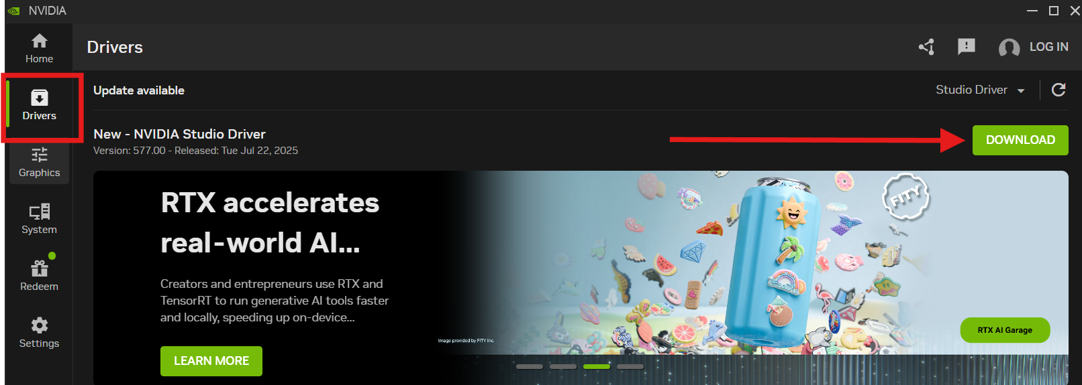
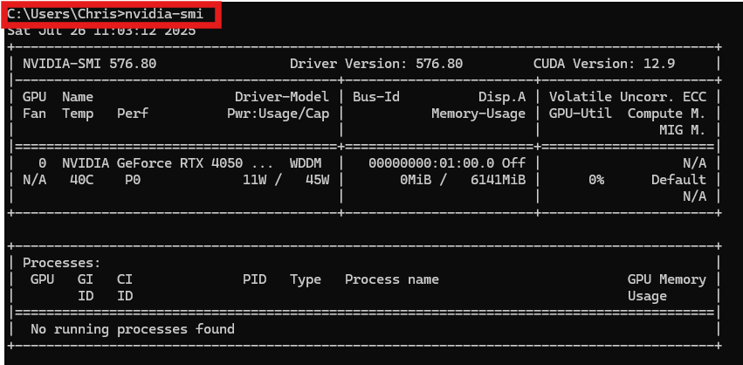
Check NVIDIA Driver & CUDA Support (Windows)
Update to the latest NVIDIA Studio driver using the NVIDIA App
Verify driver and CUDA capabilities
In Windows PowerShell or Command Prompt:
nvidia-smi
Notes:
First, download and install the latest NVIDIA GPU studio driver for your GPU on Windows to the latest version. To do this, I recommend using the NVIDIA App. Be sure to select the Studio version of the Driver as Studio drivers are optimized for compute-intensive tasks. Once the driver is installed, run the Windows command and validate the driver version and the CUDA Version line. The CUDA version shown is the maximum toolkit level your driver supports.

Slide 7
Installing Ubuntu on WSL2
Notes:
In this section, we will install Ubuntu and WSL2. Ubuntu is a full Linux Distribution that includes the source code for the operating system, inclusive of the shell, tools, compilers and libraries. WSL2 enables Windows to run Linux distributions, like Ubuntu, natively on Windows 11.

Slide 8
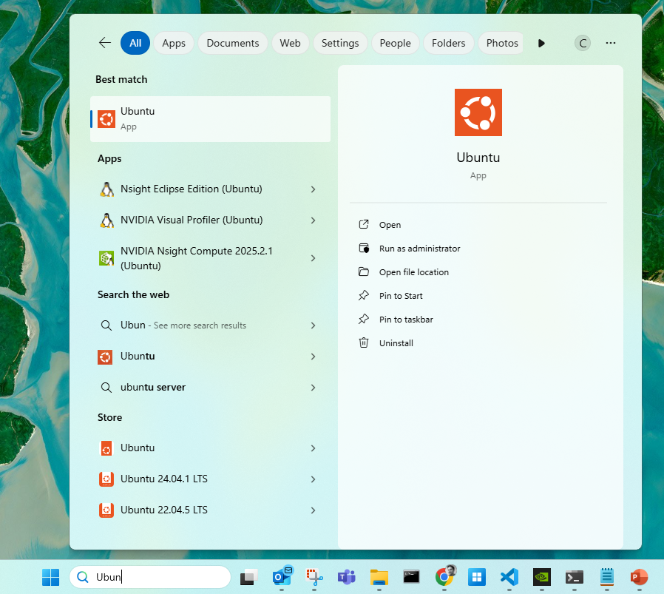
Install WSL2 with Ubuntu
In Windows PowerShell (Admin), run these commands individually and in sequence:
dism.exe /online /enable-feature /featurename:VirtualMachinePlatform /all /norestart
dism.exe /online /enable-feature /featurename:Microsoft-Windows-Subsystem-Linux /all /norestart
wsl --install
Notes:
For this step, Run a PowerShell as an administrator and run the commands individually in sequence. The first command enables the Windows Virtual Machine Platform, and the second enables the Windows Subsystem for Linux (WSL) feature. The third command installs a WSL2 Linux distribution – in this case, Ubuntu. You will be prompted to enter a username and password for the environment, do so and record this for reference. After setup, you’ll be able to open Ubuntu from the Start menu or Windows Terminal. Reboot if prompted.

Slide 9
Install CUDA Toolkit inside WSL2
Notes:
In this section, we’ll install the CUDA toolkit in the Ubuntu environment that matches the Windows driver capability. Then we’ll set PATH and library variables so compilers and TensorFlow find CUDA. If you do not already have an Ubuntu terminal running, go ahead and launch one from the Windows Start menu now as the commands on the next slide will be run from within the Ubuntu environment.

Slide 10
Install CUDA Toolkit in Ubuntu (WSL2)
wget https://developer.download.nvidia.com/compute/cuda/repos/wsl-ubuntu/x86_64/cuda-wsl-ubuntu.pin
sudo mv cuda-wsl-ubuntu.pin /etc/apt/preferences.d/cuda-repository-pin-600
wget https://developer.download.nvidia.com/compute/cuda/12.9.1/local_installers/cuda-repo-wsl-ubuntu-12-9-local_12.9.1-1_amd64.deb
sudo dpkg -i cuda-repo-wsl-ubuntu-12-9-local_12.9.1-1_amd64.deb
sudo cp /var/cuda-repo-wsl-ubuntu-12-9-local/cuda-*-keyring.gpg /usr/share/keyrings/
sudo apt-get update
sudo apt-get -y install cuda-toolkit-12-9
Notes:
In this section we install the appropriate CUDA minor version compatible with the NVIDIA driver using the Ubuntu terminal. My GPU Driver is compatible with CUDA version 12.9. You can adjust the commands to use a earlier minor version if needed. Install the NVIDIA CUDA toolkit by executing the following commands one by one in sequence.

Slide 11
Set CUDA Environment Variables
Add CUDA bin and lib64 to PATH and LD_LIBRARY_PATH
echo 'export PATH=/usr/local/cuda-12.9/bin${PATH:+:${PATH}}' >> ~/.bashrc
echo 'export LD_LIBRARY_PATH=/usr/local/cuda-12.9/lib64${LD_LIBRARY_PATH:+:${LD_LIBRARY_PATH}}' >> ~/.bashrc source ~/.bashrc
Notes:
Configure CUDA Environment Variables in WSL2 by executing the following commands one by one in sequence in the Ubuntu terminal.

Slide 12
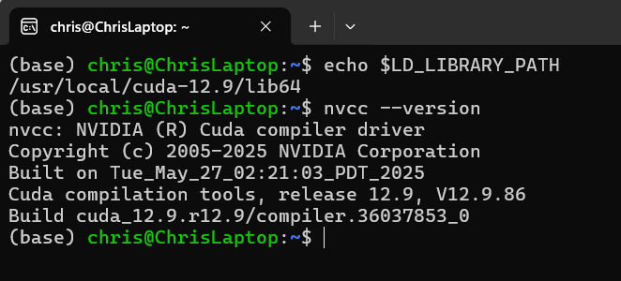
Verify CUDA Environment Variables
Verify the installations
nvcc --version
echo $LD_LIBRARY_PATH
Notes:
Execute the following commands one by one in sequence in the Ubuntu terminal to verify the CUDA Version and path to CUDA libraries.

Slide 13
Create Python Environment & TensorFlow GPU
Notes:
Next, we’ll create a clean Python environment in our Ubuntu on WSL2 environment and install a TensorFlow build that bundles the proper CUDA and cuDNN versions. This keeps dependencies isolated and reproducible.

Slide 14
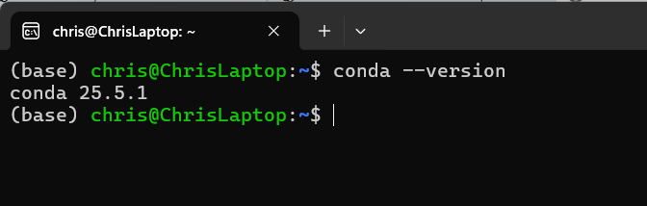
Install Miniconda
Download, install, and initialize Miniconda for Linux
wget https://repo.anaconda.com/miniconda/Miniconda3-latest-Linux-x86_64.sh
bash Miniconda3-latest-Linux-x86_64.sh
rm Miniconda3-latest-Linux-x86_64.sh
Restart terminal and verify
conda –version
Notes:
First, we need to install and initialize Miniconda for Linux in the Ubuntu environment. Execute the first three commands one by one in sequence in the Ubuntu terminal. Once that is complete, close the Ubuntu terminal and re-open a new one. Once that is done, run the 4th command to verify Miniconda was installed properly.

Slide 15
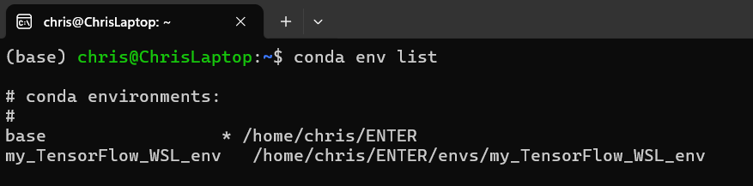
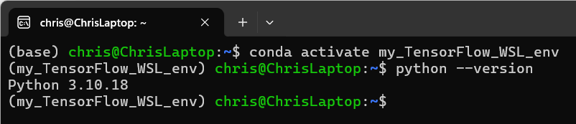
Create the Conda Environment
Use Conda to create the Python environment
conda create --name my_TensorFlow_WSL_env python=3.10
Validate the environment
conda env list
Activate the environment and validate Python version
conda activate my_TensorFlow_WSL_env
python --version
Notes:
Use Conda to create a Python environment in the Ubuntu terminal. Be sure to use Python version 3.10. Execute these commands one by one in sequence to create, validate and activate the new conda environment.

Slide 16
Install TensorFlow and CUDA
Install TensorFlow and CUDA in the active Python environment
pip install tensorflow[and-cuda]
Install Data Science libraries in the active Python environment
conda install numpy pandas scikit-learn matplotlib jupyterlab Ipykernel
Notes:
With the new conda Python environment activated, we will install tensorflow and CUDA along with compatible GPU libraries. In addition, install commonly used Python libraries for working with TensorFlow projects in Python. Execute these commands one by one in sequence in the Ubuntu terminal.

Slide 17
PROGRAM in your Ubuntu Environment from VS Code In Windows
Notes:
Next, we will validate that the Ubuntu environment can be used to develop in the VS Code application installed on the Windows 11 laptop. To do this, VS Code needs to recognize the Ubuntu environment as a remote development environment, even though it is running locally on the windows machine. This is sometimes referred to as “Remote WSL2”. Once we confirm that VS Code can work with the Ubuntu environment, we’ll select the Python interpreter we created for the TensorFlow environment and run test code.

Slide 18
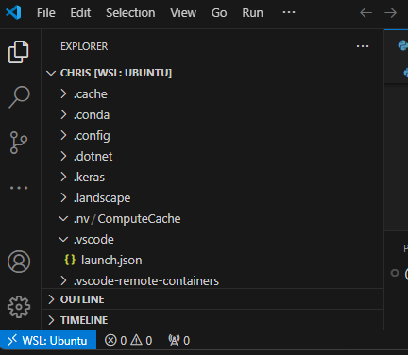
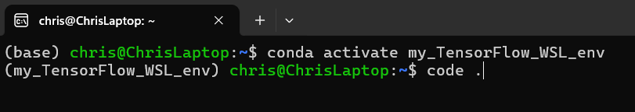
Open Project in VS Code (Remote WSL)
Launch VS Code from the Ubuntu (WSL) Terminal using the following command:
code .
Notes:
In the Ubuntu terminal, navigate to a working directory and execute the code command to launch VS Code. This will launch a VS Code instance and should load the WSL: Ubuntu environment as a remote development environment. Ater running the command, ensure "WSL: Ubuntu" appears in the lower-left corner. This confirms Remote WSL is working. If you are not a regular VS Code user for Python development, take a moment to ensure the VS Code Python Extension is installed in the VS Code environment. Use the left-hand menu to select extensions and search for Python. Locate the Python Extension from Microsoft and install it if it is not yet installed.

Slide 19
Verify GPU Access in TensorFlow
Notes:
Finally, let’s verify TensorFlow sees the GPU and can compute on it. We’ll list physical and logical GPUs, confirm CUDA is built, and run a small matrix multiplication.

Slide 20
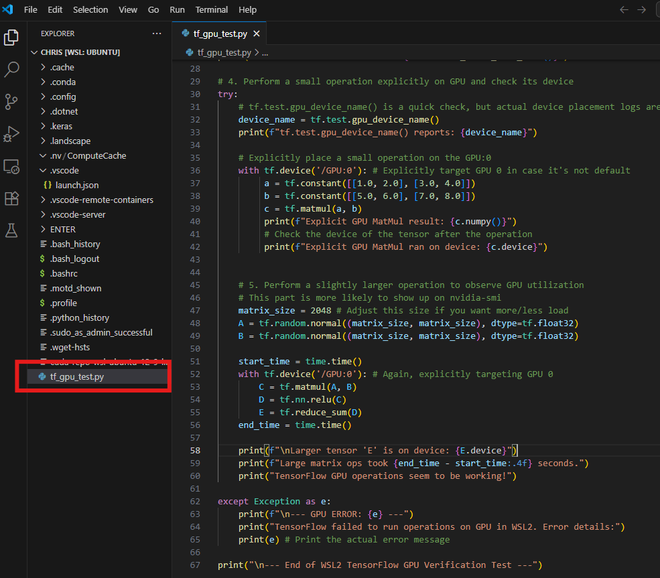
Create a Test File in VS Code in Ubuntu
Create a new Python file named “tf_gpu_test.py” in the Ubuntu environment within VS Code.
Copy the code from this GitHub project file into the test file.
https://github.com/ChristopherAlanMurphy/TensorFlow.GPU.Windows11.via.WSL2/blob/main/tf_gpu_test.py
Notes:
Create a test .py file in the Ubuntu working directory from within VS Code. I have provided a GitHub repository containing the Python test file that can be used to validate a workload is being processed on the NVIDIA GPU. You can access the file at the repository indicated here and re-use the code on your laptop.

Slide 21
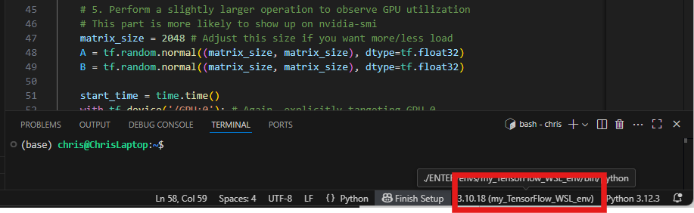
Select Your TensorFlow Python Environment
Within the VS Code instance launched from Ubuntu (WSL), ensure the newly created TensorFlow environment is selected as the active Python interpreter.
Notes:
Select the Python interpreter inside the WSL environment so your code uses GPU-enabled TensorFlow. The terminal at the bottom of the VS Code window should now display the environment as active. If not, you can select the python interpreter using the command palette in VS Code.

Slide 22
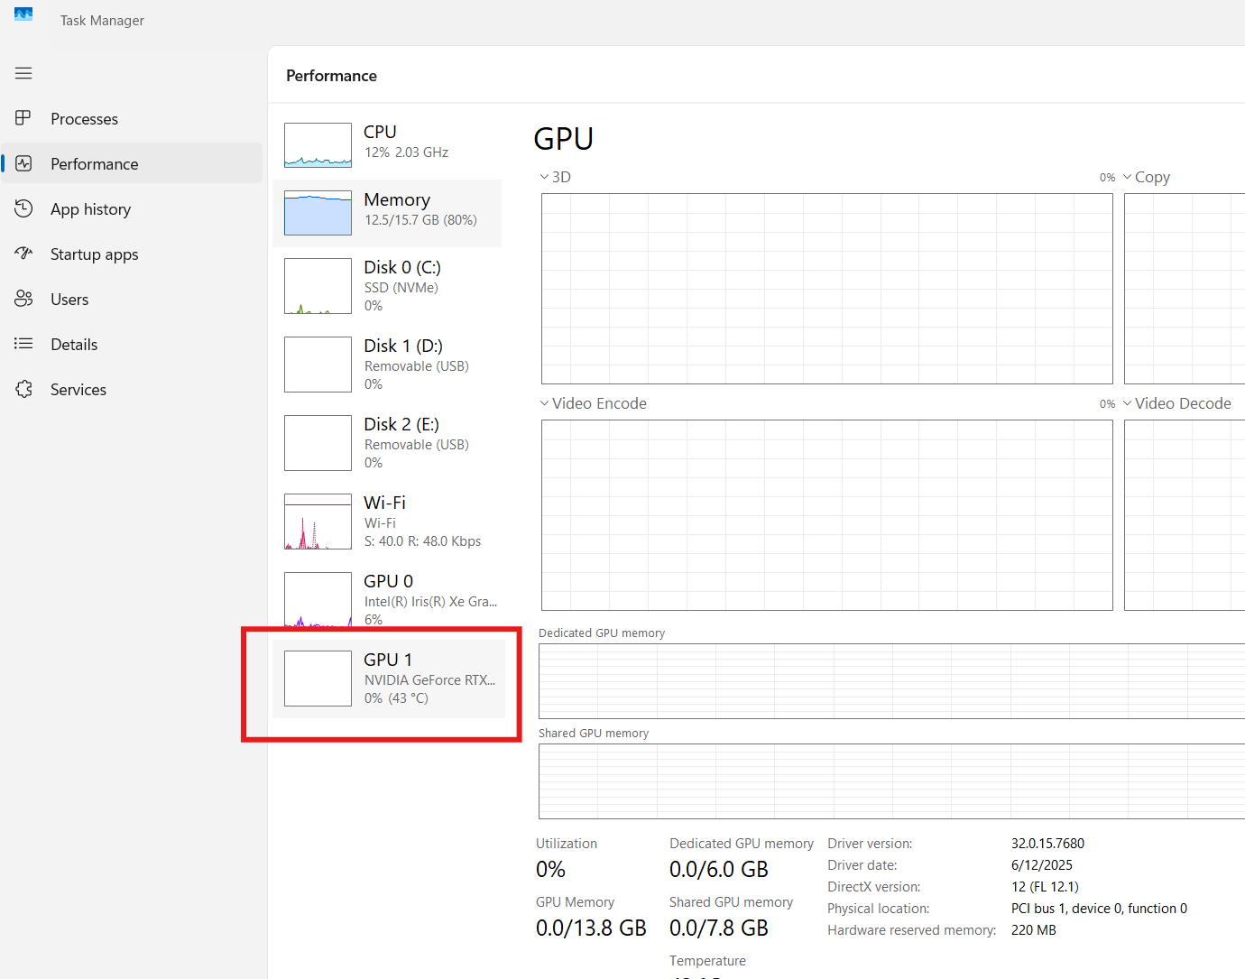
Monitor GPU Activity
Open the Task Manager -> Performance Window and Select the NVIDIA GPU.
Notes:
For a quick check to validate code is running on the GPU visually, you can open up the task manager and watch the processes occurring on the GPU.

Slide 23
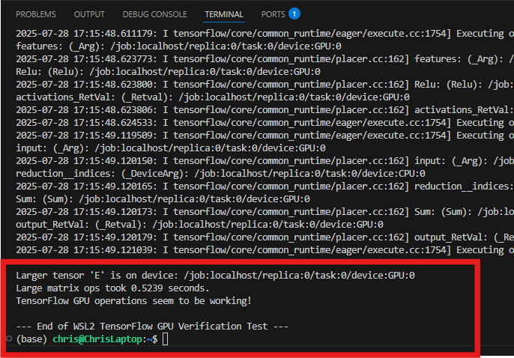
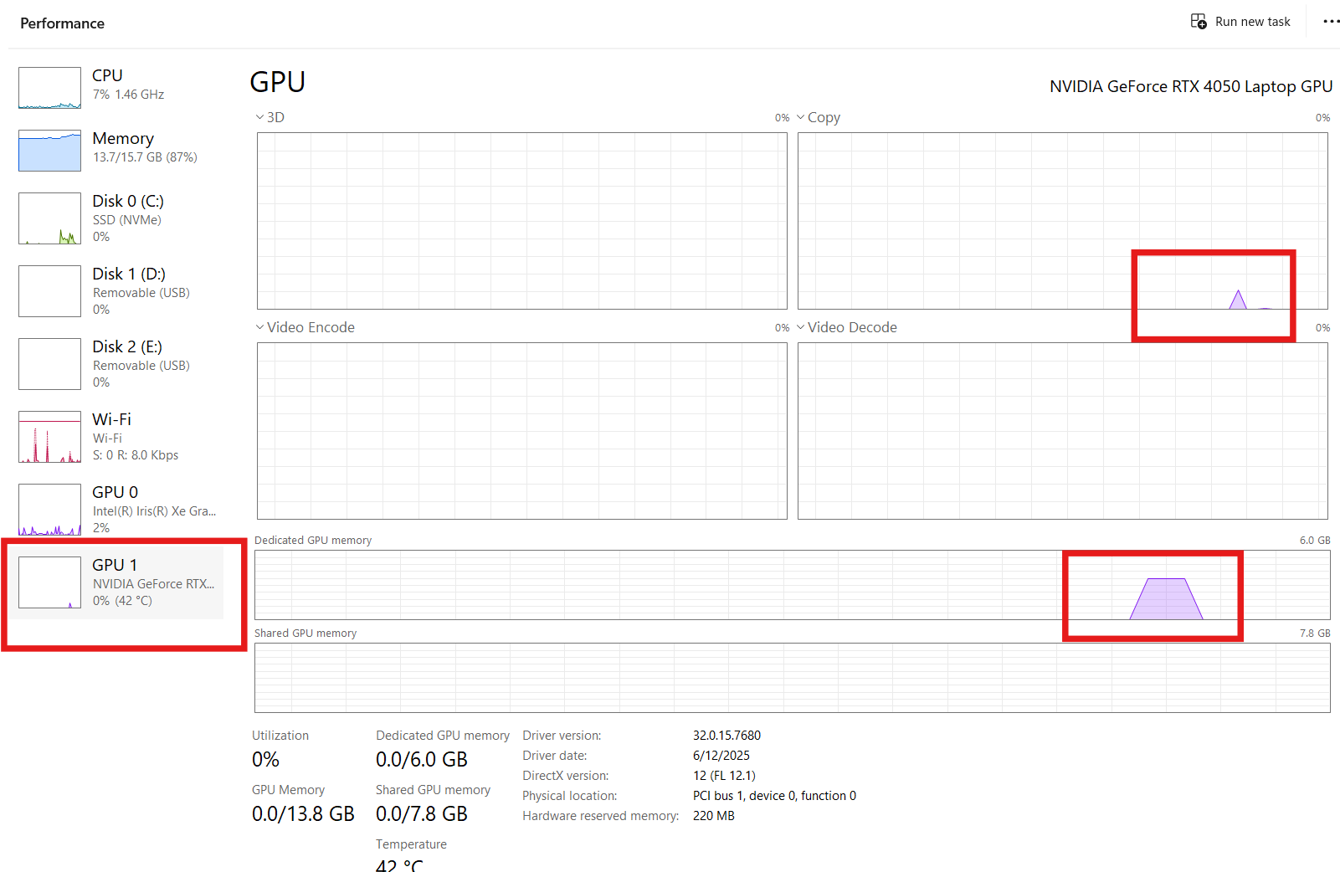
Run the Test File in VS Code
Use the VSCode interface to run the test Python file and review the terminal output and GPU performance.
Notes:
And now, the moment we’ve been waiting for… test to see if the TensorFlow code will run on the GPU. Run the test file in VS code inside the Ubuntu WSL environment with the Python TensorFlow environment we created selected as the active Python interpreter. Watch the terminal output for the messages in the file to ensure that the file processes correctly. At this time, you should see a spike in memory on the GPU in the task manager. Watch the interpreter terminal window in VS Code and validate the processing occurs and the messages confirm the GPU was utilized. If the file runs successfully, and you see activity in the performance monitor for the GPU, the environment is set up to properly leverage the GPU for TensorFlow workloads. You can now use this Ubuntu / WSL2 / Python environment for creating TensorFlow projects that leverage your GPU.

Slide 24
Common Pitfalls

Slide 25
Common Pitfalls & Fixes
Driver–CUDA mismatch or outdated drivers
PATH/LD_LIBRARY_PATH or conda env not active
VS Code using the wrong interpreter
Notes:
If TensorFlow does not see the GPU, confirm the NVIDIA GPU Studio driver is up to date, CUDA toolkit matches driver capability, and environment variables are set. In VS Code, ensure the WSL Conda interpreter where TensorFlow with CUDA was installed is selected. Additional research may be required to match the NVIDIA driver and CUDA compatibility.

Slide 26
CREATING this Presentation
I leveraged Google Gemini to investigate and verify the code used in this installation.
After manually creating a summary guide document, I utilized ChatGPT-4o to create a PowerPoint (PPTX) deck.
I manually updated the deck for content, presentation, slide notes (talking points), flow, pacing, and design.
I created a Python notebook in Google Colab to convert slide notes text to .MP3 audio using the Azure text-to-speech API.
I manually imported audio into each slide of the PPTX and configured playback settings and exported as a video
Notes:
I used this project as a vehicle to explore AI services. Google Gemini proved a valuable resource in educating me on the possibilities of Linux on Windows, and suggesting installation and configuration commands. ChatGPT did a poor job of converting my guide summary to PowerPoint, which required a full overhaul. While tedious, using a custom Python notebook to process the speech-to-text task and store the resulting .MP3 was efficient. Manually importing the audio and configuring the PowerPoint as a video was busywork. In the future, I will create an AI Agent to recieve a PowerPoint file and process the conversion to a narrated video, automatically.

Slide 27
About Me
Christopher A. Murphy
Masters of Applied Data Science
Please visit my project portfolio at the following URL:
https://www.calanmurphy.com
Linked In:
https://www.linkedin.com/in/christophermurphy/
Notes:
Please visit my portfolio at https://www.calanmurphy.com.

Slide 28
Thank you!

