Slide 1
Enabling TensorFlow GPU on Windows 11 with the Windows Subsystem for Linux 2
Notes:
Welcome! This content is geared toward data science students who are new to hardware acceleration and want to leverage their GPU for processing TensorFlow workloads directly on their laptops. This guide assumes recent NVIDIA GPUs are installed on the Windows 11 laptop.
In this session, we’ll enable GPU acceleration for TensorFlow on Windows 11 using the Windows Subsystem for Linux… we’ll refer to this as “WSL2“ moving forward. We’ll install the latest NVIDIA driver on Windows, set up WSL2 with Ubuntu, install CUDA inside Linux, create a Python environment, install TensorFlow with GPU support, and verify the environment with a simple script.

Slide 2
Why WSL2 for TensorFlow GPU?
Notes:
TensorFlow versions 2.11 and newer no longer provide native, direct GPU support for Windows.
TensorFlow has phased out native Windows GPU "wheels“… meaning they no longer produce pre-compiled software packages for TensorFlow to work natively on Windows.
I recommend using the Windows Subsystem for Linux 2 as it more natively supports TensorFlow and provides a lightweight Linux environment on Windows with direct GPU passthrough – enabling the officially supported Linux TensorFlow builds on Windows.
We’ll keep things minimal and reproducible so you can follow step by step to set this up on your own Windows 11 environment.

Slide 3
Benefits
Linux-first support for modern TensorFlow GPU builds
Near-native performance with simple setup
NVIDIA GPU passthrough from Windows to WSL2
Notes:
WSL2 runs a real Linux kernel side by side with Windows, giving you near-native performance, package managers, standard Linux tooling, and passthrough access from Linux to underlying Windows software like the NVIDIA drivers required to access the GPU on Windows 11.
In the industry, most deep learning frameworks target Linux first, so this approach is reliable and provides some visibility into working with data science project environments and code on Linux.

Slide 4
My Starting Point
My System Specifications:
Dell XPS 15 Laptop
Windows 11 operating system
(Windows 11 Home, OS Build 26100.4349, Windows Feature Experience Pack 1000.26100.107.0)
VS Code Version 1.101.2
NVIDIA GeForce RTX 4050 Laptop GPU
NVIDIA Studio Driver version 576.80
NVIDIA Reference: https://developer.nvidia.com/cuda-gpus
Notes:
By following the steps in this tutorial, I successfully established an environment to run TensorFlow workloads on my laptop GPU. These were my starting environment specifications.

Slide 5
GPU Prerequisites
Notes:
It’s important to have the latest driver for your NVIDIA GPU. Let’s explore how to install the latest driver and confirm GPU and CUDA support.

Slide 6
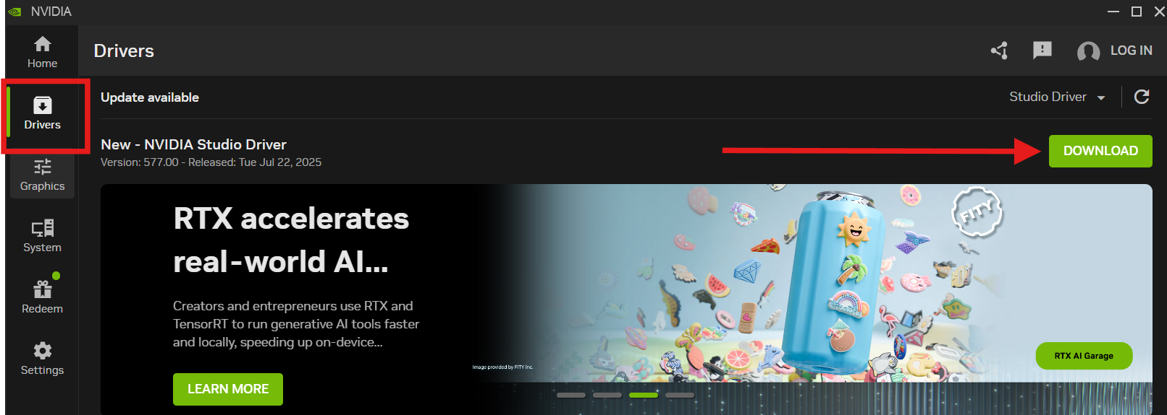
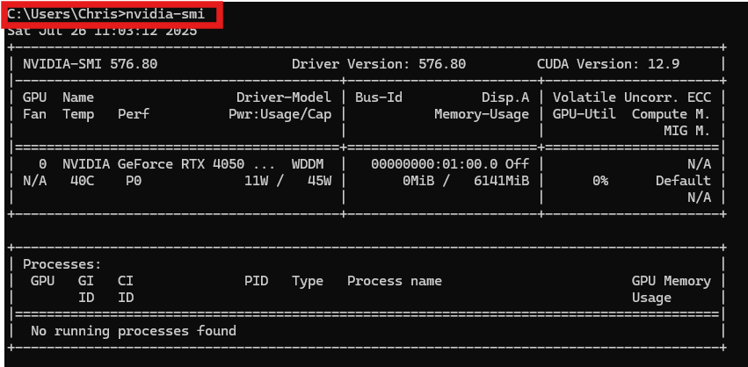
Check NVIDIA Driver & CUDA Support (Windows)
Update to the latest NVIDIA Studio driver using the NVIDIA App
Verify driver and CUDA capabilities
In Windows PowerShell or Command Prompt:
nvidia-smi
Notes:
First, download and install the latest NVIDIA GPU studio driver for your GPU on Windows to the latest version. To do this, I recommend using the NVIDIA App. Be sure to select the Studio version of the Driver as Studio drivers are optimized for compute-intensive tasks that leverage the GPU for general-purpose computing.
Once the driver is installed, run the Windows command and validate the driver version and the CUDA Version line. The CUDA version shown is the maximum toolkit level your driver supports. It’s generally fine to use a matching or slightly older CUDA toolkit in WSL2.
The NVIDIA GPU Drivers are backwards compatible with older CUDA versions.

Slide 7
Installing WSL2 & Ubuntu
Notes:
Now we’ll install WSL2 with Ubuntu.

Slide 8
Install WSL2 with Ubuntu
In Windows PowerShell (Admin), run these commands individually and in sequence:
dism.exe /online /enable-feature /featurename:VirtualMachinePlatform /all /norestart
dism.exe /online /enable-feature /featurename:Microsoft-Windows-Subsystem-Linux /all /norestart
wsl --install
Notes:
For this step, Run a PowerShell as administrator and run the commands individually in sequence.
The first command enables the Virtual Machine Platform. The second command enables the Windows Subsystem for Linux (WSL)… and the third command installs a WSL2 Linux distribution.
You will be prompted to enter a username and password for the environment – record this for later.
After setup, you’ll be able to open Ubuntu from the Start menu or Windows Terminal.
Reboot if prompted.

Slide 9
Install CUDA Toolkit inside WSL2
Notes:
In this section, we’ll install the CUDA toolkit that matches the Windows driver capability. Then we’ll set PATH and library variables so compilers and TensorFlow find CUDA.

Slide 10
Install CUDA Toolkit in Ubuntu (WSL2)
wget https://developer.download.nvidia.com/compute/cuda/repos/wsl-ubuntu/x86_64/cuda-wsl-ubuntu.pin
sudo mv cuda-wsl-ubuntu.pin /etc/apt/preferences.d/cuda-repository-pin-600
wget https://developer.download.nvidia.com/compute/cuda/12.9.1/local_installers/cuda-repo-wsl-ubuntu-12-9-local_12.9.1-1_amd64.deb
sudo dpkg -i cuda-repo-wsl-ubuntu-12-9-local_12.9.1-1_amd64.deb
sudo cp /var/cuda-repo-wsl-ubuntu-12-9-local/cuda-*-keyring.gpg /usr/share/keyrings/
sudo apt-get update
sudo apt-get -y install cuda-toolkit-12-9
Notes:
In this section we install the appropriate CUDA minor version compatible with the driver to work in the WSL2 environment. While this version shows CUDA version 12.9, you should be able to adjust the commands for the minor version if needed. My GPU Driver is compatible with CUDA version 12.9.
Install the NVIDIA CUDA toolkit by executing the following commands one by one in sequence in the WSL2 Ubuntu terminal:

Slide 11
Set CUDA Environment Variables
Add CUDA bin and lib64 to PATH and LD_LIBRARY_PATH
echo 'export PATH=/usr/local/cuda-12.9/bin${PATH:+:${PATH}}' >> ~/.bashrc
echo 'export LD_LIBRARY_PATH=/usr/local/cuda-12.9/lib64${LD_LIBRARY_PATH:+:${LD_LIBRARY_PATH}}' >> ~/.bashrc source ~/.bashrc
Notes:
Configure CUDA Environment Variables in WSL2 by executing the following commands one by one in sequence in the WSL2 Ubuntu terminal.

Slide 12
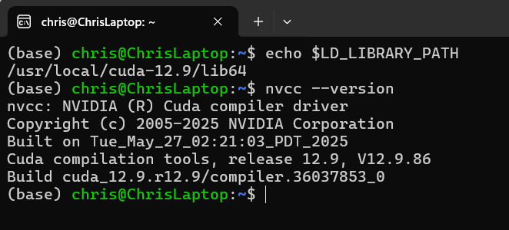
Verify CUDA Environment Variables
Verify the installations
nvcc --version
echo $LD_LIBRARY_PATH
Notes:
Execute the following commands one by one in sequence in the WSL2 Ubuntu terminal to verify the CUDA Version and path to CUDA libraries.

Slide 13
Create Python Environment & TensorFlow GPU
Notes:
Next we’ll create a clean Python environment and install a TensorFlow build that bundles the proper CUDA and cuDNN versions. This keeps dependencies isolated and reproducible.

Slide 14
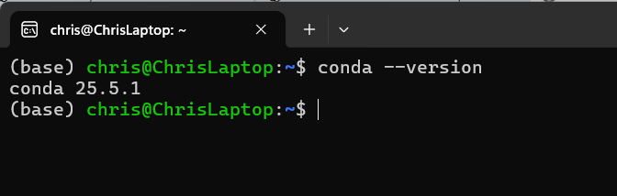
Install Miniconda
Download, install, and initialize Miniconda for Linux
wget https://repo.anaconda.com/miniconda/Miniconda3-latest-Linux-x86_64.sh
bash Miniconda3-latest-Linux-x86_64.sh
rm Miniconda3-latest-Linux-x86_64.sh
Restart terminal and verify
conda –version
Notes:
First, we need to install and initialize Miniconda for Linux in the Ubuntu / WSL2 environment. Execute the first three commands one by one in sequence in the Ubuntu terminal. Once that is complete, close the Ubuntu terminal and re-open a new one. Once that is done, run the 4th command to verify Miniconda was installed properly.

Slide 15
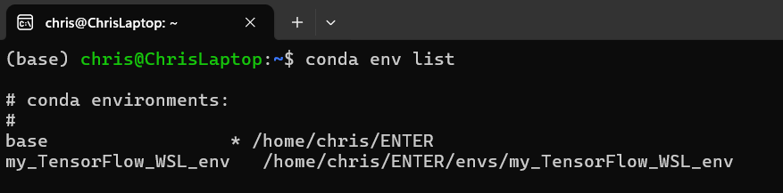
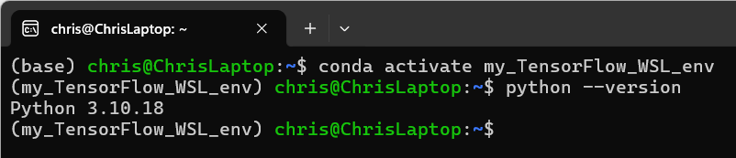
Create the Conda Environment
Use Conda to create the Python environment
conda create --name my_TensorFlow_WSL_env python=3.10
Validate the environment
conda env list
Activate the environment and validate Python version
conda activate my_TensorFlow_WSL_env
python --version
Notes:
Use Conda to create a Python environment. Be sure to use Python version 3.10. Execute these commands one by one in sequence to create, activate and validate the new conda environment.

Slide 16
Install TensorFlow and CUDA
Install TensorFlow and CUDA in the active Python environment
pip install tensorflow[and-cuda]
Install Data Science libraries in the active Python environment
conda install numpy pandas scikit-learn matplotlib jupyterlab Ipykernel
Notes:
With the new conda Python environment activated, install tensorflow and CUDA along with compatible GPU libraries. In addition, install commonly used Python libraries for working with TensorFlow projects in Python. Execute these commands one by one in sequence in the Ubuntu terminal.

Slide 17
Open your Environment in VS Code
Notes:
Next, we will validate Remote-WSL, select the Python interpreter, and run some test code to validate the environment.

Slide 18
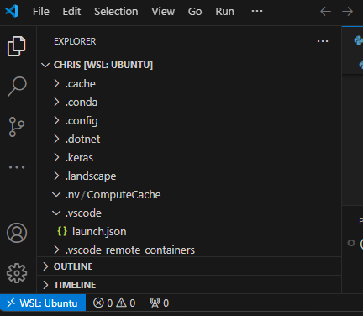
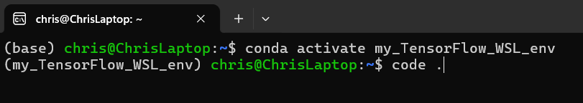
Open Project in VS Code (Remote WSL)
Launch VS Code from the Ubuntu (WSL) Terminal using the following command:
code .
Notes:
This is a quick and easy way to launch VS Code from a directory location within the Ubuntu (WSL2) Terminal. This allows you to launch Ubuntu, navigate to the project directory, and quickly launch a VS Code instance to begin working in that directory. Ater running the command, ensure "WSL: Ubuntu" appears in the lower-left corner. This confirms Remote WSL is working.
At this point, take a moment to ensure the VS Code Python Extension is installed in the VS Code environment. Use the left-hand menu to select extensions and search for Python. Locate the Python Extension from Microsoft and install it if it is not yet installed.

Slide 19
Verify GPU Access in TensorFlow
Notes:
Finally, let’s verify TensorFlow sees the GPU and can compute on it. We’ll list physical and logical GPUs, confirm CUDA is built, and run a small matrix multiplication.

Slide 20
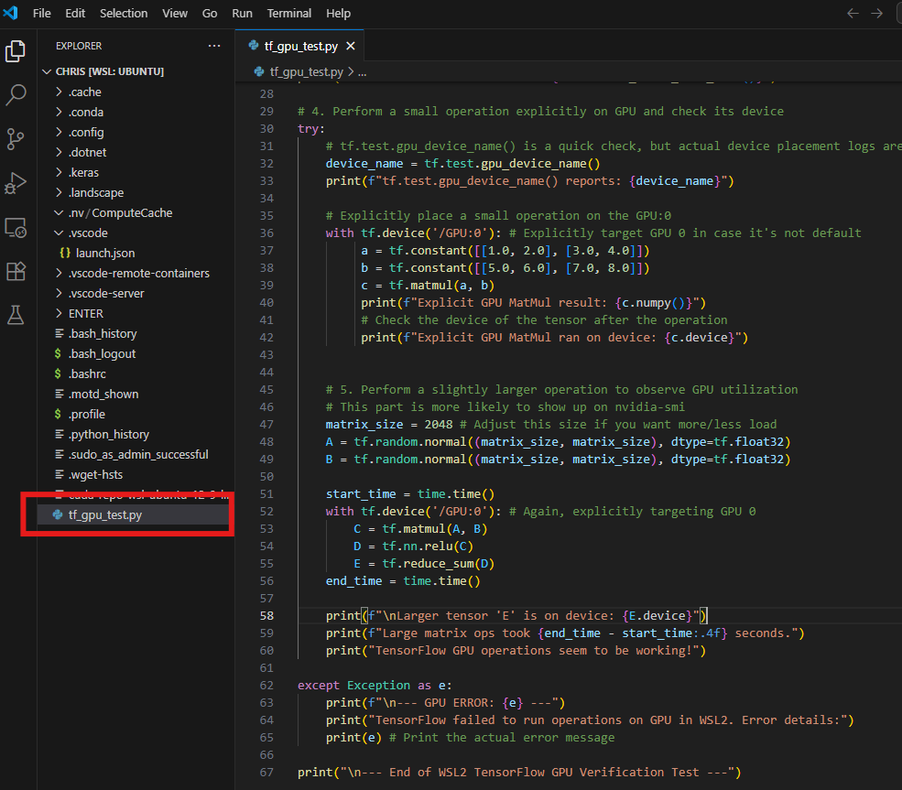
Create a Test File in VS Code in Ubuntu
Create a new Python file named “tf_gpu_test.py” in the Ubuntu environment within VS Code.
Copy the code from this GitHub project file into the test file.
https://github.com/ChristopherAlanMurphy/TensorFlow.GPU.Windows11.via.WSL2/blob/main/tf_gpu_test.py
Notes:
I have provided a GitHub repository containing the Python test file that can be used to validate a workload is being processed on the NVIDIA GPU. You can access the file at the repository indicated here and re-use the code on your laptop.

Slide 21
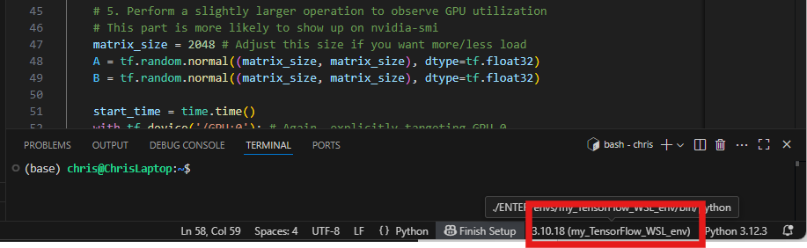
Select Your TensorFlow Python Environment
Within the VS Code instance launched from Ubuntu (WSL), ensure the newly created TensorFlow environment is selected as the active Python interpreter.
Notes:
Select the Python interpreter inside the WSL environment so your code uses GPU-enabled TensorFlow. The terminal at the bottom of the VS Code window should now display the environment as active. If not, you can select the python interpreter using the command palette in VS Code.

Slide 22
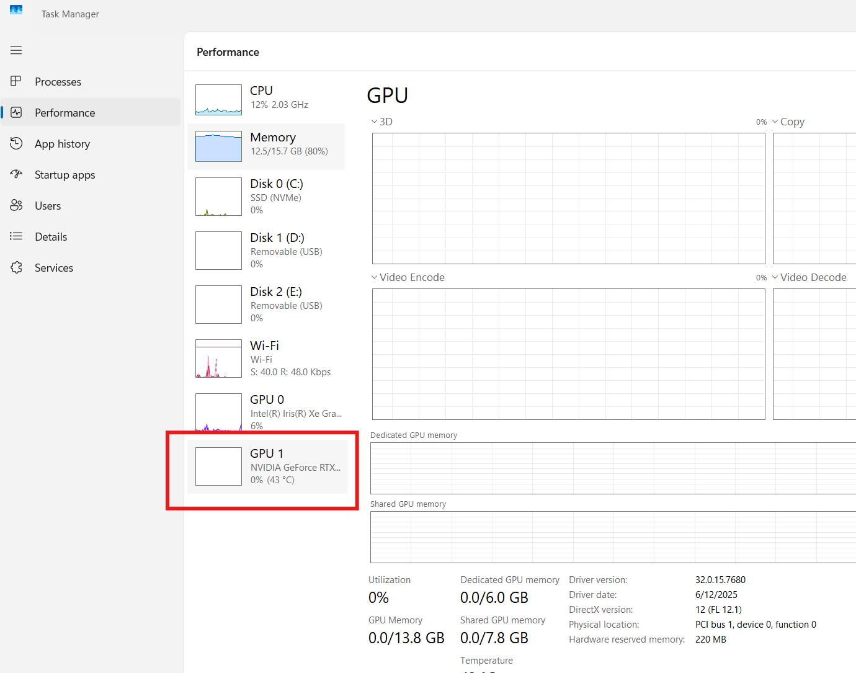
Monitor GPU Activity
Open the Task Manager -> Performance Window and Select the NVIDIA GPU.
Notes:
For a quick check, you can open up the task manager and watch the processes occurring on the GPU.

Slide 23
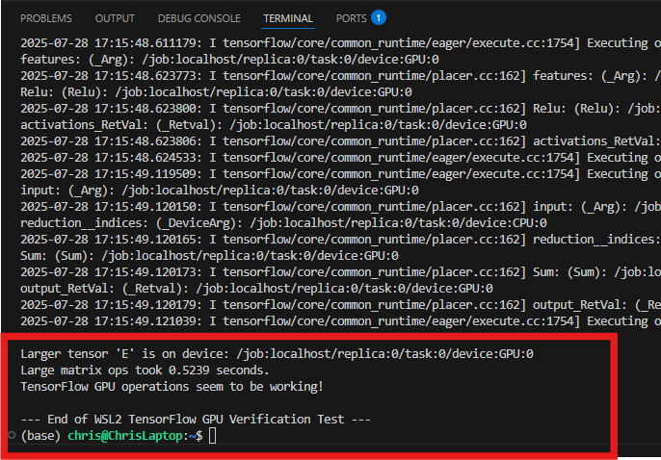
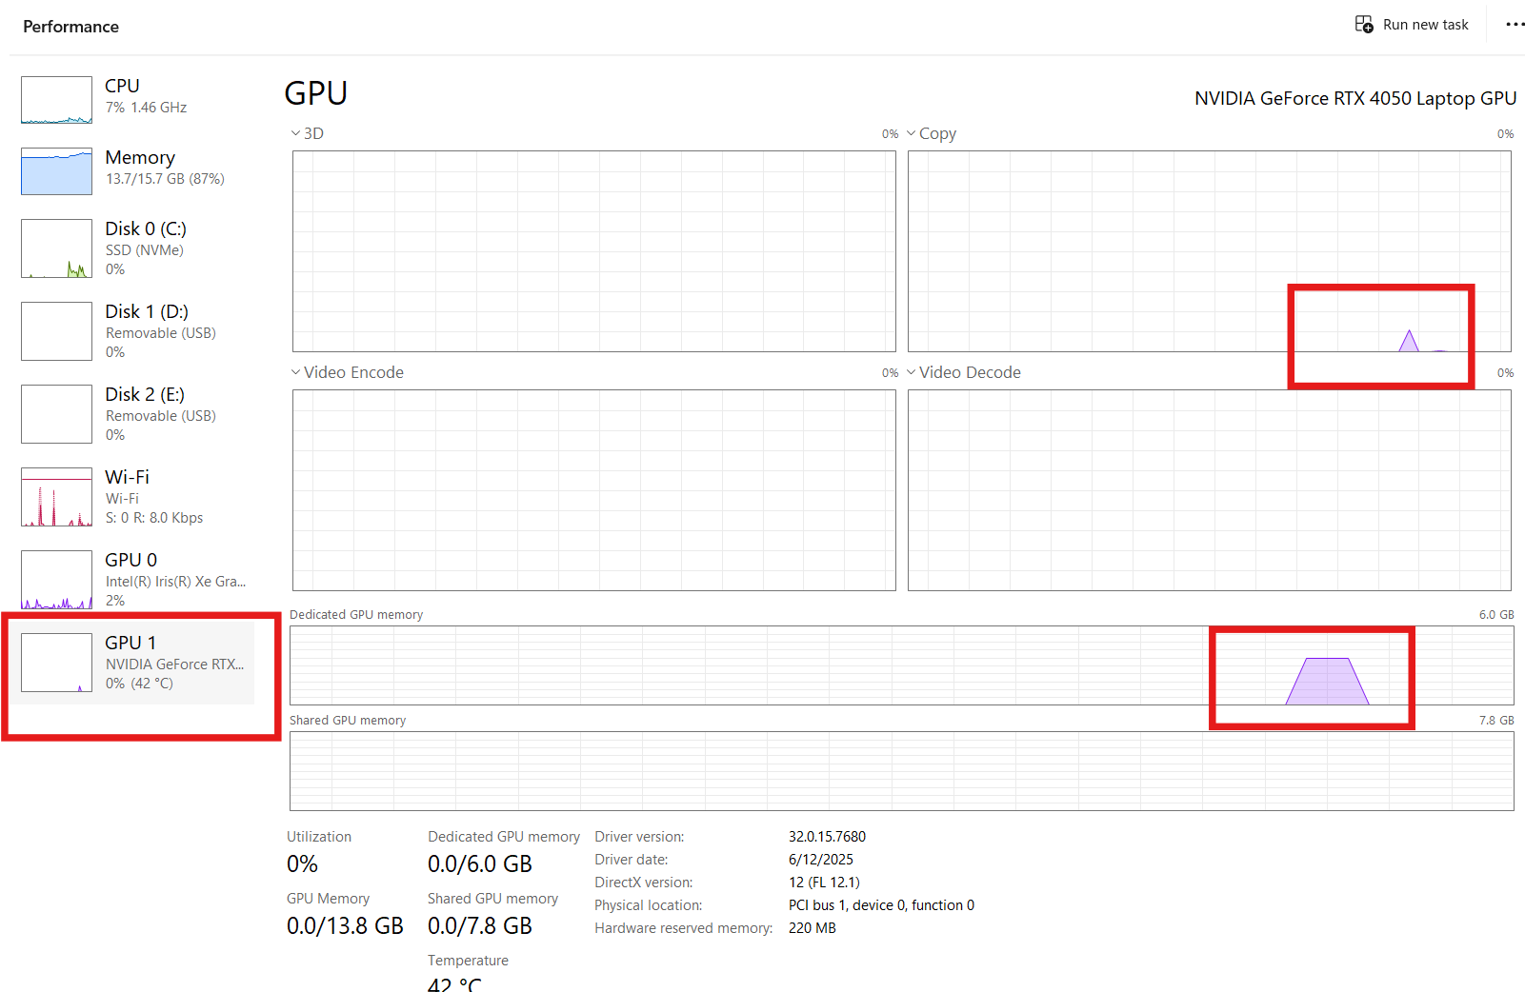
Run the Test File in VS Code
Use the VSCode interface to run the test Python file and review the terminal output and GPU performance.
Notes:
Run the test file in VS code inside the Ubuntu WSL environment with the correct python interpreter environment selected. Watch the terminal output for the messages in the file to ensure that the file processes correctly. At this time, you should see a spike in memory on the GPU in the task manager. If the file runs successfully, and you see activity in the performance monitor for the GPU, the environment is set up correctly. You can now use this Ubuntu / WSL2 / Python environment for creating TensorFlow projects that leverage your GPU.

Slide 24
Common Pitfalls
Notes:
Let’s review common pitfalls and how to resolve them, then summarize the workflow.

Slide 25
Common Pitfalls & Fixes
Driver–CUDA mismatch or outdated drivers
PATH/LD_LIBRARY_PATH or conda env not active
VS Code using the wrong interpreter
Notes:
If TensorFlow does not see the GPU, confirm the NVIDIA GPU Studio driver is up to date, CUDA toolkit matches driver capability, and environment variables are set. In VS Code, ensure the WSL Conda interpreter where TensorFlow with CUDA was installed is selected.

