Slide 1

Predicting NBA Player Performance
Christopher Bui
Project 2 - Luther

Slide 2
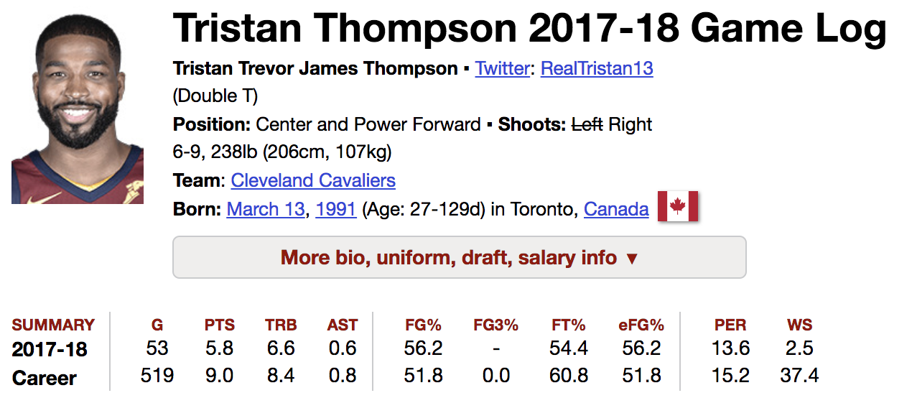
Contract: $16 Million / year for 5 years
$100 Million spending limit

Slide 3
Objective
Construct a reliable model for predicting player performance
Outcome:
Potential for team organizations invest smartly
Save tens - hundreds of millions of dollars
Notes:
Tristan, so how can we avoid this?
Model
goal

Slide 4
Define the variables
Response Variable
Performance = Points Per Game for a season
Features
Games played, PTS, FG%, TRB, TOV, AST
Notes:
Usually ppl want you to score more, this is good, nature of the game

Slide 5
Methods
selenium, BeautifulSoup, statsmodels, sklearn
Start from 1979 due to creation of 3 point line
Averaged first 3 seasons for each player
4th season PTS = future values
Notes:
Nba created in 1946
First 3 seasons because rookie; know em young

Slide 6
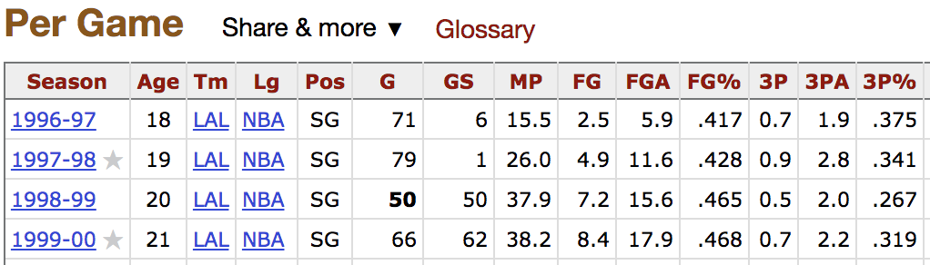
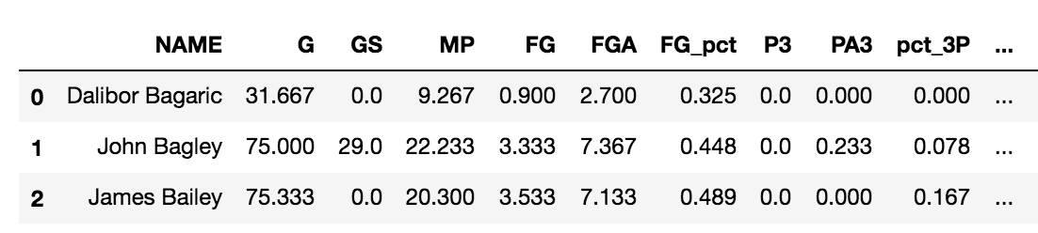
Assumption: Injured 4th season = 0 PTS

Slide 7
Selecting Key Features
Initially include all features for Baseline
Select lowest P-values < 0.05
Reject extremely high P-values
Selected Features:
14/25
Took out steals, blocks, assists ...

Slide 8
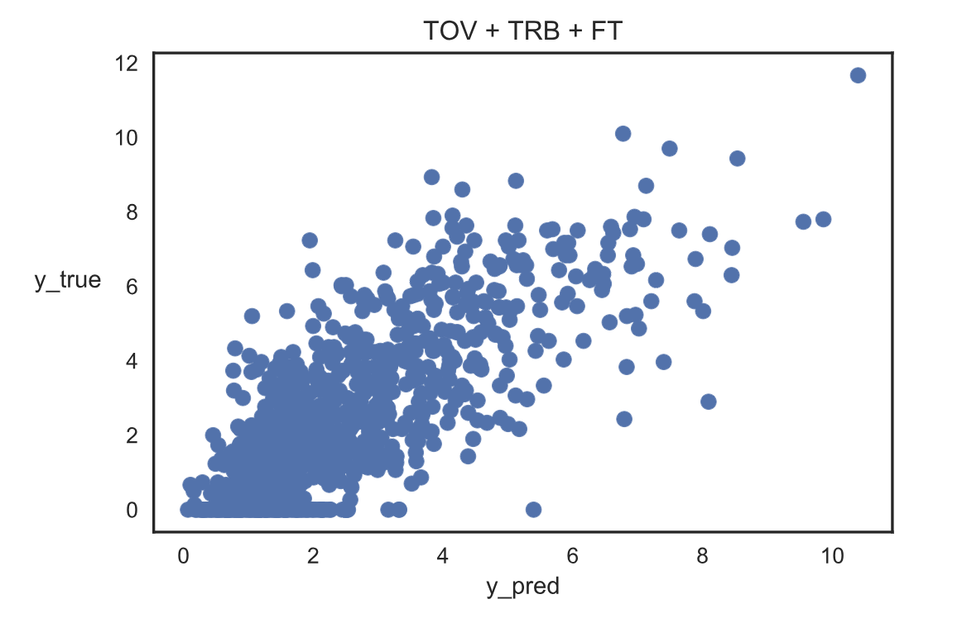
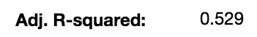

Slide 9
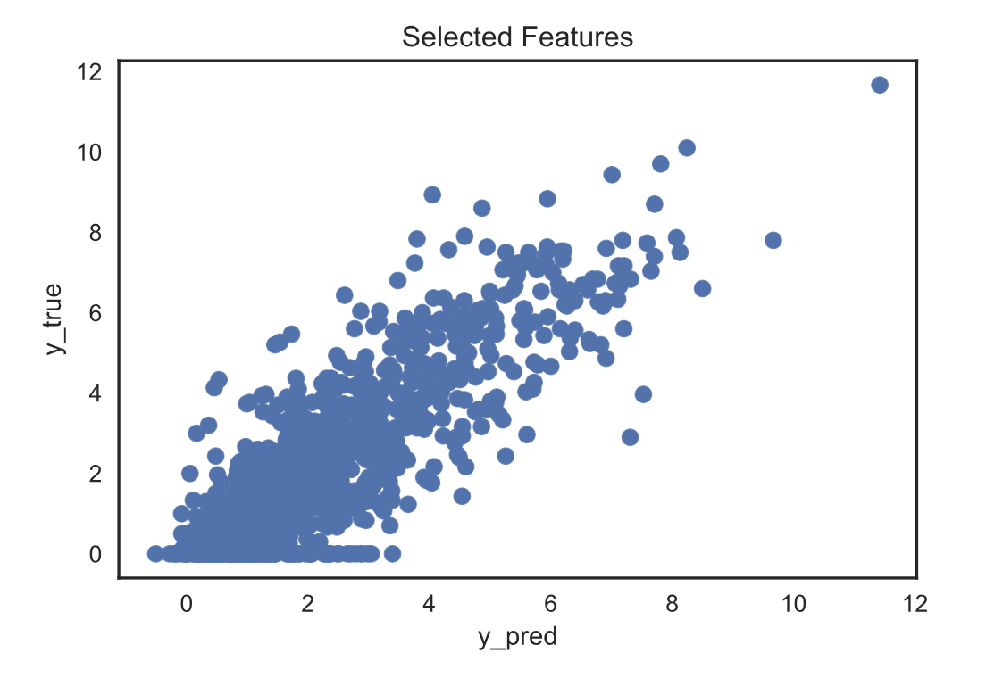
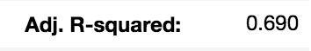

Slide 10
Determining Type of Fit
Was there a better fit than linear?
If so, see at what degree we would be underfitting or overfitting
Started: Degree 3

Slide 11
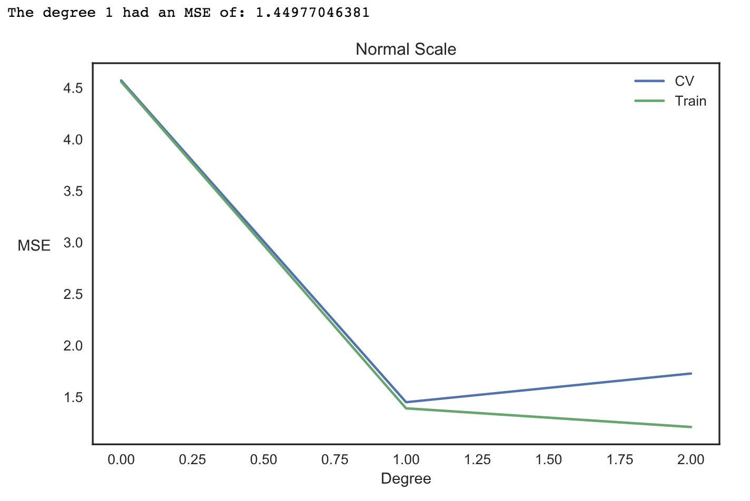
Notes:
We know this to be a sort of linear relationship; makes sense given the nature of the sport

Slide 12
K-Fold Cross Validation
952 Rows
Test Size = 30 %
10 Folds
Mean R^2 : 0.670 +/- =.06
Mean Square Error: 1.449 +/- 0.212

Slide 13
Improvements to the model
Get more relevant data not appearing on the stat sheet
Minutes of rest
Diet intake
Daily routine, etc.
Perhaps reduce the number of features given new data

Slide 14
Future
Gives a quantitative platform to reduce risk
Teams can make sound business decisions in their interests
Attracts more business/sponsors/fans

Slide 16
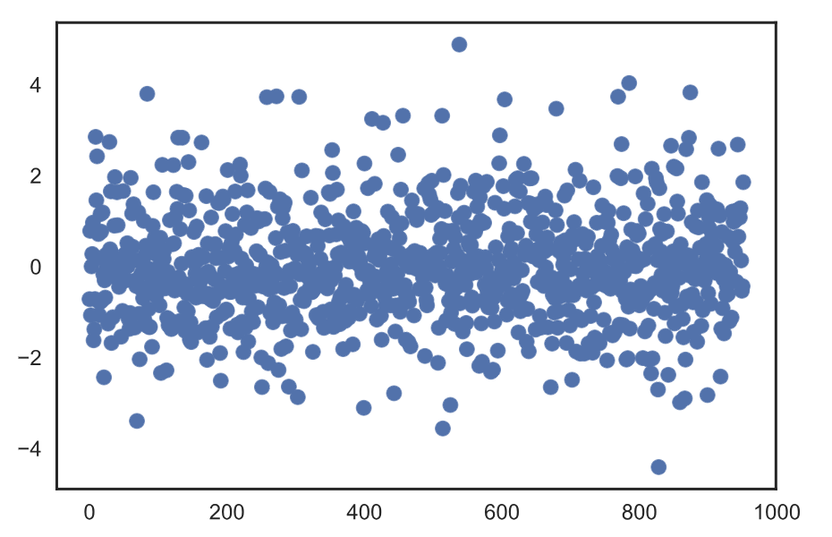

Slide 17
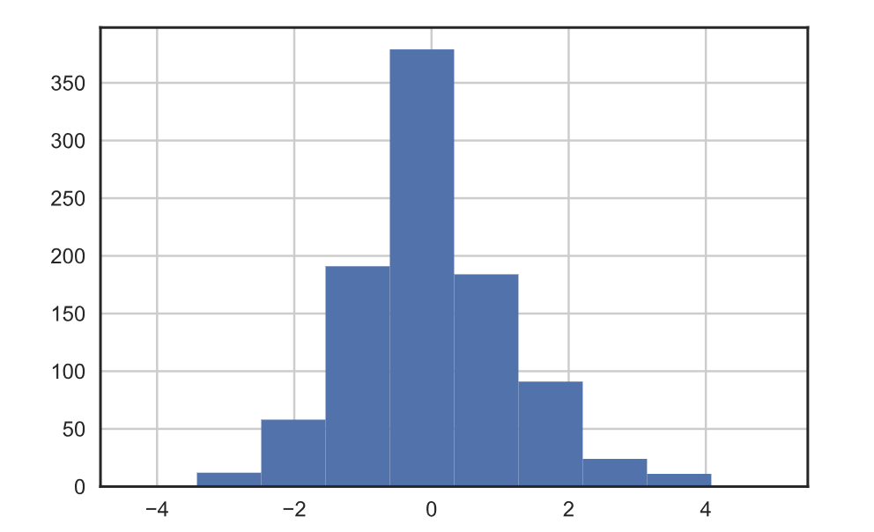

Slide 18
