Slide 1
Predicting Credit Card Defaulting
Christopher Bui
Project #3

Slide 2


Background
Credit Card Defaulting
Unable to pay back your credit debt
1-3% default
Circumstances
2005
Taiwan in economic downturn
Notes:
To fill you in, what credit card defaulting is, is when a client from a credit issuer such as a bank is unable to pay their debt

Slide 3
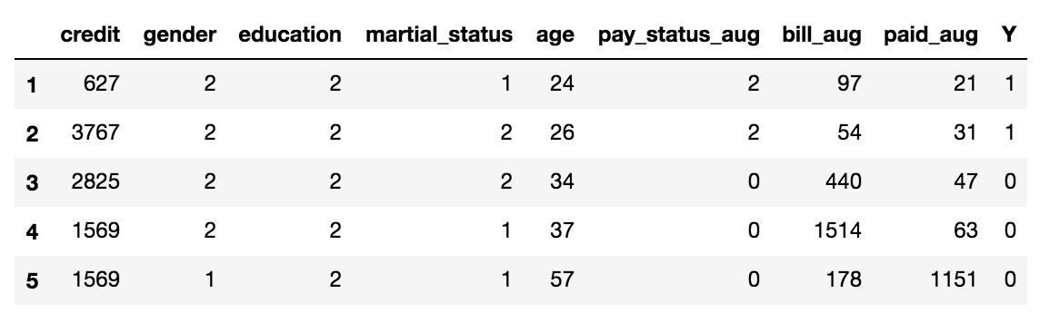
Data
23 Features 30,000 Observations
April - September 2005

Slide 4
Tools / Methods
Matplotlib, Sklearn, Github
AWS EC2
Classification Models
KNN, CART
Notes:
Github for version control

Slide 5
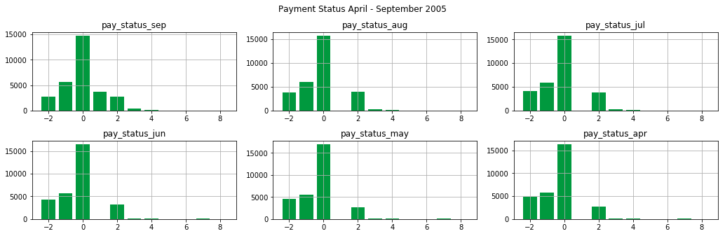
86 % pay early / on time
Notes:
-so despite economic downturn, you still have a relatively low amount of default
-Say that data is highly unbalanced
-86% pay early/on time

Slide 6
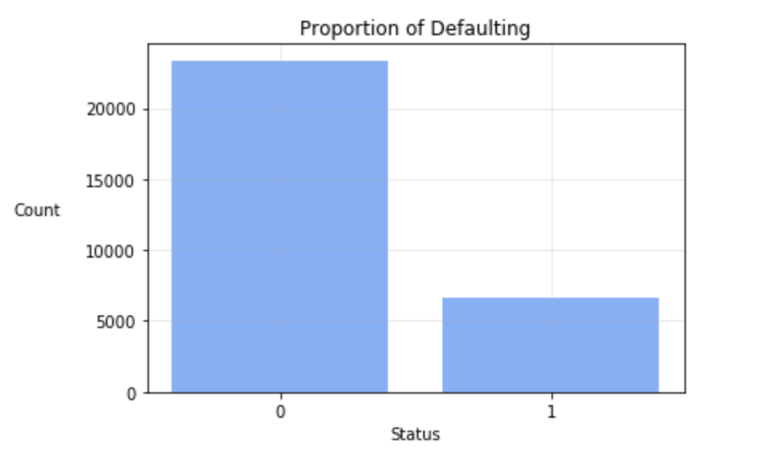
22% Defaulted
6600 / 30000 Defaulted

Slide 7
Choosing Model

Slide 8
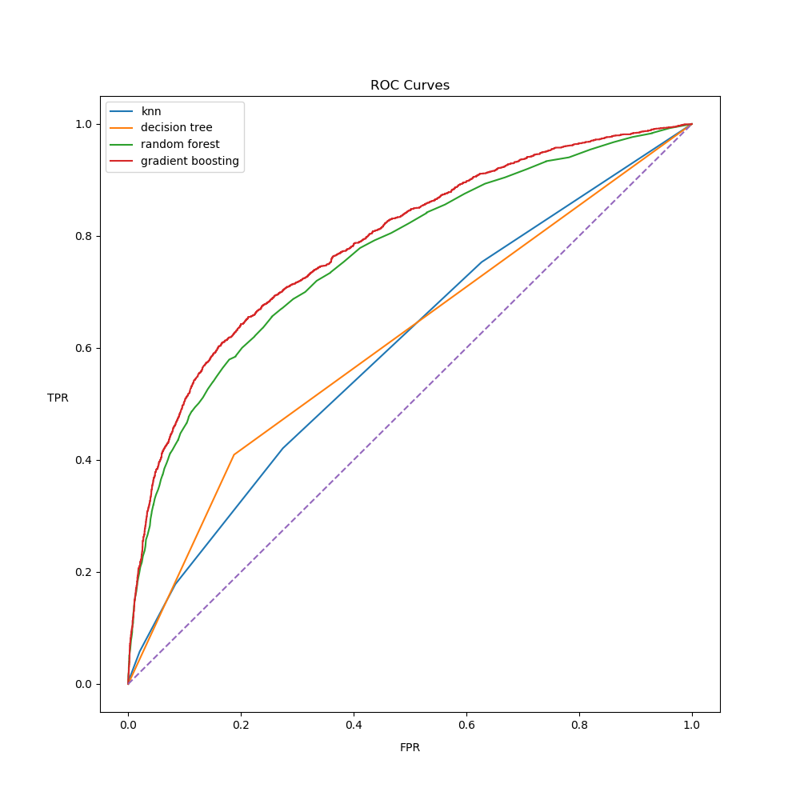
Model | AUC
GRAD | 0.79
RF | 0.77
TREE | 0.61
KNN | 0.59

Slide 9
Gradient Boosting
max_depth = 3, 5, 10 . . .
n_estimators = 100, 200, 300 . . .
max_features = 12, 19, All . . .
Notes:
-explain in general what gradient boosting is/does
-consistently gave best scores, so decided to tune the parameters

Slide 10
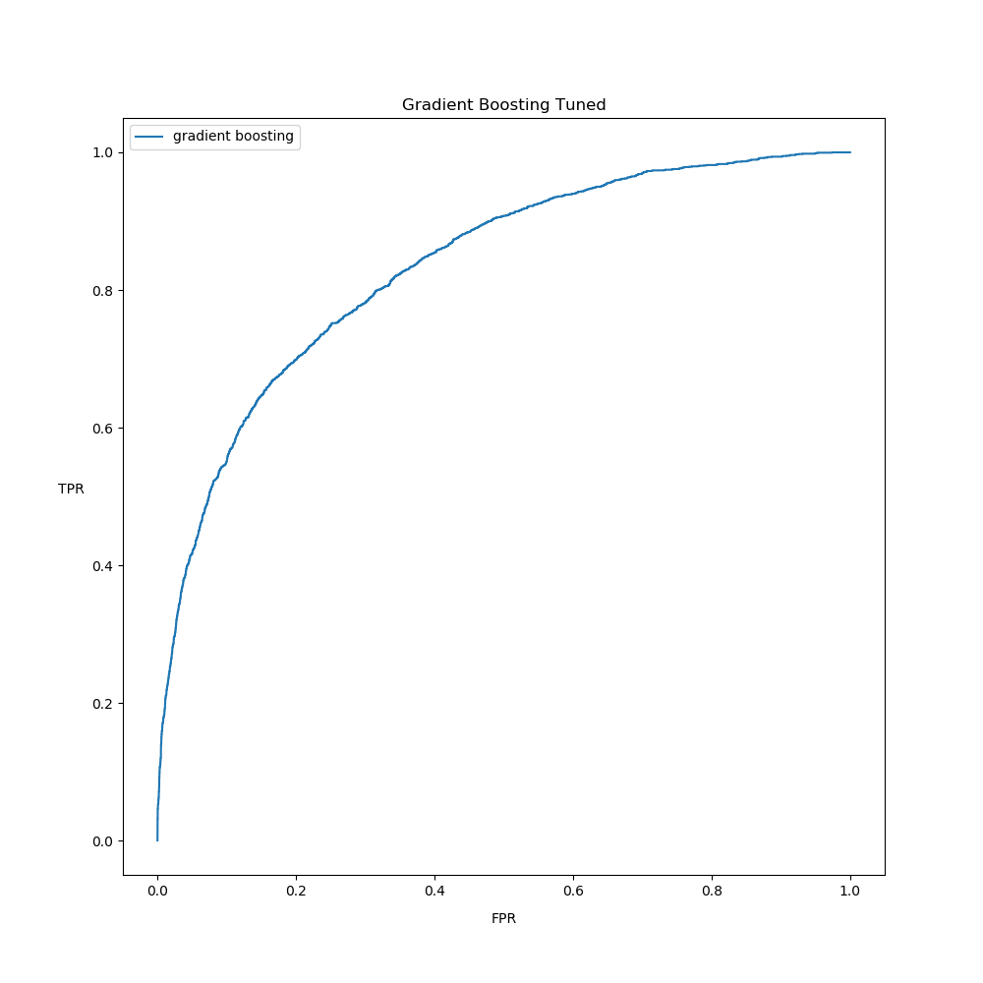
Before & After
Old AUC: 0.79
New AUC: 0.83
Shows Improvement
Optimal Parameters:
max_depth=3
n_estimators=300
max_features=ALL

Slide 11
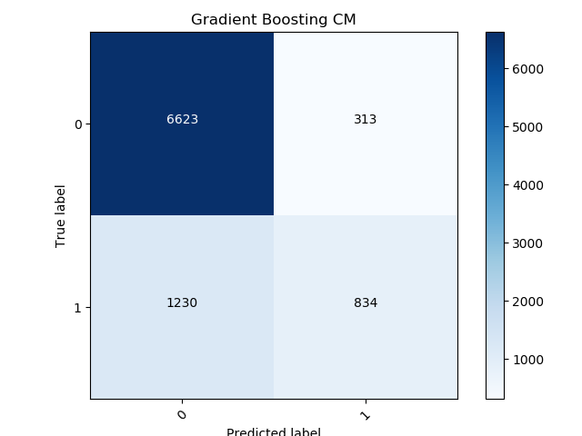
Metric | Score
Precision | 0.72
Recall | 0.40
F1 | 0.48
Accuracy | 0.82
AUC | 0.83
True Neg.
False Pos.
False Neg.
True Pos.
Notes:
Recall: True Positive / Actual Total Positives = 40%
Precision: TP / (FP + TP) = 72%
F1 is 50%...kinda useless

Slide 12
Best Features
bill_sep & pay_status_sep (Most Important Features)
Follow up features: bill_aug, bill_jul
What about earlier months’ payment status?
Much less important (30% of pay_status_sep)
Model follows natural intuition to a degree
Look at the most recent status of a client (Sept.)
Notes:
-for each iteration, we looked at the best features; some consistently showed up
-bill_sep & pay_status_sep were most important by far 50-100% higher than other features

Slide 13

Status of the Model
High Precision….”Ok” Recall
Only Relatively Small Proportion Defaults
Recall = 0.4 → 2640 / 6600 defaulters 👍
Accuracy = 0.83
Livable Results
Try to understand model’s relation to the situation
Notes:
-High precision, but low recall
-need more features
-default not too costly, so we can afford low recall
-precision is a good measure
-6600/30000 total defaulted
-recall = 0.4 → 2640 ppl
-capture .4 at a high precision ...pretty adequate
.3 threshold failed
.9 thresh → high precision, super low recall

Slide 14
Future Directions
Model adequate for the situation
Enabled promising efforts to collect different types of data & improve model
Fiscal features of debt, payment status do not guarantee a clear signal of defaulting
Find a better generalized dataset
Notes:
Thresholding shows that
TW was in economic crisis

Slide 15
END

Slide 16
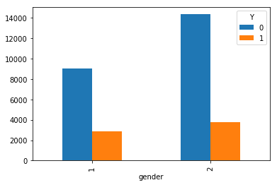
Defaulting & Gender

Slide 17
Thresholding
> 50% to default
Metric | Score
Precision | 0.72
Recall | 0.40
F1 | 0.52
Accuracy | 0.83
> 90% to default
Metric | Score
Precision | 1.00
Recall | 0.006
F1 | 0.01
Accuracy | 0.77
Notes:
Some ppl do pay it off after sept.

Slide 18
max_depth: 3 max_features: None n_estimators: 250
best_score: 0.4751666776850824
precision: 0.7243195785776997recall: 0.3997093023255814accuracy: 0.8274444444444444auc: 0.8279312993437229
[[6622 314] [1239 825]]
[0.06675498 0.00668585 0.02515955 0.01785101 0.06194356 0.09467239 0.02537071 0.02599007 0.02815825 0.0218619 0.02489656 0.09296947 0.06334256 0.06699342 0.04253396 0.04790901 0.0557756 0.04993573 0.03861271 0.03059331 0.02831242 0.04715636 0.03652061]
*bill_sep & pay_status_sep still most important features*next highest/moderate features were index[12,13] (bill_aug, bill_jul)pay_status in aug&jul weren't strong features *good estimator is your bill amount lines up with common sense

Slide 19
max_depth: 3 max_features: None n_estimators: 300
best_score: 0.47536320315804237
precision: 0.7271142109851787recall: 0.40406976744186046accuracy: 0.8285555555555556auc: 0.8321877193364805
[[6623 313] [1230 834]]
[0.06932896 0.00588784 0.0243248 0.01754372 0.05821014 0.0824601 0.02436829 0.023781 0.02670914 0.02050335 0.02443363 0.0887392 0.05895782 0.06925458 0.05120494 0.04954589 0.05408405 0.05525376 0.04267801 0.03387458 0.03438822 0.04473817 0.0397298 ]
*improving n_estimators to 300 keeping depth=3, using all features improved a bit*roc score not as good, but f1 improved, precision & accuracy seem to be steadily improving

