Slide 1

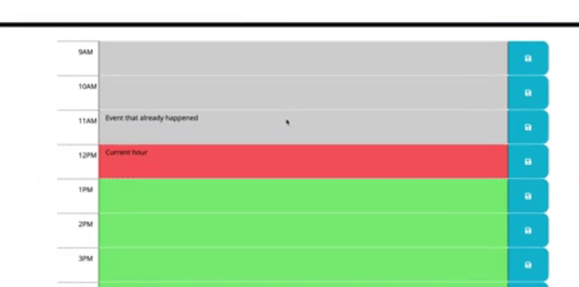

Content
Each Biz hour - 9am-5pm
Text-editable
Save button on right
Text saved local storage. On refresh command to trigger local storage.
Current hour highlighted
Past in grey
Future in green
Header
<p>
Moment.js todays date
layout
80% cards?
Bootstrap grid?1-10-1?
Table?
Jqury to collect set time for each row - data attribute . 9am-10am to contain hours. in html: data-hour=9
timer every second. for loop. then set class. remove then apply. JS
click listener with text area to insert text. JS
click lisiner for local storage. JS clear on new day. keep for present day.
JQuery

