Slide 1
How your brain works

Slide 2
Housekeeping
Number of pull requests I have received as of 2:40 p.m.: 2. Where are the rest of you?
Tuesday class: Oct. 1. I have a 6 p.m. flight to catch. Class will either be 1) held online 2) very short 3) cancelled. Not sure yet.

Slide 3
Online learning outside class
http://www.codecademy.com/
To complete the online code courses, you must send me a screenshot of your badge.
Everyone start with Web Fundamentals.
You have one week to finish the course.
After the course, we’ll hack Chartbuilder.
Up next: JavaScript, then D3.

Slide 4
How your brain works
Understanding cognition is important to visualizing data.

Slide 5
Introduction to cognition
There are three steps to “seeing”
Seeing
Perceiving
Knowing
They are all different phenomena.
What do you see here? What does your brain see, perceive, and know?

Slide 6
Seeing
You might think you see in a fairly wide angle.
You do not.
Your main focal plane is quite narrow, which means for you to “see” something clearly, it must be in that narrow range.
“Movement” attracts our vision.
Moving objects, bright colors, uncommonly shaped items attract our eyes.

Slide 7
How does this apply to graphics?
If your graphic “moves,” do not expect people to read text. Place it where the motion ends.
Use colors only for the most important things.
“If you know that the brain prioritizes what it pays attention to, prioritize beforehand.” – Cairo.

Slide 8
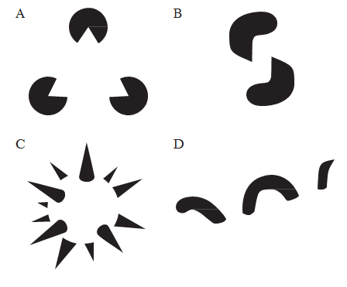
Perception

Slide 9
Perception
What the brain “sees” is a composite image coming from both eyes.
Your brain is a pattern matching machine. It perceives patterns from imperfect data.
This is evolution – your brain was trained to detect predators hiding in weeds so you didn’t get eaten.

Slide 10
Cognition
The brain is much better at quickly detecting shade variations than shape differences.

Slide 11
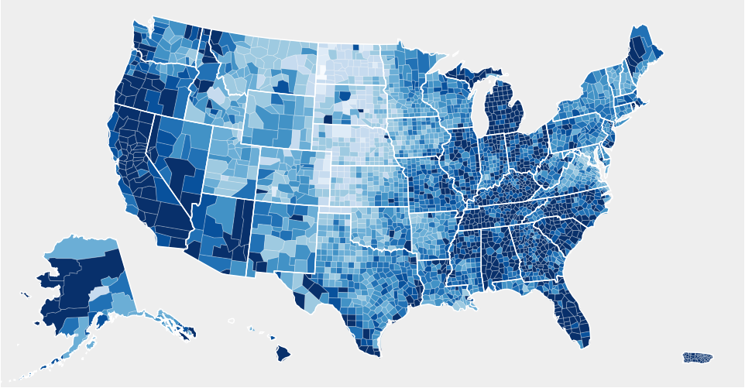
Cognition

Slide 12
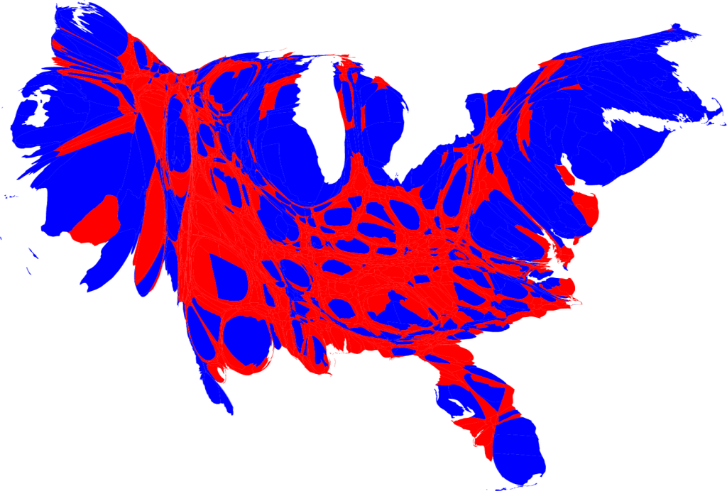
Cognition

Slide 13
Assignments
Assignment: Read Cairo Part II: Cognition
Start your Code Academy Class

