Slide 1
Computer Programming Internship Project Presentation
Christopher Coen | 25-June-2020

Slide 2
Projects
Scientific Calculator: Recreating and expanding upon a previous assignment in a different language.
Contact Book: Simple input and storage system which reminds the user of birthdays of those inputted.
Python Snake: A simple example of the classic game Snake, programmed in Python as it was learned.

Slide 3
Calculator
Netbeans Integrated Development Environment (IDE): Developed and produced by JetBrains to develop Graphical User Interfaces, and Console and Web Applications.
Swing Application: A Graphical User Interface library for the Java SE platform.
Java: A general purpose, class-based programming language, designed to have as few implementation dependencies as possible.

Slide 4
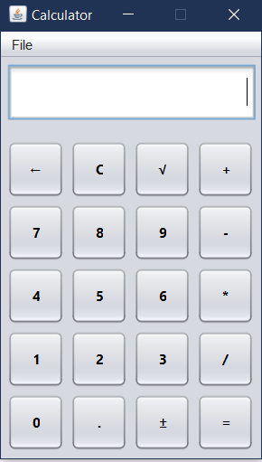
Calculator cont.
Screen on opening application.
Addition, subtraction, multiplication, and division.
Decimals, plus-minus, and square roots.

Slide 5
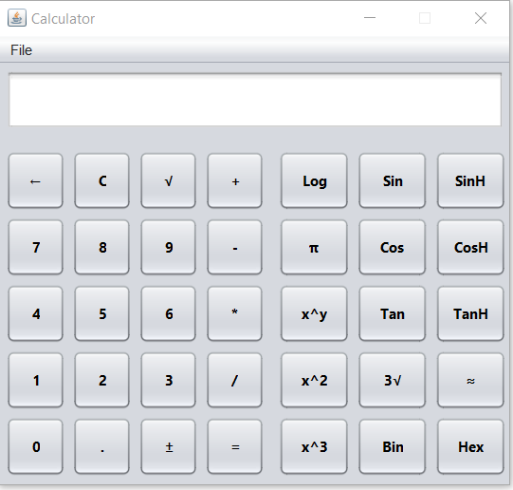
Calculator cont.
Standard trigonometry and hyperbolic trigonometry functions.
Cube and Square (root) functions, Logarithmic, as well as exponential functions.
Binary, hexidecimal, rounding, and pi functions.

Slide 6
Calculator cont
Generic Number Format:
Gets button label from the button being pressed as a String ‘iNum’ and adds it to the txtDisplay TextBox.
TxtDisplay TextBox is then overwritten as whatever the new string is.

Slide 7
Calculator cont.
Generic Function Format:
Takes the numbers from within the txtDisplay TextBox as ‘operator’.
Runs it through whatever JavaMath function is best associate with that button’s label.
Displays the results of that function in the txtDisplay TextBox.

Slide 8
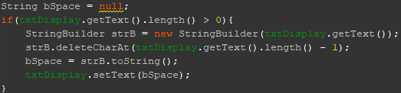
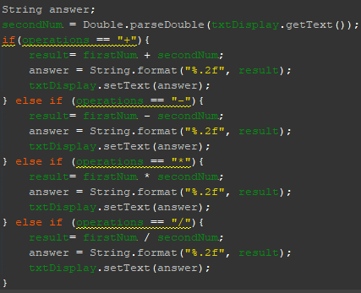
Calculator cont.
Exceptions:
Plus-Minus and Exponentials
Binary and Hexadecimal
Backspace
Equals

Slide 9
Contact Book
Visual Studio Integrated Development Environment (IDE): Developed by Microsoft to develop Graphical User Interfaces (GUI), and Console and Web Applications.
Windows Forms App (.NET Framework): A project using the Windows Forms (WinForms) user interface.
C#: A general-purpose, multi-paradigm programming language developed by Microsoft.

Slide 10
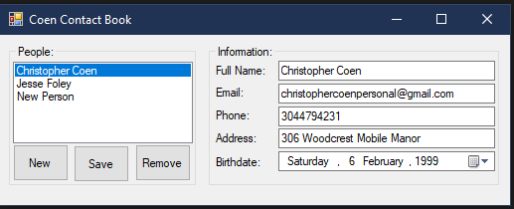
Contact Book cont.
List of people on left
Information per person fills in the right.

Slide 11
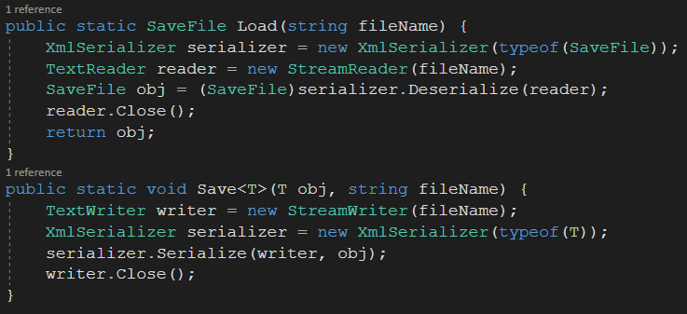
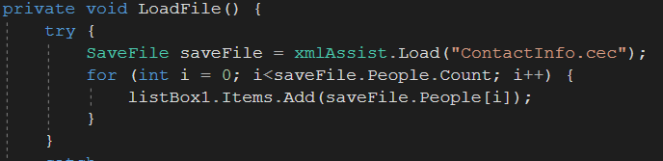
Contact Book cont.

Slide 12
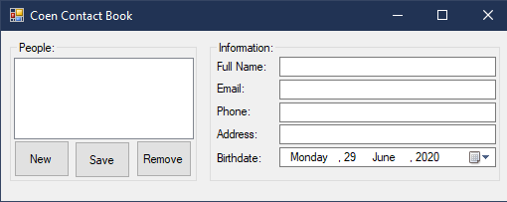
Contact Book cont.
User presses the ‘New’ button. Insert data into the right side of the program. Save.
Save needs to be pressed once all changes to the new contact are made, or it won’t save.
Moving to a new contact without saving causes saves to be overwritten by the last set of data saved under a person’s individual contact.

Slide 13
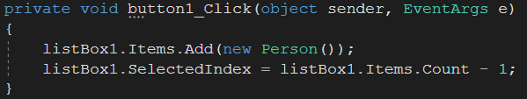
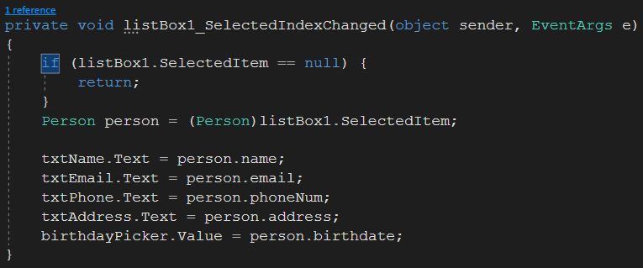
Contact Book cont
Person:
name,
email,
phone number,
address,
and birthday.

Slide 14
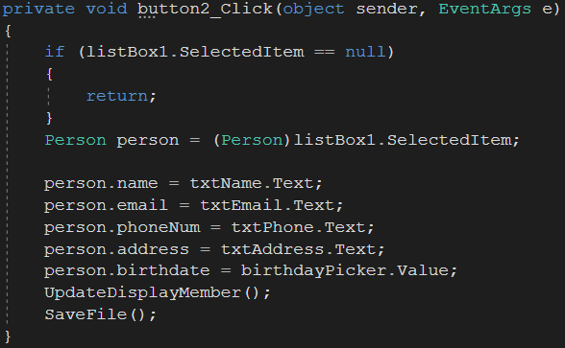
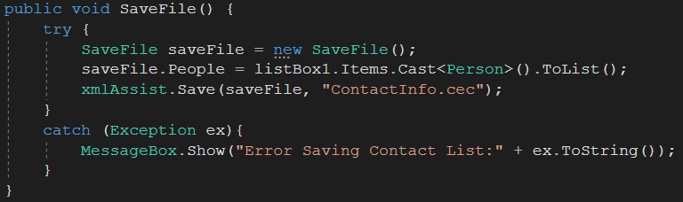
Contact Book cont.

Slide 15
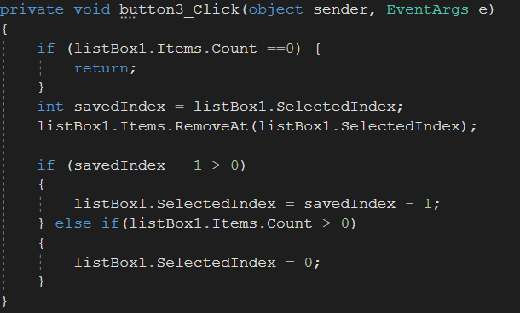
Contact Book cont.
Looks at the item you have selected – if any.
Removes the item on the selected index.
New selected index is the next item on the list.

Slide 16
PyGames Snake
IDEAL: An integrated development environment for Python, bundled with the default implementation of Python.
PyGames: A cross-platform set of Python modules designed for writing video games.
PyInstaller: A bundling applications that 'freezes' Python applications into stand-alone executables alongside all dependencies.
Python: An interpreted, general purpose programming language with a design philosophy focused on readability.

Slide 17
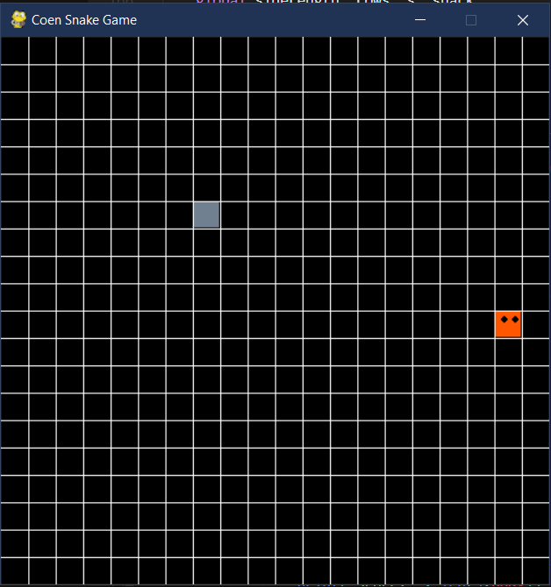
PyGames Snake cont.
Player taps up, down, left, or right. Snake follows that order.
If snake goes to edge of screen, it goes out the other side.
Snake touches cube, snake gains length.
Snake touches snake, snake dies and score is displayed.

Slide 18
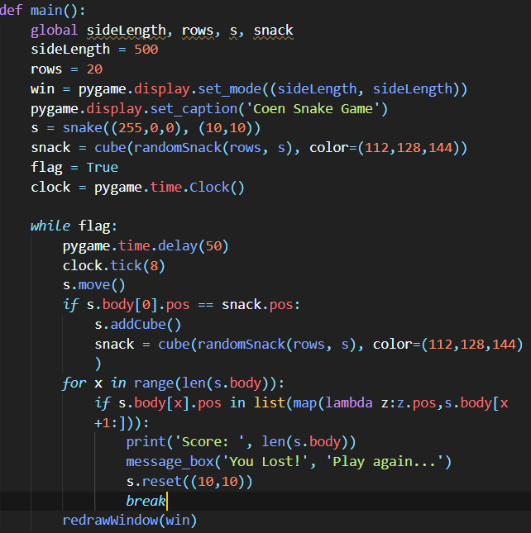
PyGames Snake cont.
SideLength determines both dimensions of the Window. Rows determines number of rows.
They need to divide evenly or it looks off.
Declares the snake and a random cube to act as snack and triggers the game’s starting flag.
Game is on a delayed based on the clock. 8Fps with additional delay.
When the snake moves onto a block, it adds to its length.
When the snake moves onto itself, it loses and the number of cubes you collected is displayed in a console.

Slide 19
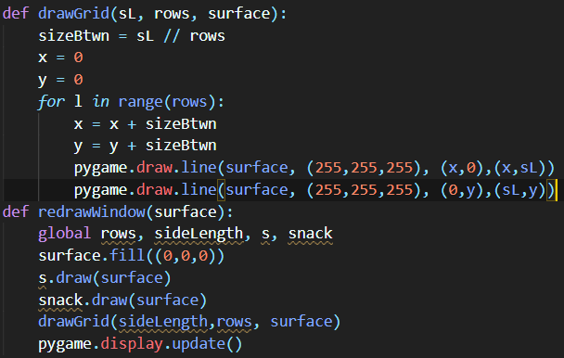
PyGames Snake cont.
Surface of program is filled black,
Snake is drawn,
Snack is drawn,
White lines are drawn ‘between’ the rows,
Display is updated.

Slide 20
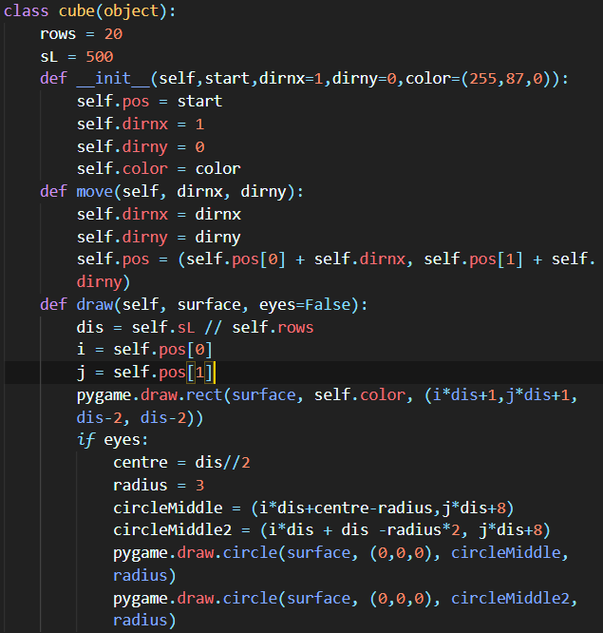
PyGames Snake cont.
Cube is basis of both the Snake and Snack, as well as what determines the number of rows and length of sides.
Any differentiation from this initial version of a cube is decided by the individual object when they’re created.

Slide 21
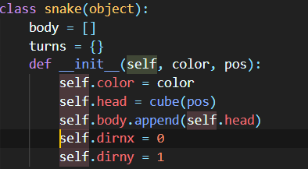
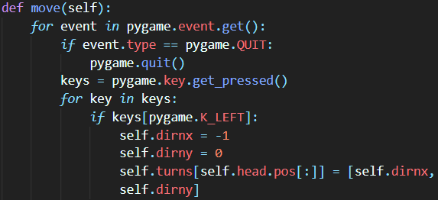
PyGames Snake cont.
Snake is a color, with a position.
Program reads the arrow keys and moves the snake’s head correspondingly.
Body follows the order of the head’s read movement.

Slide 22
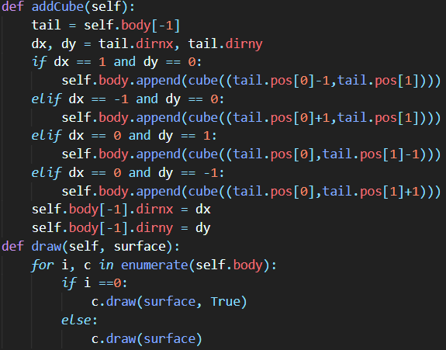
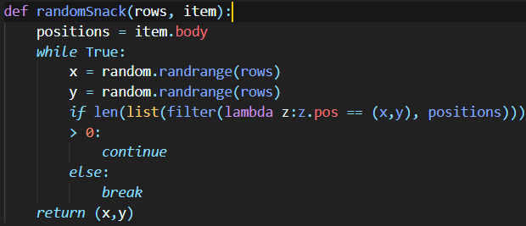
PyGames Snake cont.

Slide 23
Reflections: Calculator
Beginnings of highlight in key problems with my workflow.
Need to not over complicate things.
Need to use online resources more.
Figured out how to do Jar files.

Slide 24
Reflections: Contact Book
Workflow complications made abundantly clear.
Finally figured out key aspects of Windows Forms that I had issues with in assignments earlier in the course.
Learned File I/O in C#.

Slide 25
Reflections: PyGames Snake
Re-learned python in a new way.
Found out that IDEAL is a thing.
Learned PyGames in the above mentioned way.
Learned PyInstaller, likewise using way above.

