Slide 1
S⁴
Science of Science Summer School
iSchool, Syracuse University — August 3 / 7, 2020

Slide 2
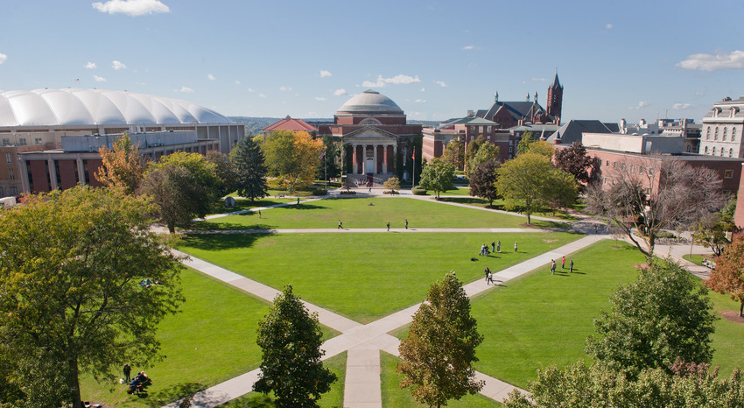
S⁴
Science of Science Summer School
iSchool, Syracuse University — August 3 / 7, 2020

