Slide 1
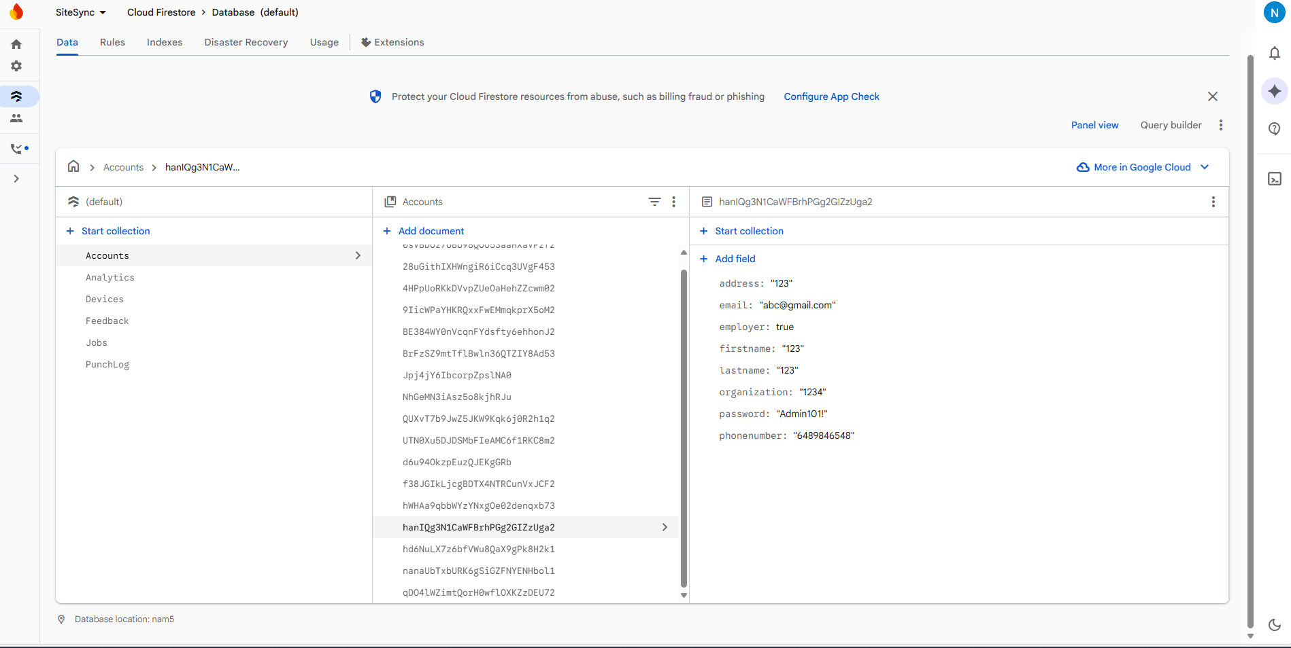
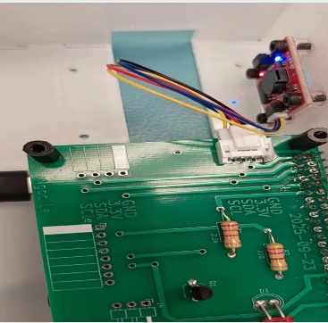
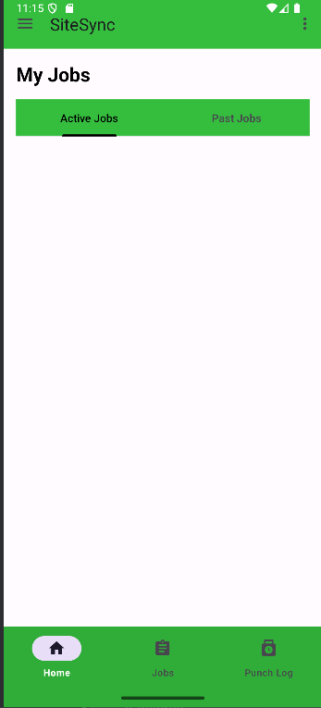
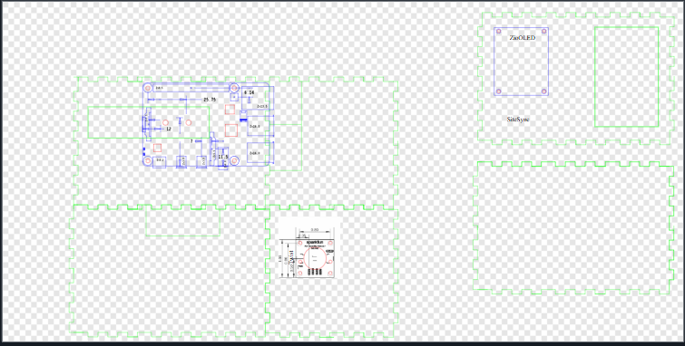
SiteSync – Job Management System
Tyler Meira, Anthony Mancia, Ngoc Le, Amos Sadiq, Computer Engineering Technology
INTRODUCTION
SiteSync is a time management system mainly targeted towards construction sites, warehouses or residential jobsites, with portability in mind. Our app will also help connect employers and employees, while helping them maintain an open line of communication throughout the job process.
PCB ASSEMBLY
Each of our PCB includes a stacking header, a qwicc connector, two resistors and two LEDS.
We have decided to use two PCBs for our project stacking on top of a pi. One pcb will be attached with buzzer and fingerprint, the other pcb will be attached with Oled display and servo.
MOBILE APP RESULTS
Employers can see when the employees ‘ punchlogs in the app. Employers also can add more jobs in the job board. Employee can clock in and clock out using fingerprint scanner.
Users are allowed to change their information.
There is help available in the app in case users needs guidance.
Our app has 3 tabs such as home, job and punchlogs
.
DATABASE
TESTING AND NEXT STEPS
Alll of our sensors are working properly. Our future goal for now is to test how they work with each other after assembling,
ENCLOSURE DESIGN
We have ordered 3D cut for our case. The pi is mounted to the bottom of the case. Buzzer is mounted to the side and Oled display is mounted above the pi. The case is taller than usual because we need two pcbs and pi to complete our project.
ACKNOWLEDGEMENTS
Professors, etc.
Notes:
Section Start Slide

