Slide 1
Generative Models
Chris Gruber

Slide 2
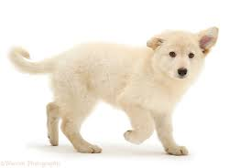
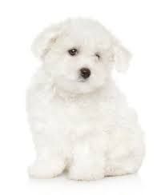
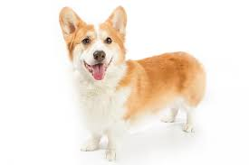
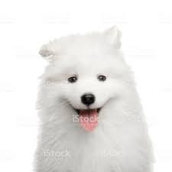
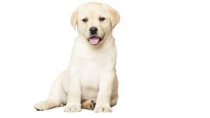
What is a generative model?
Model that learns from data and produces synthetic data as output
Model
Train
Generate

Slide 3
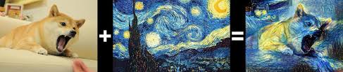
Where are generative models actually used?
Supplementing existing datasets
Image augmentation: colorization, resolution improvement, inpainting, etc.
Security and fraud detection
Artificial face aging
Deep fakes
Style transfer

Slide 4
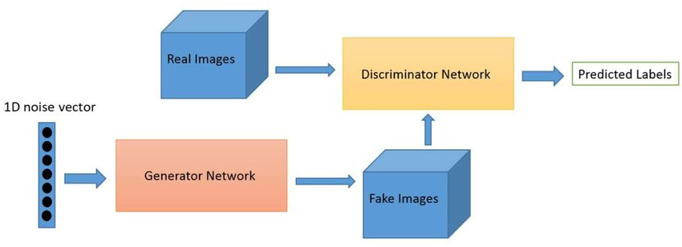
GAN Schematic

Slide 5
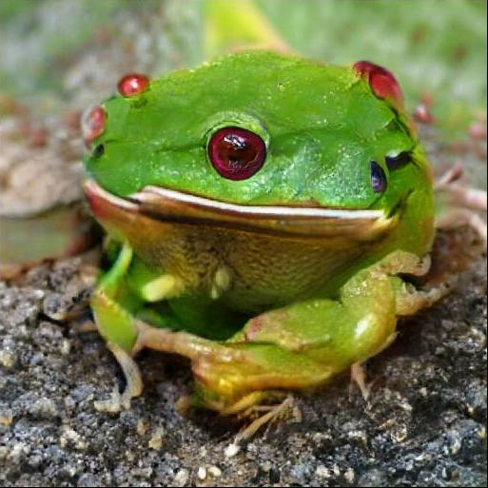
Why are generative models hard to train?
Instability – the generator and discriminator parameters diverge
“Mode collapse” – the generator only learns some features of the dataset
Weak gradients – the gradient descent algorithm breaks down

Slide 6
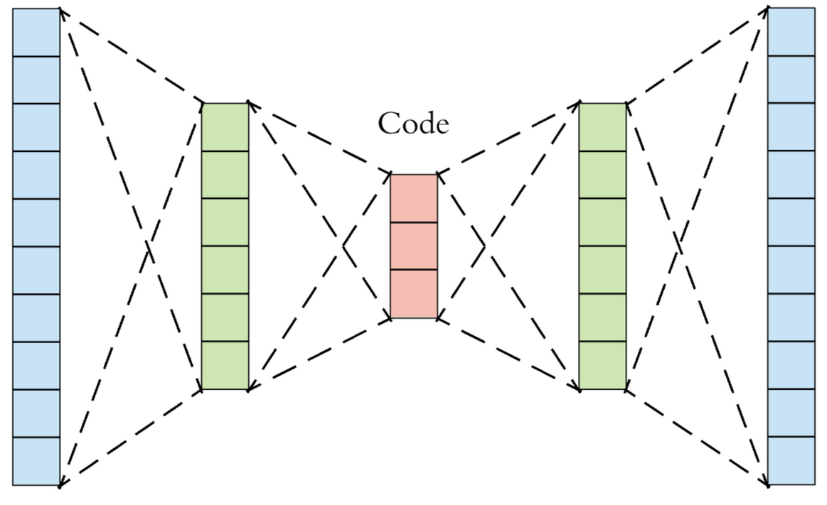
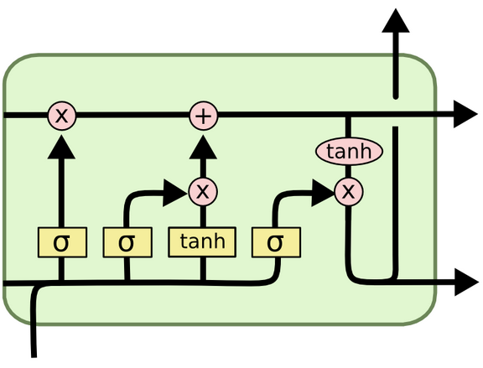
How do generative models intersect with deep learning?
Neural autoencoders
Language generation
Text embeddings
Recursive and convolutional networks
Language translation
Semantic search

Slide 7
Resources and References
Articles and guides
Tour of various GAN architectures
Recommended intermediate reference
Academic papers
Review paper of GANs from an academic lens
Paper on training GANs
Tools and training
GANLab: an interactive tool to learn about GANs
GAN Dissection: MIT’s interactive GAN painting tool
Notes:
Plug the ChiPy mentorship!

Slide 8
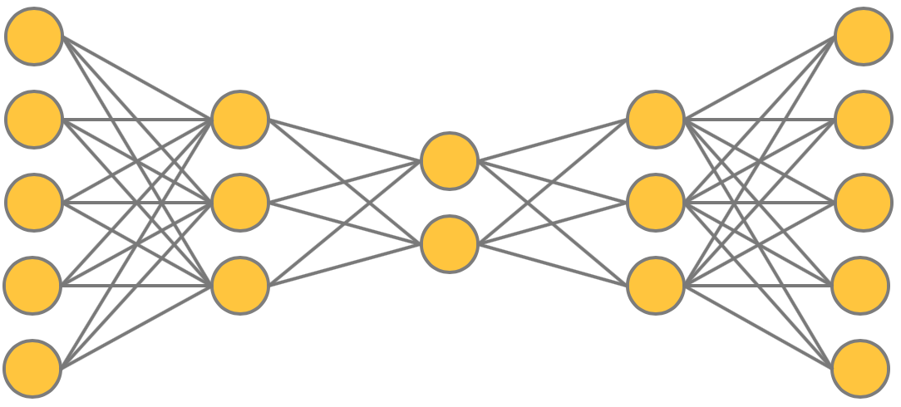
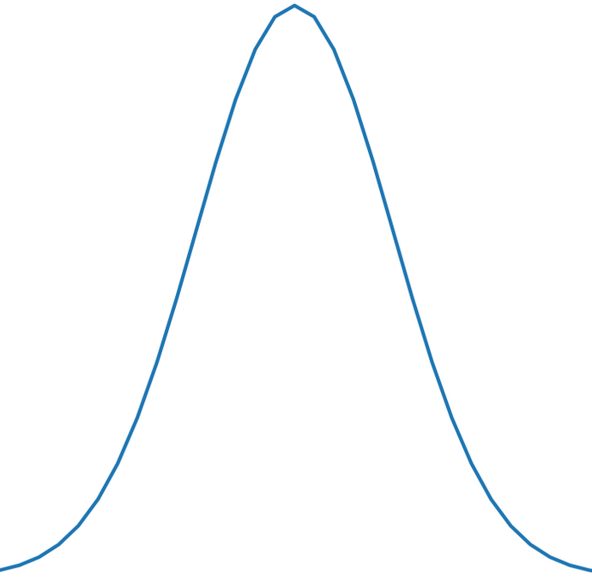
DEMO – Variational Autoencoder
original dim
original dim
intermediate dim
intermediate dim
latent dim
2
256
256
784
784
Notes:
Plug the ChiPy mentorship!

Slide 9
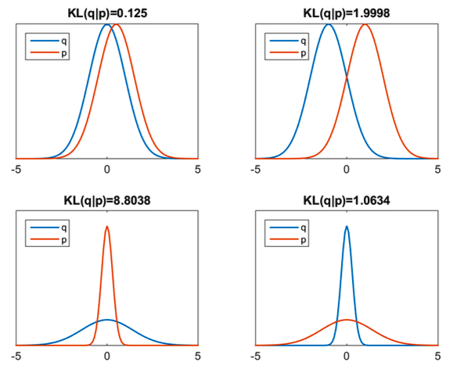
DEMO – Variational Autoencoder
Notes:
Plug the ChiPy mentorship!

Slide 10
DEMO – Text Generation
Feed a sequence of letters into an LSTM network to generate text
one_letter_at_a
ne_letter_at_a_
e_letter_at_a_t
_letter_at_a_ti
letter_at_a_tim
_
t
i
m
e
time
prediction
Notes:
Plug the ChiPy mentorship!

Slide 11
Thanks!
https://github.com/ChristopherGruber/Generative_Models
Notes:
Plug the ChiPy mentorship!

