Slide 1
Introduction to Keras
Chris Gruber
ChiPy February 2018

Slide 2
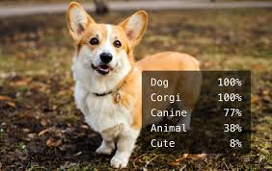




Notes:
Goals:
Reduce the intimidation factor of neural networks
Inspire ChiPy to give it a try

Slide 3
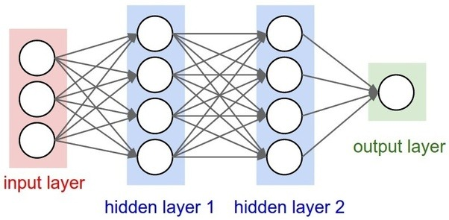
“depth” of network

Slide 4
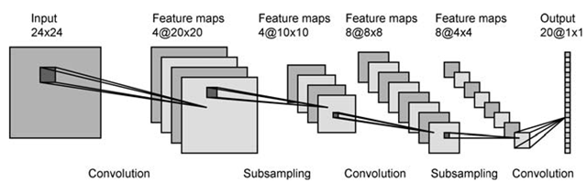
LeNet-5 Architecture

Slide 5
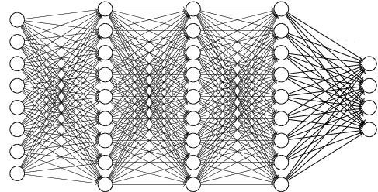
Inputs
Outputs

Slide 6
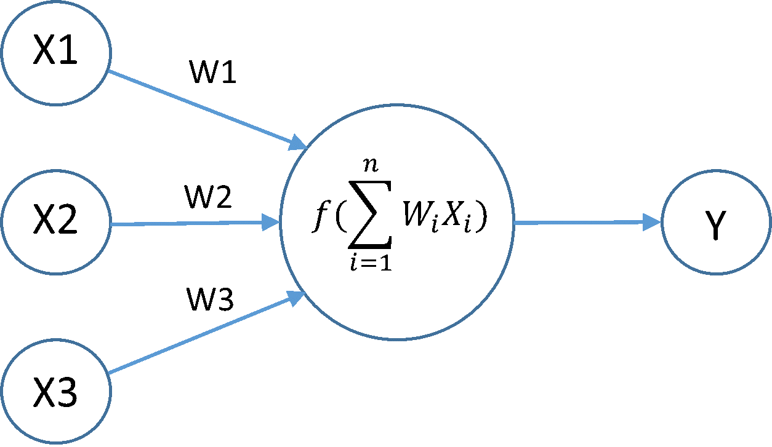
X₁
W₁
W₂
X₂
W_{n}
…
X_{n}

Slide 7
X₁
W₁
W₂
X₂
W_{n}
…
X_{n}

Slide 8
X₁
W₁
W₂
X₂
W_{n}
…
X_{n}

Slide 9
X₁
W₁
(
)
W₂
f
X₂
W_{n}
…
X_{n}

Slide 10
X₁
W₁
(
)
W₂
f
X₂
W_{n}
…
X_{n}

Slide 11
Keras is a high-level API that interfaces with frameworks like TensorFlow
Mimics the syntax of scikit-learn
Balances ease and flexibility with prebuilt components and customizable templates
Implementations of convolution, pooling, and other advanced layers
Other features: data sets, precompiled models, TensorFlow interfaces, …

Slide 12
Keras has pre-defined classes for most neural network components
Nodes
Activations
Initializations
Optimizers
Loss Functions
Callbacks
Also possible to create user-defined versions of all of these
Simple networks are constructed using the Sequential class
One line of code One layer of network
…

Slide 13
Developing networks in Keras is fast
Keras can be used with TensorFlow code interspersed
Pre-compiled networks for famous architectures
Very active community

Slide 14
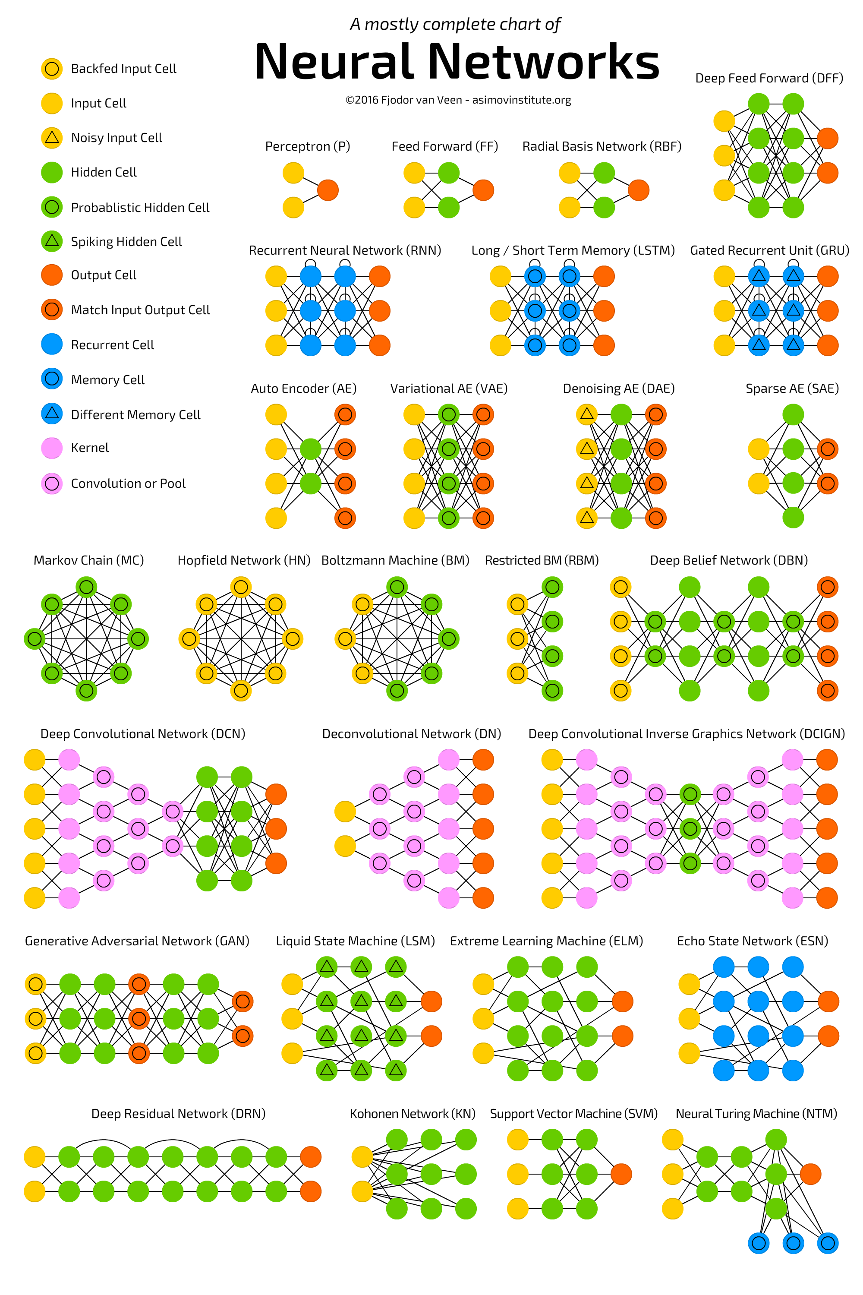

Slide 15
Links and Resources
Keras documentation
Keras Homepage
Official "Getting Started" Guide
Long List of Keras Links
Tutorials and guides
Keras Blog
Beginner's Guide
End-to-End Data Munging and Modeling Walkthrough
More Information about Neural networks
Neural Networks and Deep Learning eBook
Introduction to Long Short-Term Memory Networks

Slide 16
Links and Resources
Advice on designing and training neural networks
How to Choose Layer Size and Number of Layers
What are Some Rules of Thumb for Training Neural Networks?
Explanation of neural network types
Types of Neural Networks (Wikipedia)
Explanation of Neural Network Types
Book Chapter Explaining Neural Network Types, Backpropagation, etc.
Discussions on when to use neural networks
Why aren't neural networks used for everything?
What problems cannot be addressed using neural networks?
Neural Networks and the Universal Approximation Theorem

Slide 17
Keras Demo

Slide 18
Use Keras’s Sequential class to initialize the network

Slide 19
Construct a network with three layers of ten nodes

Slide 20
Construct a network with three layers of ten nodes

Slide 21
Construct a network with three layers of ten nodes

Slide 22

Train the network using hand-written digit samples
7

Slide 23

Train the network using hand-written digit samples
1

Slide 24

Test the network with examples from outside the training data
?

Slide 25
Time to code!

Slide 26
Thanks!
Notes:
Plug the ChiPy mentorship!

