Slide 1
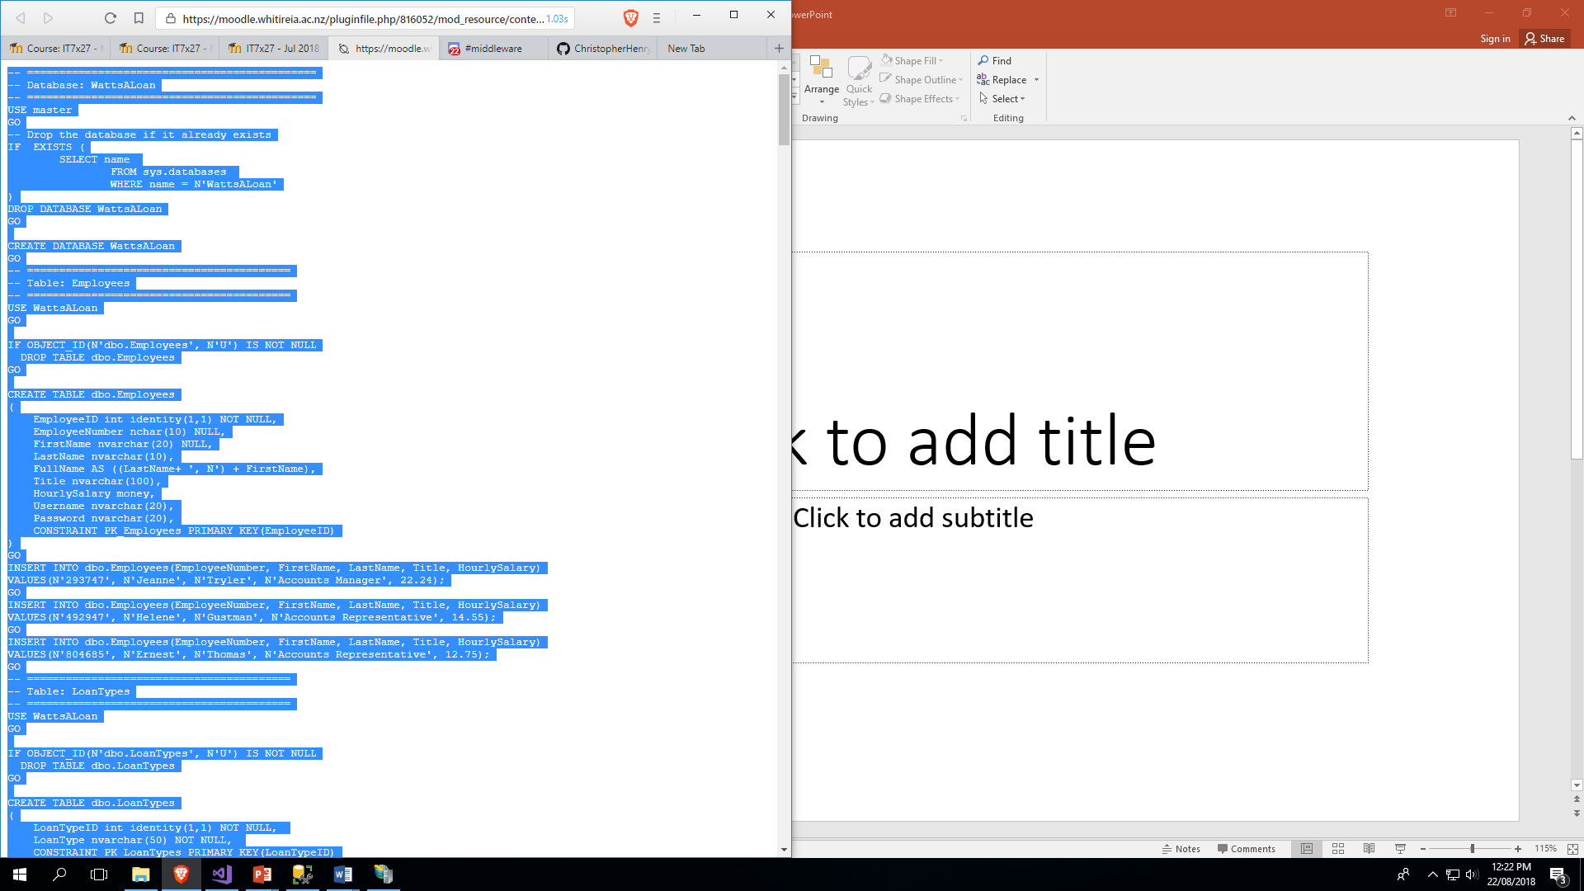

Slide 2
-- ============================================= -- Database: WattsALoan -- ============================================= USE master GO -- Drop the database if it already exists IF EXISTS ( SELECT name FROM sys.databases WHERE name = N'WattsALoan' ) DROP DATABASE WattsALoan GO CREATE DATABASE WattsALoan GO -- ========================================= -- Table: Employees -- ========================================= USE WattsALoan GO IF OBJECT_ID(N'dbo.Employees', N'U') IS NOT NULL DROP TABLE dbo.Employees GO CREATE TABLE dbo.Employees ( EmployeeID int identity(1,1) NOT NULL, EmployeeNumber nchar(10) NULL, FirstName nvarchar(20) NULL, LastName nvarchar(10), FullName AS ((LastName+ ', N') + FirstName), Title nvarchar(100), HourlySalary money, Username nvarchar(20), Password nvarchar(20), CONSTRAINT PK_Employees PRIMARY KEY(EmployeeID) ) GO INSERT INTO dbo.Employees(EmployeeNumber, FirstName, LastName, Title, HourlySalary) VALUES(N'293747', N'Jeanne', N'Tryler', N'Accounts Manager', 22.24); GO INSERT INTO dbo.Employees(EmployeeNumber, FirstName, LastName, Title, HourlySalary) VALUES(N'492947', N'Helene', N'Gustman', N'Accounts Representative', 14.55); GO INSERT INTO dbo.Employees(EmployeeNumber, FirstName, LastName, Title, HourlySalary) VALUES(N'804685', N'Ernest', N'Thomas', N'Accounts Representative', 12.75); GO -- ========================================= -- Table: LoanTypes -- ========================================= USE WattsALoan GO IF OBJECT_ID(N'dbo.LoanTypes', N'U') IS NOT NULL DROP TABLE dbo.LoanTypes GO CREATE TABLE dbo.LoanTypes ( LoanTypeID int identity(1,1) NOT NULL, LoanType nvarchar(50) NOT NULL, CONSTRAINT PK_LoanTypes PRIMARY KEY(LoanTypeID) ); GO INSERT INTO LoanTypes(LoanType) VALUES(N'Personal Loan'); GO INSERT INTO LoanTypes(LoanType) VALUES(N'Car Financing'); GO INSERT INTO LoanTypes(LoanType) VALUES(N'Credit Card'); GO INSERT INTO LoanTypes(LoanType) VALUES(N'Furniture Loan'); GO -- ========================================= -- Table: Customers -- ========================================= USE WattsALoan GO IF OBJECT_ID(N'dbo.Customers', N'U') IS NOT NULL DROP TABLE dbo.Customers GO CREATE TABLE dbo.Customers ( CustomerID int identity(1,1) NOT NULL, DateCreated datetime2 NULL, FullName nvarchar(50) NOT NULL, BillingAddress nvarchar(100), BillingCity nvarchar(50), BillingState nvarchar(50), BillingZIPCide nvarchar(10), EmailAddress nvarchar(100), CONSTRAINT PK_Customers PRIMARY KEY(CustomerID) ) GO INSERT INTO Customers(DateCreated, FullName, BillingAddress, BillingCity, BillingState, BillingZIPCide, EmailAddress) VALUES(N'2/26/2004', N'Julius Ramse', '927 Feuler Ave', N'Silver Spring', 'MD', N'20904', N'ramses1990@netscape.net'); GO INSERT INTO Customers(DateCreated, FullName, BillingAddress, BillingCity, BillingState, BillingZIPCide) VALUES(N'06/22/2006', N'Gertrude Vaillant', '10055 Larsenic Rd', N'Takoma Park', 'MD', N'20910'); GO INSERT INTO Customers(DateCreated, FullName, BillingAddress, BillingCity, BillingState, BillingZIPCide, EmailAddress) VALUES(N'12/3/2004', N'James Barrouch', '4204 Fallon Drive', N'Silver Spring', 'MD', N'20906', N'barrouchj@hotmail.com'); GO INSERT INTO Customers(DateCreated, FullName, BillingAddress, BillingCity, BillingState, BillingZIPCide) VALUES(N'08/02/2006', N'Christine Rougher', '825 Manning Street', N'Alexandria', 'VA', N'22231'); GO INSERT INTO Customers(DateCreated, FullName, BillingAddress, BillingCity, BillingState, BillingZIPCide, EmailAddress) VALUES(N'10/08/2006', N'Patrick Heller', '2480 Clarington Drive NW', N'Washington', 'DC', N'20006', N'hellerp@yahooo.com'); GO -- ========================================= -- Table: LoanAllocation -- ========================================= USE WattsALoan GO IF OBJECT_ID(N'dbo.LoanAllocations', N'U') IS NOT NULL DROP TABLE dbo.LoanAllocations GO CREATE TABLE dbo.LoanAllocations ( LoanAllocationID int identity(1,1) NOT NULL, DatePrepared datetime2 NOT NULL, EmployeeID int NULL CONSTRAINT FK_LoanPreparer FOREIGN KEY REFERENCES Employees(EmployeeID), CustomerID int NOT NULL CONSTRAINT FK_LoanReceiver FOREIGN KEY REFERENCES Customers(CustomerID), AccountNumber nchar(10), LoanTypeID int NOT NULL CONSTRAINT FK_LoanTypes FOREIGN KEY REFERENCES LoanTypes(LoanTypeID), LoanAmount money NOT NULL, InterestRate decimal(6,2) NOT NULL, Periods decimal(6,2) NOT NULL, InterestAmount AS ((LoanAmount*(InterestRate/(100)))*(Periods/(12))), FutureValue AS (LoanAmount+(LoanAmount*(InterestRate/(100)))*(Periods/(12))), MonthlyPayment AS ((LoanAmount+(LoanAmount*(InterestRate/(100)))*(Periods/(12)))/Periods), Notes Text, CONSTRAINT PK_LoanAllocations PRIMARY KEY(LoanAllocationID) ) GO INSERT INTO LoanAllocations(DatePrepared, EmployeeID, CustomerID, AccountNumber, LoanTypeID, LoanAmount, InterestRate, Periods, Notes) VALUES(N'2/26/2004', 2, 1, N'9171394', 4, 6500.00, 12.65, 36, 'The loan will be delivered by our furniture business partner Helios Furnian'); GO INSERT INTO LoanAllocations(DatePrepared, EmployeeID, CustomerID, AccountNumber, LoanTypeID, LoanAmount, InterestRate, Periods, Notes) VALUES(N'06/22/2007', 2, 2, N'8628064', 2, 16500.00, 10.20, 60, 'For this car loan, our partner Arlington Honda will process and deliver the car.'); GO INSERT INTO LoanAllocations(DatePrepared, EmployeeID, CustomerID, AccountNumber, LoanTypeID, LoanAmount, InterestRate, Periods, Notes) VALUES(N'12/3/2006', 1, 3, N'8468364', 3, 500.00, 18.65, 48, 'This is a regular credit card.'); GO INSERT INTO LoanAllocations(DatePrepared, EmployeeID, CustomerID, AccountNumber, LoanTypeID, LoanAmount, InterestRate, Periods, Notes) VALUES(N'08/02/2006', 3, 4, N'2483047', 1, 3500.00, 12.74, 36, 'This is personal/cash loan allocated to a customer who walked in the store and requested it.'); GO INSERT INTO LoanAllocations(DatePrepared, EmployeeID, CustomerID, AccountNumber, LoanTypeID, LoanAmount, InterestRate, Periods, Notes) VALUES(N'10/08/2006', 2, 5, N'1311804', 4, 22748.36, 12.28, 60, 'This is a regular car financing loan'); GO -- ========================================= -- Table: Payments -- ========================================= USE WattsALoan GO IF OBJECT_ID(N'dbo.Payments', N'U') IS NOT NULL DROP TABLE dbo.Payments GO CREATE TABLE dbo.Payments ( PaymentID int identity(1, 1) NOT NULL, PaymentDate datetime2 NOT NULL, EmployeeID int NULL CONSTRAINT FK_Employees FOREIGN KEY REFERENCES Employees(EmployeeID), LoanAllocationID int NOT NULL CONSTRAINT FK_LoanAllocations FOREIGN KEY REFERENCES LoanAllocations(LoanAllocationID), PaymentAmount money NOT NULL, Balance money, Notes Text, CONSTRAINT PK_Payments PRIMARY KEY(PaymentID) ) GO -- Stored Procedures USE WattsALoan; GO CREATE PROCEDURE SpecifyCurrentBalance (@PmtDate datetime2, @EmplID int, @LaID int, @PmtAmt money, @Response bit OUTPUT) AS BEGIN TRANSACTION; BEGIN TRY -- Get the amount that was lent to the customer DECLARE @AmountOfLoan money; SET @AmountOfLoan = (SELECT las.FutureValue FROM LoanAllocations las WHERE (las.LoanAllocationID = @LaID)); -- If the customer had already made at least one payment, -- get the current balance of the customer's account DECLARE @CurrentBalance money; SET @CurrentBalance = (SELECT MIN(pay.Balance) FROM Payments pay WHERE (pay.LoanAllocationID = @LaID)); -- If the customer has never made a payment (yet), -- to specify the balance, subtract the current payment -- from the original amount of the loan IF @CurrentBalance IS NULL BEGIN INSERT INTO Payments(PaymentDate, EmployeeID, LoanAllocationID, PaymentAmount, Balance) VALUES(@PmtDate, @EmplID, @LaID, @PmtAmt, @AmountOfLoan - @PmtAmt); END -- If the customer had already at least one payment, -- subtract the current payment from the previous balance ELSE BEGIN INSERT INTO Payments(PaymentDate, EmployeeID, LoanAllocationID, PaymentAmount, Balance) VALUES(@PmtDate, @EmplID, @LaID, @PmtAmt, @CurrentBalance - @PmtAmt); END END TRY BEGIN CATCH IF @@TRANCOUNT > 0 BEGIN ROLLBACK TRANSACTION; SELECT @Response = 0; END END CATCH; IF @@TRANCOUNT > 0 BEGIN COMMIT TRANSACTION; SELECT @Response = 1; END GO USE WattsALoan; GO --Insert New Employee -- ================================================ SET ANSI_NULLS ON GO SET QUOTED_IDENTIFIER ON GO CREATE PROCEDURE InsertEmployee( @EmployeeNumber nchar(10) ,@FirstName nvarchar(20) ,@LastName nvarchar(10) ,@Title nvarchar(100) ,@HourlySalary money ,@Response bit OUTPUT) AS BEGIN TRANSACTION; BEGIN TRY -- SET NOCOUNT ON added to prevent extra result sets from -- interfering with SELECT statements. SET NOCOUNT ON; INSERT INTO [WattsALoan].[dbo].[Employees] ([EmployeeNumber] ,[FirstName] ,[LastName] ,[Title] ,[HourlySalary] ) VALUES (@EmployeeNumber ,@FirstName ,@LastName ,@Title ,@HourlySalary) END TRY BEGIN CATCH IF @@TRANCOUNT > 0 BEGIN ROLLBACK TRANSACTION; SELECT @Response = 0; END END CATCH; IF @@TRANCOUNT > 0 BEGIN COMMIT TRANSACTION; SELECT @Response = 1; END GO USE WattsALoan; GO -- Update Employee -- ================================================ SET ANSI_NULLS ON GO SET QUOTED_IDENTIFIER ON GO -- ============================================= CREATE PROCEDURE UpdateEmployee( @EmployeeID int, @EmployeeNumber nchar(10), @FirstName nvarchar(20), @LastName nvarchar(10), @Title nvarchar(100), @HourlySalary money, @Response bit OUTPUT) AS BEGIN TRANSACTION; BEGIN TRY -- SET NOCOUNT ON added to prevent extra result sets from -- interfering with SELECT statements. SET NOCOUNT ON; UPDATE [WattsALoan].[dbo].[Employees] SET [EmployeeNumber] = @EmployeeNumber ,[FirstName] = @FirstName ,[LastName] = @LastName ,[Title] = @Title ,[HourlySalary] = @HourlySalary WHERE EmployeeID = @EmployeeID END TRY BEGIN CATCH IF @@TRANCOUNT > 0 BEGIN ROLLBACK TRANSACTION; SELECT @Response = 0; END END CATCH; IF @@TRANCOUNT > 0 BEGIN COMMIT TRANSACTION; SELECT @Response = 1; END GO USE WattsALoan; GO -- Delete an Employee -- ================================================ SET ANSI_NULLS ON GO SET QUOTED_IDENTIFIER ON GO -- ============================================= CREATE PROCEDURE DeleteEmployee -- Add the parameters for the stored procedure here (@EmployeeID int, @Response bit OUTPUT) AS BEGIN TRANSACTION; BEGIN TRY -- SET NOCOUNT ON added to prevent extra result sets from -- interfering with SELECT statements. SET NOCOUNT ON; DELETE FROM [WattsALoan].[dbo].[Employees] WHERE EmployeeID = @EmployeeID END TRY BEGIN CATCH IF @@TRANCOUNT > 0 BEGIN ROLLBACK TRANSACTION; SELECT @Response = 0; END END CATCH; IF @@TRANCOUNT > 0 BEGIN COMMIT TRANSACTION; SELECT @Response = 1; END GO USE WattsALoan; GO --Insert new loan type -- ================================================ SET ANSI_NULLS ON GO SET QUOTED_IDENTIFIER ON GO -- ============================================= CREATE PROCEDURE InsertLoan -- Add the parameters for the stored procedure here (@LoanType nvarchar(50), @Response bit OUTPUT) AS BEGIN TRANSACTION; BEGIN TRY -- SET NOCOUNT ON added to prevent extra result sets from -- interfering with SELECT statements. SET NOCOUNT ON; INSERT INTO [WattsALoan].[dbo].[LoanTypes] ([LoanType]) VALUES (@LoanType) END TRY BEGIN CATCH IF @@TRANCOUNT > 0 BEGIN ROLLBACK TRANSACTION; SELECT @Response = 0; END END CATCH; IF @@TRANCOUNT > 0 BEGIN COMMIT TRANSACTION; SELECT @Response = 1; END GO USE WattsALoan; GO --Insert Customer -- ================================================ SET ANSI_NULLS ON GO SET QUOTED_IDENTIFIER ON GO -- ============================================= CREATE PROCEDURE InsertCustomer (@DateCreated datetime2 ,@FullName nvarchar(50) ,@BillingAddress nvarchar(100) ,@BillingCity nvarchar(50) ,@BillingState nvarchar(50) ,@BillingZIPCide nvarchar(10) ,@EmailAddress nvarchar(100) ,@Response bit OUTPUT) AS BEGIN TRANSACTION; BEGIN TRY -- SET NOCOUNT ON added to prevent extra result sets from -- interfering with SELECT statements. SET NOCOUNT ON; INSERT INTO [WattsALoan].[dbo].[Customers] ([DateCreated] ,[FullName] ,[BillingAddress] ,[BillingCity] ,[BillingState] ,[BillingZIPCide] ,[EmailAddress]) VALUES (@DateCreated ,@FullName ,@BillingAddress ,@BillingCity ,@BillingState ,@BillingZIPCide ,@EmailAddress) END TRY BEGIN CATCH IF @@TRANCOUNT > 0 BEGIN ROLLBACK TRANSACTION; SELECT @Response = 0; END END CATCH; IF @@TRANCOUNT > 0 BEGIN COMMIT TRANSACTION; SELECT @Response = 1; END GO USE WattsALoan; GO --Update Customer -- ================================================ SET ANSI_NULLS ON GO SET QUOTED_IDENTIFIER ON GO -- ============================================= CREATE PROCEDURE UpdateCustomer (@CustomerID int ,@DateCreated datetime2 ,@FullName nvarchar(50) ,@BillingAddress nvarchar(100) ,@BillingCity nvarchar(50) ,@BillingState nvarchar(50) ,@BillingZIPCide nvarchar(10) ,@EmailAddress nvarchar(100) ,@Response bit OUTPUT) AS BEGIN TRANSACTION; BEGIN TRY -- SET NOCOUNT ON added to prevent extra result sets from -- interfering with SELECT statements. SET NOCOUNT ON; UPDATE [WattsALoan].[dbo].[Customers] SET [DateCreated] = @DateCreated ,[FullName] = @FullName ,[BillingAddress] = @BillingAddress ,[BillingCity] = @BillingCity ,[BillingState] = @BillingState ,[BillingZIPCide] = @BillingZIPCide ,[EmailAddress] = @EmailAddress WHERE [CustomerID] = @CustomerID END TRY BEGIN CATCH IF @@TRANCOUNT > 0 BEGIN ROLLBACK TRANSACTION; SELECT @Response = 0; END END CATCH; IF @@TRANCOUNT > 0 BEGIN COMMIT TRANSACTION; SELECT @Response = 1; END GO USE WattsALoan; GO -- Create Loan Allocation -- ================================================ SET ANSI_NULLS ON GO SET QUOTED_IDENTIFIER ON GO -- ============================================= CREATE PROCEDURE InsertLoanAllocation (@DatePrepared datetime2(7) ,@EmployeeID int ,@CustomerID int ,@AccountNumber nchar(10) ,@LoanTypeID int ,@LoanAmount money ,@InterestRate decimal(6,2) ,@Periods decimal(6,2) ,@Response bit OUTPUT) AS BEGIN TRANSACTION; BEGIN TRY -- SET NOCOUNT ON added to prevent extra result sets from -- interfering with SELECT statements. SET NOCOUNT ON; INSERT INTO [WattsALoan].[dbo].[LoanAllocations] ([DatePrepared] ,[EmployeeID] ,[CustomerID] ,[AccountNumber] ,[LoanTypeID] ,[LoanAmount] ,[InterestRate] ,[Periods]) VALUES (@DatePrepared ,@EmployeeID ,@CustomerID ,@AccountNumber ,@LoanTypeID ,@LoanAmount ,@InterestRate ,@Periods) END TRY BEGIN CATCH IF @@TRANCOUNT > 0 BEGIN ROLLBACK TRANSACTION; SELECT @Response = 0; END END CATCH; IF @@TRANCOUNT > 0 BEGIN COMMIT TRANSACTION; SELECT @Response = 1; END GO -- Code to execute stored procedures in SQL Server --USE WattsALoan; --GO --EXECUTE SpecifyCurrentBalance '03/25/2004', 2, 1, 249.08; --GO --EXECUTE SpecifyCurrentBalance '01/30/2006', 2, 5, 611.93; --GO --EXECUTE SpecifyCurrentBalance '04/20/2004', 1, 1, 249.08; --GO --EXECUTE SpecifyCurrentBalance '10/28/2006', 2, 4, 134.38; --GO

Slide 3
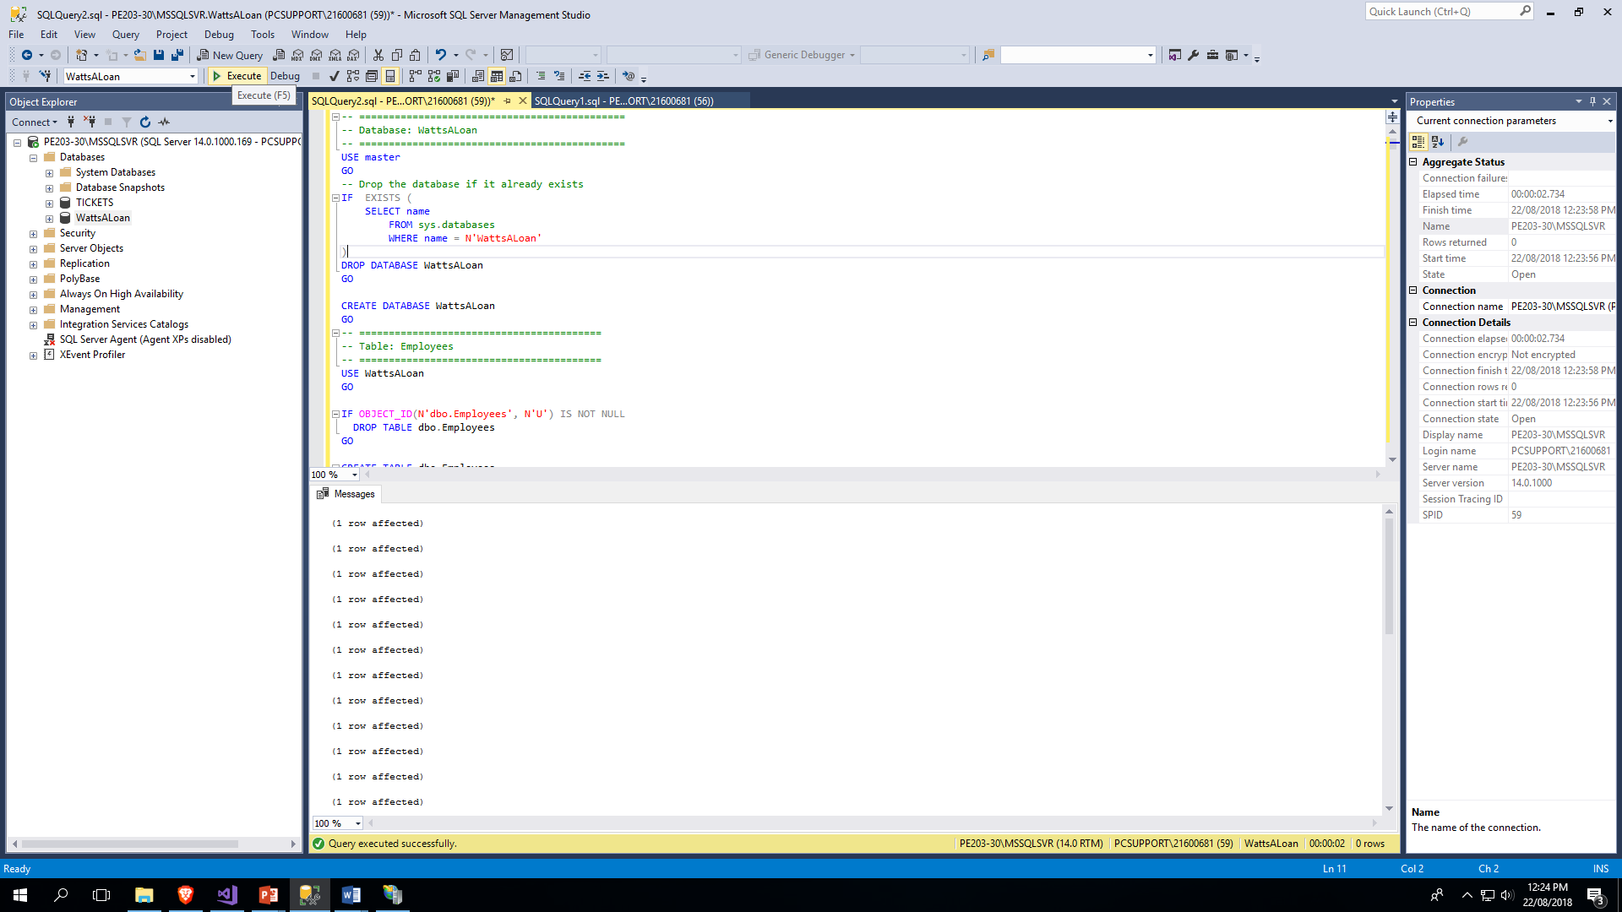

Slide 4
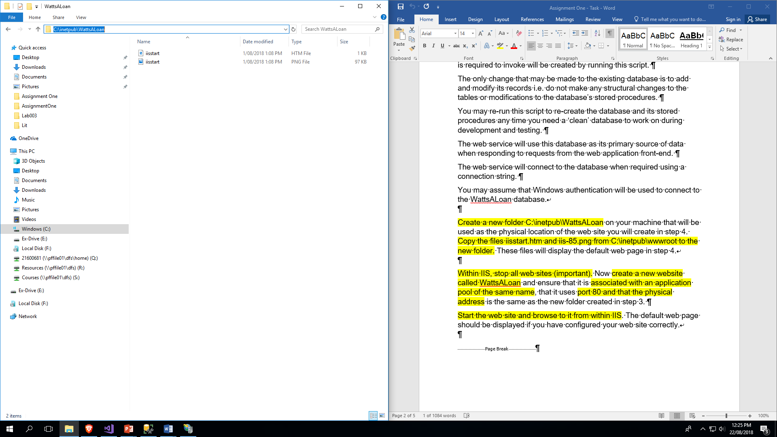

Slide 5
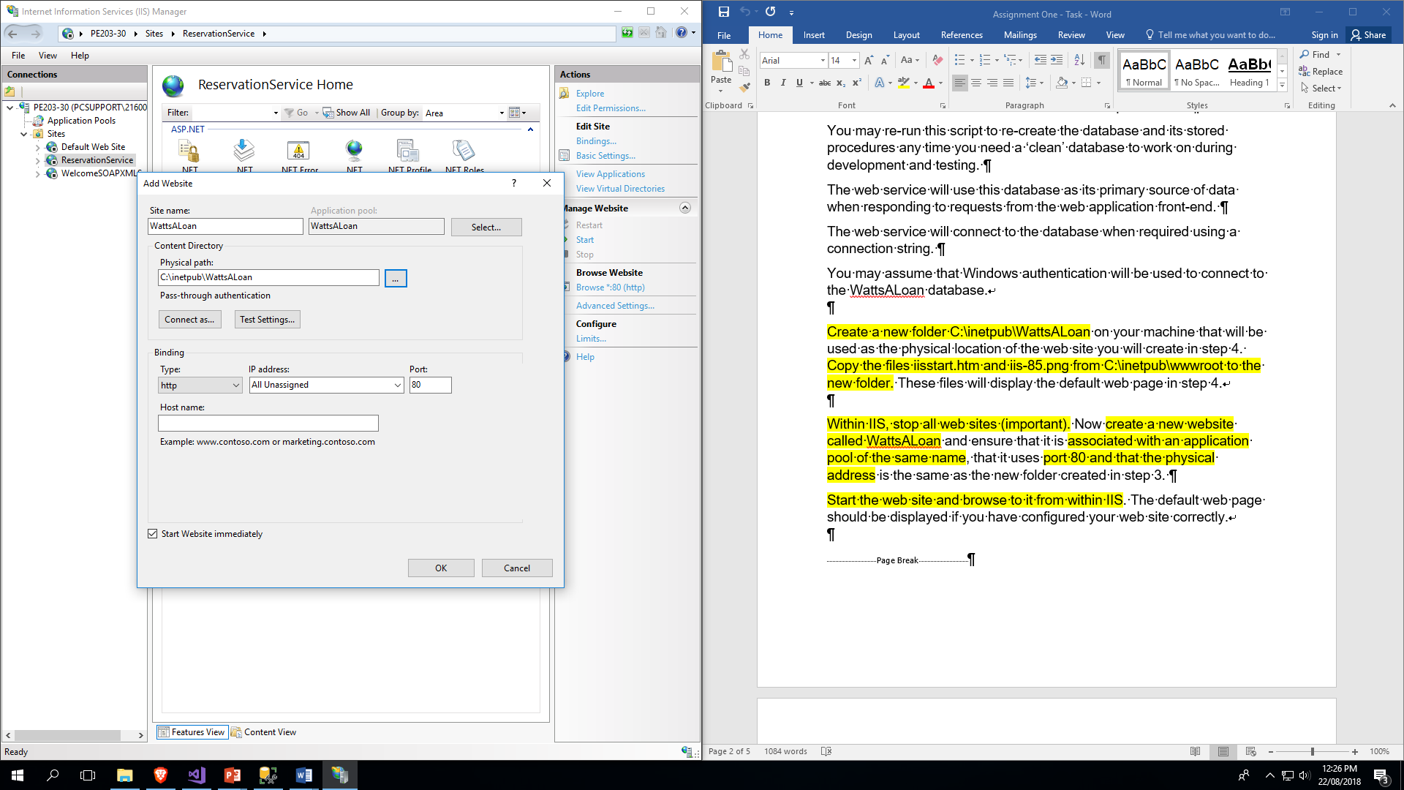

Slide 6
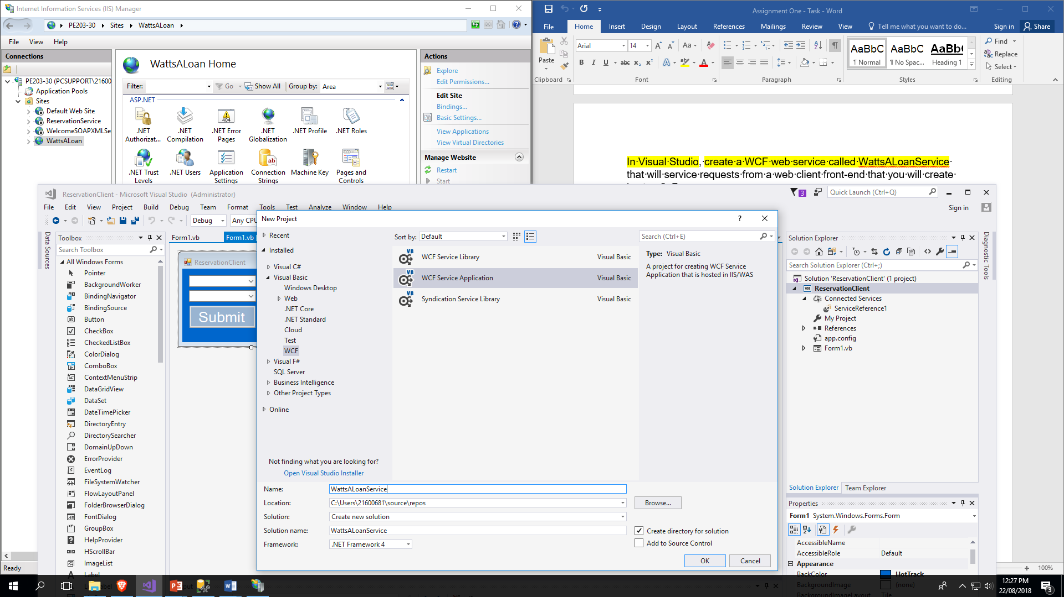

Slide 7
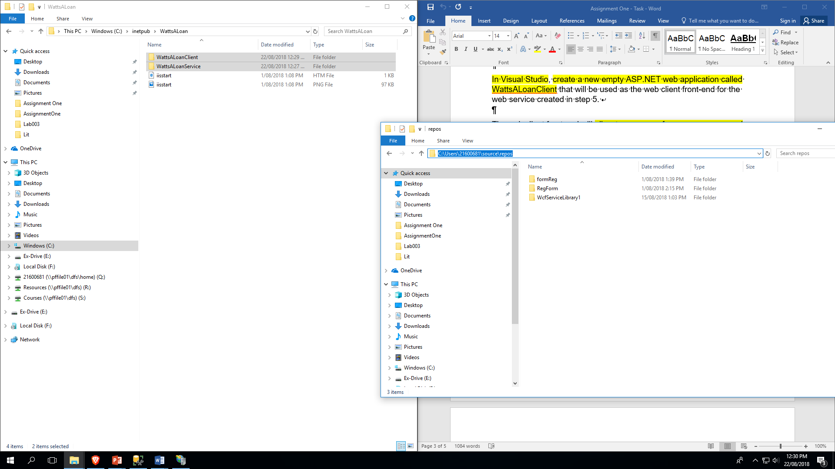

Slide 8
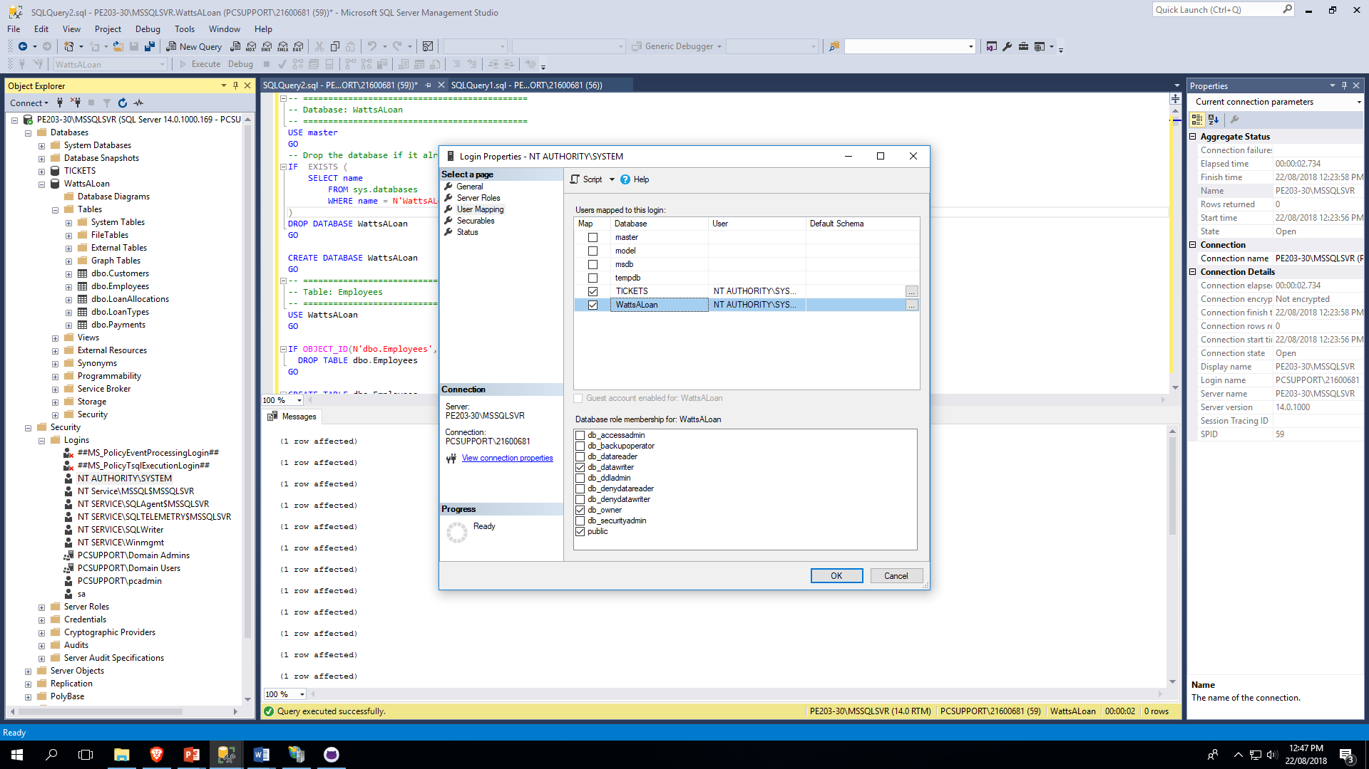

Slide 9
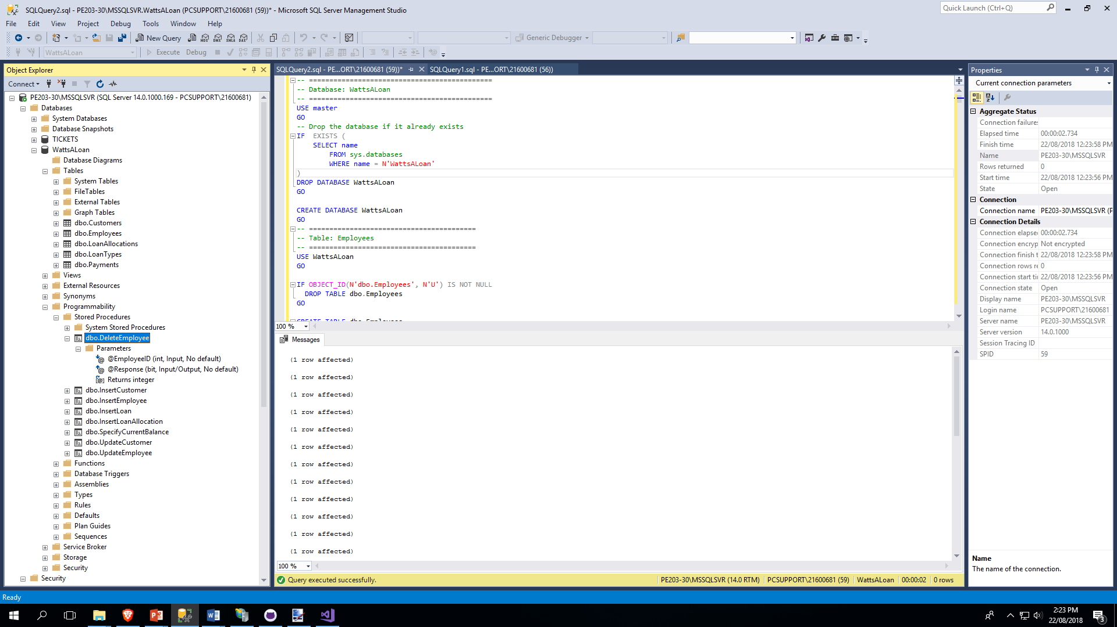

Slide 10
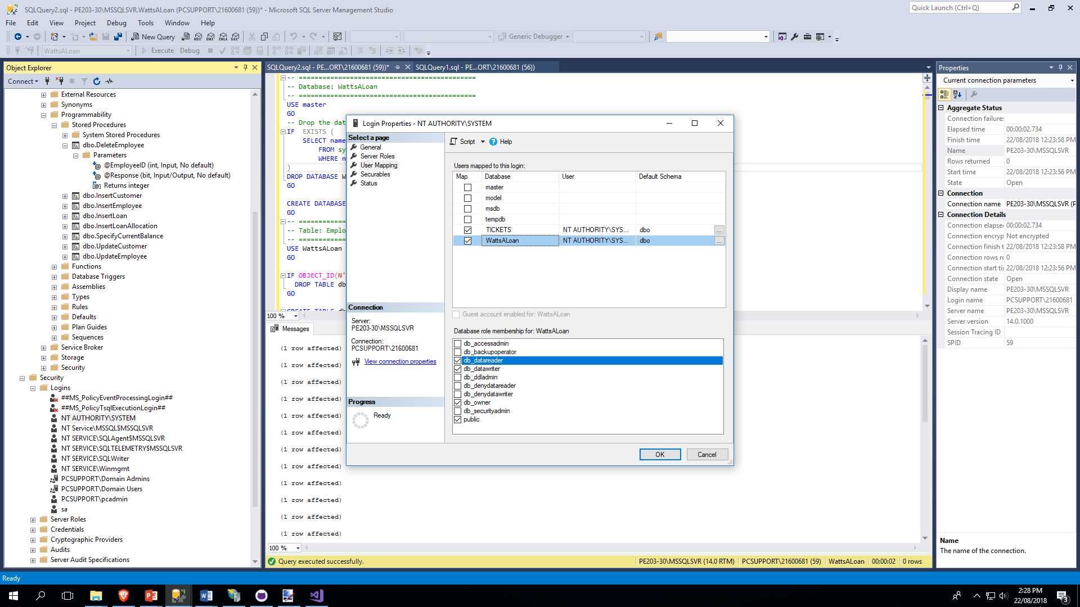

Slide 11
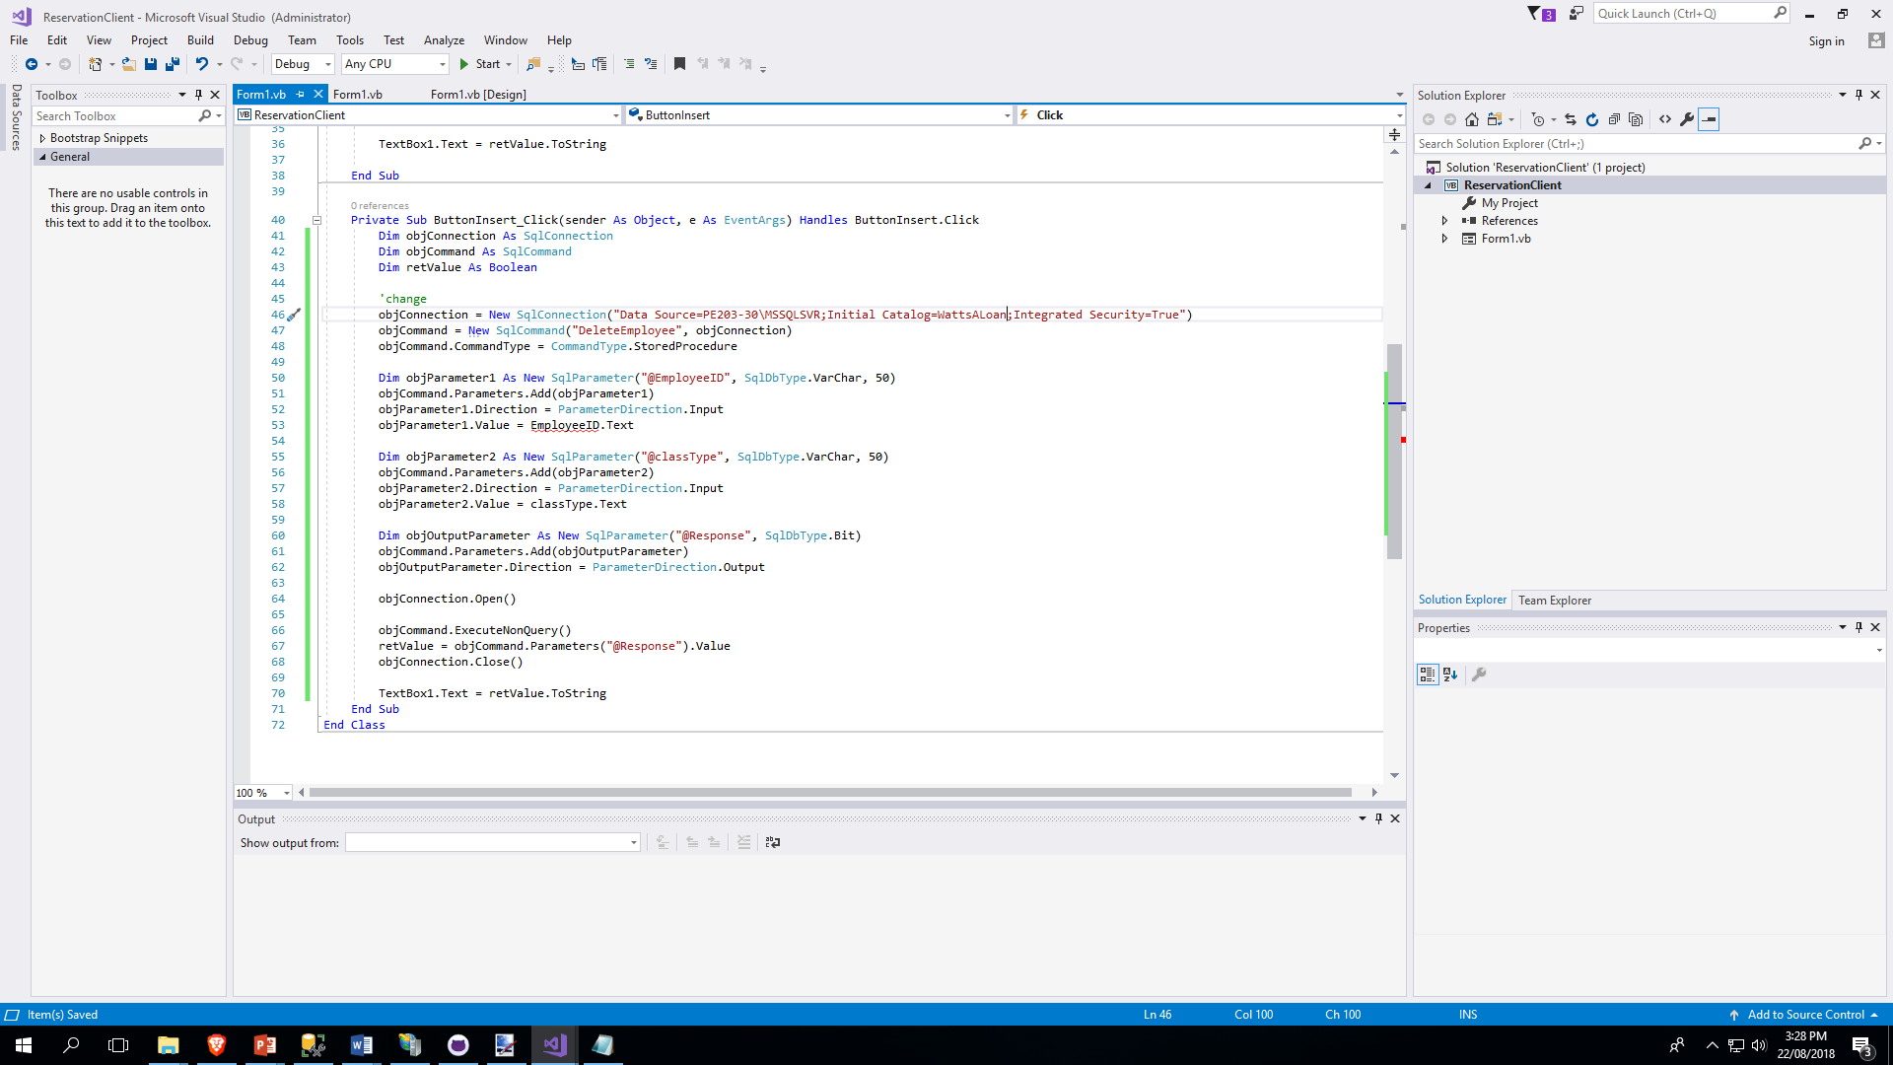

Slide 12
