Slide 1

£7,836.55
WASTE SPEND
ANALYSIS
Identified Waste
42.7% of your £18,338.25 total spend
552
£522.44/mo
Objection Experts
Total Conversions
Est. Monthly Savings
Prepared by Christopher Hoole
Google Ads Specialist | March 2026
christopherhoole.com
Data period: Jan 2025 — Mar 2026 (15 months)

Slide 2
Executive Summary
Data: Jan 2025 — Mar 2026
£18,338.25
£7,836.55
42.7%
552
Total Spend Analysed
Waste Identified
Of Budget Wasted
Total Conversions
Key Findings
895+ locations generated clicks but zero conversions, accounting for £5,694.35 in wasted spend
258 search terms consumed £1,485.38 with zero conversions — many are irrelevant to planning objections
Sunday CPA of £47.39 vs weekday average of £32.61 — a 45% premium with no bid adjustment
The "Neighbourhood Objections" ad group spent £79 with zero conversions
Most negative keywords use exact match only — slight variations of blocked terms still trigger ads
Recommendation: Implementing the quick wins identified in this report could save an estimated £522.44/month and significantly reduce cost per conversion.
Christopher Hoole | christopherhoole.com | Confidential
2

Slide 3
Search Term Waste
Data: Jan 2025 — Mar 2026
258 search terms spent £1,485.38 with zero conversions
Search Term | Clicks | Cost | Conv.
planning objection letters | 19 | £43.55 | 0
object to a planning application | 14 | £38.32 | 0
planning application objection | 10 | £33.03 | 0
advice on objecting to planning application | 12 | £32.03 | 0
objection letter for planning permission | 12 | £31.05 | 0
objection letter to planning applications | 17 | £30.93 | 0
opposing planning applications | 12 | £25.93 | 0
planning refusal | 5 | £24.49 | 0
planning permission objections | 12 | £24.36 | 0
objections to planning permission | 15 | £24.18 | 0
planning application objection letter | 9 | £23.63 | 0
objecting to neighbours planning application | 12 | £23.37 | 0
objecting to planning application | 11 | £23.32 | 0
objection to a planning application | 5 | £23.09 | 0
planning permission disputes | 6 | £22.63 | 0
Key Insight
These 258 non-converting search terms represent 8.1% of total spend.
Many are users searching for general planning advice, templates, or services unrelated to planning objections.
These should be blocked with negative keywords to prevent further waste.
£1,485.38
Total Non-Converting Search Term Spend
Christopher Hoole | christopherhoole.com | Confidential
3

Slide 4
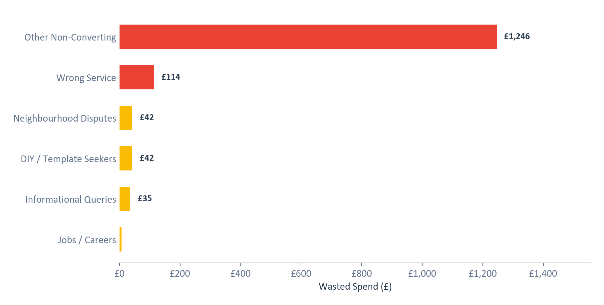
Waste by Category
Data: Jan 2025 — Mar 2026
Non-converting search terms grouped by intent category
Category Breakdown
Other Non-Converting: £1246 (768 clicks)
Wrong Service: £114 (37 clicks)
Neighbourhood Disputes: £42 (25 clicks)
DIY / Template Seekers: £42 (24 clicks)
Informational Queries: £35 (14 clicks)
Jobs / Careers: £6 (2 clicks)
Action Required:
Add phrase-match negative keywords for each category
Review 'Other' category for additional patterns
Set up weekly search term reviews
Christopher Hoole | christopherhoole.com | Confidential
4

Slide 5
Negative Keyword Gaps
Data: Jan 2025 — Mar 2026
Protection gaps that allow irrelevant traffic through
Currently Blocked
Should Be Blocked
622 total negative keywords
Recommended additions based on search term analysis
Exact match: 221 keywords
Broad match: 383 keywords
Phrase match: 17 keywords
Examples (exact match):
[town planner]
[planning consultancy]
[retrospective planning permission]
[planning department]
[planning advisors]
[pre planning advice]
Phrase match negatives for:
"planning permission" (wrong service)
"planning consultant" / "planning advisor"
"template" / "example" / "sample"
"how to write" / "DIY"
"neighbour dispute" / "fence" / "boundary"
"job" / "career" / "salary"
Critical Issue:
221 of 431 negatives use exact match only. This means a negative for [planning consultant] won't block "planning consultants" (plural) or "best planning consultant near me".
Switch to phrase match for broader protection.
Christopher Hoole | christopherhoole.com | Confidential
5

Slide 6
Ad Group Performance
Data: Jan 2025 — Mar 2026
£79 spent on ad groups with zero conversions
Ad Group | Spend | Clicks | Conversions | CPA | Status
Planning Objections | £17413 | 6990 | 527 | £33.06 | Active
Planning Objection Consultants | £490 | 127 | 18 | £27.51 | Active
Planning Objection Letters | £351 | 228 | 8 | £46.81 | Active
Neighbourhood Objections | £79 | 23 | 0 | N/A | WASTE
Neighbourhood Objections
Volume Concentration
Created in October 2025 as part of a restructure, but has never generated a single conversion.
With only £79 spent, the waste is small — but the ad group fragments the campaign's data, making it harder for the algorithm to optimise.
Recommendation: Pause this ad group and consolidate volume.
95% of all spend
goes through the "Planning Objections" ad group.
The three smaller ad groups account for just 5% of spend combined. This fragmentation means the algorithm never gets enough data to optimise.
Christopher Hoole | christopherhoole.com | Confidential
6

Slide 7
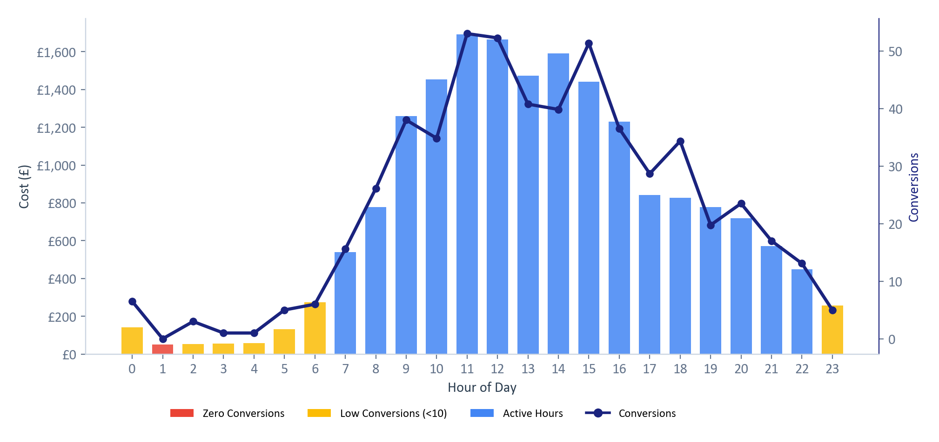
Time-of-Day Performance
Data: Jan 2025 — Mar 2026
£51 spent during hours with zero conversions
Key Findings
Dead zone: 1am
£51 spent with 0 conversions
Best hour: 18:00
CPA £24.11 (34 conversions)
Peak performance:
9am-6pm business hours show the strongest conversion volume.
Recommendation:
Reduce bids during off-peak hours (midnight-6am). Increase bids during peak business hours.
Red = zero conversions | Amber = low (<10) | Blue = active | Line = conversions
Christopher Hoole | christopherhoole.com | Confidential
7

Slide 8
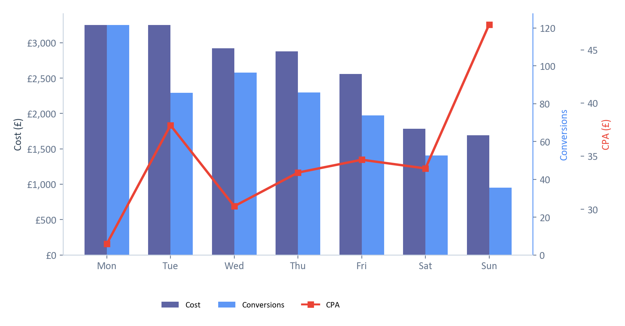
Day-of-Week Performance
Data: Jan 2025 — Mar 2026
Sunday CPA £47.39 vs £32.61 weekday avg — 45% premium
Monday (Best)
122 conversions
CPA: £26.74
Conv rate: 9.9%
Sunday (Worst)
36 conversions
CPA: £47.39
Premium: £527 excess spend
Recommendation
Reduce Sunday bids by 20-30%. Increase Monday/Wednesday bids where CPA is lowest.
Christopher Hoole | christopherhoole.com | Confidential
8

Slide 9
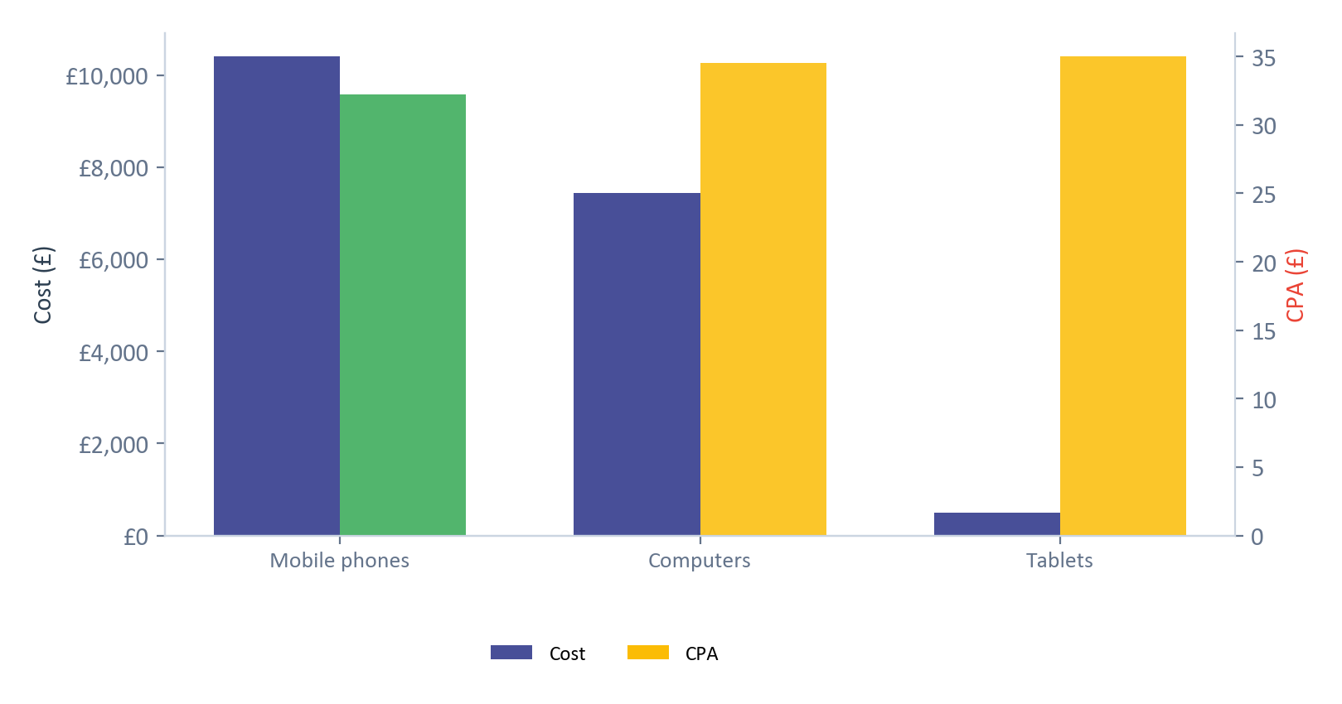
Device Performance
Data: Jan 2025 — Mar 2026
GLO Campaign — performance and current bid adjustments by device
Device | Spend | Clicks | Conv. | CPA | Conv Rate | Bid Adj.
Mobile phones | £10,398.36 | 4675 | 323 | £32.24 | 6.9% | +10%
Computers | £7,445.04 | 2415 | 216 | £34.55 | 8.9% | +10%
Tablets | £489.86 | 278 | 14 | £34.99 | 5.0% | -20%
Analysis
Mobile has the best CPA (£32.24) but the highest spend — this is positive.
Current bid adjustments (+10% mobile, +10% desktop, -20% tablet) are reasonable but could be refined.
Tablets have the weakest conversion rate (5.0%) and highest CPA.
Recommendation: Reduce tablet bids to -30% or -40%.
Christopher Hoole | christopherhoole.com | Confidential
9

Slide 10
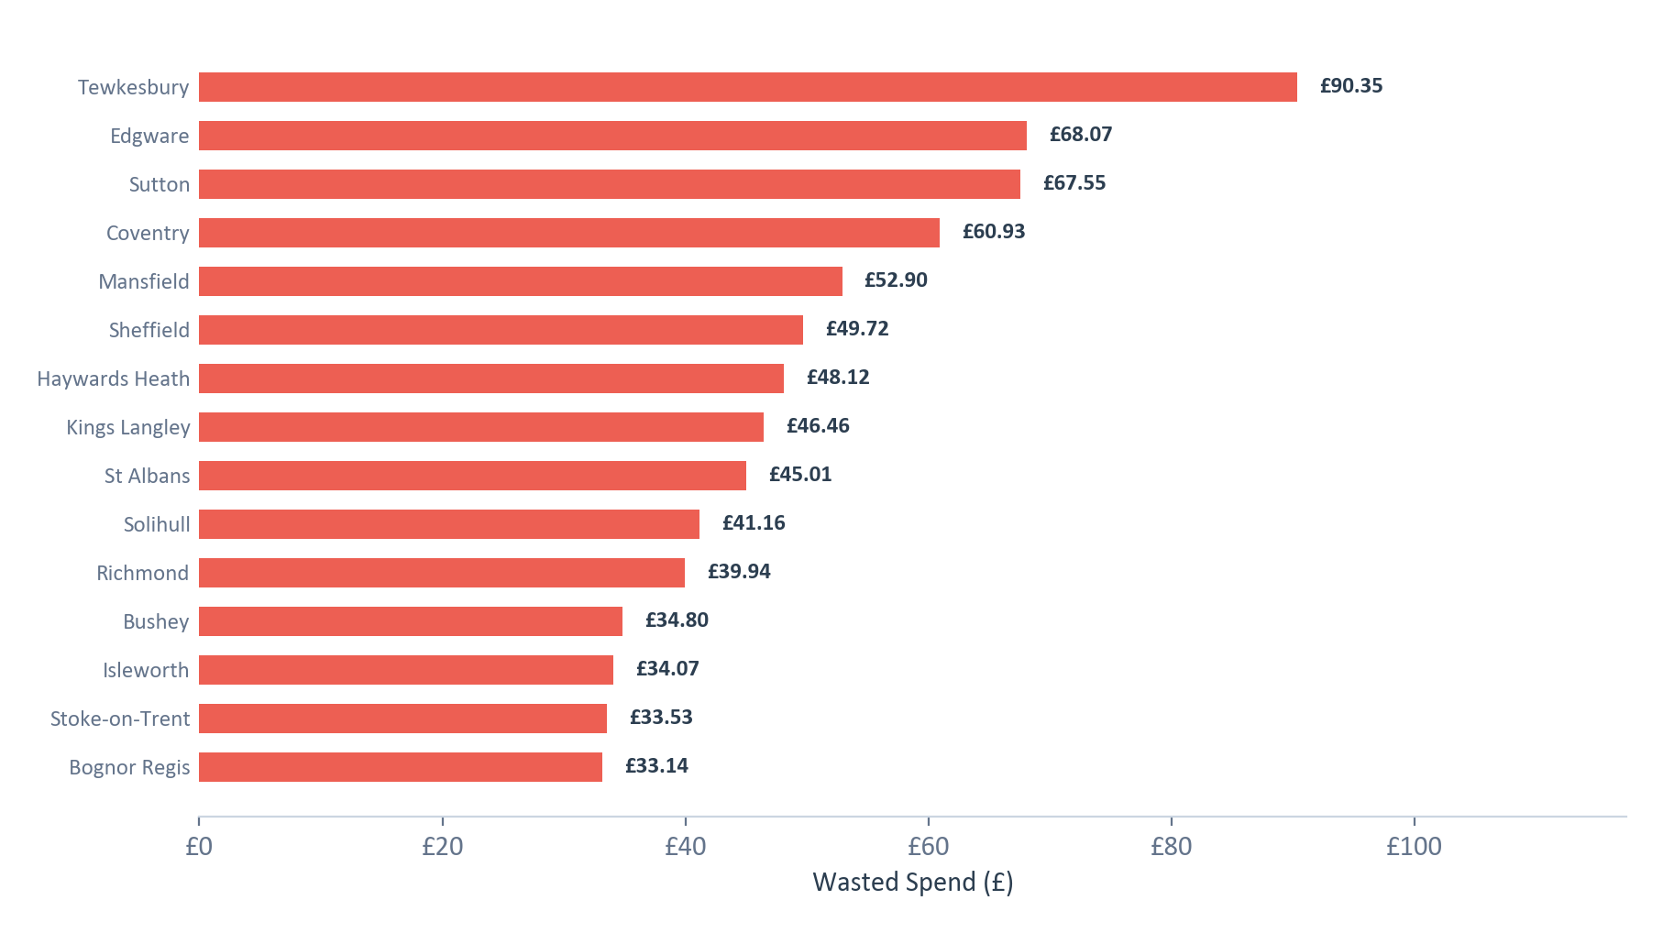
Geographic Waste
Data: Jan 2025 — Mar 2026
895+ locations spent £5,694.35 with zero conversions
Key Finding
£5,694.35 — 31% of total spend — went to locations that never converted.
While individual amounts are small, the cumulative waste across 895+ locations is the largest single waste category.
This is typical of UK-wide targeting without geographic bid adjustments.
Recommendations
Identify top-converting regions and increase bids there
Exclude consistently non-converting areas
Add location bid adjustments to focus budget on proven areas
Christopher Hoole | christopherhoole.com | Confidential
10

Slide 11
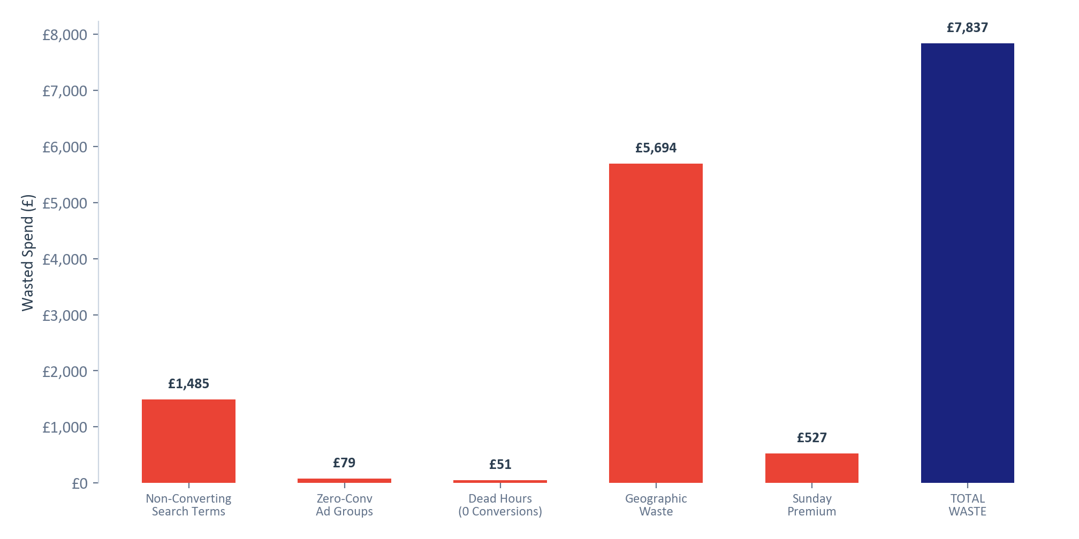
Total Waste Summary
Data: Jan 2025 — Mar 2026
£7,836.55
Non-Converting Search Terms
19%
£1,485.38
of your £18,338.25 (42.7%) was spent on non-converting traffic
Zero-Conv Ad Groups
1%
£78.91
Dead Hours (0 Conversions)
1%
£50.8
Geographic Waste
73%
£5,694.35
Sunday Premium
7%
£527.11
Note: Some overlap exists between categories. The total represents the upper bound of identifiable waste.
Christopher Hoole | christopherhoole.com | Confidential
11

Slide 12
Quick Wins
Data: Jan 2025 — Mar 2026
Immediate actions to reduce waste and improve performance
# | Action | Detail | Est. Saving
1 | Add Phrase-Match Negative Keywords | Block the waste categories identified: DIY/templates, wrong services, jobs, neighbourhood disputes. Switch from exact to phrase match for broader protection. | £100-150/mo
2 | Pause Neighbourhood Objections Ad Group | Zero conversions, fragmenting campaign data. Consolidate volume into the main Planning Objections ad group. | £5-10/mo
3 | Implement Ad Schedule Bid Adjustments | Reduce bids during dead hours (1am-5am) by 50-80%. Increase bids during peak business hours (9am-5pm Mon-Fri). | £30-50/mo
4 | Reduce Sunday Bids by 20-30% | Sunday CPA (£47.39) is 45% higher than weekdays. Apply a bid reduction to control costs. | £35-50/mo
5 | Tighten Geographic Targeting | Exclude consistently non-converting regions. Add location bid adjustments to focus budget on proven areas. | £200-380/mo
6 | Adjust Tablet Bids to -30% or -40% | Tablets have the weakest conversion rate (5.0%) and highest CPA. Increase bid reduction from the current -20%. | £15-25/mo
Estimated Monthly Savings
Annualised Saving
What's Next?
£380-655/month
£4,560-7,860/year
Report 2: Account Structure & Issues
Why costs increased after October 2025
Christopher Hoole | christopherhoole.com | Confidential
12

